Slide 1
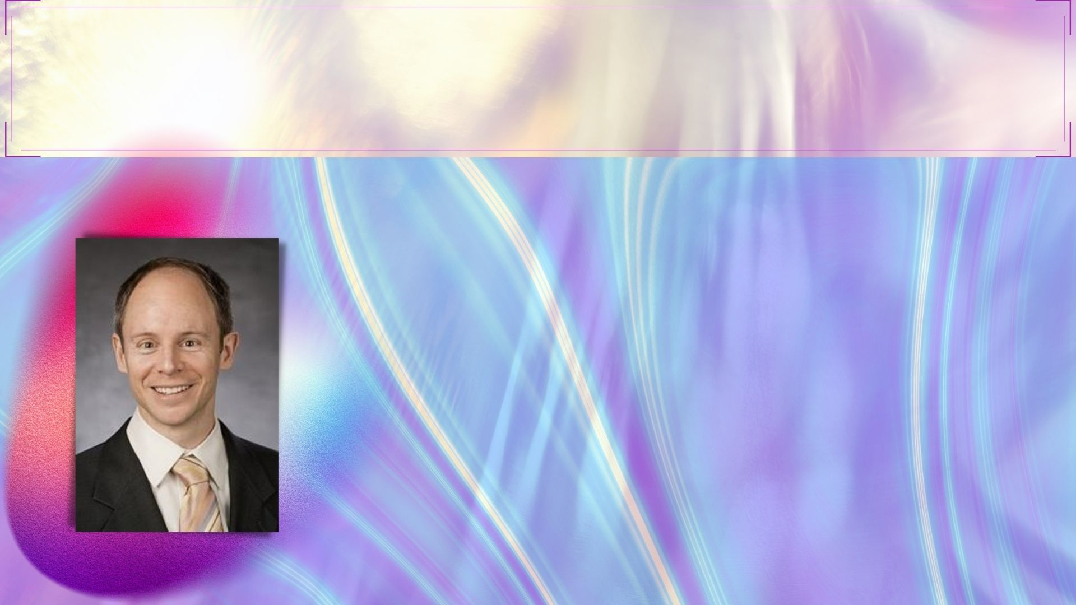
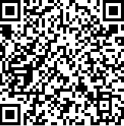

COMPSCI/ECON 206 COMPUTATIONAL MICROECONOMICS
Computer Science Meets Economics
Guest Speaker: Prof. Vincent Conitzer|Ph.D.
Kimberly J. Jenkins Distinguished University Professor of New Technologies
Professor of Computer Science, Professor of Economics, and Professor of Philosophy
Duke University
Host: Prof. Luyao Zhang | Ph.D.
Assistant Professor of Economic, Social Science Division
Senior Research Scientist, Data Science Research Center
Duke Kunshan University
Time: Apr. 19th , Tuesday
9:00 –10:15 AM Durham/9:00-10:15 PM Kunshan
Zoom ID: 979 7226 4083
Scan me for zoom info
All DKU-Duke Community Members are Welcomed!

