Slide 1
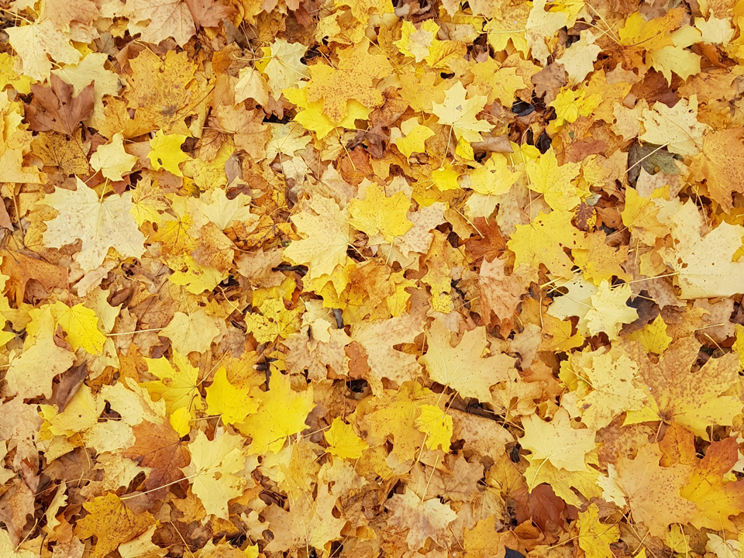


TOPTIC
Deep learning
Name：孙双运
Student NO.：Y45180273
注：文本框可根据需求改变颜色、移动位置；文字可编辑

Slide 2

CONTENTS
01
Introduction
点击添加文本
02
History
03
点击添加文本
Supervised learning
04
Applications
点击添加文本
05
The future of deep learning
点击添加文本

Slide 3
Introduction
Deep learning allows computational models that are composed of multiple processing layers to learn representations of data with multiple levels of abstraction. These methods have dramatically improved the state-of-the-art in speech recognition, visual object recognition, object detection and many other domains such as drug discovery and genomics. Deep learning discovers intricate structure in large data sets by using the back propagation algorithm to indicate how a machine should change its internal parameters that are used to compute the representation in each layer from the representation in the previous layer. Deep convolutional nets(深度卷积网络) have brought about breakthroughs in processing images, video, speech and audio, whereas recurrent nets have shone light on sequential data such as text and speech.
点击添加文本
点击添加文本
点击添加文本
点击添加文本

Slide 4

Machine-learning technology powers many aspects of modern society: from web searches to content filtering on social networks to recommendations on e-commerce websites, and it is increasingly present in consumer products such as cameras and smart phones. Machine-learning systems are used to identify objects in images, transcribe speech into text, match news items, posts or products with users’ interests, and select relevant results of search. Increasingly, these applications make use of a class of techniques called deep learning.

Slide 5

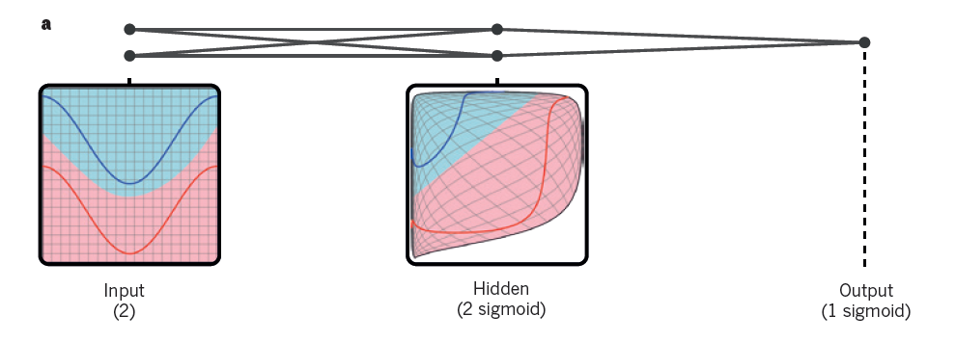
Conventional machine-learning techniques were limited in their ability to process natural data in their raw form. For decades, constructing a pattern-recognition or machine-learning system required careful engineering and considerable domain expertise to design a feature extractor that transformed the raw data (such as the pixel values of an image) into a suitable internal representation or feature vector from which the learning subsystem, often a classifier, could detect or classify patterns in the input.

Slide 6
Representation learning is a set of methods that allows a machine to be fed with raw data and to automatically discover the representations needed for detection or classification. Deep-learning methods are representation-learning methods with multiple levels of representation, obtained by composing simple but non-linear modules that each transform the representation at one level (starting with the raw input) into a representation at a higher, slightly more abstract level. With the composition of enough such transformations, very complex functions can be learned. For classification tasks, higher layers of representation amplify aspects of the input that are important for discrimination and suppress irrelevant variations. An image, for example, comes in the form of an array of pixel values, and the learned features in the first layer of representation typically represent the presence or absence of edges at particular orientations and locations in the image. The second layer typically detects motifs by spotting particular arrangements of edges, regardless of small variations in the edge positions. The third layer may assemble motifs into larger combinations that correspond to parts of familiar objects, and subsequent layers would detect objects as combinations of these parts. The key aspect of deep learning is that these layers of features are not designed by human engineers: they are learned from data using a general-purpose learning procedure. Deep learning is making major advances in solving problems that have resisted the best attempts of the artificial intelligence community for many years. It has turned out to be very good at discovering intricate structures in high-dimensional data and is therefore applicable to many domains of science, business and government.

Slide 7

The most common form of machine learning, deep or not, is supervised learning. Imagine that we want to build a system that can classify images as containing, say, a house, a car, a person or a pet. We first collect a large data set of images of houses, cars, people and pets, each labelled with its category. During training, the machine is shown an image and produces an output in the form of a vector of scores, one for each category. We want the desired category to have the highest score of all categories, but this is unlikely to happen before training. We compute an objective function that measures the error (or distance) between the output scores and the desired pattern of scores. The machine then modifies its internal adjustable parameters to reduce this error. These adjustable parameters, often called weights, are real numbers that can be seen as ‘knobs’ that define the input–output function of the machine. In a typical deep-learning system, there may be hundreds of millions of these adjustable weights, and hundreds of millions of labelled examples with which to train the machine.
To properly adjust the weight vector, the learning algorithm computes a gradient vector that, for each weight, indicates by what amount the error would increase or decrease if the weight were increased by a tiny amount. The weight vector is then adjusted in the opposite direction to the gradient vector.

Slide 8
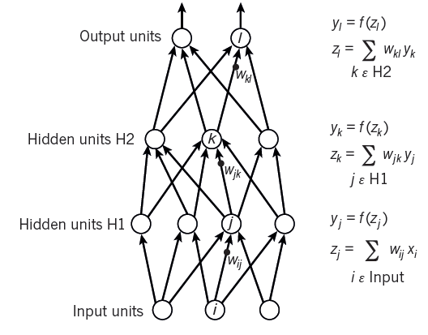
KEY TECHNOLOGY
The objective function, averaged over all the training examples, can be seen as a kind of hilly landscape in the high-dimensional space of weight values. The negative gradient vector indicates the direction of steepest descent in this landscape, taking it closer to a minimum, where the output error is low on average.
点击添加文本
点击添加文本
点击添加文本
点击添加文本

Slide 9
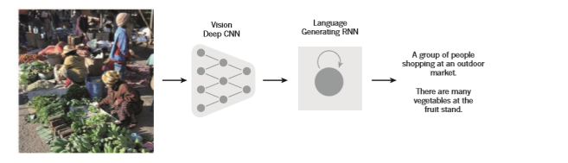
Applications
Since the early 2000s, ConvNets have been applied with great success to the detection, segmentation and recognition of objects and regions in images. These were all tasks in which labelled data was relatively abundant, such as traffic sign recognition, the segmentation of biological images particularly for connectomics, and the detection of faces, text, pedestrians and human bodies in natural images. A major recent practical success of ConvNets is face recognition.
Importantly, images can be labelled at the pixel level, which will have applications in technology, including autonomous mobile robots and self-driving cars. Companies such as Mobileye and NVIDIA are using such ConvNet-based methods in their upcoming vision systems for cars. Other applications gaining importance involve natural language understanding and speech recognition.
点击添加文本
点击添加文本
点击添加文本
点击添加文本

Slide 10
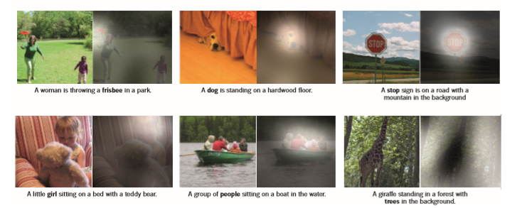
Applications
点击添加文本
点击添加文本
点击添加文本
点击添加文本
点击添加文本

Slide 11
Mastering the game of Go with deep neural networks
and tree search
The game of Go has long been viewed as the most challenging
of classic games for artificial intelligence owing to its enormous
search space and the difficulty of evaluating board positions
and moves. Here we introduce a new approach to computer
Go that uses ‘value networks’ to evaluate board positions and
‘policy networks’ to select moves. These deep neural networks
are trained by a novel combination of supervised learning from
human expert games, and reinforcement learning from games
of self-play. Without any look ahead search, the neural networks
play Go at the level of state- of-the-art Monte Carlo tree （蒙特卡罗树）
Search programs that simulate thousands of random games of self-
Play. We also introduce a new search algorithm that combines Monte
Carlo simulation with value and policy networks. Using this
search algorithm, our program AlphaGo achieved a 99.8%
winning rate against other Go programs, and defeated the
human European Go champion by 5 games to 0. This is the first
time that a computer program has defeated a human professiona
l player in the full-sized game of Go, a feat previously thought to be
at least a decade away.
点击添加文本
http://www.365yg.com/i6482364961115865614/#mid=1567011643360258
点击添加文本
点击添加文本
点击添加文本

Slide 12
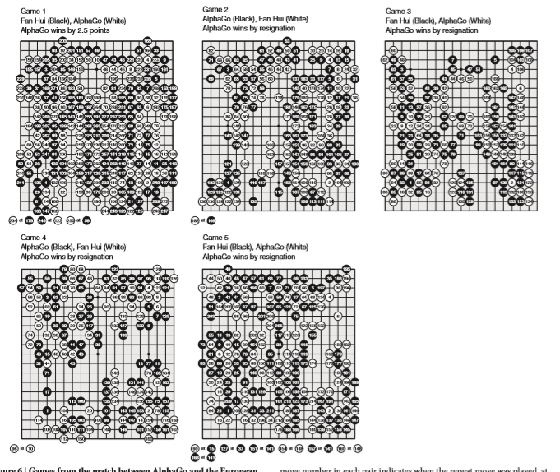
defeated the human European Go champion by 5 games to 0.
点击添加文本
点击添加文本
点击添加文本
点击添加文本

Slide 13
The future of deep learning
Unsupervised learning had a catalytic effect in reviving interest in deep
learning, but has since was already shadowed by the successes of purely supervised learning. Human and animal learning is largely unsupervised : we discover the structure of the world by observing
it, not by being told the name of every object. Human vision is an active process that sequentially samples the optic array in an intelligent, task- Specific way using a small, high-resolution fovea with a large, low-resolution surround . We expect much of the future progress in vision to come from Systems that are trained end-to-end and combine ConvNets with RNNs that use reinforcement learning to decide where To look.
点击添加文本
点击添加文本
人类视觉是一个活跃的过程，它使用具有大型低分辨率环绕声的小型高分辨率中央凹，以智能，任务特定的方式顺序采样光学阵列。 我们预计未来的远景进展将来自端到端训练的系统，并将ConvNets与使用强化学习的RNN结合起来决定在哪里观看
点击添加文本
点击添加文本

Slide 14

Systems combining deep learning and reinforcement learning are in their infancy, but they already outperform passive vision systems at classification tasks and produce imPressive results in learning to play many different video games 100. Natural language understanding is another area in which deep learning is poised to make a large impact over the next few years. We expect systems that use RNNs to understand sentences or whole documents will become much better When they learn strategies for selective attending to one part at a time. Ultimately, major progress in artificial intelligence will come about through systems that combine representation learning with complex reasoning. Deep learning and simple reasoning have been used for speech and handwriting recognition for a long time

Slide 15
Video about deep learning
https://m.365yg.com/group/6605497765684314628/?iid=46573994320&app=video_article&timestamp=1540133483&utm_source=copy_link&utm_medium=android&utm_campaign=client_share
http://www.365yg.com/i6606608147865928195/#mid=1567011643360258
点击添加文本
点击添加文本
点击添加文本
点击添加文本

Slide 16


