Slide 1
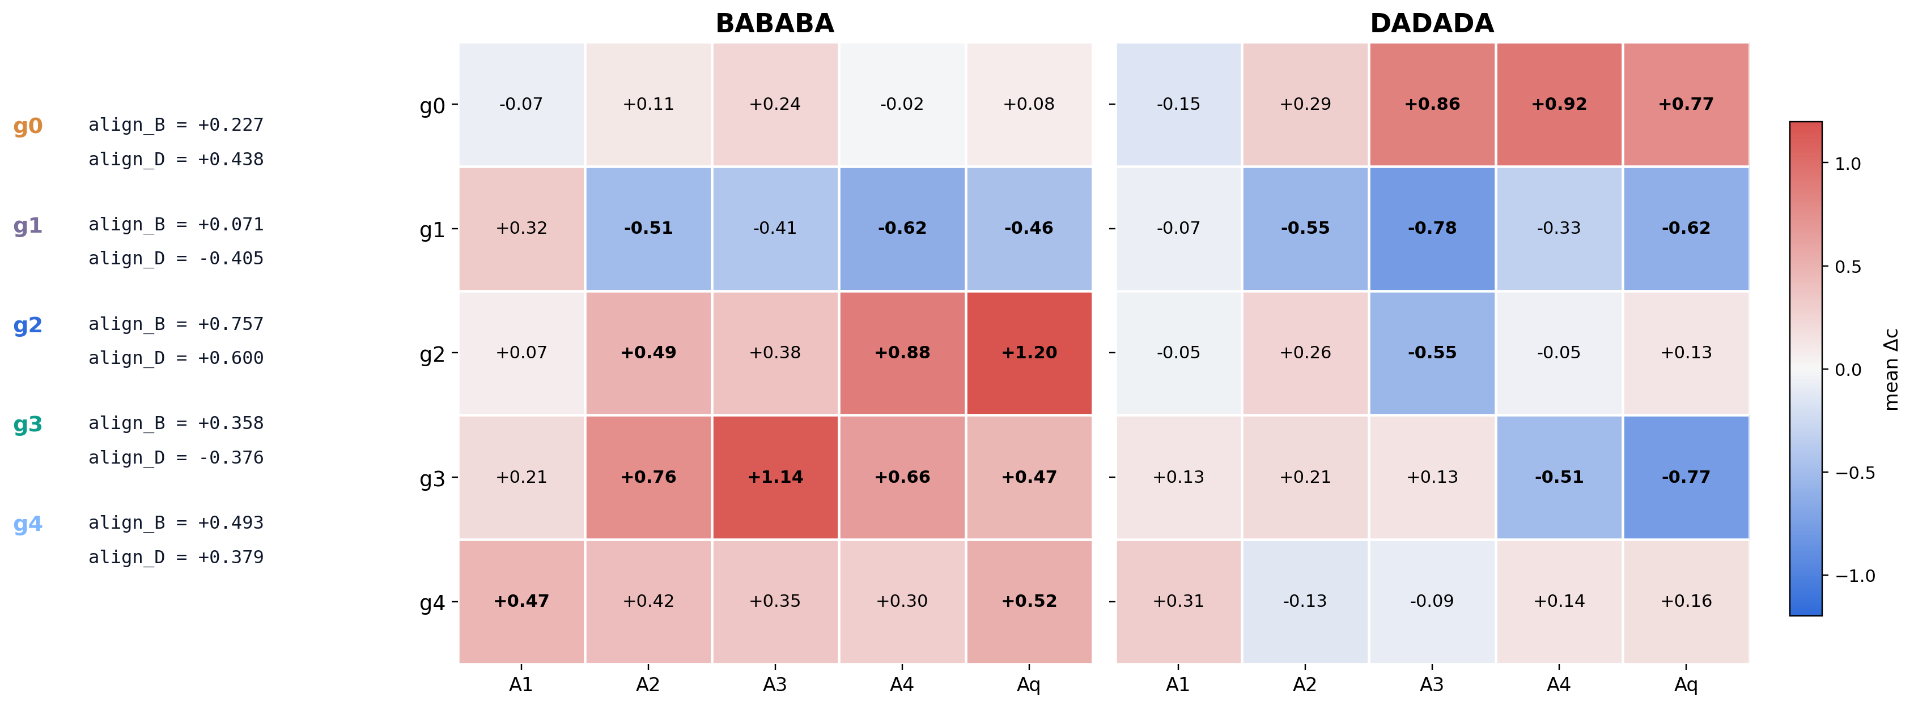
Which Inside-A Features Change Over Steps?
Inside-A carries most of the stepwise change. The next question is which A-features are being reweighted across matched A slots.
Takeaway. Inside A, the same role-defined features do not stay fixed: g2/g3/g4 are amplified along the B branch, while the D branch strengthens g0 and suppresses anti-D axes such as g1 and g3.

Slide 2
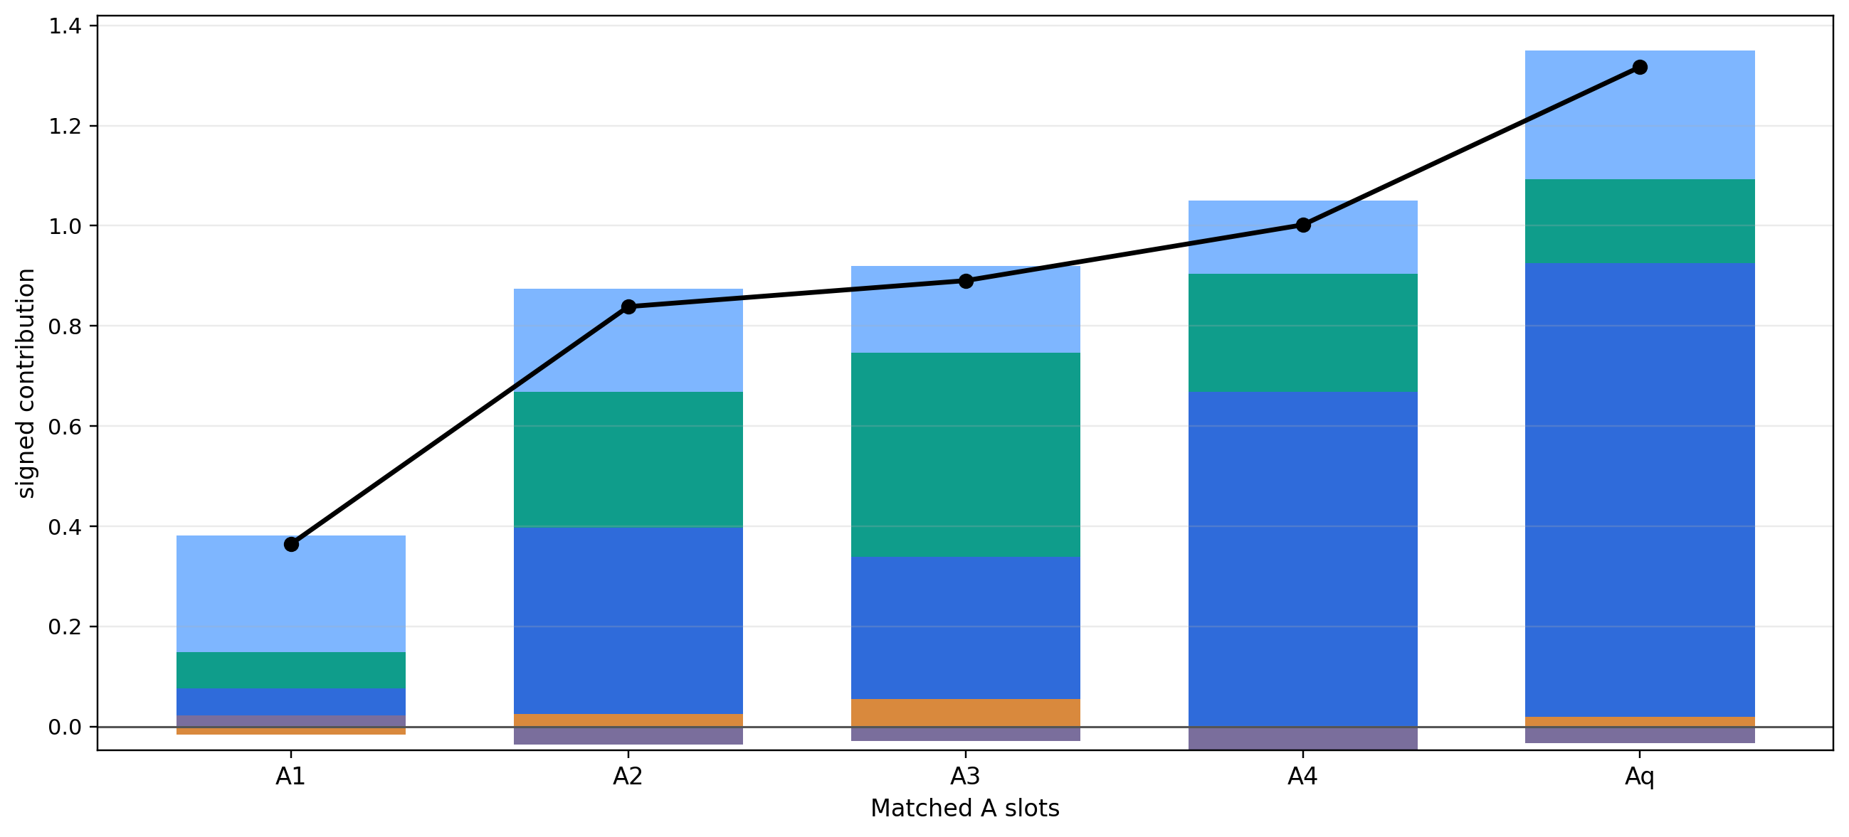
BABABA: Which Features Drive the B-Directed Drift?
Contribution asks not just which features changed, but which of those changes actually pushed the state toward B. Each colored segment shows how much one inside-A feature contributes to that B-directed drift, relative to the AAA baseline. Segments above zero support B-directed drift; segments below zero oppose it.
g0
g1
g2
g3
g4
total

Slide 3
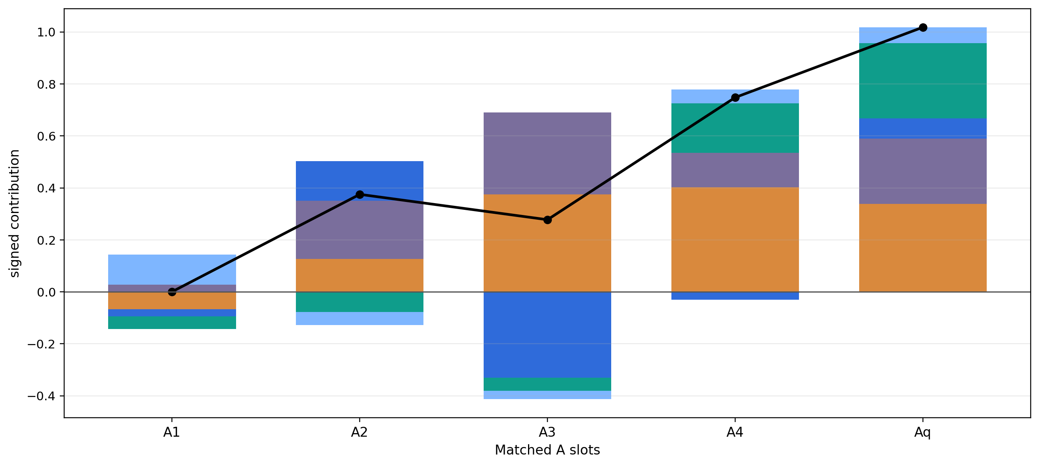
DADADA: Which Features Drive the D-Directed Drift?
Contribution asks not just which features changed, but which of those changes actually pushed the state toward D. Each colored segment shows how much one inside-A feature contributes to that D-directed drift, relative to the AAA baseline. Segments above zero support D-directed drift; segments below zero oppose it.
g0
g1
g2
g3
g4
total

