Slide 1

TOPIC : Human Action Recognition in Videos
Institute of Computer Network Information Center, Chinese Academy of Science
Preseneted BY Fayaz Ali

Slide 2
Outlines
1. INTODUCTION
2. RELATED WORK
3. Methodogy
4. Results
5. CONCLUSION

Slide 3
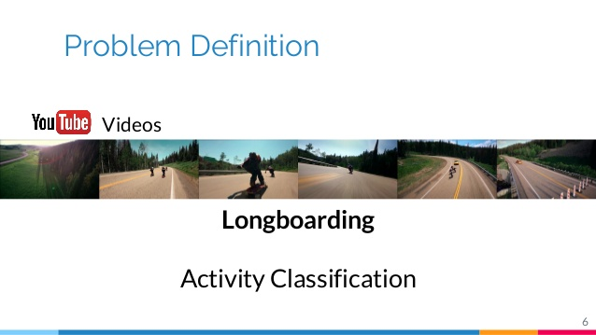
1. INTODUCTION

Slide 4
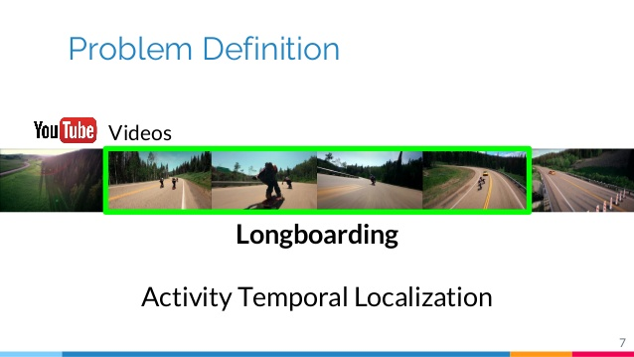

Slide 5
How to do it ?

Slide 6
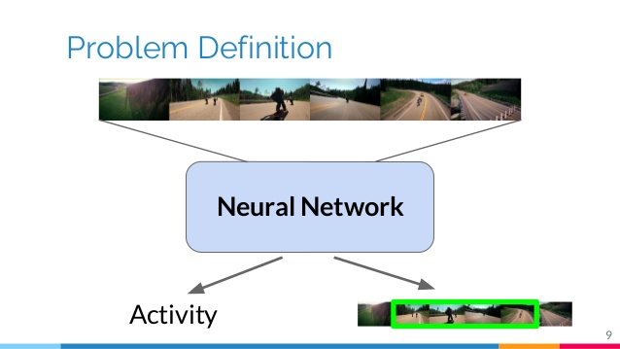
Solution

Slide 7
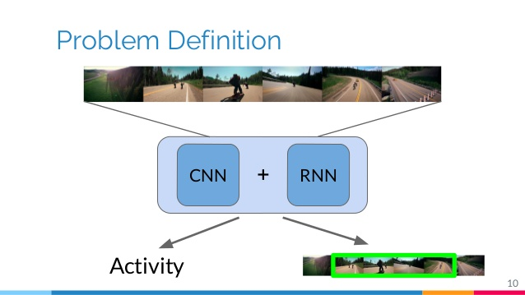
Solution

Slide 8
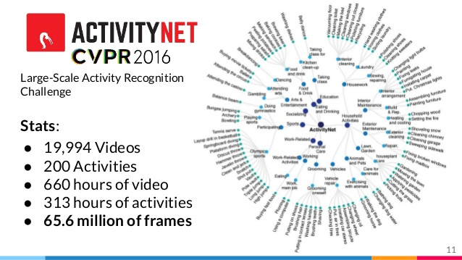
Dtaset

Slide 9
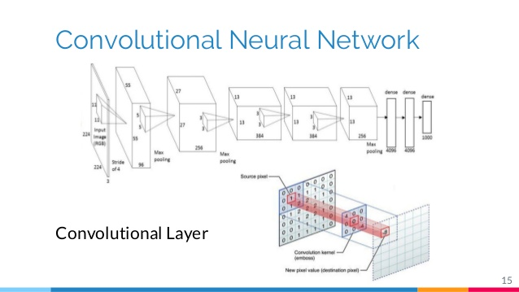
2. RELATED WORK

Slide 10
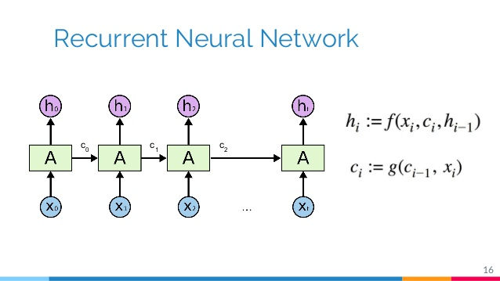
CONTINU…
Notes:
The (RNNs) Recurrent Neural Network was chosen being the basic module to determine the main task of this project,RNNs are mainly used to learn from temporal sequences as text generation or speech recognition, but they have also been used in tasks related to the video

Slide 11
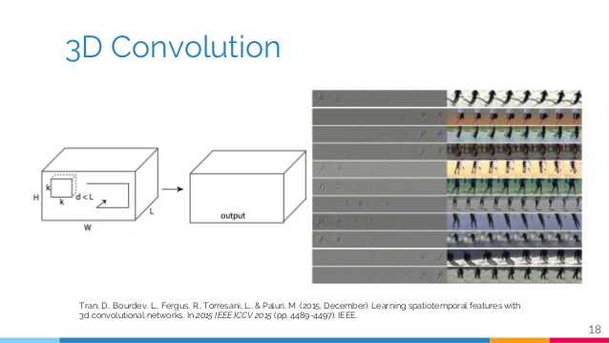
Notes:
The novel work presented in ^{[24]}is based on Convolutional Neural Networks, more concretely on the C3D network before explained. It proposes to divide each video in multiple sequences of different lengths and predict for each one whether if they depict an activity or not.
The C3D network ^{[5]}was chosen as a feature extractor, due to its good performance. This network is comprised of 8 convolutional layers, with 5 pooling layers, with two fully-connected layers and finally a Softmax output at the end of the Network.

Slide 12
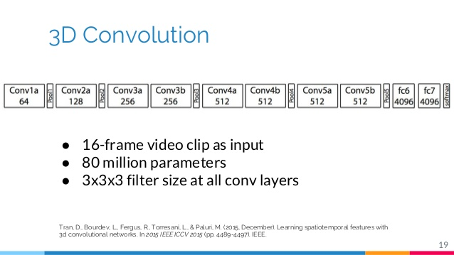

Slide 13
3. Methodogy
a. Exracting C3D Features
b. Audio Features
c. Network Features
d. Training Methodology
e. Post Processing

Slide 14
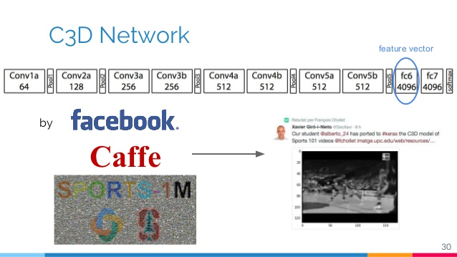
a. Exracting C3D Features

Slide 15
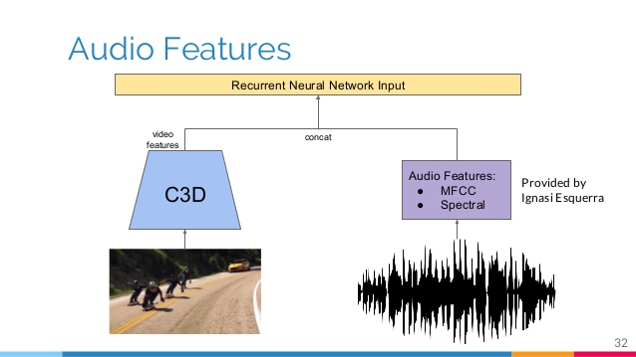
b. Audio Features
Notes:
In this project, the MFCC and Spectral descriptors were adopted ^{[15]}. Both MFCC and Spectral descriptors were extracted using specialized software: SPro ^{[30]} and Essential

Slide 16
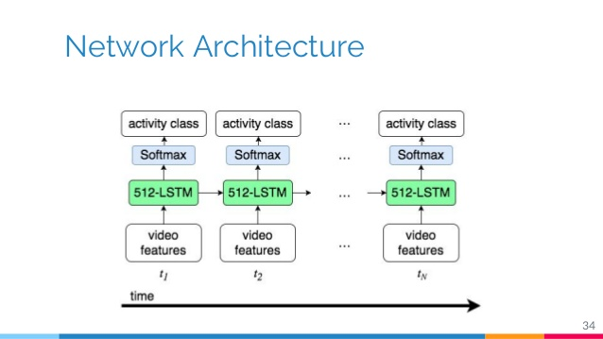
c. Network Features

Slide 17
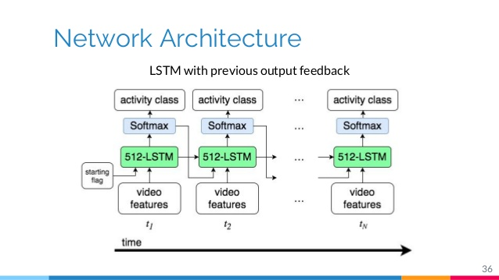

Slide 18
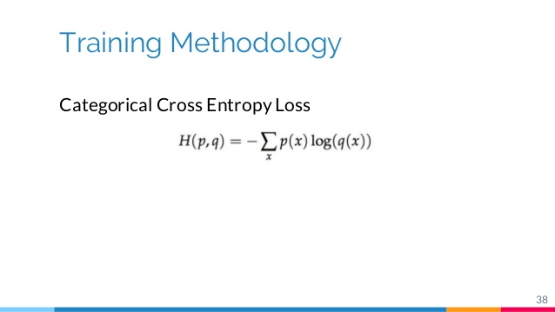
d. Training Methodology

Slide 19
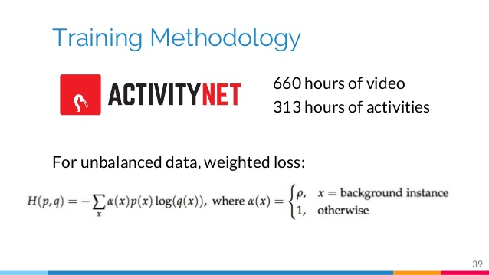

Slide 20
4. Rsults

Slide 21
Rsults

Slide 22
Rsults

Slide 23
Rsults
Global Activities | AP
Eating and drinking Activities | 0.2558
Sports, Exercise, and Recreation | 0.3002
Household Activities | 0.2625
Socializing, Relaxing, and Leisure | 0.26060
Personal Care | 0.11234
Global (mAP) | 0.23830

Slide 24
Rsults

Slide 25
5 .Conclusion
This proposed solution for both the classification and detection tasks of the ActivityNet Challenge 2016. We propose a system consisting of two different stages. First, the videos are organized in 16-frame clips, for which we individually extract both audio and visual features.
Visual features were extracted from a pre trained 3D convolutional network (C3D), while MFCC coefficients were extracted for audio. On top of these features,we train a recurrent neural network to predict the activity sequence of each video at the granularity of the 16-frames clip.

Slide 26
