Slide 1
A Review of Researches on Deep Learning in Remote Sensing Application
Published:International Journal of Geosciences, 2019, 10, 1-11

Slide 2
Authors:
Ming Zhu1,2*, Yongning He2, Qingyu He2
1. Institute of Geoscience and Resources, China University of Geosciences, Beijing, China 2. Geographic Information Center of Guangxi, Nanning, China

Slide 3
Contents:
Image Understanding
Remote Sensing
Deep Learning

Slide 4
Image Understanding
Reasons:
largest sources of data
medical diagnostics
Traffic monitoring
underwater exploration
homeland security

Slide 5
Why Understand Images
Prime source of information
Major Problems and challenges:
sheer size of data/
The problems of search, annotation, and classification of videos on Youtube are examples of challenges where the size of image data becomes a problem.
New research initiatives Images
form an integral part of the landscape of big data attracting,

Slide 6
Solution
To find low-dimensional representations of images to enable statistical analysis.
One direction is to use pixel locations in images as nodes in a graph and to model the interaction between pixels values using edges.
Example: Markov Random Field (MRF) .
where the neighboring pixels form cliques that completely describe conditional and joint distributions of pixel values
Directed vs. Undirected Graphical Models
Directed Graphical Model (or Directed Acyclic Graphs- DAG):
The directed edges in a DAG give causality relationships, DAGs are also called Bayesian Network
The undirected edges in UGM give correlations between variables, UGMs are also called Markov Random Fields (MRF).
applications in image denoising, segmentation, and related applications.

Slide 7
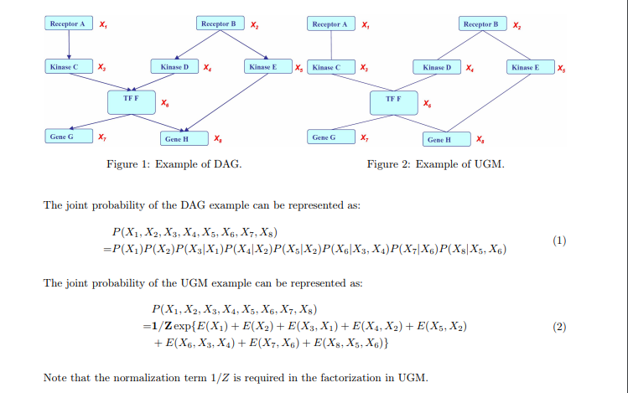

Slide 8
Remote sensing and Deep Learning
The deep learning method in remote sensing application is mainly used in three aspects:
surface classification,
object detection
change detection

Slide 9
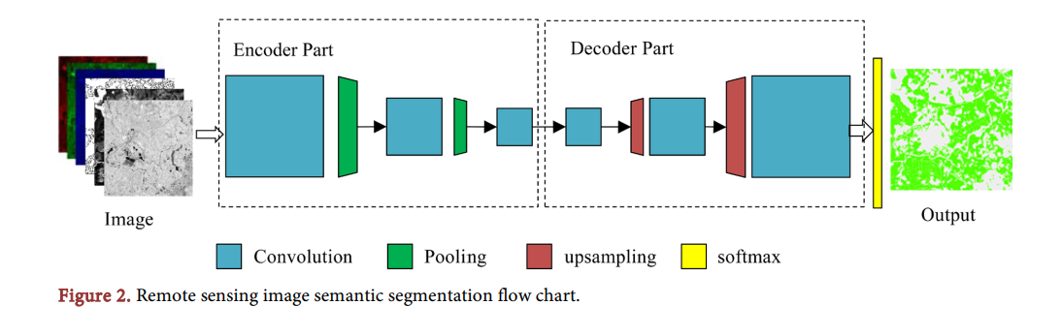
Land Cover Classification Methods of Remote Sensing Image : deep belief network (DBN), convolution neural network (CNN) and spare auto encoder (SAE), among which the deep convolution neural network is the most popular approach at present.
land cover classification is a problem of image segmentation

Slide 10
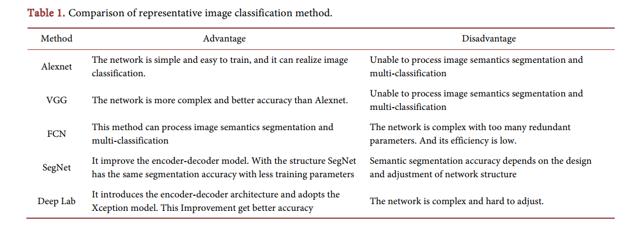

Slide 11
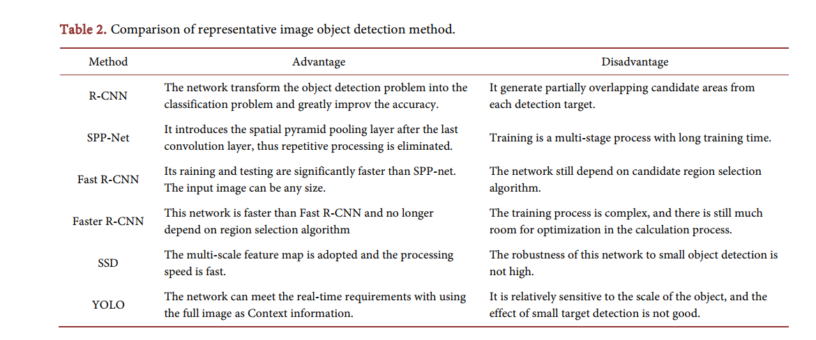
Object Detection

Slide 12
Change Detection
Process of detecting changes using remote sensing imagery obtained at different times.
These changes are due in part to natural phenomena, such as droughts, floods, and landslides, the other part is due in human activities as new roads, excavation of the surface or construction of new houses.
Compared to models for surface classification and object detection, there are less deep learning models for image change detection .
Two approaches:
1.To detect the correspondent points of two imagery through deep learning and determine whether there are changes to the correspondent points.
2. To translate the change detection problem into the surface classification problem, and acquire the changed region through semantic segmentation

Slide 13
shortcomings
1. lack of strict mathematical basis for the design and improvement of the networks
2. The requirements for training samples are high
3.The construction, adjustment and improvement of deep network still rely on the experience of developers
4.Smart remote sensing application

Slide 14
Thank you

