Slide 1

论文分享报告
Heterogeneous Graph Convolutional Network
乔子越
2019-06-10

Slide 2
Reference
Kipf, Thomas N., and Max Welling. “Semi-supervised classification with graph convolutional networks.” arXiv preprint arXiv:1609.02907 (2016). (ICLR 2017)
Schlichtkrull, M., Kipf, T. N., Bloem, P., Van Den Berg, R., Titov, I., & Welling, M. (2018, June). Modeling relational data with graph convolutional networks. In European Semantic Web Conference (pp. 593-607). Springer, Cham.

Slide 3
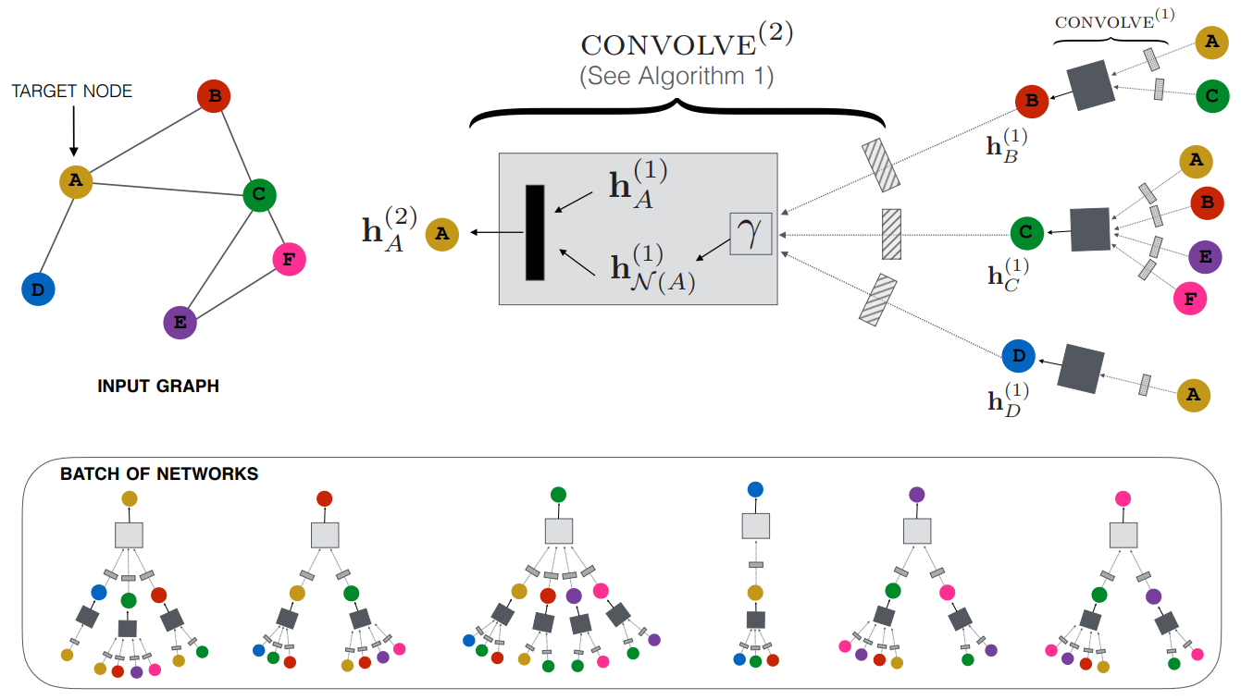
Graph Convolutional Network[1]
Graph Convolutional Network and related graph neural network models can be understood as special cases of a simple differentiable message passing model that operate on local graph neighborhoods to concatenate self embedding and neighbor embedding to generate each node’s embedding.

Slide 4
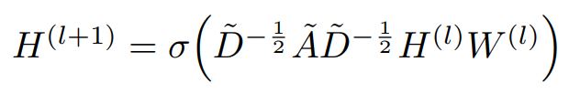
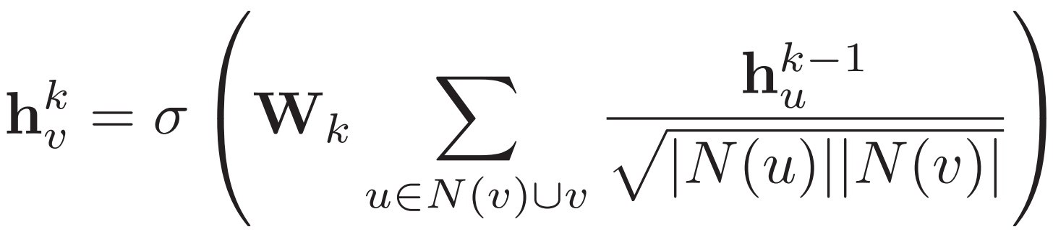
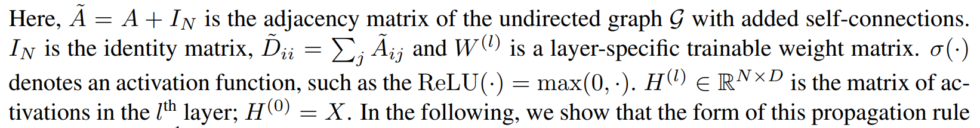
Graph Convolutional Network
Aggregator (Convolution layer):
1) Overall:
2) Node level:
N(u) denotes the degree of node u
Notes:
A tilde

Slide 5
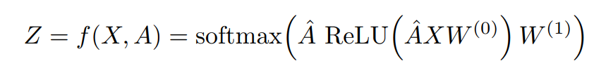

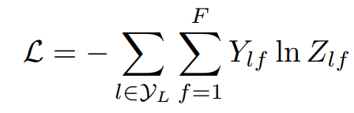
Graph Convolutional Network
We can feed these embeddings into any loss function and run stochastic gradient descent to train the aggregation parameters.
Output model：
Task specific.
1) supervised task (e.g., node classification):
where
2) unsupervised task (network embedding)
Random walks (node2vec, DeepWalk)
Graph factorization
i.e., train the model so that “similar” nodes have similar embeddings.

Slide 6
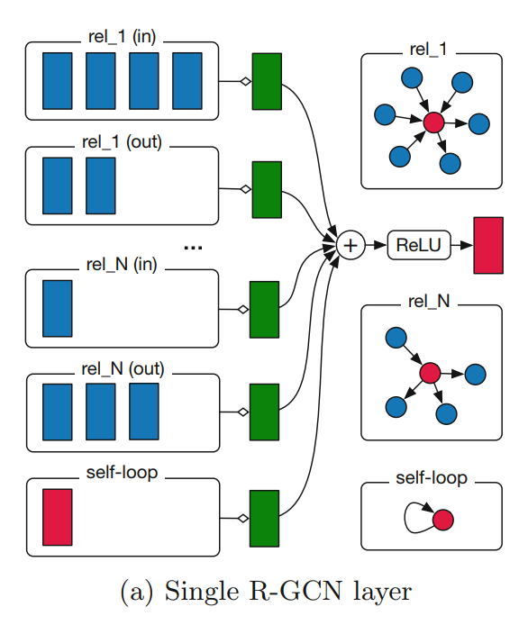
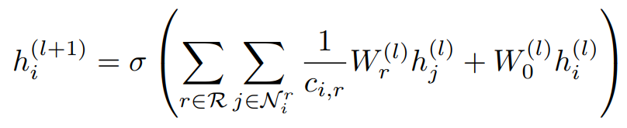
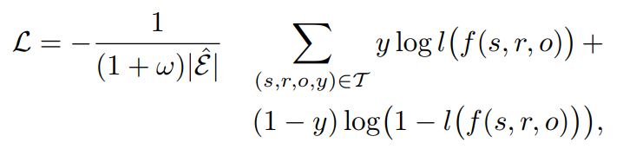

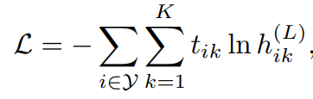
Relational Graph Convolutional Network[2]
Applied on graph with multiple relations (heterogeneous network)
Aggregator (Convolution layer):
Output model：
1) Link prediction (recovery of missing facts, i.e. subject-predicate-object triples)
2) entity classification (recovery of missing entity attributes)
Two supervised task, no solution for heterogeneous network embedding(unsupervised task).

Slide 7
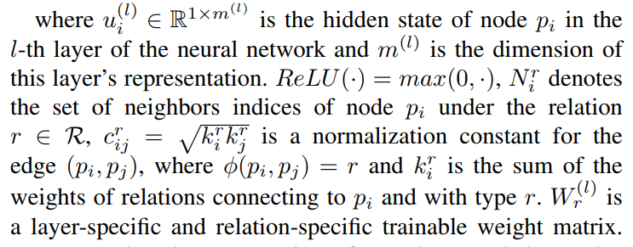
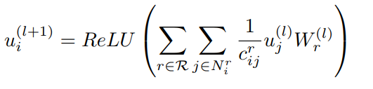
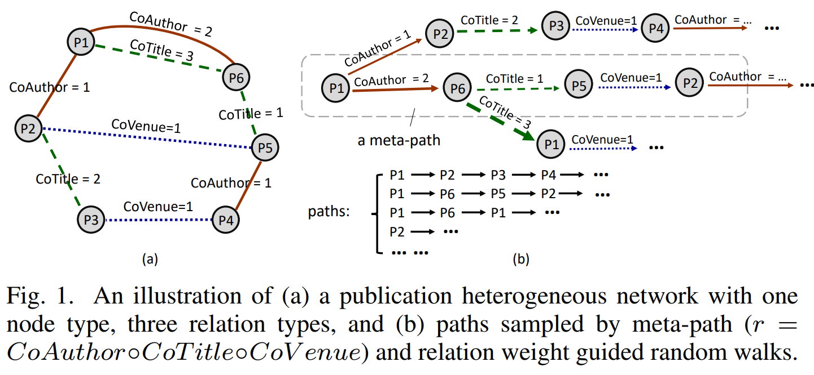


Heterogeneous Graph Convolutional
Network Embedding
Aggregator (Convolution layer):
Output model：
RW: paths generated by meta-path and relation weight guided random walk

Slide 8
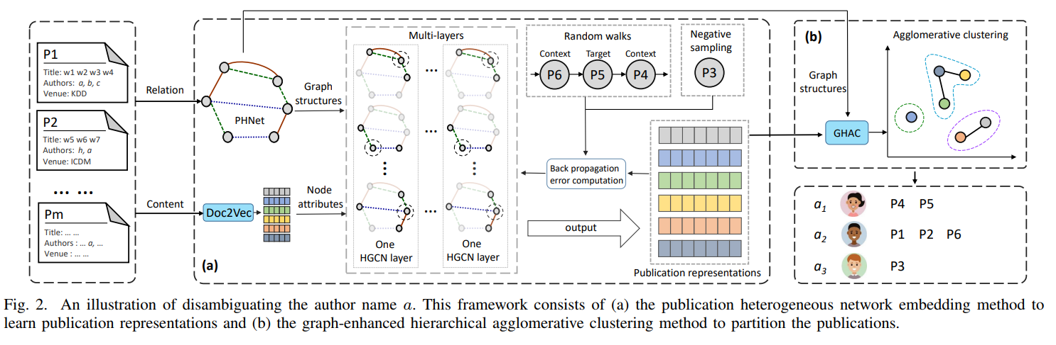
Heterogeneous Graph Convolutional
Network Embedding
The application of HGCN embedding on author name disambiguation:

