Slide 1


Slide 2
Functionalities:
Admin:
Retrieve user info
View the entire DB
Manage accounts
Reg user:
Retrieve your emails
View your email info
Compose emails
Why this is the best project:
Daily uses
Communication tool
Perfect UI for the perfect U
Stalk your friends as users

Slide 3
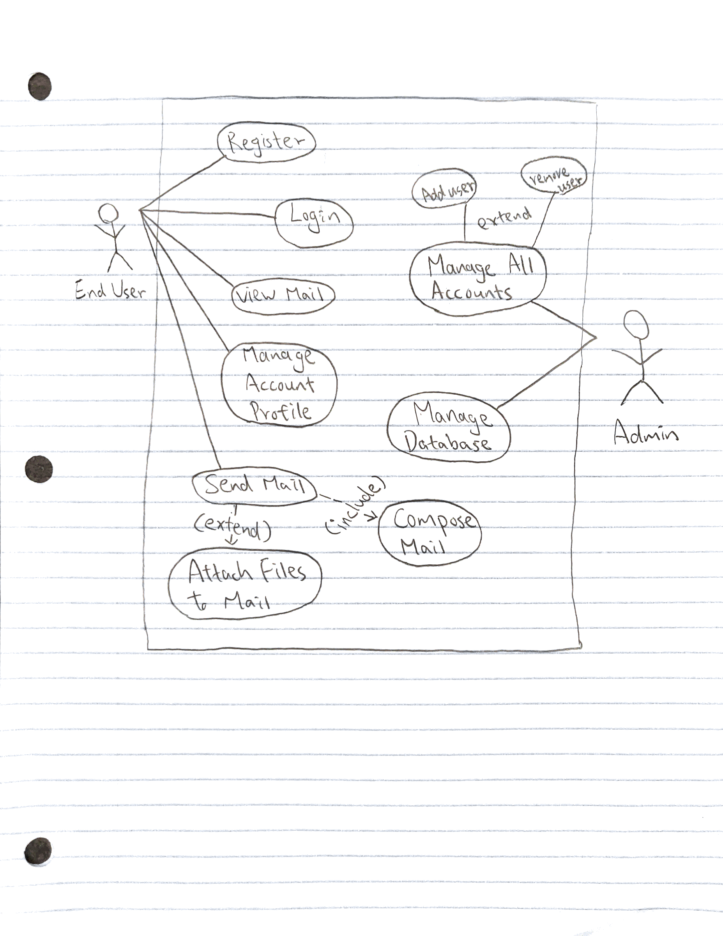
UML Use Case Diagram

Slide 4
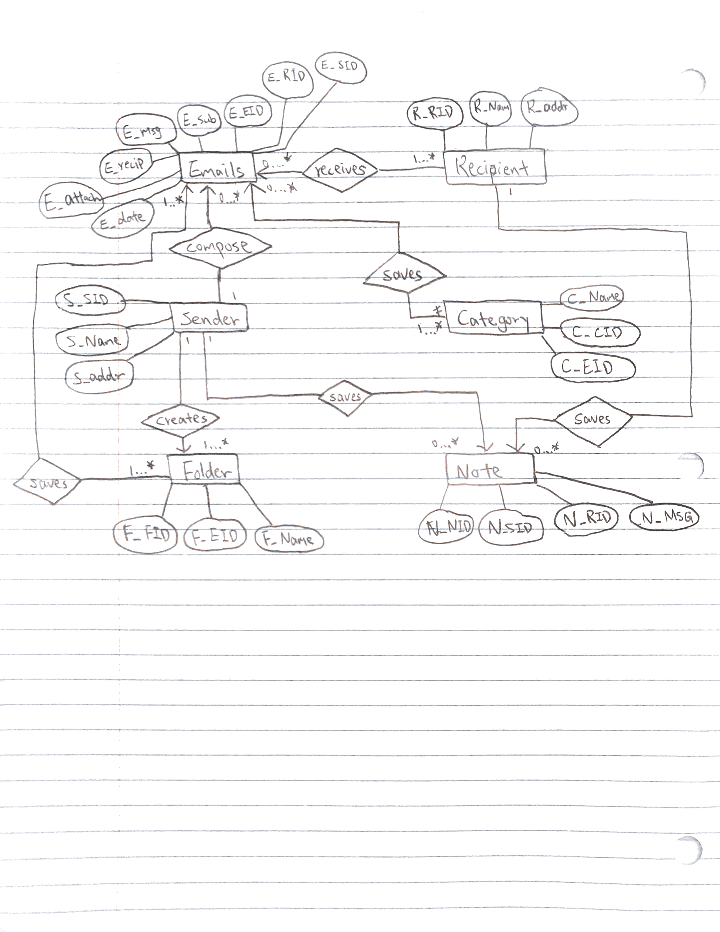
ER Diagram

Slide 5
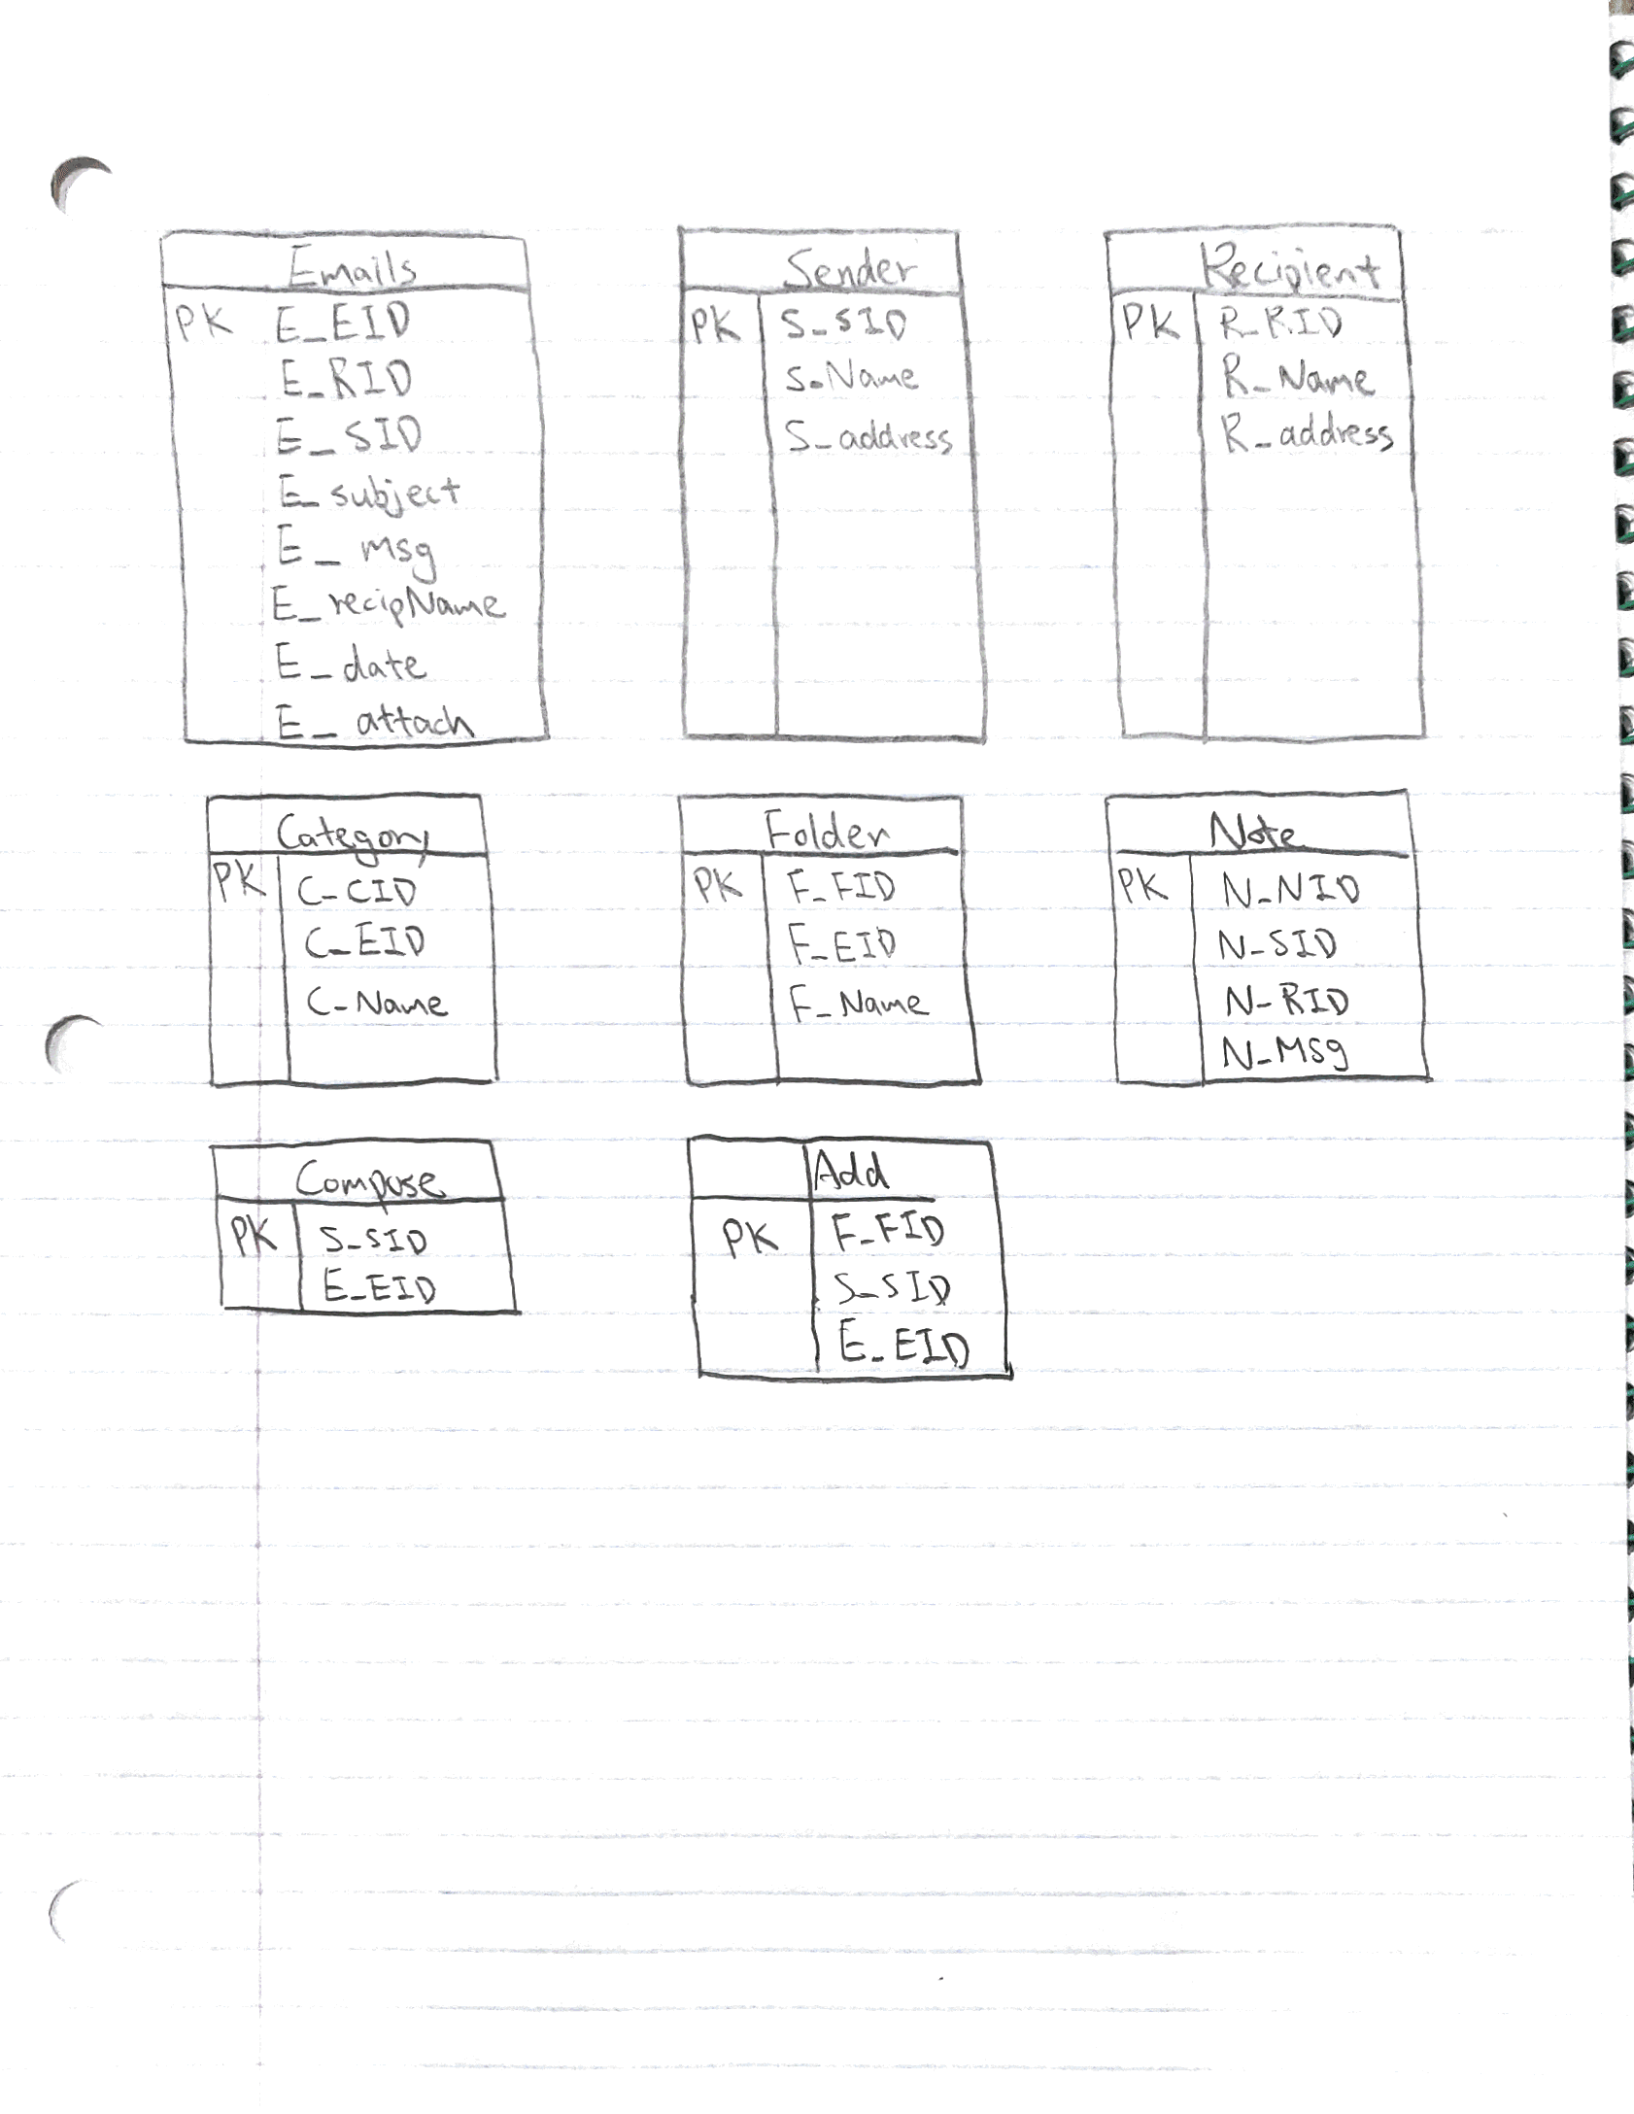
Relation Schema

Slide 6
Implementations
PHP, HTML, CSS for:
Frontend(interface) of the product.
PHP for:
The connection between the database and the interface
SQL for:
querying and writing data for the database table

Slide 7


READY?
PRESS!

