Slide 1
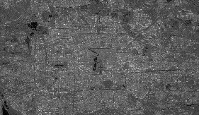
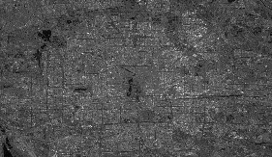
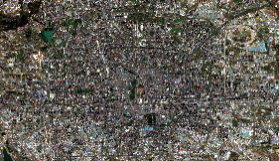

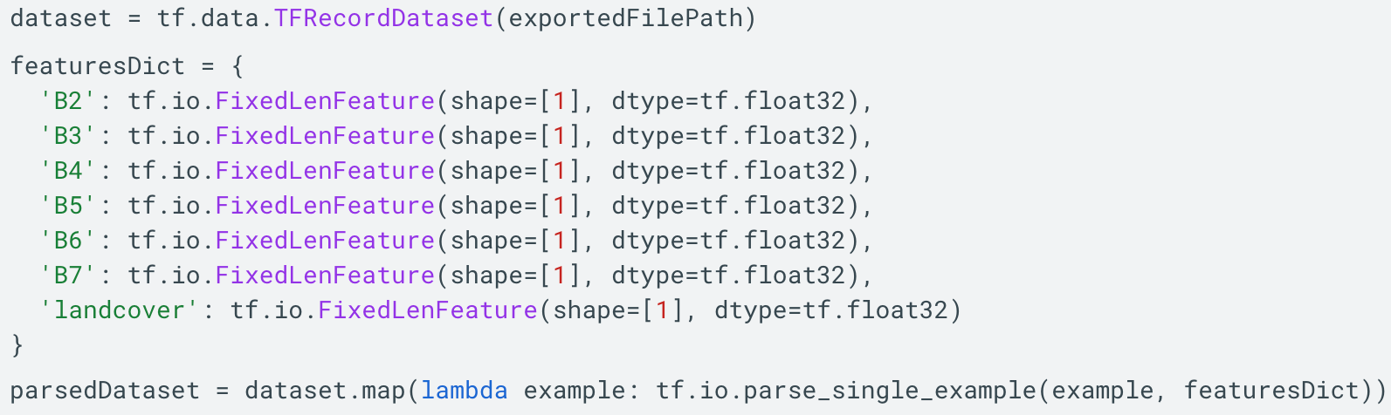
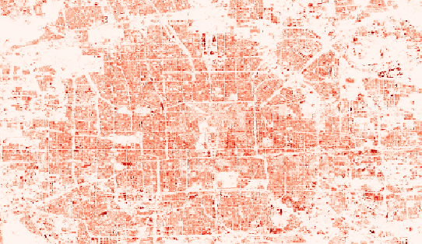
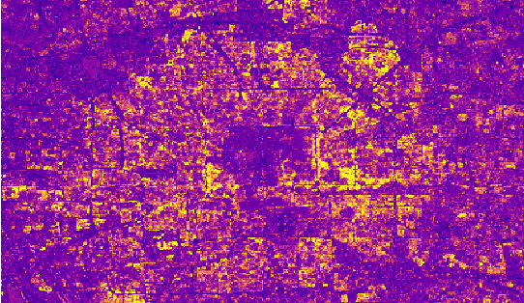
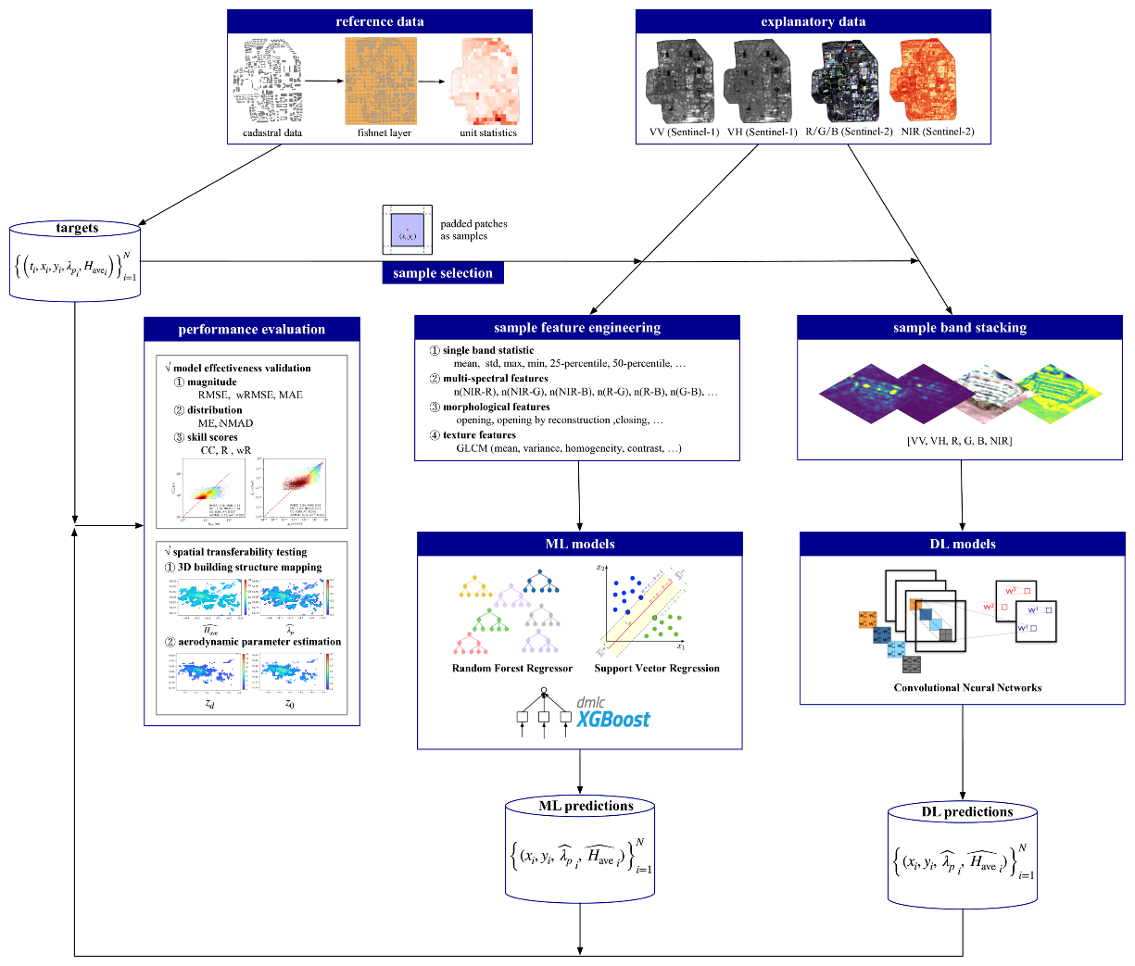
Sentinel Imagery on Google Earth Engine
TFrecords on Google AI Platform
1.1 Data export
ee.batch.Export.table.
toCloudStorage
(fileFormat=“TFRecord”)
Sentinel-1-VV
Sentinel-1-VH
Sentinel-2-RGB
Sentinel-2-NIR
2.2 Model Loading
ee.Model.fromAiPlatformPredictor
inputOverlapSize
proj, fixInputProj
outputBands
projectName
modelName
version
inputTileSize
Multiple Input
Multiple Output
?
Predicted results on Google Earth Engine
2.3 Prediction
ee.Model.predictImage(ee.Image)
GEE
AI Platform
2.1 EEification
earthengine model prepare
Input name
Output name
Input array
Output band
average building footprint
average building height
ML models on Google AI Platform
1.2 Training
tensorflow.keras.Model.fit()
Convolutional Neural
Networks (CNN)
Random Forest
eXtreme Gradient Boosting
Prediction with pretrained CNN models from SHAFTS on Google Cloud Infrastructures

Slide 2
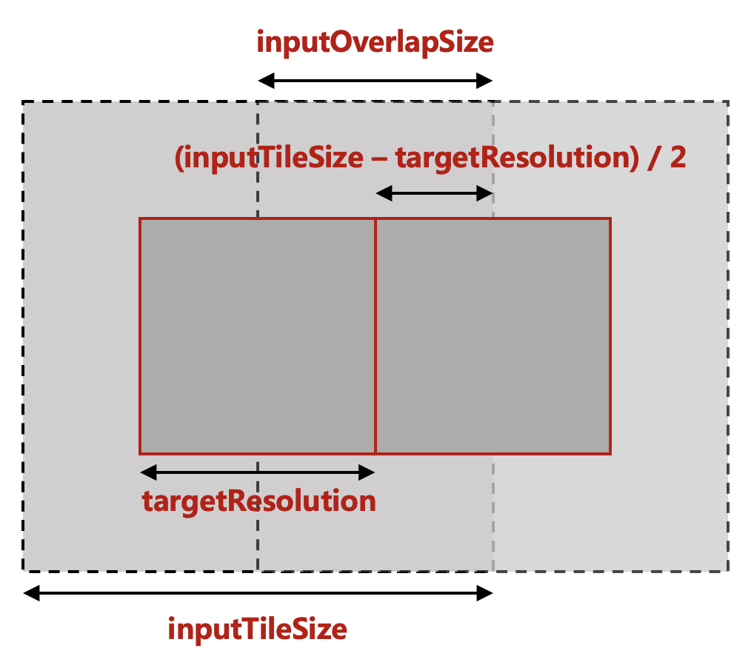
Workflow for global 3D building information mapping
Google Earth Engine
Sentinel-1/2 image
SRTM data
Google Earth Engine
High Resolution Settlement Layer
region
selection
Note: The HRSL dataset includes the information of human population at a resolution of 30 m.
image patching
3.2 Local machine
saved Tensorflow models
3.1 Google Cloud Storage
saved Tensorflow models
model loading
Compute Engine
Tensorflow model instances
Compute Engine
Predicted building height and footprint images
Google Cloud Storage
patched TFRecord datasets
dataset
loading
model
predicting
Note: The `Compute Engine` here can be a Google Virtual Machine, a Google Colab notebook or a local machine.
Prediction with pretrained CNN models from SHAFTS on Google Cloud Infrastructures

Slide 3
inputOverlapSize
(inputTileSize – targetResolution) / 2
targetResolution
inputTileSize
Resources

