Slide 1
WORKSIDE SOFTWARE LLC
PROPERTY INTELLIGENCE
Find. Analyze. Monitor. Act.
Continuous distressed-property intelligence for investors and acquisition teams.
1
2
3
4
5
DISTRESS
OPPORT.
INTELL.
DECISION
MONITOR
Turn fragmented data into a prioritized pipeline of properties worth investigating.
PROPERTY INTELLIGENCE • WORKSIDE SOFTWARE LLC
1

Slide 2
THE PROBLEM
Investors don't have a data problem.
They have a decision problem.
Tax records
Assessor
Foreclosures
Mortgages
THE QUESTION
Which properties actually matter?
Liens
AVMs
Comps
Title data
Each source tells part of the story. Investors still have to decide where to spend time, data dollars and due-diligence effort.
PROPERTY INTELLIGENCE • WORKSIDE SOFTWARE LLC
2

Slide 3
THE INEFFICIENCY
The traditional workflow is backwards.
Too much research happens before anyone knows whether the property deserves it.
1
2
3
4
5
6
7
8
Lead list
Property
Mortgage
Comps
Liens
Repairs
Numbers
Not a deal
Hours of work can end with a conclusion that should have been obvious much earlier.
PROPERTY INTELLIGENCE
Reverse the funnel.
PROPERTY INTELLIGENCE • WORKSIDE SOFTWARE LLC
3

Slide 4
THE MODEL
Property Intelligence reverses the funnel.
Start broad and inexpensive. Add cost and depth only as a candidate becomes more promising.
11,316
Tax-distressed candidates
312
High priority
118
High residential
81
High single-family
Few
Investor-quality leads
PROPERTY INTELLIGENCE • WORKSIDE SOFTWARE LLC
4

Slide 5
DISCOVERY
Start with evidence of distress.
A distress signal creates a candidate — not an investment recommendation.
TAX DISTRESS
MORTGAGE DISTRESS
PROPERTY EVENTS
Power-to-Sell
Delinquency
Tax auction
Notice of Default
Notice of Trustee Sale
Auction activity
Transfer / deed
Mortgage changes
Recorded events
Evidence of distress tells us where to look. The rest of the system determines whether there is economic room to investigate further.
PROPERTY INTELLIGENCE • WORKSIDE SOFTWARE LLC
5

Slide 6
IDENTITY
Turn records into actual properties.
Identity and provenance come before analysis.
1
2
3
4
5
County
ATN / APN
Assessor
Canonical
Address
ATTOM ID
Verified
Property
Keep each source identity separate. Know exactly where every fact came from.
PROPERTY INTELLIGENCE • WORKSIDE SOFTWARE LLC
6

Slide 7
COST EFFICIENCY
Screen before you spend.
The deeper the data, the fewer properties should reach it.
COUNTY / PUBLIC
ATTOM
RENTCAST
TITLE / LIENS
Broad discovery
Low cost
Mortgage • NOD/NTS
Home equity
AVM • Comps
Market evidence
Deep encumbrance
Finalists
Spend more data dollars only as the probability that a property deserves attention increases.
PROPERTY INTELLIGENCE • WORKSIDE SOFTWARE LLC
7

Slide 8
EVIDENCE
Build the financial picture — without manufacturing certainty.
Every output is labeled by what kind of evidence it represents.
KNOWN
ESTIMATED
CALCULATED
UNKNOWN
Tax delinquency
NOD / NTS
Recorded mortgage
AVM
Loan balance
Home equity model
Equity envelope
MAO
Investigation priority
Other liens
Condition / rehab
Verified payoff
PROPERTY INTELLIGENCE • WORKSIDE SOFTWARE LLC
8

Slide 9
REAL-WORLD PROOF
A real property moved from anonymous tax record to investable intelligence.
3484 Haven St became our first end-to-end production proof case.
TAX DELINQUENCY
INDEPENDENT AVM
AVM RANGE
2025 RESALE
ATTOM EST. LOAN
$49,262
$353,000
$323K–$383K
$117,500
$114,181
WHAT THE SYSTEM ESTABLISHED
Single Family • 3 BD / 1.5 BA • 1,265 SF • Built 1966 • 15 comps • Exact Assessor crosswalk • Durable Property lineage
Started as an anonymous county tax record.
PROPERTY INTELLIGENCE • WORKSIDE SOFTWARE LLC
9

Slide 10
CREDIBILITY
But Property Intelligence doesn't call it a deal.
Finding apparent equity is not the same as finding an investment.
WHAT WE KNOW
WHAT STILL NEEDS VERIFICATION
Property identity
Tax distress
Independent valuation
Mortgage estimate
Comparable evidence
Other liens / encumbrances
Verified payoff
Tax redemption amount
Condition / rehab
Title issues / transaction costs
The system identifies uncertainty instead of hiding it.
PROPERTY INTELLIGENCE • WORKSIDE SOFTWARE LLC
10

Slide 11
ACQUISITION DECISION
From evidence to Maximum Allowable Offer.
The investor defines the hurdle. Property Intelligence does the math.
1
2
3
4
5
6
7
Exit value
Rehab
Holding
Financing
Selling
Encumbrances
Required return
MAXIMUM ALLOWABLE OFFER
A defensible acquisition threshold based on evidence + investor assumptions.
If critical inputs are unknown, the system can stop instead of manufacturing precision.
PROPERTY INTELLIGENCE • WORKSIDE SOFTWARE LLC
11

Slide 12
THE SECOND ACT
The problem with every static lead list.
The property keeps changing after you find it.
SEP
DEC
MAR
APR
APR 18
MAY
Tax distressed
NOD recorded
NTS recorded
Auction scheduled
Auction postponed
Cured / sold / transferred
An annual list can be obsolete months before the next release.
PROPERTY INTELLIGENCE • WORKSIDE SOFTWARE LLC
12

Slide 13
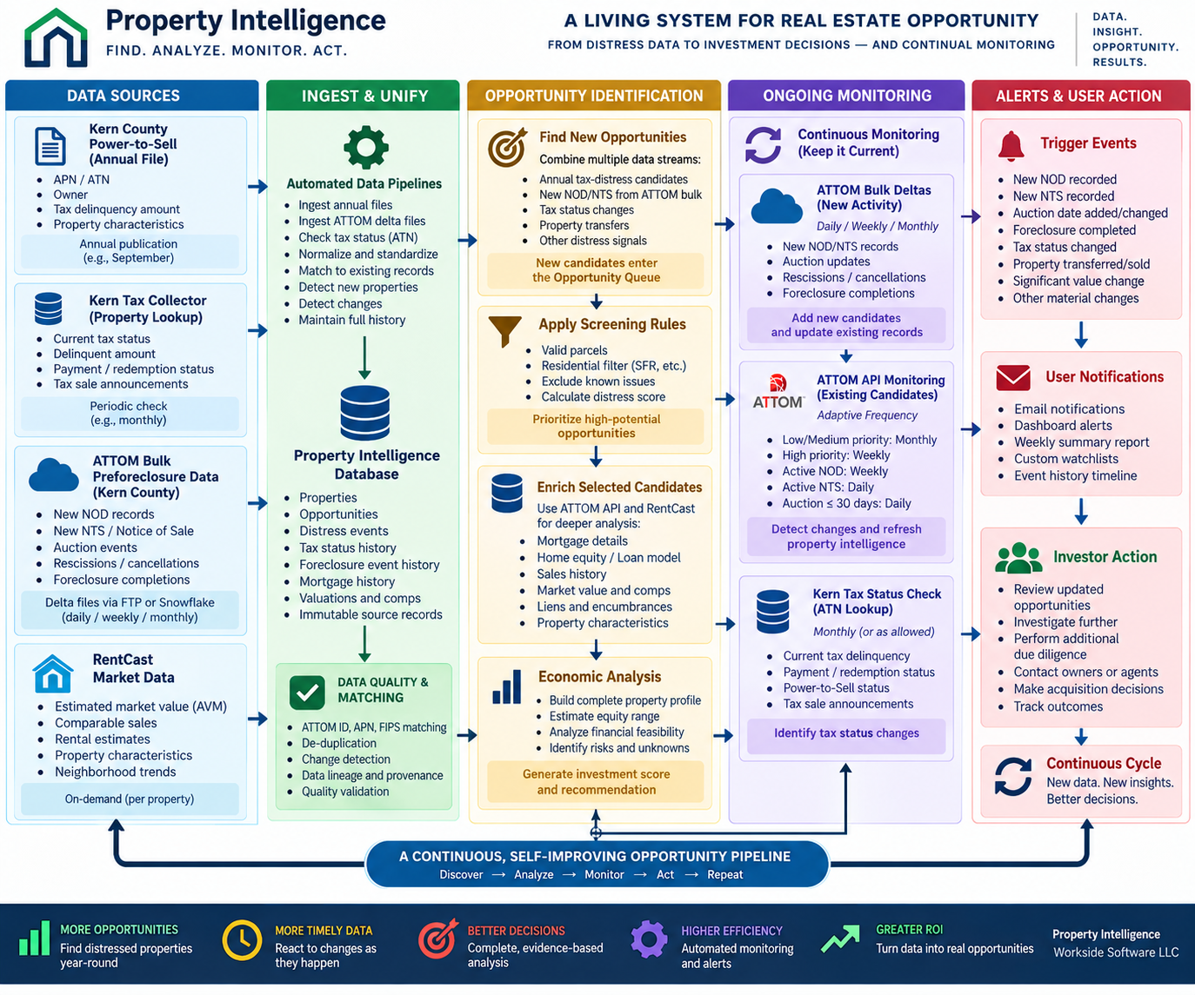
CONTINUOUS INTELLIGENCE
Property Intelligence keeps watching.
Discover → analyze → monitor → detect change → recalculate → alert.
MATERIAL EVENTS
New NOD / NTS
Auction scheduled or changed
Mortgage change
Property transfer
Tax status change
New lien
Material valuation change
The opportunity doesn't disappear from our radar after the first analysis.
PROPERTY INTELLIGENCE • WORKSIDE SOFTWARE LLC
13

Slide 14
CUSTOMER EXPERIENCE
What changed this week?
Investors shouldn't have to repeatedly research hundreds of properties.
7
2
1
1
MATERIAL EVENTS
New NODs
New NTS
Auction moved
1
1
1
Tax distress resolved
Property transferred
Economics improved
Property Intelligence tells the user where something important changed.
PROPERTY INTELLIGENCE • WORKSIDE SOFTWARE LLC
14

Slide 15
ARCHITECTURE
The data network.
We don't replace data providers. We make their evidence useful together.
COUNTY / PUBLIC
ATTOM
RENTCAST
TITLE / LIEN
Tax distress
Assessor
Tax auctions
Mortgage
NOD / NTS
Home equity
Foreclosure deltas
AVM
Comps
Property evidence
Open liens
PACE / HOA
Releases
Title chain
PROPERTY INTELLIGENCE
Decision + continuous intelligence layer
PROPERTY INTELLIGENCE • WORKSIDE SOFTWARE LLC
15

Slide 16
THE VALUE PROPOSITION
From thousands of records to the few properties that matter.
Property Intelligence is the decision and monitoring layer above fragmented real estate data.
DISCOVER
ANALYZE
DECIDE
MONITOR
Find distress before investors spend time researching it.
Combine property, mortgage, valuation and encumbrance evidence.
Evaluate economics and calculate a defensible acquisition threshold.
Continuously detect events that can change the opportunity.
Property Intelligence continuously turns fragmented real estate data into a prioritized pipeline of opportunities investors can investigate based on evidence rather than guesswork.
Find. Analyze. Monitor. Act.
PROPERTY INTELLIGENCE • WORKSIDE SOFTWARE LLC
16

