Slide 1

Technical Writing:
Real-World Writing
in the 21st Century
WVDE

Slide 2
Essential Questions:
How does technical writing in school prepare students for adult living, learning, and work settings?
How does technical writing compare to academic writing?
How does technical writing reflect 21st century learning and engage 21st century learners?

Slide 3
Participants will KNOW
what technical writing is
what technical writing looks like in the content areas
how to integrate technical writing into your content area
how to assess technical writing

Slide 4
Participants will DO
identify writing in their CSOs
identify technical writing to use with specific content
develop a technical writing prompt using the FAT-P format

Slide 5
What do YOU write?
At home?
At work?
For learning?
Notes:
Participants will use the 4-column graphic organizer to record in each column. At this point, have them only focus on recording in the first 3 columns. Discuss their lists and relate these to being technical or practical writing.

Slide 6
What opportunities do you give your students to write?
Notes:
Have participants fill in the 4th column of their sheet by listing the type of writing assignments they give to their students. Discuss this list and see how many of the assignments fall into the realm of technical or practical writing.

Slide 7

What is Technical Writing?

Slide 8
Technical Writing AKA …
Business Writing
Workplace Writing
Professional Writing
Informational Writing
Notes:
Tell participants that they may hear Technical Writing called by many different names.
Also inform them that the kind of writing that we usually do in school is academic writing.

Slide 9
What is Technical Writing?
It is the type of everyday writing that surrounds us from the time we wake until we climb in bed at night.
Directions on the toothpaste tube
Nutrition benefits on the cereal box
Business letters and catalogs that come in the mail
Written instructions for assembling a new product
Tax receipts and notices
Product safety information
Notes:
First of all, technical writing has many names – practical, informational, workplace, professional, business or transactional writing. It is just what is shown on this slide. It is the type of writing that surrounds us daily.
Many states have begun to focus on technical writing instruction by having students write proposals, action plans, position papers, observation reports, incident reports, process explanations and progress reports.

Slide 10
How is Technical Writing Different?
The information is organized, presented and communicated in a specific format.
The writing is concise, clear and accurate.
The writing takes into account the audience’s needs, biases and prior understanding.
The writing presents information to help readers solve a problem or gain a better understanding of a situation.
The writing conveys technical, complex, or specialized information in a way that is easy for a non-technical reader to understand.
Notes:
Technical or business writing skills are developed in the same way that traditional literary-response writing is developed. The roots are in the basic essay that is featured in K-12 writing instruction. The integral difference comes when writers have to think critically, problem solve, analyze, and synthesize information.

Slide 11
What employers say…
1/3 of the employees in America’s top companies are poorly trained in writing and cannot compose a coherent business response (National Commission on Writing)
Conscientious employers are retraining employees to write in the workplace
Notes:
So what?? This retraining of employees is expensive and is figured into the costs that consumers like us pay for products and services.
Other companies are not retraining, they are simply replacing them with better-trained employees. Some of the ill-prepared employees are actually college graduates.

Slide 12
SCANS Report
Three-Part Foundation needed on the job
    Basic Skills (reads, writes, performs mathematical operations, listens and speaks)
    Thinking Skills (Thinks creatively, makes decisions, solves problems, visualizes, knows how to learn, and reasons)
    Personal Qualities (Displays responsibility, self-esteem, sociability, self-management, and integrity and honesty)
Notes:
The Secretary’s Commission on Achieving Necessary Skills (SCANS) was a 2 year study that focused on a “high-performance economy characterized by high-skill, high-wage employment.” The commission was asked to analyze what specific skills students needed to master for success in the world outside the classroom.

Slide 13
SCANS Report
Five Workplace Competencies
    Resources: Identifies, organizes, plans and allocates resources
    Interpersonal: Works with others
    Information: Acquires and uses information
    Systems: Understands complex interrelationships
    Technology: Works with a variety of technologies
Notes:
SCANS report was a 2 year study that focused on a “high-performance economy characterized by high-skill, high-wage employment.”

Slide 14
SCANS Report
Possessing basic writing skills means that students need “to communicate thoughts, ideas, information, and messages in writing; and create documents such as letters, directions, manuals, reports, graphs, and flow charts.”
Notes:
Point out the products of technical writing – letters, directions, etc.

Slide 15
American Diploma Project (ADP)
Schools need to train students to “communicate essential information effectively via email, write proposals to obtain new business, communicate key instructions to colleagues or convey policies to customers.”
Notes:
The ADP was begun in 2001 to restore the value of the high school diploma. It set benchmarks for each content area. The skills needed for English are described on the slide.
The report goes on to say that “poor writing may easily affect a company’s bottom line and even precipitate legal action. The discipline used to create, reshape, and polish pieces of high-quality writing prepares students for occasions when they must write quickly and clearly on demand, whether in the workplace or in college classrooms.

Slide 16
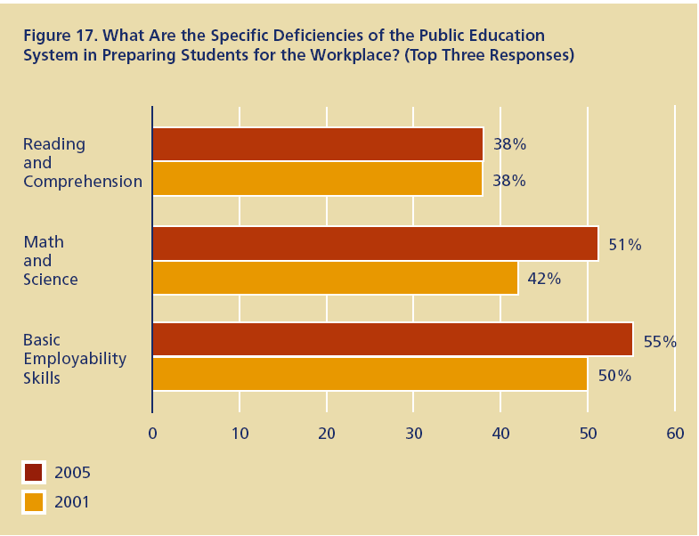
2005 Skills Gap Report-NAM
Notes:
This data from the 2005 Skills Gap Report of the National Association of Manufacturers shows the top three deficiencies identified by companies. Notice the increase from 2001 to 2005.

Slide 17
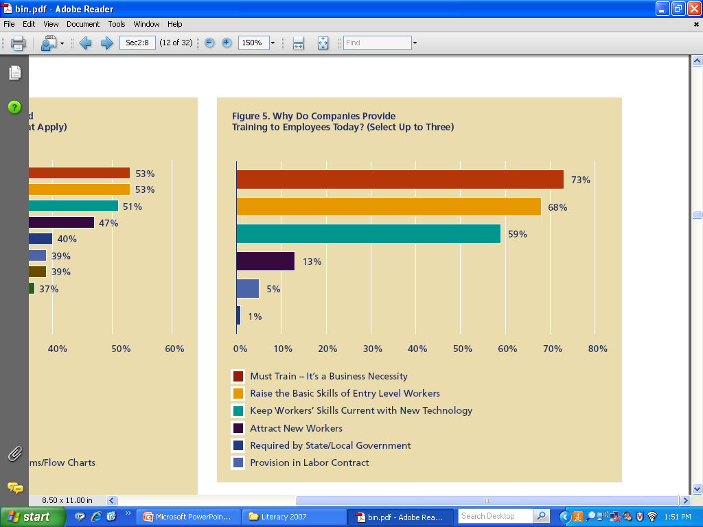
2005 Skills Gap Report-NAM
Notes:
In this NAM slide you can see that raising the entry level of workers represents the reason why 68% of the companies train their employees.

Slide 18
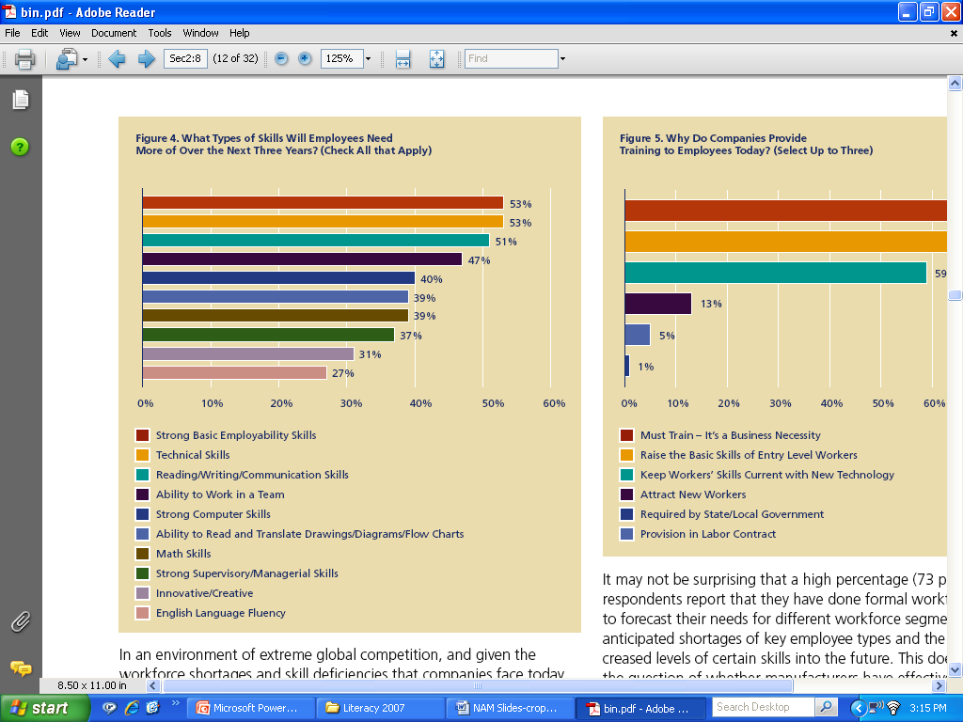
2005 Skills Gap Report-NAM
Notes:
This NAM slide shows that 51% of the businesses say that reading, writing, and communication skills are needed for the new employees.

Slide 19

What does all this mean?
ALL teachers must help students become better technical writers so that they will be prepared for the writing they will have to do as successful adults in the workplace.

Slide 20
Activity:
Look at the CSOs for your grade level and content area and identify types of writing that are already embedded.
Notes:
NOTE: Alert teachers before the training to bring a copy of their grade and content CSOs.
At this point we will have teachers look at the CSOs for their grade level and content area. Have them highlight or mark the mention of writing.
Discuss the writing they found mentioned. We know the RELA people will have many explicit mentions. Others may find it a little harder. The writing opportunities will be identified further when we do the second activity.

Slide 21
Technical writing is a natural partner to academic writing. It is descriptive, creative, and expository, but the format is different and the standards are higher.
Technical writing requires 100% accuracy.

Slide 22
Academic Writing | Technical Writing
Descriptive Writing | Job Description, Incident Report, Résumé, Process Explanation
Narrative Writing | Observation Report, Progress Report
Analysis | Performance Evaluation, Feasibility Report
Cause and Effect | Analytical Report, Product Field Test Report
Compare-Contrast | Product Comparison, Feasibility Report
Persuasive Writing | Proposal, Action Plan
Notes:
As you can see from this slide, all of the skills of academic writing that are taught in school can be easily applied to technical writing.
Technical writing stretches the student beyond the competencies required for academic writing. They must use higher levels of analysis and decision making. They must determine the needs of the audience and the purpose of the communication.
The types of technical writing listed on this chart also fit with the 21st Century Learning Skills and Technology Tools Content Standards and Objectives for West Virginia Schools, Policy 2520.14.

Slide 23
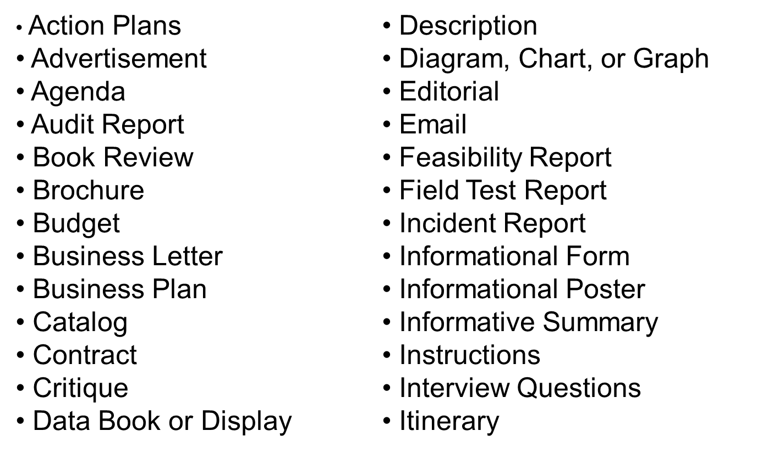
Examples of Technical Writing:
Notes:
Point out that all of these are just examples of many more that can be used.

Slide 24
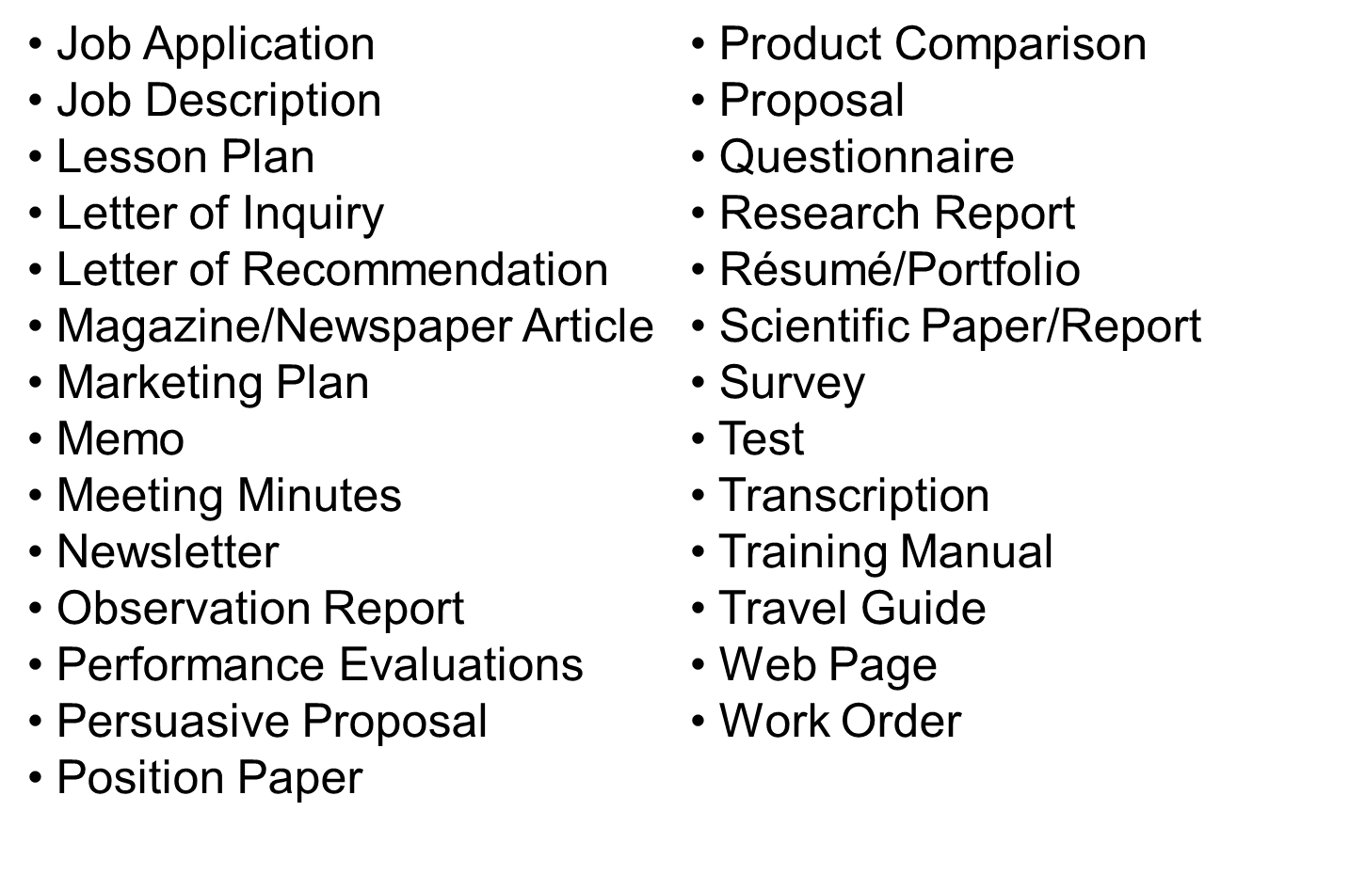
Examples of Technical Writing:
Notes:
Point out that all of these are just examples of many more that can be used.

Slide 25

Activity:
Look at the CSOs for your grade and content and see which of the Examples of Technical Writing might be used.
Notes:
Distribute the Examples list and give the teachers time to go back through their CSOs and decide where they could use one of the types of technical writing with students.
After teachers have had time to examine the CSOs, move to the next slide.

Slide 26

Activity:
Be able to identify at least one example
of technical writing and be able to briefly explain how it could be used in a lesson you have planned.
Notes:
Give teachers time to process this assignment and prepare their ideas. They can jot it on a post-it note. They will need this when they participate in the next activity.

Slide 27

Inside-Outside Circle
Notes:
For this activity, have people find a partner and decide who is A and who is B. Have all the A’s stand up and form a circle. Then they will turn their back to the inside of the circle. Have partner B’s stand up and locate their partner A. This should form a circle with an inner and outer ring.
(You may have to pair “twins” if there is an odd number of people. You might also have to work around chairs, tables, etc.)
Partner A is the Inside and Partner B is the Outside. Participants are going to share their lesson idea for a piece of technical writing. Start with Partner A listening and Partner B talking. After 1 minute, switch and have Partner A talk and Partner B listen.
After both partners have shared, have Partner A’s raise their right hands. They will move two people to the right while the outside circle (Partner B’s) stay put. Repeat the sharing with Partner A’s speaking first.
After both partners have shared their ideas, have the Partner B’s (Outside Circle) raise their right hands and move two people to their right. Partner B will share first.
The reason this is a great activity is that it forces all participants to be accountable for having and sharing their plan.

Slide 28

Results??
Notes:
At this time, debrief the group by having them share ideas they had for the content areas. Record results under the headings of all content areas represented in the training (Math, Music, Driver’s Ed.)

Slide 29
How Do I Use Technical Writing in
My Content Area?
Mathematics
Course | Technical Writing
Consumer Math | Action Plan, Budget
General Math | Statistics Project: Survey, Action Plan, Progress Report
Algebra II | Process Explanation, Observation Report, Field Test Report, Letter of Request, Action Plan, Oral Presentation
Notes:
As you go through the following set of slides, just point out that all areas of content can involve students in Technical Writing.

Slide 30
How Do I Use Technical Writing in
My Content Area?
Science
Course | Technical Writing
Biology I | Observation Report, Field Test Report, Letter of Inquiry, Brochure, Action Plan, Progress Report, Process Explanation, Incident Report, Safety Guidelines
Physical Science | Process Explanation, Technical Instructions, Product Description, Incident Report, Observation Report
Inquiry | Brochure on Ecosystem, Action Plan
Greenhouse | Manual, Brochure

Slide 31
How Do I Use Technical Writing in
My Content Area?
Social Studies
Course | Technical Writing
American History | Itinerary, Progress Report, Cost Analysis, Letter of Inquiry, Brochure, Oral Presentation, Business Plan, Financial Statement, News Release
U. S. Government | Letter of Inquiry regarding Legislation, Feasibility Report, Persuasive Letter
Criminology | Incident Report

Slide 32
How Do I Use Technical Writing in
My Content Area?
English Language Arts
Course | Technical Writing
English, College Prep | Analysis of Technical Writing, Oral Presentation, Brochure, News Release
English | Chart, Graph, Table, Letter of Request, Action Plan, Progress Report, Persuasive Letter, Process Explanation
Creative Writing | Incident Report, Progress Report

Slide 33
How Do I Use Technical Writing in
My Content Area?
Health/Physical Education
Course | Technical Writing
Aerobics | Action Plan, Graph, Chart, Observation Report, Letter of Request, Product Description, Product Comparison, Process Explanation
Health | Observation Report, Survey, Letter of Inquiry, Interview, Brochure, Action Plan, Progress Report, Persuasive Letter

Slide 34
How Do I Use Technical Writing in
My Content Area?
Visual and Performing Arts
Course | Technical Writing
Music | Observation Report, Letter of Request, Letter of Inquiry, Brochure, Agenda, Program, Website, Flyer, Marketing Plan
Art | Action Plan, Process Explanation, Observation Report, Technical Instructions, Evaluation, Interview, Website, Marketing Plan, Progress Report

Slide 35
How Do I Use Technical Writing in
My Content Area?
Career & Technical Education
Cluster | Technical Writing
Health Services | Observation Report, Survey, Letter of Inquiry, Interview, Brochure, Action Plan, Progress Report, Persuasive Letter, Patient Charting, Journal, Research, Transcription
Human Services | Action Plan, Process Explanation, Observation Report, Instructions, Evaluation, Interview, Website, Progress Report, Advertisement, Proposal, Critique, Review, Business Letter, Proposal, Job Application
Science/Natural Resources | Observation Report, Brochure, Proposal, Training Manual, Newsletter, Progress Report, Budget Plan, Data Report, Research, Website

Slide 36
How Do I Use Technical Writing in
My Content Area?
Career & Technical Education
Cluster | Technical Writing
Engineering/ Technical | Observation Report, Proposal, Letter of Inquiry, Interview, Brochure, Action Plan, Progress Report, Training Manual, Instructions, Estimate, Audit Report, Work Order
Arts and Humanities | Action Plan, Process Explanation, Advertisement, Review, Instructions, Evaluation, Interview, Website, Progress Report, Budget Plan, Proposal, Newspaper or Magazine Article, Publication
Business/ Marketing | Observation Report, Brochure, Proposal, Training Manual, Newsletter, Progress Report, Business Plan, Marketing Plan, Publication, Contract, Review

Slide 37

What assignments
are appropriate
at what grade
levels?
Notes:
For the next few slides just let the teachers look at the kinds of assignments that might be used at the different grade levels.
Should they only be used at that grade level? NO
This chart could be useful for a middle or high school that wanted to ensure that their students had experience with many different kinds of technical writing over the course of several years. That would eliminate the overuse of e certain ones while neglecting others.

Slide 38
Technical Writing K-2
Advertisement for a product
Simple Book Review
Description of a person or thing
Email message
Instructions
Job Description
Memo
Web page

Slide 39
Technical Writing 3-5
Action Plan for a project
Brochure
Letters (Business, Inquiry, Recommendation)
Editorial
Incident Report
Interview Questions
Newsletter
Performance Evaluation
Questionnaire
Travel Guide

Slide 40
Technical Writing 6-7th Grade
Incident Report
Travel Guide
Field Test Report
Newsletter
Letter of Inquiry
Catalog Product Description
Oral Presentation

Slide 41
Technical Writing 8th Grade
Safety Guidelines
Informational Poster
Magazine Article
Survey Questionnaire
Itinerary
Informative Summary
Oral Presentation

Slide 42
Technical Writing 9th Grade
Letter of Request
Process Explanation
Product Description
Flyer
Pamphlet
Progress Report
Instructions
Oral Presentation

Slide 43
Technical Writing 10th Grade
Letters: Inquiry, Adjustment, Request
Technical Instructions
Technical Definition
Flyer
Pamphlet
Observation Report
Analysis: Cause and Effect
Process Description
Oral Presentation

Slide 44
Technical Writing 11th Grade
Letters: Application, Follow-up, Complaint
Résumé and Cover Letter
Job Description
Proposal
Description of a Mechanism
Action Plan
Memo to Co-workers
Flyer/Pamphlet
Oral Presentation

Slide 45
Technical Writing 12th Grade
Letters: Recommendation, Resignation
Performance Evaluation
Observation Report
Analysis; Compare and Contrast
Informative Summary
Feasibility Report
Market Research Report
Process Description
Oral Presentation

Slide 46

What does a Technical Writing Assignment look like?

Slide 47
Many professional athletes and celebrities, like movie stars and musical recording artists, receive multi-million dollar salaries. Many people think these salaries are excessive; others believe they are justifiable. As a reporter for your local newspaper you are going to write an editorial in which you defend or oppose the salaries of these people.
Persuasive Proposal
Marketing Advertisement
Notes:
Notice this assignment is written with a real-world context. The student is able to take what he or she knows about the salaries of athletes, movie stars, or musicians and couple that with what he or she thinks about the fairness of it all. He or she will use this information to craft a piece of writing that could be used in a real-world setting.
The writing assignment or prompt is known as a FAT-P. It gives students the Format (editorial), Audience (readers of the newspaper), Topic (salaries of celebrities), and Purpose (to defend or oppose).
Let’s look at another one.

Slide 48
Many new technological advances have been made in the way Americans listen to music. CD players replaced record players because they were more portable. In the past few years MP3 players have become very popular. You are a consumer advocate investigating which of these devices is the best value. You will write an article for your magazine, Consumer Guide, in which you express your findings and recommend one of these products to your readers.
Product Description
Product Comparison
Magazine Article
Notes:
Give participants time to read the slide, then click to show the types of technical writing involved.
Move to the next slide to examine the FAT-P.

Slide 49
Many new technological advances have been made in the way Americans listen to music. CD players replaced record players because they were more portable. In the past few years MP3 players have become very popular. You are a consumer advocate investigating which of these devices is the best value. You will write an article for your magazine, Consumer Guide, in which you express your findings and recommend one of these products to your readers.
Format
Audience
Topic
Purpose
Notes:
Give participants time to read the slide, then click to show the types of technical writing involved.
Move to the next slide to examine the FAT-P.

Slide 50
Your Turn
Decide on a type of Technical Writing you could
use in your classroom.
Create a prompt for the assignment using the FAT-P
format.
    Format
    Audience
    Topic
    Purpose
Make sure the prompt has a real-world context.
Write the prompt on chart paper and post it on the wall.
Notes:
Go over the directions for this assignment and clarify any questions they may have. Walk around and check progress as they create. After all charts have been posted, move to the next slide.

Slide 51




Gallery Walk
Notes:
Participants will get up and walk around to read the prompts posted on the chart paper. Tell them to try and identify the FAT-P in each prompt they read.
When most people have moved back to their seats, debrief by asking for comments.

Slide 52


How DO I Assess Technical Writing?

Slide 53

100% Accuracy
is Expected.
Notes:
Remind them that the documents that they send into public view are supposed to be perfect. Someone who sends out business communications with errors in spelling, grammar or mechanics will not be working for that company very long.
Also remind the participants that we have several ways to assure that our workplace communications are perfect – spell check, peer editing, etc. Why shouldn’t students be able take advantage of the same resources we use in the workplace?
One suggestion for managing technical writing in the classroom is that when the teacher spots the first error on the page he/she puts a checkmark next to the error and writes “NY” for Not Yet at the top of the paper and hands it back to the student. They can tell the student, “I found one error; you may find more.” Students are asked to revise until all mistakes are corrected. This pushes the student to learn critical editing skills.
While students edit and revise, either alone, in pairs, or in small groups, teachers have time for pull-out groups to teach mini-lessons on writing skills. The teacher may also work with an individual student who can’t seem to get an assignment corrected after several tries. To keep track of completed student assignments, the teacher can create a check-off chart.

Slide 54

Disengaged Learners
Technical writing widens the sphere of students who use higher-order thinking and writing skills to include students who might not have learned these skills through literary response
writing.
Notes:
Teachers report that disengaged students “wake up” when relevant topics are introduced that require problem solving, audience analysis, decision making and response in technical writing. Teachers are surprised at their positive reactions and enthusiastic participation. The subject may be more rigorous because it is relevant, but students are up for the challenge.
The practical, hands-on students are relieved that someone finally understands their style of learning.

Slide 55
Infusing workplace skills and standards into traditional courses raises expectations and gives students an opportunity to excel.
Notes:
Relate this slide back to the whole goal of 21st century learning: “ to prepare students with the necessary 21st century skills, personal dispositions and deep understanding of world-class curricula that enables them to function effectively as family member, citizen, worker and leader in a global digital information age.”

Slide 56
Questions
and
Comments

Slide 57


Reflection
Things I learned
Things I confirmed
Question I still have
Notes:
For the reflection, participants should reflect using the 3, 2, 1 Strategy. They can use their own paper to state 3 things they learned, 2 things they confirmed that they already knew, and 1 question they still have about today’s session.

