Slide 1

Automobile Accidents
Sunuk Kim, Minseo Jeonn,
Doeon Kim
Data Analysis Project(mid)

Slide 2
Outline
Introduction
Prepare Data
A. Default Prediction
B. Weather, Traffic, Injury
C. Return to entire dataset
Appendix
Notes:
Okay. Let’s start with introduction

Slide 3


Automobile Accidents
Dataset Overview
Records: 42,183 real automobile accidents in the USA (2001)
Injury Levels:
No Injury
Injury
Fatality
Additional Information
Day of the week
Weather conditions
Road type

Slide 4

Purpose of the Analysis
Objective
Predict whether reported accidents will result in an injury (MAX_SEV_IR = 1 or 2) or no injury(MAX_SEV_IR = 0)

Slide 5
Outline
Introduction
Prepare Data
A. Default Prediction
B. Weather, Traffic, Injury
C. Return to entire dataset
Appendix
Notes:
Okay. Let’s start with introduction

Slide 6
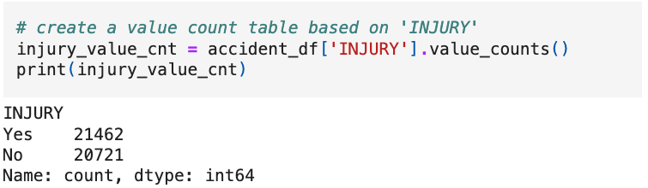
Variable Creation
Variable Name: INJURY
Definition:
If MAX_SEV_IR = 1 or 2 → INJURY = “Yes”
If MAX_SEV_IR = 0 → INJURY = “No”

Slide 7
Outline
Introduction
Prepare Data
A. Default Prediction
B. Weather, Traffic, Injury
C. Return to entire dataset
Appendix
Notes:
Okay. Let’s start with introduction

Slide 8
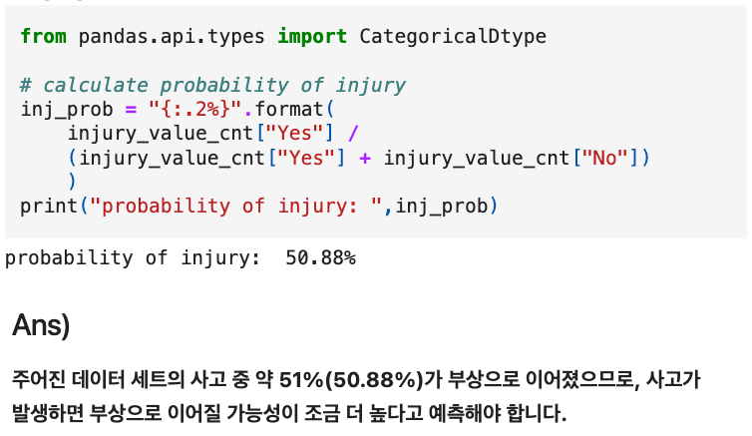
Default Prediction
Predicting INJURY without Additional Information
Prediction:

Slide 9
Outline
Introduction
Prepare Data
A. Default Prediction
B. Weather, Traffic, Injury
C. Return to entire dataset
Appendix
Notes:
Okay. Let’s start with introduction

Slide 10
Weather, Traffic, Injury
Analyzing Initial Records
Selected Records:
Focus on the first 12 records of the dataset.
Response Variable:
INJURY
Predictor Variables:
WEATHER_R: Weather condition (1 = No adverse weather, 2 = Rain/Snow or other adverse weather)
TRAF_CON_R: Traffic Control Device (0 = None, 1 = Traffic Right, 2 = Other (signs, traffic police, etc.))

Slide 11
Weather, Traffic, Injury
Pivot Table Analysis of INJURY as a Function of Two Predictors
Objective
Create a Pivot table to examine the relationship between INJURY and the two predictor variables: WEATHER_R and TRAF_CON_R using the first 12 records of the dataset.

Slide 12
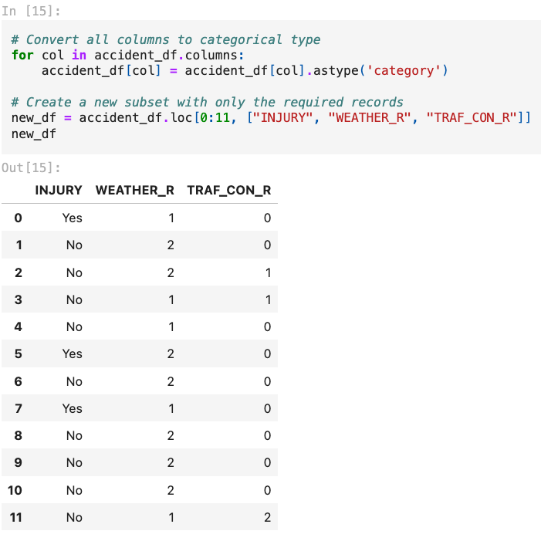
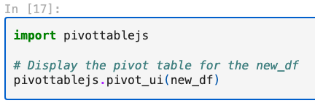
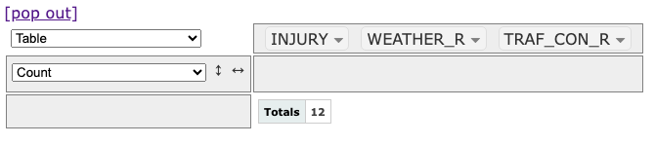
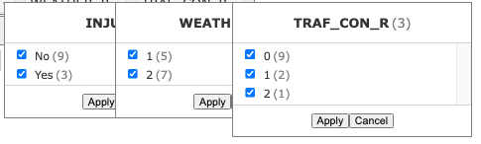
Weather, Traffic, Injury

Slide 13
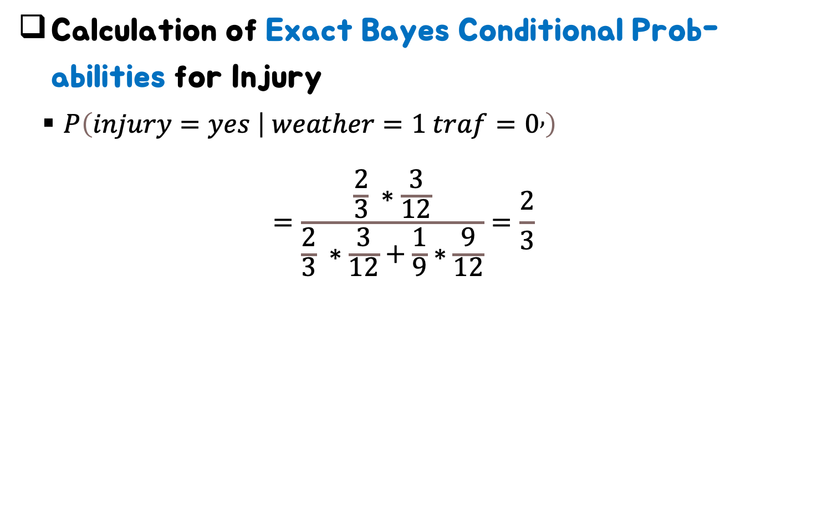
Weather, Traffic, Injury
Calculation of Exact Bayes Conditional Prob-abilities for Injury
$P\left(injury=yes | weather=1 traf=0,\right)$
$$=\frac{\frac{2}{3} ∗\frac{3}{12}}{\frac{2}{3} ∗\frac{3}{12}+\frac{1}{9}∗\frac{9}{12}}=\frac{2}{3}$$

Slide 14
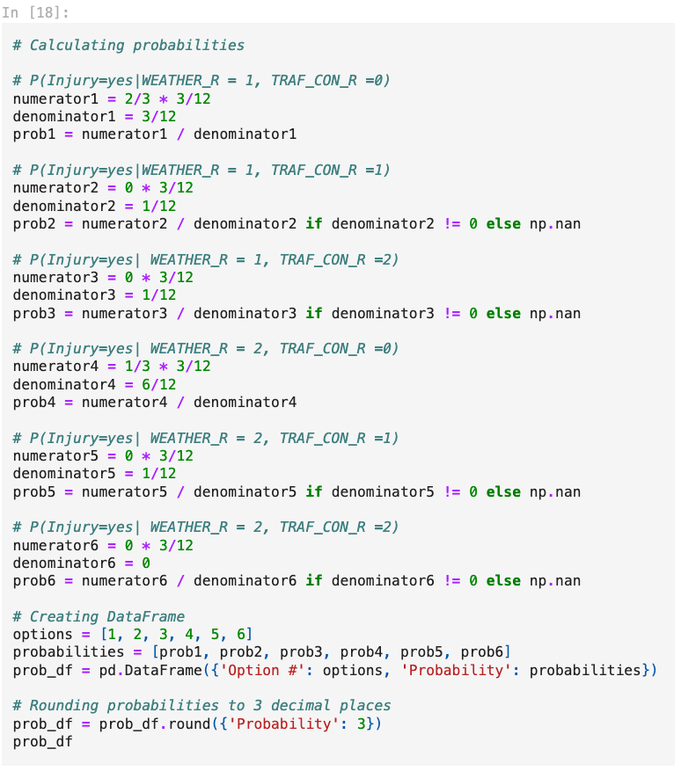
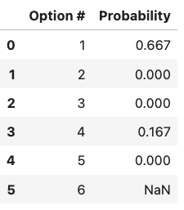
Weather, Traffic, Injury
Calculation of Exact Bayes Conditional Prob-abilities for Injury

Slide 15
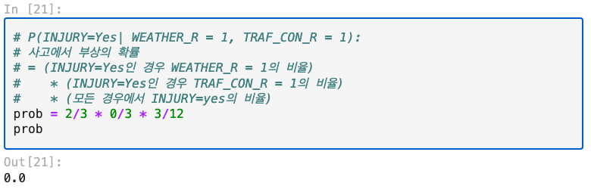

Weather, Traffic, Injury
Calculating Naïve Bayes Conditional Prob-ability:
WEATHER_R = 1 and TRAF_CON_R = 1
$\frac{\frac{2}{3} ∗\frac{0}{3} ∗\frac{3}{12}}{\frac{2}{3} ∗\frac{0}{3} ∗\frac{3}{12}+\frac{3}{9}∗\frac{2}{9}∗\frac{9}{12}}=0$

Slide 16
Weather, Traffic, Injury
Objective:
Run a Naïve Bayes classifier using Scikit-learn.
Obtain probability values and classification results, and compare these with the exact Bayesian classification results.

Slide 17
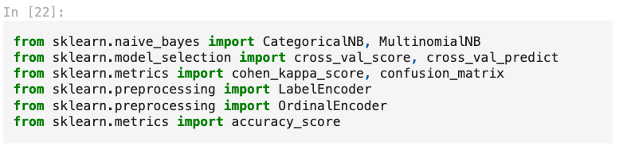
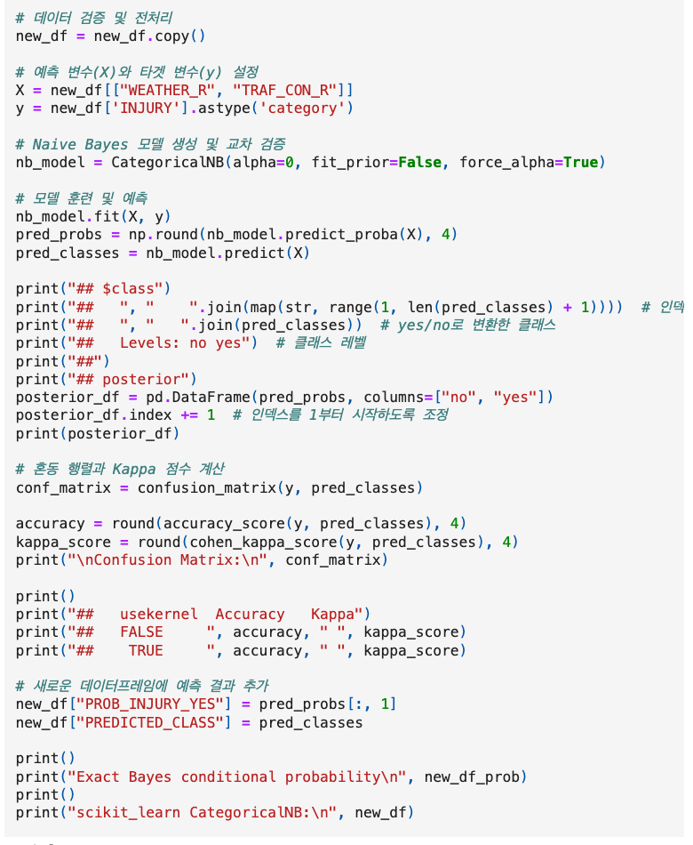
Weather, Traffic, Injury
Codes

Slide 18
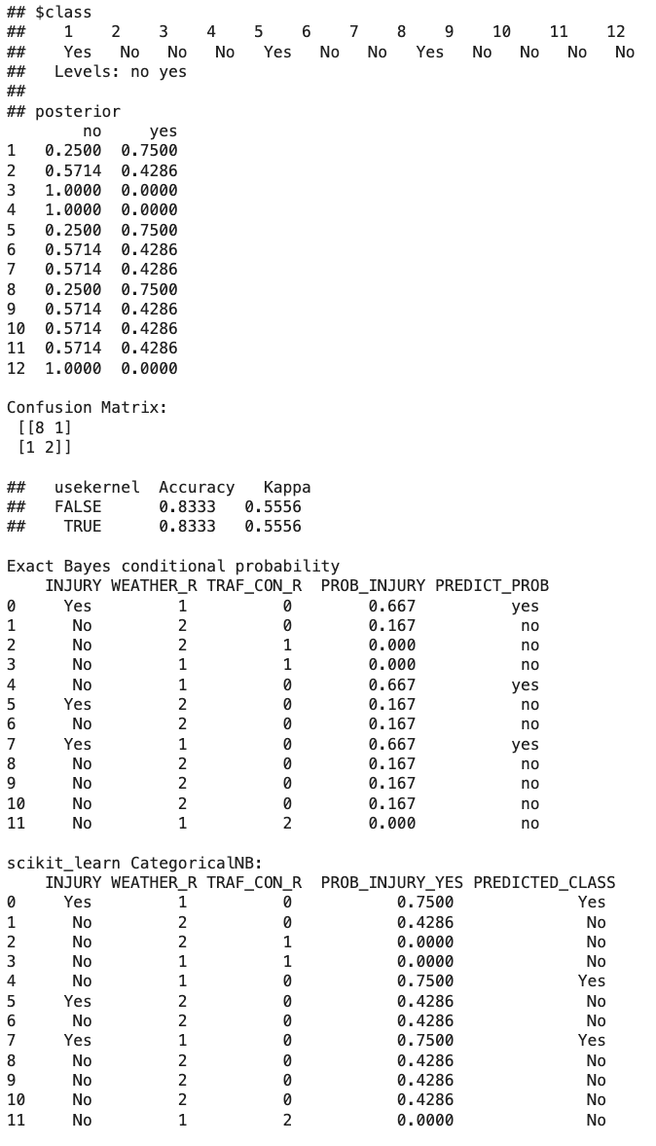
Weather, Traffic, Injury
Notes:
비교 분석 모델의 분류 결과와 정확한 베이즈 조건부 확률 결과를 비교하여 다음과 같은 결론을 도출할 수 있습니다: 분류 결과 비교: PREDICT_PROB (scikit-learn CategoricalNB)와 PROB_INJURY (정확한 베이즈)의 예측 결과는 항상 일치했습니다. 그러나 확률 값에는 차이가 존재했습니다. 예를 들어, 1번 레코드는 두 모델 모두 yes로 예측되었지만, 그 확률은 각각 0.7500과 0.667로 서로 달랐습니다. 이러한 차이는 scikit-learn에서 정의된 CategoricalNB 모델의 학습 방법이 정확한 베이즈 모델과 다르기 때문입니다. CategoricalNB는 Laplace smoothing과 같은 기법을 사용하여 확률을 계산하고, 데이터의 빈도수에 따라 확률을 조정합니다. 반면, 정확한 베이즈 모델은 주어진 데이터에 대한 확률을 직접적으로 계산하여 확률값을 제공합니다. 관측치 랭킹 비교: PROB_INJURY와 PREDICT_PROB의 값에 따라 관측치의 랭킹이 동일한지 확인할 수 있습니다. 일반적으로 확률값에 기반한 랭킹이 일치하므로, 각 레코드의 예측이 어떻게 정렬되는지 확인해야 합니다. 결론적으로, 모델의 출력값과 정확한 베이즈 분류 결과는 예측 클래스에서 일치하지만, 예측 확률에서는 차이가 존재했습니다. 이는 CategoricalNB의 학습 방법과 정확한 베이즈 모델 간의 차이에 기인합니다. 각 모델의 성능을 비교하고 이해하는 것은 예측 문제를 해결하는 데 중요한 요소입니다.

Slide 19
Outline
Introduction
Prepare Data
A. Default Prediction
B. Weather, Traffic, Injury
C. Return to entire dataset
Appendix
Notes:
Okay. Let’s start with introduction

Slide 20
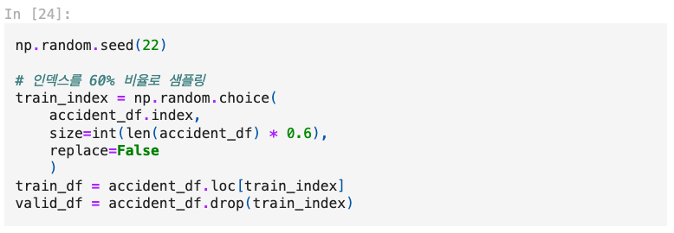
Return to entire dataset
Training Data(60%) and Validation Data(40%)

Slide 21
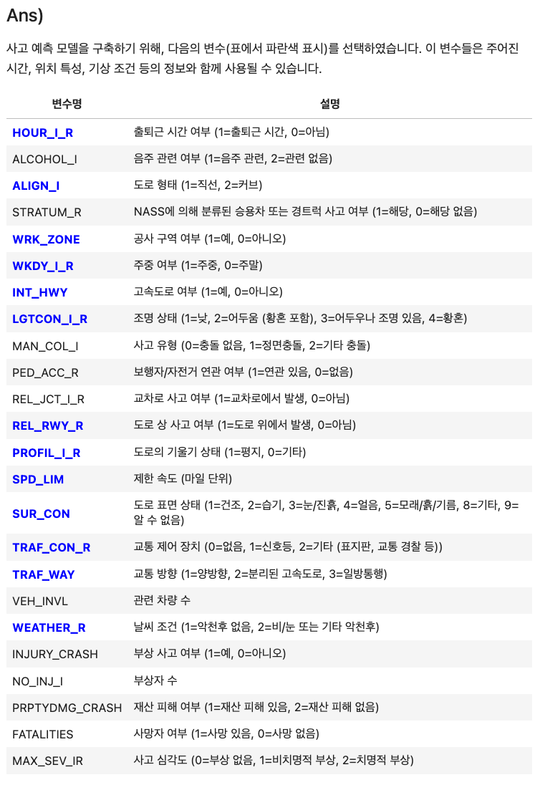
Return to entire dataset

Slide 22
Return to entire dataset
Selecting Predictors for Analysis
Analysis Context:
Assumption: At prediction time, no specific accident details or initial report are available.
Available Data: Only location characteristics and weather conditions are provided.
Reference:
Data Specifications: File data specification page for detailed predictor descriptions.

Slide 23
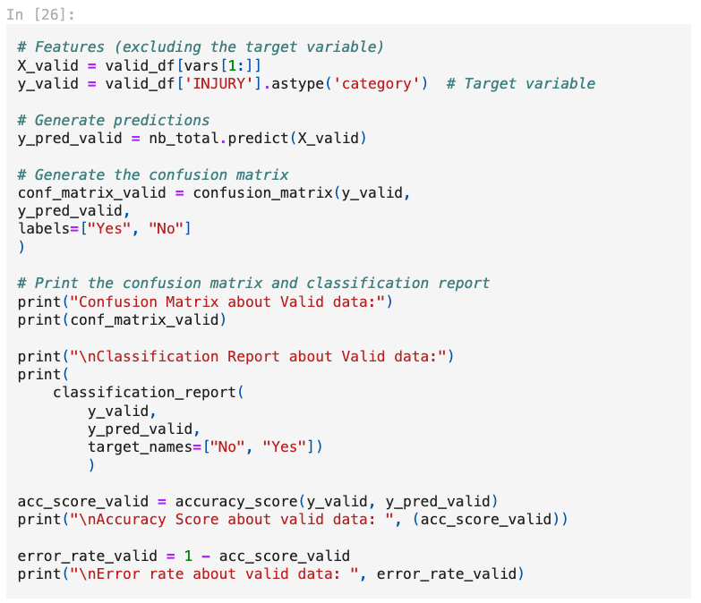
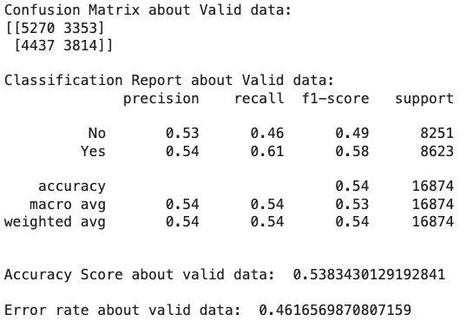
Validation Dataset Error Rate

Slide 24
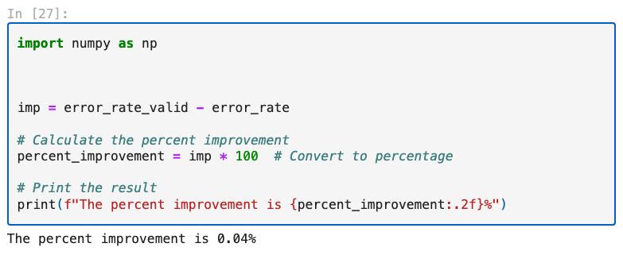
Return to entire dataset
Relative Improvement with Naïve Bayes Rule

Slide 25
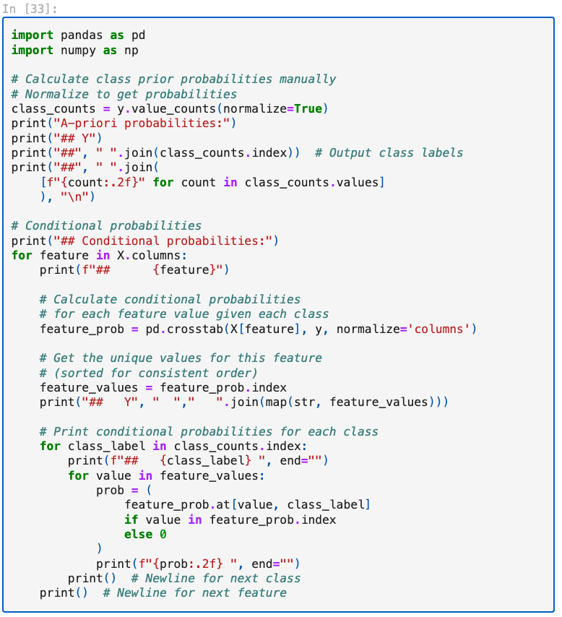
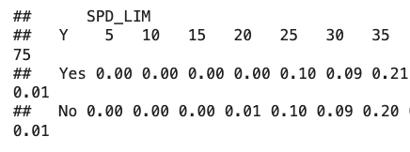
Conditional Probability Analysis
Why is P(INJURY = No | SPD_LIM = 5) = 0?

Slide 26
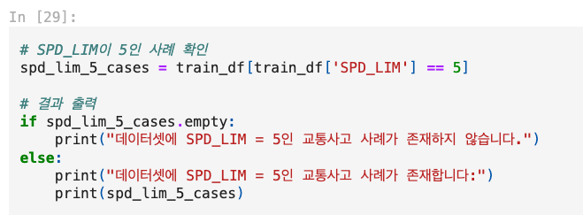
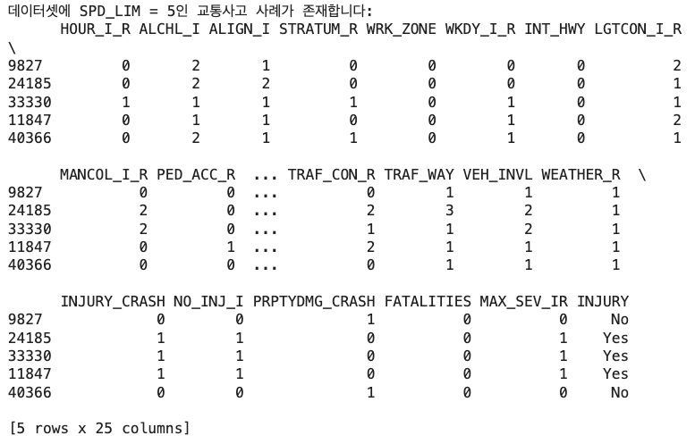
Conditional Probability Analysis
Why is P(INJURY = No | SPD_LIM = 5) = 0?

Slide 27
Conditional Probability Analysis
Why is P(INJURY = No | SPD_LIM = 5) = 0?
ANS)
Explanation: The probability is 0 because there are very few cases with SPD_LIM = 5, and only a limited number are classified as INJURY = No.
Dataset Observation: In the training data, only 5 cases have SPD_LIM = 5, and of these, only 2 cases are recorded as INJURY = No.
Result: Due to this limited data, the estimated probability of P(INJURY = No | SPD_LIM = 5) is calculated as 0.

Slide 28
Outline
Introduction
Prepare Data
A. Default Prediction
B. Weather, Traffic, Injury
C. Return to entire dataset
Appendix
Notes:
Okay. Let’s start with introduction

Slide 29
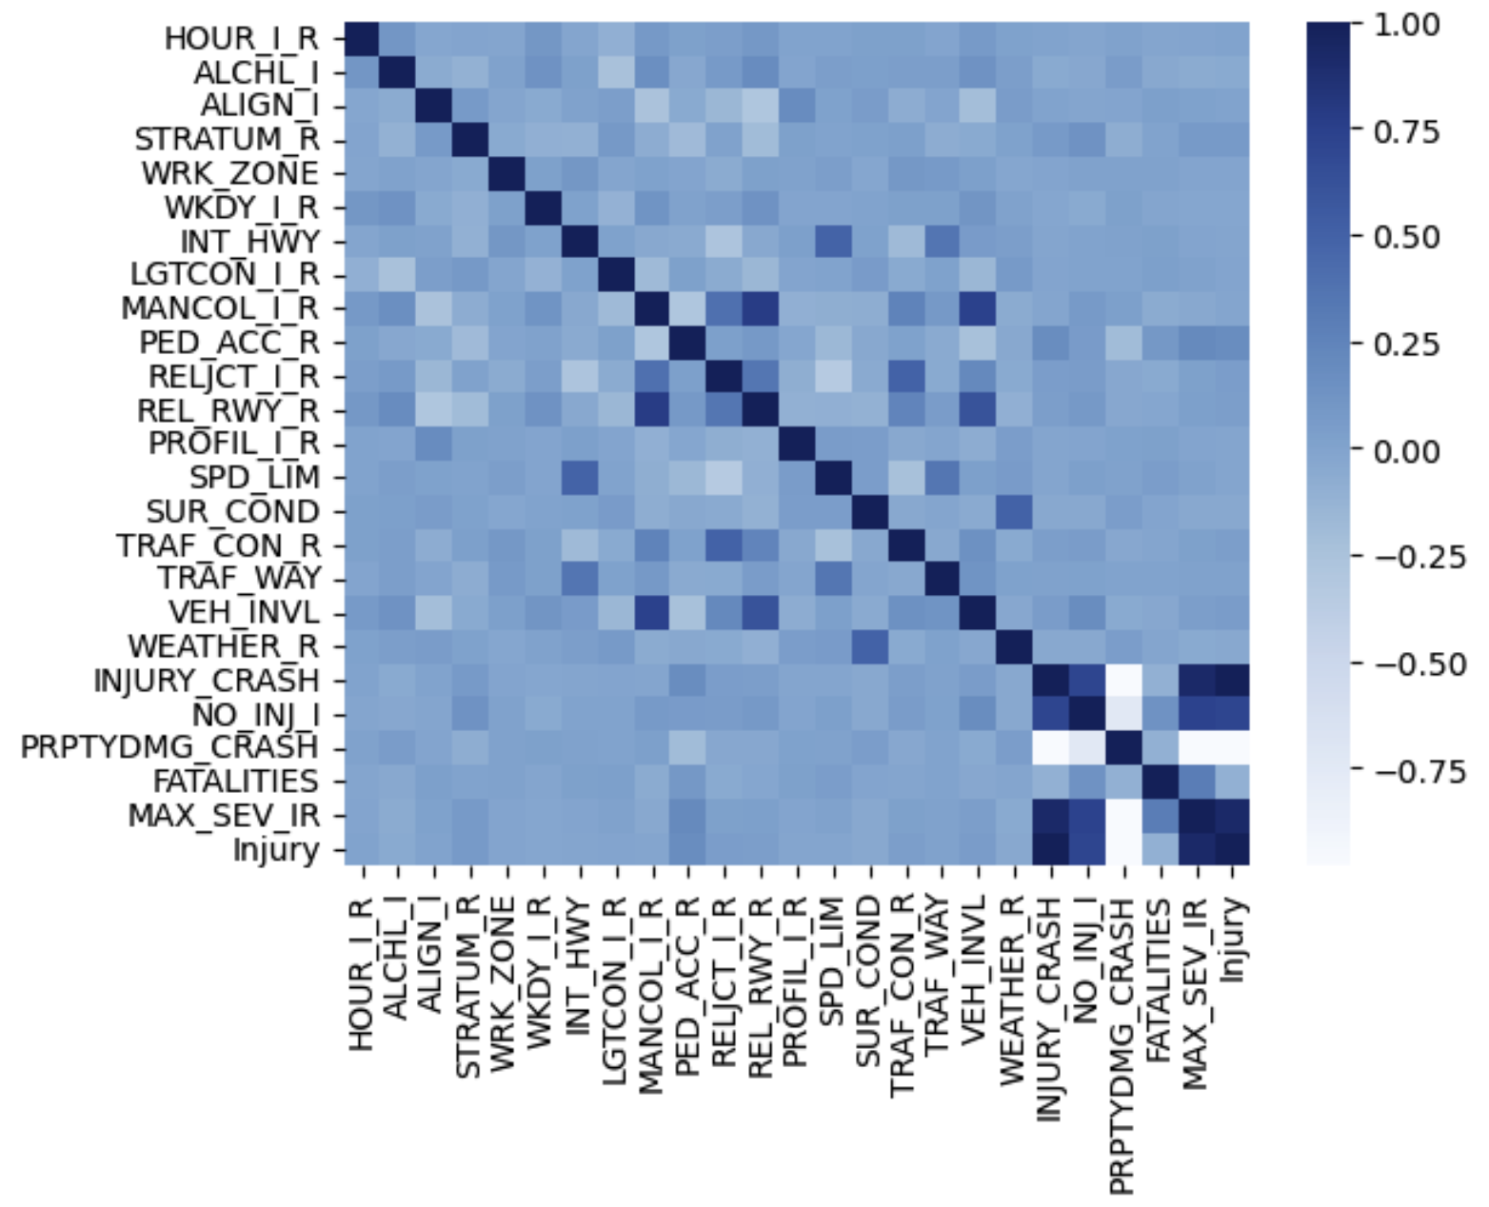
Appendix
Variance Correlation (original)

Slide 30
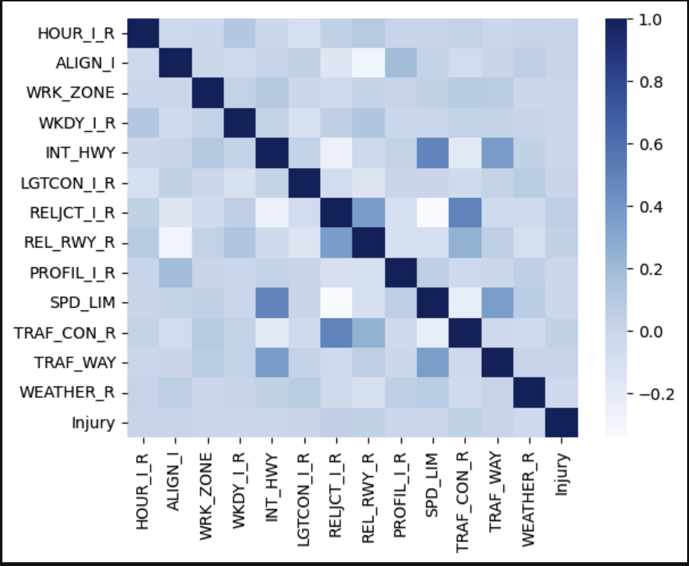
Appendix
Variance Correlation (dropped)

Slide 31
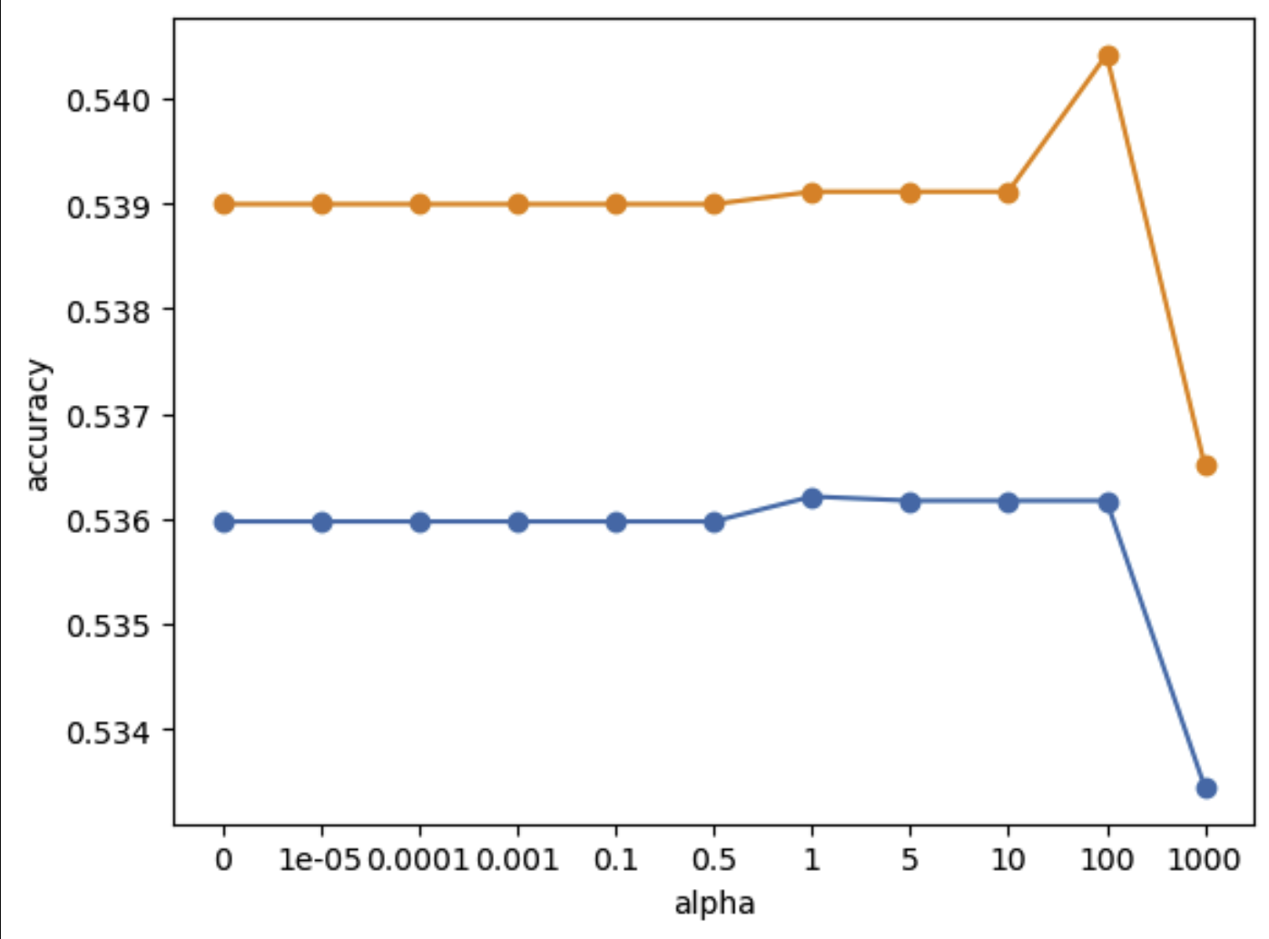
Appendix
Hyper parameter sensitivity “Alpha”
Val
Train

Slide 32
Thank You
Presenter: Sunuk Kim
Code: https://github.com/sunukkim98/DataAnalysis
This presentation file was prepared by Sunuk Kim, Minseo Jeon
and Jaeheon Kim
Notes:
Thank you for listening.
If you have any questions, please feel free to ask me.

