Slide 1
Estimation of Power using Bike Sensors

Slide 2
Problem Statement
Outcomes/Predictions
The goal is to estimate power expenditure based on biking related sensors readily available in the market. Power sensors are expensive, but heart rate, GPS sensors are affordable. We seek to estimate power from data from the affordable sensors.
This is a subset of a broader study - to estimate power for all human activities in real-time. We chose biking because of availability of sensors.
Applications of this work may include:
Estimation of individual metabolic demand
Determine the intensity of different physical activities
Estimation of VO2 (maximal oxygen consumption)
Determination of individual fitness
This project is a typical example of domain knowledge trumping machine learning.
There were two fundamental limitations: 1) lack of wind data (missing feature), 2) Nyquist-Shannon theory.
Under this circumstance our best model surprisingly turned out to be a linear regressor with computed features based on physical theory. See notebook part2 for the governing equations from high school physics.
The best estimator had 19.5 MAE on test data. This is about 5% of the overall max of power, and ~19% of the mean of power.
Please see notebook part3 for further details.

Slide 3
Data Acquisition
Sensors:
Garmin HRM-Pro chest strap heart-rate monitor
Garmin Edge 1040 GPS (lat/lon)
Garmin Varia RTL515 bike radar (vehicle count)
SRAM Quarq Rival AXS power meter (power, cadence)
Raw data from the sensors were sent real-time over Garmin’s ANT+ protocol to a bike computer. Aggregated data was later downloaded from Garmin connect web site in their binary format.
Data was from 5 bicycle rides of a single individual around the San Francisco bay area. This data should be considered proprietary.
Variable | Value
Data source | Self-generated from various sensors
Rows # | 47,066
Columns # | 10 (5+7 after feature engineering)
Numerical Cols # | 10 (5+7 after feature engineering)
Missing Values Present # | 7,438
Outliers #

Slide 4
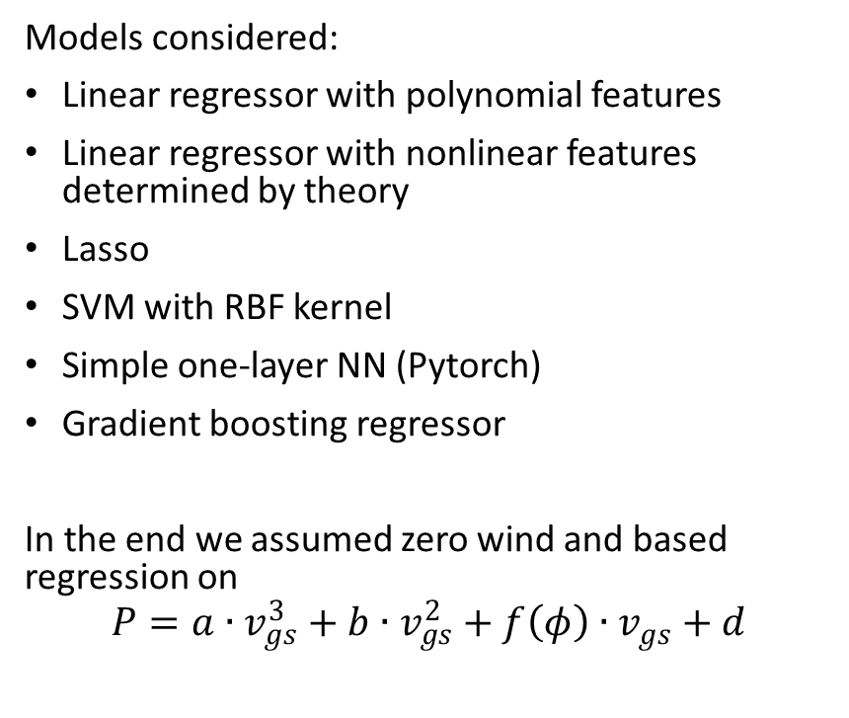
Data Preparation
Modeling
Data files were in Garmin proprietary binary format, which need be converted using a 3rd party library
Data validation/removal of data points based on physical constraints
Computation of derivatives, moving averages, phase shifts
Linear interpolation imputation for missing data
Computation of VIF scores in attempt to remove feature collinearity
Feature engineering – created new features based on physics. In fact the best model used none of the original features directly (they were computed from the original futures)
Standardization
Models considered:
Linear regressor with polynomial features
Linear regressor with nonlinear features determined by theory
Lasso
SVM with RBF kernel
Simple one-layer NN (Pytorch)
Gradient boosting regressor
In the end we assumed zero wind and based regression on
$$P=a∙v_{gs}^{3}+b∙v_{gs}^{2}+f\left(φ\right)∙v_{gs}+d$$

Slide 5
Model Evaluation
References
Data consisted of 5 bicycle rides of a single individual. We’ve trained on 4 rides and tested on the remaining.
We tried hyperparameter optimization for gradient boosting regressor, however its performance after tuning was inferior to linear regression with theory-based features.
In the end a simple MAE, MSE computation was sufficient for comaprison
fitdecode library: python library used to decode Garmin binary files

