Slide 1
#3 JogjaJS MeetUp
SPEED UP YOUR JAVASCRIPT
USING WEB WORKER(S)

Slide 2
Sunu Pinasthika Fajar
(Mahasiswa)

Slide 3
CONCURRENCY
JavaScript is a single-threaded environment
Developers mimic 'concurrency' by using techniques like setTimeout(), setInterval(), XMLHttpRequest, and event handlers.
All of these features run asynchronously, but non-blocking doesn't necessarily mean concurrency. Asynchronous events are processed after the current executing script has yielded

Slide 4
WEB WORKER(S)
The Web Workers specification defines an API for spawning background scripts in your web application.
Web Workers allow you to do things like fire up long-running scripts to handle computationally intensive tasks, but without blocking the UI or other scripts to handle user interactions.

Slide 5
COMMAND
Main App :
worker = new Worker('task.js');
postMessage();
OnMessage Event

Slide 6
COMMAND
Worker :
postMessage();
OnMessage Event

Slide 7
RESTRICTIONS
Google Chrome's security restrictions, workers will not run locally (e.g. from file://)
Worker scripts must be external files with the same scheme as their calling page. Thus, you cannot load a script from a data: URL or javascript: URL, and an https: page cannot start worker scripts that begin with http: URLs.

Slide 8
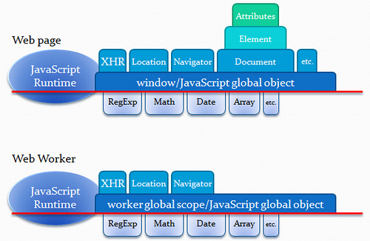
FEATURES

Slide 9
SUMBER COPY PASTE
http://www.html5rocks.com/en/tutorials/workers/basics/
http://blogs.msdn.com/b/eternalcoding/archive/2012/09/20/using-web-workers-to-improve-performance-of-image-manipulation.aspx

