Slide 1
VIBE CODERS TOKYO #9 · MODELS, MODELS, MODELS
If an AI coding agent can think harder,
should we always ask it to?
LIGHT
Fast · clear · reversible
Choosing reasoning effort in Claude Code and Codex.
MEDIUM
Context · coordination · tests
AUDIENCE VOTE →
Light, Medium, or Deep?
What would you choose for your next coding task?
DEEP
Ambiguous · complex · high-risk
A practical framework for choosing how much thinking a coding task deserves
Notes:
[Sources]
- User-provided source deck and outline in https://github.com/sunveda/vibe-coders-tokyo-9/tree/main

Slide 2
02 / THE IDEA
What does “reasoning effort” mean?
How much thinking does the task deserve?
01
02
Context
Alternatives
How much code must it
How many approaches are
understand?
plausible?
More thinking is not automatically better.
03
04
Edge cases
Verification
What could fail?
How carefully must we
test?
Reasoning effort is a task decision—not a quality button.
Notes:
[Sources]
- User-provided source deck and outline in https://github.com/sunveda/vibe-coders-tokyo-9/tree/main

Slide 3
02 / THE FRAMEWORK
Three levels. One question.
Choose the lowest reasoning level that can reliably solve the task.
01 · SPEED
02 · CONTEXT
03 · RISK
Light
Medium
Deep
Clear, local, reversible.
Everyday development.
Ambiguous, complex, high-risk.
Simple helpers, boilerplate, documentation, and routine fixes.
Normal features, related files, project conventions, and tests.
Difficult bugs, architecture, refactors, security, and migration.
Same framework: Claude Code and Codex. Product labels may differ by interface.
Notes:
[Sources]
- User-provided source deck and outline in https://github.com/sunveda/vibe-coders-tokyo-9/tree/main

Slide 4
03 / SAME TASK, TWO TOOLS
Same task. Same reasoning question.
Choose the effort from the task—not from the tool’s brand.
Light
Claude Code: Light
Codex: Light
Simple helpers · boilerplate · docs · routine fixes
Medium
Claude Code: Medium
Codex: Medium
Normal features · related files · tests · integration
Deep
Claude Code: Deep
Codex: Deep
Difficult bugs · refactors · architecture · security
Takeaway: the same task generally deserves the same reasoning level in both tools.
Notes:
[Sources]
- User-provided source deck and outline in https://github.com/sunveda/vibe-coders-tokyo-9/tree/main

Slide 5
04 / AUDIENCE SCENARIO
Easy task: how much thinking?
SCENARIO
What would you choose?
“Add a helper that formats a date as YYYY-MM-DD and write a unit test.”
Claude Code? Codex?
Light, Medium, or Deep?
Light
Medium
Deep
Reveal:
Light / Light
The task is deterministic, local, reversible, and easy to verify. Deep reasoning adds time without much benefit.
Vote first. Reveal second.
Notes:
[Sources]
- User-provided source deck and outline in https://github.com/sunveda/vibe-coders-tokyo-9/tree/main

Slide 6
05 / AUDIENCE SCENARIO
Normal feature: how much thinking?
THE REQUEST
Your vote?
“Add CSV upload to an existing application. Validate rows, show errors, store valid records, and add tests.”
Choose a level for Claude Code and Codex.
○ Light
○ Medium
This touches validation, persistence, UI, and verification.
○ Deep
REVEAL · CLAUDE CODE / CODEX
Why: the agent must inspect the repository, coordinate several files, and run tests—but the requirements are clear.
Medium / Medium
Enough thinking to integrate reliably.
Notes:
[Sources]
- User-provided source deck and outline in https://github.com/sunveda/vibe-coders-tokyo-9/tree/main

Slide 7
06 / AUDIENCE SCENARIO · DIFFICULT BUG
Now the cost of being wrong is high.
THE SCENARIO
AUDIENCE VOTE
“Users are randomly logged out after refreshing the page.”
Light?
Medium?
Deep?
It happens in production, but not locally. Find the root cause and add a regression test.
LIGHT
MEDIUM
DEEP
Possible surfaces: cookies · tokens · session state · timing · deployment
REVEAL · CLAUDE CODE / CODEX
The symptom is ambiguous and cross-cutting. Deep reasoning gives the agent room to form hypotheses, inspect evidence, reproduce the failure, and verify the fix.
DEEP / DEEP
Deep reasoning is justified when investigation is more valuable than speed.
Notes:
[Sources]
- User-provided source deck and outline in https://github.com/sunveda/vibe-coders-tokyo-9/tree/main

Slide 8
07 / THE TRAP
An unclear prompt beats deep reasoning.
First, ask for the missing pieces.
AUDIENCE SCENARIO
REPRODUCE
EXPECTED
“Fix the login bug.”
What steps trigger it?
What should happen
instead?
ENVIRONMENT
EVIDENCE
Ask the room: Which reasoning level would you choose?
Where does it happen?
What logs or errors exist?
Correct first move: clarify the task before escalating reasoning.
A better prompt makes every reasoning level more useful.
Notes:
[Sources]
- User-provided source deck and outline in https://github.com/sunveda/vibe-coders-tokyo-9/tree/main

Slide 9
08 / PRACTICAL SYNTHESIS
Choose effort from clarity, scope, and risk.
Same logic for Claude Code and Codex. Start with the task, then choose the effort.
01 · CLARITY
02 · SCOPE
Light
Claude Code: Light
Codex: Light
Clear and local?
Normal feature?
Speed first.
→
One file. Predictable. Easy to verify.
Known requirements. Several files. Tests.
Medium
Claude Code: Medium
Codex: Medium
03 · RISK
04 · ESCALATE
Everyday coordination.
Ambiguous or high-risk?
Start lower.
→
Deep
Claude Code: Deep
Codex: Deep
Hidden causes. Production impact. High cost of error.
Raise the level if the first attempt fails.
Investigate and verify.
Rule of thumb: use the lowest level that can reliably solve the task. Clarify before escalating.
Notes:
[Sources]
- User-provided source deck and outline in https://github.com/sunveda/vibe-coders-tokyo-9/tree/main

Slide 10
08 / CLOSING THOUGHT
Think just enough.
LIGHT
Clear · local · reversible
“Use Light for speed, Medium for everyday development, and Deep when the cost of being wrong is higher than the cost of waiting.”
MEDIUM
Context · coordination · tests
DEEP
Ambiguous · complex · high-risk
DISCUSSION PROMPT
What is a task where you changed reasoning level after the first
attempt failed?
Same task → Claude Code level vs. Codex level → compare the result.
Notes:
[Sources]
- User-provided source deck and outline in https://github.com/sunveda/vibe-coders-tokyo-9/tree/main

Slide 11

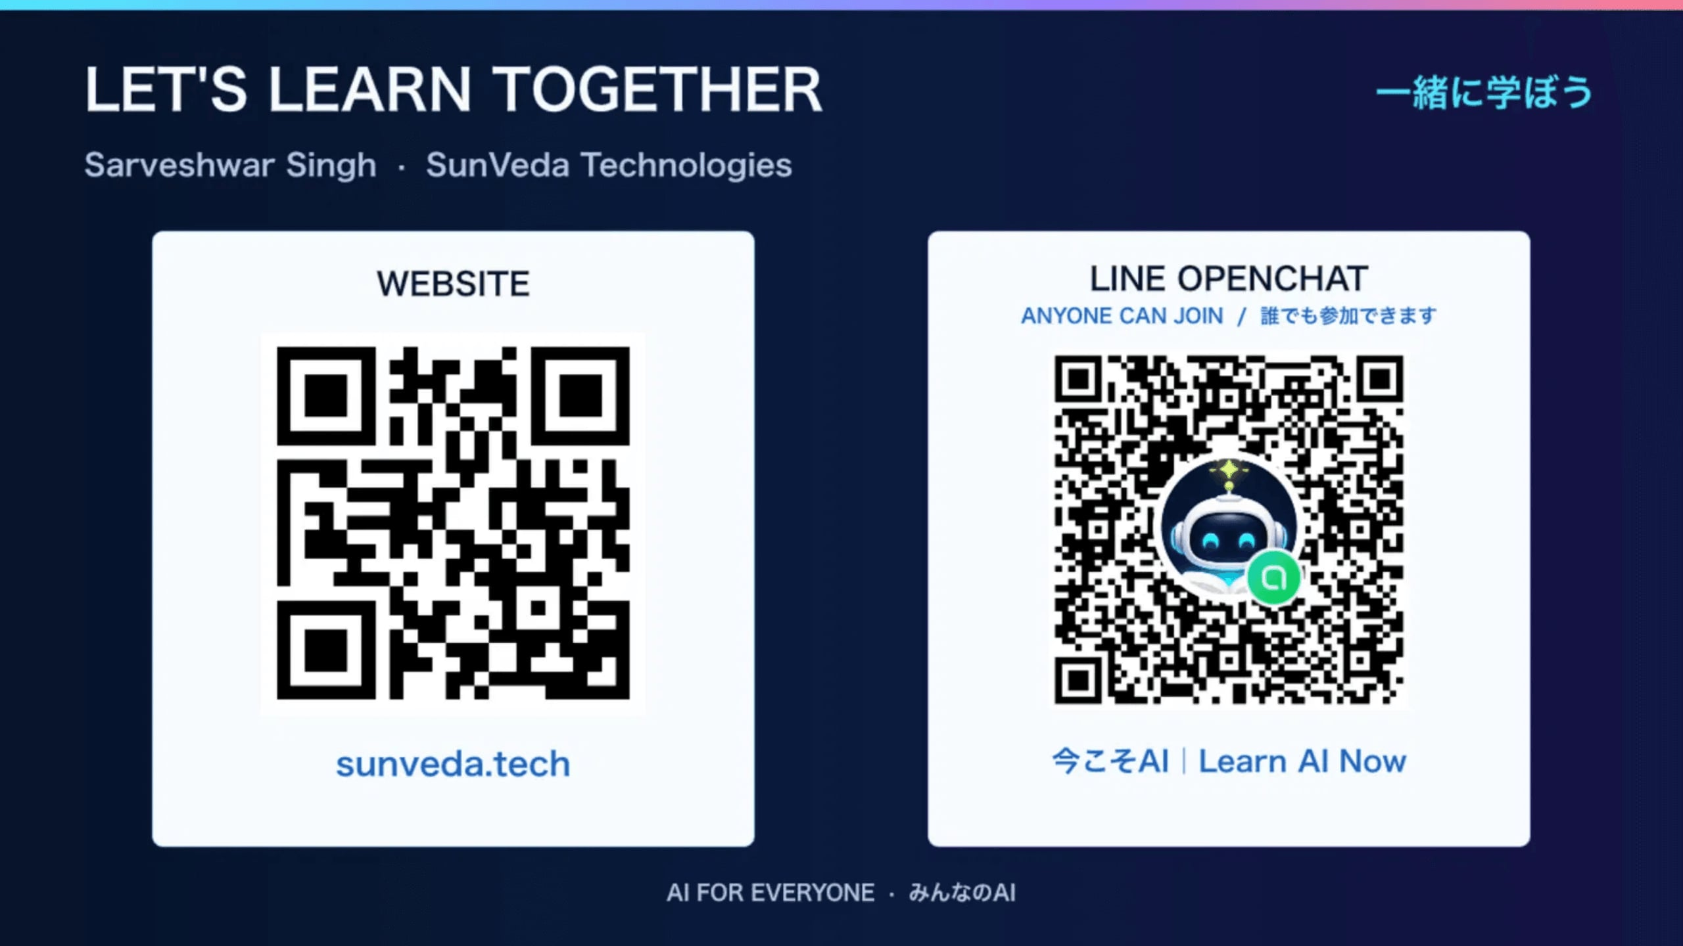
Notes:
[Sources]
- Preserved closing page from https://github.com/sunveda/codex-meetup-tokyo-2026-08-07-fri/blob/main/topic-1-codex-for-everyone/codex-for-everyone-bilingual.pdf

