Slide 1
Shape and Topology Optimization of Plane Frame Structure Using Force Density Method
Wei Shen, Makoto Ohsaki

Slide 2
Optimization of Frames
Size Optimization
Shape Optimization
F F F
Topology Optimization

Slide 3
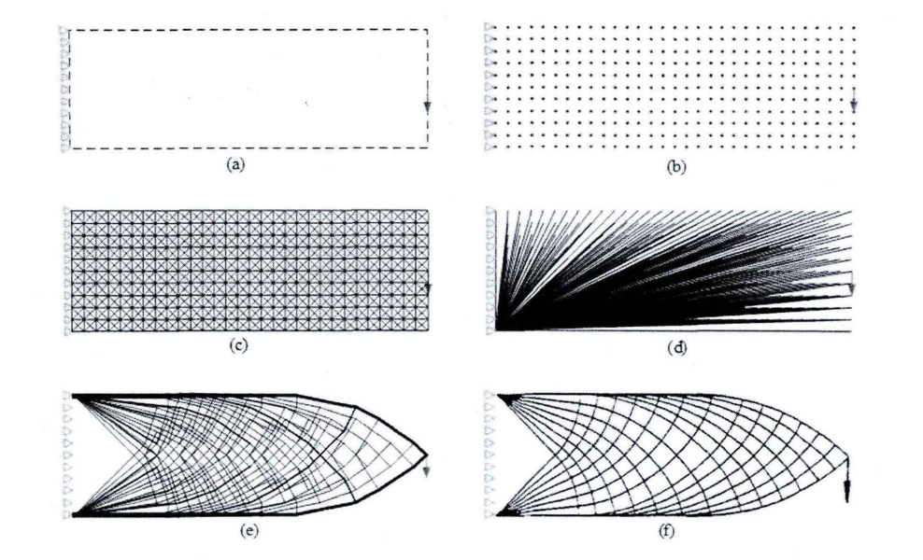
Challenge
Ground structure method
Melting nodes
P
Stiffness Matrix
Singular
Source: Ge Gao, Research on theory and application of truss
structure, 2016, PhD Thesis.

Slide 4
Possible approach
Force density method(FDM)
Widely used in tension and tensegrity structure
Axial force
Force density
Member length
Determine
q for each element
Structural Shape

Slide 5
Introducing FDM
Truss structure
Shape optimization: optimal nodal location
Pin joint
(h)
j
m
(d)
Only axial force
(i)
Only force equilibrium
(g)
(e)
k
l
(f)
Determined by q

Slide 6
Introducing FDM
Denote the connectivity matrix as C , where
m
j
i=1,2, …, m; j, k=1, 2, …, n
(i)
{
{
C_{free} C_{fix}
l
k
Divide nodes to free and fix nodes
And rearrange the matrix C

Slide 7
Nodal location
Determination of nodal location
Force density vector
q = (q_{d}, q_{e}, q_{f}, q_{g}, q_{h}, q_{i})
No external load on free nodes
Functions of q

Slide 8
Problem formulation
Frame structure
Rigid joint
(h)
Same discretization with Truss
j
m
(d)
Axial force
Shear force
Moment
FDM (q)
(g)
(i)
(e)
k
Optimal shape of Frame
l
(f)
Minimize :
Subject to:

Slide 9
Sensitivity Analysis
For objective function
Adjoint variable method
For Volume constraint

Slide 10
Further Improvement
Minimize :
Subject to:
Optimal result with thin element and closely spaced nodes
Delete
Merge
Minimize :
Subject to:

Slide 11
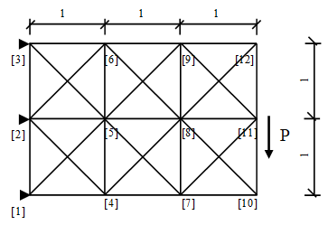
Numerical Example
Cantilever beam
d_{lower} = 0.001 and d_{upper} = ∞
q_{lower} = -1000 and q_{upper} = 1000
V_{upper} = 1
Pin support

Slide 12
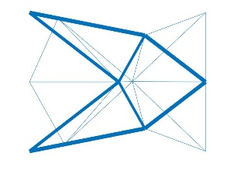
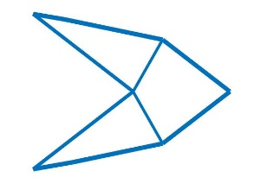
Numerical Example
Solution | Volume | Compliance
Before | 1 | 83.2042
After | 1 | 82.0946

Slide 13
Conclusion
Brief Summary
The proposed method includes：
Shape and topology optimization
Force density method
Further optimization (Filter)
And has the following conclusion:
Melting nodes can be avoid by restricting q

Slide 14
Thanks for your kind attention

