Slide 1
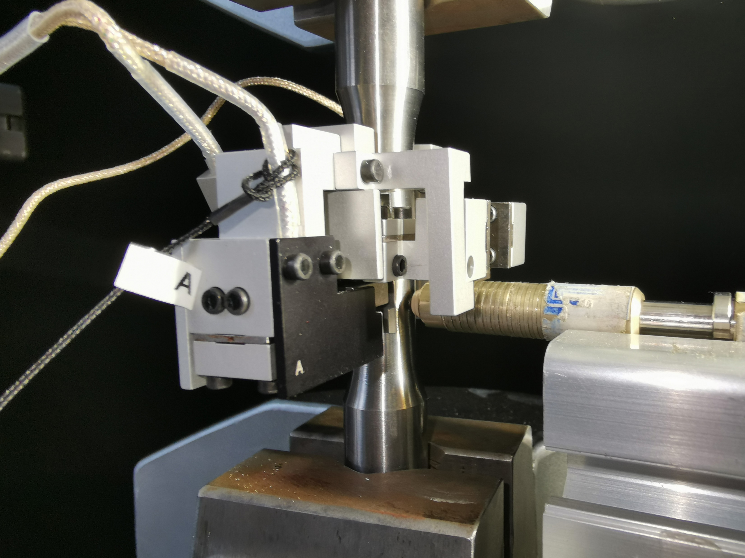
Specimen
Feritscope
Extensometer

