Slide 1
Stochastic Progressive Photon Mapping
随机渐进光子映射
Group19 孙伟喨 田皓原 范顾聪骢

Slide 2
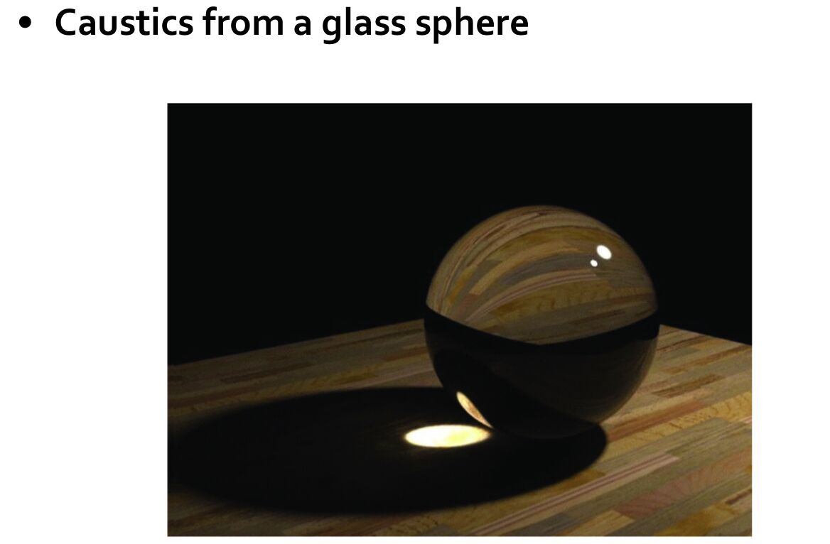
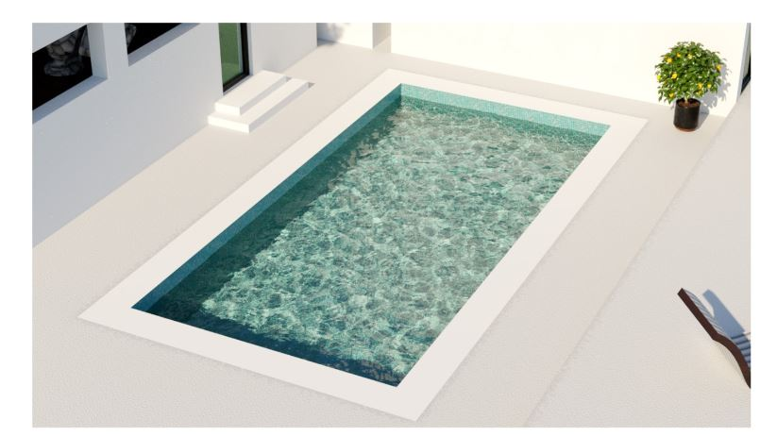
SDS(specular-diffuse-specular) path

Slide 3
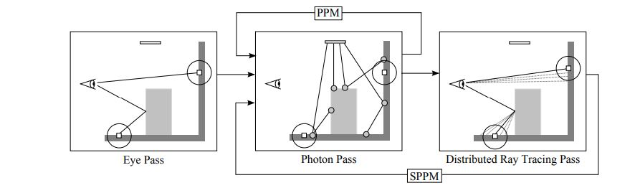
PM->PPM->SPPM
[2009]Stochastic Progressive Photon Mapping Toshiya Hachisuka, Henrik Wann Jensen

Slide 4
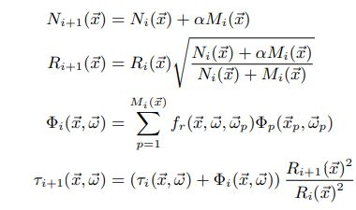
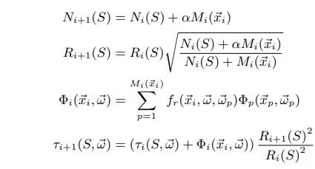


PPM
SPPM

Slide 5
Stochastic Progressive Photon Mapping
2 pass:
1.ray tracing pass
2. photon mapping pass

Slide 6
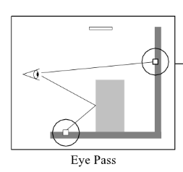
1.ray tracing pass
记录hitpoint用于photon mapping

Slide 7
brdf的属性：specular, diffuse, refraction, d, s
Russian Roulette 算法
for example: 对于一个物体的brdf属性有如下：0.1, 0.6, 0.3, 0.9, 0.1
应用Russian Roulette 算法随机0-1的数
specular
diffuse
refraction

Slide 8
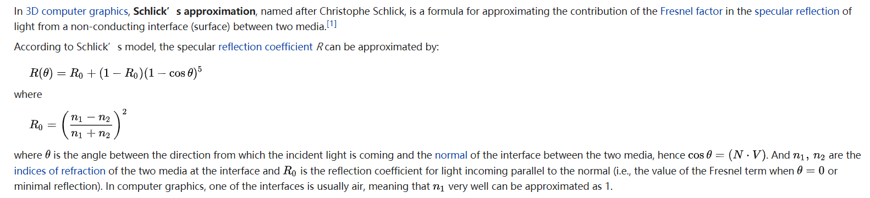
refraction

Slide 9
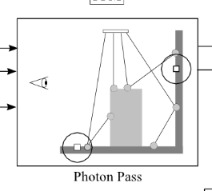
2.photon pass
d
s

Slide 10
kd-tree construction
ObjectKDTree(objects)
Initialized in camera::render once before all
Implemented in scene::ObjectKDTree
KDTree(hitpoints)
Initialized in camera::render_loop each time before photon mapping (after ray tracing)
Implemented in hitpoint::KDTree

Slide 11
ObjectKDTree(objects)
scene::ObjectKDTreeNode
Bounding box
Faces(such as triangles) vector
Child nodes
objectKDTree->intersect()
Intersect from an ObjectKDTreeNode, check the ray intersection and the intersection of child nodes

Slide 12
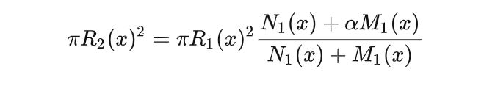
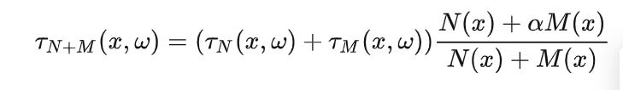
KDTree(hitpoints)
hitpoints::KDTreeNode
Bounding box
radius
hitpoints
Child nodes
hitpoints::update()
If a photon is within a KDTreeNode’s bounding box, update with the following formulas, then check its child nodes
Update the search radius
Update the flux

Slide 13
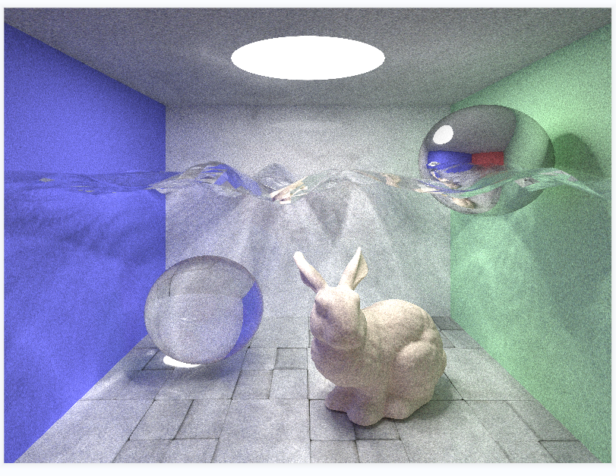
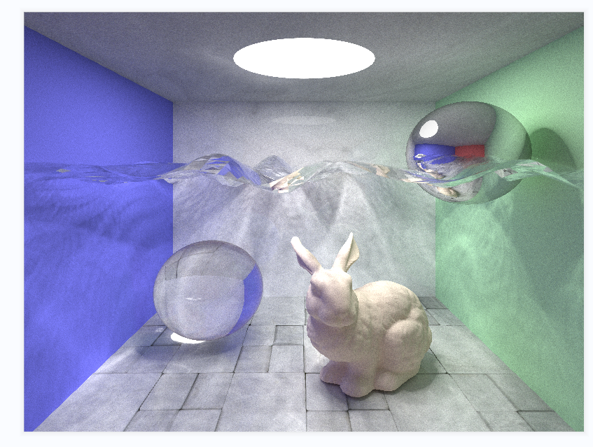
results
Picture resolution 800*600
100 rounds, 200000 photons
600 rounds, 200000 photons

Slide 14
contribution
Our group’s work distribution is almost equal. And we read the paper, learn the SPPM, do the most coding, debugging together by tencent meeting. The detailed work distribution is shown below.
Sun Weiliang (2020533010): The whole frame, object.cpp, texture.cpp
Tian Haoyuan (2020533013): scene.cpp(tracing fucntion), camera.cpp(SPPM)
Fan gucongcong (2020533042): hitpoint.cpp(kdtree), camera.cpp(SPPM)

