Slide 1


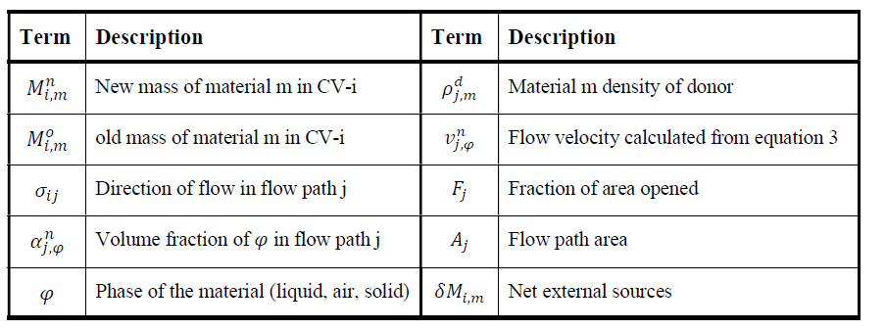
Mass
Manual 305pg
Manual 308pg

Slide 2
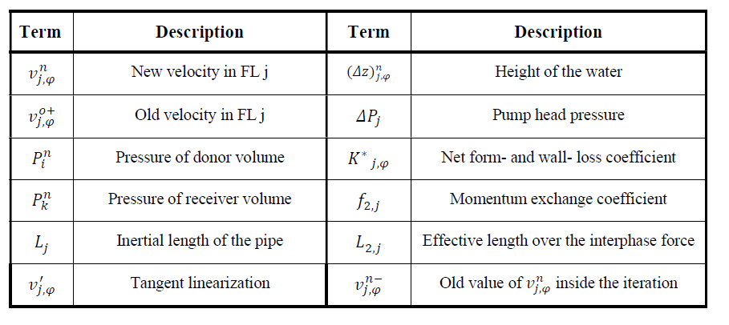
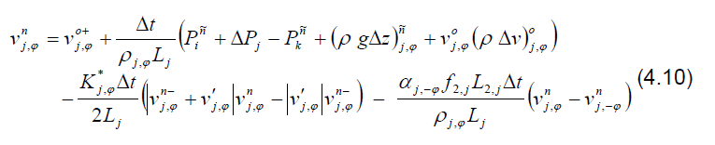
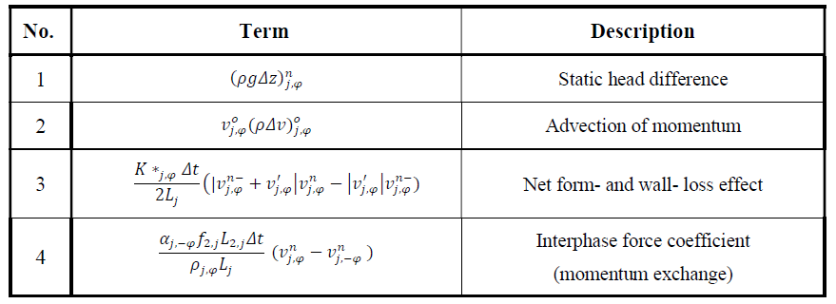
Momentum
manual 309pg (same as NUTHOS eq3)
Main effective terms in Mom eqn

Slide 3
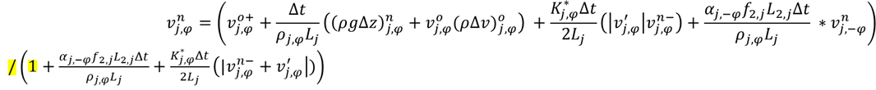
Mom eqn (python code ver)

Slide 4
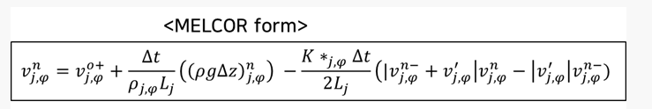
Momentum eqn
이전 time step velocity
다음 time step velocity
Python code
v_o_2가 이전 time step velocity가 맞는지요??
다음 time step velocity

