Slide 1
Visualizations
ZIKA, H1N1, SARS, EBOLA

Slide 2
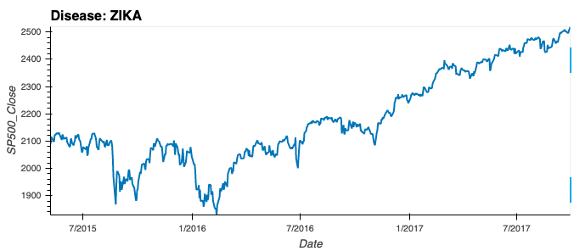
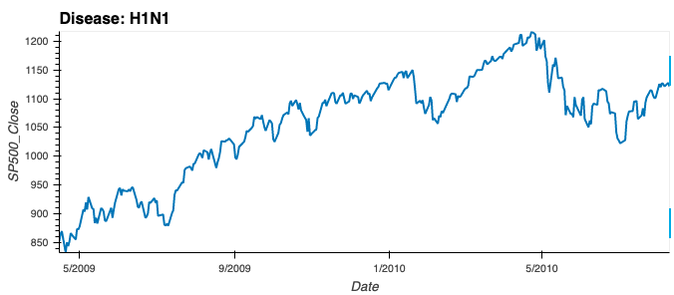
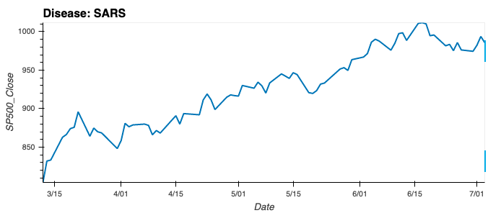
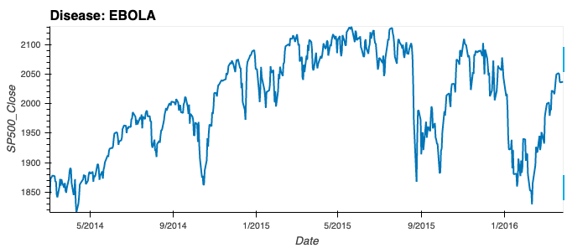
SPY (S&P500)

Slide 3
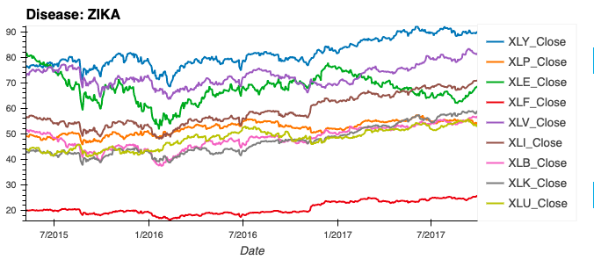
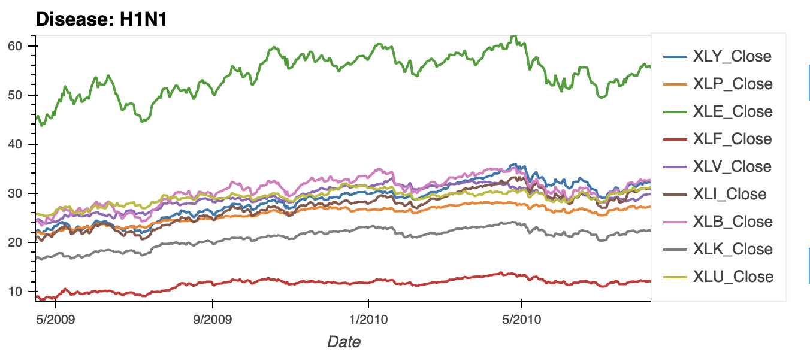
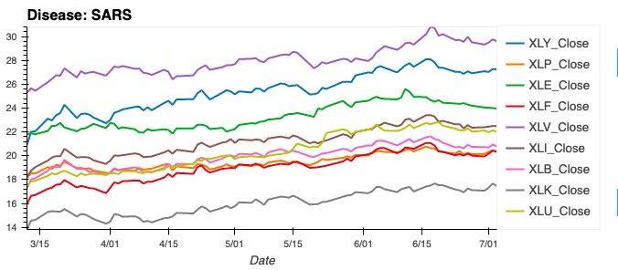
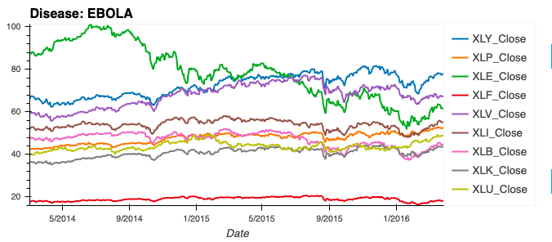
SPY_Sectors
XLY: Consumer Discretionary | XLF: Financials | XLB: MAterials
XLP: Consumer Staples | XLV: Health Care | XLK: Technology
XLE: Energy | XLI: Industrials | XLU: Utilities

Slide 4
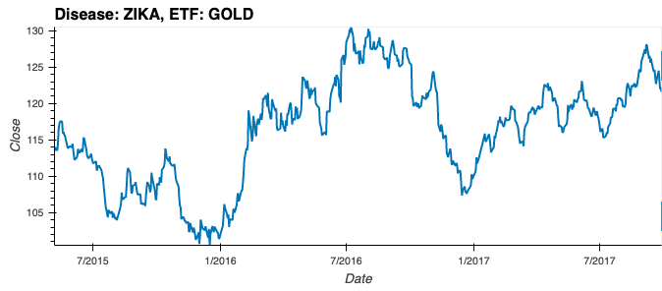
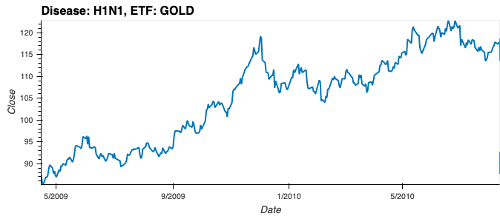
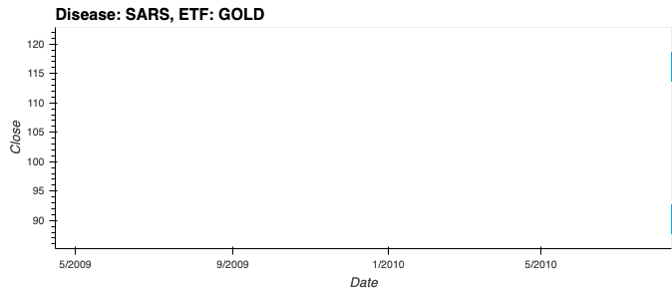
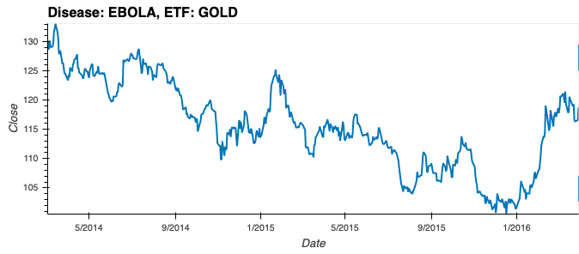
GOLD (Gold ETF)
No Data Found!

Slide 5
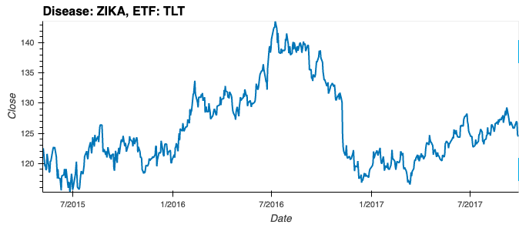
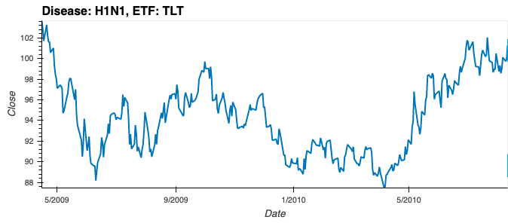
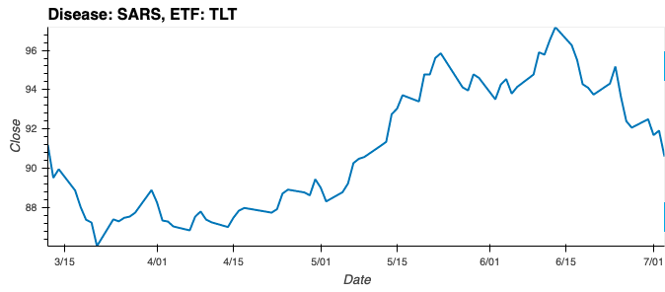
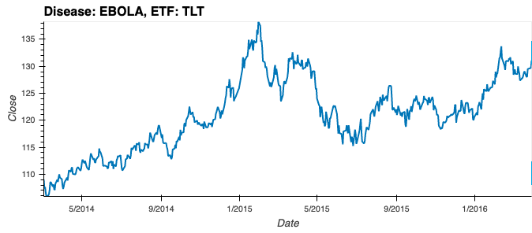
TLT (T-Bonds ETF)

Slide 6
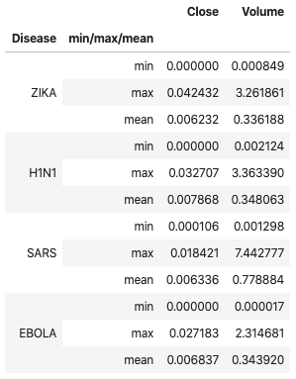
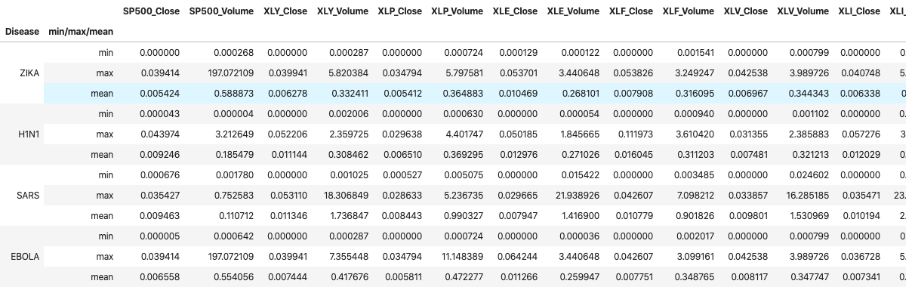
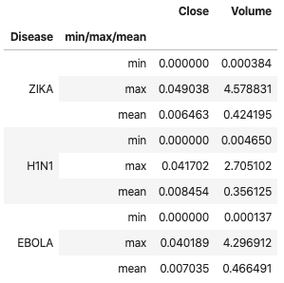
Volatility Index (Tailor Made – Step 1)
TLT Tranches
SPY/Sectors Tranches
GOLD Tranches

Slide 7
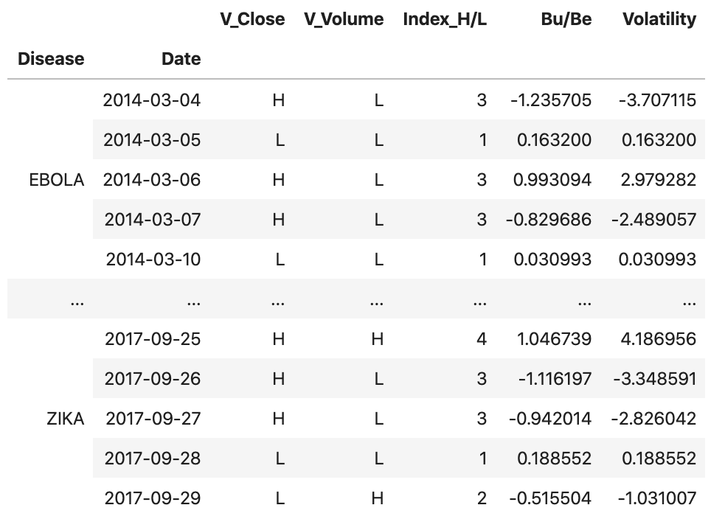
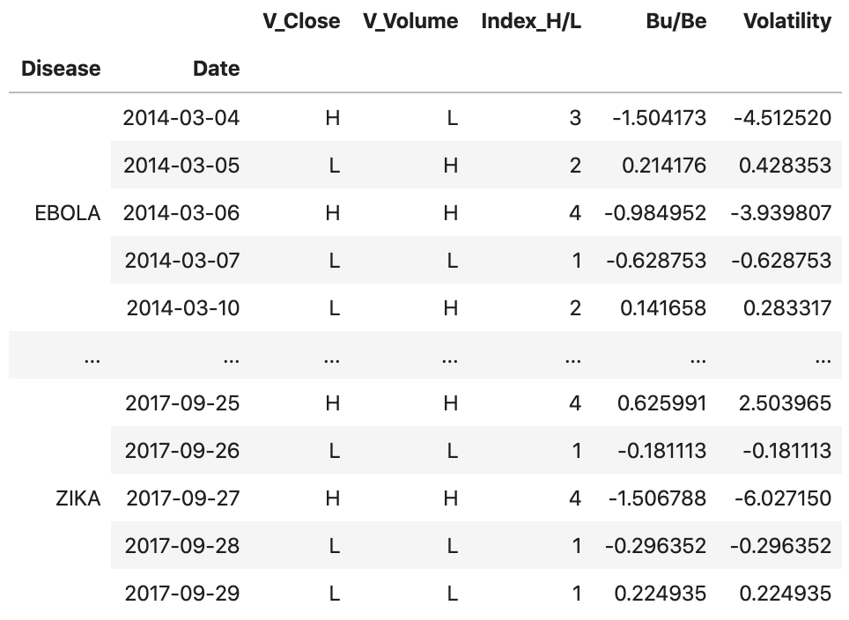
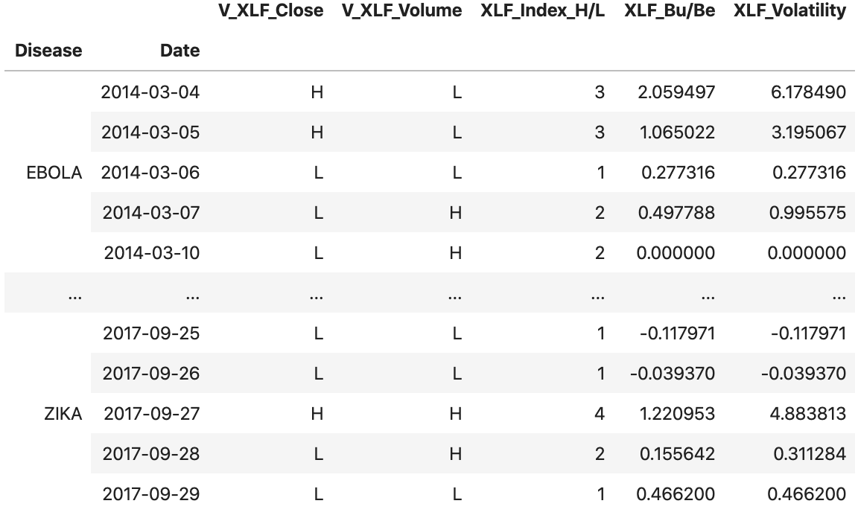
Volatility Index (Tailor Made – Step 2)
GOLD Volatility
TLT Volatility
SPY/Sectors Volatility
Indexes to identify Bu/Be Trends, based on %Change, Close Prices & Volumes

Slide 8
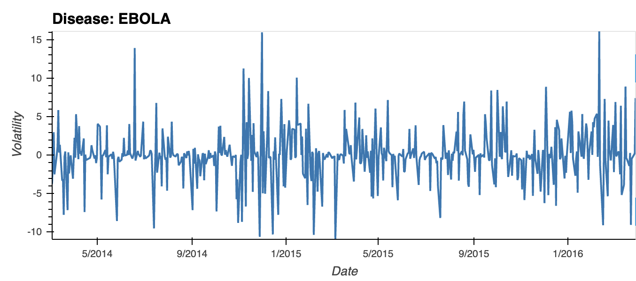
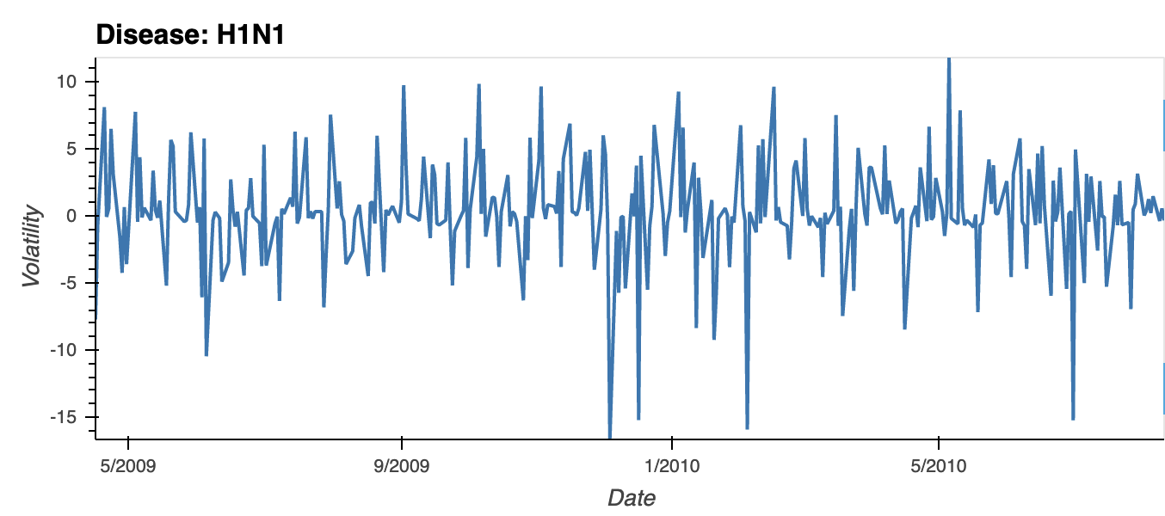
Volatility Index (Tailor Made – GOLD Visualization)

Slide 9
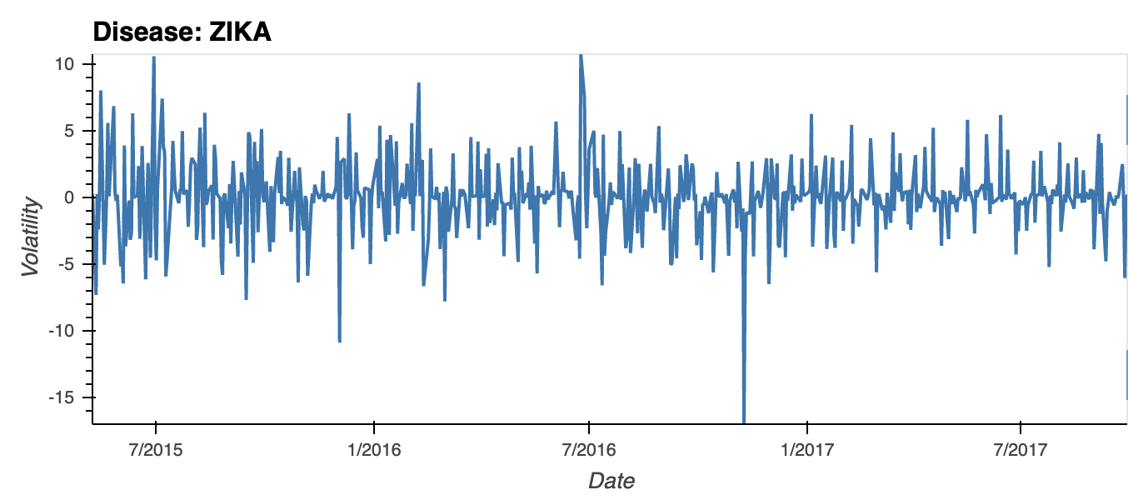
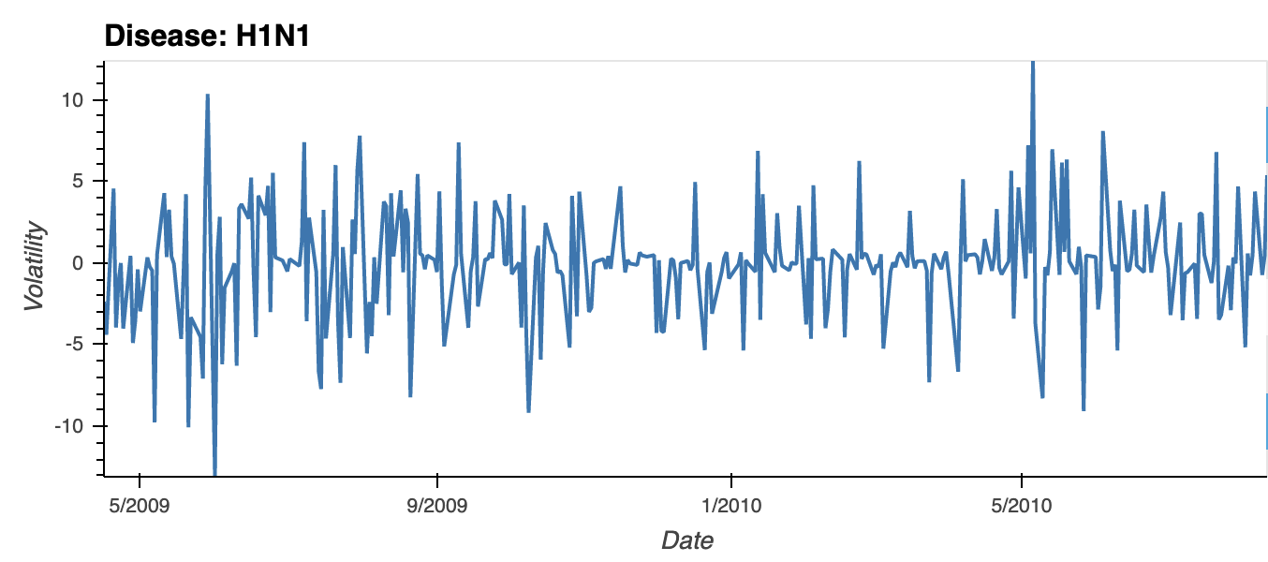
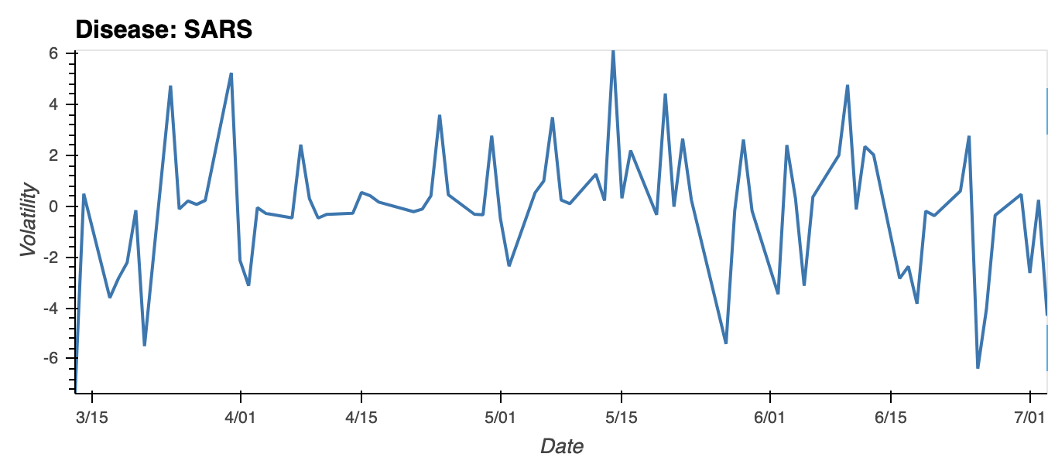
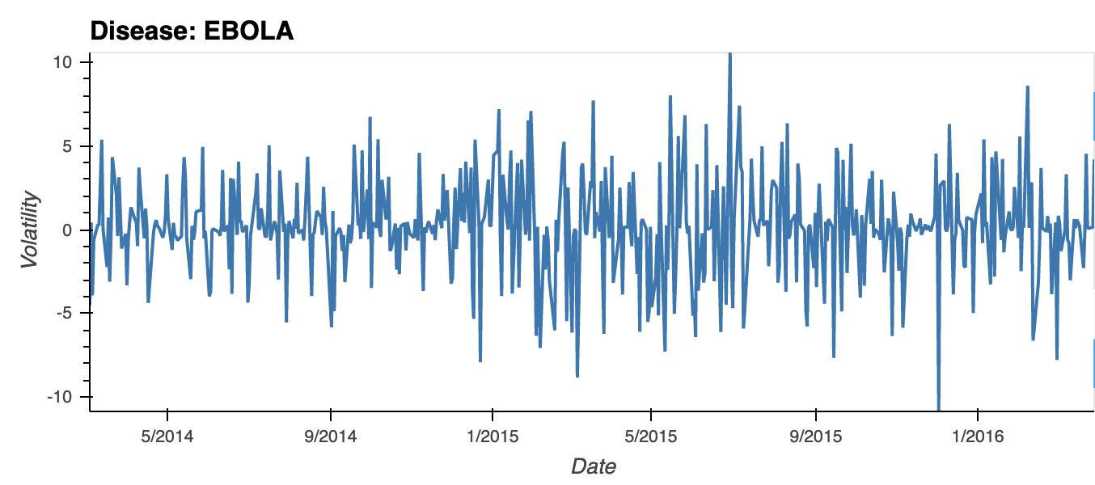
Volatility Index (Tailor Made – TLT Visualization)

Slide 10
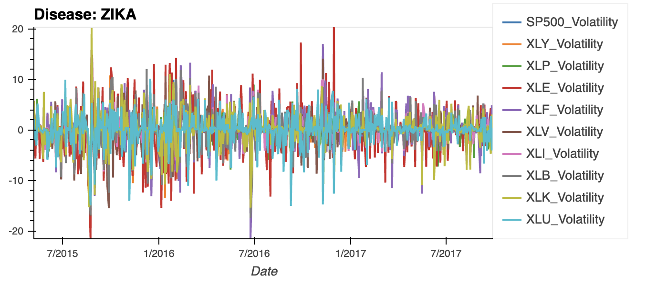
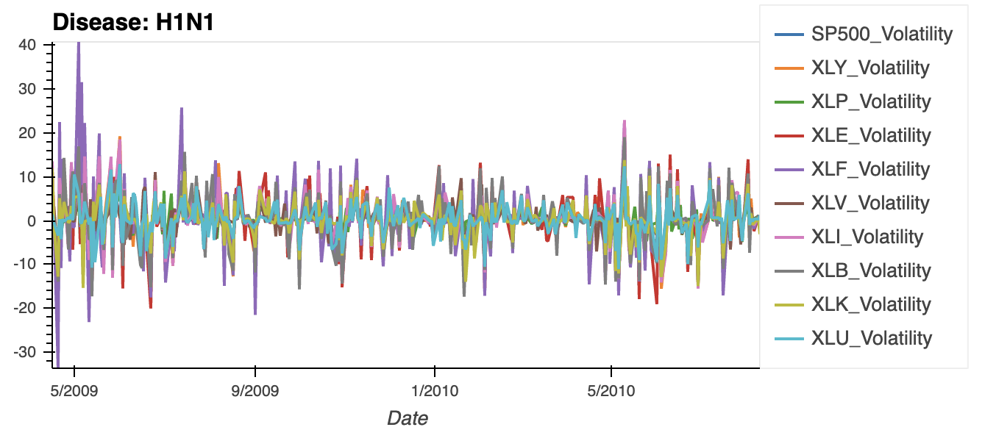
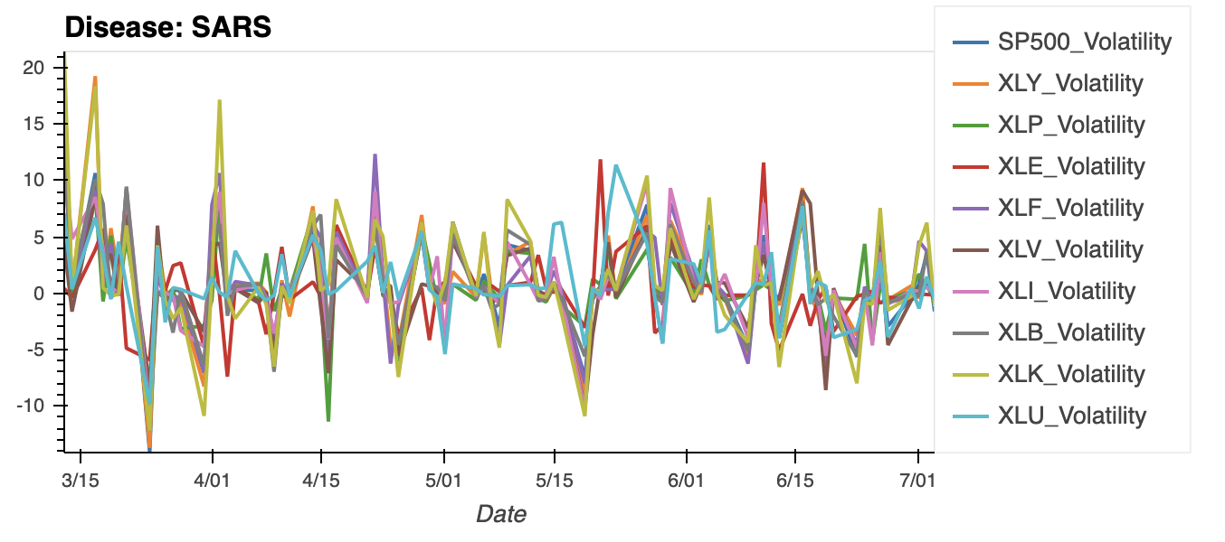
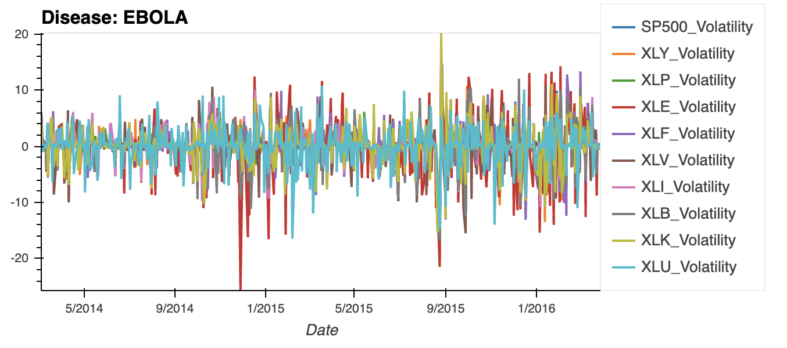
Volatility Index (Tailor Made – S&P500 Visualization)

Slide 13
agenda
introduction
Hypothesis discussion
General process
Data
Sources
Clean-up
Analysis
results
Conclusion
Recommendations
appendix

Slide 14
introduction HYPOTHESIS
We believe that global epidemics have a cyclical effect on the stock market. Further, we believe that this cycle can be predicted through epidemiological statistics, news reports, and volatility in the market.

Slide 15
introduction General process
Establish a broad timeline for diseases (start stop)
Pull s&P 500 (SPY) performance data across those time periods. Quick visual check on repeated patterns
Search for signal
check news dates for key events, plot those dates across the s&p 500 data
Calculate volatility of the spy, SPY SECTORS, GOLD ETF, TREASURIES ETF, in those date ranges
Calculate rates of infection and deaths (summary statistics)
Calculate correlation between:
News and market fluctuations
Volatility and market fluctuations
Summary statistics and market fluctuations
Analyze results
Draw conclusions

Slide 16
DATA sources
Sars, ebola, zika, h1n1 DISEASE DATES
Cdc and who data
Pulled statistics from open source website, Kaggle. We were able to obtain datasets for zika, sars, and ebola
Datasets contained summary numbers of reported illnesses and deaths
H1n1 data was not found
Only reported zika illness data for united-states, due to the organization of the found dataset
World news data
Used times api
Travis to fill out
Stock data
Pulled data from GOOGLE SHEETS/FINANCE CODE
SPY, SPY SECTORS, GOLD ETF, TREASURY ETF

Slide 17




DATA EXPLORATION AND CLEAN-UP
CDC AND WHO DATA
VIA KAGGLE OPEN SOURCE WEBSITE
ONLY FOUND ZIKA, SARS, EBOLA
PULLED CSV DATASETS INTO SQL VIA POSTGRES
PERFORMED SOME CLEAN-UP IN SQL/postgres
OTHER CLEAN-UP IN PYTHON/jupyterlab
FOR DEATH AND ILLNESS REPORTS:
value each reported time period (positional)
Change between each point (velocity)
Rate of change between each point (acceleration)

Slide 18
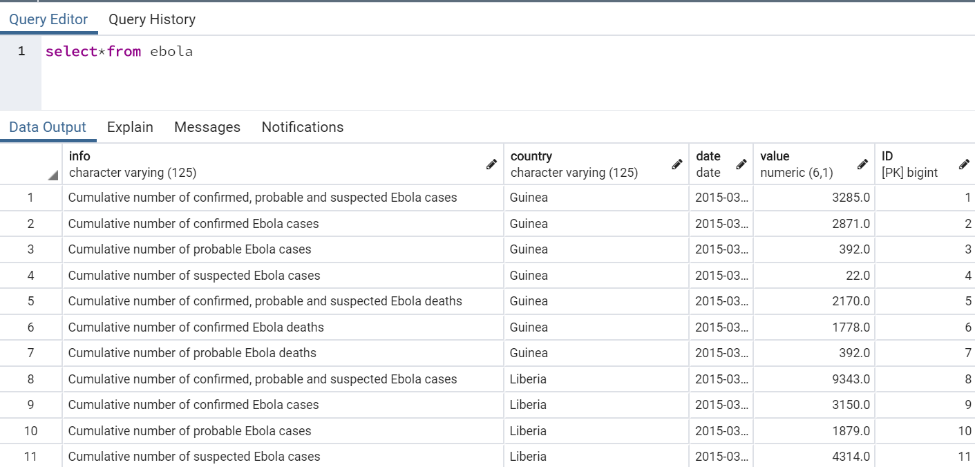
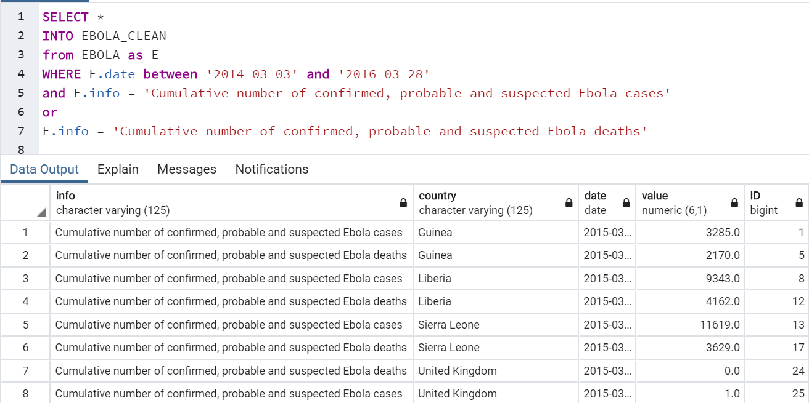
DATA EXPLORATION AND CLEAN-UP
EBOLA CLEAN UP IN SQL
SARS REQUIRED PARSING OF DATES
ZIKA CLEAN UP IN JUPYTER LAB

Slide 19
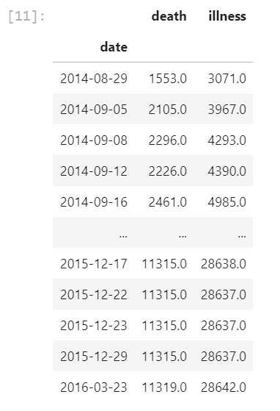
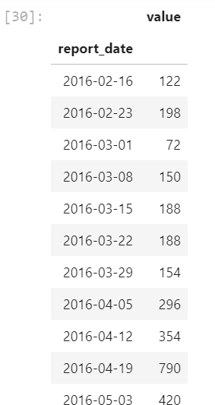
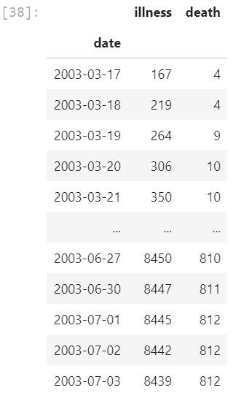
DATA EXPLORATION AND CLEAN-UP
EBOLA
ZIKA
SARS

Slide 20
Analysis characterization of summary statistics
Ebola and sars data came back as a cumulative report
Zika came back as a discrete instance
Searching for 4 factors:
Cumulative results (summation)
Discrete instances (positional information)
Changes in discrete instances over each report period (velocity information)
Rate-of-change (acceleration information)
Show code and charts

Slide 21
Analysis news data
travis

Slide 22
Analysis spy, spy sectors, gold etf, treasury etf
andres

Slide 23
Analysis volatility
andres

Slide 24
Analysis correlation
ZIKA CUMULATIVE
ZIKA VELOCITY
SARS CUMULATIVE
SARS VELOCITY
EBOLA CUMULATIVE
EBOLA VELOCITY
NEWS

Slide 25
results

Slide 26
results summary statistics
Trends of each disease
Correlation To the market

Slide 27
results volatility
Correlation To the market

