Slide 1
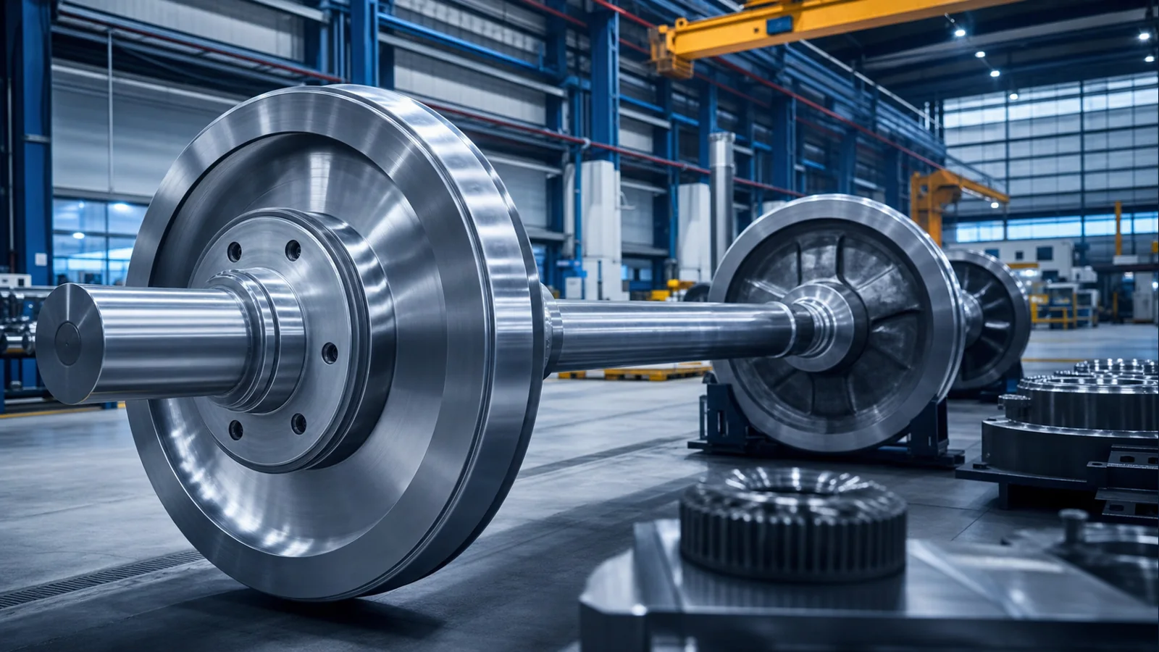

INTERNATIONAL RAILWAY COMPONENTS CATALOG
Railway Wheels & Components
Forged railway wheels, train wheels, railroad wheels, railway wheelsets, axles, bogies and rolling stock components for global industrial buyers.
OEM
OEM Manufacturing
EX
Global Supply
www.railwheel.com

Slide 2
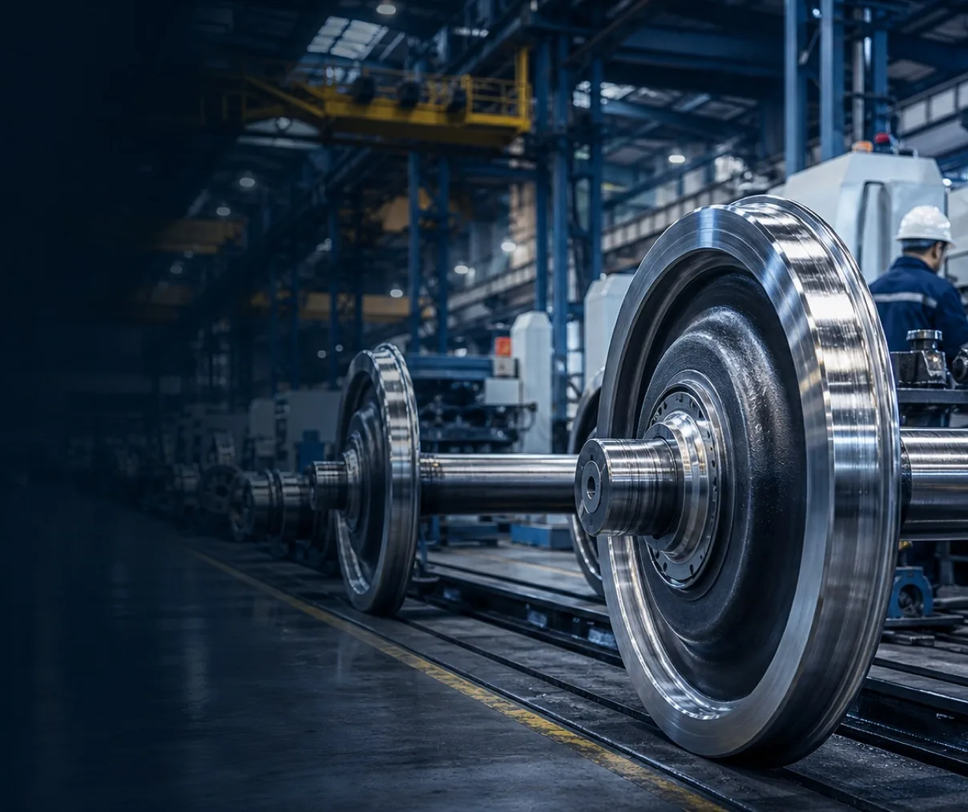
COMPANY PROFILE
PREMIUM INDUSTRIAL CATALOG
Focused Railway Component Supplier
Railwheel supplies railway wheels, train wheels, railroad wheels, wheelsets, axles, bogies and railway spare parts for international buyers.
RW
Railway Wheel Focus
Forged wheels and heavy-duty train wheel supply.
OEM
Custom Projects
Support for drawings, samples and technical requirements.
EX
Export Coordination
Packing, documents and shipment planning.
QA
Quality Mindset
Inspection records and traceability discussion.
www.railwheel.com
Railway Wheels | Wheelsets | Axles | Bogies | Railway Spare Parts
02

Slide 3
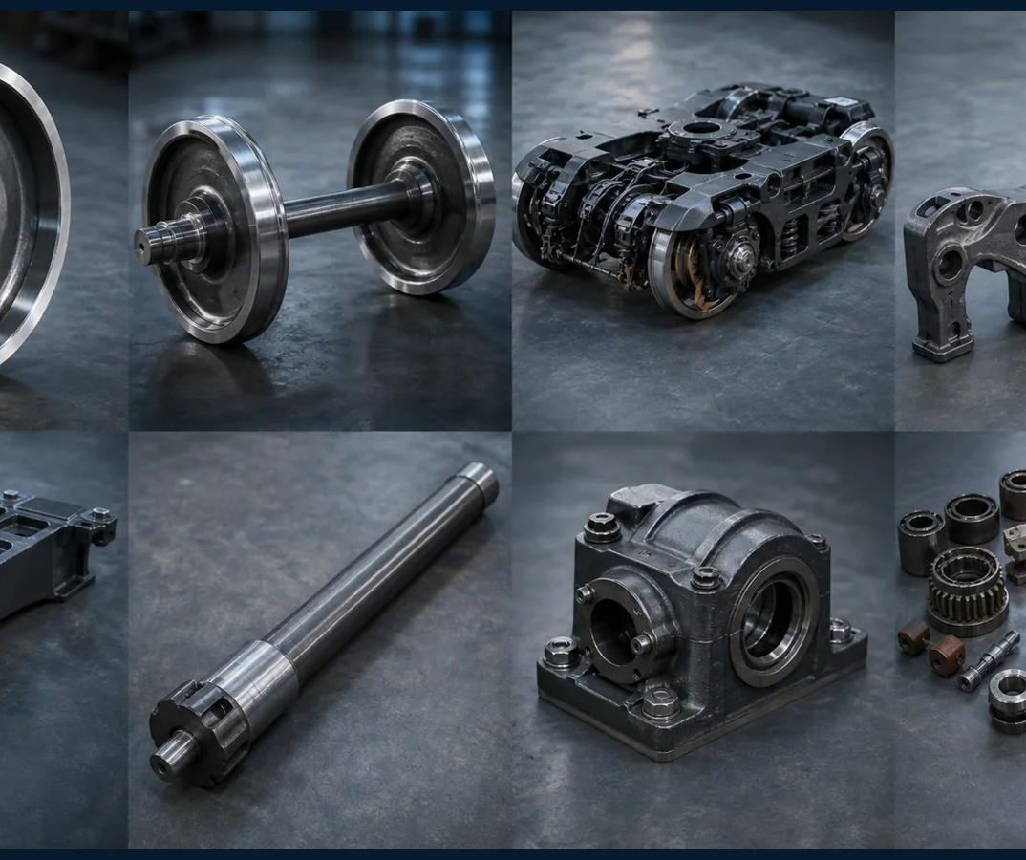
COMPANY STRENGTHS
PREMIUM INDUSTRIAL CATALOG
Why Choose Railwheel
A premium sourcing partner for railway wheel, wheelset, axle, bogie and rolling stock component procurement.
01
Technical Communication
Clear drawing review before quotation.
02
Industrial Network
Manufacturing routes for forged, cast and machined parts.
03
Quality Records
Material certificates and inspection reports on request.
04
Global Service
Direct English support from inquiry to shipment.
www.railwheel.com
Railway Wheels | Wheelsets | Axles | Bogies | Railway Spare Parts
03

Slide 4

WORLDWIDE MARKET
Global Railway Supply
Railwheel supports overseas railway operators, OEMs, maintenance contractors and industrial railway buyers across freight, passenger, metro, mining and port applications.
Freight Wagons
Passenger Coaches
Metro
Locomotives
www.railwheel.com
Railway Wheels | Wheelsets | Axles | Bogies | Railway Spare Parts
04

Slide 5

FACTORY OVERVIEW
PREMIUM INDUSTRIAL CATALOG
Industrial Manufacturing Capability
A coordinated manufacturing base for railway forgings, railway castings, machined parts, wheelsets and bogie components.
FG
Forging
Steel forming route for railway wheels and axles.
MC
Machining
CNC finishing for functional interfaces.
HT
Heat Treatment
Process planning for wheel and axle performance.
AS
Assembly
Wheelset and component package coordination.
www.railwheel.com
Railway Wheels | Wheelsets | Axles | Bogies | Railway Spare Parts
05

Slide 6
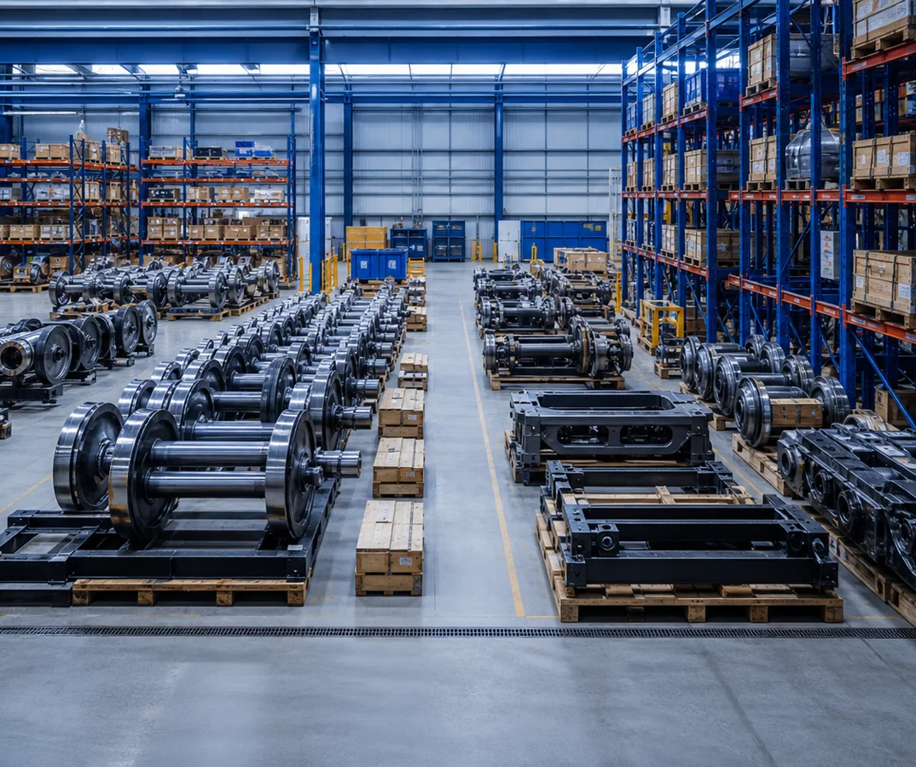
PRODUCTION CAPACITY
PREMIUM INDUSTRIAL CATALOG
Capacity for Export Programs
Production planning is organized around drawings, standards, batch size, inspection expectations and global shipping schedule.
01
Batch Supply
Wheels, axles, wheelsets and bogie parts.
02
Multi-product Orders
Grouped supply for rolling stock projects.
03
Packing Readiness
Heavy-duty export packing for long-distance transport.
04
Repeat Orders
Reference records for long-term supply.
www.railwheel.com
Railway Wheels | Wheelsets | Axles | Bogies | Railway Spare Parts
06

Slide 7
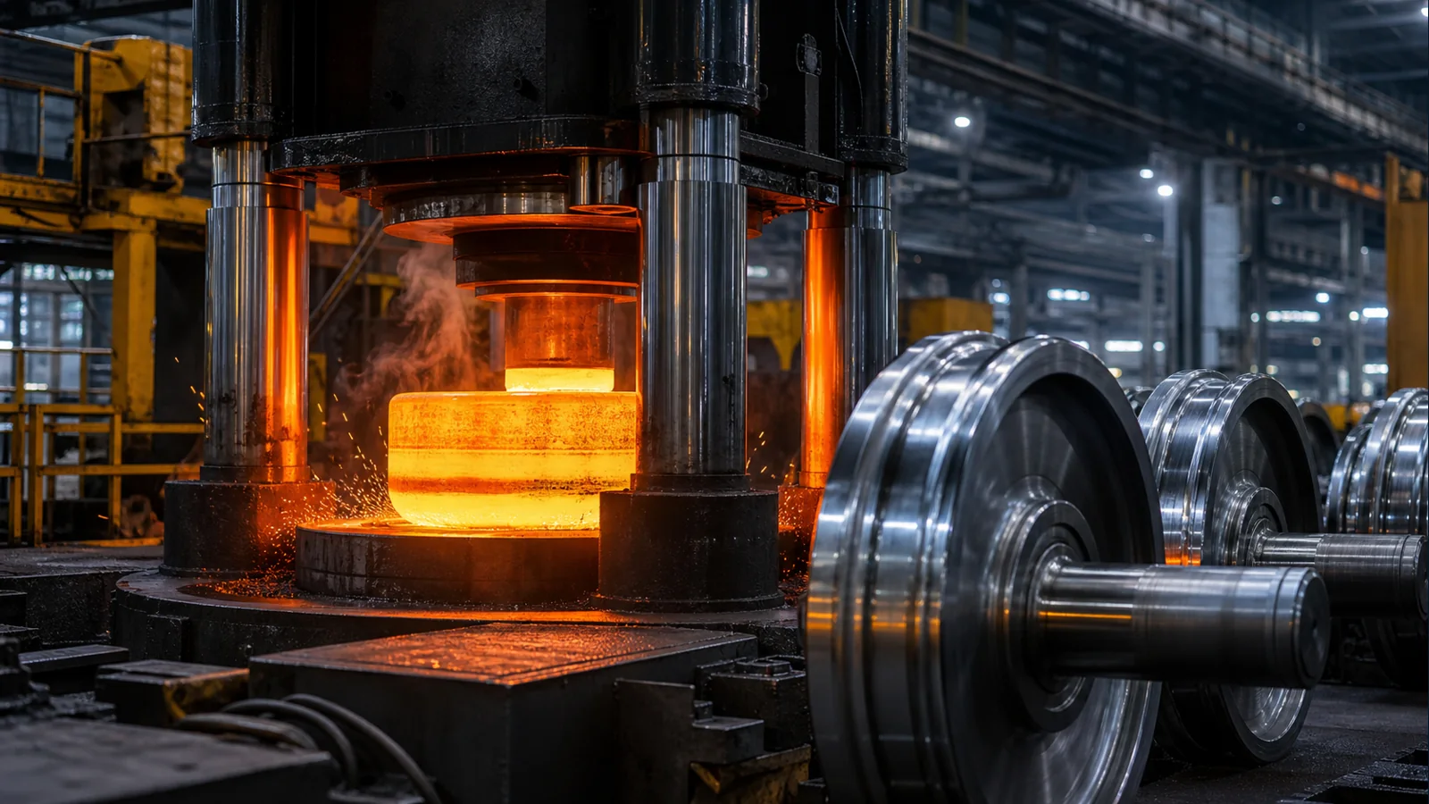
MANUFACTURING PROCESS
Forging & Forming
Controlled production connects material preparation, forging, rolling, heat treatment, machining, inspection, packing and shipment.
Material
Forging
Heat Treatment
Inspection
www.railwheel.com
Railway Wheels | Wheelsets | Axles | Bogies | Railway Spare Parts
07

Slide 8
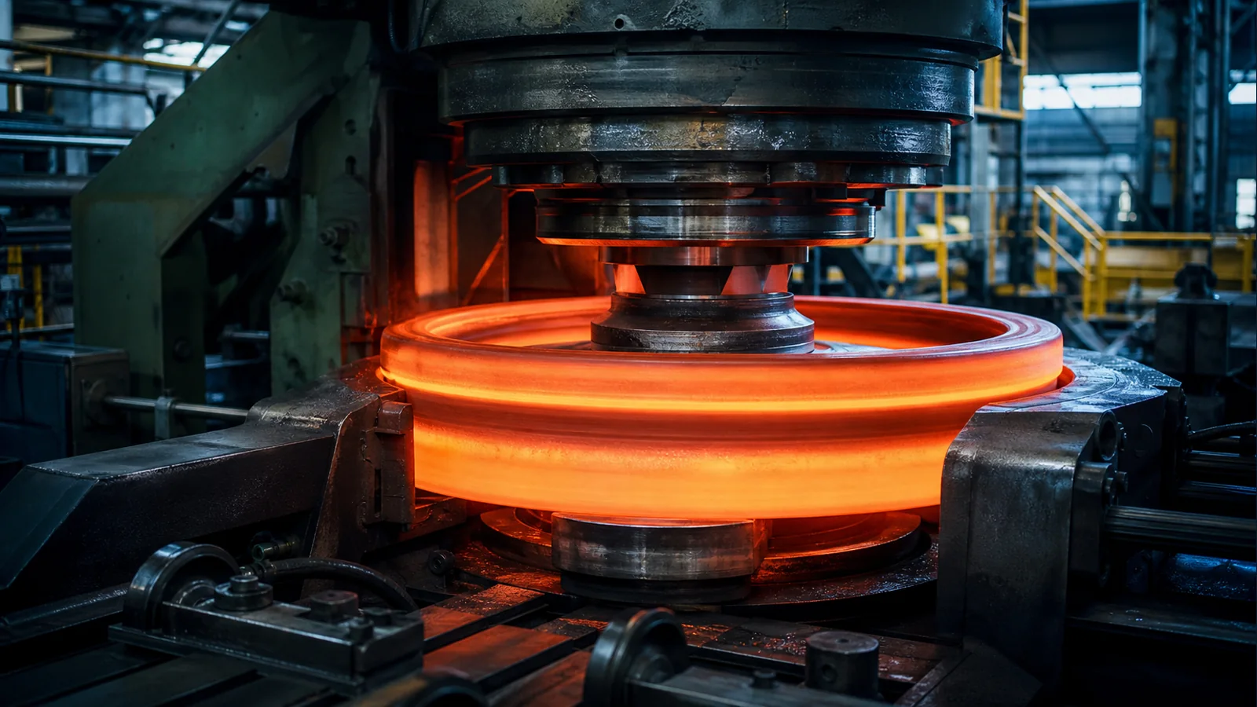
WORKSHOP
Rolling Process
Wheel rolling and forming operations create the geometry foundation for forged railway wheels, train wheels and railroad wheels.
Wheel Blank
Rolling Mill
Profile Control
Traceability
www.railwheel.com
Railway Wheels | Wheelsets | Axles | Bogies | Railway Spare Parts
08

Slide 9
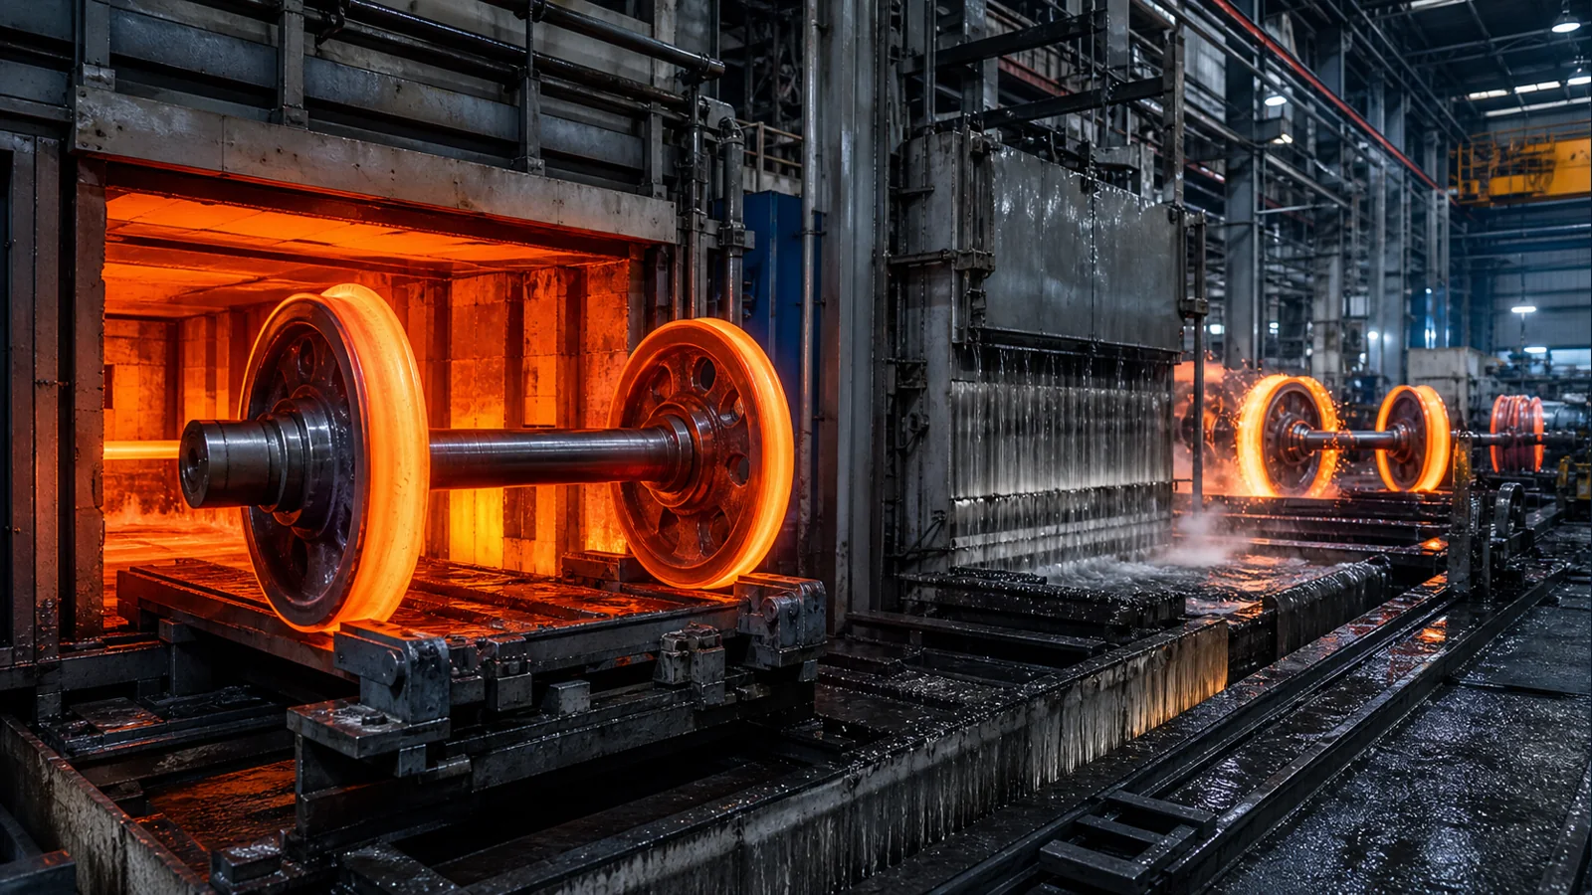
WORKSHOP
Heat Treatment
Heat treatment planning supports hardness, structure and service performance for steel railway wheels and heavy-duty components.
Furnace
Quenching
Hardness
Records
www.railwheel.com
Railway Wheels | Wheelsets | Axles | Bogies | Railway Spare Parts
09

Slide 10
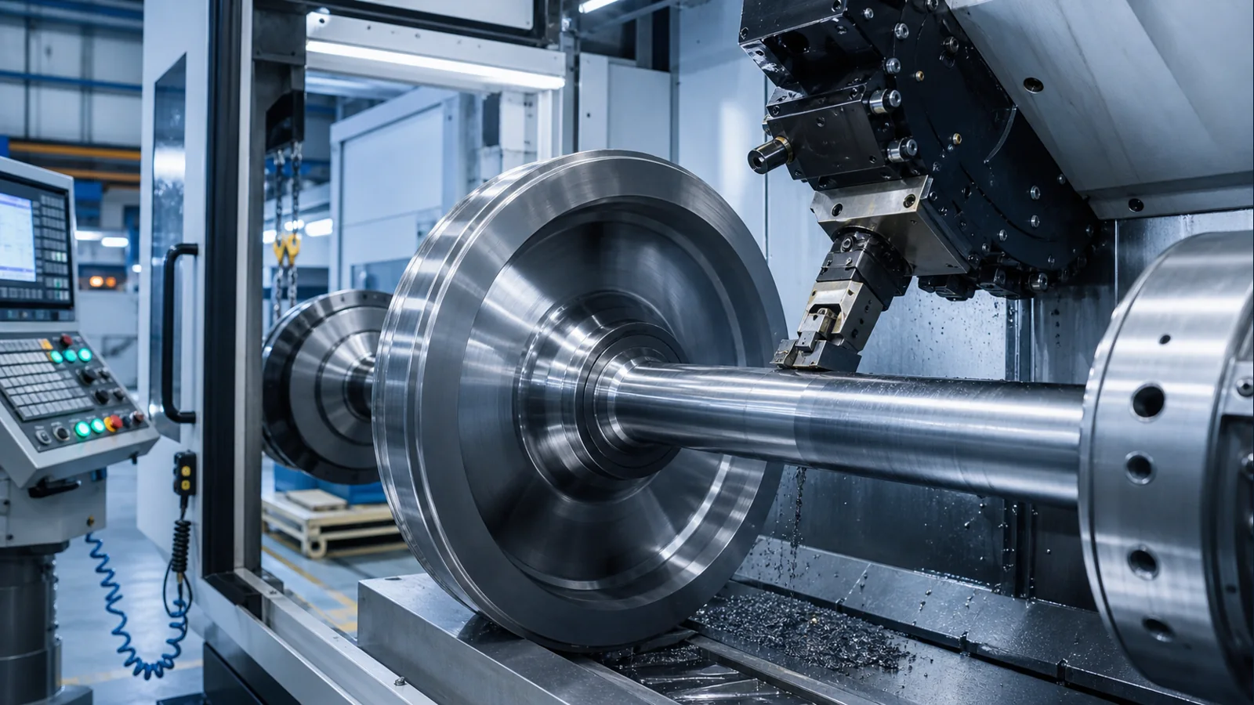
WORKSHOP
CNC Machining
Precision machining supports axle seats, bores, interfaces and finished dimensions for wheels, axles and machined railway components.
CNC
Tolerance
Surface
Interface
www.railwheel.com
Railway Wheels | Wheelsets | Axles | Bogies | Railway Spare Parts
10

Slide 11
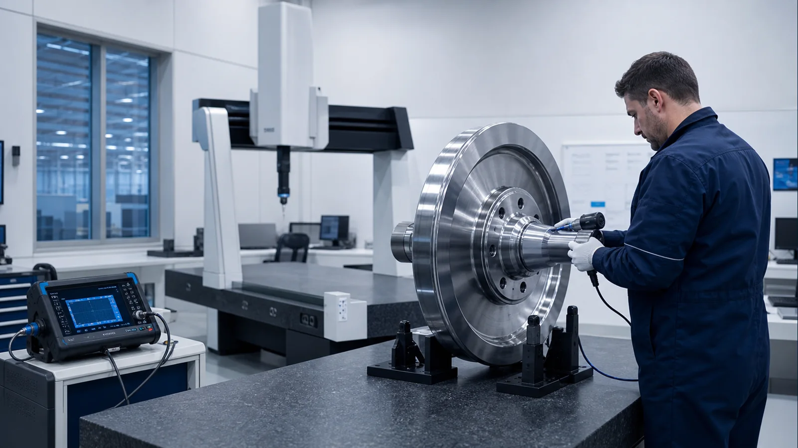
QUALITY
Inspection & Testing
Inspection activities may include dimensional control, hardness checks, ultrasonic testing, chemical analysis and visual inspection.
UT
Hardness
Dimensions
Reports
www.railwheel.com
Railway Wheels | Wheelsets | Axles | Bogies | Railway Spare Parts
11

Slide 12
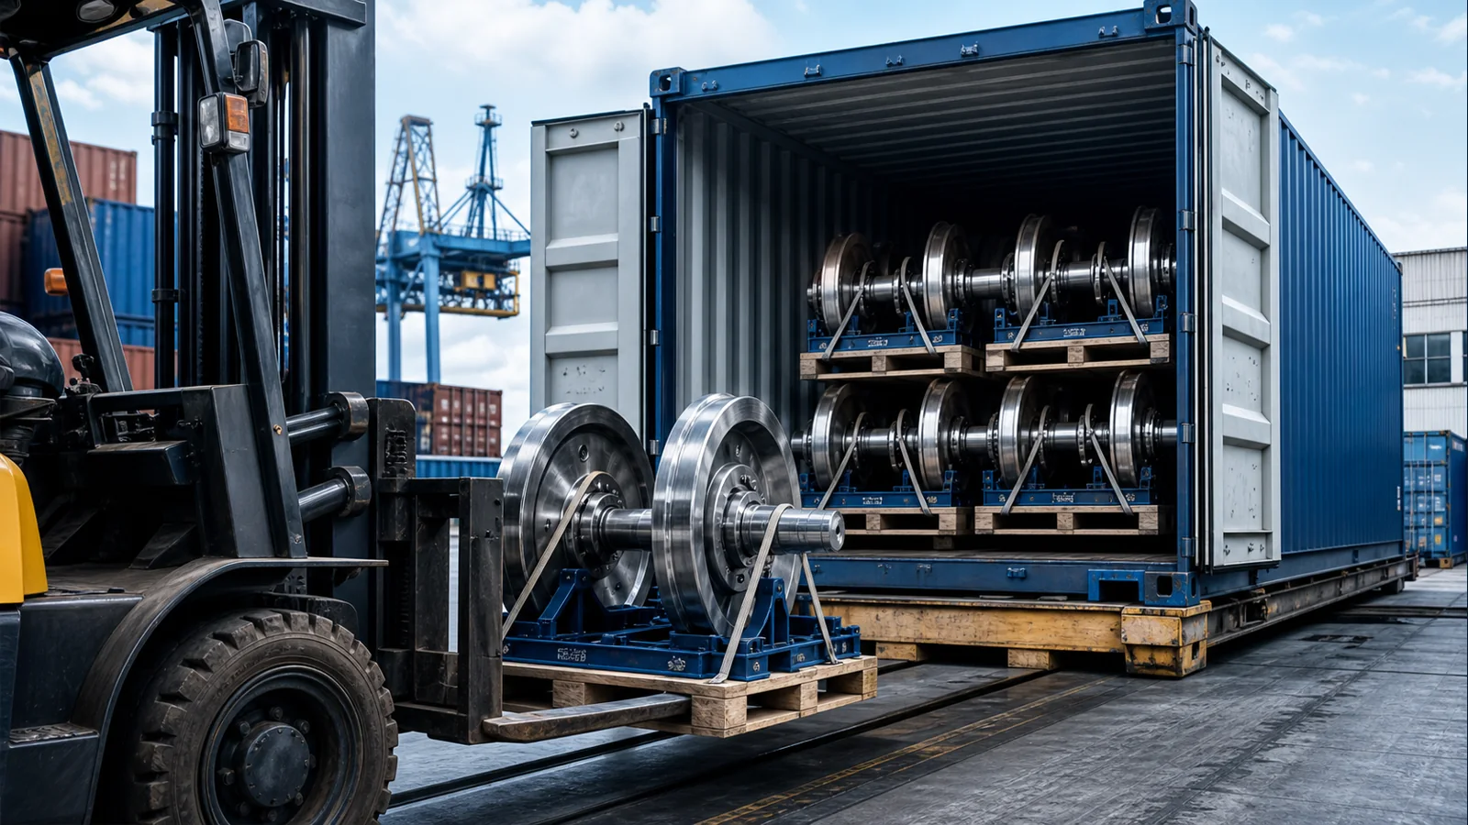
LOGISTICS
Container Loading
Export packing and container loading are planned to protect heavy railway wheels, wheelsets, axles and spare parts during international transport.
Steel Frame
Anti-rust
Labels
Shipment
www.railwheel.com
Railway Wheels | Wheelsets | Axles | Bogies | Railway Spare Parts
12

Slide 13
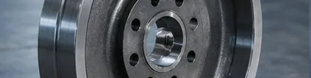
FORGED RAILWAY WHEEL
Railway Wheels
Product Overview
Advantages
Railway Wheels supplied for rolling stock manufacturers, railway operators, maintenance workshops and industrial buyers requiring dependable railway spare parts.
Drawing-based confirmation
OEM and customized manufacturing support
Export packing and documentation
Technical Features
Applications & Standards
Material and dimensional control
Freight wagons / Passenger coaches / Metro vehicles / Locomotives / Mining and industrial railways
Machined interfaces according to project drawings
UIC, AAR, EN and customer-specific requirements can be discussed according to drawings and contracts.
Surface protection for long-distance shipment
www.railwheel.com
Railway Wheels | Wheelsets | Axles | Bogies | Railway Spare Parts
13

Slide 14

WHEELSET ASSEMBLY
Railway Wheelsets
Product Overview
Advantages
Railway Wheelsets supplied for rolling stock manufacturers, railway operators, maintenance workshops and industrial buyers requiring dependable railway spare parts.
Drawing-based confirmation
OEM and customized manufacturing support
Export packing and documentation
Technical Features
Applications & Standards
Material and dimensional control
Freight wagons / Passenger coaches / Metro vehicles / Locomotives / Mining and industrial railways
Machined interfaces according to project drawings
UIC, AAR, EN and customer-specific requirements can be discussed according to drawings and contracts.
Surface protection for long-distance shipment
www.railwheel.com
Railway Wheels | Wheelsets | Axles | Bogies | Railway Spare Parts
14

Slide 15
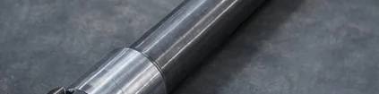
FORGED RAILWAY AXLE
Railway Axles
Product Overview
Advantages
Railway Axles supplied for rolling stock manufacturers, railway operators, maintenance workshops and industrial buyers requiring dependable railway spare parts.
Drawing-based confirmation
OEM and customized manufacturing support
Export packing and documentation
Technical Features
Applications & Standards
Material and dimensional control
Freight wagons / Passenger coaches / Metro vehicles / Locomotives / Mining and industrial railways
Machined interfaces according to project drawings
UIC, AAR, EN and customer-specific requirements can be discussed according to drawings and contracts.
Surface protection for long-distance shipment
www.railwheel.com
Railway Wheels | Wheelsets | Axles | Bogies | Railway Spare Parts
15

Slide 16
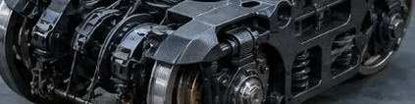
RAILWAY BOGIE
Railway Bogies
Product Overview
Advantages
Railway Bogies supplied for rolling stock manufacturers, railway operators, maintenance workshops and industrial buyers requiring dependable railway spare parts.
Drawing-based confirmation
OEM and customized manufacturing support
Export packing and documentation
Technical Features
Applications & Standards
Material and dimensional control
Freight wagons / Passenger coaches / Metro vehicles / Locomotives / Mining and industrial railways
Machined interfaces according to project drawings
UIC, AAR, EN and customer-specific requirements can be discussed according to drawings and contracts.
Surface protection for long-distance shipment
www.railwheel.com
Railway Wheels | Wheelsets | Axles | Bogies | Railway Spare Parts
16

Slide 17
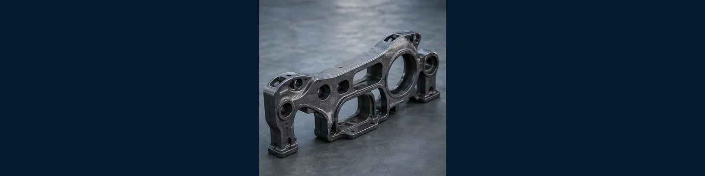
BOGIE CASTING
Side Frames
Product Overview
Advantages
Side Frames supplied for rolling stock manufacturers, railway operators, maintenance workshops and industrial buyers requiring dependable railway spare parts.
Drawing-based confirmation
OEM and customized manufacturing support
Export packing and documentation
Technical Features
Applications & Standards
Material and dimensional control
Freight wagons / Passenger coaches / Metro vehicles / Locomotives / Mining and industrial railways
Machined interfaces according to project drawings
UIC, AAR, EN and customer-specific requirements can be discussed according to drawings and contracts.
Surface protection for long-distance shipment
www.railwheel.com
Railway Wheels | Wheelsets | Axles | Bogies | Railway Spare Parts
17

Slide 18
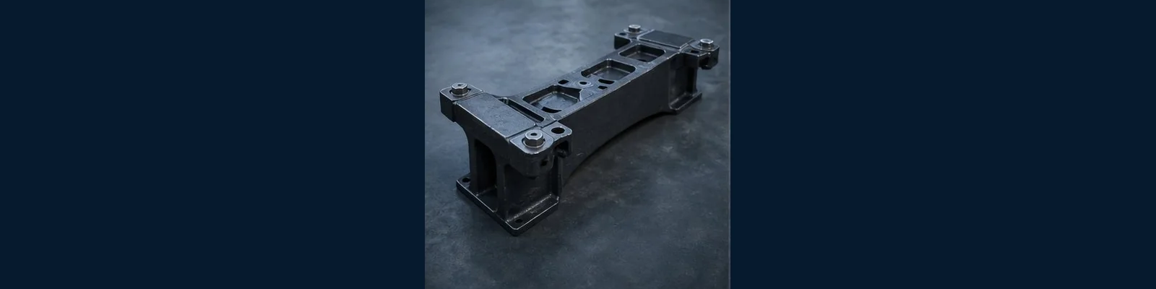
BOGIE CASTING
Bolsters
Product Overview
Advantages
Bolsters supplied for rolling stock manufacturers, railway operators, maintenance workshops and industrial buyers requiring dependable railway spare parts.
Drawing-based confirmation
OEM and customized manufacturing support
Export packing and documentation
Technical Features
Applications & Standards
Material and dimensional control
Freight wagons / Passenger coaches / Metro vehicles / Locomotives / Mining and industrial railways
Machined interfaces according to project drawings
UIC, AAR, EN and customer-specific requirements can be discussed according to drawings and contracts.
Surface protection for long-distance shipment
www.railwheel.com
Railway Wheels | Wheelsets | Axles | Bogies | Railway Spare Parts
18

Slide 19
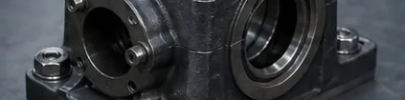
MACHINED COMPONENT
Bearing Housing
Product Overview
Advantages
Bearing Housing supplied for rolling stock manufacturers, railway operators, maintenance workshops and industrial buyers requiring dependable railway spare parts.
Drawing-based confirmation
OEM and customized manufacturing support
Export packing and documentation
Technical Features
Applications & Standards
Material and dimensional control
Freight wagons / Passenger coaches / Metro vehicles / Locomotives / Mining and industrial railways
Machined interfaces according to project drawings
UIC, AAR, EN and customer-specific requirements can be discussed according to drawings and contracts.
Surface protection for long-distance shipment
www.railwheel.com
Railway Wheels | Wheelsets | Axles | Bogies | Railway Spare Parts
19

Slide 20
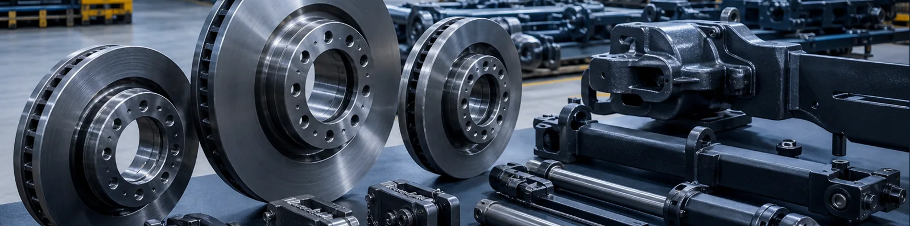
BRAKE COMPONENT
Brake Disc
Product Overview
Advantages
Brake Disc supplied for rolling stock manufacturers, railway operators, maintenance workshops and industrial buyers requiring dependable railway spare parts.
Drawing-based confirmation
OEM and customized manufacturing support
Export packing and documentation
Technical Features
Applications & Standards
Material and dimensional control
Freight wagons / Passenger coaches / Metro vehicles / Locomotives / Mining and industrial railways
Machined interfaces according to project drawings
UIC, AAR, EN and customer-specific requirements can be discussed according to drawings and contracts.
Surface protection for long-distance shipment
www.railwheel.com
Railway Wheels | Wheelsets | Axles | Bogies | Railway Spare Parts
20

Slide 21
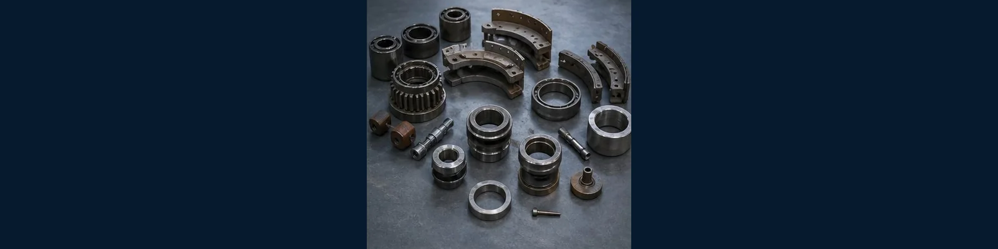
ROLLING STOCK COMPONENT
Coupler
Product Overview
Advantages
Coupler supplied for rolling stock manufacturers, railway operators, maintenance workshops and industrial buyers requiring dependable railway spare parts.
Drawing-based confirmation
OEM and customized manufacturing support
Export packing and documentation
Technical Features
Applications & Standards
Material and dimensional control
Freight wagons / Passenger coaches / Metro vehicles / Locomotives / Mining and industrial railways
Machined interfaces according to project drawings
UIC, AAR, EN and customer-specific requirements can be discussed according to drawings and contracts.
Surface protection for long-distance shipment
www.railwheel.com
Railway Wheels | Wheelsets | Axles | Bogies | Railway Spare Parts
21

Slide 22
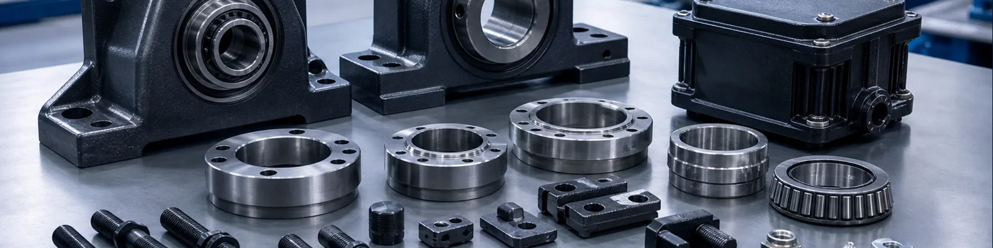
RAILWAY SPARE PARTS
Railway Fasteners
Product Overview
Advantages
Railway Fasteners supplied for rolling stock manufacturers, railway operators, maintenance workshops and industrial buyers requiring dependable railway spare parts.
Drawing-based confirmation
OEM and customized manufacturing support
Export packing and documentation
Technical Features
Applications & Standards
Material and dimensional control
Freight wagons / Passenger coaches / Metro vehicles / Locomotives / Mining and industrial railways
Machined interfaces according to project drawings
UIC, AAR, EN and customer-specific requirements can be discussed according to drawings and contracts.
Surface protection for long-distance shipment
www.railwheel.com
Railway Wheels | Wheelsets | Axles | Bogies | Railway Spare Parts
22

Slide 23
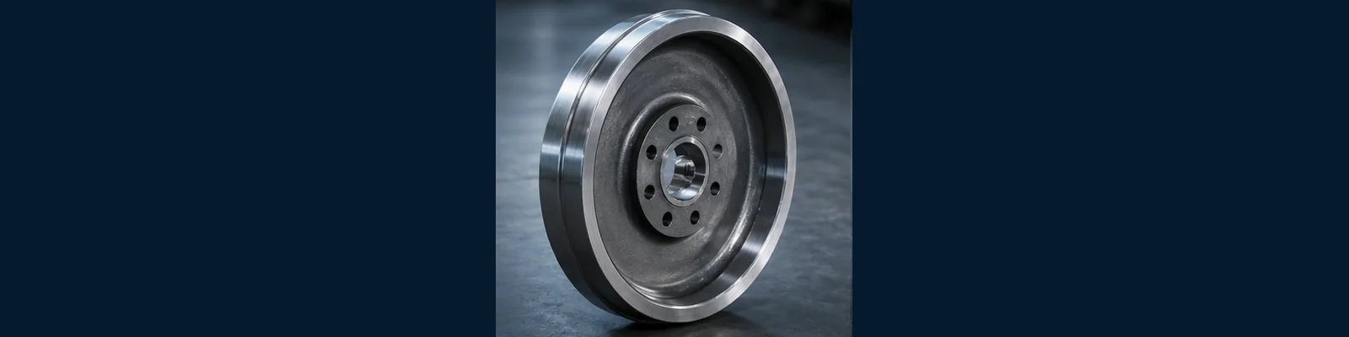
FORGED COMPONENTS
Railway Forgings
Product Overview
Advantages
Railway Forgings supplied for rolling stock manufacturers, railway operators, maintenance workshops and industrial buyers requiring dependable railway spare parts.
Drawing-based confirmation
OEM and customized manufacturing support
Export packing and documentation
Technical Features
Applications & Standards
Material and dimensional control
Freight wagons / Passenger coaches / Metro vehicles / Locomotives / Mining and industrial railways
Machined interfaces according to project drawings
UIC, AAR, EN and customer-specific requirements can be discussed according to drawings and contracts.
Surface protection for long-distance shipment
www.railwheel.com
Railway Wheels | Wheelsets | Axles | Bogies | Railway Spare Parts
23

Slide 24
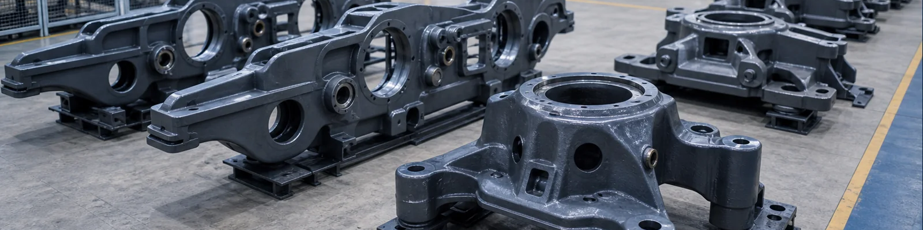
CAST COMPONENTS
Railway Castings
Product Overview
Advantages
Railway Castings supplied for rolling stock manufacturers, railway operators, maintenance workshops and industrial buyers requiring dependable railway spare parts.
Drawing-based confirmation
OEM and customized manufacturing support
Export packing and documentation
Technical Features
Applications & Standards
Material and dimensional control
Freight wagons / Passenger coaches / Metro vehicles / Locomotives / Mining and industrial railways
Machined interfaces according to project drawings
UIC, AAR, EN and customer-specific requirements can be discussed according to drawings and contracts.
Surface protection for long-distance shipment
www.railwheel.com
Railway Wheels | Wheelsets | Axles | Bogies | Railway Spare Parts
24

Slide 25
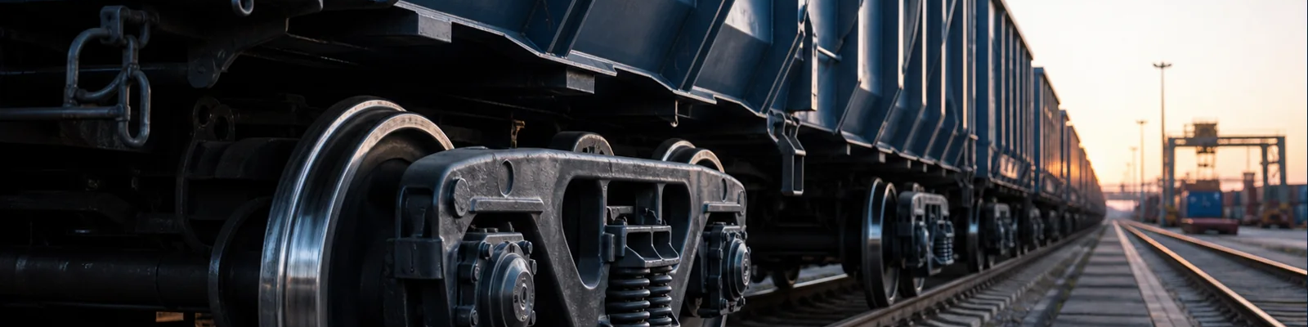
FREIGHT RAILWAY APPLICATION
Freight Wagon Parts
Product Overview
Advantages
Freight Wagon Parts supplied for rolling stock manufacturers, railway operators, maintenance workshops and industrial buyers requiring dependable railway spare parts.
Drawing-based confirmation
OEM and customized manufacturing support
Export packing and documentation
Technical Features
Applications & Standards
Material and dimensional control
Freight wagons / Passenger coaches / Metro vehicles / Locomotives / Mining and industrial railways
Machined interfaces according to project drawings
UIC, AAR, EN and customer-specific requirements can be discussed according to drawings and contracts.
Surface protection for long-distance shipment
www.railwheel.com
Railway Wheels | Wheelsets | Axles | Bogies | Railway Spare Parts
25

Slide 26
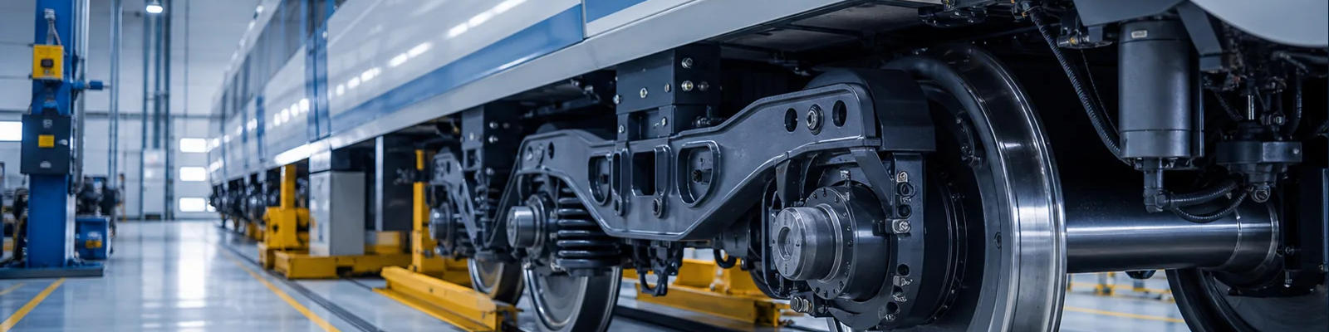
PASSENGER RAILWAY APPLICATION
Passenger Coach Parts
Product Overview
Advantages
Passenger Coach Parts supplied for rolling stock manufacturers, railway operators, maintenance workshops and industrial buyers requiring dependable railway spare parts.
Drawing-based confirmation
OEM and customized manufacturing support
Export packing and documentation
Technical Features
Applications & Standards
Material and dimensional control
Freight wagons / Passenger coaches / Metro vehicles / Locomotives / Mining and industrial railways
Machined interfaces according to project drawings
UIC, AAR, EN and customer-specific requirements can be discussed according to drawings and contracts.
Surface protection for long-distance shipment
www.railwheel.com
Railway Wheels | Wheelsets | Axles | Bogies | Railway Spare Parts
26

Slide 27
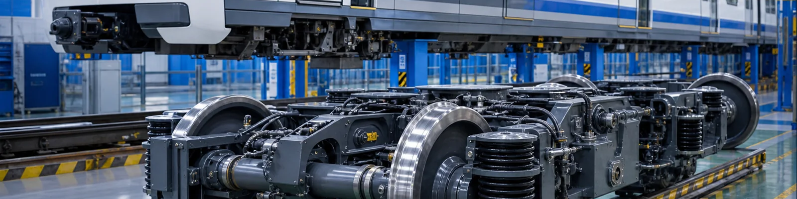
URBAN RAIL APPLICATION
Metro Components
Product Overview
Advantages
Metro Components supplied for rolling stock manufacturers, railway operators, maintenance workshops and industrial buyers requiring dependable railway spare parts.
Drawing-based confirmation
OEM and customized manufacturing support
Export packing and documentation
Technical Features
Applications & Standards
Material and dimensional control
Freight wagons / Passenger coaches / Metro vehicles / Locomotives / Mining and industrial railways
Machined interfaces according to project drawings
UIC, AAR, EN and customer-specific requirements can be discussed according to drawings and contracts.
Surface protection for long-distance shipment
www.railwheel.com
Railway Wheels | Wheelsets | Axles | Bogies | Railway Spare Parts
27

Slide 28
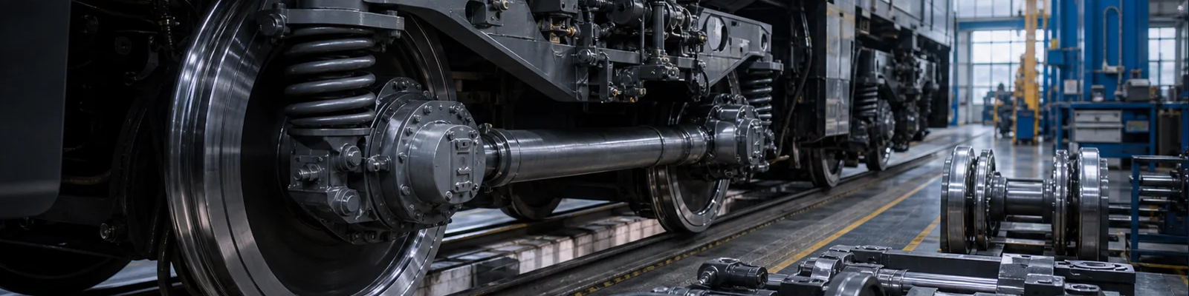
HEAVY RAIL APPLICATION
Locomotive Parts
Product Overview
Advantages
Locomotive Parts supplied for rolling stock manufacturers, railway operators, maintenance workshops and industrial buyers requiring dependable railway spare parts.
Drawing-based confirmation
OEM and customized manufacturing support
Export packing and documentation
Technical Features
Applications & Standards
Material and dimensional control
Freight wagons / Passenger coaches / Metro vehicles / Locomotives / Mining and industrial railways
Machined interfaces according to project drawings
UIC, AAR, EN and customer-specific requirements can be discussed according to drawings and contracts.
Surface protection for long-distance shipment
www.railwheel.com
Railway Wheels | Wheelsets | Axles | Bogies | Railway Spare Parts
28

Slide 29
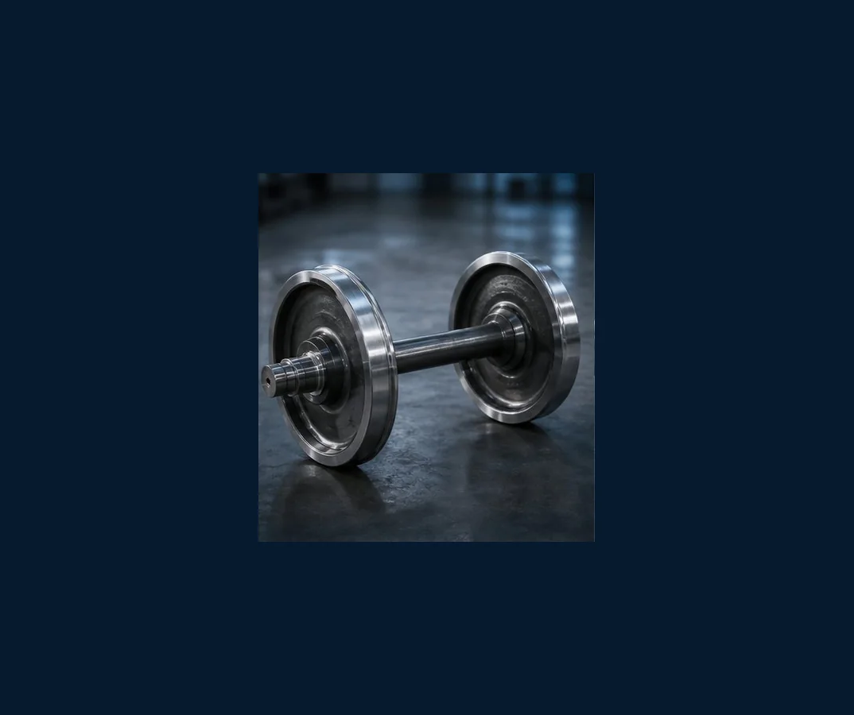
OEM MANUFACTURING
PREMIUM INDUSTRIAL CATALOG
Custom Railway Component Programs
Railwheel supports OEM manufacturing for railway wheel, train wheel, wheelset, axle, bogie and spare part projects based on drawings and technical requirements.
DWG
Drawing Review
Confirm material, geometry, tolerance and inspection scope.
STD
Standards
Discuss UIC, AAR, EN and customer specifications.
QA
Inspection Plan
Prepare practical records for buyer review.
EX
Export Package
Packing, marking, photos and shipment documents.
www.railwheel.com
Railway Wheels | Wheelsets | Axles | Bogies | Railway Spare Parts
29

Slide 30
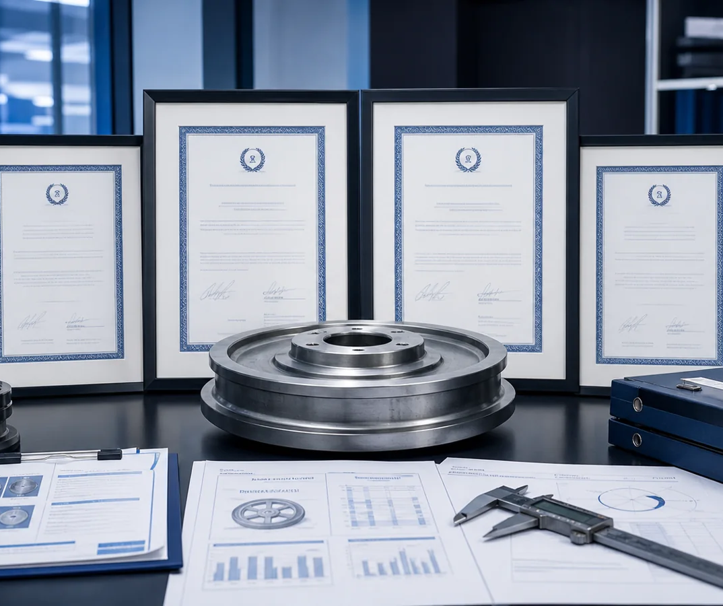
TECHNICAL STANDARDS
PREMIUM INDUSTRIAL CATALOG
UIC, AAR, EN & Customer Specifications
International railway buyers often combine public standards with project drawings and contract acceptance requirements.
UIC
UIC References
International railway terminology and practices.
AAR
AAR Requirements
North American railroad wheel and component context.
EN
European Standards
Wheel, axle and wheelset project references.
OEM
Customer Drawings
Final acceptance follows buyer documentation.
www.railwheel.com
Railway Wheels | Wheelsets | Axles | Bogies | Railway Spare Parts
30

Slide 31
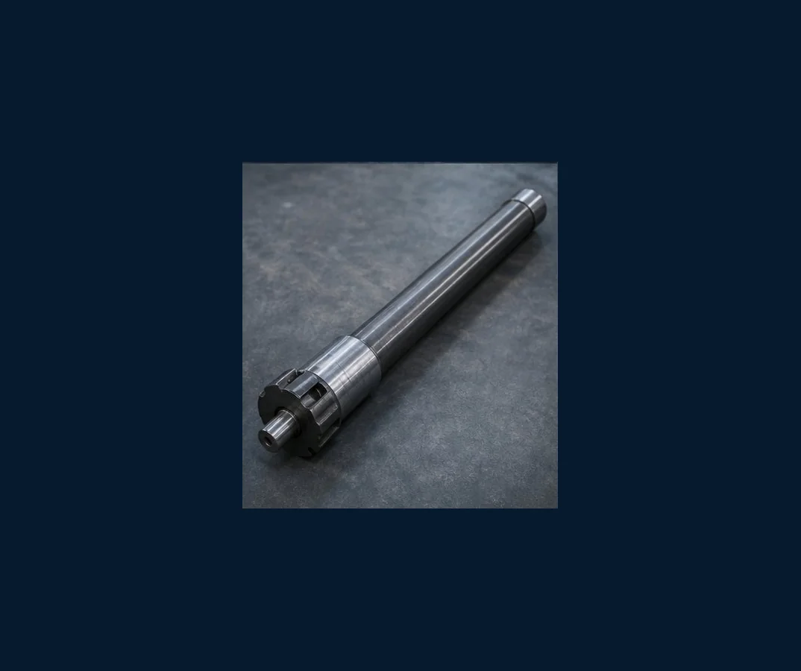
MATERIAL
PREMIUM INDUSTRIAL CATALOG
Steel, Forging & Casting Control
Material selection is matched to axle load, speed, route profile, operating environment and inspection requirements.
ST
Steel Selection
Material grade aligned with application.
FG
Forged Parts
Railway wheels, train wheels and axles.
CS
Cast Parts
Side frames, bolsters and bogie components.
SP
Surface Protection
Anti-rust and coating options.
www.railwheel.com
Railway Wheels | Wheelsets | Axles | Bogies | Railway Spare Parts
31

Slide 32
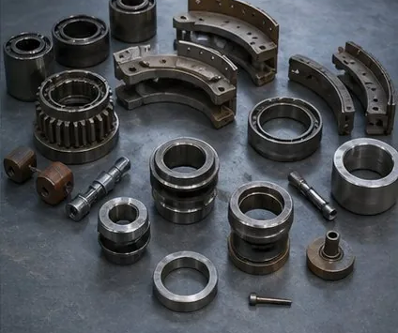
INSPECTION EQUIPMENT
PREMIUM INDUSTRIAL CATALOG
Testing & Documentation
Industrial buyers can request inspection documentation for material, dimensions, surface condition and packing release.
UT
Ultrasonic Testing
Internal integrity checks where required.
HD
Hardness Testing
Heat treatment and rim condition review.
DM
Dimension Inspection
Critical interface and tolerance confirmation.
RP
Reports
Document package according to buyer needs.
www.railwheel.com
Railway Wheels | Wheelsets | Axles | Bogies | Railway Spare Parts
32

Slide 33
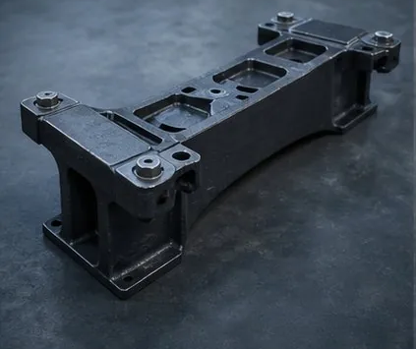
PACKAGING
PREMIUM INDUSTRIAL CATALOG
Heavy-duty Export Packing
Railway wheels, wheelsets, axles and bogie parts require stable packing, anti-rust protection, labels and lifting considerations.
FR
Steel Frames
For heavy wheels, axles and assemblies.
CS
Cases
Wooden cases for machined spare parts.
AR
Anti-rust
Protection for ocean freight and storage.
PH
Packing Photos
Visual records before shipment.
www.railwheel.com
Railway Wheels | Wheelsets | Axles | Bogies | Railway Spare Parts
33

Slide 34
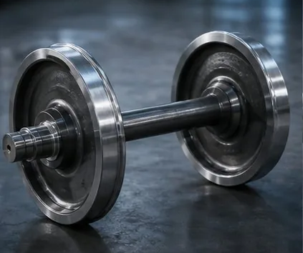
SHIPPING
PREMIUM INDUSTRIAL CATALOG
International Delivery Support
Railwheel coordinates shipment discussion for sea freight, port delivery, package size, weight and document preparation.
SEA
Sea Freight
Container shipment for global buyers.
TRK
Truck Transfer
Domestic logistics and port delivery.
DOC
Documents
Invoice, packing list and shipment data.
SCH
Schedule
Delivery planning aligned with inspection.
www.railwheel.com
Railway Wheels | Wheelsets | Axles | Bogies | Railway Spare Parts
34

Slide 35
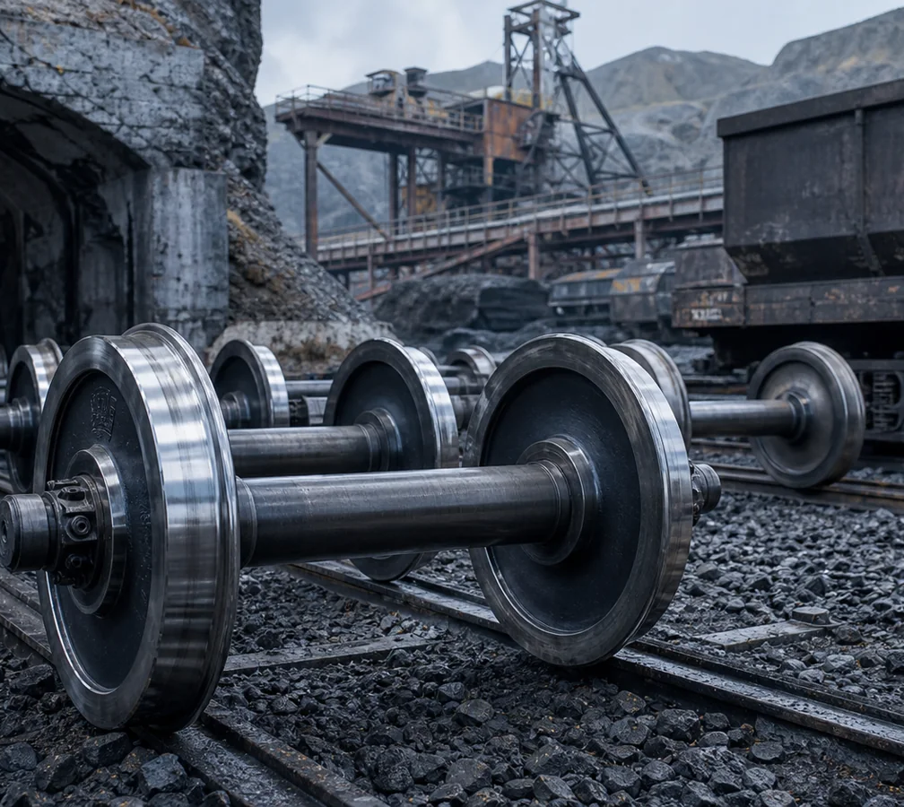
PROJECT CASE
PREMIUM INDUSTRIAL CATALOG
Mining Railway Wheel Supply
Heavy-duty wheel and wheelset support for harsh industrial railway conditions.
Country
Overseas mining market
Products
Heavy haul railway wheels, axles and wheelsets
Industry
Mining railway
Application
Ore wagons and maintenance replacement
Delivery
Export packed by batch
Result
Stronger procurement visibility and repeat inquiry basis
www.railwheel.com
Railway Wheels | Wheelsets | Axles | Bogies | Railway Spare Parts
35

Slide 36
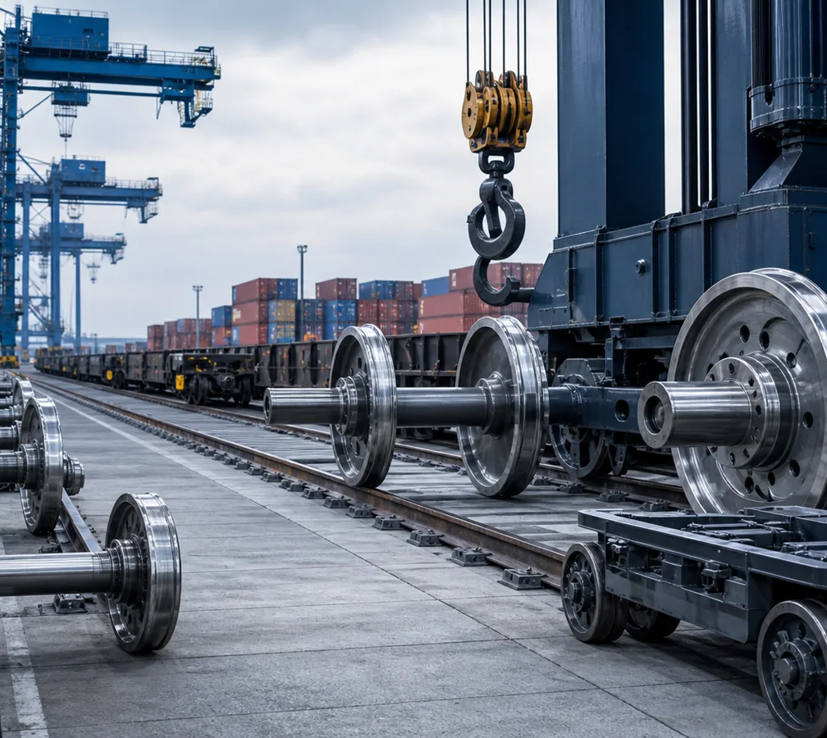
PROJECT CASE
PREMIUM INDUSTRIAL CATALOG
Port Railway & Crane Wheel Project
Railway wheel and crane wheel sourcing for port logistics and industrial transport.
Country
International port market
Products
Port railway wheels, crane wheels and spare parts
Industry
Port and logistics
Application
Container terminal rail movement
Delivery
Container loading with packing photos
Result
Consolidated shipment of heavy rail components
www.railwheel.com
Railway Wheels | Wheelsets | Axles | Bogies | Railway Spare Parts
36

Slide 37

PROJECT CASE
PREMIUM INDUSTRIAL CATALOG
Railway Wheelset Project Review
Technical coordination before quotation improves drawing accuracy and delivery planning.
Country
Global OEM buyer
Products
Railway wheelsets, train wheels and axles
Industry
Rolling stock manufacturing
Application
OEM and maintenance supply
Delivery
Drawing-based production schedule
Result
Clear technical scope before purchase order
www.railwheel.com
Railway Wheels | Wheelsets | Axles | Bogies | Railway Spare Parts
37

Slide 38

CUSTOMER VISITS
PREMIUM INDUSTRIAL CATALOG
Factory Visit & Technical Meetings
Customer visits help international buyers review production flow, quality expectations, packing plans and long-term railway component supply programs.
ME
Engineering Discussion
Review drawings, standards and applications.
WK
Workshop Visit
Confirm manufacturing and inspection flow.
QA
Quality Review
Discuss test records and document scope.
SP
Supply Planning
Coordinate repeat order and delivery schedule.
www.railwheel.com
Railway Wheels | Wheelsets | Axles | Bogies | Railway Spare Parts
38

Slide 39
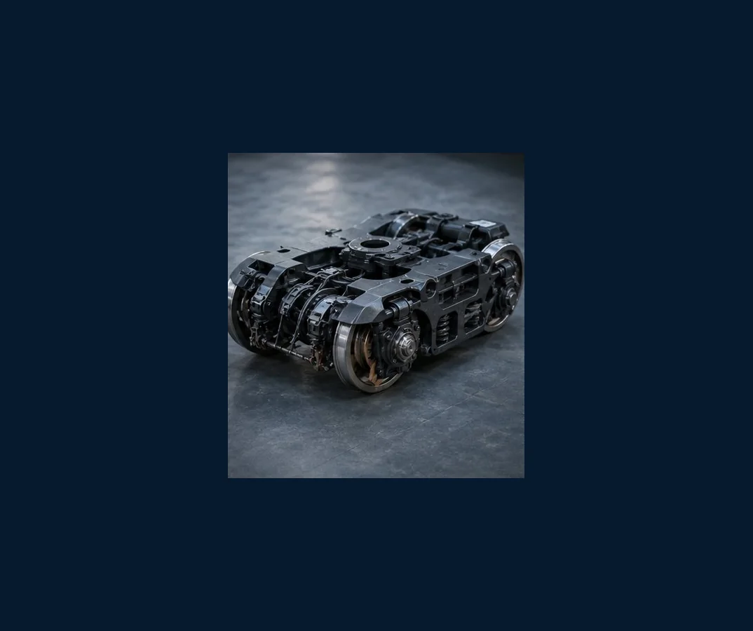
CUSTOMER VISITS
PREMIUM INDUSTRIAL CATALOG
Application Review with Buyers
Railwheel supports product selection for freight wagon, passenger coach, metro, locomotive, mining and industrial railway applications.
FR
Freight Applications
Wheels, wheelsets and bogie components.
MT
Metro Applications
Passenger railway wheel and axle projects.
IN
Industrial Rail
Mining, port and steel plant rail systems.
OEM
Custom Supply
Drawing-based railway spare parts.
www.railwheel.com
Railway Wheels | Wheelsets | Axles | Bogies | Railway Spare Parts
39

Slide 40
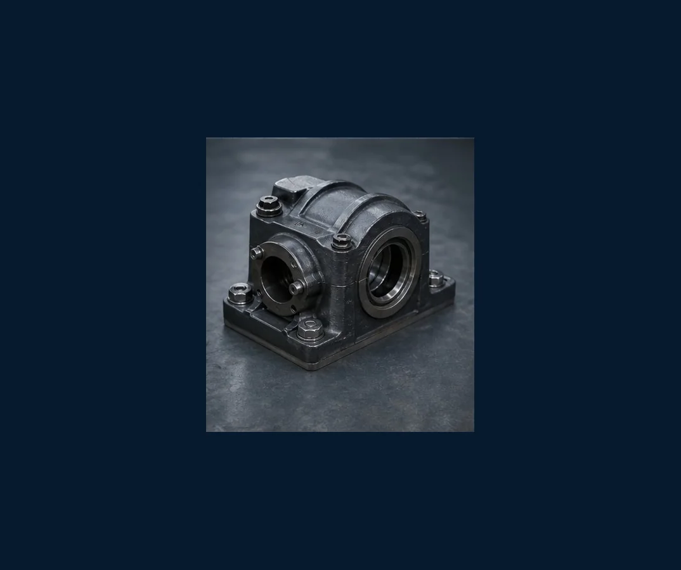
CERTIFICATES
PREMIUM INDUSTRIAL CATALOG
Quality Certificates & Compliance
Certificate pages support buyer approval, internal project review and export release for railway wheels and rolling stock components.
MAT
Material Certificates
Heat number, grade and traceability details.
INS
Inspection Reports
Dimensional, visual and test records.
STD
Standard References
UIC, AAR, EN and customer specifications.
EXP
Export Documents
Packing, labels and shipment records.
www.railwheel.com
Railway Wheels | Wheelsets | Axles | Bogies | Railway Spare Parts
40

Slide 41
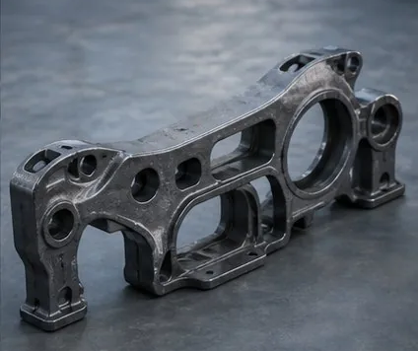
FAQ & SERVICE
PREMIUM INDUSTRIAL CATALOG
Buyer FAQ and After-sales Support
Railwheel keeps communication practical: send drawings, standards, quantity and destination to receive focused technical feedback and quotation.
Q1
Can you customize?
Yes, based on drawings, samples or standards.
Q2
What products?
Railway wheels, wheelsets, axles, bogies and spare parts.
Q3
What documents?
Material certificates and inspection records as required.
Q4
How to quote?
Send drawing, quantity, application and destination.
www.railwheel.com
Railway Wheels | Wheelsets | Axles | Bogies | Railway Spare Parts
41

Slide 42

Build Your Next Railway Component Supply Program
Send drawings, standards, quantities and destination to receive a focused quotation for railway wheels, train wheels, railroad wheels, wheelsets, axles, bogies and rolling stock components.
Ma'anshan Railwheel Industrial Technology Co., Ltd.
Website: www.railwheel.com
Email: amy@railwheel.com
WhatsApp / WeChat: +86 17755518921

