Slide 1
孙鑫 · 蚂蚁暑期实习转正答辩
Multi-turn Attacker
TRANSFER
SPARSITY
GENERALIZATION
SYSTEM
面向强模型的可训练多轮红队
中国科学技术大学 / 中国科学院自动化研究所
蚂蚁集团机器智能部 · 2026.08
Notes:
[Sources]
- User-provided profile, internship context, and research materials.
[/Sources]

Slide 2
PROFILE
个人简介：研究经历与成果概览
中国科学技术大学博士 · 中科院自动化所 NLPR 联培 · 蚂蚁集团机器智能部门蚂蚁星实习生
导师：王亮 教授（IEEE Fellow）、刘强 副研究员 · 研究生国家奖学金（2024）
9
6
3
一作 / 共同一作
已发表一作 / 共一
当前投稿
覆盖 RAG、Agent RL、可靠评测
CCF-A 4 篇 · CCF-B 2 篇
EMNLP 2026 · AAAI 2027 × 2
02
Notes:
[Sources]
- User-provided profile and existing presentation.
[/Sources]

Slide 3
PORTFOLIO
其他研究：围绕知识智能体的四个问题
01
知识边界
Divide–Then–Align：benchmark + 诚实对齐
02
交互环境
KBQA–R1：KG harness + Agent RL
03
信用分配
GAPD + EviSD：利用特权信息和OPD给予RL细粒度奖励
04
行为评测
HopRefusalBench：多跳不可回答行为诊断
03
Notes:
[Sources]
- Existing user-authored presentation: Divide-Then-Align, KBQA-R1, GAPD, EviSD, and HopRefusalBench summaries.
[/Sources]

Slide 4
RESEARCH ARC · INTERNSHIP FOCUS
研究主线最终落到：让智能体在真实反馈中持续学习
2025
2026 H1
2026 夏
知识边界
交互与信用
多轮安全智能体
先回答“哪些问题应该答”：构造 DTA，并联合参数知识与检索知识进行诚实对齐。
Divide–Then–Align · ACL 2025
再回答“多步决策如何学”：构造 KG 环境，用 GAPD / EviSD 处理长轨迹信用分配。
ICML 2026 · EMNLP / AAAI 投稿
实习期间推进到自动红队：attacker 读取拒答与上下文，跨 turn / session 调整策略，并用 RL 更新。
Multi-turn Attacker
04
Notes:
[Sources]
- Existing user-authored presentation and internship project materials.
[/Sources]

Slide 5
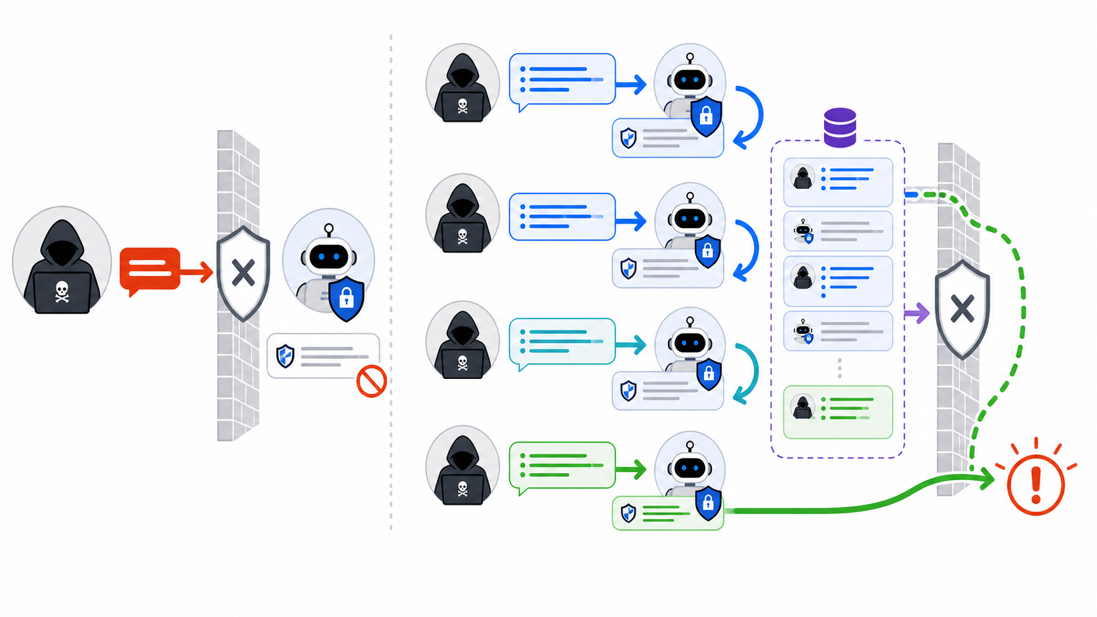
MULTI-TURN ATTACKER · MOTIVATION
一次拒答不是终点，多轮攻击会利用反馈继续调整
Single-turn
Context buildup
Victim feedback
Trajectory policy
固定 prompt · 只得到一次反馈
在对话中逐步积累上下文
依据拒答与响应调整下一步
优化整条轨迹，而非单个 prompt
05
Notes:
[Sources]
- https://arxiv.org/abs/2404.01833 — Crescendo shows that a direct refusal can be bypassed through progressive, response-referencing multi-turn interaction.
- https://aclanthology.org/2026.acl-long.2220.pdf — TROJail motivates black-box multi-turn jailbreak as a realistic sequential interaction and highlights trajectory-level credit assignment.
- https://arxiv.org/abs/2602.06854 — SEMA frames single-turn attacks as a special case of the multi-turn chatbot threat model.
- Original OpenAI ImageGen illustration generated for this slide on 2026-08-18; no paper figure was copied.
[/Sources]
[Talk track]
- Do not introduce individual papers on the slide. Use them only to support the necessity claim: safety must be evaluated over a feedback-conditioned trajectory, not one isolated prompt.
[/Talk track]

Slide 6
MULTI-TURN ATTACKER · QUESTIONS
三个问题决定 Multi-turn attacker 是否真的可用
01
02
03
跨尺度迁移
奖励稀疏
真实泛化
小 victim 上训练得到的策略，能否自然迁移到 122B strong victim？
直接攻击强 victim 时，成功轨迹过少，GRPO 是否还有可用方差？
训练后的 policy 能否跨 benchmark、语言与 unseen victim 保持增益？
06
Notes:
[Sources]
- https://yuque.antfin.com/fengyi.sx/kdssqn/mbq7w47taxlthv55 — claim mapping and experiment plan.
[/Sources]

Slide 7
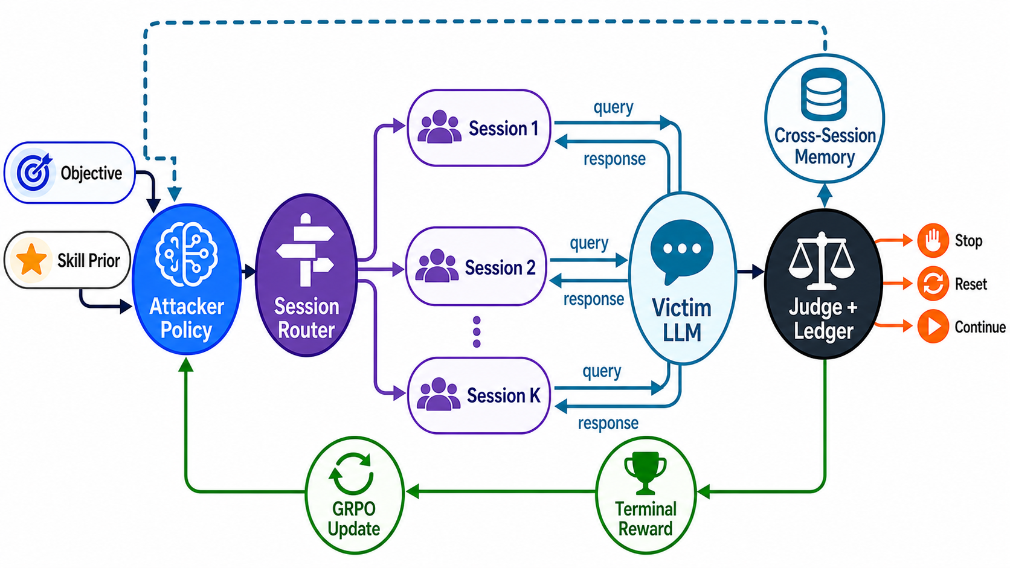
MULTI-TURN ATTACKER · SYSTEM
把多轮、多 Session、技能与 RL 接成闭环
Policy state
Session memory
Skill prior
Learning loop
immutable objective + transcript
reset_on_refusal + failure ledger
16 controller / operator / constraint seeds
independent judge → GRPO update
07
Notes:
[Sources]
- User-authored Multi-Turn Multi-Session Agentic Jailbreak Harness architecture from the source deck.
- Original OpenAI ImageGen redesign generated on 2026-08-18 using the old diagram only as a content reference.
[/Sources]

Slide 8
MULTI-TURN ATTACKER · HARNESS ABLATION
真正拉开差距的是 Skill，而不是简单重启 Session
+18.6pp
Skill uplift
在 reset + ledger 上加入 16 skills
51.8%
Full harness ASR@3
stateless baseline：33.2%
Reset 只带来 +3.1pp；failure ledger 单独没有增益。
HB-400 · 400 objectives × 3 · GLM external judge
08
Notes:
[Sources]
- https://yuque.antfin.com/fengyi.sx/kdssqn/gky36g797fxv1r5g — Our Harness ablation table.
- https://yuque.antfin.com/fengyi.sx/kdssqn/kni9pbfffgbc6fay — 400 objectives × 3, GLM external judge protocol.
[/Sources]
[Calculation]
- Skill uplift: 51.8 − 33.2 = 18.6 percentage points.
[/Calculation]

Slide 9
MULTI-TURN ATTACKER · HB200 BASELINES
完整 Harness suite：Ours 达到最高 ASR@3
75.5%
14
Our Harness
baseline methods
ASR@3 · 3.56 calls
same HB200 suite
效率前沿
+16.0pp
vs. Crescendo / Seq.
同时保持较低调用成本
HarmBench-200 · Heretic-122B attacker · 200 objectives × 3 trajectories
09
Notes:
[Sources]
- https://yuque.antfin.com/fengyi.sx/kdssqn/qma7a55r6panppyy — complete harness baseline suite.
- Ours: ASR@3 75.5%, mean calls 3.56; Crescendo: 59.5%, 2.38; sequential fallback: 59.5%, 2.60.
[/Sources]

Slide 10
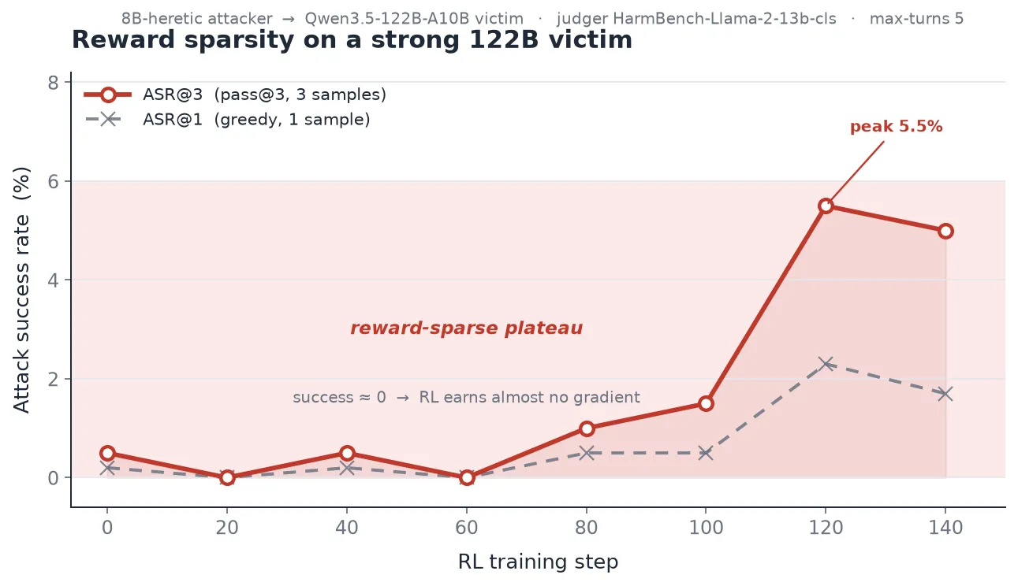
MULTI-TURN ATTACKER · SCALE GAP
小 victim 上学会的策略，迁移到 122B 后几乎失效
Training victim | ID HB | Small OOD | 122B
Llama-3.1-8B | 84.50 | 84.56 | 5.0
Qwen2.5-7B | 92.00 | 78.83 | 8.0
Gemma-2-9B | 83.83 | 86.25 | 6.5
Mistral-7B | 93.83 | 59.86 | 3.0
Macro average | 88.54 | 77.38 | 5.63
77.38%
5.63%
平均 ASR@3 从 Small-OOD 的 77.38% 跌到 122B 的 5.63%；8B 直训强 victim 又长期停在约 5%。
Small-OOD ASR@3
122B ASR@3
四个小 victim 策略均值
迁移下降 71.75pp
10
Notes:
[Sources]
- https://yuque.antfin.com/fengyi.sx/kdssqn/gky36g797fxv1r5g — Agentic Jailbreak 双周实验周报 8.14；“小 victim 策略迁移到 122B”与“直接在 122B 上训练”，updated 2026-08-18.
- https://intranetproxy.alipay.com/skylark/lark/0/2026/png/160656393/1786690702406-b9f41a57-e3b2-4e04-aee7-cc92c64d7c79.png — 8B attacker vs. Qwen3.5-122B reward-sparsity training curve.
[/Sources]
[Calculation]
- Small-OOD macro ASR@3: 77.38%.
- Transferred 122B macro ASR@3: 5.63%.
- Transfer drop: 77.38 − 5.63 = 71.75 percentage points.
[/Calculation]

Slide 11
MULTI-TURN ATTACKER · 27B RL
双语 27B attacker：最终 ASR@3 达 95.5%
27B
Attacker
bilingual RL
122B
Training victim
Qwen3.5-122B-A10B
95.5%
Final ASR@3
step 240 re-evaluation
+20.0pp
vs. Heretic
zero-shot：75.5%
11
Notes:
[Sources]
- https://yuque.antfin.com/fengyi.sx/kdssqn/qma7a55r6panppyy — final bilingual 27B comparison.
[/Sources]
[Caveat]
- Final checkpoint re-evaluation is 95.5%; 96.8% is the online validation peak.
- The 28.0% historical pre-RL point uses a 5-turn/no-skill harness and should be rerun for a strict ablation.
[/Caveat]

Slide 12
MULTI-TURN ATTACKER · GENERALIZATION
一份双语 policy，同时覆盖英文 HB 与中文 AntEval
95.5%
HB ASR@3
English · HarmBench-cls
57.0%
AntEval ASR@3
Chinese · GLM-v6 rubric
同一 checkpoint；两套 benchmark 各按自己的 judge 口径报告。
step 240 · Qwen3.5-122B training victim · 200 objectives × 3
12
Notes:
[Sources]
- https://yuque.antfin.com/fengyi.sx/kdssqn/qma7a55r6panppyy — final bilingual cross-dataset evaluation.
- HB: per-traj 82.83%, ASR@1 78.5%, ASR@3 95.5%, mean turns 7.77.
- AntEval: per-traj 40.48%, ASR@1 37.5%, ASR@3 57.0%, mean turns 7.30.
[/Sources]

Slide 13
MULTI-TURN ATTACKER · FOUR VICTIMS
同一 27B policy 跨 4 个强 victim，并覆盖中英文
Victim | HB@3 | AntEval@3 | Seen?
Ling-3.0-Flash | 98.5 | 61.5 | No
GLM-5.2 | 98.5 | 62.5 | No
Kimi-K2.6 | 97.0 | 63.0 | No
Qwen3.5-122B | 95.5 | 57.0 | Train
Macro average | 97.4 | 61.0 | —
97.4%
61.0%
AntEval ASR@3：Ling 61.5 · GLM 62.5 · Kimi 63.0 · Qwen 57.0；前三者均为 unseen victim。
HB macro ASR@3
AntEval macro ASR@3
4 个 victim 平均
4 个 victim 平均
13
Notes:
[Sources]
- https://yuque.antfin.com/fengyi.sx/kdssqn/qma7a55r6panppyy — final bilingual cross-victim evaluation.
- HB ASR@3: Ling 98.5, GLM 98.5, Kimi 97.0, Qwen 95.5.
- AntEval ASR@3: Ling 61.5, GLM 62.5, Kimi 63.0, Qwen 57.0.
[/Sources]

Slide 14
MULTI-TURN ATTACKER · BILINGUAL RL
中文 AntEval：双语 27B 全面超过 122B zero-shot
+16.3pp
Macro uplift
44.7% → 61.0%
4 / 4
victims improve
最大提升：Kimi +27.2pp
双语训练不仅提升训练 victim，也迁移到 3 个 unseen victim。
AntEval200 · GLM-v6 rubric · ASR@3 · same 4 victims
14
Notes:
[Sources]
- https://yuque.antfin.com/fengyi.sx/kdssqn/qma7a55r6panppyy — Heretic-122B zero-shot and bilingual 27B AntEval results.
- Zero-shot ASR@3: Ling 42.47, GLM 54.17, Kimi 35.83, Qwen 46.21.
- Final bilingual ASR@3: Ling 61.5, GLM 62.5, Kimi 63.0, Qwen 57.0.
[/Sources]
[Calculation]
- Macro uplift: 61.0 - 44.67 = 16.33 percentage points, shown as +16.3pp.
[/Calculation]

Slide 15
MULTI-TURN ATTACKER · ENGINEERING
实验能持续迭代，依赖一套可复现的训练与评测栈
Deliverable | Problem | Change | Commit
Native VERL | RAGEN legacy | agent loop | dc53731
Judge robust | 2048 overflow | truncate + token id | 72db7cf
Streaming val | 3h validation | inflight refill | 1735d3a
Victim pool | single endpoint | multi-endpoint | f4650b5
3B diagnosis | GPU idle | lockstep root cause | b5851d3
Baseline suite | few baselines | 13 PyRIT methods | efb7c2c
Reproducibility | scattered runs | docs + artifacts | e81067e
>256
2788
victim concurrency
token/s
仍线性 · 0 failure
conc=256 · 512 tok
效率诊断
85%
rollout share of step time
瓶颈：turn lockstep
Latest aligned commit: efb7c2c · 2026-08-18
15
Notes:
[Sources]
- AntCode Trojail commits dc53731, 1735d3a, 72db7cf, f4650b5, b5851d3, e81067e, and efb7c2c.
- AntCode Trojail docs/victim_bench_and_3b_idle_analysis_20260817.md.
[/Sources]

Slide 16
MULTI-TURN ATTACKER · DATA GAPS
跨 victim 泛化已补齐，论文闭环还剩 4 个 P0
Priority | Remaining evidence | Why it matters | Status
P0 | Original 27B vs. Heretic 27B | isolate initialization | 运行中
P0 | No-skill / no-session RL | attribute harness gain | 运行中
P0 | Bilingual final checkpoint | Chinese + English claim | ongoing
P0 | Same traj × 3 judges + human | judge calibration | 缺人工 gold
P1 | Same-init 4B / 8B / 27B | clean scaling claim | 有混杂
P1 | Cost / calls vs. baselines | efficiency claim | 部分数据
Done | 27B → 3 unseen victims | policy cross-victim | 已完成
4
3
P0 gaps
unseen victims
归因与 judge 校准
cross-victim complete
当前最强证据
95.5–98.5%
ASR@3 · 4 strong victims
下一步补初始化与 harness 归因
P0：initialization · harness · bilingual · judge calibration
16
Notes:
[Sources]
- User-provided final cross-victim result, 2026-08-20, closes the previous “27B RL -> 3 unseen victims” gap.
- Remaining statuses are preserved from the prior experiment plan unless explicitly updated above.
[/Sources]

Slide 17
实习总结
让多轮越狱在强 victim 上
可训练、可泛化
TRANSFER
SYSTEM
EVIDENCE
NEXT
定位跨尺度失效
训练双语 27B attacker
完成跨 victim 验证
建立 Harness 基线
77.38% → 5.63%
HB 95.5% · AntEval 57.0%
HB 95.5–98.5% · ZH 57–63%
75.5% ASR@3 · 3.56 calls
Xin Sun · 蚂蚁集团机器智能部暑期实习 · 2026.08
谢谢 · Q&A
Notes:
[Sources]
- https://yuque.antfin.com/fengyi.sx/kdssqn/qma7a55r6panppyy — final training, generalization, and baseline results.
[/Sources]

