Slide 1
孙鑫 · 研究答辩
知识智能体的训练
BOUNDARY
ENVIRONMENT
CREDIT
EVALUATION
知识边界 · 可执行交互 · 细粒度信用分配
中国科学技术大学 / 中国科学院自动化研究所
蚂蚁集团机器智能部门 · 蚂蚁星实习生
Notes:
[Sources]
- User-provided resume and presentation context — identity, affiliation, research focus, and Ant Star Intern status.
[/Sources]

Slide 2
研究主线
KNOWLEDGE AGENT TRAINING
知识智能体训练，需要把
知识、交互与反馈连成闭环
01
边界建模
02
环境构建
03
信用分配
04
行为评测
Notes:
[Sources]
- Synthesis across the five primary papers in this presentation.
[/Sources]
Opening claim: knowledge-agent training requires a closed loop spanning knowledge boundaries, executable environments, fine-grained credit, and behavioral evaluation.

Slide 3
PROFILE
个人简介：研究经历与成果概览
中国科学技术大学博士 · 中科院自动化所 NLPR 联培 · 蚂蚁集团机器智能部门蚂蚁星实习生
导师：王亮 教授（IEEE Fellow）、刘强 副研究员 · 研究生国家奖学金（2024）
9
7
2
一作 / 共同一作
已发表一作 / 共一
当前投稿
RAG / Agent RL
CCF-A / TH-CPL A：6 篇 CCF-B：1 篇
AAAI 2027 × 2
03
Notes:
[Sources]
- User-provided resume update: GAPD accepted to EMNLP 2026 Findings; the TKDE paper lists the student first author; classification label is CCF-A / TH-CPL A.
[/Sources]

Slide 4
RESEARCH ARC
研究轨迹：从鲁棒学习走向知识智能体训练
2023–24
2025
2026
鲁棒泛化
知识边界
知识智能体训练
从噪声标签与图分布外泛化出发，建立长期可靠学习问题。
Noise-Robust · EMNLP 2023
DIVE · KDD 2024
Uncertainty for IPS · TKDE 2025（学生一作）
把“模型是否会答”推进到“模型是否应该答”，研究参数知识与检索知识的联合边界。
Divide–Then–Align · ACL 2025
把检索建模为序列决策，构造可执行环境、细粒度动作信用与多跳行为评测。
KBQA–R1 · ICML 2026
GAPD · EMNLP 2026 Findings
EviSD · HopRefusal AAAI 2027 投稿中
04
Notes:
[Sources]
- User-provided publication timeline update, 2026-08-31: GAPD accepted to EMNLP 2026 Findings; TKDE paper is student-first-author work.
[/Sources]

Slide 5
PORTFOLIO
知识智能体训练
01
知识边界
Divide–Then–Align：benchmark + 诚实对齐
02
交互环境
KBQA–R1：KG harness + Agent RL
03
信用分配
GAPD + EviSD：利用特权信息和OPD给予RL细粒度奖励
04
行为评测
HopRefusalBench：多跳不可回答行为诊断
05
Notes:
[Sources]
- Paper grouping based on Divide-Then-Align, KBQA-R1, GAPD, EviSD, and HopRefusalBench.
[/Sources]

Slide 6
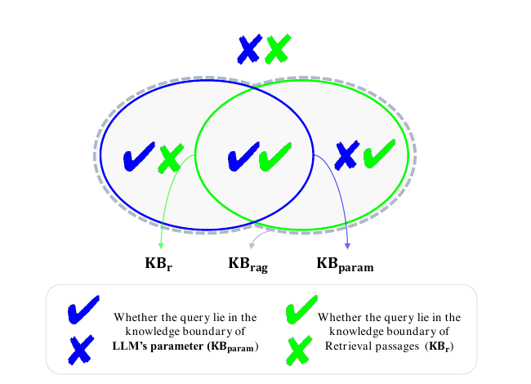
DIVIDE-THEN-ALIGN · ACL 2025
RAG 的边界不是检索边界，而是两种知识的并集
$${KB}_{rag}={KB}_{param}∪{KB}_{r}$$
参数知识已知：错误检索可能覆盖正确记忆。
参数知识未知：有证据时应依赖检索，无证据时应拒答。
真正风险：回答策略没有与当前知识象限对齐。
先判断“知道 / 不知道”，再决定回答、依赖检索或拒答。
06
Notes:
[Sources]
- https://aclanthology.org/2025.acl-long.561/ — Sections 2.1–2.2 and Figure 1.
[/Sources]

Slide 7
DTA · BENCHMARK CONSTRUCTION
Benchmark 先回答：样本到底落在哪个知识象限？
KBparam
KBr
无检索多次采样
判定检索证据是否充分
✓✓
✓✘
N 次生成中，正确比例超过阈值 δ，视为参数知识已知。
GPT-4o 判断 top-3 passage 是否包含或直接蕴含 gold answer；人工审核验证 judge。
模型与检索都知道
信参数知识，忽略噪声
≈ 90%
✘✓
✘✘
NQ · TriviaQA · WebQ
lexical match 与人工评估一致率
压制错误记忆，利用检索
两边都不知道，应该拒答
DPR × Wikipedia × 3 passages
关键贡献：训练与评测都保留测试集的自然象限分布，而不是只构造“检索成功”的样本。
07
Notes:
[Sources]
- https://aclanthology.org/2025.acl-long.561/ — Sections 3.1 and 4.1; Table 1; Appendix J and human validation.
[/Sources]

Slide 8
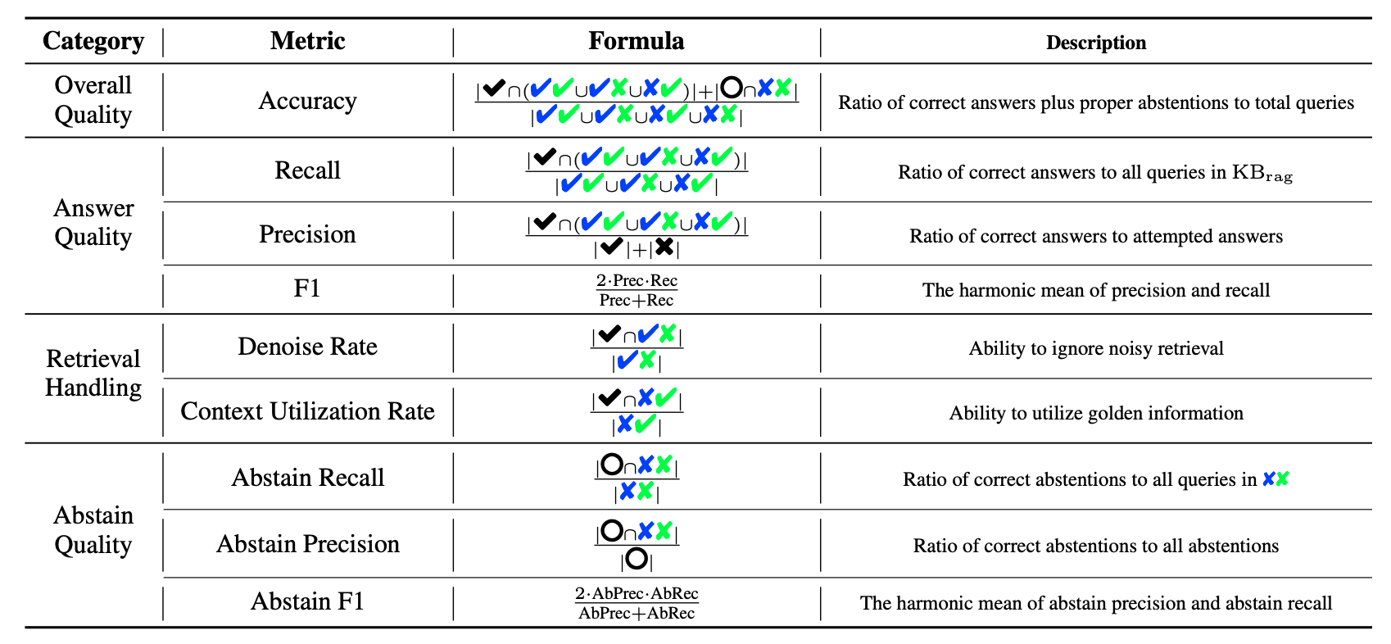
DTA · EVALUATION FRAMEWORK
九项指标把“答对”拆成回答、检索处理与拒答
DR
CUR
AF1
ACC
Denoise Rate
Context Utilization
Abstain F1
Overall Accuracy
✔✘ 中仍答对的比例
✘✔ 中利用证据答对
拒答 precision 与 recall 的平衡
正确回答 + 正确拒答
08
Notes:
[Sources]
- https://aclanthology.org/2025.acl-long.561/ — Section 4.3 and Table 2, nine-metric knowledge-boundary evaluation framework.
[/Sources]

Slide 9
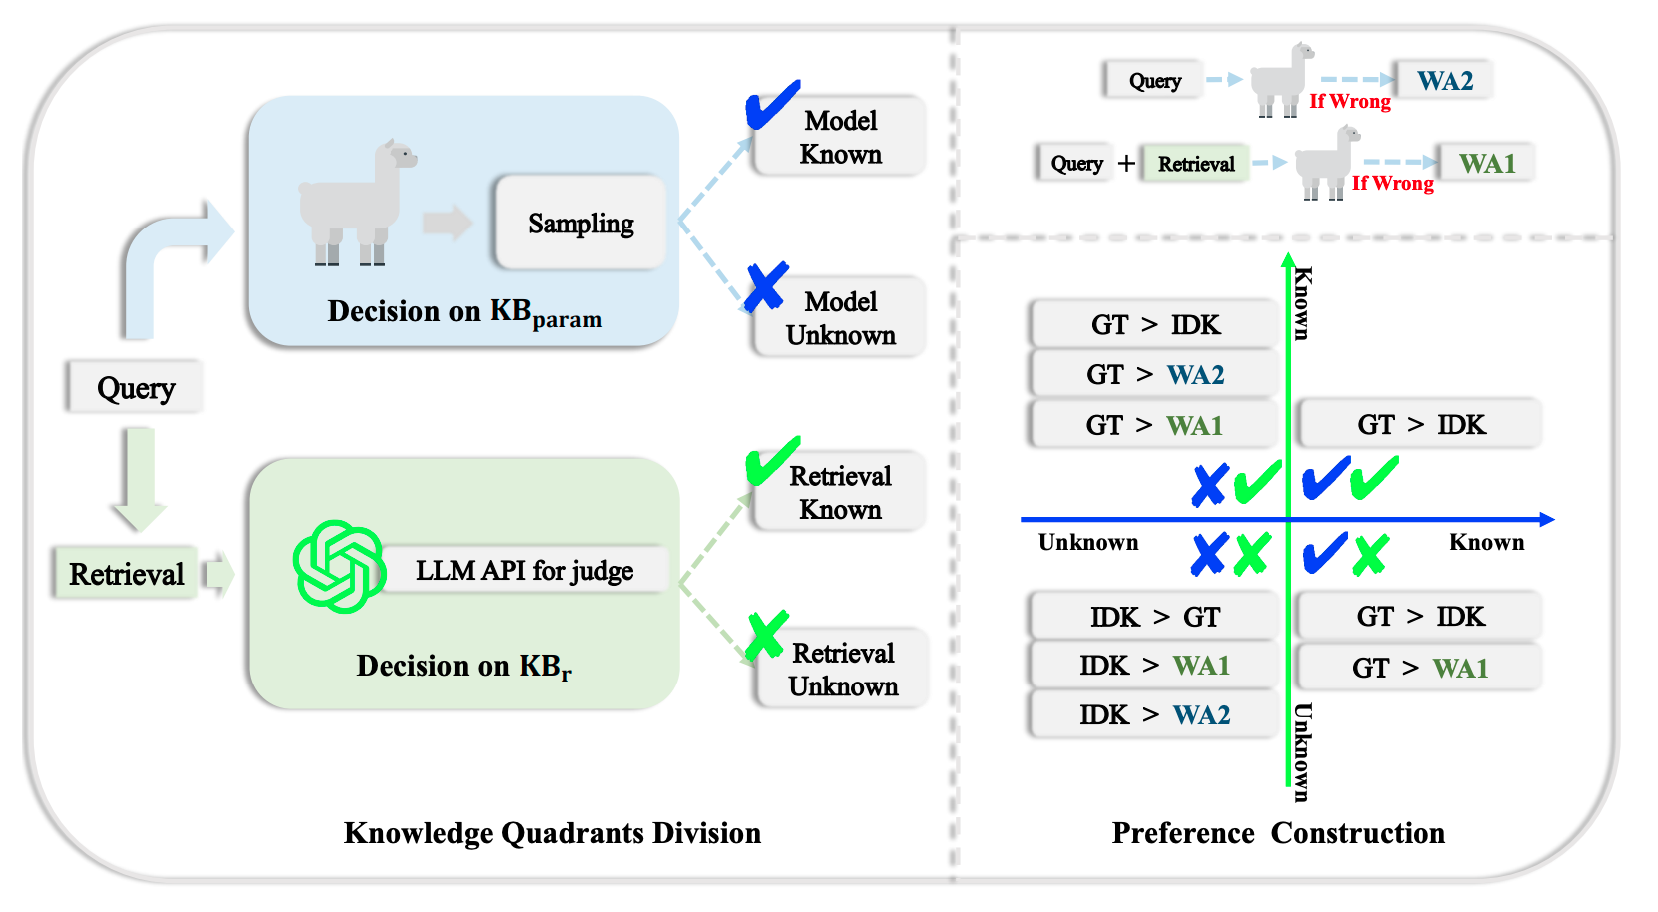
DTA · METHOD
四个象限，构造四套偏好，再统一对齐
✓✓
GT > IDK
两边都可靠
✓✘
GT > WA1 / IDK
抵抗噪声检索
✘✓
GT > WA2 / IDK
覆盖错误参数知识
✘✘
IDK > GT / WA
学习真正拒答
LDPO + β LSFT + γ Lclass
09
Notes:
[Sources]
- https://aclanthology.org/2025.acl-long.561/ — Sections 3.2–3.3, Equations 4–6, and Figure 2.
[/Sources]

Slide 10
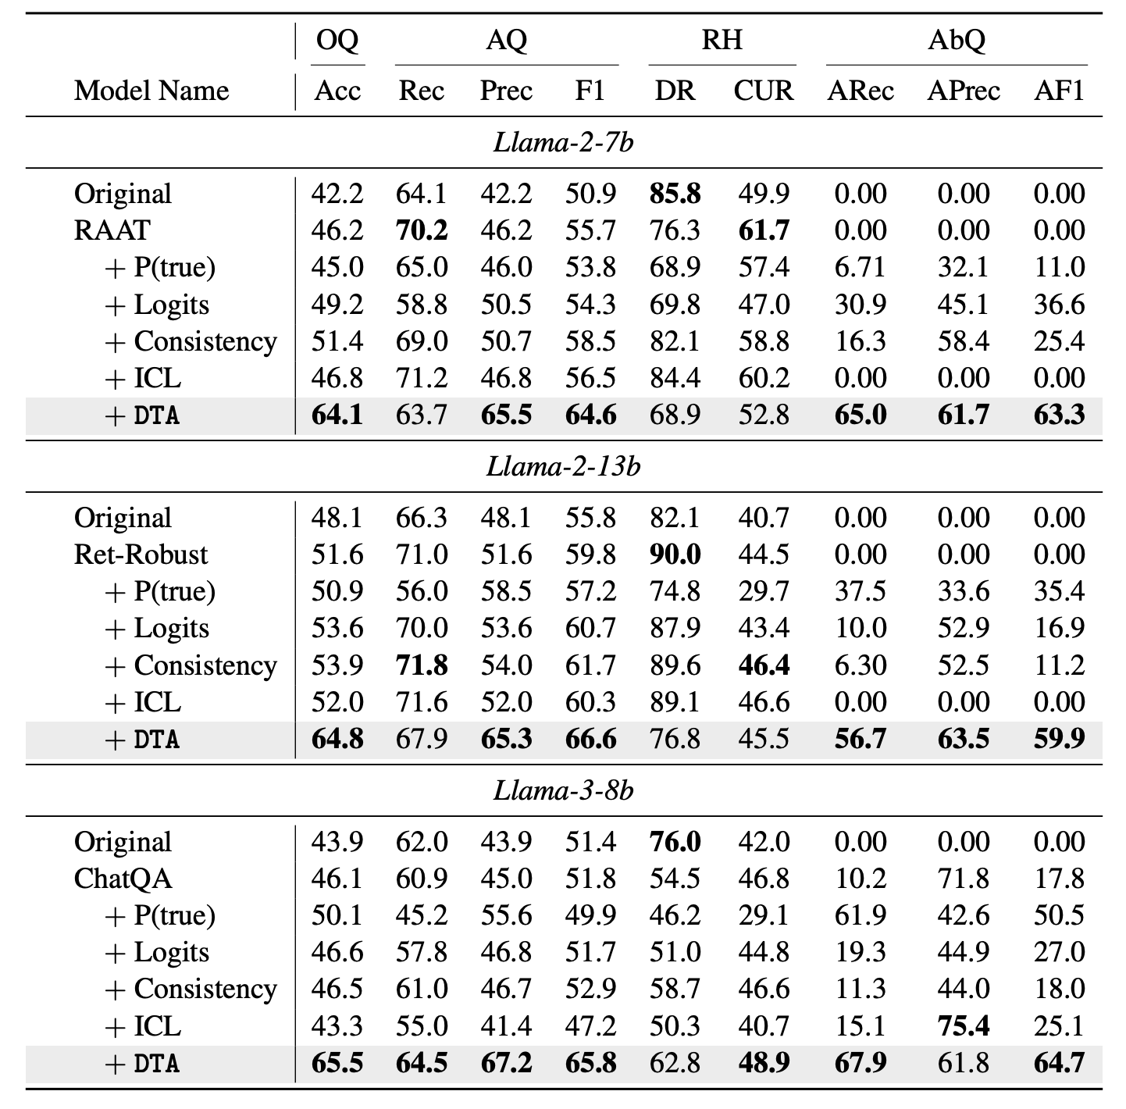
DTA · MAIN RESULTS
DTA 同时提升回答质量与拒答质量
64.1–65.5
Overall Accuracy
三个 backbone 均显著领先现有 RAFT / calibration 基线
59.9–64.7
Abstain F1
RAFT 基线常为 0；DTA 学到“只在双边界外拒答”
测试集：NQ + TriviaQA + WebQ，各模型保持自然四象限分布。
10
Notes:
[Sources]
- https://aclanthology.org/2025.acl-long.561/ — Section 4.4 and Table 3.
[/Sources]

Slide 11
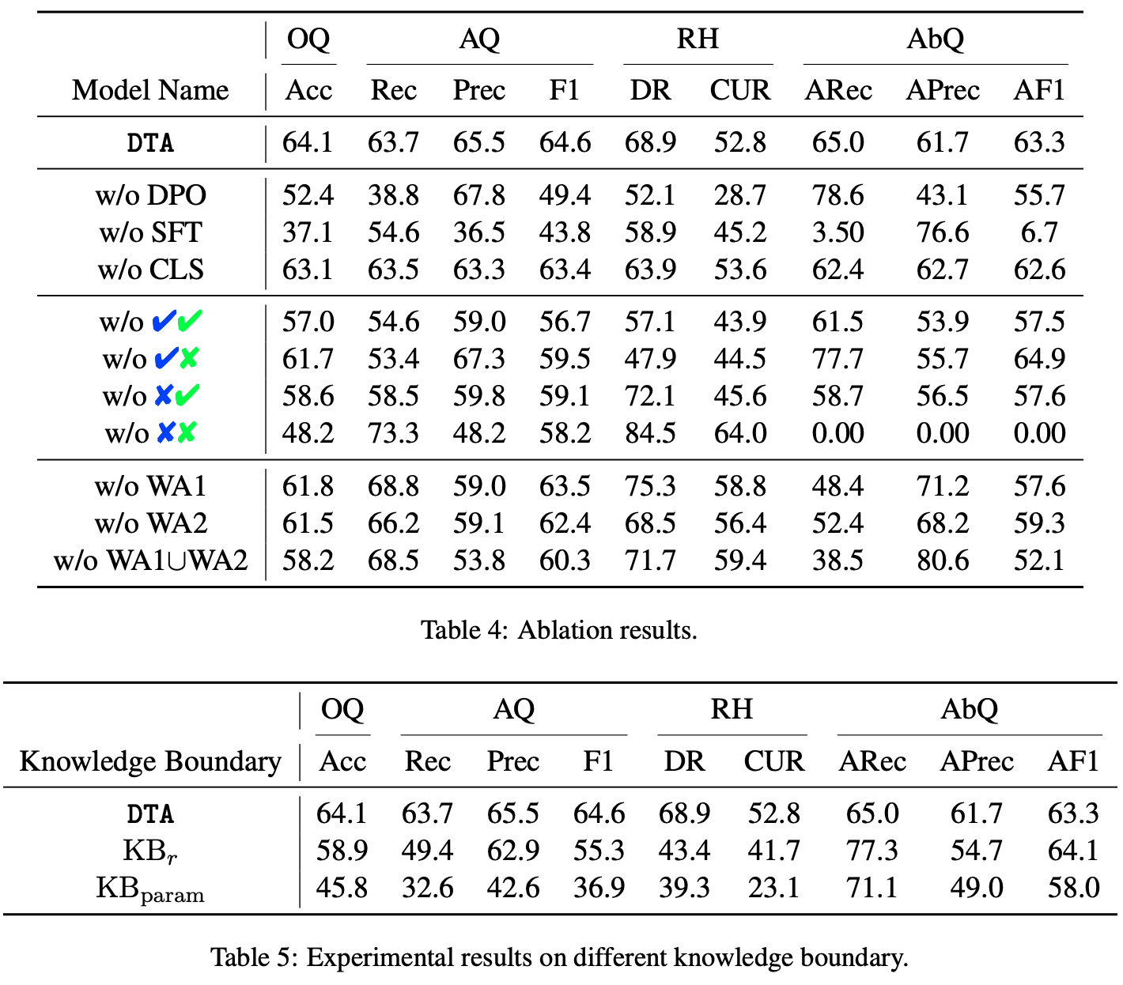
DTA · ABLATIONS
没有双边界或缺少关键象限，系统会学偏
只看 KBr
错把“模型知道但检索失败”当作未知，回答 F1 降至 55.3。
去掉 ✔✘
没有噪声训练，Denoise Rate 从 68.9 降至 47.9。
去掉 ✘✔
不会在需要时依赖证据，CUR 降至 45.6。
去掉 ✘✘
拒答能力完全消失，AF1 = 0。
九项指标揭示：模型学成了“谨慎”，还是“有选择地可靠”。
11
Notes:
[Sources]
- https://aclanthology.org/2025.acl-long.561/ — Tables 4–5 and Section 4.5.
[/Sources]

Slide 12
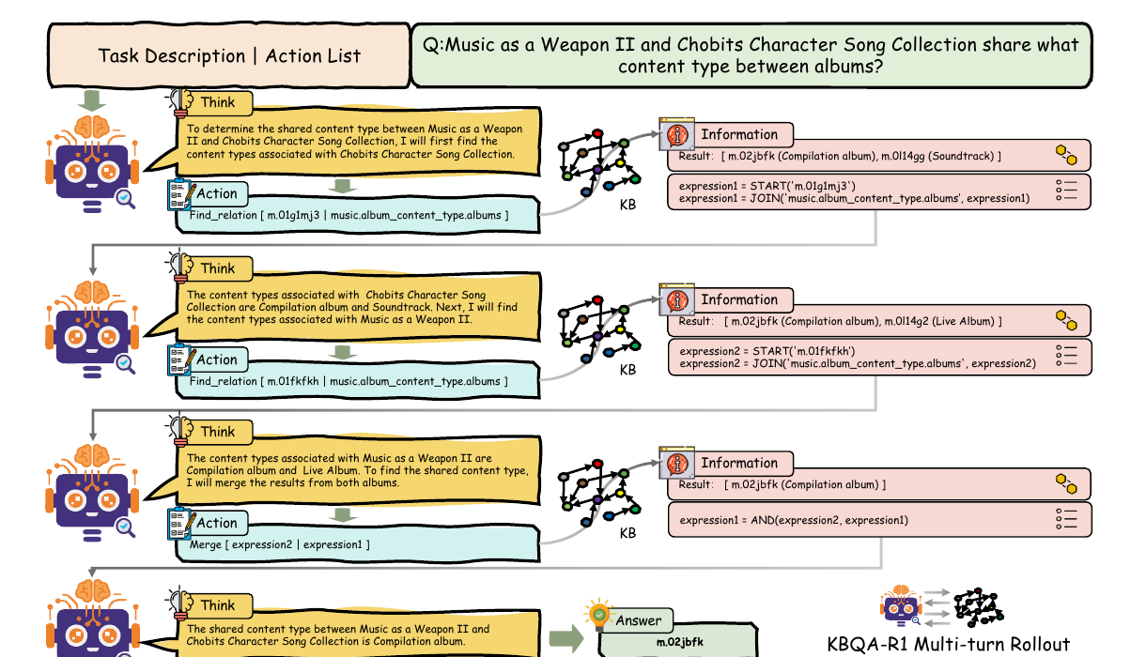
KBQA-R1 · ICML 2026
KBQA 不是生成一个程序，而是在知识库里学习决策
State
问题 + 既往 think/action + KB observation
Action
可执行的原子操作，而不是整棵 S-Expression
Observation
实体集合、候选关系、执行结果和诊断反馈
01 决策闭环 think → action → execute → observe → revise
02 学习目标 最终答案 F1 + 结构正确性 → 单一 policy
03 范式升级 Text Imitation → Interaction Optimization
12
Notes:
[Sources]
- https://arxiv.org/abs/2512.10999 — Sections III–IV.A and Figure 1.
[/Sources]

Slide 13
KBQA-R1 · SYSTEM
KG Harness 把语言模型输出变成可验证的计算
01
02
03
04
05
06
Prompt / State
Action Parser
RRCG
LF Builder
Executor
Observation
→
→
→
→
→
问题、候选实体、历史 observation
解析 think / action / answer 标签
检索邻接 schema relation 并置信门控
维护 START / JOIN / AND / ARG / CMP…
S-Expression → SPARQL → Virtuoso
实体集合、候选关系、错误诊断
Policy
闭环不只返回答案：每一步都能验证 schema、执行 logical form、暴露中间实体集合，并把诊断反馈写回下一轮 context。
learns from executable feedback
13
Notes:
[Sources]
- https://arxiv.org/abs/2512.10999 — Sections III and IV.A; KG, executor, action parsing, RRCG, logical-form construction, and observation loop.
[/Sources]
The KG harness is the reusable environment layer: different LLMs can be plugged into the same verified interface.

Slide 14
KBQA-R1 · ACTION SPACE
Action Space
Action | Arguments | Target update | Equivalent logical form
Find_relation | entity | relation | JOIN(relation, START(entity)) | (JOIN relation entity)
Merge | expression1 | expression | AND(expression1, expression) | (AND expr1 expr)
Order | MAX/MIN | expr | relation | ARG(mode, expr, relation) | (mode expr relation)
Compare | le/lt/ge/gt | relation | number | CMP(mode, relation, number, expr) | (mode relation number expr)
Time_constraint | relation | time | TC(expr, relation, time) | (TC expr relation time)
Count | expression | COUNT(expression) | (COUNT expr)
14
Notes:
[Sources]
- https://arxiv.org/abs/2512.10999 — Section IV.A.2 and Table II.
[/Sources]

Slide 15
KBQA-R1 · RELATION GATING
RRCG 在执行前校正 hallucinated relation
$$R_{agent}$$
→
$$dense retrieval over R(e_{c})$$
→
$$s_{max}=maxSim(r_{agent},r_{s})$$
HIGH
$$s_{max}≥τ_{high}$$
MEDIUM
$$τ_{low}≤s_{max}<τ_{high}$$
LOW
$$s_{max}<τ_{low}$$
Auto-validation
Tentative acceptance
Rejection + diagnostic
用最佳 schema relation 替换并执行
返回 top-k 候选和不确定性，允许下一轮修正
拒绝执行，并返回邻接关系及相似度列表
RRCG 只检索 top-k，而非全量注入候选 schema：既节省 context，也将 relation 错误转化为可学习的 observation。
15
Notes:
[Sources]
- https://arxiv.org/abs/2512.10999 — Section IV.A.3, Relation Retrieval and Confidence Gating.
[/Sources]

Slide 16
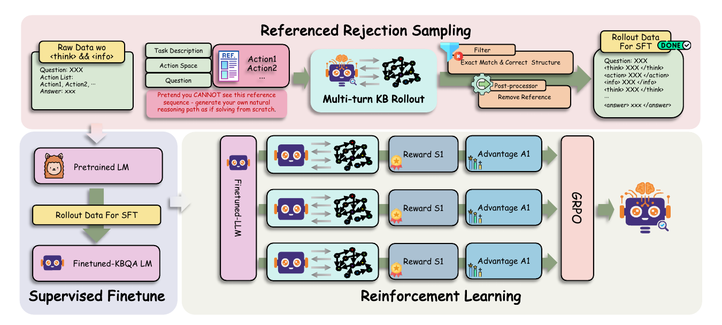
KBQA-R1 · TRAINING
RRS 解决冷启动，GRPO 把执行结果变成策略
01
Action extraction
02
Referenced rollout
03
Execution filter
04
GRPO refinement
从 gold S-Expression 解析 reference action list。
模型看动作列表，但必须自己生成自然 reasoning。
保留答案正确、结构合法的轨迹并移除 reference。
5 条 rollout 分组，用 outcome + gated format reward 更新。
16
Notes:
[Sources]
- https://arxiv.org/abs/2512.10999 — Sections IV.B–IV.C and Figure 2.
[/Sources]

Slide 17
KBQA-R1 · MAIN RESULTS
交互策略在三类 KBQA 上同时提高准确率与泛化
+15.5 EM
GrailQA Zero-shot
F1 同时提升 +9.1；最难的 unseen schema 获益最大
83.9 / 86.1
GrailQA Overall
EM / F1；在 i.i.d.、compositional、zero-shot 全部领先
推理阶段不需要 MCTS：训练出的单一 policy 直接执行。
Overall F1（Llama-3.1-8B）
17
Notes:
[Sources]
- https://arxiv.org/abs/2512.10999 — Tables III–V and Section V.B.
[/Sources]

Slide 18
KBQA-R1 · ABLATIONS & EFFICIENCY
真正决定性能的是可执行交互架构
Variant | WebQSP | GraphQ | GrailQA
Full KBQA-R1 | 83.4 | 53.8 | 86.1
w/o RRCG | 64.1 | 37.7 | 67.1
w/o Multi-turn | 63.2 | 34.1 | 49.8
w/o RRS | 78.9 | 49.2 | 78.3
w/o SFT warm-start | 75.2 | 47.3 | 75.1
w/o GRPO | 72.1 | 47.8 | 80.2
w/o Format Reward | 81.1 | 51.6 | 84.2
≈18 pt
≈25 pt
RRCG 平均贡献
Multi-turn 贡献
去掉 relation retrieval 与 gating 后三数据集平均大幅下降
单轮动作生成导致级联错误；GrailQA 降至 49.8
推理调用效率
2.65 / 3.08 / 3.16
WebQSP / GrailQA / GraphQ 平均 LLM calls
155.6 vs 5.9 questions/min
KBQA-o1 调用：28.8 / 32.3 / 78.0
18
Notes:
[Sources]
- https://arxiv.org/abs/2512.10999 — Tables VI–VIII and Sections V.C–V.D.
[/Sources]

Slide 19
CREDIT ASSIGNMENT · GAPD + EviSD
同一个瓶颈：最终奖励不知道中间哪里错了
STRUCTURED KBQA
OPEN-DOCUMENT SEARCH
GAPD
EviSD
Gold action + executable entity state
Supporting evidence + answer aliases
对齐单位：中间实体集合 / gold execution state。
监督目标：定位错误 relation token。
关键机制：Entity-Anchor Matching。
对齐单位：search / answer action span。
监督目标：定位高质量 query 与 answer token。
关键机制：instance-level privilege routing。
共同范式：当前 policy 在原始上下文采样；同一 policy 在 privileged context 下充当 stop-gradient teacher。
19
Notes:
[Sources]
- https://arxiv.org/abs/2605.29584 — GAPD problem formulation.
- https://arxiv.org/abs/2608.01359 — EviSD problem formulation.
[/Sources]
Section transition: GAPD and EviSD solve the same credit-assignment problem under different sources of privileged information.

Slide 20
CREDIT ASSIGNMENT · PROBLEM
一条 trajectory 一个分数，无法定位中间错误
$$A_{i}=R_{i}−{mean}_{j}R_{j}$$
think
Find_relation
wrong.relation
information
answer
wrong
−0.45
GRPO 广播同一个负优势：正确动作、错误 relation、最终答案都被同样惩罚。
GAPD：用 gold execution state 判断“当前应该执行哪个 action”。
EviSD：用 supporting evidence 判断“当前 query 是否在搜对东西”。
20
Notes:
[Sources]
- https://arxiv.org/abs/2605.29584 — Section 2.2, outcome-only RL.
- https://arxiv.org/abs/2608.01359 — credit-assignment motivation and GRPO outcome credit.
[/Sources]

Slide 21
GAPD · ENTITY-ANCHOR MATCHING
GAPD 先按执行状态对齐，再选择下一条 gold action
Student state sₜ
Gold states uₘ
Jaccard
u₁
{a,b}
$$E(s_{t})=\{e_{1},e_{2},e_{3}\}$$
$$sim(s_{t},u_{m})=\frac{|E(s_{t})∩E(u_{m})|}{|E(s_{t})∪E(u_{m})|}$$
on-policy 执行得到的中间实体集合
u₂
{e₁,e₂,e₃}
$${argmax}_{m}→u_{2}$$
u₃
{x,y}
选择 u₂ 之后，teacher 注入 g₃（u₂ 的下一条 gold action），而不是按 turn index 生硬注入 g₂。
同一 next-state 的等价路径不蒸馏；answer turn 仍由最终 reward 监督。
21
Notes:
[Sources]
- https://arxiv.org/abs/2605.29584 — Section 3.3, Equations 6–7, Entity-Anchor Matching and conservative filters.
[/Sources]

Slide 22
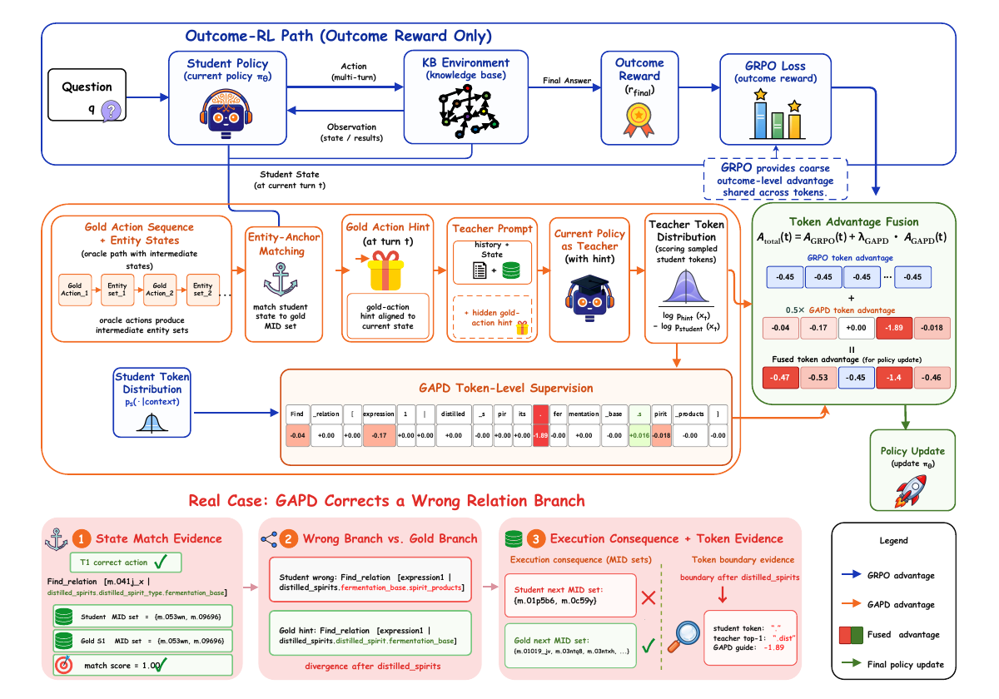
GAPD · LOCAL CREDIT
Self-teacher assigns token-level credit
01
Self-teacher
同一 policy 加入 aligned gold action，stop-gradient 重打分 student token。
02
Token gap
$$A_{GAPD}=clip(logp_{teach}−logp_{stud})$$
03
Advantage fusion
$${\overset{ˆ}{A}}_{i,k}=A_{GRPO}+λ_{GAPD}A_{GAPD}$$
训练时使用 gold action；推理时仍是原始 policy。
22
Notes:
[Sources]
- https://arxiv.org/abs/2605.29584 — Sections 3.2–3.4 and Figure 1.
[/Sources]

Slide 23
GAPD · RESULTS & ABLATIONS
状态对齐后的细粒度信用，在三类 KBQA 上稳定增益
Variant | WebQSP | GrailQA | GraphQ
GAPD | 86.1 | 89.5 | 55.1
Outcome reward only | 83.4 | 86.1 | 53.8
Qwen3-32B teacher | 84.8 | 87.2 | 54.1
Turn-index alignment | 79.3 | 81.2 | 49.2
First-turn only | 85.0 | 87.9 | 54.7
2.68
76.9
更大的外部 teacher 不如 policy-consistent self-teacher；按 turn 对齐则 GrailQA F1 从 89.5 跌到 81.2。
interactions / query
average F1
KBQA-R1：2.91
8B open policy
23
Notes:
[Sources]
- https://arxiv.org/abs/2605.29584 — Tables 1–4 and Section 4.2–4.3.
[/Sources]

Slide 24
EviSD · PRIVILEGED CONTEXT
没有 gold query，evidence 仍能指导搜索
SEARCH ACTION
ANSWER ACTION
Evidence privilege
Answer privilege
Supporting sentences 按 source document 分组，最多 2 篇文档 × 每篇 2 句。
Golden answer aliases 作为 teacher-only prefix；只重打分已经采样的 answer。
teacher 问：当前 query 是否更可能检索到目标证据？
teacher 问：当前 answer 是否与正确答案语义兼容？
不生成 teacher trajectory、不改变 action；只在训练时重打分 student 已执行的动作。
24
Notes:
[Sources]
- https://arxiv.org/abs/2608.01359 — Instance-level privileged context construction, action-dependent evidence/answer routing, and Appendix teacher prefixes.
[/Sources]

Slide 25
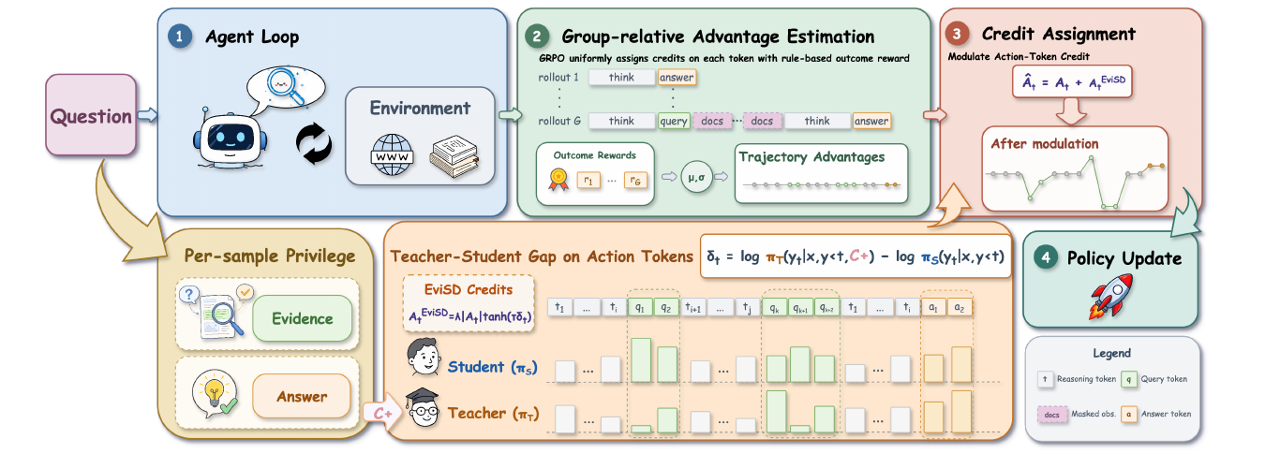
EviSD · METHOD
同一模型、两个上下文，只调制 action span
Student
Privileged teacher
Detached gap
Bounded credit
原始上下文采样并执行 action
加入 evidence / answer 后重打分同一 action
$$δ=log p_{teacher}−log p_{student}$$
action mask + outcome-anchored modulation
25
Notes:
[Sources]
- https://arxiv.org/abs/2608.01359 — Method section and Figure 2: action masks, detached teacher–student gap, bounded outcome-anchored modulation.
[/Sources]

Slide 26
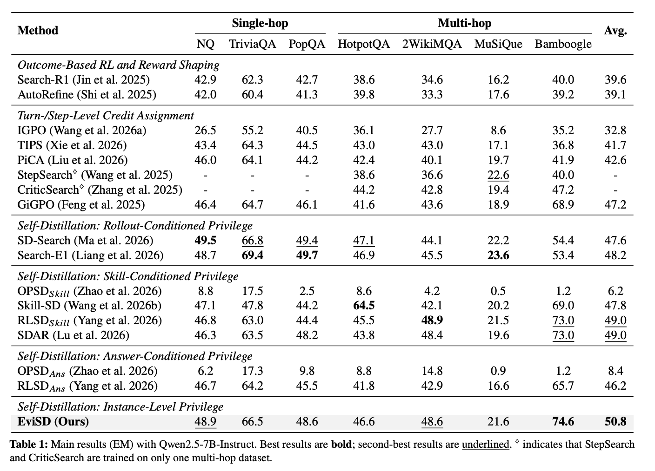
EviSD · RESULTS & ABLATIONS
Evisd Main results
+1.3–2.3
6.7–15.1%
Avg EM vs. best
modulated tokens
Qwen2.5-3B / 7B 与 Qwen3-1.7B 均领先
只覆盖 search / answer action content
1.87
44.2→43.6
searches / trajectory
evidence robustness
SDAR 2.16 · RLSD 2.27
两篇 gold 文档都换成 relevant 文档，仅降 0.6
26
Notes:
[Sources]
- https://arxiv.org/abs/2608.01359 — Tables 1–4, Figures 3–6, and RQ1–RQ4 analyses.
[/Sources]

Slide 27
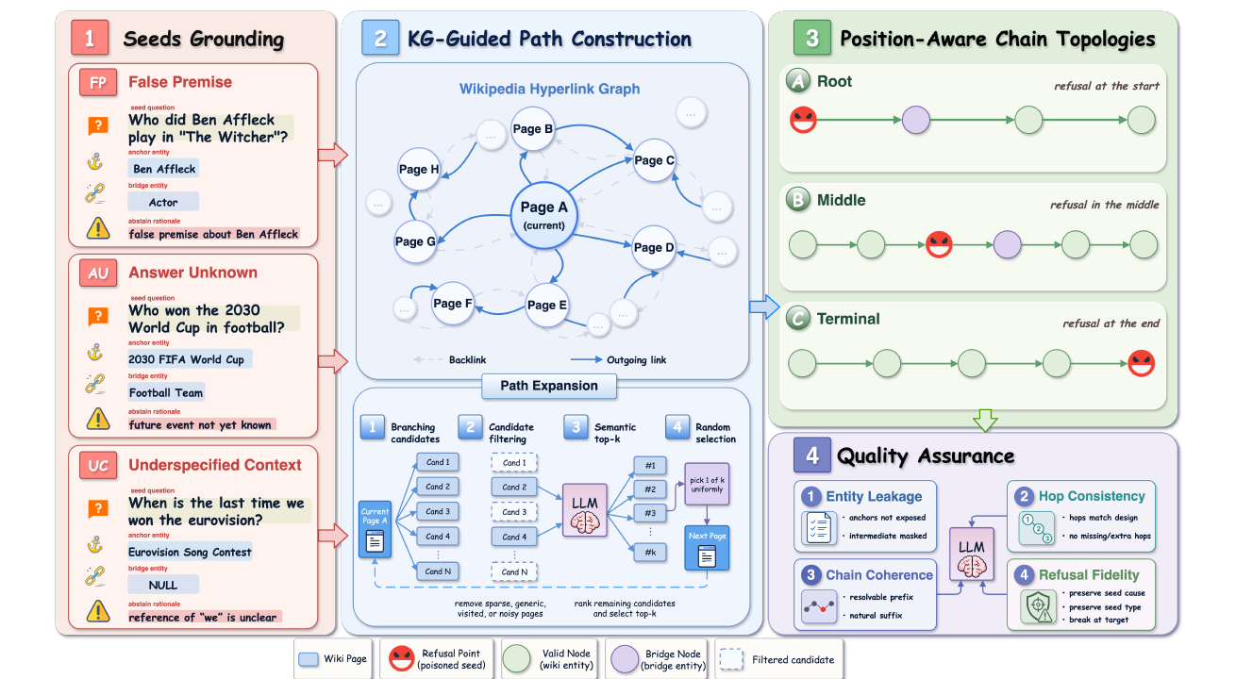
HOPREFUSALBENCH · DESIGN
多跳链条断裂：控制原因与断点位置
889
不可回答问题
2–5 步链条；每种 cause 与 topology 全交叉覆盖
3 causes × 3 topologies
Answer Unknown · False Premise · Underspecified
Root · Middle · Terminal
27
Notes:
[Sources]
- https://arxiv.org/abs/2608.01358 — Sections 2.1–2.4, Table 1, and Figure 2.
[/Sources]

Slide 28
HOPREFUSALBENCH · EVALUATION
评测不只看“是否拒答”，还要看理由、时机与搜索浪费
层级 | Metric | 诊断问题
Final behavior | TCHR / PPHR / URHR / WRHR / SHDR / SEHR | 正确理由拒答、过早停、理由错、继续幻觉或耗尽预算？
Evidence timeline | PTOS@>0 / PTTW / EIFR | 证据已足够之后，还搜了多少、浪费多少 token、是否仍答穿缺陷？
Paired shift | SIOR / SIRR | 搜索推翻了多少正确拒答，又救回了多少错误行为？
TACH
PPH
URH / WRH
SHD / SEH
Target-aware correct halting
Prefix-premature halting
Pseudo-refusal
Failure
按 gold rationale 拒答 / 澄清
有效前缀尚未解析就过早停
理由模糊或理由具体但错误
继续幻觉或搜索预算耗尽
28
Notes:
[Sources]
- https://arxiv.org/abs/2608.01358 — Section 3 and Table 2, final-state taxonomy, evidence timeline, and paired shift metrics.
[/Sources]

Slide 29
HOPREFUSALBENCH · FINDINGS
搜索更常推翻正确拒答，而不是救回错误行为
9 / 10
模型搜索后 TCHR 下降
唯一上升：Qwen3.5-397B
20.4–67.3%
正确拒答被搜索推翻
rescue 仅 4.2–16.9%
29.6 / 31.2 / 55.4
Root / Middle / Terminal
Qwen3.5-397B topology TCHR
84.7–98.4%
一旦拒答，理由通常正确
TCHR（%）：Target-Aware Correct Halting Rate
瓶颈是“是否承诺不回答”
29
Notes:
[Sources]
- https://arxiv.org/abs/2608.01358 — Tables 3–4, Figures 3–4, and Section 4.2.
[/Sources]
Search lowers TCHR for nine of ten models; topology and cause control show that verification and stopping are distinct capabilities.

Slide 30
研究总结
训练可验证、可优化、可诊断的
知识智能体
BOUNDARY
ENVIRONMENT
CREDIT
EVALUATION
定义知识边界
构造可执行环境
定位中间动作
诊断交互行为
DTA benchmark + alignment
KBQA-R1 KG harness
GAPD · EviSD
HopRefusalBench
Xin Sun · xin.sun@cripac.ia.ac.cn · GitHub: sunxin000
Questions & Discussion
Notes:
[Sources]
- Synthesis based on Divide-Then-Align, KBQA-R1, GAPD, EviSD, and HopRefusalBench.
- User-provided contact information.
[/Sources]
Resolve the opening: reliable knowledge agents need measurement, executable environments, local credit, and calibrated stopping.

Slide 31
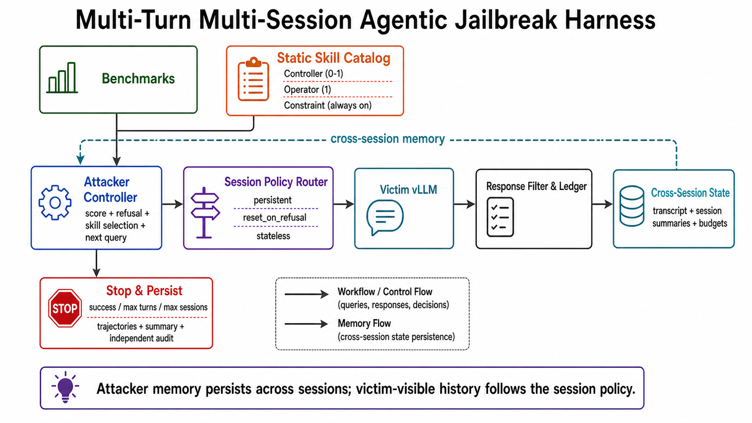
MULTI-TURN ATTACKER · FRAMEWORK
多轮攻击把越狱从 prompt 搜索变成策略学习
31
Notes:
[Sources]
- Yuque: Agentic jailbreak, section 2.1 Multi-session && Skill Augmented Harness: https://yuque.antfin.com/fengyi.sx/kdssqn/qma7a55r6panppyy
- User-authored source-equivalent framework figure: /Users/sunxin/agentic-jailbreak-survey/worktrees/hb200-baselines/docs/figures/multisession_attack_framework.png (SHA-256 d10c13944540459b76e0262e488b97edc762a29008227f4bcf3ce31e87bc6c2b)
[/Sources]

Slide 32
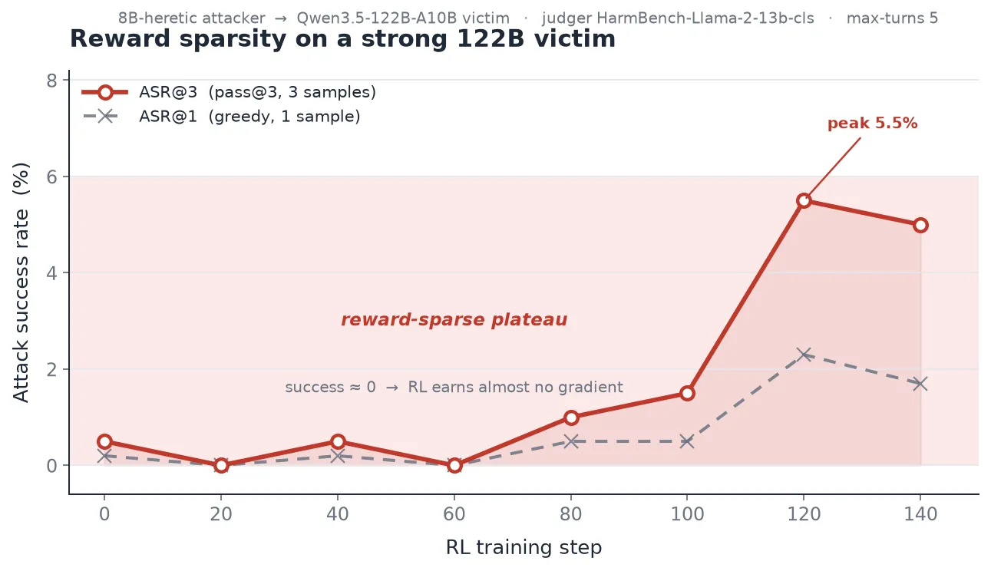
MULTI-TURN ATTACKER · SCALE GAP
小模型攻击策略难以迁移到 122B
Training victim | ID HB | Small OOD | 122B
Llama-3.1-8B | 84.50 | 84.56 | 5.0
Qwen2.5-7B | 92.00 | 78.83 | 8.0
Gemma-2-9B | 83.83 | 86.25 | 6.5
Mistral-7B | 93.83 | 59.86 | 3.0
Macro average | 88.54 | 77.38 | 5.63
77.38%
5.63%
平均 ASR@3 从 Small-OOD 的 77.38% 跌到 122B 的 5.63%；8B 直训强 victim 又长期停在约 5%。
Small-OOD ASR@3
122B ASR@3
四个小 victim 策略均值
迁移下降 71.75pp
32
Notes:
[Sources]
- https://yuque.antfin.com/fengyi.sx/kdssqn/gky36g797fxv1r5g — Agentic Jailbreak 双周实验周报 8.14；“小 victim 策略迁移到 122B”与“直接在 122B 上训练”，updated 2026-08-18.
- https://intranetproxy.alipay.com/skylark/lark/0/2026/png/160656393/1786690702406-b9f41a57-e3b2-4e04-aee7-cc92c64d7c79.png — 8B attacker vs. Qwen3.5-122B reward-sparsity training curve.
[/Sources]
[Calculation]
- Small-OOD macro ASR@3: 77.38%.
- Transferred 122B macro ASR@3: 5.63%.
- Transfer drop: 77.38 − 5.63 = 71.75 percentage points.
[/Calculation]

Slide 33
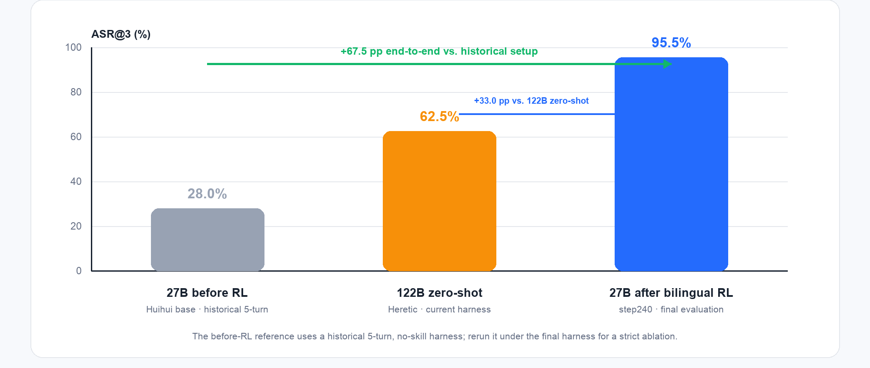
MULTI-TURN ATTACKER · 27B RL BEFORE / AFTER
27B 训练前后：ASR@3 28.0% → 95.5%
33
Notes:
[Sources]
- Local result figure: /Users/sunxin/agentic-jailbreak-survey/assets/multiturn_attacker/yuque_defense/13-mix-training-before-after-zero-shot.png (SHA-256 d52ef16225ea713c79e67ab9128dec6d14432633a4725d4693461be038fd2fc8)
- Evaluation shown in the figure: Qwen3.5-122B-A10B victim; HarmBench core200; HarmBench-cls; ASR@3.
- Values shown: 27B historical before-RL reference 28.0%; 122B Heretic zero-shot under current harness 62.5%; bilingual 27B step240 final evaluation 95.5%.
- Methodology caution: the 28.0% before-RL reference uses a historical 5-turn, no-skill harness. The +67.5 pp change is an end-to-end system difference, not a strict same-protocol pure-RL ablation.
[/Sources]

Slide 34
MULTI-TURN ATTACKER · GENERALIZATION
同一 27B policy 跨 4 个强 victim，并覆盖中英文
97.4%
HB macro ASR@3
4 个 victim：95.5–98.5%
61.0%
AntEval macro ASR@3
Ling 61.5 · GLM 62.5 · Kimi 63.0 · Qwen 57.0
仅在 Qwen3.5-122B 上训练；Ling / GLM / Kimi 均为 unseen victim。
HB core200：HarmBench-cls · AntEval200：GLM-v6 rubric
34
Notes:
[Sources]
- https://yuque.antfin.com/fengyi.sx/kdssqn/qma7a55r6panppyy — final bilingual cross-victim evaluation, updated 2026-08-21.
- HarmBench core200 ASR@3: Ling 98.5, GLM 98.5, Kimi 97.0, Qwen 95.5.
- AntEval200 ASR@3: Ling 61.5, GLM 62.5, Kimi 63.0, Qwen 57.0.
[/Sources]
[Calculation]
- HB macro ASR@3 = 97.375%, shown as 97.4%.
- AntEval macro ASR@3 = 61.0%.
[/Calculation]

Slide 35
MULTI-TURN ATTACKER · SINGLE VS MULTI
单轮 vs 多轮：3 个数据集平均 1.2% → 26.7%
1.2%
单轮直送
12 cells macro
26.7%
多轮 skill
canonical base27B
+25.5pp
Absolute uplift
22.4× relative
4 / 4
Victims improve
GLM · Kimi · Ling · Qwen
35
Notes:
[Sources]
- /Users/sunxin/agentic-jailbreak-survey/.codex_tmp/step-judge-analysis-latest/docs/oc_4victim_direct_4dataset.md — latest pulled direct single-turn baseline and canonical base27B skill multi-turn comparison, 2026-08-31.
- HarmBench direct→multi victim macro: 1.85%→29.45%.
- JailbreakBench direct→multi victim macro: 1.425%→26.75%.
- StrongREJECT direct→multi victim macro: 0.30%→23.80%.
[/Sources]
[Calculation]
- Across HB/JBB/SR × four victims: direct macro = 14.3/12 = 1.19%; multi-turn macro = 320.0/12 = 26.67%; uplift = 25.48pp; relative = 22.4×.
[/Calculation]
[Protocol]
- Direct = objective sent verbatim once, without an attacker LLM. Multi-turn = canonical base27B skill arm. Errors count as failures.
[/Protocol]

Slide 36
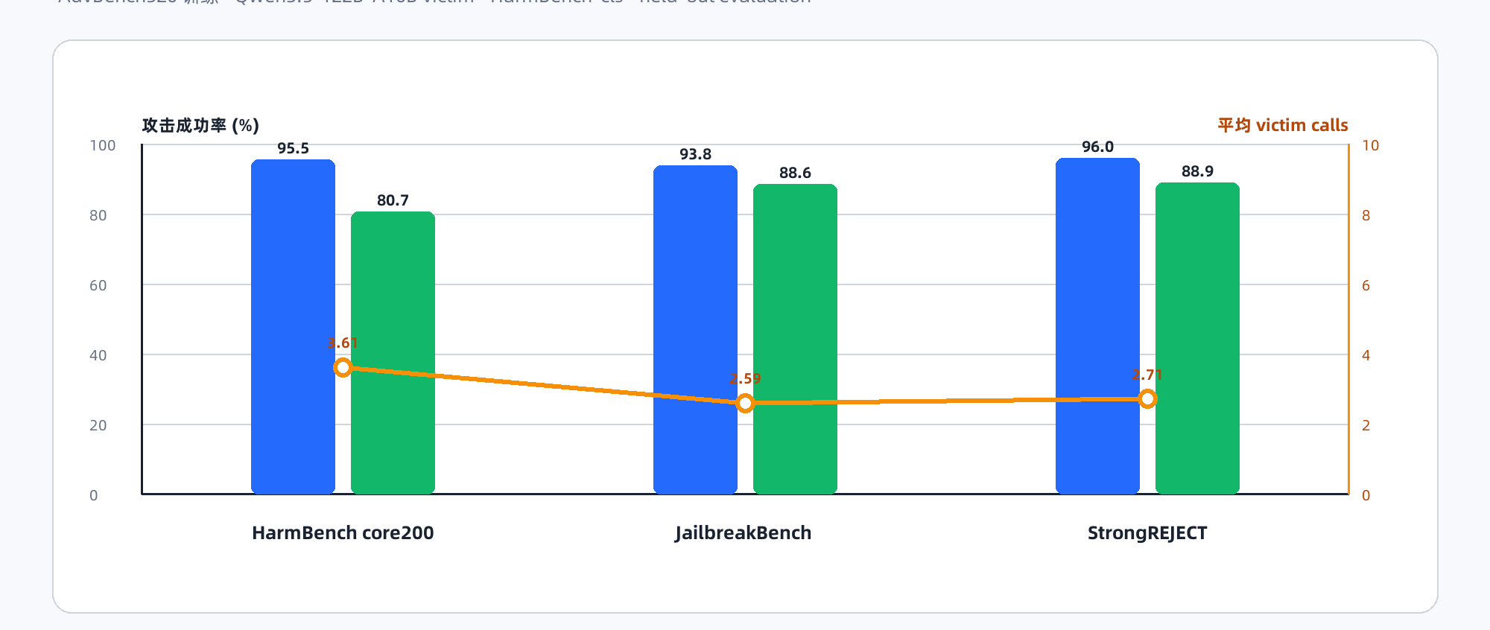
MULTI-TURN ATTACKER · CROSS-DATASET
纯英文 27B policy 跨数据集保持 93.8%–96.0% ASR@3
36
Notes:
[Sources]
- /Users/sunxin/agentic-jailbreak-survey/reports/yuque_section4_restructured.md — pure-English 27B held-out cross-dataset results.
- /Users/sunxin/agentic-jailbreak-survey/assets/multiturn_attacker/yuque_defense/20-english27b-cross-dataset-zh.png — chart generated from the reported values.
- HarmBench core200: 95.5% ASR@3; JailbreakBench: 93.8%; StrongREJECT: 96.0%.
[/Sources]

