Slide 1
Python Tutorial COMP 550- Natural Language Processing
By: Sunyam Bagga
Date: Sept 14, 2018

Slide 2
Overview
Basic Python Syntax
Python Data Structures
Useful libraries:
numpy
scikit-learn
nltk
Toy Spam Email Detection problem

Slide 3
Intro to Python
Widely used high-level, general-purpose programming language
First version: 20 February 1991
We’ll use Python 2.7
Why Python?
Super easy to use: simple syntax.
Lots of powerful libraries: sklearn, nltk, tensorflow, keras, opencv, numpy, pandas, matplotlib, scipy

Slide 4
First assignment to a variable will create it.
Variable types don’t need to be declared. Python figures out the variable types on its own.
Whitespace is meaningful, especially indentation and placement of newlines.
Use a newline to end a line of code. (Not a semicolon like in C++ or Java.) (Use \ when must go to next line prematurely.)
No braces { } to mark blocks of code in Python… Use consistent indentation instead.

Slide 5
If statement
>>> x = int(raw_input("Please enter an integer: "))
Please enter an integer: 42
>>> if x < 0:
... x = 0
... print 'Negative changed to zero'
... elif x == 0:
... print 'Zero'
... elif x == 1:
... print 'Single'
... else:
... print 'More'
https://docs.python.org/2/tutorials/

Slide 6
For loops
>>> # Measure some strings:
... words = ['cat', 'window', 'defenestrate']
>>> for w in words:
... print w, len(w)
...
cat 3
window 6
defenestrate 12

Slide 7
Classes and Objects
Objects are an encapsulation of variables and functions into a single entity.
Objects get their variables and functions from classes.
Classes are essentially a template to create your objects.

Slide 8
Classes and Objects
Simple example:
Assign MyClass to an object:
>>> class MyCourse:
... name = "NLP"
... def function(self): #called method
... print "I love NLP."
>>> myObject = MyCourse()
Now the variable "myObject" holds an object of the class "MyCourse" that contains the variable and the function defined within the class called "MyCourse".

Slide 9
Classes and Objects
Accessing elements of an object
>>> myObject.name
'NLP'
>>> myOtherObject = MyCourse()
>>> myOtherObject.name = "comp599"
>>> print myOtherObject.name
comp599

Slide 10
Numpy
Fundamental package for scientific computing with Python.
Has a powerful N-dimensional array object
Many useful functions
>>> import numpy as np
>>> x = np.array([[1,2,3],[4,5,6]],np.int32)
array([[1, 2, 3],
[4, 5, 6]])

Slide 11
Numpy
Array Slicing
Generate views of the data
Format: start : stop : step
>>> import numpy as np
>>> x = np.array([[1,2,3],[4,5,6]],np.int32)
array([[1, 2, 3],
[4, 5, 6]])
>>> y = x[:,1]
>>> y
array([2, 5])
>>> z = np.array([0,1,2,3,4,5,6,7,8,9])
>>> z[1:7:2]
array([1, 3, 5])

Slide 12
Scikit-learn
Machine Learning package in Python.
Includes many classification, regression and clustering algorithms.
Useful for preprocessing, and evaluation phase
Also includes some datasets.

Slide 13
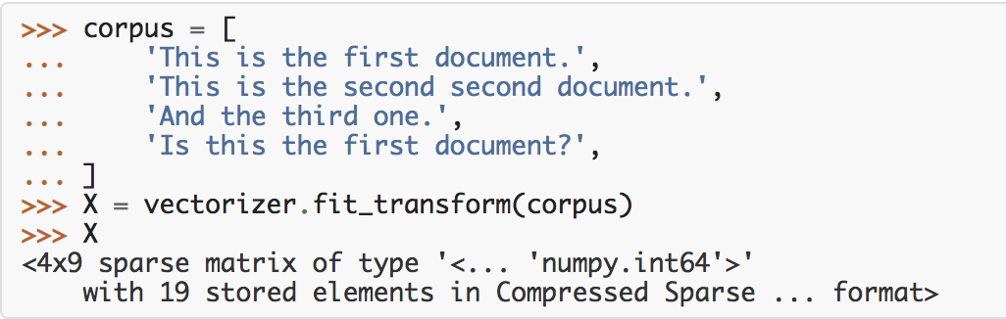
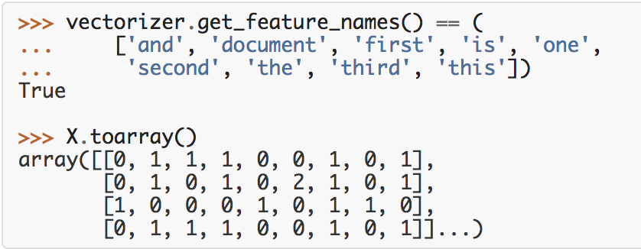
Count Vectorizer
http://scikit-learn.org/stable/modules/feature_extraction.html

Slide 14
Example: Linear Regression
http://scikit-learn.org/stable/auto_examples/linear_model/plot_ols.html
import numpy as np
from sklearn import datasets, linear_model
# Load the diabetes dataset
diabetes = datasets.load_diabetes()
# Use only one feature
diabetes_X = diabetes.data[:, np.newaxis, 2]
# Split the data into training/testing sets
diabetes_X_train = diabetes_X[:-20]
diabetes_X_test = diabetes_X[-20:]
# Split the targets into training/testing sets
diabetes_y_train = diabetes.target[:-20]
diabetes_y_test = diabetes.target[-20:]
# Create linear regression object
regr = linear_model.LinearRegression()
# Train the model using the training sets
regr.fit(diabetes_X_train, diabetes_y_train)
# The mean square error
print("Residual sum of squares: %.2f" % np.mean((regr.predict(diabetes_X_test) - diabetes_y_test) ** 2))

Slide 15
NLTK
Natural Language ToolKit
Contains useful NLP tools such as stemmers, lemmatizers, parsers with a bunch of corpora

Slide 16
NLTK
Tokenizers
Divide string into lists of substrings.
For example, tokenizers can be used to find the words and punctuation in a string:
>>> from nltk.tokenize import word_tokenize
>>> s = "Good muffins cost $3.88 in New York. Please buy me two of them."
>>> word_tokenize(s)
['Good', 'muffins', 'cost', '$', '3.88', 'in', 'New', 'York', '.', 'Please', 'buy', 'me', 'two', 'of', 'them', '.']
http://www.nltk.org/_modules/nltk/tokenize.html

Slide 17
NLTK
Stemmers
Remove morphological affixes from words, leaving only the word stem.
Example: Porter stemmer
>>> from nltk.stem.porter import *
>>> stemmer = PorterStemmer()
>>> plurals = ['caresses', 'flies', 'dies', 'mules','denied', 'died', 'agreed', 'owned', 'humbled', 'sized', 'meeting', 'stating', 'siezing', 'itemization', 'sensational', 'traditional', 'reference', 'colonizer', 'plotted']
>>> singles = [stemmer.stem(plural) for plural in plurals]
>>> print(' '.join(singles))
caress fli die mule deni die agre own humbl size meet state siez item sensat tradit refer colon plot
http://www.nltk.org/howto/stem.html

Slide 18
NLTK
Lemmatizers
Determine the lemma of words
Example: WordNet Lemmatizer
>>> from nltk.stem import WordNetLemmatizer
>>> wnl = WordNetLemmatizer()
>>> words = ['dogs', 'churches', 'aardwolves', 'abaci', 'hardrock']
>>> lemmata = [wnl.lemmatize(word) for word in words]
>>> for lemma in lemmata: print lemma
dog church aardwolf abacus hardrock
http://www.nltk.org/_modules/nltk/stem/wordnet.html

Slide 19
Detecting Spam Emails
Pretty common supervised learning problem (text classification)
Let’s see all of these libraries in action now!
A toy dataset can be found here:
https://github.com/sunyam/Python-Tutorial/tree/master/dataset
# If time isn't enough:# Range and ZIP# Write/Read from a file# Write/Read from a CSV# Pandas basics

Slide 20
Useful Resources
https://pythonprogramming.net/machine-learning-tutorials/
https://pythonprogramming.net/tokenizing-words-sentences-nltk-tutorial/
https://docs.python.org/2/tutorial/

