Slide 1
Context Based Pedestrian Path Prediction
Yasheng Sun
117020910076

Slide 2
Outline
1
Background
2
Model
3
Training Details
3
Experiment
3
4
3
Conclusion
3
5

Slide 3
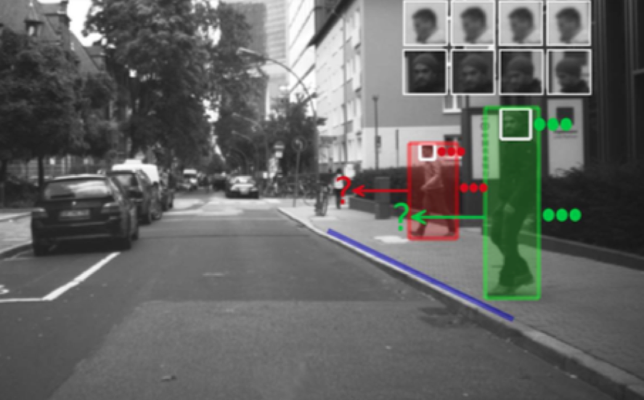
Background
Pedestrian path prediction from an approaching vehicle is challenging. Situation criticality, pedestrian awareness thereof, and positioning vs. curbside provides information for more accurate trajectory prediction.

Slide 4
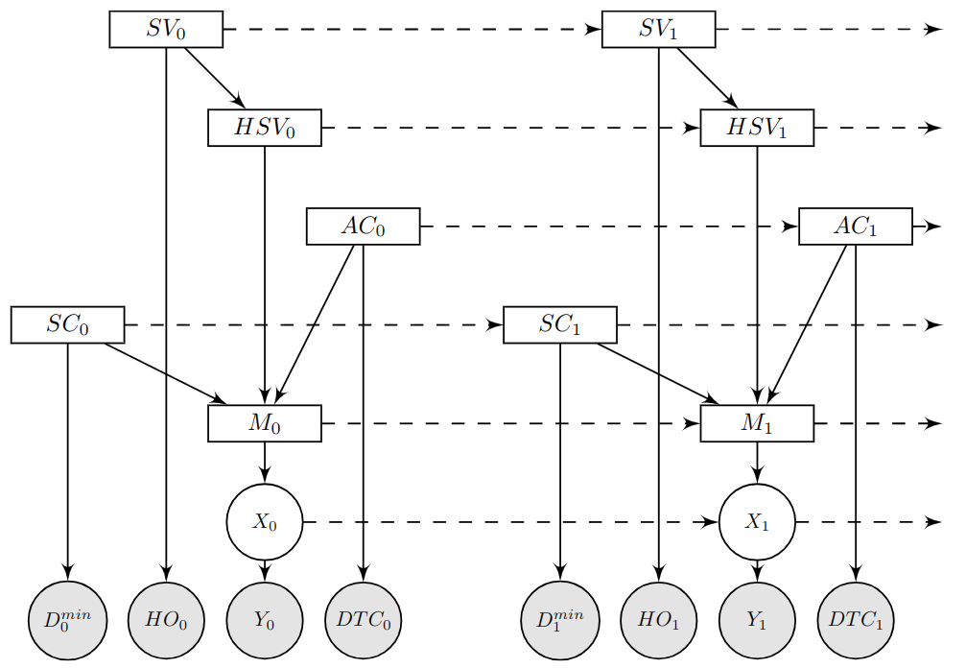


Model
Dynamic Bayesian Network(DBN)
Switching Linear Dynamic System(SLDS)
The DBN unrolled in two time slices.
Context information (HSV, AC, SC) is model as latent state which influences
the switching state in SLDS.
The switching sate in SLDS chooses
the transformation matrix at each time
step.

Slide 5
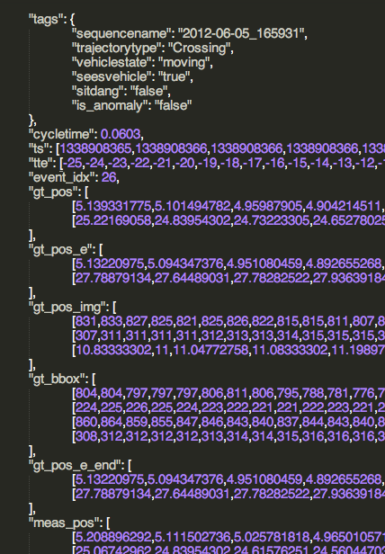
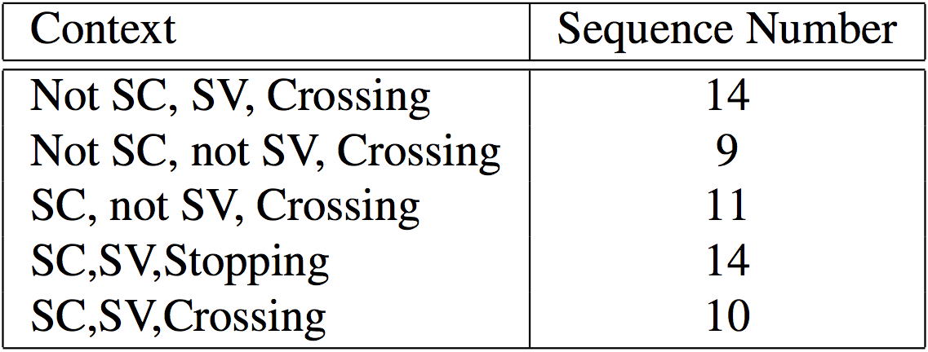
Training Details
Data Description
Statistics of Dataset
The dataset consists of 58 sequences recorded using a stereo camera mounted behind the windshield of a vehicle.
5 scenarios are involved in this dataset,
including 4 normal scenarios and 1 anomalous scenario.

Slide 6
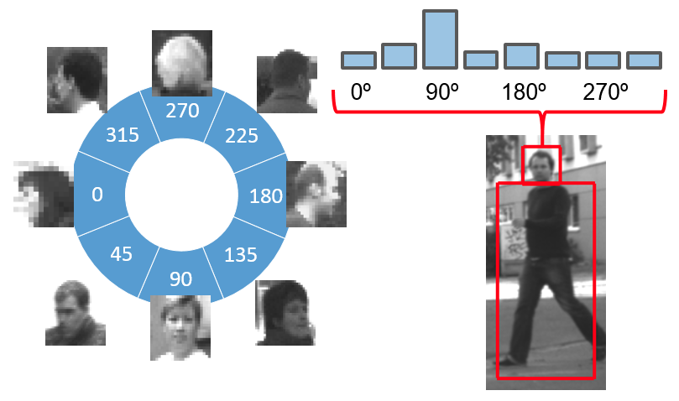
Training Details
Angle domain (0,360) of head
orientation is discretized to 8 classes.
The angle distribution conditioned on see- vehicle is model as a multinomial distribution.
The head measurement and ground-truth of a crossing pedestrian.

Slide 7
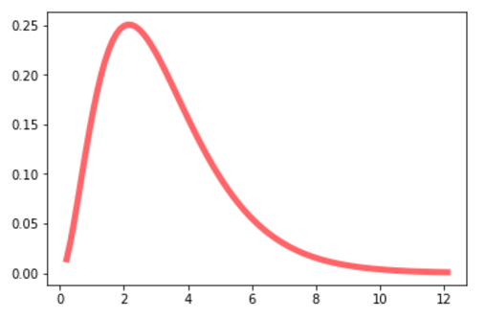
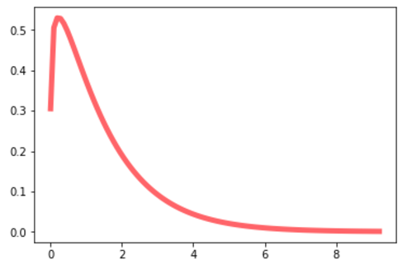
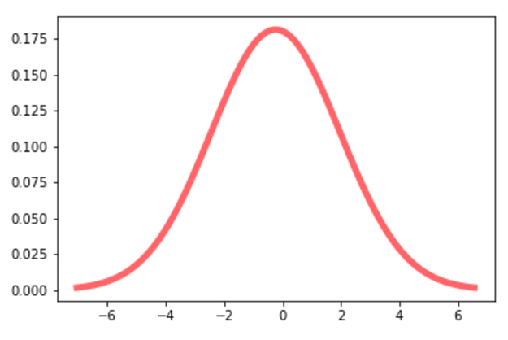
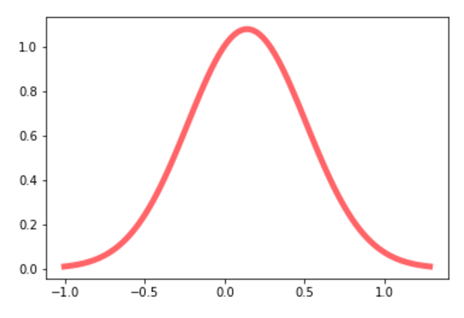
Training Details
AC = 0
AC = 1
SC = 0
SC = 1

Slide 8
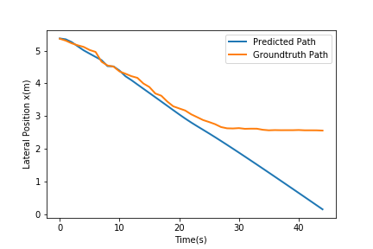
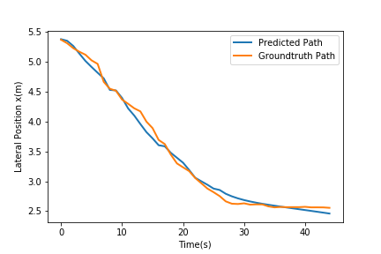


Experiment
The predicted lateral position and the ground-truth lateral position. Upper figure shows the result predicted at TTE = -18(t=13) and lower figure shows the result predicted at TTE = -4(t=27)

Slide 9
Conclusion
A novel model based on DBN for pedestrian path prediction in the intelligent vehicle domain is presented.
The model, a DBN, incorporated the pedestrian situational awareness, situation criticality and spatial layout of the environment as latent states on top of an SLDS.
The proposed model overall outperformed simpler models with or without partial contextual cues by predicting GT pedestrian positions more accurate

Slide 10
Thanks！

