Slide 1


Bank of Baroda Hackathon - 2022
Technology Partner
Your Team Name : INTECHNOZZ
Your team bio :Technology like art is a soaring exercise of the human imagination
Date :20-09-2022

Slide 2

Problem Statement?
We mainly choose this problem to provide the public with better services according to their need from the bank.
To avoid the waiting period in the bank and also providing a better solution for the distrust people
People who is not fond of using online banking visit the banks which extends the count of people in the bank
People who are not provided with ATM cards are also pushed to bank

Slide 3
User Segment & Pain Points
User segment:
It includes the customer user-segment to reduce the distressed people in the queue Pain
Points:
According to online banking there is no security of transaction and receiving the amount, due to that problem there is no proper way of handling the online banking

Slide 4
Pre-Requisite
We are projecting our solution by the means of machine learning ,artificial intelligence. We are planning to execute our detection and recoginition process by using cloud storage in such that we came to know AI AZURES by which we are going to further development of our project .the major role in our project is image processing for that we are proceeding to learn about the computer vision features

Slide 5
Azure tools or resources
We need AI AZURE inorder to train the images and the behavioural patterns of the persons . Also we need computer vision cloud for storage of our collected dataset.

Slide 6
Any Supporting Functional Documents
In our project we are providing enhanced surveillance to detect and consider the customer sentiments and their behavioural patterns and provide them with the better services .
We are developoing a prototype solutuion for detecting the distrust people who visit the bank by expecting the better solution from the bankers in the recoginition appproach.

Slide 7
Key Differentiators & Adoption Plan
Our motive is to provide the customer with better services and time management who directly visits the bank neglecting the online banking.
Engaging the customers with their top priorities and needs .
Our adaptation mainly depends on the people are not fond of online banking and transactions like actions.

Slide 8
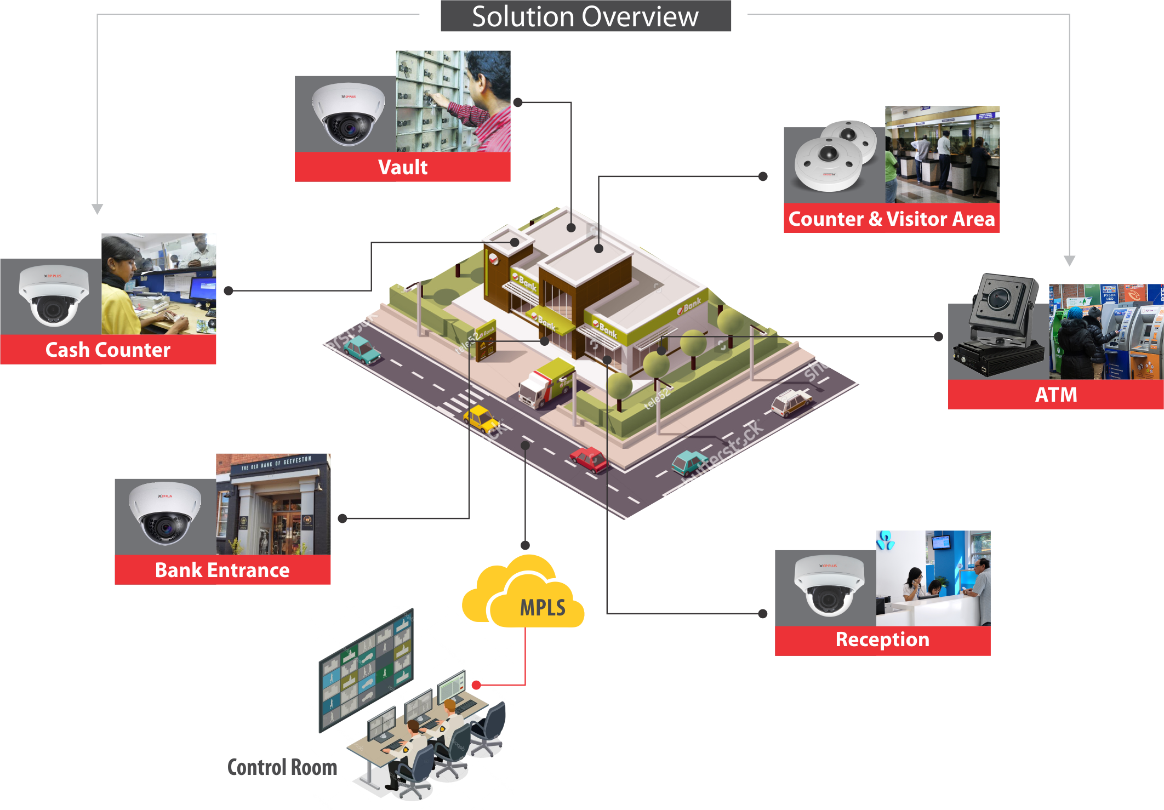
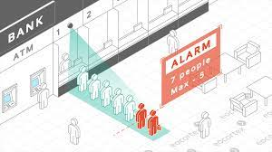
GitHub Repository Link & supporting diagrams, screenshots, if any
https://github.com/sunyavimalkumar09/sunyavimalkumar09/blob/main/README.md

Slide 9
Thank You
K . Sunya B.Tech IT (Team Leader)
N. Sakthi Priya B.Tech IT
K. Vannamathi B.Tech IT
S. Nithya Sri B.Tech IT

