Slide 1
Generate implications for design How stimuli are retrieved and help to transform to generate design ideas
Sun Ying, 13/06/2016 Dresden

Slide 2
Outline
Practical and theoretical problems
The research focus
Purpose of literature review
Current status of the research
Discussion and conclusion
Implications for further research
Notes:
design research is inherently paradoxical which means it is both empirical and imaginative. It cannot be simply empirical
because the typical consumers that researchers need to understand are rarely able to articulate their needs.

Slide 3

Practical problems – from personal perspectives
Study and work experience
1) design survey result cannot be fully utilized for design idea generation
2) not easy to get inspired
3) limited design ideas generation methods
What are good sources for design inspiration?
How to translate empirical findings to creative design ideas?
Notes:
As designer, I want to know what are good sources to generate design inspiration and how to generate creative design ideas.

Slide 4

Practical problems – common situation?
Qualitative interview to
16 IF awarded designers
1) Limited design methods to get design ideas, and not effective to translate empirical findings to ideas
2) Cannot articulate clearly how to get inspiration & generate design ideas
Notes:
3) Unique background & experience, different motivation and personality have an influence on how to resolve design problems.
As designer, I want to know what are good sources to generate design inspiration and how to generate creative design ideas.

Slide 5
Theoretical problems – design ideas generation
An outstanding challenge in design is translating empirical findings and other knowledge into design ideas as this creative leap across the divide is very difficult.
---Sas, C. & Zimmerman, J. (2014) Generating implication for design through design research.
There is still no overall consensus on how best to incorporate the fieldwork results into design. Despite many research efforts, bridging such gap between still remains a matter of concern to designers today.
---Diggins, T., & Tolmie, P. (2003). The ‘adequate’ design of ethnographic outputs for practice: some explorations of the characteristics of design resources. Personal and Ubiquitous Computing.
Notes:
Despite many research efforts, bridging the gap between fieldwork data and design still remains a matter of concern to designers today.
This creative leap across the divide is very difficult, and more structured methods are needed to guide the process of envisioning design from fieldwork outputs.

Slide 6
The research focus
inspiration
ideation
implementation
Research
Concept
Design
Model
Test
Engineering
Production
Design implications:idea that inform design
Product design process--”Costello Design”
Notes:
To find out how implications for design are generated in practice. To what extent the visualization is used to help generate the design implications.

Slide 7
Purpose of literature review
How designers get their inspiration source?
What are the main factors to influence design ideas generation?
By which way the designers translating the research findings to ideas?
What do we already know in the stimuli helping generate design ideas?
Notes:
To find out how implications for design are generated in practice. To what extent the visualization is used to help generate the design implications.

Slide 8
Current status of the research
Author's Name | Title/Quotation | Year | Research topic
Sas et.al Chandrasekera, T. & Ngoc, V.; Hagen, U.; Eckert, C.M. | Generating implication for design through design research; The effect of subliminal suggestions on SMI in design process; Where do game design ideas come from? Source of inspiration in industrial practice; | 2014 2012 2009 2003 | design ideas generation in different professional area: architectural design, fashion design, game design, interaction design, mechanical design and etc.
Sas, C., Whittaker, S. Dow, S., Forlizzi, J. & Zimmerman, J. | Generating implication for design through design research. "An outstanding challenge in design is translating empirical findings and other knowledge into ideas that inform design, also known as generating implications for design." | 2014 | synthesize different types of design implications into a framework to guide their generation and identify a broader range than previously described.
Rapanta, C. & Cantoni, L. | Being in the users’ shoes: Anticipating experience while designing online courses. "Still others have identified the end users as the primary trigger for design ideation, with designers attempting to reduce the design problem complexity by empathizing with learners and better anticipating the user experience." | 2014 | identified the end users as the primary trigger for design ideation
Cross, N. Smith, S. M. | Design thinking. /The constraining effects of initial ideas. "It is commonly thought that inspiration strikes when intense work sessions are alternated with periods of mental relaxation away from the design problem or, similarly, after a period of incubation or shift in context, often after a period of feeling blocked or fixated on an unworkable idea." | 2011 2003 | When inspiration and design ideas strikes
Hutchinson, A. & Tracy, M.W. | Design ideas, reflection, and professional identity how graduate students explore the idea generation process. "Understanding one’s individual idea generation process can be seen as a component of professional identity for designer, which involves the integration of knowledge, action." | 2015 | Influence factors such as designers’ emotion influence generation of design
Gonḉalves & etl. | What inspires designers? Preferences on inspirational approaches during idea generation. "it is the designer who generates, selects, tests, and refines ideas as a means to refine the design problem and arrive at an effective solution. " | 2014 | What stimuli/activities trigger the awareness or formation of a design idea
Notes:
Other studies have examined how stimuli may trigger the emergence of design ideas or influence the content of those ideas; these include text-based stimuli, visual stimuli, subliminal stimuli, verbal or conversational stimuli, and other idea generation activities.
---(Cai et al. 2010; Chandrasekera et al. 2013; Goldschmidt and Sever 2011; Gonḉalves et al. 2014; Perttula & Sipila¨ 2007; Salter and Gann 2003).

Slide 9
Current status of the research
Design ideas generation
Translate empirical findings into design ideas
Serendipitous
Stimuli perspectives
Different types design of implications (What)
Emotional factors during ideation
Different types design ideas
(What)
Different professuonal area
(Where)
Different professuonal area
(Where)
Idea generation time
(When)
Different types of stimuli
Dual (positive & negative) effects on design performance
What stimuli do designer use to trigger designer ideas
End user as primary trigger
Images, text, object
Preference for visual stimuli
No distinction between student & professional designers in stimuli choosing
Notes:
Designers use different types of stimuli in their surroundings helping to generate design ideas include pictorial, verbal, audible or tangible and so on.

Slide 10
Factors influence design ideas generation
The factors that influence design ideas generation:
Different types design implications (Sas and etl, 2014, Meneweger and etl, 2012; Obrist and etl, 2012)
Different professional area (Sas and et.al, 2014, Chandrasekera. & Ngoc, 2012; Hagen, and Eckert, 2012)
Idea generation time (Cross, 2011; Smith, 2003)
Emotion factors during ideation (Hutchinson, 2015, Rapanta & Cantoni, 2014; Yang & Hung, 2014)
Stimuli perspectives (Gonḉalves and etl, 2014; Goldschmidt and Smolkov, 2010; Keller and etl, 2009)
Notes:
To find out how implications for design are generated in practice. To what extent the visualization is used to help generate the design implications.

Slide 11
Significant of stimuli in ideation
Empirical findings
Design ideas
Stimuli
Definition: something external that influences the design activity to elicit the formation of creative solutions for existing problems/potential needs, such as examples of products, pictures, written documents and etc.
Searching for inspirational stimuli is an essential step in the intial stage of the design ideas generation (Gonḉalves & etl., 2014).
Understanding what and how stimuli designers use can help to support designers in a more efficient search, retrieval and usage of available inspirational sources.
Notes:
Literature review provided some evidence on the effectiveness of stimuli in design ideas generation
Searching for inspirational stimuli is an essential step in the intial stage of the design process

Slide 12
Current situation of stimuli during ideas generation
Author's Name | Gonḉalves, Cardoso, & Badke | Rapanta & Cantoni | Cai, Do, & Zimring. | Goldschmidt & Sever | Perttula & Sipilä | Salter & Gann
Title/Quotation | “Generation of design idea is a process that is rooted in individual knowledge and is often considered a precedent-based type of reasoning.” | “Designers attempt to reduce the design problem complexity by empathizing with learners and better anticipating the learning experience.” | Extended linkography and distance graph in design evaluation | “Results show that text-stimuli yield designs that receive higher originality grades compared to a no-stimulus condition, but practicality is not affected.” | The idea exposure paradigm in design idea generation | Sources of ideas for innovation in engineering design
Year | 2014 | 2014 | 2013 | 2011 | 2007 | 2003
Research topic/area | activities or stimuli trigger formation of a design idea | end user as primary trigger | visual stimuli | text stimuli; object stimuli | different types of examples | verbal or conversational stimuli
Have Done: What types of stimuli designers might be using during design ideas generation.

Slide 13
Different types of stimuli
Mostly mentioned stimuli in papers include:
1) Visual stimuli (Goncalves, 2014; Malaga, 2000)
2) Text stimuli (Goldschmidt & Sever, 2010),
3) Object stimuli (Goncalves, 2014)
4) Verbal or conversational stimuli (Salter & Gann, 2003)
Most research focus on the benefit of different types or categories of stimuli. However, less research pay attention to which stimuli would make design ideas generation more effectively by specific project.
Notes:
Designers use different types of stimuli in their surroundings helping to generate design ideas include pictorial, verbal, audible or tangible and so on.

Slide 14
Influence of visual stimuli
Designers: preference for visual stimuli such as images, prototypes That might be partly because it can provide straightforward and intuitive cues without translation between different modalities.
Visual stimuli has shown dual effect during design ideas generation:
Help to generate more creative ideas than non-visual stimuli
Help student & expert architects to deal with ill-defined problem
Pictorial representation of existing problem could hinder the creative ideas generation
The effectiveness evaluation of viusal stimuli should be based on specific project and particular settings.
Notes:
Designers use different types of stimuli in their surroundings helping to generate design ideas include pictorial, verbal, audible or tangible and so on.

Slide 15
Comparision of student & professional designers
No distinction between what student & professional designers use as inspirational sources and idea generation methods.
Education programs focus on specific techniques without addressing concurrent transformation.
Professional designer generated design ideas more efficiently than stuent designer probably because of they tend to categories information or insights in different ways.
Notes:
Designers use different types of stimuli in their surroundings helping to generate design ideas include pictorial, verbal, audible or tangible and so on.

Slide 16
Hypothesis of research
Between student & professional designers
?
Same stimuli
Different ideas
Different
H1: Different way to transfer empirical findings
How different visual stimuli are retrieved and transformed to generate design ideas?
Preference for
visual stimuli
H2: Different mindset
What is the difference in mindset when generating design ideas?
Notes:
Designers use different types of stimuli in their surroundings helping to generate design ideas include pictorial, verbal, audible or tangible and so on.

Slide 17
Discussion
The reason about the researchers concerned about designers’ experience to utilize stimuli, a probable explanation is the designers’ responsibility to generates, tests, and refines meaningful design as a means to arrive at an effective solution
New media such as 3D printing, virtual reality, give more requirement to designers and design education, and makes another challenge for them lies in acquiring the mechanisms to conduct a timely and appropriate selection of useful stimuli amongst the overwhelming diversity of available sources, according to different project
Notes:
Designers use different types of stimuli in their surroundings helping to generate design ideas include pictorial, verbal, audible or tangible and so on.

Slide 18
Discussion
In additional, some studies obtained clear theoretical underpinnings, which were not apparent in the others. The use of well established measures with clear reliability and validity information was not enough.
Some studies compare the ideation between designers group with stimuli and non-stimuli group, where concrete evidence on whether stimuli help to generate design ideas was clearly presented.
Notes:
Designers use different types of stimuli in their surroundings helping to generate design ideas include pictorial, verbal, audible or tangible and so on.

Slide 19
Conclusion
Stimuli influence the design activity to elicit the formation of creative solutions for existing problems or potential needs, and they have dual (positive or negative) effect on design ideas generation.
Researches have discussed what stimuli designers looked for during ideation, however, there are few research to investigate how the different types of stimuli are used helping to transform empirical findings to design ideas.
There is no distinction between what student and professional designers use as inspirational sources and idea generation methods during ideas generation.
Notes:
Designers use different types of stimuli in their surroundings helping to generate design ideas include pictorial, verbal, audible or tangible and so on.

Slide 20
Implication for further research
More research needs to conduct in less explored skills area such as how stimuli are used during design ideas generation process
The use of well established measures with clear reliability and validity information was not enough.
Help designers reflect upon their own design idea generation process, explore their mindset involved would generate lasting benefit.
Research should not only pay attention to specific techniques, but also the whole process included during design ideas generation
Notes:
Designers use different types of stimuli in their surroundings helping to generate design ideas include pictorial, verbal, audible or tangible and so on.

Slide 21
Research questions
1. How do designers conduct a selection of stimuli, amongst the overwhelming diversity of available (visual) sources?
2. How different types of stimuli are used helping to transform empirical findings into design ideas?
3. What might be the difference between student and professional designers on the way to utilize (visual) stimuli during ideation? What is the difference about their mindset?

Slide 22
Methodology – flow chart
Literature review
Object of study, research scope
Research question
Methodology
Memos
Sampling
Instrument
Data analysis
Ethical issues
Convenience sampling
Semi-structured qualitative interview
Transcribe
coding by specific stimuli
Feedback about research questions
Feedback about interview questions
Matrix Structure
Qualitative interpretation
observation
other material
Compare the perspectives:
1) selection of various stimuli
2) transformation of empirical findings
3) student and professional
Purposeful sampling
Audio record, pictures
Return visit
Dolphi method
Nvivo
Data collection
guidance for designers to conduct an appropriate selection of stimuli

Slide 23
Contributions of proposed research
Knowing the influence of various visual stimuli during idea generation.
Help designer have a better identity by reflecting on ideation process, offer student designers a deep understanding of professional designers' expertise in particular field, and which type of mindset they use to transfer design research to design ideas effectively
Build a guidance for designers to conduct an appropriate selection of stimuli, amongst the overwhelming diversity of available stimuli, to transfer empirical findings (one kind of knowledge) to design implications (another knowledge).
Notes:
Understanding one's individual idea generation process could be a component of designer's professional identity, which involves the integration of knowledge, action.
---Hutchinson, A. & Tracy, M.W. (2015) Design ideas, reflection, and professional identity how graduate students explore the idea generation process.

Slide 24
Reference
Brown, T. (2009) Change by design: How design thinking transforms organizations and inspires innovation. HarperCollins Publishers: New York.
Chansri, N. and Koomsap, P. (2014) Sketch-based modeling from a paper-based overtraced freehand sketch. The International Journal of Advanced Manufacturing Technology, Volume 75 (5) — Nov 1, 2014.
Charmaz, K. (2006) Constructing Grounded Theory: A practical guide through qualitative analysis. London: SAGE Publications.
Cross, N. (2011) Design Thinking: Understanding How Designers Think and Work. Bloomsbury Academic: New York, USA.
Dall’Alba, G. (2009). Learning professional ways of being: Ambiguities of becoming. Educational Philosophy and Theory, 41(1), 34–45.
De Vaus, D. A. (2001) Research design in social research. London: SAGE.
Diggins, T., and Tolmie, P. (2003). The ‘adequate’ design of ethnographic outputs for practice: some explorations of the characteristics of design resources. Personal and Ubiquitous Computing.
Dix, A., Finlay, J., Abowd, G.D. and Beale, R. (2014) Human-computer interaction. Pearson Prentice, New York, USA.
Gerber, E., and Carroll, M. The psychological experience of prototyping. Design studies, Volume 33 (1) — Jan 1, 2012.
Goldschmidt, G. and Sever, A.L. (2010) Inspiring design ideas with text. Design studies, 32(2), 139-155.
Goldschmidt, G. and Tatsa, D. How good are good ideas? Correlates of design creativity. Design studies, Volume 26 (6) — Nov 1, 2005.
Gonḉalves, M., Cardoso, C., and Badke-Schaub, P. (2014). What inspires designers? Preferences on inspirational approaches during idea generation. Design Studies, 35(1), 29–53.
Hagen, U. (2009) Where do game design ideas come from? Innovation and Recycling in Games Developed in Sweden. Proceedings of DiGRA 2009.
Herring, S.R., Jones, B.R. & Bailey, B.P. (2009) Idea generation Techniques among Creative professionals. 42nd Hawaii International Conference on System Science.
Hutchinson, A. & Tracy, M.W. (2015) Design ideas, reflection, and professional identity how graduate students explore the idea generation process. Instructional Science. 09/2015; 43(5):527-544.
Kusano, K., Nakatani, M. and Ohno, T. (2013) Scenario-based interactive UI design. Association for Computing Machinery — Apr 27, 2013.
Notes:
Designers use different types of stimuli in their surroundings helping to generate design ideas include pictorial, verbal, audible or tangible and so on.

Slide 25
Reference
Laurel, B. ed. (2003) Design Research: Methods and Perspectives. Cambridge, Massachusetts: MIT Press.
Linstone, H.A., Turoff, M. and Helmer, O. (2002) The Delphi Method: Techniques and applications. Available at <http://is.njit.edu/pubs/delphibook/> Retrieved on [Feb 2016]
Malaga, R.A. (2000). The effect of stimulus modes and associative distance in individual creativity supports systems. Decision Support System, 29(2), 125-141.
Masten, D. and Plowman, T. (2003) Digital ethnography: The next wave in understanding the consumer experience. DMI Journal Vol. 14, No. 2, Spring 2003.
Meneweger, T., Sundstrom, P., Obrist, M., and Tscheligi, M. (2012) How designers can make sense of qualitative research findings: a case study. In Association for Computing Machinery — Oct 14, 2012.
Meyer, M. (2013) Designing visualization for biological data. Leonardo, Volume 46 (3) — Jun 1, 2013.
obristsbraMose, J.M. (2007) ‘Sampling in Grounded Theory’ in Bryant, A., Charmaz, K. (2007) The SAGE Handbook of Grounded Theory. London: SAGE Publication. pp.229-243.
Obrist, M., Wurhofer, D., Sundstrom, P., Beck, E., Buie, E., and Hoonhout, J. (2012) The Message in the Bottle: Best Practices for Transferring the Knowledge from Qualitative User Studies. Workshop at DIS’ 12.
Pan, R., Kuo, S.P. and Strobel, J. Interplay of computer and paper-based sketching in graphicdesign. International Journal of Technology and Design Education , Volume 23 (3) — Aug 1, 2013
Pniewska, J., Adrian, W.T., and Czerwoniec, A. Prototyping: is it a more creative way for shaping ideas. Association for Computing Machinery — Jun 24, 2013.
Quesenbery, W. and Brooks, K. (2008) Storytelling for user experience: Crafting stories for better design. New York, USA: Louis Rosenfeld.
Rapanta, C. and Cantoni, L. Being in the users’ shoes: Anticipating experience while designing online courses. British Journal of Educational Technology. Vol 45, No 5, 2014. pp 765-777.
Sas, C., Whittaker, S., Dow, S., Forlizzi, J., and Zimmerman, J. (2014) Generating implications for design through design research. CHI 2014, Toronto, Canada.
Notes:
Understanding one's individual idea generation process could be a component of designer's professional identity, which involves the integration of knowledge, action.
---Hutchinson, A. & Tracy, M.W. (2015) Design ideas, reflection, and professional identity how graduate students explore the idea generation process.

Slide 26
Thank you!
Feedback ......
Notes:
Other studies have examined how stimuli may trigger the emergence of design ideas or influence the content of those ideas; these include text-based stimuli, visual stimuli, subliminal stimuli, verbal or conversational stimuli, and other idea generation activities.
---(Cai et al. 2010; Chandrasekera et al. 2013; Goldschmidt and Sever 2011; Gonḉalves et al. 2014; Perttula & Sipila¨ 2007; Salter and Gann 2003).

Slide 27
The research focus
Research
Concept
Design
Model
Test
Engineering
Production
Design implications
Product design process--”Costello Design”
Notes:
To find out how implications for design are generated in practice. To what extent the visualization is used to help generate the design implications.

Slide 28
State of research
Design ideas generation
Translate empirical findings into design ideas
Serendipitous
Stimuli perspectives
Different types design implications
(What)
Different types design ideas
(What)
Different professuonal area
(Where)
Different professuonal area
(Where)
Idea generation time
(When)
Emotion factors during ideation
Different types of stimuli
Dual (positive & negative) effect on design performance
What stimuli designer use to trigger designer ideas
End user as primary trigger
Images, text, object
Preference for visual stimuli
No distinction between student & professional designers in stimuli choosing
Notes:
Designers use different types of stimuli in their surroundings helping to generate design ideas include pictorial, verbal, audible or tangible and so on.

Slide 29
Hypothesis of research
Between student & professional designers
?
Same stimuli
Different ideas
Different
Preference for
visual stimuli
H1: Different way to transfer empirical findings
How different visual stimuli are retrieved and transformed to generate design ideas?
Education programs focus on specific techniques without addressing concurrent transformation
H2: Different mindset
What is the difference in mindset when generating design ideas?
Notes:
Designers use different types of stimuli in their surroundings helping to generate design ideas include pictorial, verbal, audible or tangible and so on.

Slide 30
Objectives – purpose to perform the work
Research
Concept
Design
Model
Test
Engineering
Production
Design Implications
Understand how designers select and utilize different (visual) stimuli helping to generate design ideas from empirical findings
Compare the situation between student and professional desigers
Help different designer reflect upon their own design idea generation process, explore designer's mindset involved
Notes:
To find out how implications for design are generated in practice. To what extent the visualization is used to help generate the design implications.

Slide 31
Research questions
1. How do designers conduct a selection of stimuli, amongst the overwhelming diversity of available (visual) sources?
2. How different types of stimuli are used helping to transform empirical findings into design ideas?
3. What might be the difference between student and professional designers on the way to utilize (visual) stimuli during ideation? What is the difference about their mindset?

Slide 32
Contributions of proposed research
Knowing the influence of various visual stimuli during idea generation.
Help designer have a better identity by reflecting on ideation process, offer student designers a deep understanding of professional designers' expertise in particular field, and which type of mindset they use to transfer design research to design ideas effectively
Build a guidance for designers to conduct an appropriate selection of stimuli, amongst the overwhelming diversity of available stimuli, to transfer empirical findings (one kind of knowledge) to design implications (another knowledge).
Notes:
Understanding one's individual idea generation process could be a component of designer's professional identity, which involves the integration of knowledge, action.
---Hutchinson, A. & Tracy, M.W. (2015) Design ideas, reflection, and professional identity how graduate students explore the idea generation process.

Slide 33
Methodology – flow chart
Literature review
Object of study, research scope
Research question
Methodology
Memos
Sampling
Instrument
Data analysis
Ethical issues
Convenience sampling
Semi-structured qualitative interview
Transcribe
coding by specific stimuli
Feedback about research questions
Feedback about interview questions
Matrix Structure
Qualitative interpretation
observation
other material
Compare the perspectives:
1) selection of various stimuli
2) transformation of empirical findings
3) student and professional
Purposeful sampling
Audio record, pictures
Return visit
Dolphi method
Nvivo
Data collection
guidance for designers to conduct an appropriate selection of stimuli

Slide 34
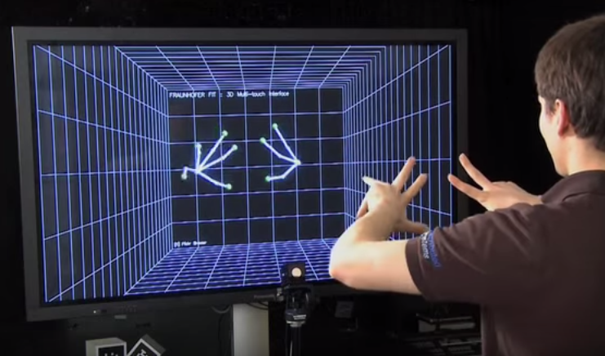
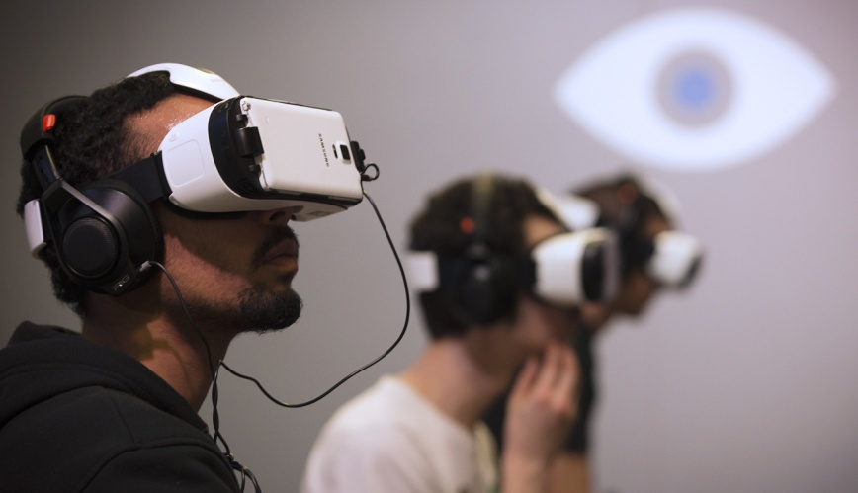
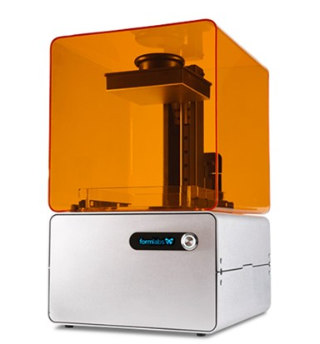
State-of-art technology
New media & technologies: expand design area, enrich way of design methods, & give more requirement to designer & design education

Slide 35
Methodology--Sampling
1. Participants: outstanding industrial designers
including student and practitioner designers and design academics.
 | Academics | Practitioners | Students
Classification | Professors, Teachers …… | Employee in Big and Small business, Freelancer …… | First semester student
Number | 6 | 6 | 6
2. Number of respondents: initially set to 18
Beginning: ‘convenience sampling’
During: ‘purposeful sampling’
Notes:
2. to choose the interviewee on the basis of accessibility
Beginning: ‘convenience sampling’, to‘identify the scope, major components, and trajectory of the overall process’ (Mose, 2007: 235)
During: ‘purposeful sampling’, accordingly to the way this scheme sorts the phenomenon.

Slide 36
Methodology--Data collection
1. One-on-one face to face/online interview depends on the availability and accessibility of interview respondents
2. Audio recording allow researcher presere raw data for review at a later date, but also to focus on the question/answer process at hand
Notes:
1. Features with grounded theory: open-ended yet directed, shaped yet emergent, paced yet flexible
2. Combines core questions together with the freedom to follow up points as necessary
3. Interview guide: easier to scrutinize step by step about how to collect data and which data to obtain.

Slide 37
Methodology--Data analysis
The data from interviews and visual dialog would be completely transcribed, thematically coded and analyzed.
Transcribed audio-recorded interview.
Thematically code according to the collected data.
Arrange data into matrix structure to analyze.
Notes:
2. All designers would be put in a line and interview questions would be put in a column. The data could be displayed in a way of one designer to each questions, but also with formation of all designers to one questions.
3. The way of coding show how the researcher select, separate and sort data to begin an analytic accounting of them.

Slide 38
Methodology – approaches lead to a solution
Transcribe, thematically code and analysis (qualitative interpretation) the data using matrix structure.
 | Question 1 sources | Question 2 types | Question 3 | …… | Conclusion
Participant 1 | field work (quites, reason) |  |  |  | Analysis
Participant 2 | human science (quotes, reason) |  |  |  | Analysis
Participant 3 | design practice (quotes, reason) |  |  |  | Analysis
Participant 4 | …… |  |  |  | Analysis
Participant 5 | individual creativity (quotes, reason) |  |  |  | Analysis
…… | …… |  |  |  | Analysis
Conclusion | Analysis |  |  |  | Analysis

Slide 39
State of research about stimuli in design ideas generation
What stimuli designers look for when they are searching for inspiration such as visual stimuli, text stimuli, object stimuli, subliminal stimuli, verbal or conversational stimuli.
Designers are typically known for having a preference for visual stimuli, such as images, sketching, collages, prototypes, storyboard, and so on.
There is no distinction between what student and professional designers use as inspirational sources/idea generation methods.
Notes:
Other studies have examined how stimuli may trigger the emergence of design ideas or influence the content of those ideas; these include text-based stimuli, visual stimuli, subliminal stimuli, verbal or conversational stimuli, and other idea generation activities.
---(Cai et al. 2010; Chandrasekera et al. 2013; Goldschmidt and Sever 2011; Gonḉalves et al. 2014; Perttula & Sipila¨ 2007; Salter and Gann 2003).

Slide 40
State of research about stimuli in DIG in educational area
Previous research conducted in different disciplines compared what stimuli they choose regarding ideation between student and professional designers, but so far less studies have explicitly addressed how such stimuli are used during ideation.
---Gonḉalves, M., Cardoso, C., & Badke-Schaub, P. (2014). What inspires designers? Preferences on inspirational approaches during idea generation. Design Studies, 35(1), 29–53.
Most education programs stop short by focusing on the development of specific knowledge and skills without addressing the concurrent transformation and design thinking during the idea generation process.
---Dall’Alba, G. (2009). Learning professional ways of being: Ambiguities of becoming. Educational Philosophy and Theory, 41(1), 34–45. doi:10.1111/j.1469-5812.00475.x.

Slide 41
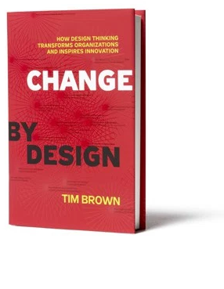
The focus research area
Design projects develop through three stages:
1. “inspiration”: gather insights from every possible sources and identify an opportunity
2. “ideation”: insights are translated into ideas and conceive general solutions
3. “implementation”: best ideas are developed into a concrete, fully conceived action plan
------Brown, T. (2009) Change by Design: How Design Thinking Transforms Organizations and Inspires Innovation. HarperCollins, New York.

