Slide 1
Week 3 - Python Fundamental II
AIAA 5031 Introduction to Computing Using Python

Slide 2
Outline
Dynamic Data Type Mechanism
Conditional Statement
Loop Statement
Break, continue, and else

Slide 3
Dynamic Data Type Mechanism

Slide 4
Questions on Variables
Question 1: How does a variable hold data?
Question 2: What is happening during value assignment?
2
a

Slide 5
Fundamental Solution
Question 1: How does a variable hold data?
Allocate some memory to the variable
Write down the value
a
 | … |  |  | ... |  |  |  |  | …
e.g., 8 bits
a=2
a
 | … | 0 | 0 | … | 0 | 0 | 1 | 0 | …
=2

Slide 6
Fundamental Solution
Question 1: How does a variable hold data?
Allocate some memory to the variable
Write down the value
Question 2: What is happening during value assignment?
Erase the previous value in the memory
Write down another value
a
 | … | 0 | 0 | … | 0 | 0 | 1 | 0 | …
=2
a=3
a
 | … | 0 | 0 | … | 0 | 0 | 1 | 1 | …
=3

Slide 7
Type?
Question 3: how to store type information
a
a
 | … | 0 | 1 | … | 0 | 1 | 1 | 0 | …
 | … | 0 | 1 | … | 0 | 1 | 1 | 0 | …
=76
=‘<’
Same binary code, different types

Slide 8
Fundamental Solution
Question 3: where is type information
int a
char a
 | … | 0 | 1 | … | 0 | 1 | 1 | 0 | …
 | … | 0 | 1 | … | 0 | 1 | 1 | 0 | …
=76
=‘<’
Set to the variable

Slide 9
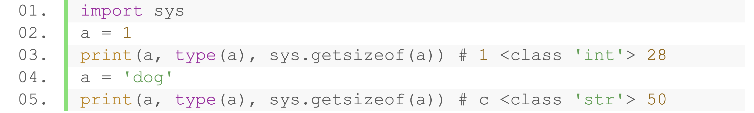
How is Dynamic Type Achieved?
Question 4: where is type information in Python?
Question 5: how are values with different size stored?
24 bits
a (8 bits)
???
0 | … | 0 | 0 | … | 1 | 1 | … | 0 | 1 | 0
 | … | 0 | 0 | … | 0 | 0 | 0 | 1 | …
=‘dog’
=1

Slide 10
How is Dynamic Type Achieved?
Question 4: where is type information in Python?
Types are linked to the objects
a (228 bits)
Brings extra memory cost
8 bytes in C but 28 bytes in Python
 | … | 0 | 0 | … | 1 | 0 | … | 1 | …
=1
meta: int, operators, methods, …

Slide 11
Dynamic Typed?
Question 5: how are values with different sizes stored?
The value are somewhere else
Variables stores their address
Assignment changes the pointed address
a (64 bits)
2 & meta
 | 0 | 0 | … | 1 | 1 | 0 | 0 |  |  | 0 | 0 | … | 1 | 0
address
2 & meta
‘dog’ & meta
a (64 bits)
 | 0 | 1 | … | 1 | 0 | 0 | 1 |  |  | 0 | 0 | … | 1 | 0 | … | 0 | 0 | … | 1 | 1 | 0
address
id() function: the identity of object (address of object in CPython)

Slide 12
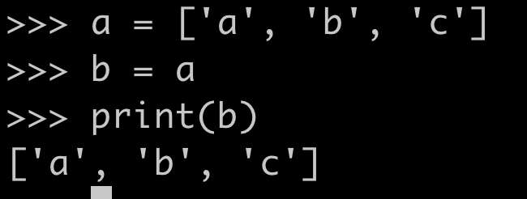
Dynamic Typed?
Question 6: What happens when assigning a variable to another?
Create another object?
dog & meta
b (64 bits)
dog & meta
a (64 bits)
 | 0 | 0 | … | 1 | 1 | 0 | 0 |  | 0 | 0 | … | 1 | 0
 | 0 | 0 | … | 0 | 0 | 1 | 1 |  | 0 | 0 | … | 1 | 0
address
address

Slide 13
Dynamic Typed?
Question 6: What happens when assigning a variable to another?
Point to the same address
a (64 bits)
dog & meta
b (64bits)
 | 0 | 1 | … | 1 | 0 | 0 | 1 |  | 0 | 0 | … | 1 | 0 | …
address
b = a: copy the information
a (64 bits)
dog & meta
b (64bits)
 | 0 | 1 | … | 1 | 0 | 0 | 1 |  | 0 | 0 | … | 1 | 0 | … | 0 | 1 | … | 1 | 0 | 0 | 1
address
address
id() function: the identity of object (address of object in CPython)

Slide 14
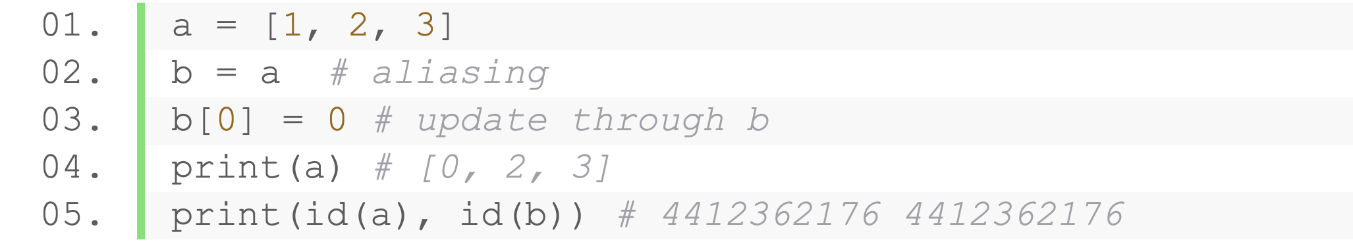
Notice: Assignment of Mutable Objects
Directly assigning an existing object to a new variable is just creating an alias
id is the same —— modification on b will reflect on a
a (64 bits)
[1,2,3] & meta
b (64bits)
 | 0 | 1 | … | 1 | 0 | 0 | 1 |  | 0 | 0 | … | 1 | 0 | … | 0 | 1 | … | 1 | 0 | 0 | 1
address
address

Slide 15
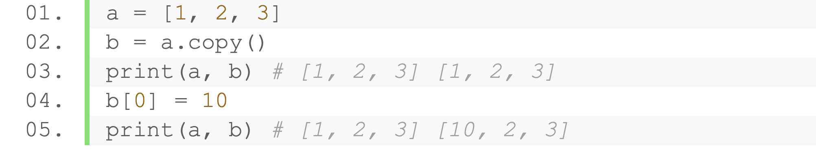
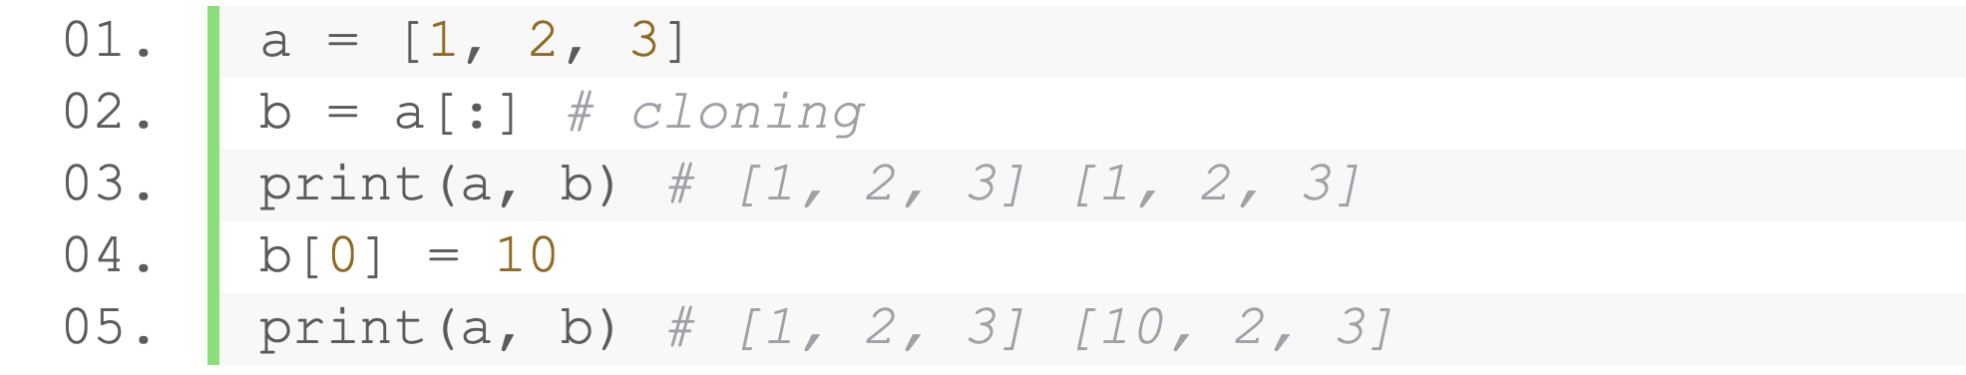
Notice: Assignment of Mutable Objects
Cloning: making an exact but separate copy
copy() function
Slicing is making a copy

Slide 16
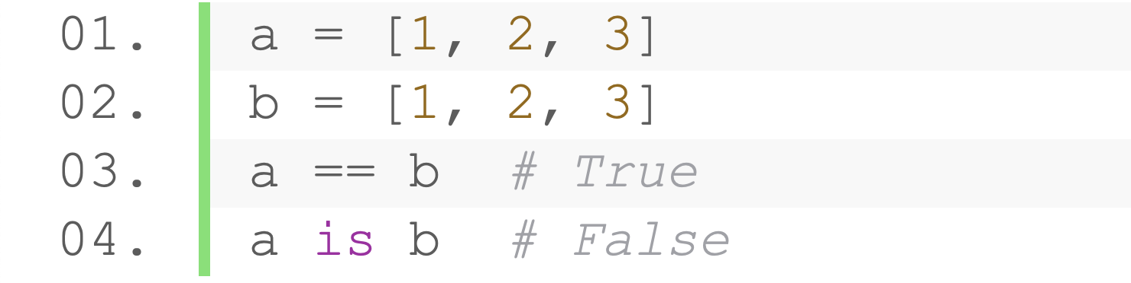
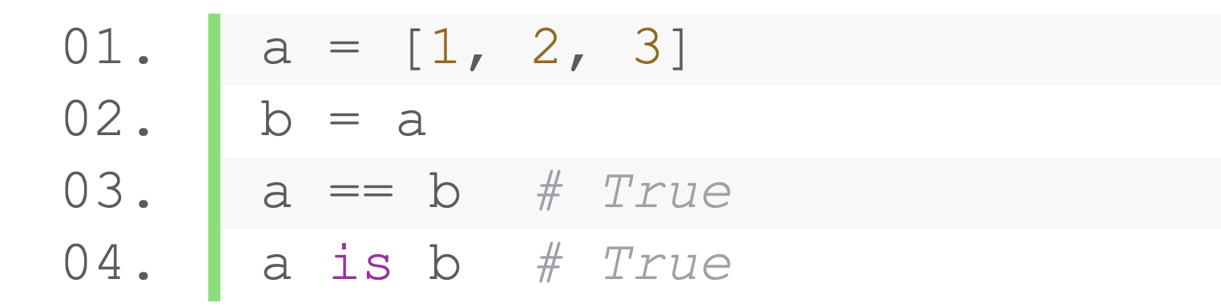
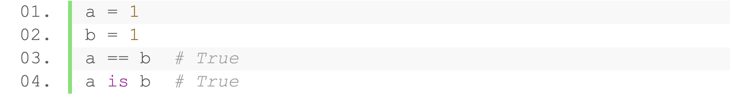
Identity Operators
Check two values (or variables) are located on the same memory or not
Operator | Description
a is b | True if a and b are identical objects
a is not b | True if a and b are not identical objects
Two variables that are equal does not imply that they are identical
The same (small) integer value are the same object in Python

Slide 17
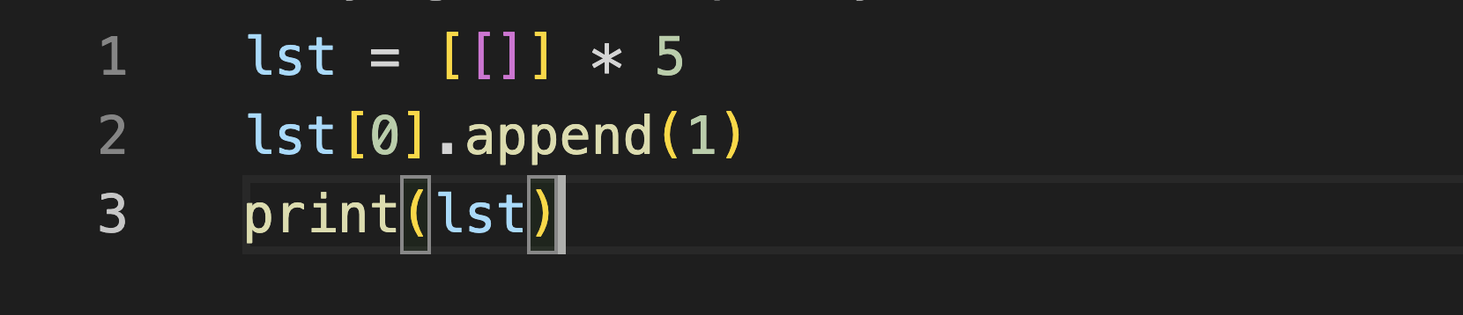
Practice
What is the output? Why?
Notes:
~1h15min

Slide 18
Assignment of Immutable Objects
Apply id() function to observe the assignment of immutable objects and think:
Given a = 1, what happens during b = a?
What happens during b += 1?
Does the immutable objects get updated?
Why doesn’t it reflect on a?
Notes:
40min

Slide 19
Control Flow

Slide 20
Control Flow
Program is not simply a list of statements that are sequentially executed
Execute certain code blocks conditionally and/or repeatedly
Combine the following statements for sophisticated programs
Conditional statements
Loop statements
break, continue, and else

Slide 21
Conditional Statement

Slide 22
Conditional Statement
Executed a set of instructions in certain conditions
Evaluate one or more conditions (expressions that return Boolean value)
Selectively execute statements based on the result (True / False)
Keywords: if, else, elif

Slide 23
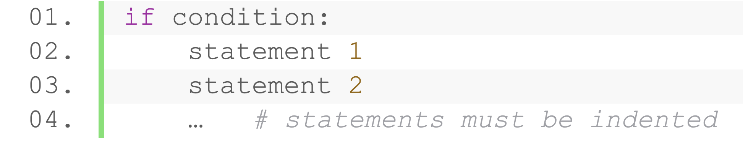
Conditional Statement
if
Evaluate the given condition
Execute when returns True
Start
Expression that returns Boolean value
Condition
No
Yes
Statement(s)
Indentations indicate to-be-execute statements
End

Slide 24
Conditional Statement
Example
Given the grade of a student
Output ‘Excellent’ if a student’s grade is higher than 80
grade = 100
if grade > 80:
print('Excellent')
Start
Grade > 80
No
Yes
Print Excellent
End

Slide 25
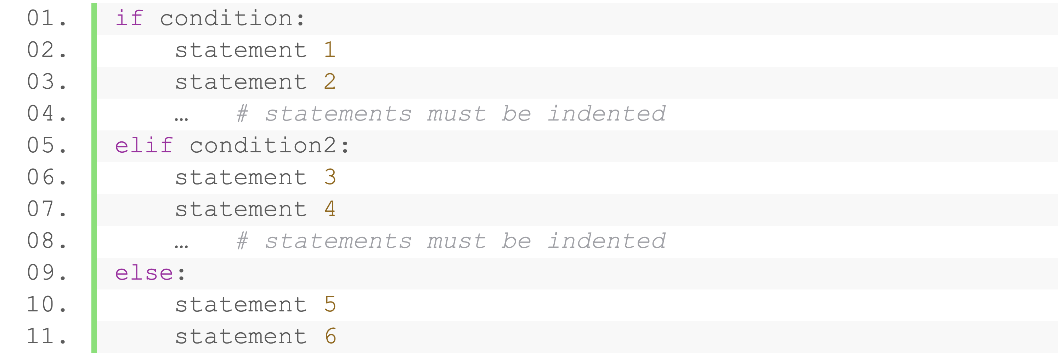
Conditional Statement
elif (optional, multiple)
After if or elif statements
Evaluate a given condition when all the previous judgements returns False
Execute when returns True
Start
Condition
No
Same
Indentations
Yes
Condition 2
No
Statement(s) 1 2
Yes
Statement(s) 3 4
End

Slide 26
Conditional Statement
Example
Given the grade of a student
Output ‘Excellent’ if higher than 80, ‘good’ if in the range [60, 80]
grade = 100
if grade > 80:
print('Excellent')
elif grade >= 60:
print('Good')
Start
Grade > 80
No
Yes
Grade > 60
No
Print Excellent
Yes
Print Good
End

Slide 27
Conditional Statement
else (optional, at most 1)
After all the if and elif statements
Execute when all the previous judgements returns False
Start
Condition
No
Yes
Condition 2
No
Statement(s) 1 2
Yes
Statement(s) 3 4
Statement(s) 5 6
End

Slide 28
Conditional Statement
Example
Given the grade of a student
Output ‘Excellent’ if higher than 80, ‘good’ if in the range [60, 80], and ‘Fail’ otherwise
Start
grade = 100
if grade > 80:
print('Excellent')
elif 60 <= grade:
print('Good')
else:
print('Fail')
Grade > 80
No
Yes
Grade > 60
No
Print Excellent
Yes
Print Good
Print Fail
End

Slide 29
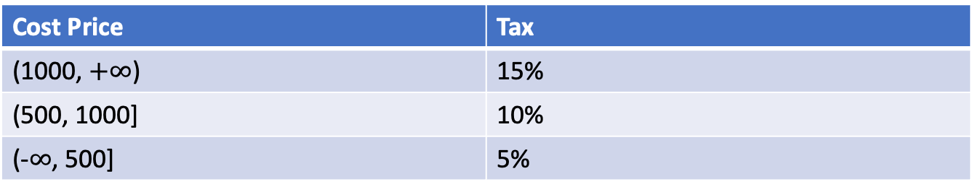
Exercise
Given the cost price of a bike
Calculate the tax to be paid according to the following criteria:
pr = int(input())
if pr > 1500:
tax = pr * 0.2
elif pr > 1000:
tax = pr * 0.15
elif pr > 500:
tax = pr * 0.1
else:
tax = pr * 0.05
print(tax)
Cost Price | Tax
(1500, +∞) | 20%
(1000, 1500] | 15%
(500, 1000] | 10%
 | 5%

Slide 30
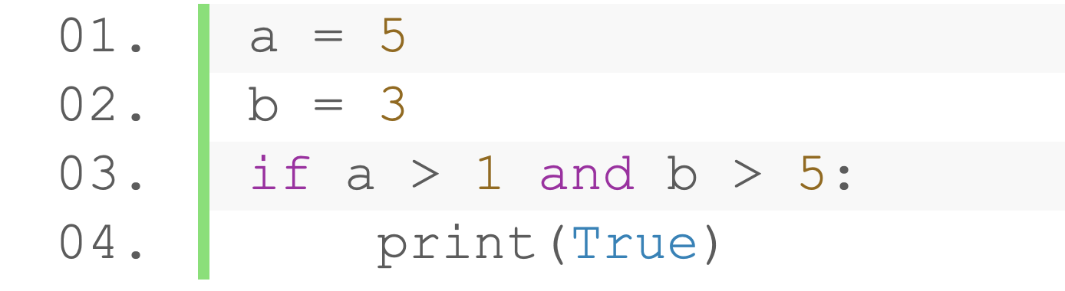
Conditional Statement
Conditions can be any expressions that generate a boolean value
Boolean values
Relational, identity, membership operations
Values that can be casted to bool types
Logical expressions
Functions returning Boolean values
None-zero as True, None and 0 as False
Notes:
36min

Slide 31
Conditional Statement
Conditional Assignment
Assign value upon some conditions
Syntax: variable_name = value1 if condition else value2
a = 5
b = a + 2 if a % 2 else a - 2
print(b)
equal
a = 5
if a % 2:
b = a + 2
else:
b = a - 2
print(b)
Notes:
40min

Slide 32
Practice (Submit)
Write a program that simulates a user access system. The program will grant or deny access based on user input and predefined criteria.
Initial accounts in the system:
username: admin, role: admin, password: 12345
username: jack, role: user, password: 00000
username: sally, role: user, password: 88888
username: guest, role: guest, password: guest-123
When running the system:
Prompt the user to input a username and a password.
If the username is not in your system, print "Username not found. Please try again.”
If the username exists, check if the password matches. If not, print "Incorrect password. Please try again.”
When the the password matches, output “Access granted. Welcome, [Username]”
Notes:
28min (不加练习)

Slide 33
Loop Statement
Repeatedly execute a block of statements

Slide 34
Loop Statement
Two kinds of loop statements
while loop: Repeatedly execute statements based on a condition
for loop: Iterate items in a collection (e.g., list, tuple, dictionary, set, string, …)
More about the loop flows:
break, continue, else

Slide 35
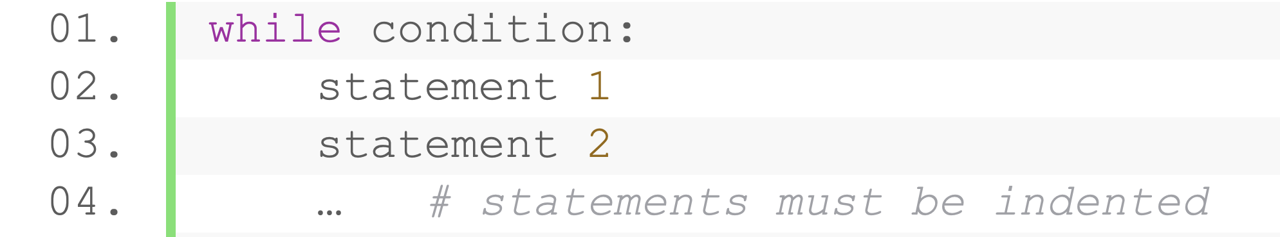
Loop Statement (while)
Repeatedly execute statements as long as a condition is true
Also use indentation and colon
start
Condition
Yes
Statement(s)
No
end
If condition is true, executes statements, or exit the loop
Go to condition expression evaluation again after each iteration

Slide 36
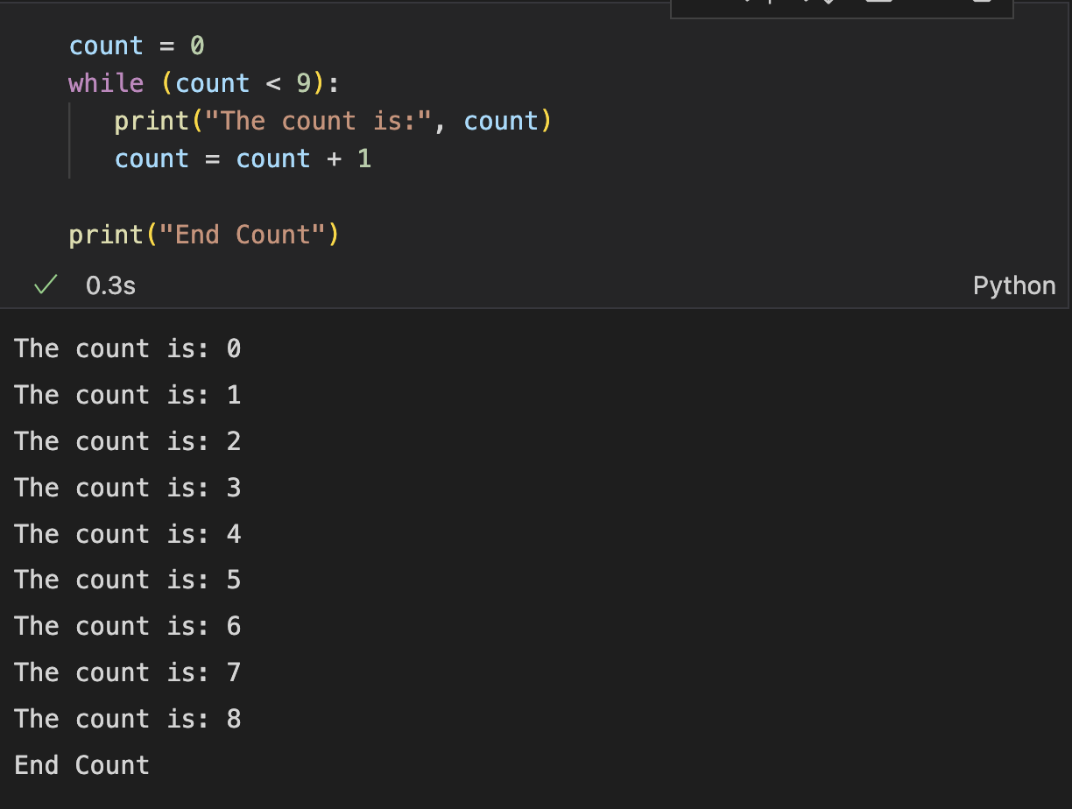
Loop Statement (while)
Example: print 0 to 8
start
count = 0
count = count + 1
count < 9
Yes
Print count
No
end

Slide 37
Practice (submit)
Given an integer n, use while statement to sum up 1 to n
1 + 2 + 3 + … + n
Sample Input:
5
Sample Output:
15

Slide 38
Practice (submit)
Exercise: given a list, output the sum of even numbers and odd numbers, respectively
Sample Input:
5 1 4 8 11 14 18 27 34 37
Sample Output:
78 81
Notes:
60min

Slide 39
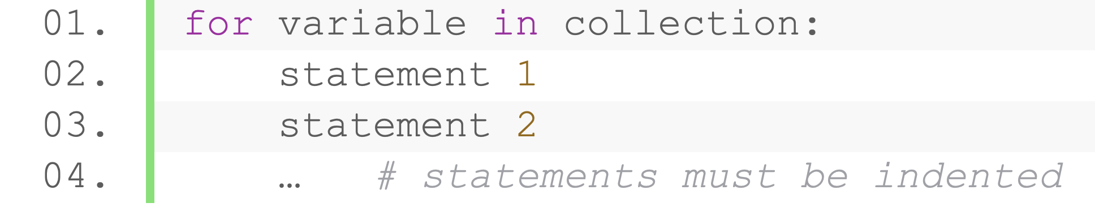
Loop Statement (for)
Iterate items in a collection (e.g., list, tuple, dictionary, set, string, …)
start
Statement(s)
Yes
unused items in c
u = the next item
No
end
For each iteration, assign one value in the collection to the variable
Repeat until used the last item

Slide 40
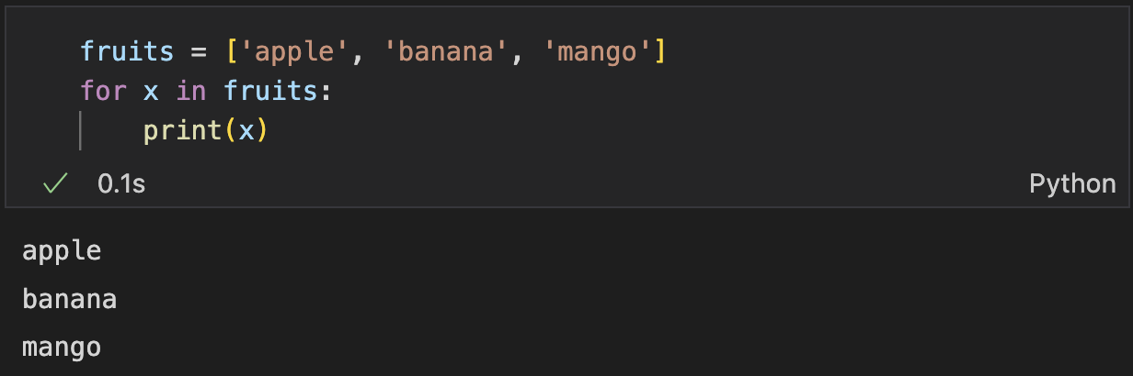
Loop Statement (for)
Iterate items in a list

Slide 41
Practice (submit)
Exercise: Given a list, output the sum of even numbers and odd numbers, respectively
Sample Input:
5 1 4 8 11 14 18 27 34 37
Sample Output:
78 81

Slide 42
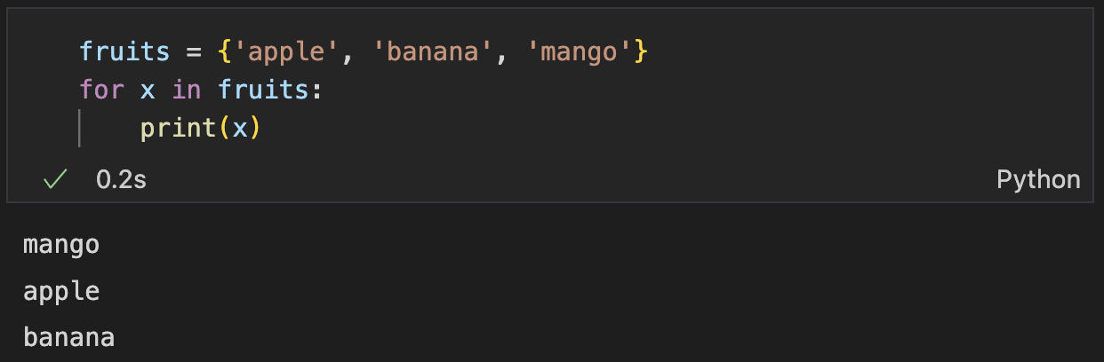
Loop Statement (for)
Iterate items in a set
Not in the original order
Not from smaller to larger
(based on hash table instead of red-black tree)

Slide 43
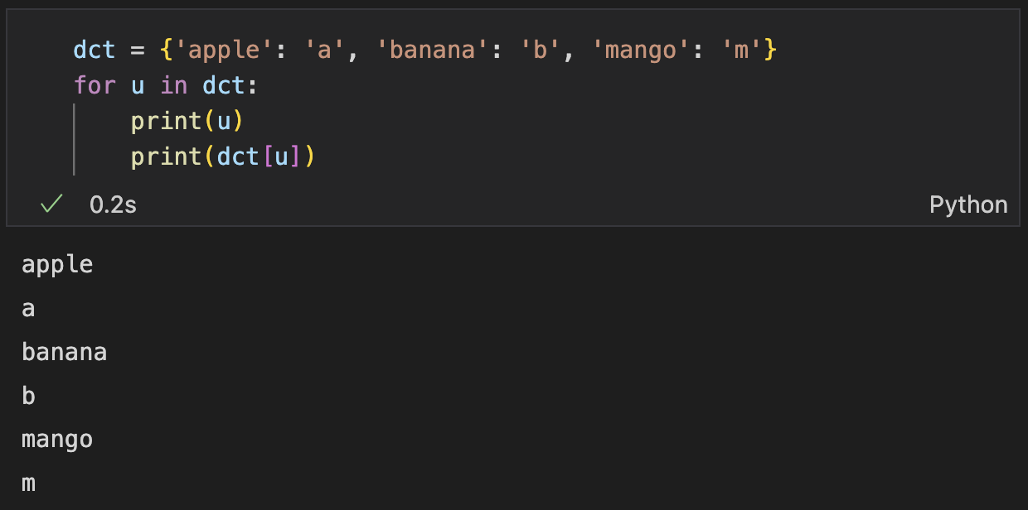
Loop Statement (for)
Iterate keys in a dictionary

Slide 44
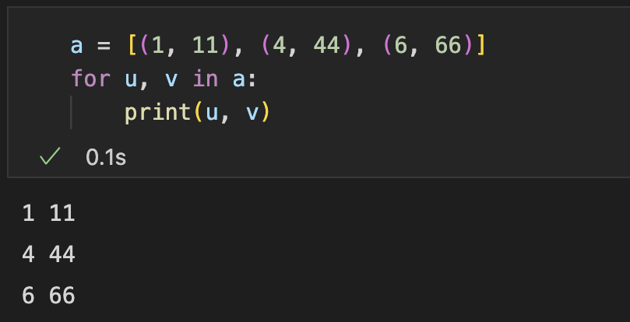
Loop Statement (for)
Iterate a collection of tuples
Assign multiple variables during iteration

Slide 45
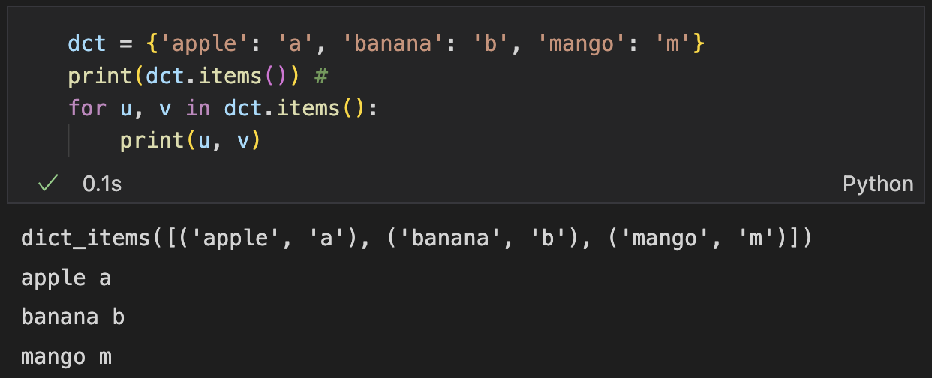
Loop Statement (for)
Iterate key-value pairs in a dictionary
dict.items(): Transform dict to a sequence of tuple

Slide 46
Loop Statement (for)
range(): generate a sequence from a start number to the stop number
Returns an iterator (Range) for the numbers
Numbers in the Range can be iterated using a for loop
Example: Generate integer numbers from 10 to 14
Access item and subranges

Slide 47
Loop Statement (for)
range(): generate a sequence from a start number to the stop number
Returns an iterator (Range) for the numbers
Numbers in the Range can be iterated using a for loop
By default start from 0
like slices, endpoint not included
Can set steps of iterations
Example: Generate integer numbers from 10 to 14, step 2

Slide 48
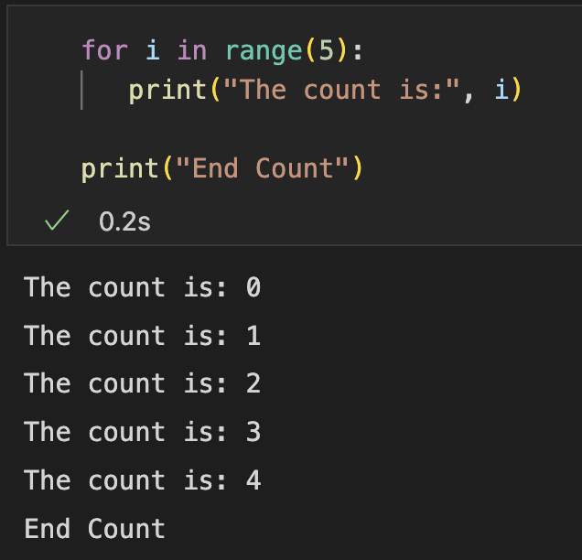
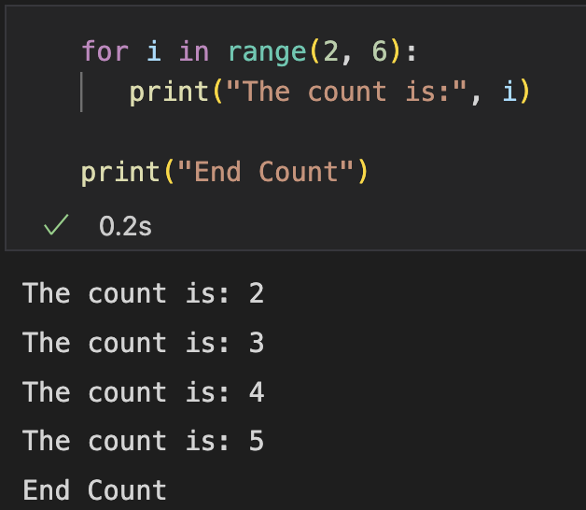
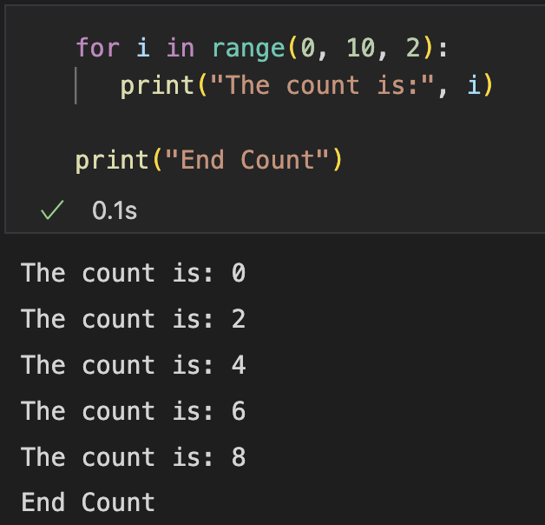
Loop Statement (for)
Iterate numbers in a range (common)
Iterate up to 4
Iterate from 2 to 6
Iterate even numbers up to 10

Slide 49
Practice (submit)
Exercise: Given n, get n!
1 * 2 * 3 … n
Sample Input:
5
Sample Output:
120

Slide 50
Practice (submit)
Exercise: Given n, get 2 * 4 * 6 * … (n - n%2)
Sample Input:
9
Sample Output:
384

Slide 51
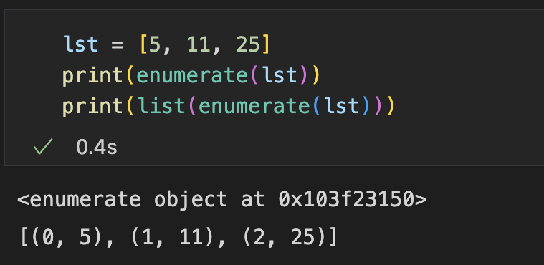
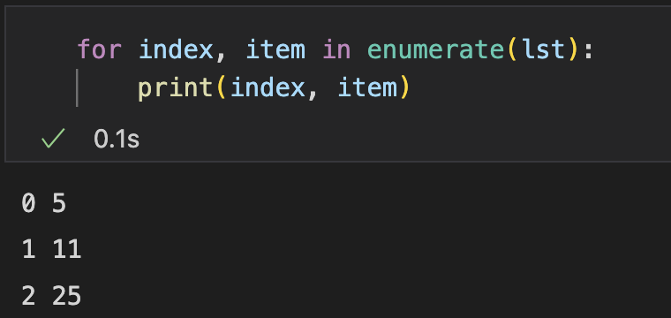
Loop Statement (for)
enumerate(): return an iterator of tuples containing (index, item)
Get the index of the current iteration

Slide 52
Practice (Submit)
Exercise: Given a list, add 10 to each value that is less than 10 (modify the list instead of creating a new one), then print the list
Sample Input:
5 10 20 50 100 7 8 21
Sample Output:
15 10 20 50 100 17 18 21

Slide 53
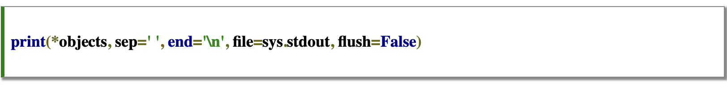
List Comprehension
A concise and elegant way to create lists in one statement
Compact and faster than normal loops for creating list
Syntax
Input collection
Filter condition (optional)
[ expression(item) for item in collection if condition ]
Output expression
variable for iteration
Equals

Slide 54
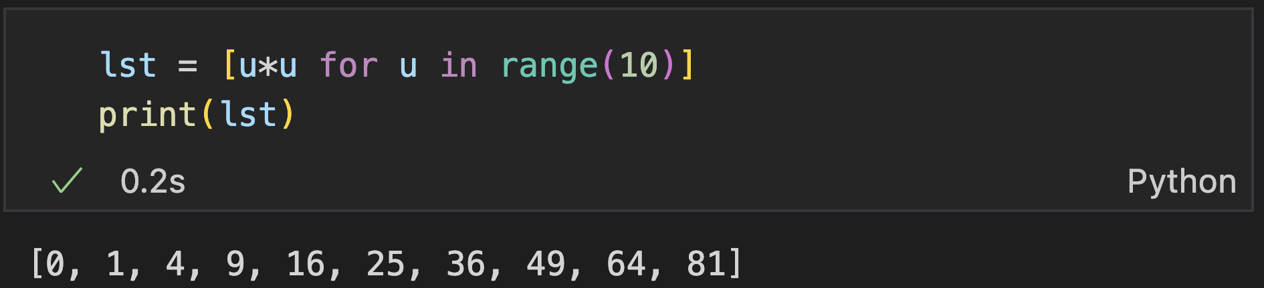
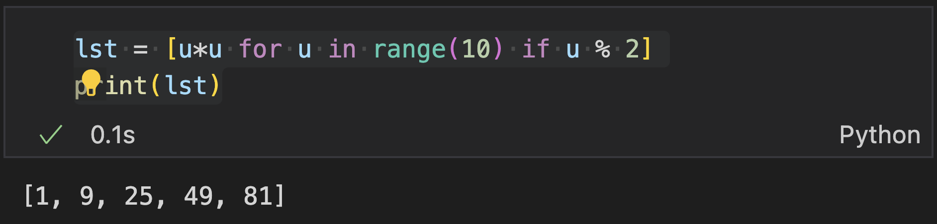
List Comprehension
Example: create a list containing 0^2, 1^2, …, 9^2
Example: create a list containing 1^2, 3^2, 5^2, …, 9^2

Slide 55
Practice (Submit)
Exercise: given a list of words, use list comprehension to output the sum of length of words starting with “a”
Sample Input:
apple pear dog cat alice aim after a
Sample Output:
19
Notes:
25min(不加练习)

Slide 56
Break, continue, and else

Slide 57
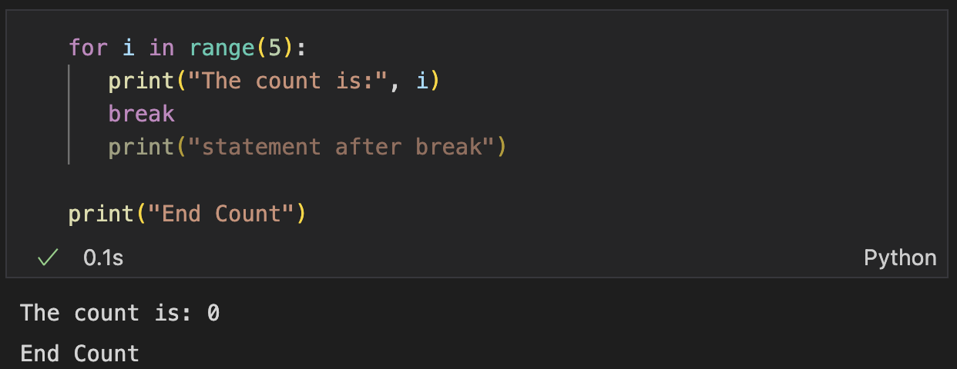
Break
Only used in loops
Immediately exit the loop when encountering a break statement
Not executed
Seems not making sense?
Notes:
https://www.guru99.com/python-break-continue-pass.html

Slide 58
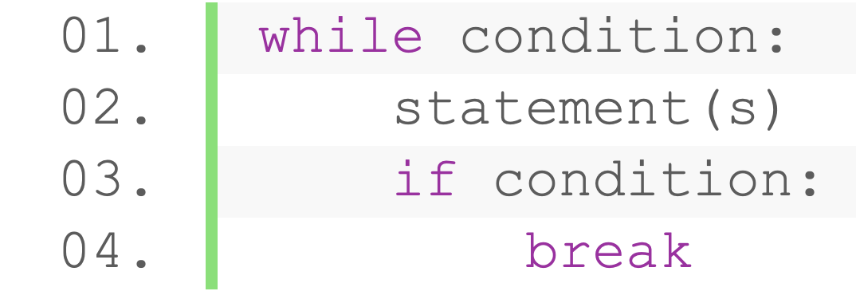
Break
Specify conditions when we want to end the loop: combine with if statement
start
Condition
Yes
Statement(s)
Statement(s)
No
No
Condition 2
end
Yes: break
Notes:
https://www.guru99.com/python-break-continue-pass.html

Slide 59
Break
Example: generate a Fibonacci sequence with values no larger than 100000.
lst = [1, 1]
for i in range(100000):
u = lst[-1] + lst[-2]
if u > 100000:
break
lst.append(u)
Notes:
https://www.guru99.com/python-break-continue-pass.html

Slide 60
Practice (Submit)
Continuously take inputs 1 by 1 from the terminal
End the program if the input number is -1
If the input is not -1, output whether the number is odd or even
Sample Input:
1
3
2
6
-1
Sample Output:
Odd
Odd
Even
Even
Notes:
https://www.guru99.com/python-break-continue-pass.html

Slide 61
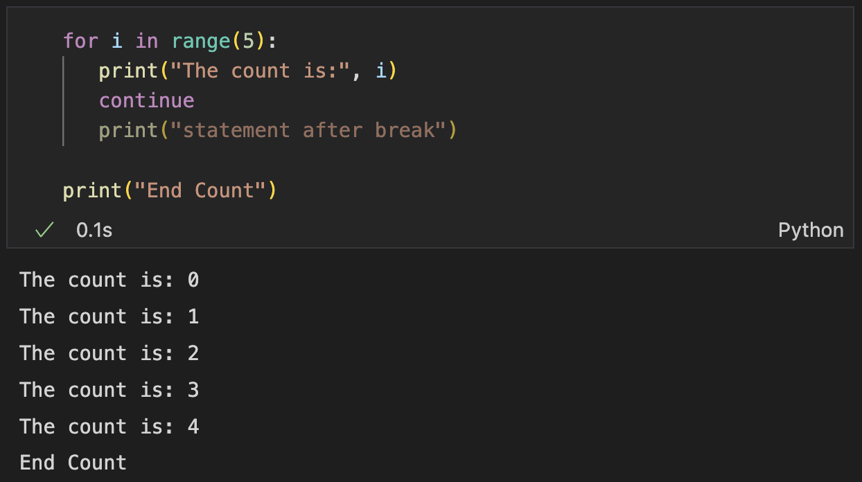
Continue
Skip the rest statements in the current iteration, directly start the next iteration
Not executed
Seems not making sense?

Slide 62
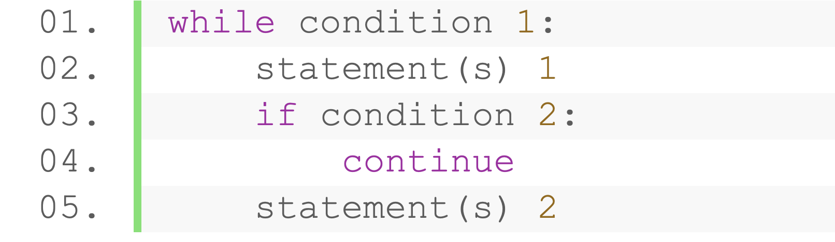
Continue
Usually combined with conditional statement
start
continue
Condition1?
Statement(s) 2
No
No
Yes
Statement(s) 1
Condition2?
end

Slide 63
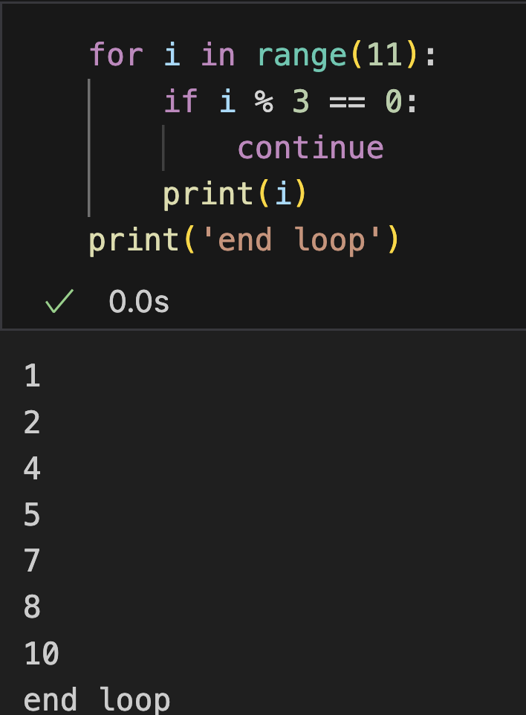
Continue
Example: print numbers from 0 to 10, skip the numbers divisible by 3
Notice:
In simple cases: can be replaced with ‘if not’ statement
Convenient for sophisticated flows and long code

Slide 64
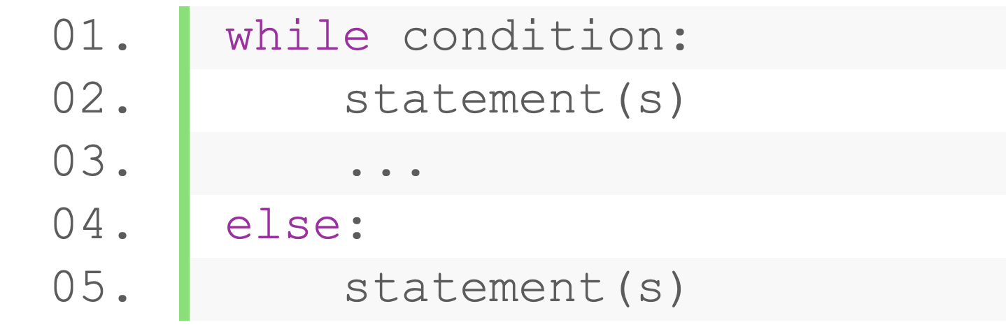
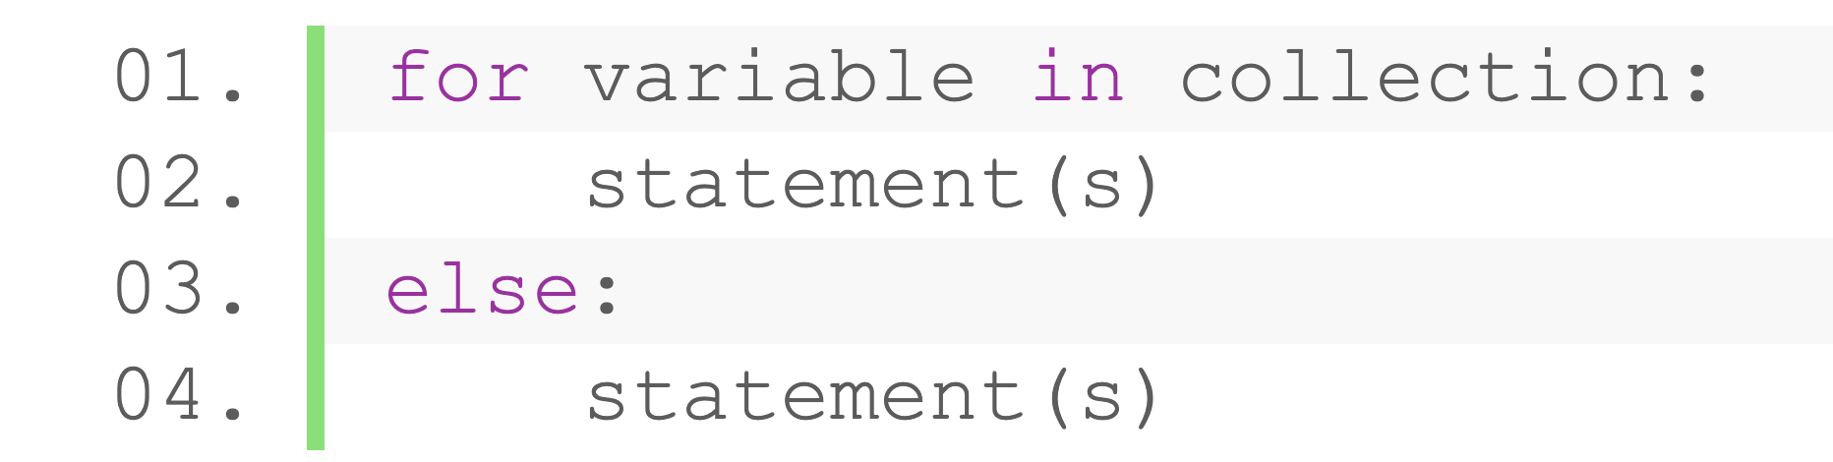
Loop-else
else in a loop specify nobreak statements:
execute only if the loop ends naturally (without encountering a break statement)
Syntax
while
for

Slide 65
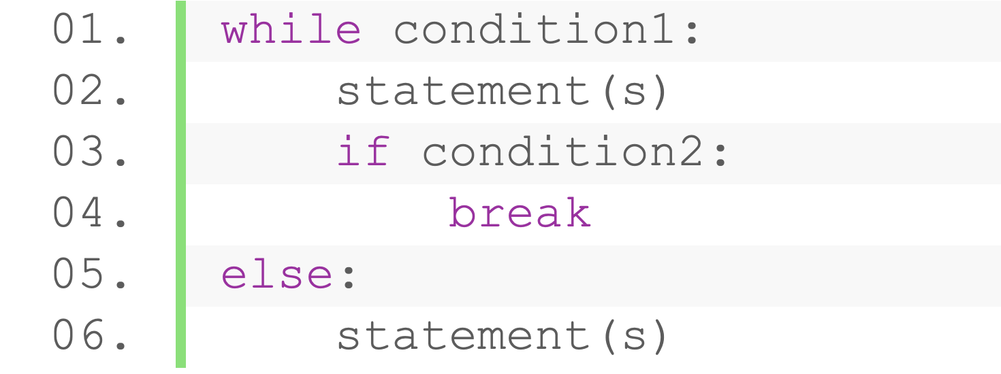
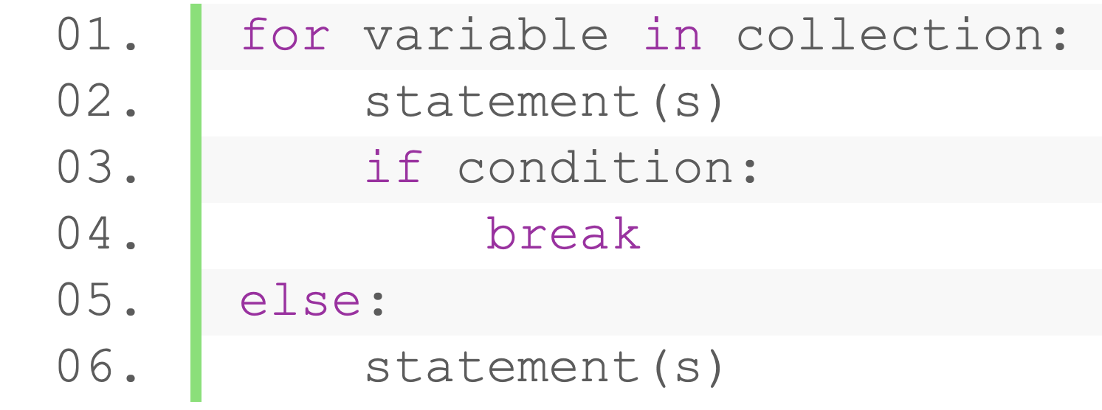
Loop-else
Combining with break statements
start
No
while
Condition
Yes
Condition 2
No
Yes
Else statement(s)
break
end
for

Slide 66
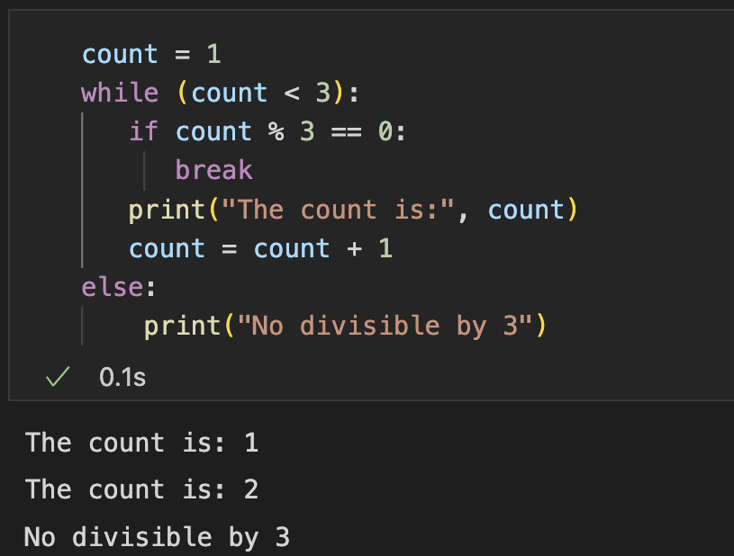
Loop-else
Example
Print the numbers from 1 to n
Stop when encountering a number divisible by 3
Print ”no divisible by 3” if no number in 1 to n divisible by 3

Slide 67
Practice (Submit)
Continuously take inputs 1 by 1 from the terminal, at most 5 numbers
End the program immediately if the input number is -1
If the input is not -1, output whether the number is odd or even
Output “terminated normally” after taking 5 numbers, otherwise “interrupted by user”
Sample Input:
1
3
2
6
5
Sample Output:
Odd
Odd
Even
Even
Odd
Terminated normally
Sample Input:
1
4
-1
Sample Output:
Odd
Even
Interrupted by user
Notes:
https://www.guru99.com/python-break-continue-pass.html

Slide 68
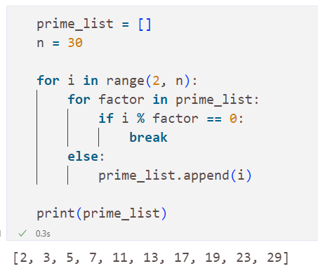
Loop-else (for)
Example: given number n, store prime numbers less than n in a list
Prime number: an integer > 1 that is only divisible by 1 and itself
Iterate numbers from 2 to n
Check if the number is divisible by the prime numbers smaller than it (stored in the prime list)
Add the number to the prime list if not divisible by prime numbers

Slide 69
Pass
A body that does nothing
Used when a statement is syntactically required but no code to execute
Behaves like a placeholder for future code
Usage:
Suppose we have a loop or a function that leave to be implemented later
Having empty body will raise syntax error

Slide 70
Practice (Submit)
Write a program that simulates a user access system. The program will grant or deny access based on user input and predefined criteria.
When running the system
Prompt the user to input a username and a password.
If the username does not exist, print "Username not found. Please try again.” Then go back to step 1.
If the username exists, check if the password matches. If not, print "Incorrect password. Please try again.” Then go back to step 1.
When the the password matches, output “Access granted. Welcome, [Username]”
Prompt an accessed user to input operations
passwd – change password (prompt the user to enter current password, if correct, prompt the user to enter new password twice. If the two passwords matches, update the password stored in your system.) go back to step 5.
adduser xxx [username] – add a user (check if the user’s role is admin, if so, check whether the username already exists in your system. If not, create a new user whose role is ‘user’, with password 000000. Output ”User successfully created.”) go back to step 5.
logout – go back to step 1.

Slide 71
Outline
Dynamic Type Mechanism
Conditional Statement
Loop Statement
Break, continue, and else

Slide 72
Thank you!
AIAA 5031 Introduction to Computing Using Python

