Slide 1
大规模机器学习算法GBDT及应用
王志伟（冰逸）
2015.06.27

Slide 2
个人
王志伟（冰逸）
2008-2011 ：北航计算机硕士
2011-2012 ：网易有道 搜索组
2012-2014 ： 百度 网页搜索 LTR组
2014-至今 ： 阿里 推荐&投放算法小组

Slide 3
大纲
GBDT算法介绍
GBDT实现原理
GBDT并行实现
应用

Slide 4
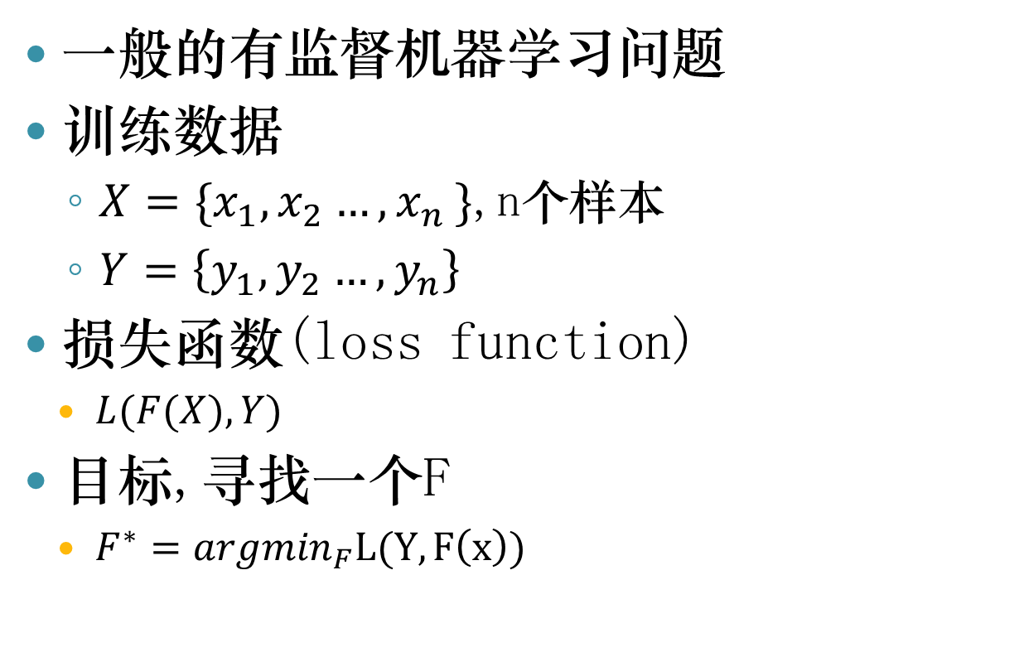
GBDT算法介绍
一般的有监督机器学习问题
训练数据
$X=\{x_{1},x_{2}{…,x}_{n}\}$,n个样本
$Y=\left\{y_{1}{,y}_{2}…,y_{n}\right\}$
损失函数(loss function)
$L(F(X),Y)$
目标,寻找一个F
$F^{∗}={argmin}_{F}L(Y,F\left(x\right))$

Slide 5
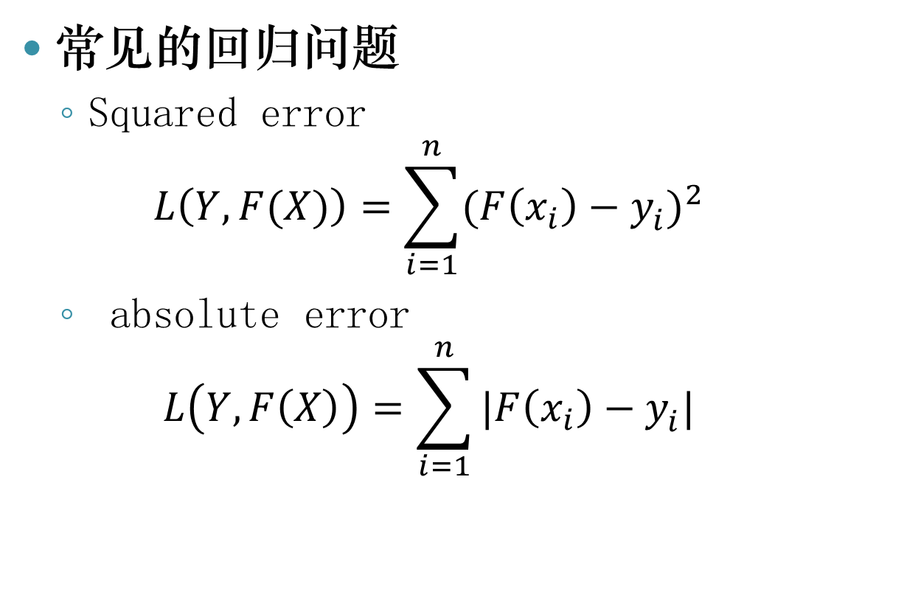
损失函数
常见的回归问题
Squared error
$$L\left(Y,F(X)\right)=\sum_{i=1}^{n}{{(F\left(x_{i}\right)−y_{i}^{})}^{2}}$$
absolute error
$$L\left(Y,F\left(X\right)\right)=\sum_{i=1}^{n}{|F\left(x_{i}\right)−y_{i}^{}|}$$

Slide 6
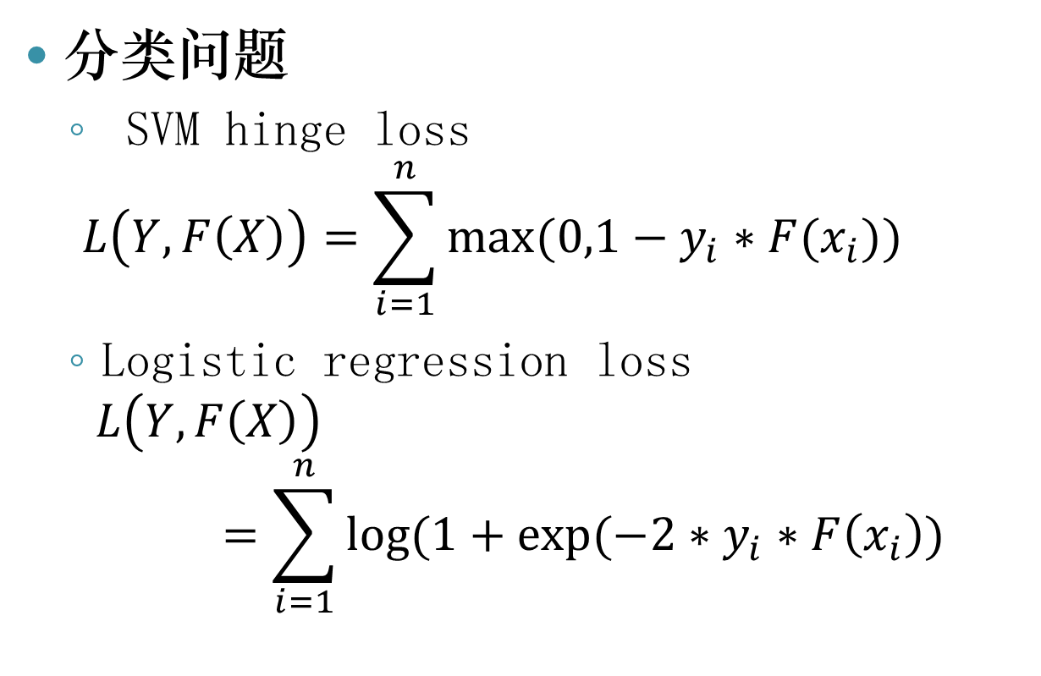
损失函数
分类问题
SVM hinge loss
$$L\left(Y,F\left(X\right)\right)=\sum_{i=1}^{n}{max⁡(0,1−y_{i}∗F(x_{i}))}$$
Logistic regression loss
$$L\left(Y,F\left(X\right)\right)=\sum_{i=1}^{n}{log⁡(1+exp⁡(−2∗y_{i}∗F\left(x_{i}\right))}$$

Slide 7
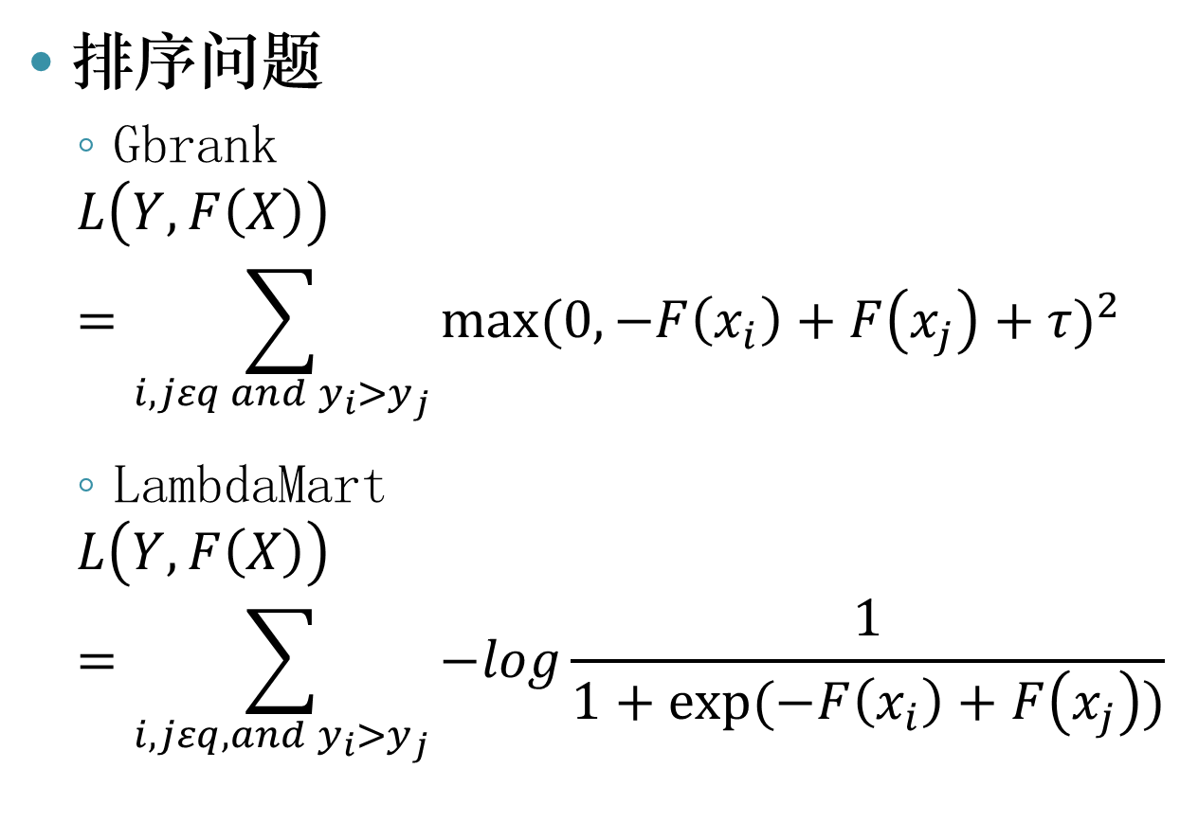
损失函数
排序问题
Gbrank
$$L\left(Y,F\left(X\right)\right)=\sum_{\begin{aligned}i,jεq and y_{i}>y_{j} \\ \end{aligned}}{{max⁡(0,−F\left(x_{i}\right)+F\left(x_{j}\right)+τ)}^{2}}$$
LambdaMart
$$L\left(Y,F\left(X\right)\right)=\sum_{i,jεq, and y_{i}>y_{j}}{−log\frac{1}{1+exp⁡(−F\left(x_{i}\right)+F\left(x_{j}\right))}}$$

Slide 8
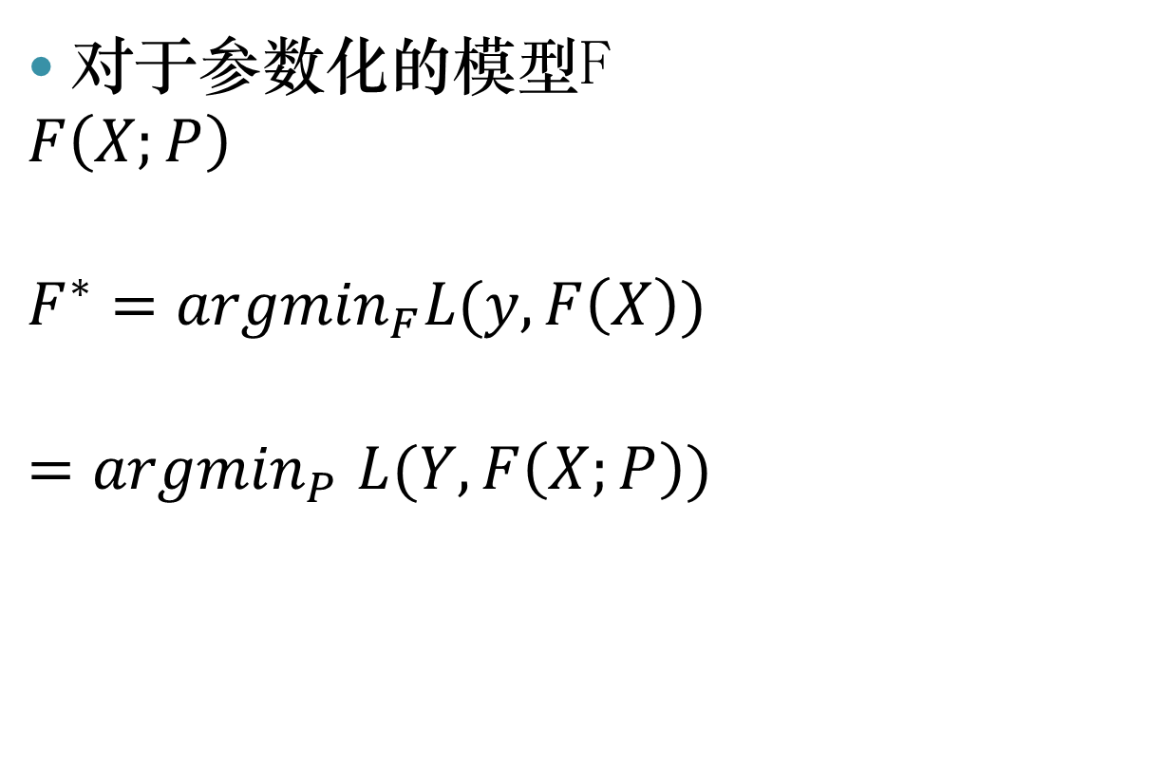

最优解$F^{∗}$
对于参数化的模型F
$$F\left(X;P\right)$$
$$F^{∗}={argmin}_{F}L(y,F\left(X\right))$$
$${=argmin}_{P}L(Y,F\left(X;P\right))$$

Slide 9
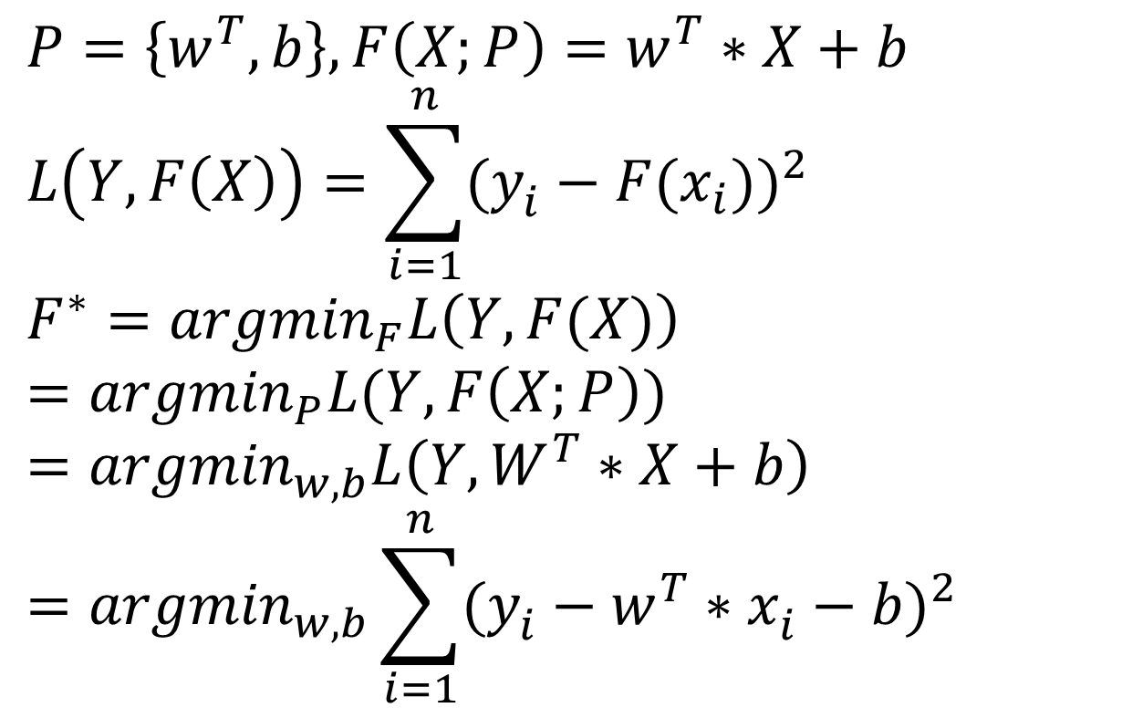
示例
$$P=\left\{w^{T},b\right\},F\left(X;P\right)=w^{T}∗X+b$$
$$L\left(Y,F\left(X\right)\right)=\sum_{i=1}^{n}{{(y_{i}^{}−F(x_{i}))}^{2}}$$
$$F^{∗}={argmin}_{F}L\left(Y,F(X)\right)$$
$$={argmin}_{P}L(Y,F\left(X;P\right))$$
$$={argmin}_{w,b}L\left(Y,W^{T}∗X+b\right)$$
$$={argmin}_{w,b}\sum_{i=1}^{n}{{(y_{i}^{}−w^{T}∗x_{i}^{}−b)}^{2}}$$

Slide 10

Gradient descent
参数P的求解
假设有一个初始解$P_{m−1}$,如何寻找一个更优解 $P_{m}$
$$p_{m}=p_{m−1}+ρ∗∆p$$

Slide 11
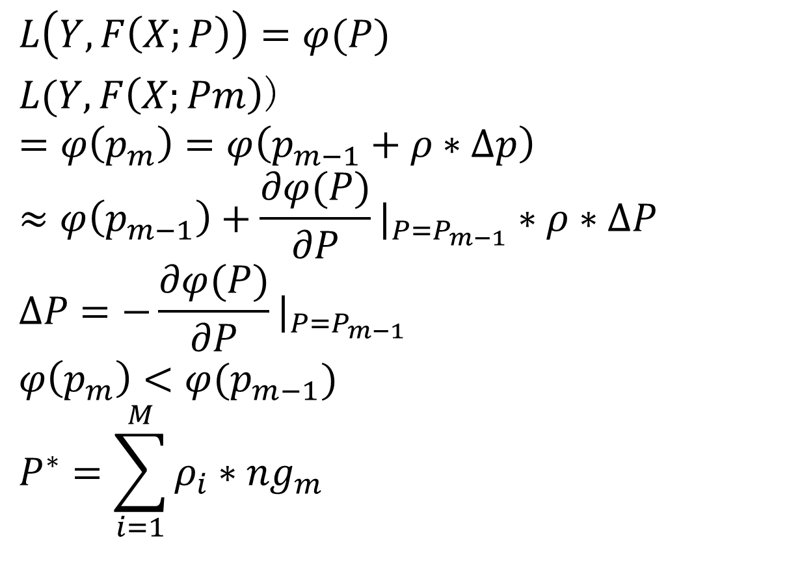
Gradient descent
$$L\left(Y,F\left(X;P\right)\right)=φ(P)$$
$L(Y,F\left(X;Pm\right)$)
$$=φ\left(p_{m}\right)=φ\left(p_{m−1}+ρ∗∆p\right)$$
$$≈φ\left(p_{m−1}\right)+\frac{∂φ(P)}{∂P}|_{P=P_{m−1}}∗ρ∗∆P$$
$$∆P=−\frac{∂φ(P)}{∂P}|_{P=P_{m−1}}$$
$$φ\left(p_{m}\right)<φ(p_{m−1})$$
$$P^{∗}=\sum_{i=1}^{M}{ρ_{i}∗{ng}_{m}}$$

Slide 12
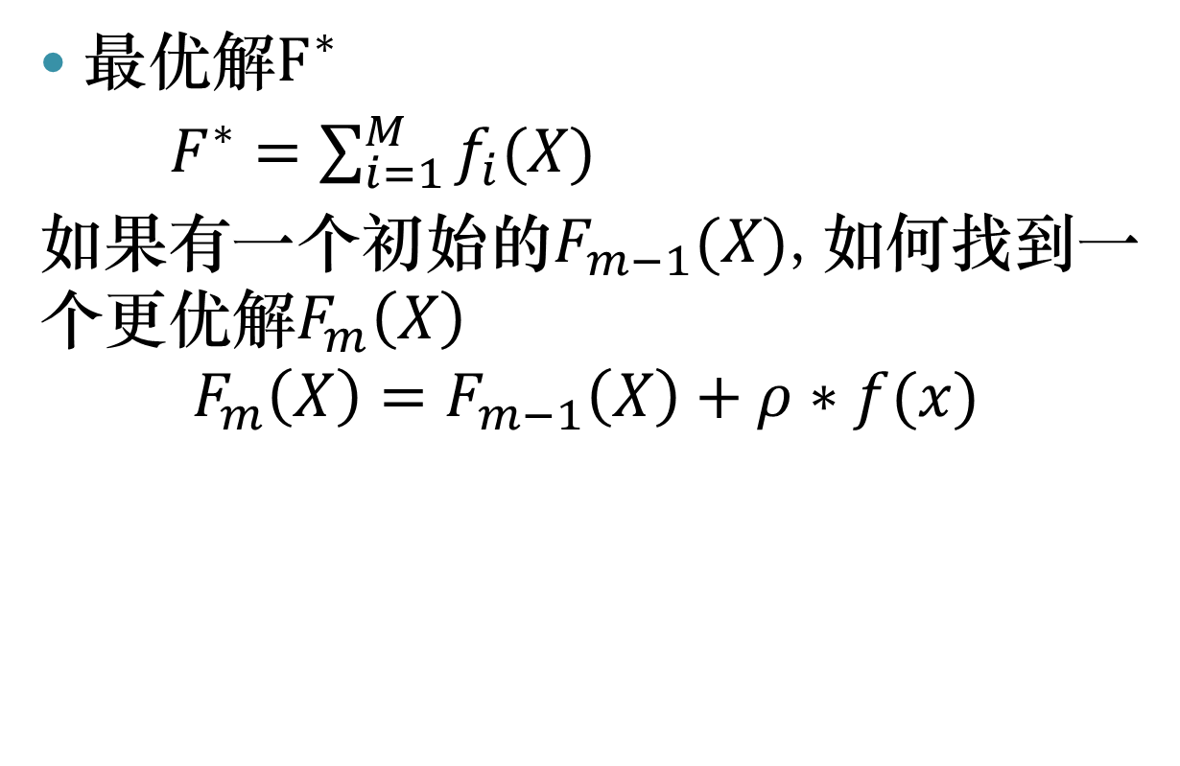
Gradient boost
最优解$F^{∗}$
$F^{∗}=\sum_{i=1}^{M}{f_{i}(X)}$
如果有一个初始的$F_{m−1}(X)$,如何找到一个更优解$F_{m}\left(X\right)$
$$F_{m}\left(X\right)=F_{m−1}\left(X\right)+ρ∗f(x)$$

Slide 13
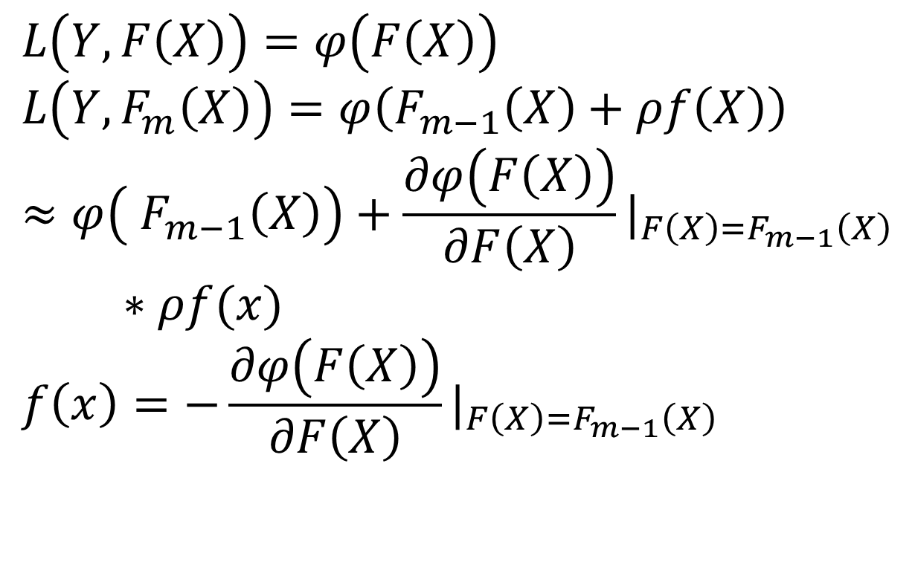
Gradient boosting
$$L\left(Y,F\left(X\right)\right)=φ\left(F\left(X\right)\right)$$
$$L\left(Y,F_{m}\left(X\right)\right)=φ\left(F_{m−1}\left(X\right)+ρf\left(X\right)\right)$$
$$≈φ\left( F_{m−1}\left(X\right)\right)+\frac{∂φ\left(F\left(X\right)\right)}{∂F\left(X\right)}|_{F\left(X\right)=F_{m−1}\left(X\right)}∗ρf(x)$$
$$f\left(x\right)=−\frac{∂φ\left(F\left(X\right)\right)}{∂F\left(X\right)}|_{F\left(X\right)=F_{m−1}\left(X\right)}$$

Slide 14
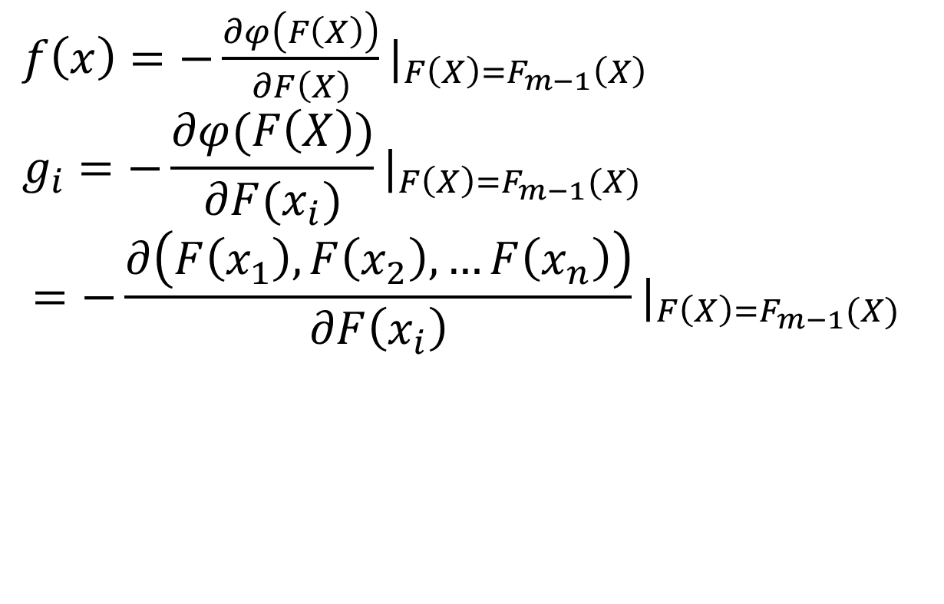
Gradient boosting
？
$f\left(x\right)=−\frac{∂φ\left(F\left(X\right)\right)}{∂F\left(X\right)}|_{F\left(X\right)=F_{m−1}\left(X\right)}$
$$g_{i}=−\frac{∂φ(F\left(X\right))}{∂F(x_{i})}|_{F\left(X\right)=F_{m−1}(X)}$$
$$=−\frac{∂\left(F\left(x_{1}\right),F\left(x_{2}\right),…F\left(x_{n}\right)\right)}{∂F\left(x_{i}\right)}|_{F\left(X\right)=F_{m−1}(X)}$$

Slide 15
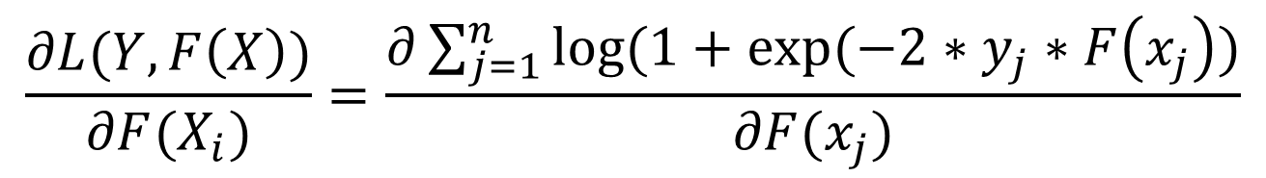
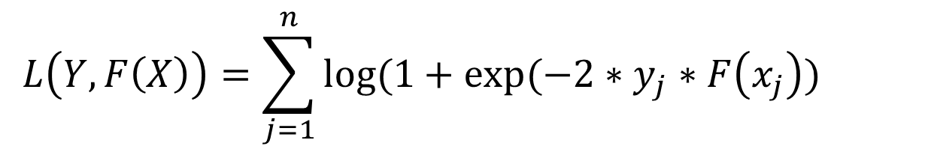
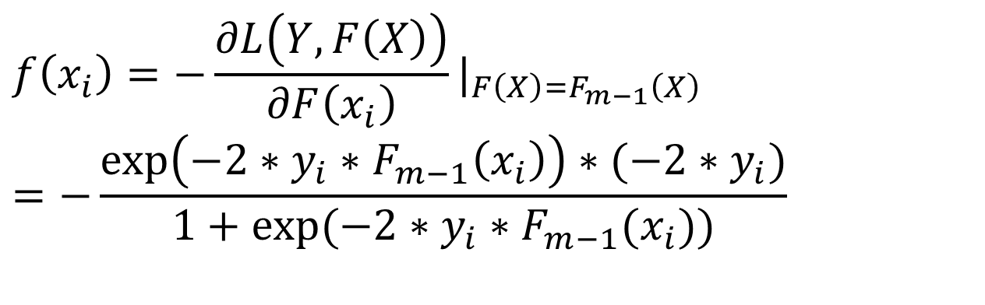
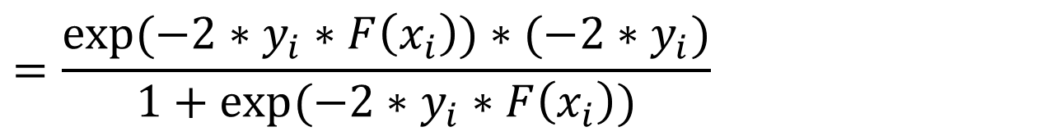
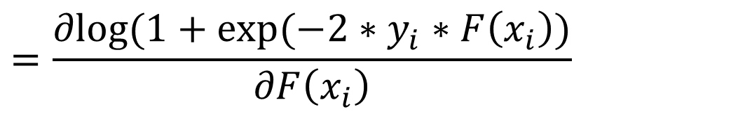
$$L\left(Y,F\left(X\right)\right)=\sum_{j=1}^{n}{log⁡(1+exp⁡(−2∗y_{j}∗F\left(x_{j}\right))}$$
$$\frac{∂L(Y,F\left(X\right))}{∂F(X_{i})}=\frac{∂\sum_{j=1}^{n}{log⁡(1+exp⁡(−2∗y_{j}∗F\left(x_{j}\right))}}{∂F(x_{j})}$$
$$=\frac{∂log⁡(1+exp⁡(−2∗y_{i}∗F\left(x_{i}\right))}{∂F\left(x_{i}\right)}$$
$$=\frac{exp⁡(−2∗y_{i}∗F\left(x_{i}\right))∗(−2∗y_{i})}{1+exp⁡(−2∗y_{i}∗F\left(x_{i}\right))}$$
$$f\left(x_{i}\right)=−{\frac{∂L\left(Y,F\left(X\right)\right)}{∂F\left(x_{i}\right)}|}_{F\left(X\right)=F_{m−1}\left(X\right)}$$
$$=−\frac{\exp\left(−2∗y_{i}∗F_{m−1}\left(x_{i}\right)\right)∗(−2∗y_{i})}{1+exp⁡(−2∗y_{i}∗F_{m−1}(x_{i}))}$$

Slide 16
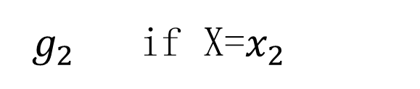
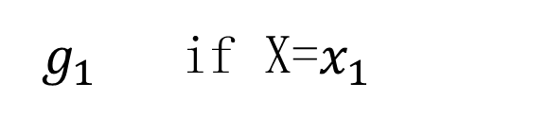
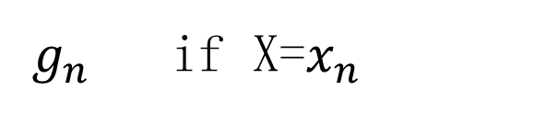
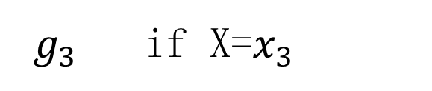
Gradient boosting
f(x)
$g_{1}$ if X=$x_{1}$
$g_{2}$ if X=$x_{2}$
$g_{3}$ if X=$x_{3}$
…
$g_{n}$ if X=$x_{n}$

Slide 17

Decision Tree
0.5 if x[1]<= 0.5 & x[2]<=1
Fea_1 <= 0.5
0.7 if x[1]<= 0.5 & x[2]>1
g(x)
YES
NO
0.8 if x[1]> 0.5 & x[2]<=2
Fea_2 <= 1
Fea_2 <= 2
1.0 if x[1]> 0.5 & x[2]>2
YES
NO
YES
NO
0.5
0.7
0.8
1.0
L个叶子的Decision Tree记 ${\left\{R_{l}\right\}}_{}^{L}$,第l的叶子节点的值记 $r_{l}$

Slide 18
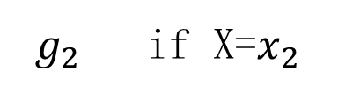
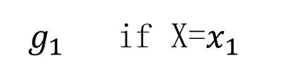
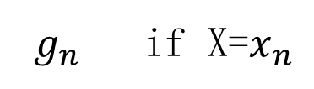
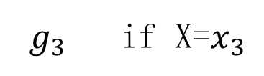
Decision Tree
$g_{1}$ if X=$x_{1}$
$g_{2}$ if X=$x_{2}$
Fit
$g_{3}$ if X=$x_{3}$
f(x)
…
$g_{n}$ if X=$x_{n}$

Slide 19
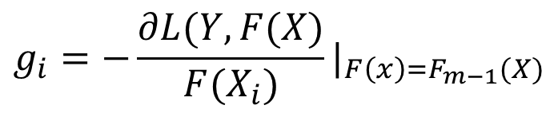

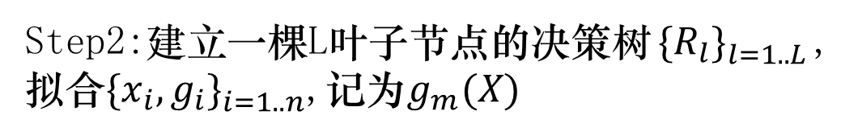
Gradient boosting Decision Tree
输入{X,Y}, 损失函数L(Y,F(X))
初始模型 $F_{0}\left(X\right)=0$
For m = 1 to M
Step1:计算在每一个样本点的负梯度gi
$$g_{i}=−\frac{∂L(Y,F(X)}{F(X_{i})}|_{F\left(x\right)=F_{m−1}(X)}$$
Step2:建立一棵L叶子节点的决策树${\{R_{l}\}}_{l=1..L}^{}$,拟合${\{x_{i},g_{i}\}}_{i=1..n}^{}$,记为$g_{m}(X)$
Step3: $F_{m}\left(X\right)=F_{m−1}\left(X\right)+ρ∗g_{m}(X)$
$$F\left(X\right)=F_{M}(X)$$

Slide 20
大纲
GBDT算法介绍
GBDT实现原理
GBDT并行实现
应用

Slide 21
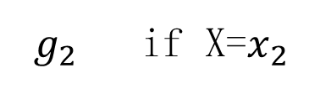
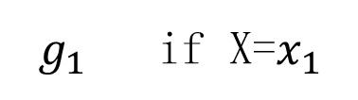
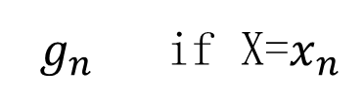
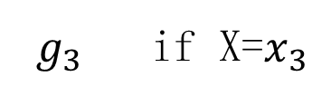
GBDT实现原理
建立决策树拟合负梯度函数
$g_{1}$ if X=$x_{1}$
$g_{2}$ if X=$x_{2}$
Fit
$g_{3}$ if X=$x_{3}$
f(x)
…
$g_{n}$ if X=$x_{n}$
g(x)

Slide 22
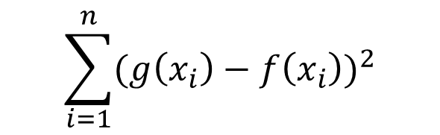
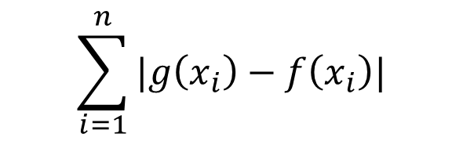
g(x)拟合f(x) 拟合指标
g(x)与f(x)的diff
absolute error
$$\sum_{i=1}^{n}{|g\left(x_{i}\right)−f\left(x_{i}\right)|}$$
square error
$$\sum_{i=1}^{n}{{(g\left(x_{i}\right)−f\left(x_{i}\right))}^{2}}$$

Slide 23
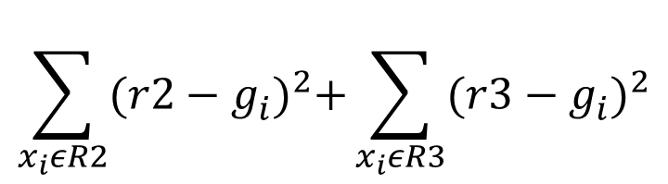
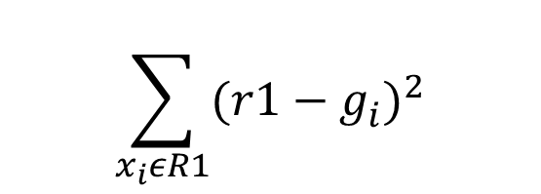
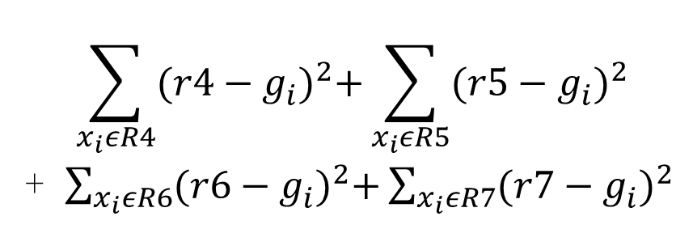
Greedy algorithm
$$\sum_{x_{i}εR1}{{(r1−g_{i}^{})}^{2}}$$
r1
$$\sum_{x_{i}εR2}{{(r2−g_{i}^{})}^{2}+\sum_{x_{i}εR3}{{(r3−g_{i}^{})}^{2}}}$$
r2
r3
r4
r5
r6
r7
$$\sum_{x_{i}εR4}{{(r4−g_{i}^{})}^{2}+\sum_{x_{i}εR5}{{(r5−g_{i}^{})}^{2}}}$$
+ $\sum_{x_{i}εR6}{{(r6−g_{i}^{})}^{2}+\sum_{x_{i}εR7}{{(r7−g_{i}^{})}^{2}}}$

Slide 24
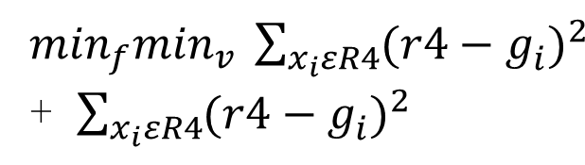
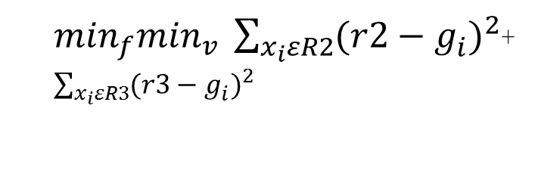
Greedy algorithm
$\min_{f}\min_{v} \sum_{x_{i}εR2}{{(r2−g_{i}^{})}^{2}}$+ $\sum_{x_{i}εR3}{{(r3−g_{i}^{})}^{2}}$
r1
$\min_{f}\min_{v} \sum_{x_{i}εR4}{{(r4−g_{i}^{})}^{2}}$+ $\sum_{x_{i}εR4}{{(r4−g_{i}^{})}^{2}}$
r2
r3
r4
r5
r6
r7
r8
r9

Slide 25
Min F min V
r1
x1(1,0)
g1(0.5))
x2(3,1)
g2(3))
x3(2,6)
g3(7))
x4(6,3)
g4(16))
x5(5,2)
g5(12))
先计算feature 1的min V
r2
r3
x1[1](1)
g1(0.5))
x2[1](3)
g2(3))
x3[1](2)
g3(7))
x4[1](6)
g4(16))
x5(5)
g5(12))
样本按feature 1的排序
x1[1](1)
g1(0.5))
x3[1](2)
g3(7))
x2[1](3)
g2(3))
x5(5)
g5(12))
x4[1](6)
g4(16))

Slide 26
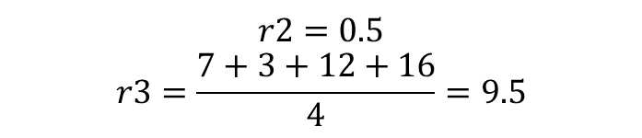
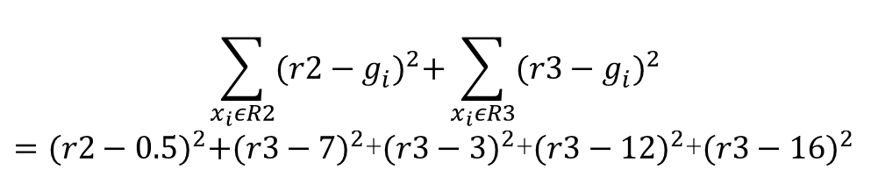

MIN v
V = 1.5
r1
x1[1](1)
g1(0.5))
x3[1](2)
g3(7))
x2[1](3)
g2(3))
x5(5)
g5(12))
x4[1](6)
g4(16))
X1(0.5)
X3(7)
X2(3)
X5(12)
X4(16)
r2
r3
$$\sum_{x_{i}εR2}{{(r2−g_{i}^{})}^{2}+\sum_{x_{i}εR3}{{(r3−g_{i}^{})}^{2}}}$$
$={(r2−0.5)}^{2}+{(r3−7)}^{2}$+${(r3−3)}^{2}$+${(r3−12)}^{2}$+${(r3−16)}^{2}$
$$r2=0.5$$
$$r3=\frac{7+3+12+16}{4}=9.5$$
$$error:97$$

Slide 27
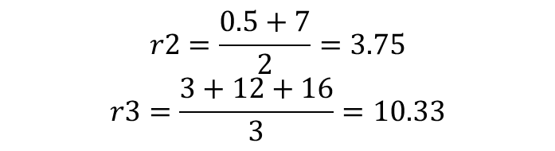
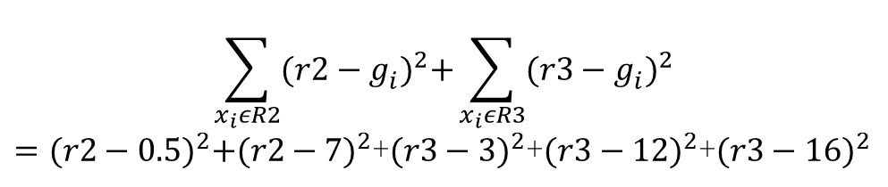

MIN v
V = 2.5
r1
x1[1](1)
g1(0.5))
x3[1](2)
g3(7))
x2[1](3)
g2(3))
x5(5)
g5(12))
x4[1](6)
g4(16))
r2
r3
$$\sum_{x_{i}εR2}{{(r2−g_{i}^{})}^{2}+\sum_{x_{i}εR3}{{(r3−g_{i}^{})}^{2}}}$$
$={(r2−0.5)}^{2}+{(r2−7)}^{2}$+${(r3−3)}^{2}$+${(r3−12)}^{2}$+${(r3−16)}^{2}$
x1(0.5)
X3(7)
x2(3)
X5(12)
X4(16)
$$r2=\frac{0.5+7}{2}=3.75$$
$$r3=\frac{3+12+16}{3}=10.33$$
$$error:109.7917$$

Slide 28
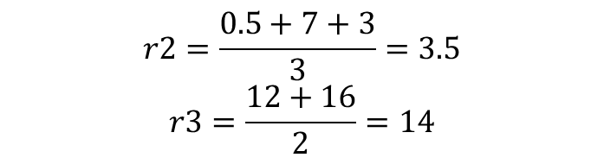
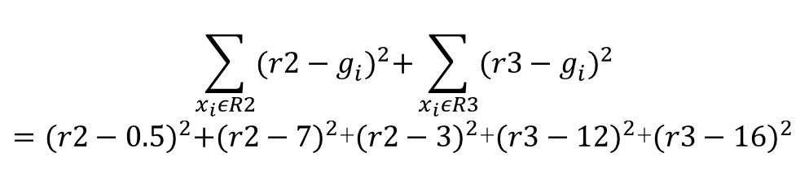

MIN v
V = 4
r1
x1[1](1)
g1(0.5))
x3[1](2)
g3(7))
x2[1](3)
g2(3))
x5(5)
g5(12))
x4[1](6)
g4(16))
r2
r3
$$\sum_{x_{i}εR2}{{(r2−g_{i}^{})}^{2}+\sum_{x_{i}εR3}{{(r3−g_{i}^{})}^{2}}}$$
$={(r2−0.5)}^{2}+{(r2−7)}^{2}$+${(r2−3)}^{2}$+${(r3−12)}^{2}$+${(r3−16)}^{2}$
x1(0.5)
x3(7)
x2(3)
X5(12)
X4(16)
$$r2=\frac{0.5+7+3}{3}=3.5$$
$$r3=\frac{12+16}{2}=14$$
$$error:29.5$$

Slide 29
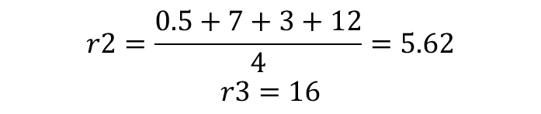
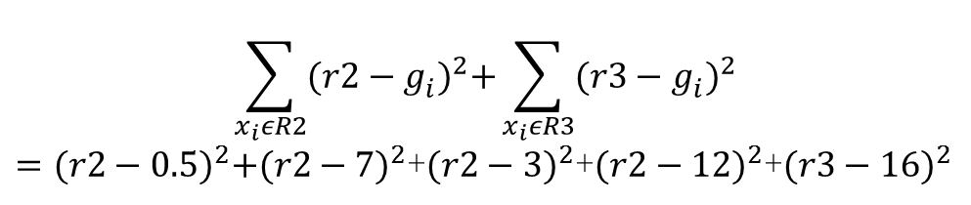

MIN v
V = 5.5
r1
x1[1](1)
g1(0.5))
x3[1](2)
g3(7))
x2[1](3)
g2(3))
x5(5)
g5(12))
x4[1](6)
g4(16))
r2
r3
$$\sum_{x_{i}εR2}{{(r2−g_{i}^{})}^{2}+\sum_{x_{i}εR3}{{(r3−g_{i}^{})}^{2}}}$$
$={(r2−0.5)}^{2}+{(r2−7)}^{2}$+${(r2−3)}^{2}$+${(r2−12)}^{2}$+${(r3−16)}^{2}$
x1(0.5)
X3(7)
X2(3)
X5(12)
X4(16)
$$r2=\frac{0.5+7+3+12}{4}=5.62$$
$$r3=16$$
$$error:75.68$$

Slide 30
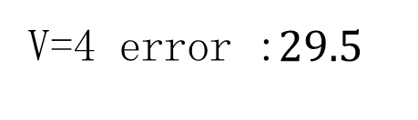
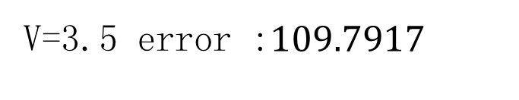
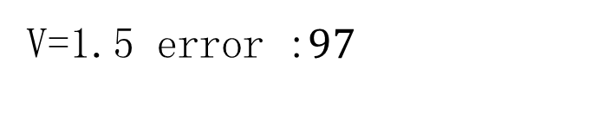
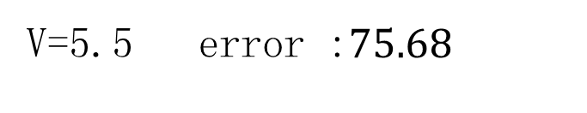
MIN v
V = 5.5
r1
x1[1](1)
g1(0.5))
x3[1](2)
g3(7))
x2[1](3)
g2(3))
x5(5)
g5(12))
x4[1](6)
g4(16))
r2
r3
V=1.5 error :$97$
V=3.5 error :$109.7917$
V=4 error :$29.5$
V=5.5 error :$75.68$

Slide 31
Min V
F1<=4
3.5
14

Slide 32
Min V
计算复杂度
N个样本，一共有n个可选的分裂点
对于一个分列V,求error n次运算
复杂度 O(N^2)
?

Slide 33
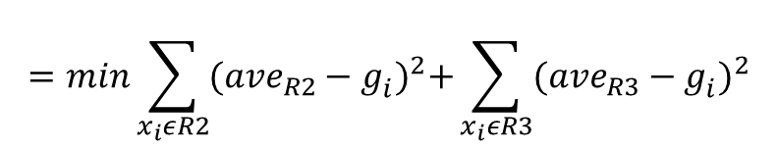





Min v
$$min\sum_{x_{i}εR2}{{(r2−g_{i}^{})}^{2}+\sum_{x_{i}εR3}{{(r3−g_{i}^{})}^{2}}}$$
$$=min\sum_{x_{i}εR2}{{({ave}_{R2}−g_{i}^{})}^{2}+\sum_{x_{i}εR3}{{({ave}_{R3}−g_{i}^{})}^{2}}}$$
$$=min\sum_{x_{i}εR2}{{g_{i}}^{2}}−{count}_{R2}∗{{ave}_{R2}}^{2}+\sum_{x_{i}εR3}{{g_{i}}^{2}}−{count}_{R3}∗{{ave}_{R3}}^{2}$$
$$=min\sum_{x_{i}εR1}{{g_{i}}^{2}}−\frac{{{sum}_{R2}}^{2}}{{count}_{R2}}−\frac{{{sum}_{R3}}^{2}}{{count}_{R3}}$$
constant
$$=min−\frac{{{sum}_{R2}}^{2}}{{count}_{R2}}−\frac{{{sum}_{R3}}^{2}}{{count}_{R3}}$$
$$=max\frac{{{sum}_{R2}}^{2}}{{count}_{R2}}+\frac{{{sum}_{R3}}^{2}}{{count}_{R3}}$$

Slide 34
MIN v
ALL_SUM=0.5+7+3+12+16=38.5
ALL_COUNT=5
x1[1](1)
g1(0.5))
x3[1](2)
g3(7))
x2[1](3)
g2(3))
x5(5)
g5(12))
x4[1](6)
g4(16))
R2_SUM=0.5
R2_COUNT=1
R2_SUM=7.5
R2_COUNT=2
R2_SUM=10.5
R2_COUNT=3
R2_SUM=22.5
R2_COUNT=4
R3_SUM=38
R3_COUNT=4
R3_SUM=31.5
R3_COUNT=3
R3_SUM=28.5
R3_COUNT=2
R3_SUM=16
R3_COUNT=1
0.5^2/1+38^2/4=361.25
7.5^2/2+31.5^2/3=358.5
10.5^2/3+28.5^2/2=442.875
22.5^2/4+16^2/1=382.5625
O(N)
V=4

Slide 35

Create Tree
输入${\{x_{i},g_{i}\}}_{i=1..n}^{}$
Step1.将所有样本放入root结点（R1），标记为可分结点
Step2.对于一个可分的结点，寻找一个最优的分裂点(fid,value),分裂结点，并将该结点标记为不可分，同时将新生成的子结点标记为可分结点。
Step3.重复step2，直至无可分结点或者叶子结点数达到域值终止。

Slide 36
大纲
GBDT算法介绍
GBDT实现原理
GBDT并行原理
应用

Slide 37

GBDT并行原理
Label
Feature l
Feature 2
Feature 3
Label
g
Work 1
Work 2
Work 3

Slide 38
Split
X1
X2
X3
X4
X5
x6
x1
x2
x3
x4
x5
x6
Fea,v
R1
R1
R1
R1
R1
R1
R1
Node table
Update
R2
R3
R2
R3
R3
R2
R2
R3
X1
X4
X5
X2
X3
X6

Slide 39
Update
Label
Feature l
Feature 2
Feature 3
Label
g
Node table
Work 1
Work 2
Work 3

Slide 40
数据并行
Feature l
Feature 2
Feature 3
Label
g
Node table
Work 1
Work 2
Work 3

Slide 41
Feature l
Feature 2
Feature 3
图例
Label
Fea
Work 1
Work 2
Work 3
g
Node
table
Work 4
Work 5
Work 6
Work 7
Work 8
Work 9

Slide 42
图例
Feature l
Label
v1
L_sum
L_count
R_sum
R_count
L_sum*L_sum/L_count+R_sum*R_sum/R_count
Fea
Work 1
v2
L_sum
L_count
R_sum
R_count
g
L_sum*L_sum/L_count+R_sum*R_sum/R_count
Node
table
v3
L_sum
L_count
R_sum
R_count
Work 4
L_sum*L_sum/L_count+R_sum*R_sum/R_count
v4
L_sum
L_count
R_sum
R_count
L_sum*L_sum/L_count+R_sum*R_sum/R_count
Work 7

Slide 43
Feature l
v1
v2
v3
v4
图例
Local left sum
Local left count
Label
Local right sum
Local right count
Fea
Work 1
Local left sum
Local left count
g
Local right sum
Local right count
Node
table
Work 4
Local left sum
Local left count
Local right sum
Local right count
Work 7
ALL_Reduce SUM
global left sum
global left count
global right sum
global right count

Slide 44
Feature l
v1
v2
v3
v4
图例
Local left sum
Local left count
Label
Fea
Work 1
Local left sum
Local left count
g
Node
table
Work 4
Local left sum
Local left count
Work 7
ALL_Reduce SUM
global left sum
global left count

Slide 45
split value list
样本
Split value list
Split value list

Slide 46



通信时间
特征个数 fea_count, 数据并行度 K组， 总work数 fea_count * K
Min V : Reduce local sum and weight
$$Num_splits∗2∗4∗\log_{2}K≈8kb∗\log_{2}K$$
Min Feature
$$2∗4∗\log_{2}(fea_{count}∗K) byte$$
Node table
$$\frac{N}{8∗K} byte$$

Slide 47

性能测试
数据量1亿2千万数据，特征150
单棵树叶子结点32 500棵树
数据并发度K | 平均计算梯度时间 | 平均建树时间 | 总时间 | 加速比
1 | 15 sec | 114.7 sec | 18.01h | 1
2 | 8 sec | 60.3 sec | 9.48 h | 1.89
4 | 4 sec | 32.2 sec | 5.02h | 3.58
8 | 2 sec | 17.2 | 2.66h | 6.75
16 | 1 sec | 11.2 | 1.69h | 10.63

Slide 48
大纲
GBDT算法介绍
GBDT实现原理
GBDT并行实现
应用

Slide 49
推荐场景
协同过滤
LR点击率预测

Slide 50
Ranking- pairwise optimization
构建pair
Click >> non click
Cart & buy >> click

Slide 51
Multi-obojective
Click & price
Price high >> price low

Slide 52
结果
收藏夹-猜你喜欢
点击率、转化率、客单价、引导成交的全面提升
手淘试用品推荐
点击率显著提升
已买到宝贝-猜你喜欢
点击率显著提升

Slide 53
集团内业务应用
共享平台、搜索、B2B、蚂蚁金服、阿里妈妈、CDO、天猫、OS、iDST、淘宝技术部、菜鸟、国际事业部等十几个BU的重要业务应用

Slide 54


算法开放&集团外部应用
御膳房算法平台
http://pai.yushanfang.com

Slide 55
Q & A
Thank you

