Slide 1















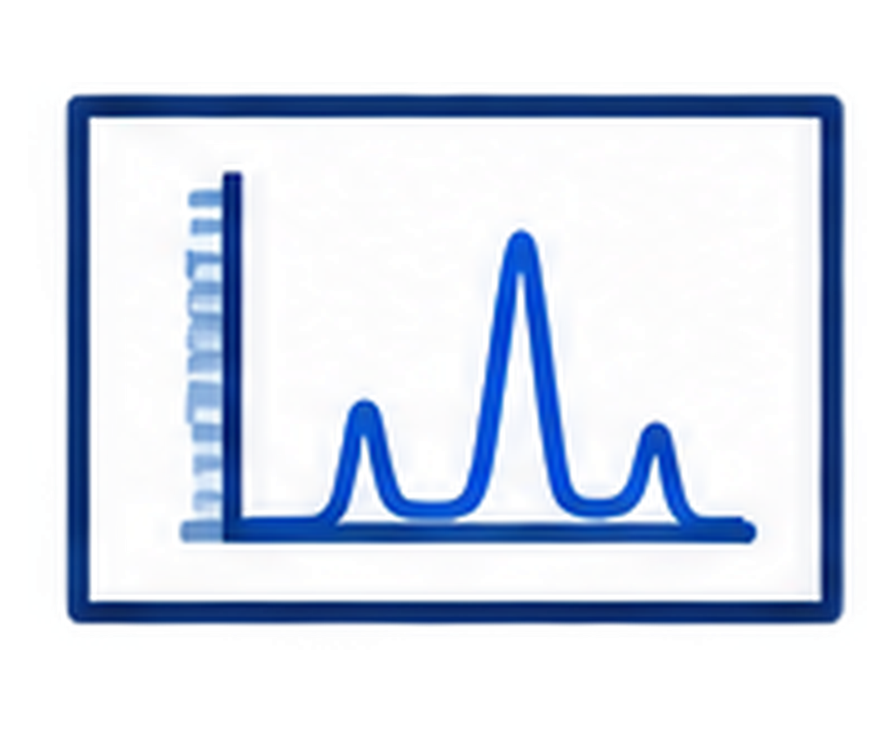







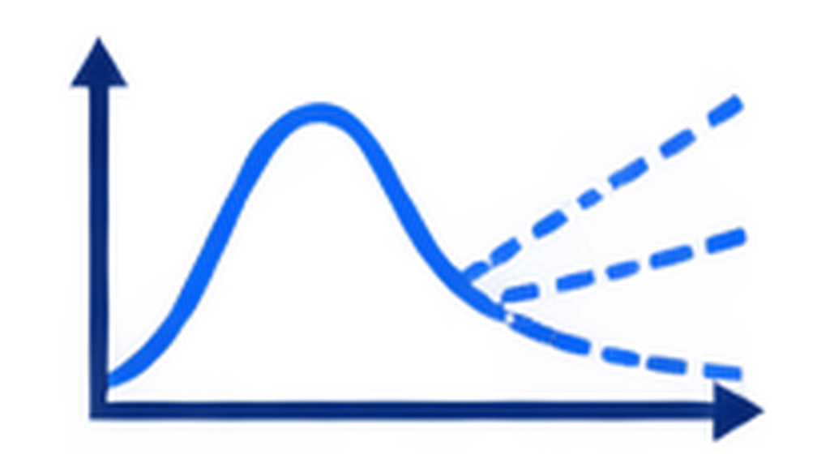

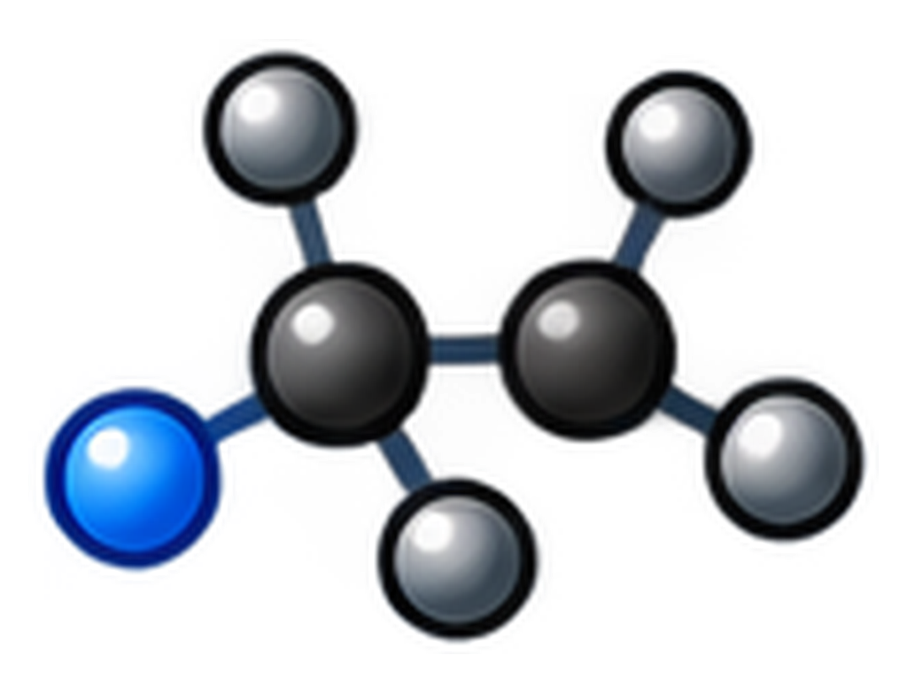

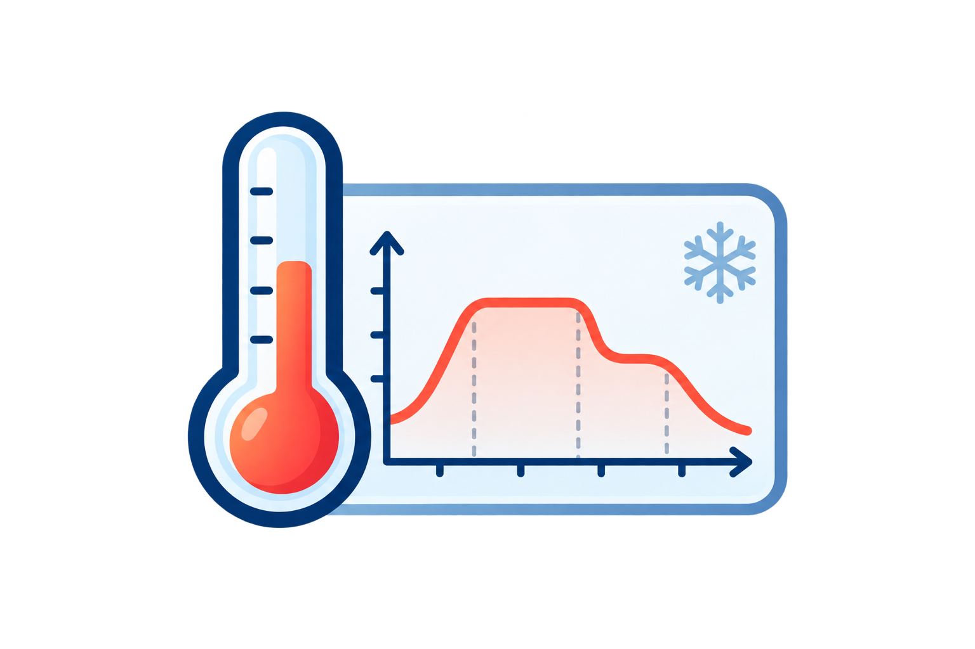

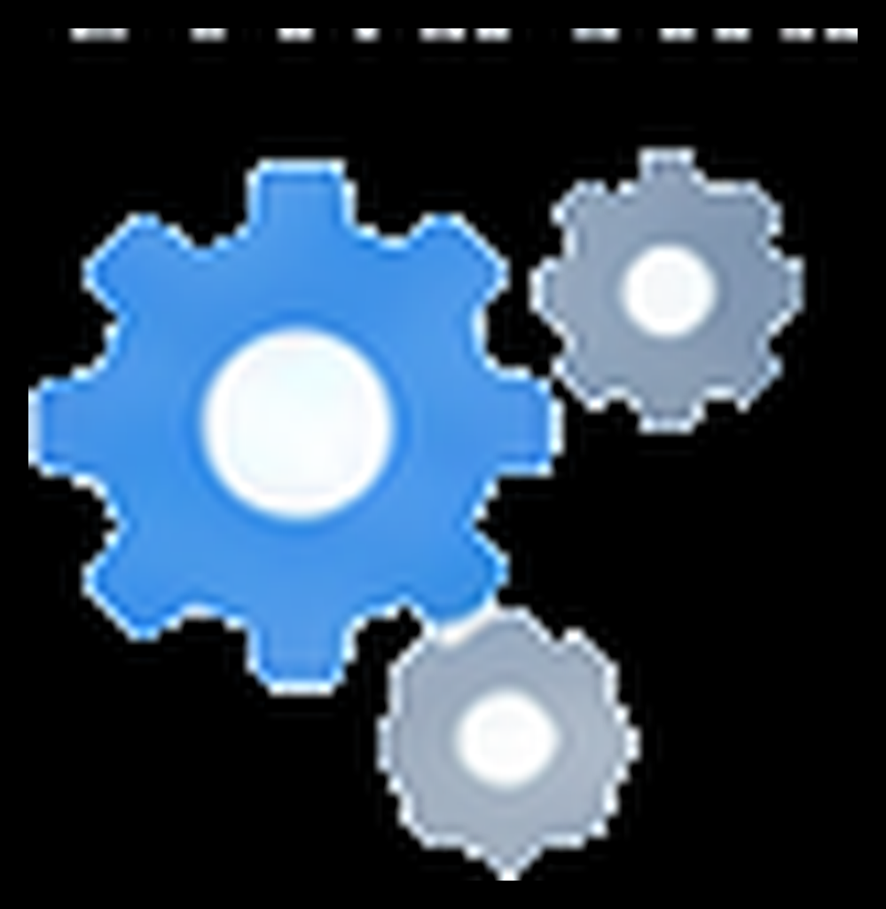



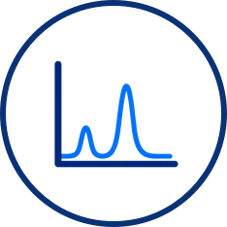




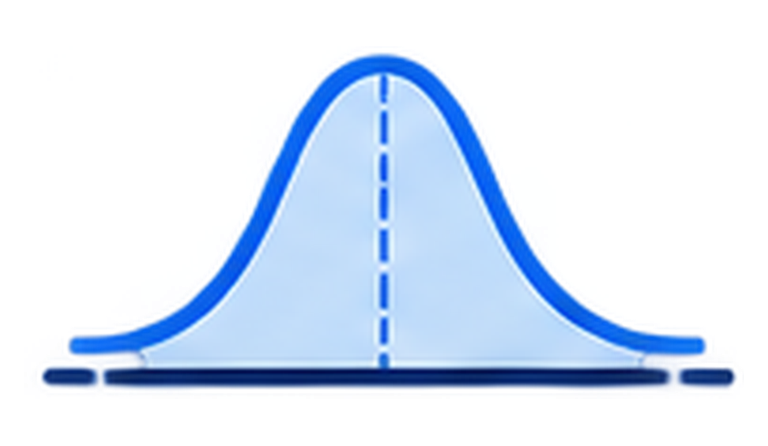
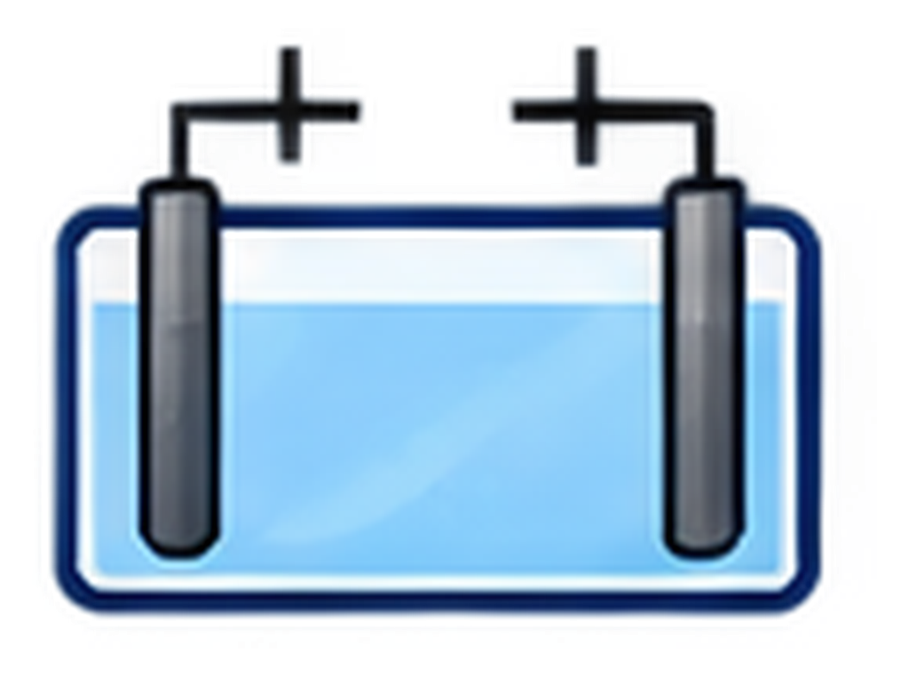


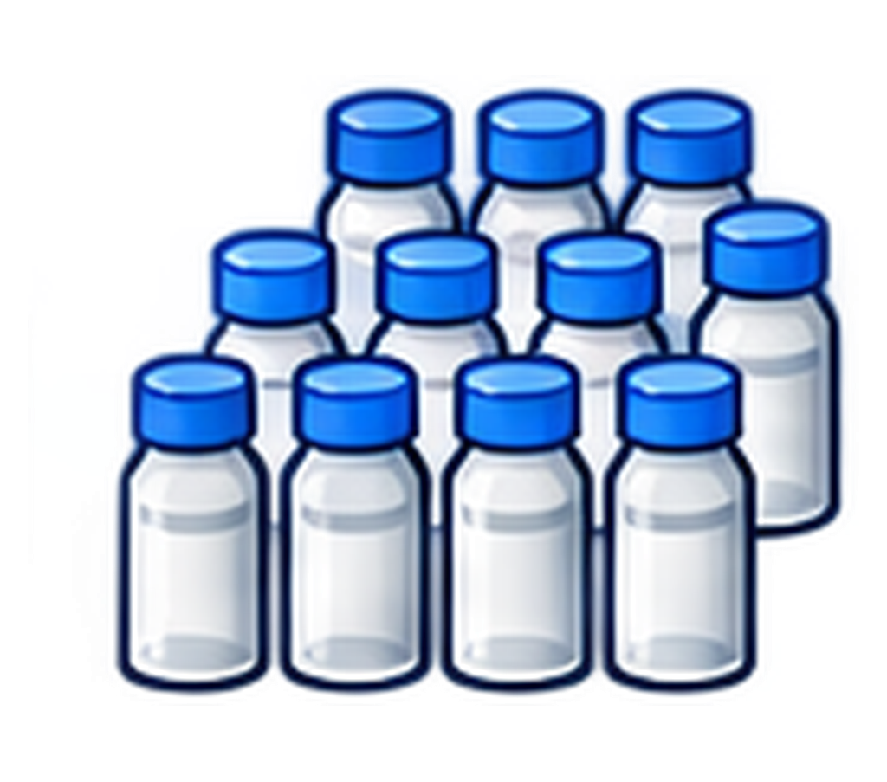
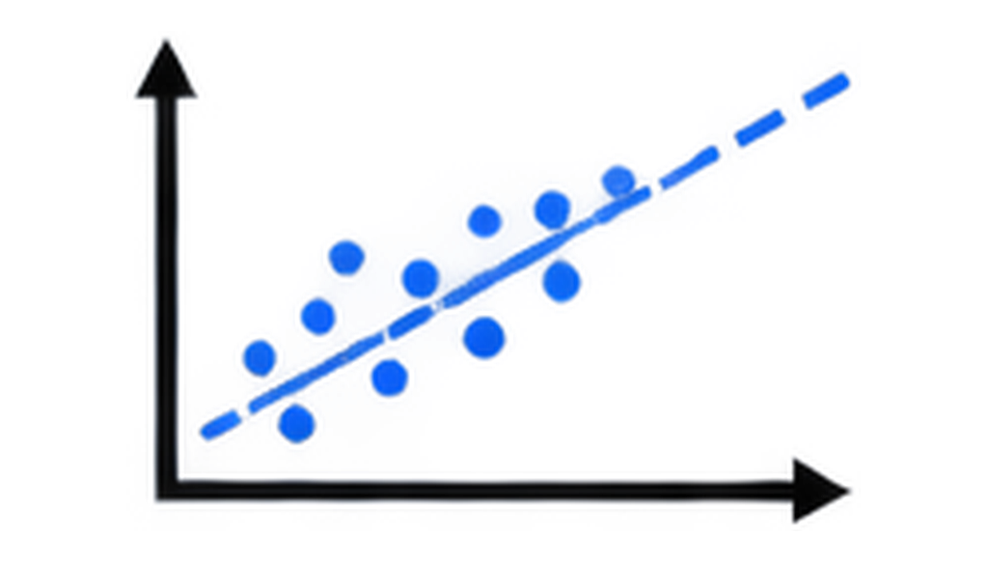



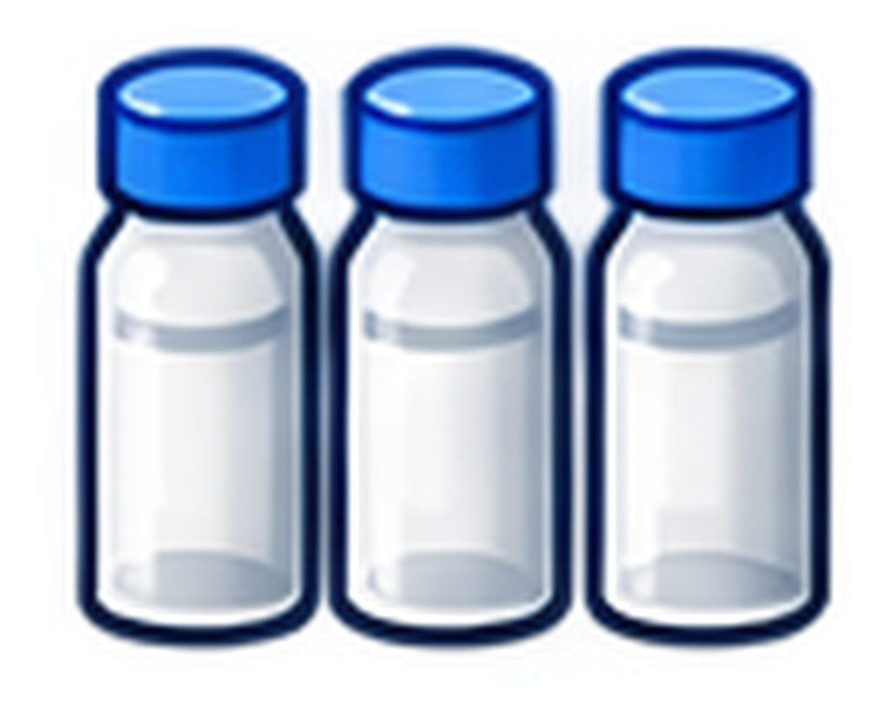
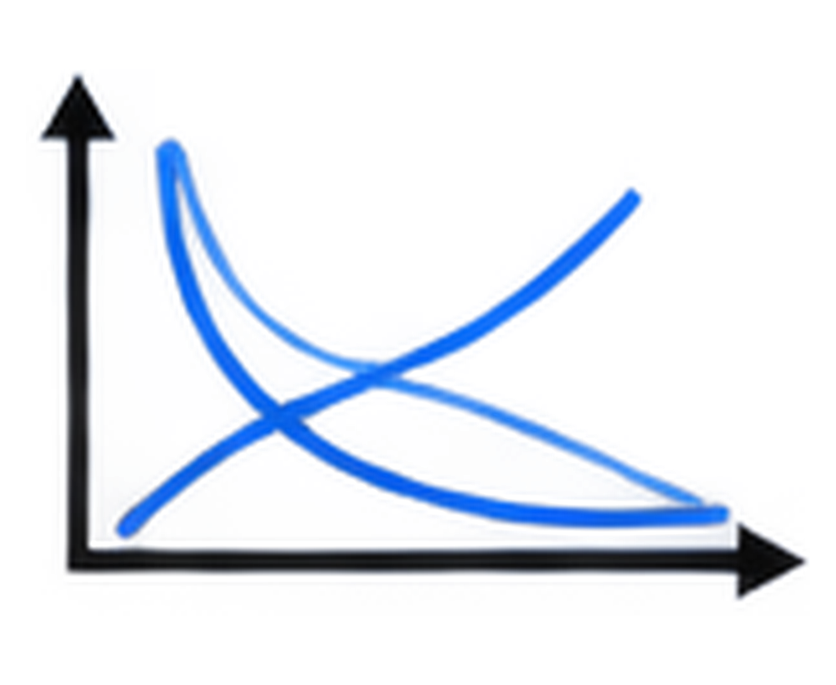

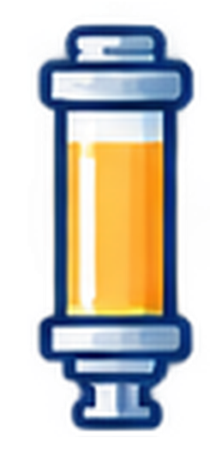
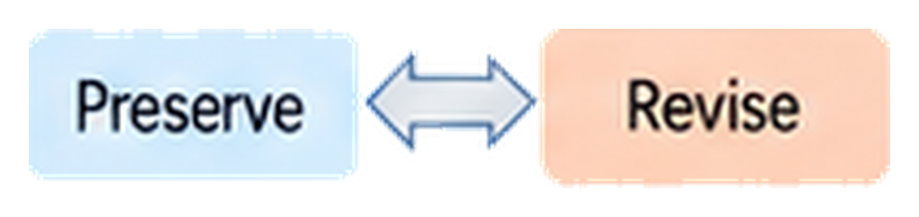
a
Static benchmarks
Real laboratories
Single-endpoint evaluation
No persistent
experimental state
Hidden laws and
unmatched worlds
score
Task success ≠
scientific generalization
Fixed dataset
b
ChemWorld
A Representative Autonomous Campaign in ChemWorld
Operational validation
A programmable chemical world
for autonomous scientific discovery
Evidence-guided iteration
Controllable
hidden laws
Sealed
recommendation
Independent
retest
Operational
achievement
Virtual instruments
and resources
Scientific understanding and prediction
Scientific
question
Agent
Choose conditions
Reaction /
thermal process
Measurement
Adaptation
Evidence
accumulation
+
+
Persistent
physical state
Composition
Phase
Thermal
history
Remaining
material
Scientific
account
(K1)
Unseen
conditions
(Q)
Evidence
review
(K2)
Prediction Uncertainty
Persistent state
(updated after every experiment)
Controllability
Traceability
Separability
Hidden laws
(physical world)
Public information
(agent view)
Operation
(what was done)
Prediction
(what will happen)
Uncertainty
(how certain)
Manipulate physics and information independently
Full research histories can be replayed and audited
Operation, prediction and uncertainty are evaluated separately
c
Controlled study design
Study scope
240 Sol campaigns / 6 families + 60 equilibrium campaigns
Opaque information
Aligned information
Mismatched information
Research envelope
Does the learned
relationship still apply?
Electrochemistry
Partitioning
Reaction / thermal
12
batches
24
batches
Same world, different information
Equilibrium
Crystallization
Purification
Notes:
Figure 1. Controlled experimental worlds. Source: FIgure1_2.pptx.

Slide 2


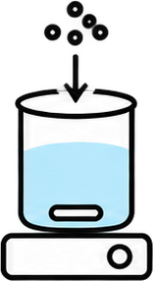



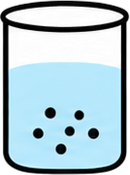




a
Twelve-batch history: fines and recovery
B11
fines 72.6%
99.7
100.0
99.5
100.0
B5
first feasible
B8
selected
B12
repeat
100
72.6
50
Quality limit (≤ 50%)
30.3
29.4
25.4
25.4
26.9
27.8
26.9
Fines (%)
0
75
42.8
45.0
45.5
44.6
44.7
44.6
44.1
50
38.1
40.0
Recovery (%)
22.6
22.4
24.8
25
0
1
2
3
4
5
6
7
8
9
10
11
12
Batch
b
Batch 8 (B8) experiment in full detail
Charge reagent
+ S2 solvent
+ C1 catalyst
Heat toward
355 K for 1 h
at 300 rpm
Controlled cool
toward 325 K
for 2 h
Add 1 mg
seed
Cool toward
250 K for 4 h
Hold 4 h
at 100 rpm
Particle-size
check
Filter
Terminate
Final assay
fines
26.6%
recovery 45.5%
purity 98.2%
fines 25.4%
c
Key observations, questions, and next tests
Observed
Agent question
Next tested action
Outcome
B1–4:
fines 99.5–100.0%
Where are
fines forming?
B5: omit quench;
cool before seeding
fines 30.3%;
first feasible
B5: feasible;
recovery 40.0%
Do colder endpoints
improve recovery?
B6/B7: end at 265/250 K;
B8: seed 5 → 1 mg
recovery 42.8 → 45.0 → 45.5%
fines < 30%
B8 best so far;
B9–10 additional probes
Does higher
concentration help?
B11: S2 0.080 → 0.040 L
B11 fines 72.6%, rejected;
B12 repeats B8: 26.9%
Notes:
Figure 2. Complete twelve-batch research session. Source: output/pptx/chemworld-figure2-typography.pptx.

Slide 3
a
Electrochemistry
b
Reaction processing
Better on both
Better on both
Better prediction only
13/30
0.2
Better prediction only
4/30
0.2
1/30
4/30
0.1
0.1
0.0
0.0
Score MAE: Discovery - Optimization
Score MAE: Discovery - Optimization
−0.1
−0.1
−0.2
Example in c–d
Worse on both
Better retest only
Worse on both
Better retest only
3/30
13/30
−0.2
17/30
5/30
−0.50
−0.25
0.00
0.25
0.50
−0.06
−0.03
0.00
0.03
0.06
Retest score: Optimization - Discovery
Retest score: Optimization - Discovery
Information:
Opaque
Aligned
MisIndexed
Information:
Opaque
Aligned
MisIndexed
c
Two independent 12-batch research paths
Discovery
Optimization
Both select batch 12
0.75
0.756
0.718
0.50
Observed score
0.25
0.00
1
2
3
4
5
6
7
8
9
10
11
12
Retest
Solvents
Potential
Electrolytes
Duration /
Independent
current
recommendation
Material pairs
Cross-pairs
Potential
Current / time / potential
retests
d
The optimization agent's subsequent predictions
Later public Q rationale (condensed): poor cross-pairs suggest material incompatibility.
Forecast + 80% interval
Withheld reference
MAE 0.229; coverage 5/12
S0/E0
S0/E1
S0/E3
S2/E0
0.6
Score
0.4
0.2
0.0
Q01
Q02
Q03
Q04
Q05
Q06
Q07
Q08
Q09
Q10
Q11
Q12
Highlighted conditions: +0.8 V, 100 mA, 7,200 s. All queries use 0.012 mol in 0.025 L.
Notes:
Figure 3. Goals, research paths and predictions. Source: D:\Projects\ChemWorld\paper\figures\venue-results\figure03-goals-paths-forecasts.svg.

Slide 4
a
Local evidence and dilute tests
b
Prior benefits can reverse for GPT-5.6 Sol
80
10⁰
8.65×
Lowest
Aligned / Opaque
concentrations
0.15862
60
0.14397
10⁻¹
0.46×
Dissociation (%)
Macro MAE (log scale)
Aligned / Opaque
40
Source assays (180)
0.01833
0.0185–2 M
10⁻²
0.01008
20
5.5–9.2% dissociation
0.00465
0.00439
0
10⁻⁵
10⁻³
10⁻¹
10¹
10⁻³
Remaining conditions
Lowest concentrations
Nominal concentration (M)
(n = 9)
Bars: mean across 5 worlds
(n = 3)
Source assays: observed by agents
Reference: 5-world mean ± SD
Opaque
Aligned
MisIndexed
c
Five model configurations show heterogeneous behavior
GPT-5.5
GPT-5.6 Luna
GPT-5.6 Terra
GPT-5.6 Sol
GPT-6 Astra
Other
0.00647
0.09867
0.03268
0.01008
0.00244
(n = 9)
0.00638
0.04997
0.01545
0.00465
0.00384
0.00461
0.05494
0.01369
0.00439
0.00234
Lowest
0.16325
0.15240
0.14611
0.01833
0.04040
(n = 3)
0.16146
0.13319
0.11466
0.15862
0.03853
0.13604
0.12556
0.12130
0.14397
0.01857
10⁻³
10⁻²
10⁻¹
10⁰
10⁻³
10⁻²
10⁻¹
10⁰
10⁻³
10⁻²
10⁻¹
10⁰
10⁻³
10⁻²
10⁻¹
10⁰
10⁻³
10⁻²
10⁻¹
10⁰
Macro MAE (log scale)
Opaque
Aligned
MisIndexed
Notes:
Selected layout F4-C / F5-B reconstructed using retained numerical evidence. Display order: GPT-5.5, GPT-5.6 Luna, GPT-5.6 Terra, GPT-5.6 Sol, GPT-6 Astra. This display order is not a measured intelligence ranking. Source records remain in paper/figures/narrative-final/source-data.json. Figure 4b: bars are five-world means, starting at 0.001 on a log axis. Figure 4c: grouped horizontal bars of five-world means, log baseline 0.001. Lowest concentration conditions (n=3) and remaining conditions (n=9) retain all twelve queries in the original posthoc concentration grouping. Figure 4a: reference error bars are sample SD, not confidence intervals. Other nine queries are not all in-distribution.

Slide 5
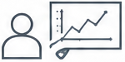
a
Lowest concentration assayed in each campaign
Opaque
Aligned
MisIndexed
Five worlds per information condition; 15 campaigns per model
10⁻¹
concentration (M)
Minimum assayed
10⁻³
10⁻⁵
GPT-5.5
GPT-5.6 Luna
GPT-5.6 Terra
GPT-5.6 Sol
GPT-6 Astra
≤ 1 mM:
0 / 15
0 / 15
0 / 15
0 / 15
11 / 15
b
Local evidence and extrapolation
d
Expanded evidence and prediction
GPT-5.6 Sol / Opaque
GPT-6 Astra (World 3, MisIndexed)
Source observations (World 1)
60
10⁰
30
Dissociation (%)
Concentration (M)
20
12 assays: apparent plateau
40
10⁻³
Dissociation (%)
20
10
0
10⁻⁵
0
0.02
0.1
1
1
2
3
4
5
6
7
8
9
10
11
12
Nominal concentration (M)
Batch
c
Five-world predictions at 13.3 µM
Dissociation
Concentration
100
Prediction
Reference
After experiments: public report (K1)
80
High loading: apparent plateau
Low loading: responsive regime
60
Dissociation (%)
Sealed forecast (Q): 13.3 µM
40
58.80% [54.20, 63.40]
Reference
20
Source observation range
Prediction
withheld
0
1
2
3
4
5
Reference
57.97%
from agent
World
40
50
60
70
Intervals: original 80% prediction intervals
Dissociation (%)
Notes:
Selected layout F4-C / F5-B reconstructed using retained numerical evidence. Display order: GPT-5.5, GPT-5.6 Luna, GPT-5.6 Terra, GPT-5.6 Sol, GPT-6 Astra. This display order is not a measured intelligence ranking. Source records remain in paper/figures/narrative-final/source-data.json. Figure 5a: three arm-colored boxplots per model, five worlds per box. Boxes show Q1-Q3, lines show medians, whiskers show minimum and maximum. Quartiles use original positive concentration values before log-axis display. The dashed 1 mM line is descriptive. Figure 5b: Sol World 1/Opaque, 12 source assays. Figure 5c: all five Sol/Opaque original 80% intervals. Figure 5d: Astra World 3/MisIndexed, all 12 batches, then condensed public K1 and original Q08. K1 is after experiments, not private contemporaneous thought. The small researcher/screen illustration is a separately cropped raster from the selected concept; scientific content is editable native shapes. No causal effect or necessity of dilute sampling is identified.

Slide 6
a
Observed and predicted purity
b
Lower MAE than the source-mean baseline
Research observations
98.53%
30 campaigns
Recovery
26/30
Blind-test reference
98.51%
30 campaigns
Fines fraction
21/30
Agent: 12 batches
93.54%
Particle size index
4/30
15 campaigns
Agent: 24 batches
94.89%
Purity
0/30
15 campaigns
0
25
50
75
100
0
10
20
30
Mean crystal purity (%)
Campaigns (of 30)
c
Information effects differ across responses
d
Purity intervals can miss the reference
Opaque
Aligned
MisIndexed
Opaque
Aligned
MisIndexed
16.3
100
98.3
95.0
15
80
73.3
8.9
9.1
9.2
60
60.0
55.0
10
Prediction MAE (percentage points)
7.9
Purity interval coverage (%)
6.1
6.8
5.0
5.1
40
5
4.0
23.3
1.0
2.0
20
0
0
12 batches
24 batches
12 batches
24 batches
12 batches
24 batches
Recovery
Purity
Notes:
Figure 6. Crystallization prediction and calibration. Source: D:\Projects\ChemWorld\paper\figures\venue-results\figure06-crystal-generalization.svg.

Slide 7
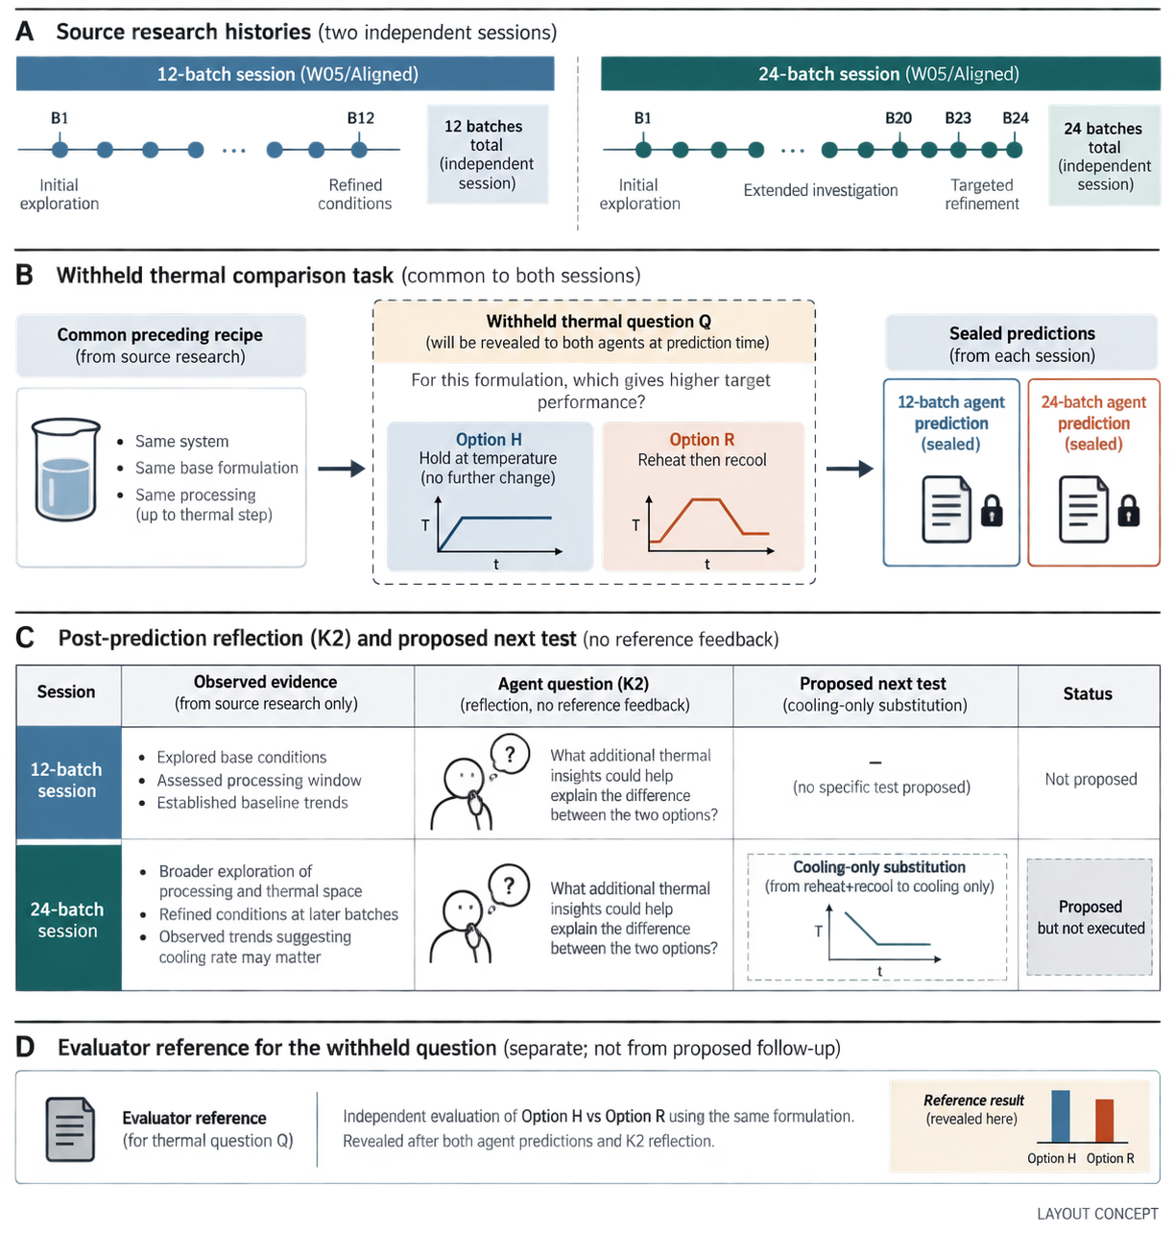
A
Source research histories
12-batch session (W05/Aligned)
24-batch session (W05/Aligned)
B1
B12
12 batches
B1
B20
B23
B24
24 batches
total
(independent
session)
total
(independent
session)
First feasible
batch
Refined
conditions
Initial
exploration
B1–19 fail the fines limit
B20 feasible
B23 selected
B
Withheld thermal comparison task
Common preceding recipe
Withheld thermal question Q
Sealed predictions
(from source research)
(revealed to both agents at prediction time)
(from each session)
For this formulation, which option produces
fewer fines?
12-batch agent
prediction
(sealed)
24-batch agent
prediction
(sealed)
• Same system
Option H
Option R
• Same base
formulation
Hold at temperature
(no further change)
Reheat then recool
• Same processing
(up to thermal step)
toward 315 K
T
278.15 K · 2 h
T
t
t
17% → 12%
49% → 35%
C
Post-prediction reflection (K2) and proposed next test
Session
Observed evidence
Agent review (K2)
Proposed next test
Status
12-batch
session
• B1 first met the fines rule
• 12 source batches completed
• Reheat–recool was untested
Thermal cycling
was untested; seed
survival had been
assumed.
–
(no specific test proposed)
Not proposed
B8 negative evidence
was underused; even
the predicted direction
is uncertain.
Cooling-only substitution
24-batch
session
• B1–19 failed the fines limit
• B20 first passed; B23 selected
• B8 showed no improvement
(B23: staged → direct cooling)
Proposed
but not
executed
T
t
D
Evaluator reference for the withheld question
Evaluator reference
Independent evaluation of H vs R, using the same formulation.
Unavailable during the agents’ Q forecasts and K2 reviews.
Fines reference
100%
(revealed here)
35%
(for thermal question Q)
Option H
Option R
Notes:
Figure S4. Sealed predictions and subsequent reflection. Source: output/pptx/chemworld-figures-final.pptx.

Slide 8
a
Electrochemistry Discovery
b
Electrochemistry Optimization
c
Partitioning
Score MAE
Score MAE
Organic-fraction MAE
12 batches
24 batches
12 batches
24 batches
12 batches
24 batches
11/15
12/15
13/15
0.1738
0.1122
improved
0.1781
0.1082
improved
0.0829
0.0238
improved
-0.3
0
+0.3
-0.3
0
+0.3
-0.2
0
+0.2
Prediction error reduction
Prediction error reduction
Prediction error reduction
d
Crystallization Recovery
e
Crystallization Fines interval coverage
f
Crystallization Retested recovery
Recovery MAE
Fines coverage (%)
Retested recovery
12 batches
24 batches
12 batches
24 batches
12 batches
24 batches
8/15
7/15
7/15
0.1043
0.0794
improved
35.6%
43.9%
improved
42.1%
39.9%
improved
-0.3
0
+0.3
-50
0
+50
-0.6
0
+0.6
Prediction error reduction
Coverage gain (percentage points)
Recovery gain
Favorable
Unfavorable
Source-assay shortfall
Median (n = 15)
Notes:
Figure 4. Six outcomes under larger research envelopes. Source: output/pptx/chemworld-figures-final.pptx.

Slide 9
a
Evidence coverage gap
b
Error reversal across regimes
12 withheld queries: mean ± SD across 5 worlds
10⁰
Bars: mean ± SD; dots: 5 worlds
80
Dilute tests
Aligned / Opaque: 0.46×
Aligned / Opaque: 8.65×
No source assays
0.15862
0.14397
60
in dilute regime
10⁻¹
Dissociation (%)
Macro MAE (log scale)
0.01833
40
Source assays (180)
0.01008
0.0185–2 M
10⁻²
0.00465
0.00439
20
5.5–9.2%
0
10⁻⁵
10⁻³
10⁻¹
10¹
10⁻³
Other nine
Dilute three
Nominal concentration (M; log scale)
Opaque
Aligned
MisIndexed
c
Original forecasts at the most dilute condition
13.3 µM
80
71.6
69.9
65.5
62.9
58.0
60
56.3
51.7
52.0
Dissociation (%)
46.0
44.8
41.3
40
Source range
20
5.5–9.2%
10.4
10.9
8.0
8.1
11.0
7.2
9.6
7.9
6.8
0
World 1
World 2
World 3
World 4
World 5
Withheld reference
Opaque
Aligned
MisIndexed
Notes:
Figure 5. Source: retained EQ_AUTONOMOUS_PROCESS.json and STORY_WORLD_ANALYSIS.json, work-ii-evidence-closeout-20260921. All 180 source assays, 60 world-query references, 30 world-level errors and 20 original forecasts/reference values are retained. Panels a/b show sample SD across five reused worlds, not confidence intervals. Panel c shows the pooled source response range. Concentration grouping is post hoc. Rebuild: paper/tools/render_figure05_readable.py and update_figure05_collection.py.

