Slide 1
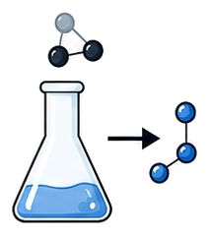
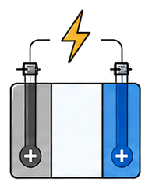
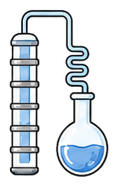




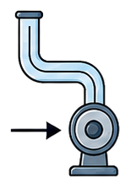

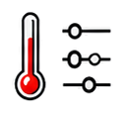













A. Composable Components
B. World Compiler
Reusable process and instrument modules with declared interfaces
Composes components into an executable world with a public contract and private mechanisms
Chemical Transformation
State & Phase Behavior
Transport & Separation
Components &
Topology
Compile & Validate
Compiled World
Public Contract (W_{pub})
Parameters &
Conditions
Compatibility
• Task card
• Observables
Phase
Behavior
Crystallization
• Operations
• Resources
Reaction
Electrochemistry
Thermal
Flow
Distillation
Feasibility
• Instruments
• Failure rules
Instrument Modules
...
Shared Declarations
Instruments
Private Mechanisms
Life Cycle
Parameters
• Constitutive laws
• Private
parameters
State
• Material identities
Public Task
Interface
• Internal
events
Interface
Constraints
Compilation Rejected
• Hidden simulator
pH
UV-vis
HPLC
GC
C. Transaction Semantics (per step)
D. Deterministic Replay & Controlled Forks
Typed action → validated execution → commit or rollback → observations & record
Deterministic Replay
Controlled Forks (Counterfactuals)
Reconstruct and replay exactly the same trajectory
Same public contract and actions;
change one private law parameter
Typed Action
from Agent
Preflight
Runtime
Precondition
Execute World Dynamics
Post-Execution
Validation
Original Run
World W,
seed ζ， actions
Reconstruct
world
Replay Run
Same W and ζ
Same actions
Parent World
(W_{pub}, θ_{p})
Different
parameter
Child World
(Wpub, θ_{c} ≠ θ_{p})
P
Pass
(C = 1)
Observations
& Record
a_{t}
P = 1
C_{pre}
Pass
F_{θ}
C_{post}
Schema, compatibility,
resources
Context-dependent
checks
Generate candidate
State integrity, solver
invariants
Public o_{t+1}
to agent
+
Evaluator record
(privileged)
State Trajectory
s₀, s₁, …, s_{T}
State Trajectory
s′₀, s′₁, …, s′_{T}
=
Same Actions
(a₀, …, a_{T-1})
Same Actions
(a₀, …, a_{T-1})
P = 0
Fail
Fail
Observations
o₀, o₁, …, o_{T}
=
Observations
o′₀, o′₁, …, o′_{T}
State Trajectories
s₀ᵖ, …, s_{T}ᵖ
State Trajectories
s₀ᶜ, …, s_{T}ᶜ
Records & Ledgers
(identical)
=
Records & Ledgers
(identical)
Observations
o₀ᵖ, …, o_{T}ᵖ
Diverge
as expected
Observations
o₀ᶜ, …, o_{T}ᶜ
Preflight Reject
Rollback (C = 0)
No execution
State unchanged
Charge attempt cost
Discard candidate, restore committed
state st and RNG, discard resource changes,
charge attempt cost, write receipt
Success path
Exact Match (zero numerical tolerance)
Failure path
Rewards, observations, terminations, metadata,
resource ledgers, events, state hashes
Differences attributable only to private-law change
public contract, actions, instruments,
resources identical

