Slide 1



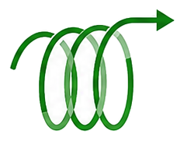









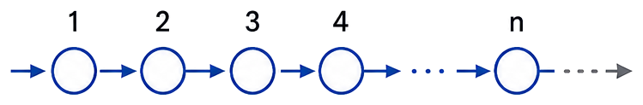


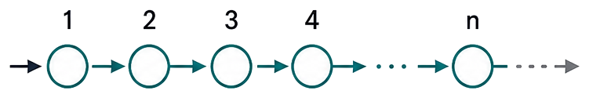
A. Frozen execution cases across workflows
B. Rollback stays inside the same experimental record
1
2
3
4
18
19
final
assay
Crystallization
World 1
Resource-limited
Charaterization
Failure &
Recovery
Continuous
Flow
…
Runtime Precondition Failure
18 subsequent commits
No Candidate State Committed
Electrochemistry
Distillation
Partition
World 2
recovery resumes from last committed state
Typed Actions
Measure
Failure / Rollback
Termination
Final Assay
C。Controlled private-law counterfactuals
D。Separate agent-facing lifecycle on a non-reference world
Controlled private-law forks
Non-reference world: separate agent-facing lifecycle
Partition law
Reaction
Thermal
Distillation
Observation
Parent world
K^{1.00} → K^{1.75}
W_{p} = (W_{pub} , θ_{p})
organic product ↑
product in organic ↑
same public contract
Change one private law
Deterministic qualification path
Provider-driven
agent run
Electrochemical material law
12 actions
15 actions
Child world
hidden row
mapping changes
construction, closure, replay
typed tools, explicit termination,
final assay
W_{c} = (W_{pub} , θ_{c})
selective product ↓
ohmic efficiency ↓
World Qualification
Agent Experiment

