Slide 1















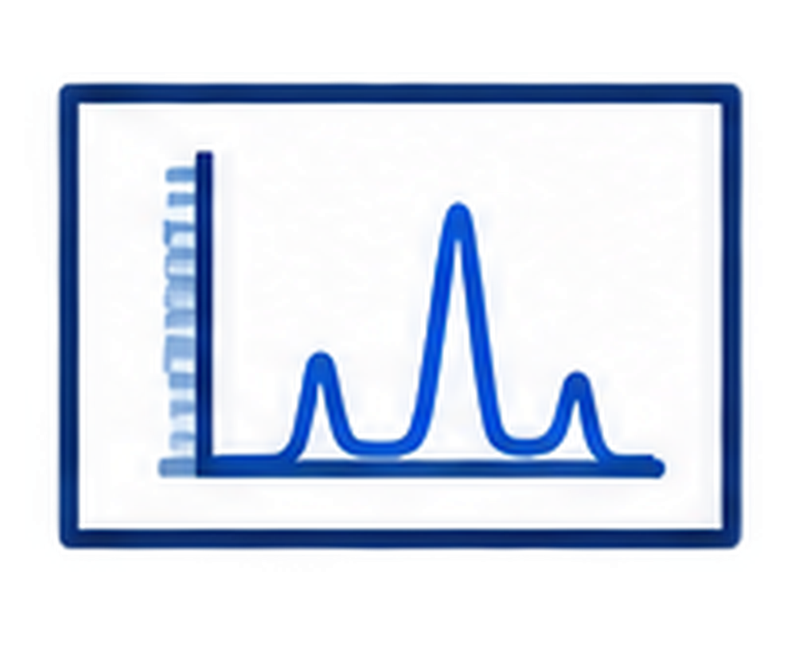







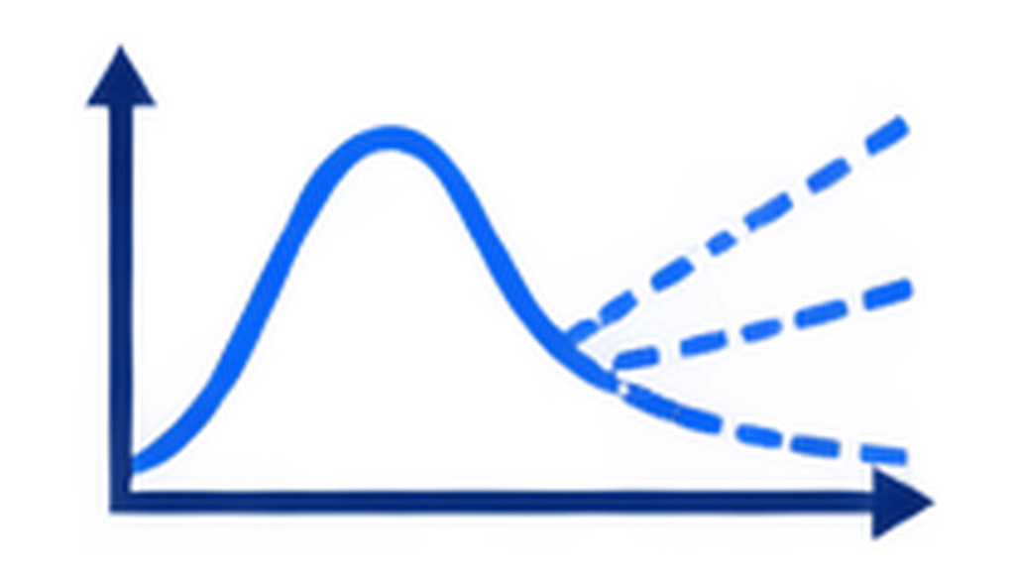

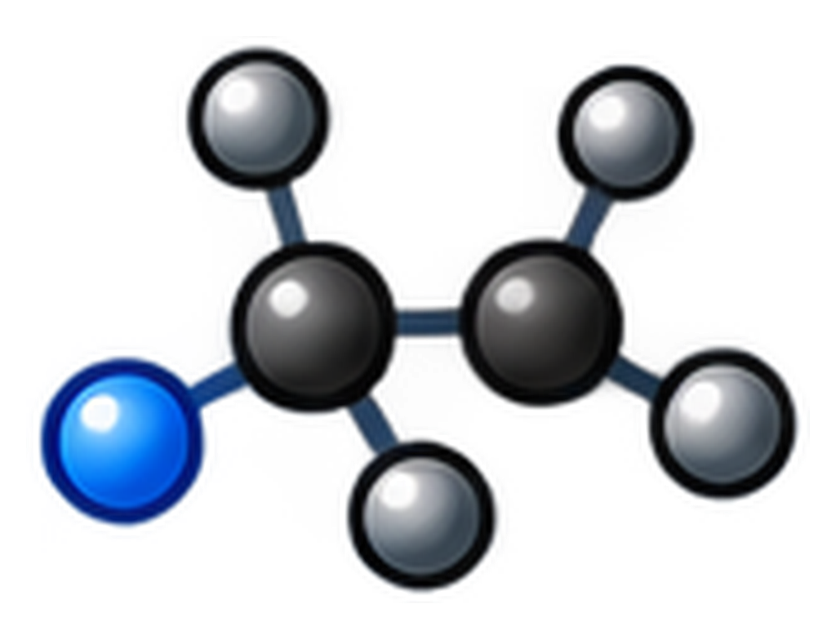

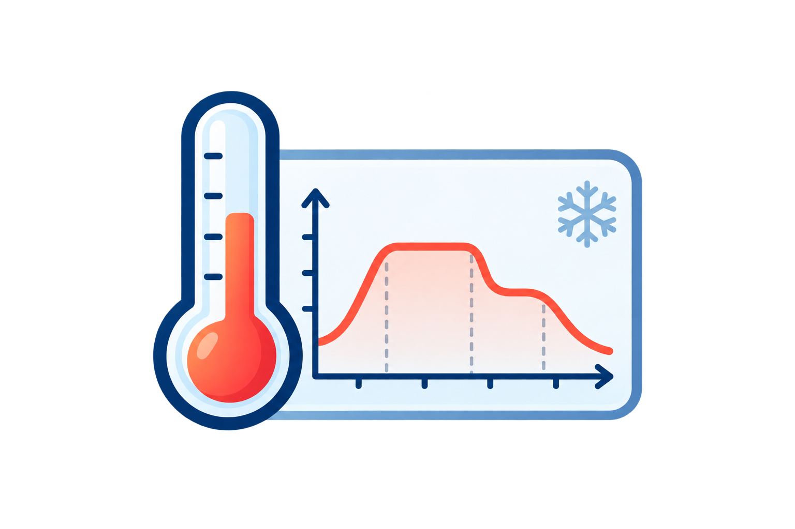

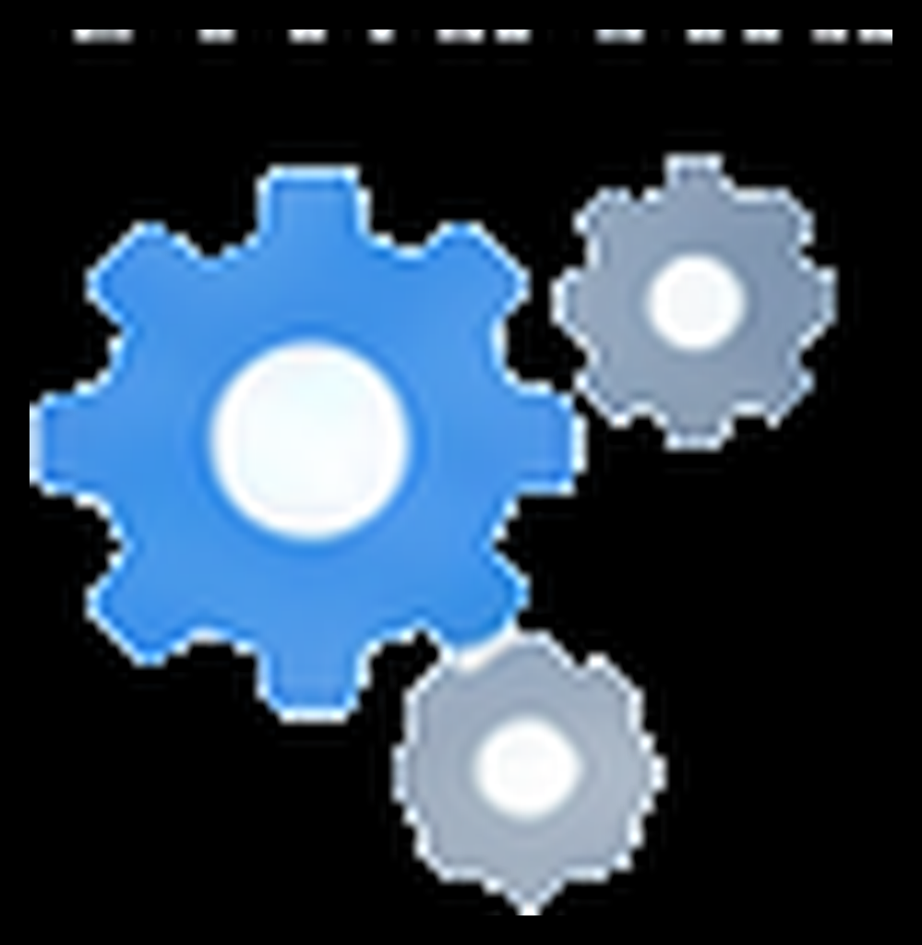



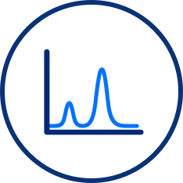




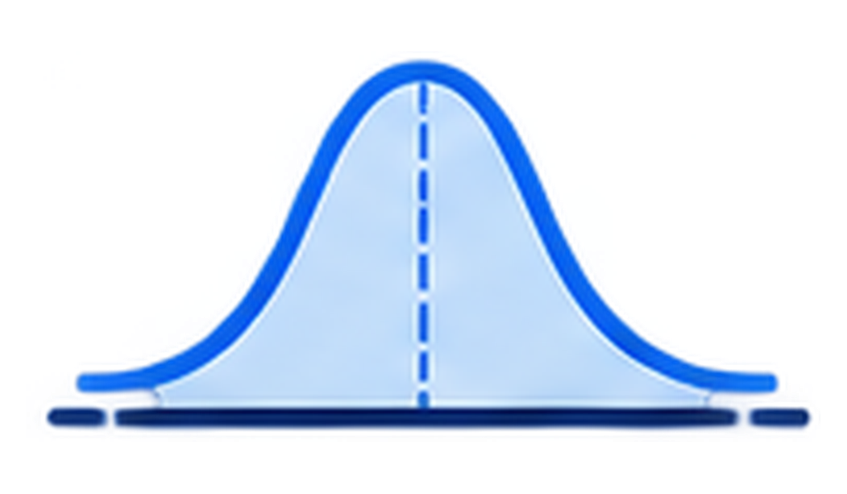
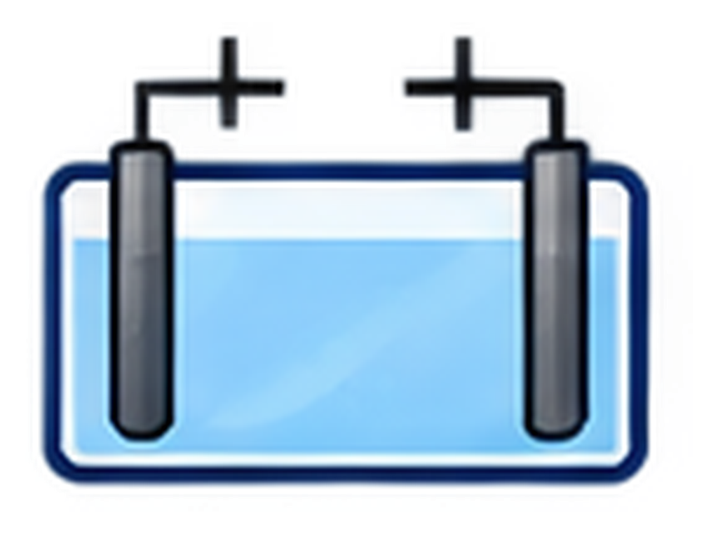


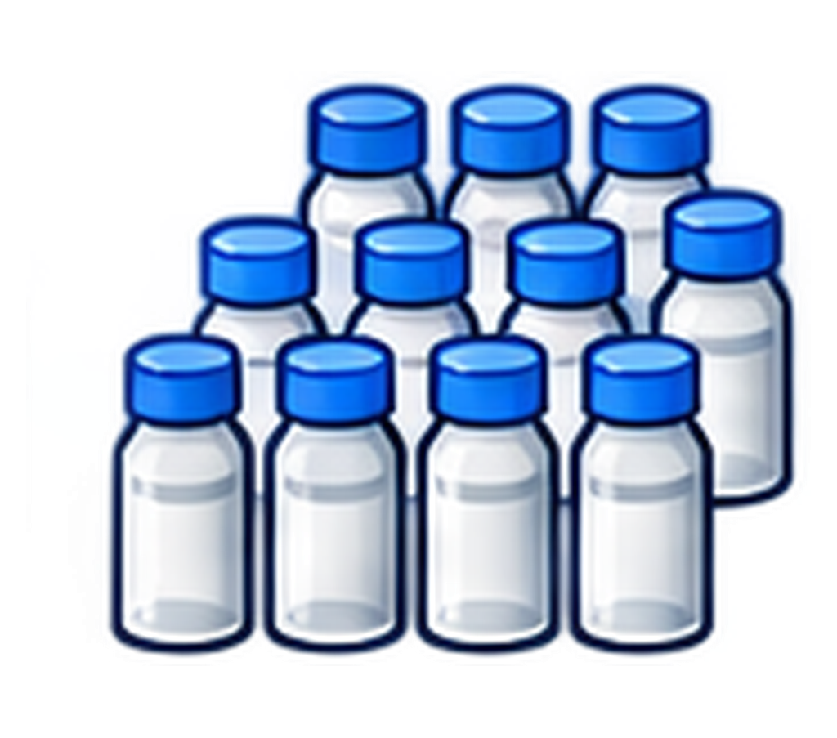
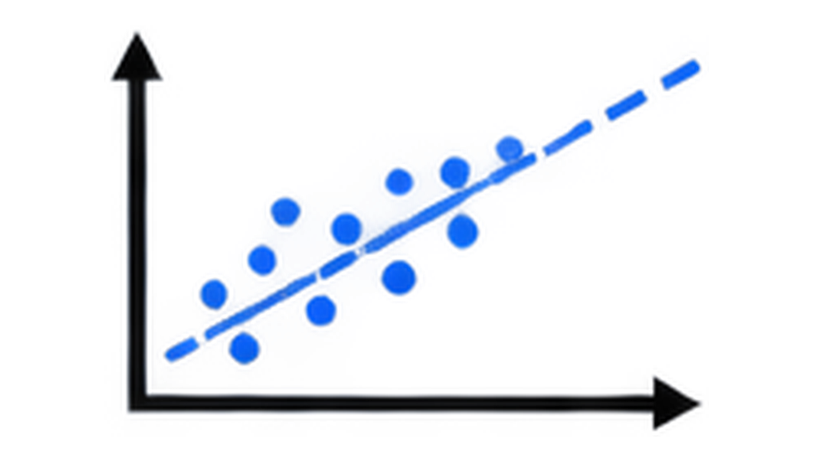



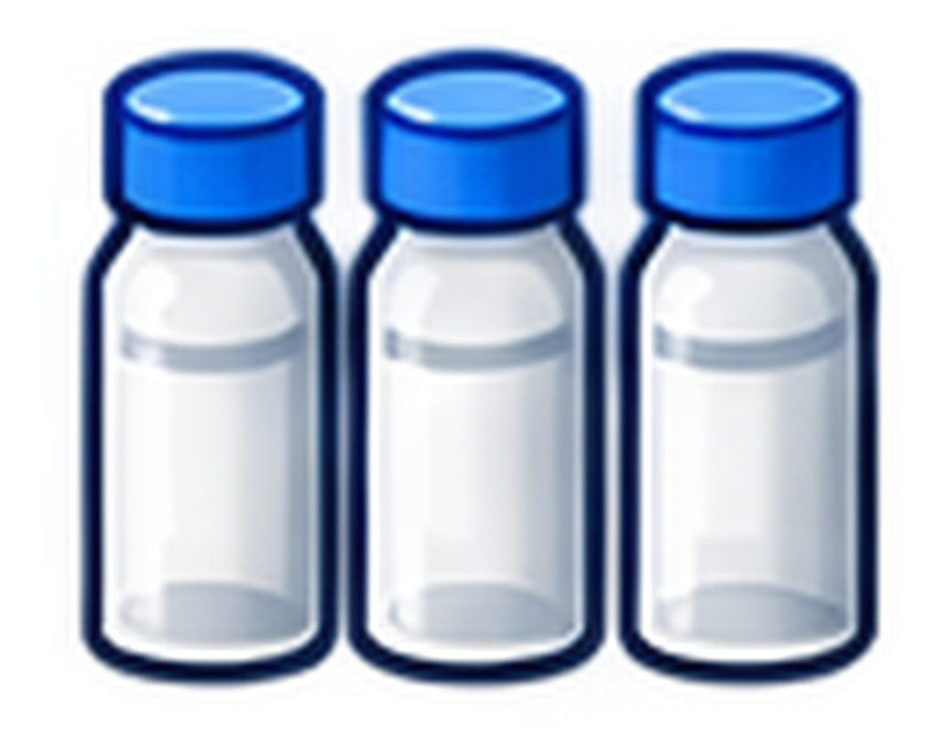
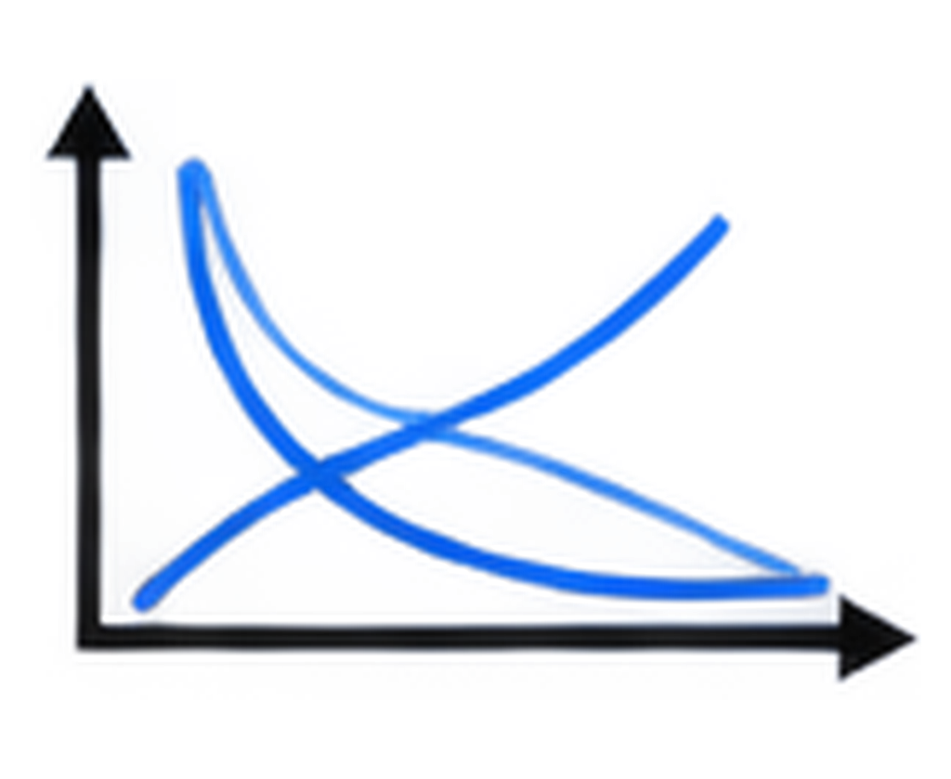

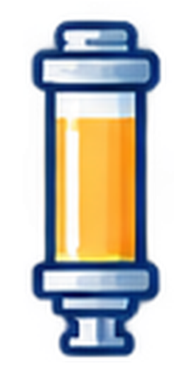
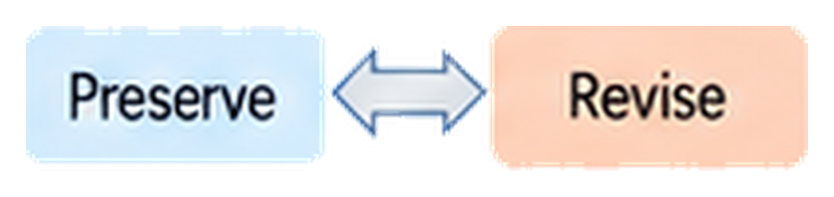
a
Static benchmarks
Real laboratories
Single-endpoint evaluation
No persistent
experimental state
Hidden laws and
unmatched worlds
score
Task success ≠
scientific generalization
Fixed dataset
b
ChemWorld
A Representative Autonomous Campaign in ChemWorld
Operational validation
A programmable chemical world
for autonomous scientific discovery
Evidence-guided iteration
Controllable
hidden laws
Sealed
recommendation
Independent
retest
Operational
achievement
Virtual instruments
and resources
Scientific understanding and prediction
Scientific
question
Agent
Choose conditions
Reaction /
thermal process
Measurement
Adaptation
Evidence
accumulation
+
+
Persistent
physical state
Composition
Phase
Thermal
history
Remaining
material
Scientific
account
(K1)
Unseen
conditions
(Q)
Evidence
review
(K2)
Prediction Uncertainty
Persistent state
(updated after every experiment)
Controllability
Traceability
Separability
Hidden laws
(physical world)
Public information
(agent view)
Operation
(what was done)
Prediction
(what will happen)
Uncertainty
(how certain)
Manipulate physics and information independently
Full research histories can be replayed and audited
Operation, prediction and uncertainty are evaluated separately
c
Controlled study design
Study scope
240 autonomous campaigns & 6 chemical system families
Opaque information
Aligned information
Mismatched information
Research envelope
Does the learned
relationship still apply?
Electrochemistry
Partitioning
Reaction / thermal
12
batches
24
batches
Same world, different information
Equilibrium
Crystallization
Purification
Notes:
Figure 1. Controlled experimental worlds. Source: FIgure1_2.pptx.

Slide 2


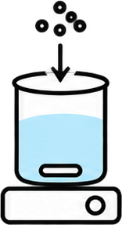



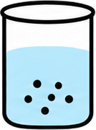




a
Twelve-batch history: fines and recovery
B11
fines 72.6%
99.7
100.0
99.5
100.0
B5
first feasible
B8
selected
B12
repeat
100
72.6
50
Quality limit (≤ 50%)
30.3
29.4
25.4
25.4
26.9
27.8
26.9
Fines (%)
0
75
42.8
45.0
45.5
44.6
44.7
44.6
44.1
50
38.1
40.0
Recovery (%)
22.6
22.4
24.8
25
0
1
2
3
4
5
6
7
8
9
10
11
12
Batch
b
Batch 8 (B8) experiment in full detail
Charge reagent
+ S2 solvent
+ C1 catalyst
Heat toward
355 K for 1 h
at 300 rpm
Controlled cool
toward 325 K
for 2 h
Add 1 mg
seed
Cool toward
250 K for 4 h
Hold 4 h
at 100 rpm
Particle-size
check
Filter
Terminate
Final assay
fines
26.6%
recovery 45.5%
purity 98.2%
fines 25.4%
c
Key observations, questions, and next tests
Observed
Agent question
Next tested action
Outcome
B1–4:
fines 99.5–100.0%
Where are
fines forming?
B5: omit quench;
cool before seeding
fines 30.3%;
first feasible
B5: feasible;
recovery 40.0%
Do colder endpoints
improve recovery?
B6/B7: end at 265/250 K;
B8: seed 5 → 1 mg
recovery 42.8 → 45.0 → 45.5%
fines < 30%
B8 best so far;
B9–10 additional probes
Does higher
concentration help?
B11: S2 0.080 → 0.040 L
B11 fines 72.6%, rejected;
B12 repeats B8: 26.9%
Notes:
Figure 2. Complete twelve-batch research session. Source: output/pptx/chemworld-figure2-typography.pptx.

Slide 3
a
Electrochemistry
b
Reaction processing
Better on both
Better on both
Better prediction only
13/30
0.2
Better prediction only
4/30
0.2
1/30
4/30
0.1
0.1
0.0
0.0
Score MAE: Discovery - Optimization
Score MAE: Discovery - Optimization
−0.1
−0.1
−0.2
Example in c–d
Worse on both
Better retest only
Worse on both
Better retest only
3/30
13/30
−0.2
17/30
5/30
−0.50
−0.25
0.00
0.25
0.50
−0.06
−0.03
0.00
0.03
0.06
Retest score: Optimization - Discovery
Retest score: Optimization - Discovery
Information:
Opaque
Aligned
MisIndexed
Information:
Opaque
Aligned
MisIndexed
c
Two independent 12-batch research paths
Discovery
Optimization
Both select batch 12
0.75
0.756
0.718
0.50
Observed score
0.25
0.00
1
2
3
4
5
6
7
8
9
10
11
12
Retest
Solvents
Potential
Electrolytes
Duration /
Independent
current
recommendation
Material pairs
Cross-pairs
Potential
Current / time / potential
retests
d
The optimization agent's subsequent predictions
Later public Q rationale (condensed): poor cross-pairs suggest material incompatibility.
Forecast + 80% interval
Withheld reference
MAE 0.229; coverage 5/12
S0/E0
S0/E1
S0/E3
S2/E0
0.6
Score
0.4
0.2
0.0
Q01
Q02
Q03
Q04
Q05
Q06
Q07
Q08
Q09
Q10
Q11
Q12
Highlighted conditions: +0.8 V, 100 mA, 7,200 s. All queries use 0.012 mol in 0.025 L.
Notes:
Figure 3. Goals, research paths and predictions. Source: D:\Projects\ChemWorld\paper\figures\venue-results\figure03-goals-paths-forecasts.svg.

Slide 4
a
Electrochemistry Discovery
b
Electrochemistry Optimization
c
Partitioning
Score MAE
Score MAE
Organic-fraction MAE
12 batches
24 batches
12 batches
24 batches
12 batches
24 batches
11/15
12/15
13/15
0.1738
0.1122
improved
0.1781
0.1082
improved
0.0829
0.0238
improved
-0.3
0
+0.3
-0.3
0
+0.3
-0.2
0
+0.2
Prediction error reduction
Prediction error reduction
Prediction error reduction
d
Crystallization Recovery
e
Crystallization Fines interval coverage
f
Crystallization Retested recovery
Recovery MAE
Fines coverage (%)
Retested recovery
12 batches
24 batches
12 batches
24 batches
12 batches
24 batches
8/15
7/15
7/15
0.1043
0.0794
improved
35.6%
43.9%
improved
42.1%
39.9%
improved
-0.3
0
+0.3
-50
0
+50
-0.6
0
+0.6
Prediction error reduction
Coverage gain (percentage points)
Recovery gain
Favorable
Unfavorable
Source-assay shortfall
Median (n = 15)
Notes:
Figure 4. Six outcomes under larger research envelopes. Source: output/pptx/chemworld-figures-final.pptx.

Slide 5
a
b
80
Dilute tests
Source assays (180)
Aligned / Opaque
Aligned / Opaque
Withheld references (60)
0.2
0.46×
8.65×
60
Dissociation (%)
0.05
40
Macro MAE (log scale)
Observed plateau
5.5-9.2%
0.01
20
0
0.002
1
−
5
−
3
−
1
1
Other nine
Dilute three
0
1
0
1
0
Nominal concentration (mol L⁻¹; log scale)
Opaque
Aligned
MisIndexed
Withheld reference
c
Most dilute test: 13.3 µM
80
71.6
69.9
65.5
62.9
58.0
60
56.3
51.7
52.0
Dissociation (%)
46.0
44.8
41.3
40
20
10.4
10.9
11.0
9.6
8.0
8.1
7.2
7.9
6.8
0
World 1
World 2
World 3
World 4
World 5
Notes:
Figure 5. Equilibrium evidence and regime reversal. Source: D:\Projects\ChemWorld\paper\figures\venue-results\figure05-eq-coverage-reversal.svg.

Slide 6
a
Observed and predicted purity
b
Lower MAE than the source-mean baseline
Research observations
98.53%
30 campaigns
Recovery
26/30
Blind-test reference
98.51%
30 campaigns
Fines fraction
21/30
Agent: 12 batches
93.54%
Particle size index
4/30
15 campaigns
Agent: 24 batches
94.89%
Purity
0/30
15 campaigns
0
25
50
75
100
0
10
20
30
Mean crystal purity (%)
Campaigns (of 30)
c
Information effects differ across responses
d
Purity intervals can miss the reference
Opaque
Aligned
MisIndexed
Opaque
Aligned
MisIndexed
16.3
100
98.3
95.0
15
80
73.3
8.9
9.1
9.2
60
60.0
55.0
10
Prediction MAE (percentage points)
7.9
Purity interval coverage (%)
6.1
6.8
5.0
5.1
40
5
4.0
23.3
1.0
2.0
20
0
0
12 batches
24 batches
12 batches
24 batches
12 batches
24 batches
Recovery
Purity
Notes:
Figure 6. Crystallization prediction and calibration. Source: D:\Projects\ChemWorld\paper\figures\venue-results\figure06-crystal-generalization.svg.

Slide 7
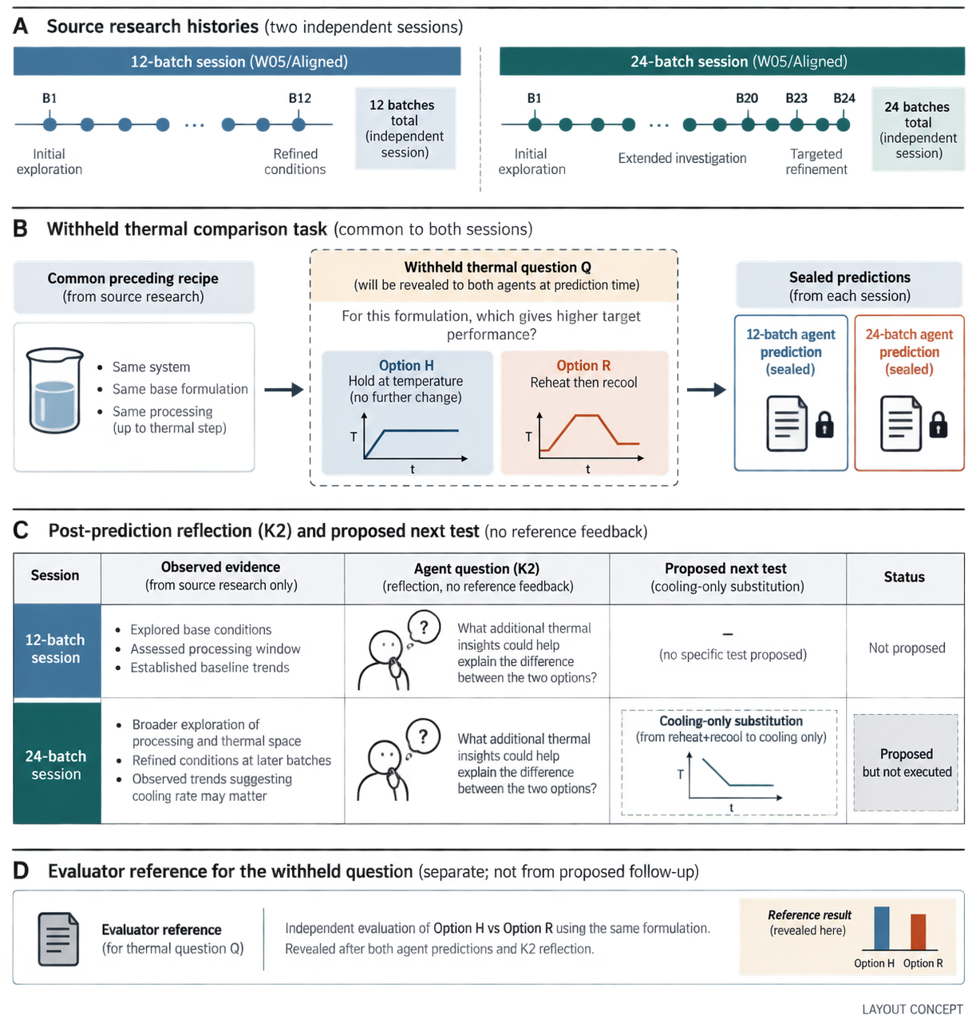
A
Source research histories
12-batch session (W05/Aligned)
24-batch session (W05/Aligned)
B1
B12
12 batches
B1
B20
B23
B24
24 batches
total
(independent
session)
total
(independent
session)
First feasible
batch
Refined
conditions
Initial
exploration
B1–19 fail the fines limit
B20 feasible
B23 selected
B
Withheld thermal comparison task
Common preceding recipe
Withheld thermal question Q
Sealed predictions
(from source research)
(revealed to both agents at prediction time)
(from each session)
For this formulation, which option produces
fewer fines?
12-batch agent
prediction
(sealed)
24-batch agent
prediction
(sealed)
• Same system
Option H
Option R
• Same base
formulation
Hold at temperature
(no further change)
Reheat then recool
• Same processing
(up to thermal step)
toward 315 K
T
278.15 K · 2 h
T
t
t
17% → 12%
49% → 35%
C
Post-prediction reflection (K2) and proposed next test
Session
Observed evidence
Agent review (K2)
Proposed next test
Status
12-batch
session
• B1 first met the fines rule
• 12 source batches completed
• Reheat–recool was untested
Thermal cycling
was untested; seed
survival had been
assumed.
–
(no specific test proposed)
Not proposed
B8 negative evidence
was underused; even
the predicted direction
is uncertain.
Cooling-only substitution
24-batch
session
• B1–19 failed the fines limit
• B20 first passed; B23 selected
• B8 showed no improvement
(B23: staged → direct cooling)
Proposed
but not
executed
T
t
D
Evaluator reference for the withheld question
Evaluator reference
Independent evaluation of H vs R, using the same formulation.
Unavailable during the agents’ Q forecasts and K2 reviews.
Fines reference
100%
(revealed here)
35%
(for thermal question Q)
Option H
Option R
Notes:
Figure S4. Sealed predictions and subsequent reflection. Source: output/pptx/chemworld-figures-final.pptx.

