Slide 1
















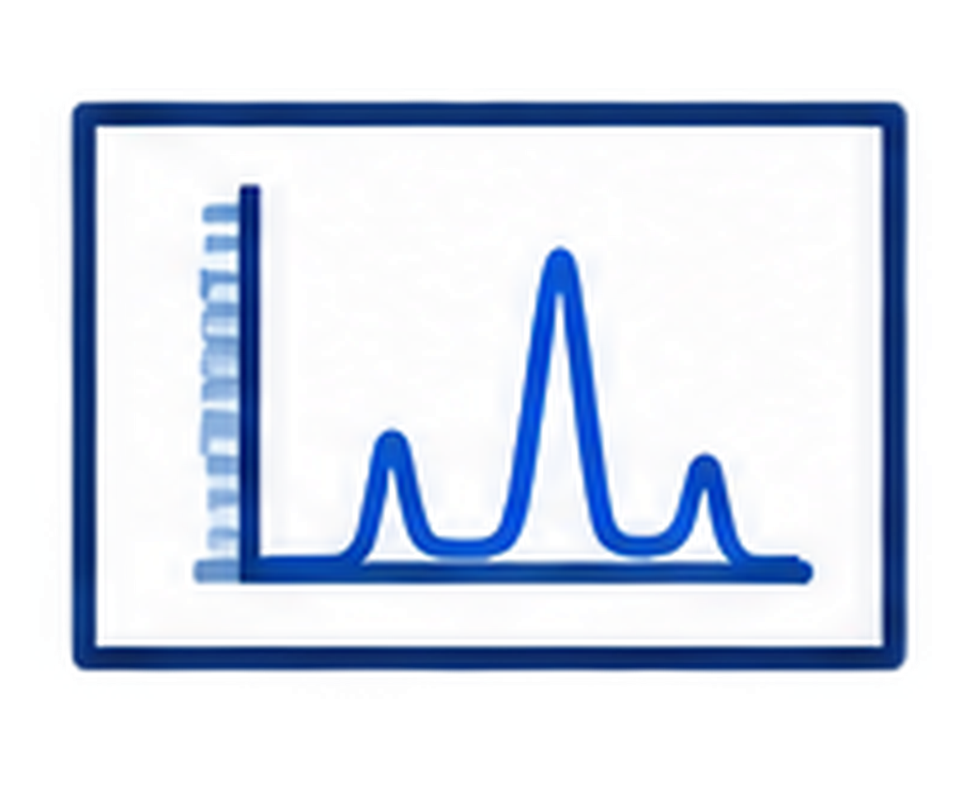






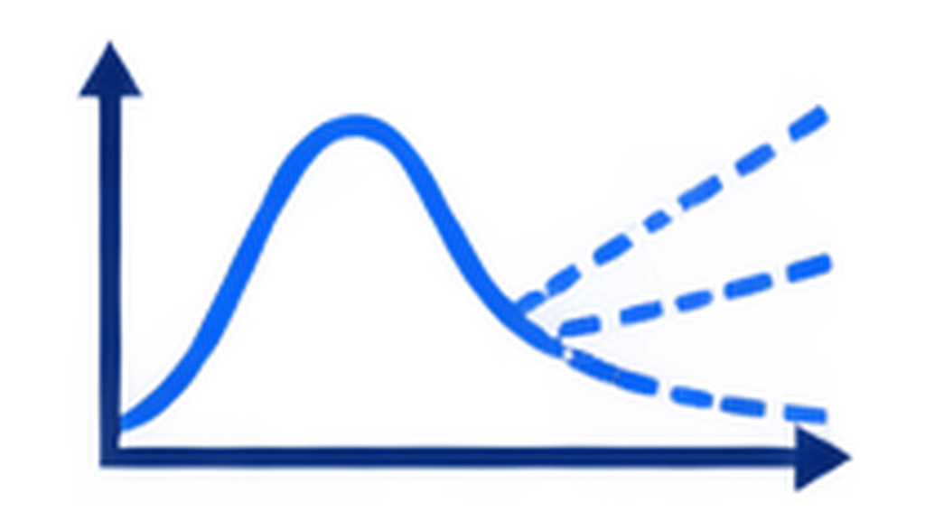

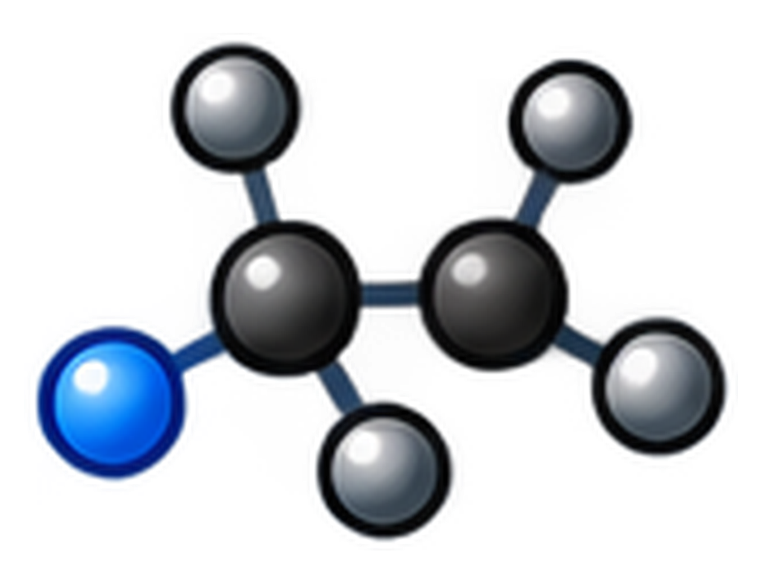

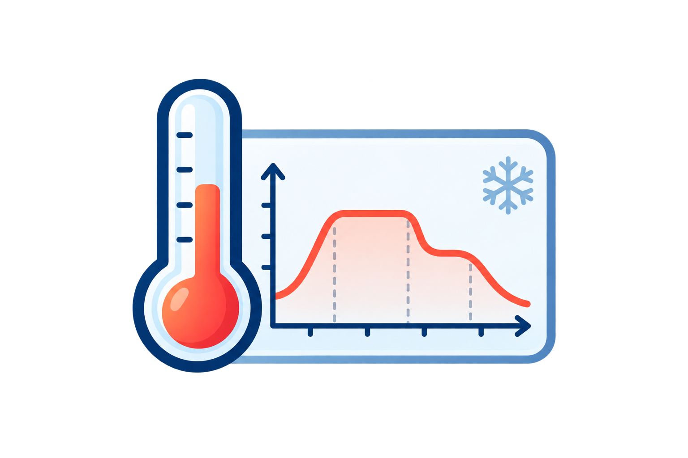










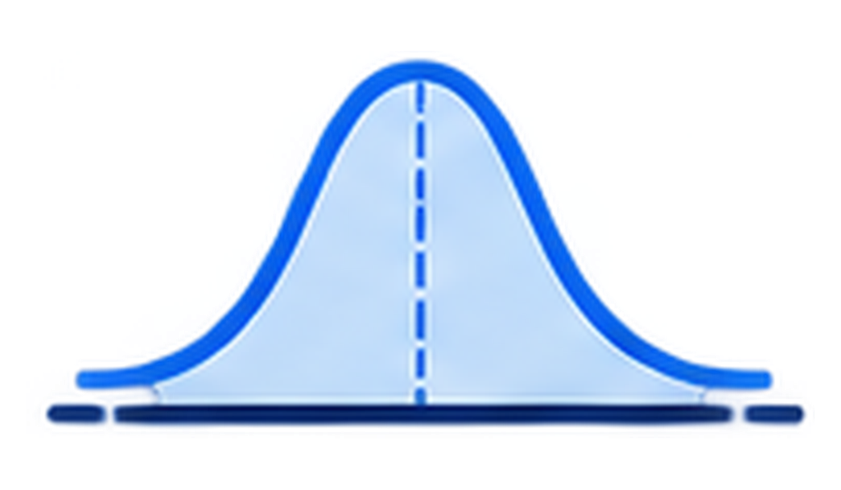


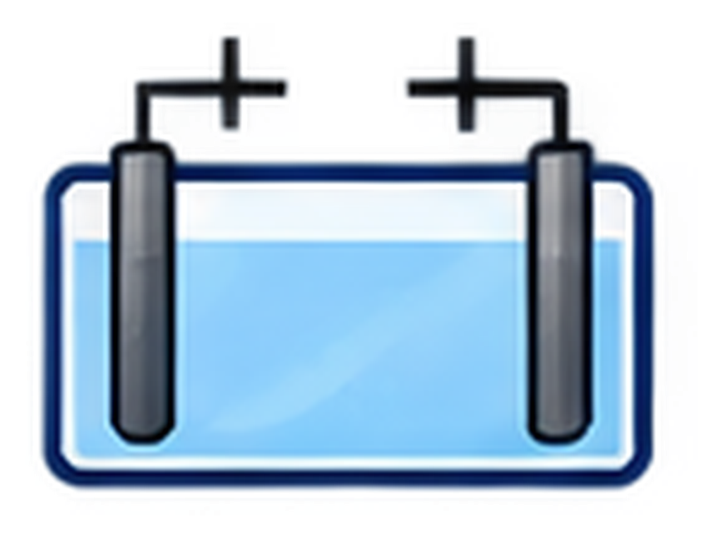



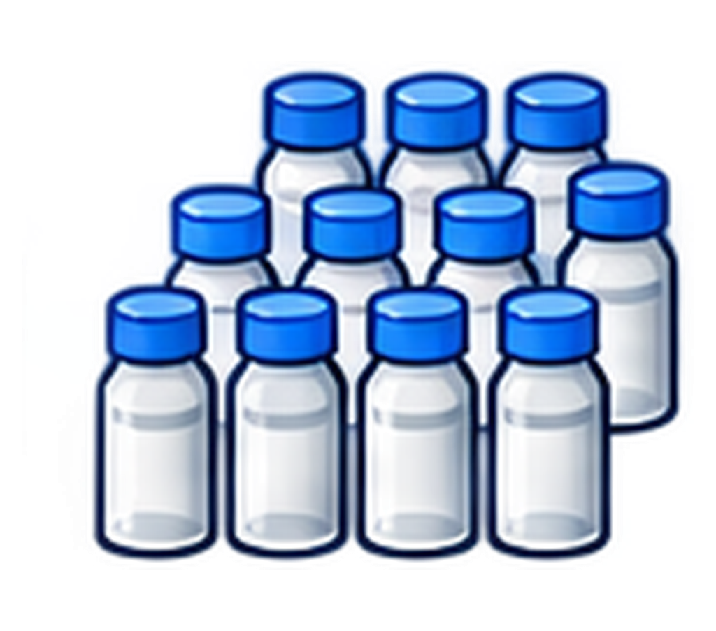
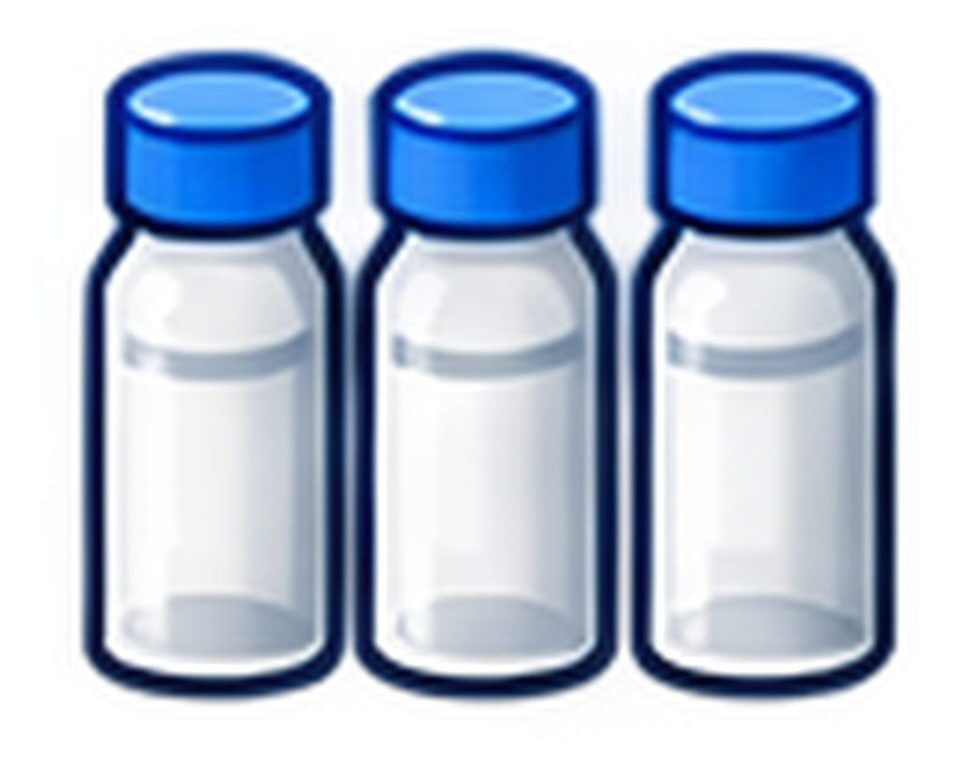
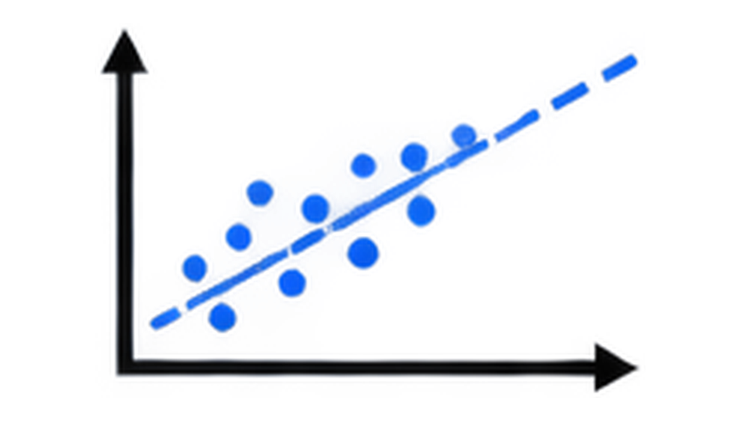
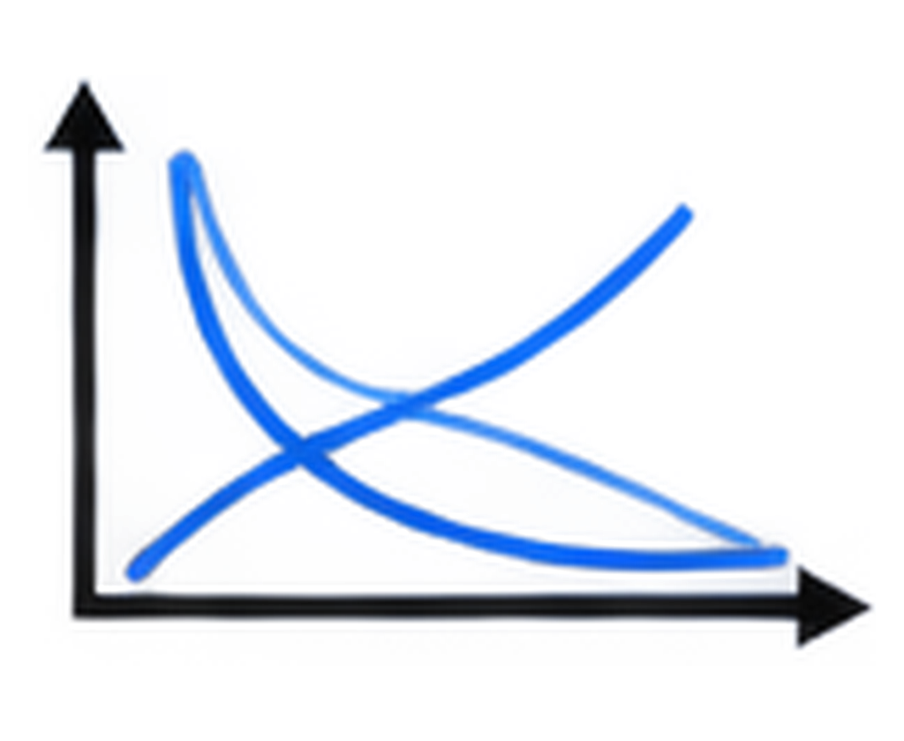


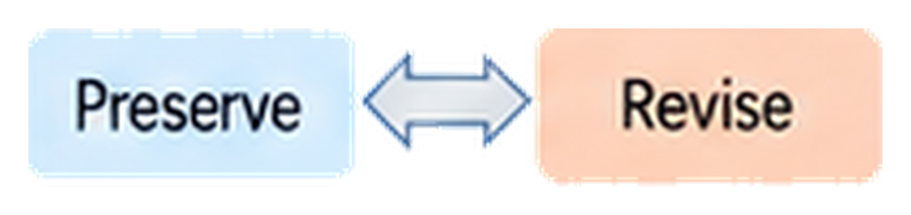
a
Static benchmarks
Real laboratories
Single-endpoint evaluation
No persistent
experimental state
Hidden laws and
unmatched worlds
score
Task success ≠
scientific generalization
Fixed dataset
b
ChemWorld
A Representative Autonomous Campaign in ChemWorld
Operational validation
A programmable chemical world
for autonomous scientific discovery
Evidence-guided iteration
Controllable
hidden laws
Sealed
recommendation
Independent
retest
Operational
achievement
Virtual instruments
and resources
Scientific understanding and prediction
Scientific
question
Agent
Choose conditions
Reaction /
thermal process
Measurement
Adaptation
Evidence
accumulation
+
+
Persistent
physical state
Persistent state
(updated after every experiment)
Scientific
account
(K1)
Unseen
conditions
(Q)
Evidence
review
(K2)
Prediction Uncertainty
(with full evidence history)
Composition
Phase
Thermal
history
Remaining
material
Controllability
Traceability
Separability
Hidden laws
(physical world)
Public information
(agent view)
Operation
(what was done)
Prediction
(what will happen)
Uncertainty
(how certain)
Physics and information can be manipulated independently
Full research histories can be replayed and audited
Operation, prediction and uncertainty are evaluated separately
c
Controlled study design
Study scope
240 autonomous campaigns & 6 chemical system families
Opaque information
Aligned information
Mismatched information
Research envelope
Does the learned
relationship still apply?
Electrochemistry
Partitioning
Reaction / thermal
12
batches
24
batches
Same world, different information
Equilibrium
Crystallization
Purification
Notes:
Reconstruction source: /Users/knitua/Downloads/ChemWorld_all_generated_figures/11_figure1_RX_same_style_revision.png. All pictograms were extracted from that source image into transparent PNG files in /Users/knitua/Desktop/Chemworld/Figure1/icon. Text, panels, arrows, and labels are editable PowerPoint objects.

Slide 2
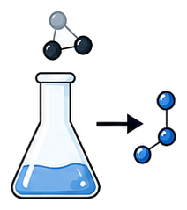



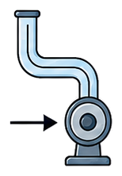
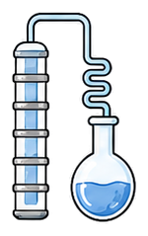


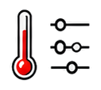





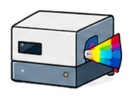








A. Composable Components
B. World Compiler
Reusable process and instrument modules with declared interfaces
Composes components into an executable world with a public contract and private mechanisms
Chemical Transformation
State & Phase Behavior
Transport & Separation
Components &
Topology
Compile & Validate
Compiled World
Compatibility
Public Contract (W_{pub})
Parameters &
Conditions
• Task card
• Observables
Reaction
Electrochemistry
Thermal
Phase
Behavior
Crystallization
Flow
Distillation
Feasibility
• Operations
• Resources
• Instruments
• Failure rules
Instrument Modules
...
Shared Declarations
Instruments
Life Cycle
Private Mechanisms
State
Parameters
• Constitutive laws
• Private
parameters
Public Task
Interface
• Material identities
• Internal
events
pH
UV-vis
HPLC
GC
Interface
Constraints
Compilation Rejected
• Hidden simulator
C. Transaction Semantics (per step)
D. Deterministic Replay & Controlled Forks
Typed action → validated execution → commit or rollback → observations & record
Deterministic Replay
Controlled Forks (Counterfactuals)
Reconstruct and replay exactly the same trajectory
Same public contract and actions;
change one private law parameter
Typed Action
from Agent
Preflight
Runtime
Precondition
Execute World Dynamics
Post-Execution
Validation
Pass
(C = 1)
Observations
& Record
Original Run
World W,
seed ζ， actions
Reconstruct
world
Replay Run
Same W and ζ
Same actions
Parent World
(W_{pub}, θ_{p})
Different
parameter
Child World
(Wpub, θ_{c} ≠ θ_{p})
a_{t}
P
P = 1
C_{pre}
Pass
F_{θ}
C_{post}
Schema, compatibility,
resources
Context-dependent
checks
Generate candidate
State integrity, solver
invariants
Public o_{t+1}
to agent
+
Evaluator record
(privileged)
State Trajectory
s₀, s₁, …, s_{T}
State Trajectory
s′₀, s′₁, …, s′_{T}
Same Actions
(a₀, …, a_{T-1})
Same Actions
(a₀, …, a_{T-1})
=
P = 0
Fail
Fail
Observations
o₀, o₁, …, o_{T}
=
Observations
o′₀, o′₁, …, o′_{T}
State Trajectories
s₀ᵖ, …, s_{T}ᵖ
State Trajectories
s₀ᶜ, …, s_{T}ᶜ
Preflight Reject
Rollback (C = 0)
Records & Ledgers
(identical)
=
Records & Ledgers
(identical)
Observations
o₀ᵖ, …, o_{T}ᵖ
Diverge
as expected
Observations
o₀ᶜ, …, o_{T}ᶜ
No execution
State unchanged
Charge attempt cost
Discard candidate, restore committed
state st and RNG, discard resource changes,
charge attempt cost, write receipt
Success path
Exact Match (zero numerical tolerance)
Differences attributable only to private-law change
Failure path
Rewards, observations, terminations, metadata,
resource ledgers, events, state hashes
public contract, actions, instruments,
resources identical

Slide 3
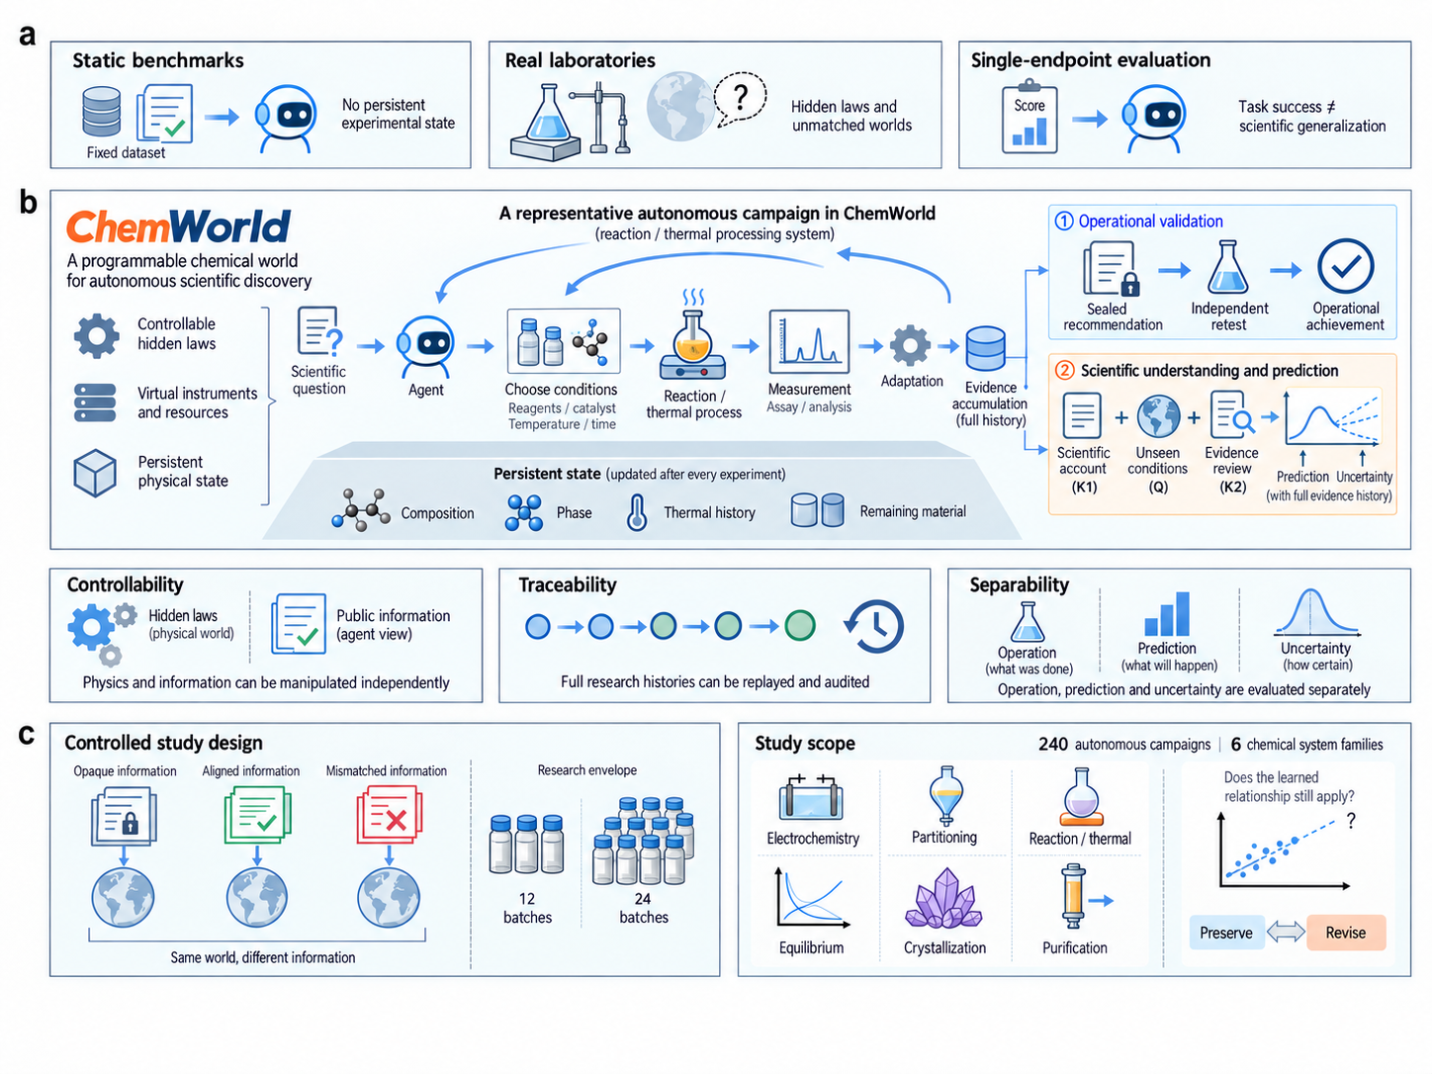

Slide 4






Traceability
Plan
Act
Observe
Update
Record
Actions, observations and state transitions are recorded for replay and audit

