Slide 1
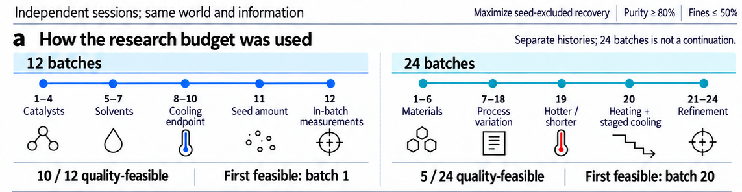
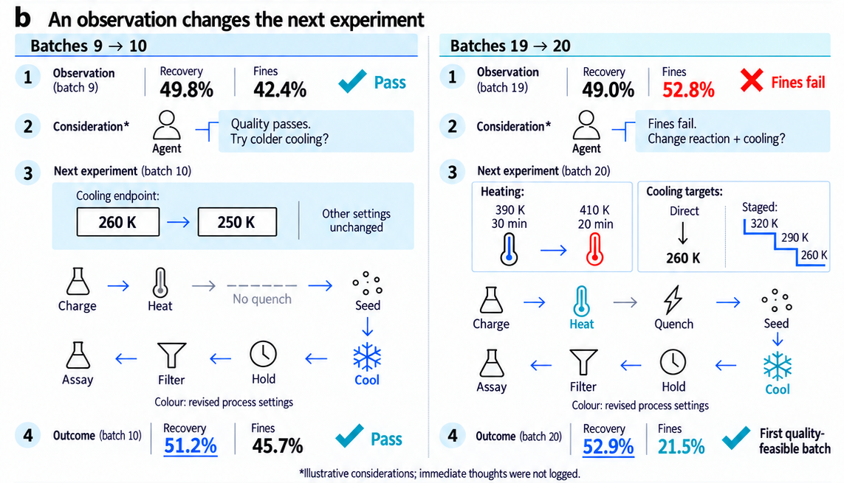

Optimization across successive batches
12-batch session
24-batch session
First feasible: 34.7%; best: 51.2%
First feasible: batch 20; best: 57.0%
● Quality-feasible × Quality-infeasible ━ Best feasible recovery so far
Independent sessions. Fines limit: 50%; all shown batches meet the purity threshold.
Quench stops reaction chemistry; cooling and crystal growth can continue.
c
Selected recipes and independent retest
Selected batch 10 (12-batch campaign)
Selected batch 23 (24-batch campaign)
Later reflection (condensed)
Later reflection (condensed)
Batch 12 had fewer fines.
Hotter, shorter heating + staged cooling.
Batch 10 led in measured recovery.
Batches 22–24 formed a broad
The small recovery gap was unresolved.
recovery plateau.
Observed: recovery 51.2% | purity 97.8% | fines 45.7%
Observed: recovery 57.0% | purity 100% | fines 14.2%
Independent retest
Independent retest
Recovery
Fines
Recovery
Fines
50.4%
46.2%
58.1%
19.3%
Both selected recipes meet quality constraints.
Selected illustrative case; independent sessions. Recovery excludes seed mass. Fines: particles <20 µm.
Heating values and cooling steps denote requested targets, not measured temperature trajectories.
Notes:
Sources: workstreams/flagship_tasks/reports/work-ii-c-formal-20260920-v3-auto/C-W05-B12-E-Aligned.md and C-W05-B24-E-Aligned.md. All 36 original source batches are retained in the native charts. Feasibility: purity >=0.80, fines <=0.50, crystal size >0. Running best is undefined until first feasibility. The 12/24 sessions are independent. Retrospective K1 accounts are not logged immediate thoughts. Quench semantics: src/chemworld/runtime/primitive_services.py, quench. The selected illustration does not estimate a causal or population-wide budget effect.

