Slide 1
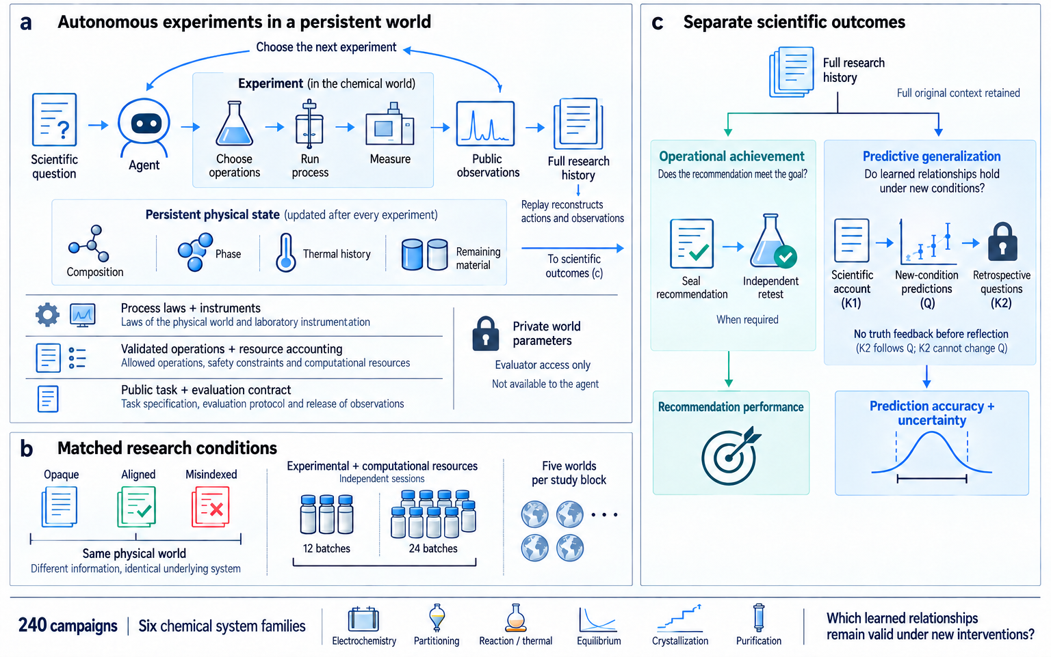
a
Autonomous experiments in a persistent world
c
Separate scientific outcomes
Choose the next experiment
Full research
history
Experiment (in the chemical world)
Full original context retained
Scientific
question
Agent
Choose
operations
Run
process
Measure
Public
observations
Full research
history
Operational achievement
Predictive generalization
Does the recommendation
meet the goal?
Do learned relationships hold
under new conditions?
Persistent physical state (updated after every experiment)
Replay reconstructs
actions and observations
Composition
Phase
Thermal history
Remaining
material
To scientific
outcomes (c)
Scientific
account
(K1)
New-condition
predictions
(Q)
Retrospective
questions
(K2)
Seal
recommendation
Independent
retest
Process laws + instruments
When required
Laws of the physical world and laboratory instrumentation
Private world
parameters
No truth feedback before reflection
Validated operations + resource accounting
(K2 follows Q; K2 cannot change Q)
Allowed operations, safety constraints and computational resources
Evaluator access only
Public task + evaluation contract
Not available to the agent
Recommendation performance
Prediction accuracy +
uncertainty
Task specification, evaluation protocol and release of observations
b
Matched research conditions
Opaque
Aligned
MisIndexed
Experimental + computational resources
Five worlds
per study block
Independent sessions
Same physical world
12 batches
24 batches
Different information; identical underlying system
240 campaigns
Six chemical system families
Which learned relationships
remain valid under new interventions?
Electrochemistry
Partitioning
Reaction / thermal
Equilibrium
Crystallization
Purification
Notes:
Retained artwork: paper\figures\ncs-full\figure01-framework.png. Only the overall title area and typography are edited. Illustrations remain raster artwork; overlaid labels are editable PowerPoint text. ChemWorld framework and retained 240-campaign programme. No new evidence.

Slide 2
a
Electrochemistry
b
Reaction processing
c
Purification
Retest improves: 26/30
Retest improves: 9/30
Purity threshold = 0.80
Prediction improves: 14/30
Prediction improves: 8/30
Eligible: 0/5, 3/5, 0/5
Opaque
Aligned
MisIndexed
Notes:
Figure 2. Retained complete strategy comparisons. EC and RX have 30 matched pairs each. P has 15 recommendations. Source: integrated-results/analysis.json and campaign_metrics.csv.

Slide 3
a
b
c
d
e
f
Electrochemistry
Discovery
Electrochemistry
Optimization
Partitioning
Crystallization
Recovery prediction
Crystallization
Interval coverage
Crystallization
Operating delivery
Score MAE
Score MAE
Organic-fraction
MAE
Recovery MAE
Fines coverage (%)
Retested recovery
Mean, 12
0.1738
0.1781
0.0829
0.1043
35.6%
0.4205
Mean, 24
0.1122
0.1082
0.0238
0.0794
43.9%
0.3994
Improved
11/15
12/15
13/15
8/15
7/15
7/15
O
World 1
A
M
O
World 2
A
M
O
World 3
A
M
O
World 4
A
M
O
World 5
A
M
Mean change
-0.3
0
+0.3
-0.3
0
+0.3
-0.2
0
+0.2
-0.3
0
+0.3
-50
0
+50
-0.6
0
+0.6
MAE reduction
MAE reduction
MAE reduction
MAE reduction
Coverage gain
(percentage points)
Recovery gain
Favorable
Unfavorable
Source shortfall
Notes:
Figure 3. All 90 response comparisons in 15 matched independent 12/24 pairs per panel. Positive change denotes lower MAE, higher coverage or higher recovery. Native editable data marks. Source shortfalls are retained and crossed. Source: campaign_metrics.csv.

Slide 4
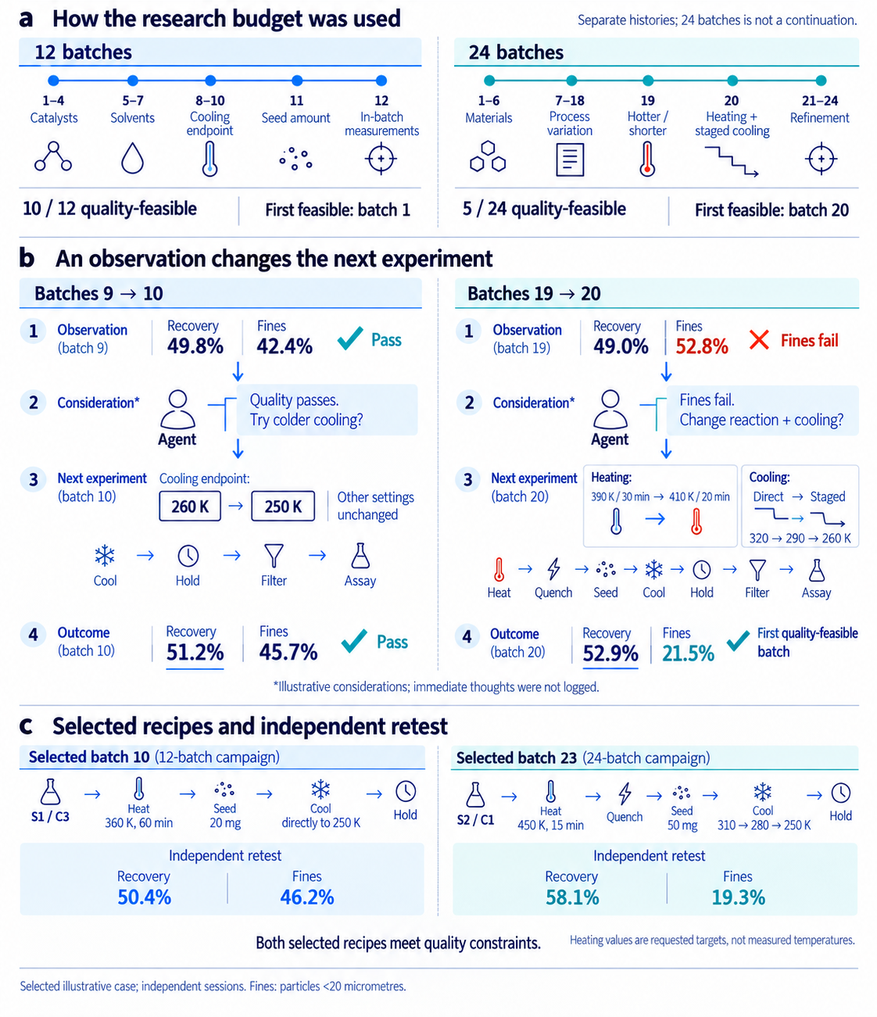
a
How the research budget was used
Separate histories: 24 batches is not a continuation.
12 batches
24 batches
1–4
5–7
8–10
11
12
1–6
7–18
19
20
21–24
Catalysts
Solvents
Cooling
endpoint
Seed amount
In-batch
measurements
Materials
Process
variation
Hotter /
shorter
Heating +
staged cooling
Refinement
10 / 12 quality-feasible
First feasible: batch 1
5 / 24 quality-feasible
First feasible: batch 20
b
An observation changes the next experiment
Batches 9 → 10
Batches 19 → 20
Observation
(batch 9)
Recovery
Fines
Pass
Observation
(batch 19)
Recovery
Fines
Fines fail
49.8%
42.4%
49.0%
52.8%
Consideration*
Quality passes.
Try colder cooling?
Consideration*
Fines fail.
Change reaction + cooling?
Agent
Agent
Next experiment
(batch 10)
Cooling endpoint:
Other settings
unchanged
Next experiment
(batch 20)
Heating:
Cooling:
260 K
250 K
390 K / 30 min → 410 K / 20 min
Direct → Staged
320 → 290 → 260 K
Cool
Hold
Filter
Assay
Heat
Quench
Seed
Cool
Hold
Filter
Assay
Outcome
(batch 10)
Recovery
Fines
Pass
Outcome
(batch 20)
Recovery
Fines
First quality-feasible
batch
51.2%
45.7%
52.9%
21.5%
* Illustrative considerations; immediate thoughts were not logged.
c
Selected recipes and independent retest
Selected batch 10 (12-batch campaign)
Selected batch 23 (24-batch campaign)
S1 / C3
Heat
360 K, 60 min
Seed
20 mg
Cool
directly to 250 K
Hold
S2 / C1
Heat
450 K, 15 min
Quench
Seed
50 mg
Cool
310 → 280 → 250 K
Hold
Independent retest
Independent retest
Recovery
Fines
Recovery
Fines
50.4%
46.2%
58.1%
19.3%
Both selected recipes meet quality constraints.
Heating values are requested targets,
not measured temperatures.
Selected illustrative case; independent sessions. Fines: particles <20 micrometres.
Notes:
Retained artwork: paper\figures\ncs-full\figure04-research-paths.png. Only the overall title area and typography are edited. Illustrations remain raster artwork; overlaid labels are editable PowerPoint text. Original C-W05 Aligned independent 12/24 sessions. Starred considerations are illustrative; immediate thoughts were not recorded.

Slide 5
a
b
Other nine
Dilute three
Other nine
Dilute three
Points: five worlds; short lines: means
Reference line: nominal 80%
Opaque
Aligned
MisIndexed
c
World 1
d
World 2
e
World 3
f
World 4
g
World 5
Information conditions use the same colors throughout
Reference mean
Observed source range
Prediction and 80% interval
Notes:
Figure 5. Post hoc dilution groups and all 15 original EQ/P sessions. Source: STORY_WORLD_ANALYSIS.json and EQ_AUTONOMOUS_PROCESS.json. Q08 references are five-observation means. Source ranges use public dissociation observations.

Slide 6
a
Recovery
b
Purity
c
Size index
d
Fines
26/30 lower error
0/30 lower error
4/30 lower error
21/30 lower error
Opaque
Aligned
MisIndexed
e
f
Forecast preserves
Forecast changes
Reference
stays near
source
Appropriate
preservation
Unnecessary change
Crystal purity
Reference
leaves source
regime
Unwarranted extension
Dilute equilibrium
Appropriate
change
Source
Reference
12 batches
24 batches
335/360 point forecasts below reference
Conceptual interpretation
Notes:
Figure 6. All 30 crystallization campaigns. Public-mean references use each original campaign only. Source: BASELINE_REANALYSIS.json. The applicability matrix is conceptual, not a measured classifier or frequency estimate.

Slide 7
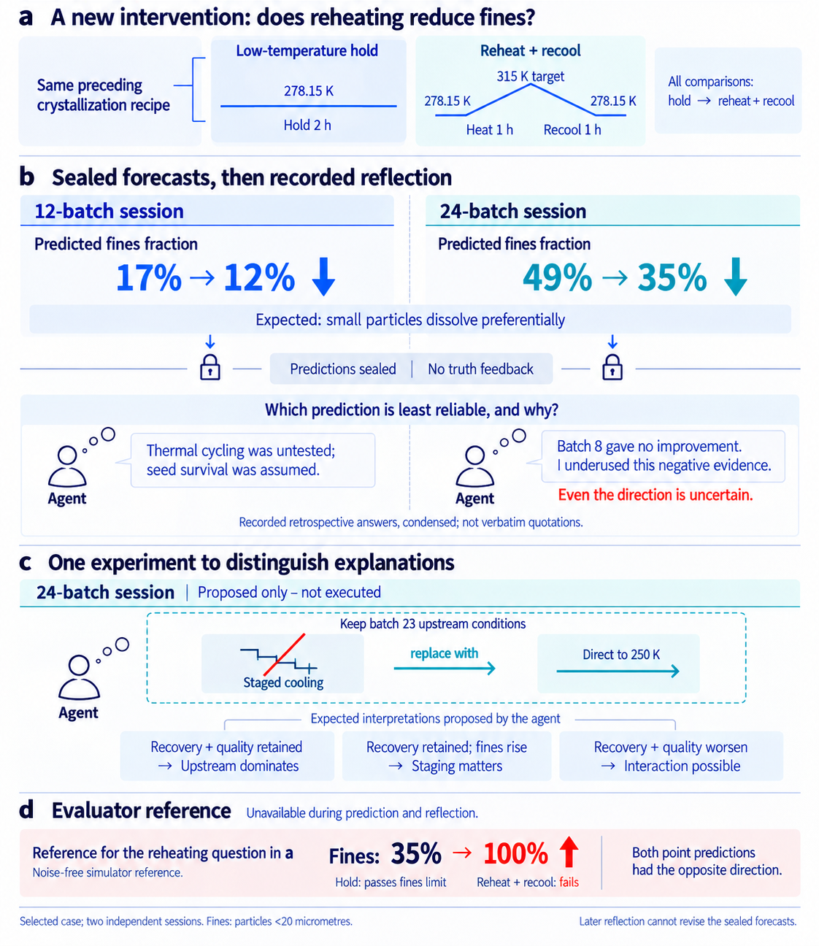
a
A new intervention: does reheating reduce fines?
Low-temperature hold
Reheat + recool
Same preceding
crystallization recipe
278.15 K
315 K target
All comparisons:
hold → reheat + recool
278.15 K
278.15 K
Hold 2 h
Heat 1 h
Recool 1 h
b
Sealed forecasts, then recorded reflection
12-batch session
24-batch session
Predicted fines fraction
Predicted fines fraction
17% → 12%
49% → 35%
Expected: small particles dissolve preferentially
Predictions sealed | No truth feedback
Which prediction is least reliable, and why?
Thermal cycling was untested;
seed survival was assumed.
Batch 8 gave no improvement.
I underused this negative evidence.
Agent
Agent
Even the direction is uncertain.
Recorded retrospective answers, condensed; not verbatim quotations.
c
One experiment to distinguish explanations
24-batch session
Proposed only – not executed
Keep batch 23 upstream conditions
replace with
Direct to 250 K
Staged cooling
Agent
Expected interpretations proposed by the agent
Recovery + quality retained
→ Upstream dominates
Recovery retained; fines rise
→ Staging matters
Recovery + quality worsen
→ Interaction possible
d
Evaluator reference
Unavailable during prediction and reflection.
Reference for the reheating question in a
Fines:
35% → 100%
Both point predictions
had the opposite direction.
Noise-free simulator reference.
Hold: passes fines limit
Reheat + recool: fails
Selected case; two independent sessions. Fines: particles <20 micrometres.
Later reflection cannot revise the sealed forecasts.
Notes:
Retained artwork: paper\figures\ncs-full\figure07-posttest-reflection.png. Only the overall title area and typography are edited. Illustrations remain raster artwork; overlaid labels are editable PowerPoint text. Original C-W05 Q/K2. Reflection received no reference feedback. Proposed cooling experiment was not executed. Evaluator reference is for reheating only.

Slide 8
a
Physical process model
State, laws, instruments, private parameters
Experimental runtime
External researcher
Validate, commit, measure, account, replay
Agent, optimizer
or human
Task and evaluation contract
Objectives, operations, budgets, termination
b
Task-world units
64
Boundary and categorical recipes
1,786
Invalid-action probes
192
Generated compositions
52
Generated: 18 new topologies + 8 new identities + 26 coverage cases
Additional: 32 module probes, 7 valid interfaces, 7 invalid compositions
Notes:
Extended Figure S1. Frozen finite-domain platform qualification, separate from 240 agent campaigns. Source: first-paper qualification and Methods. Counts 64, 1786, 192, 52; generated cases 18 + 8 + 26.

Slide 9
EC/E, disc., 12
EC/E, disc., 24
EC/E, opt., 12
EC/E, opt., 24
Score MAE
Score MAE
Score MAE
Score MAE
O
A
M
O
A
M
O
A
M
O
A
M
PA/E, disc., 12
PA/E, disc., 24
RX/P, disc., 12
RX/S, disc., 12
Organic-fraction MAE
Organic-fraction MAE
Macro MAE
Macro MAE
O
A
M
O
A
M
O
A
M
O
A
M
RX/P, opt., 12
RX/S, opt., 12
EQ/P, char., 12
EQ/S, char., 12
Macro MAE
Macro MAE
Macro MAE
Macro MAE
O
A
M
O
A
M
O
A
M
O
A
M
C/E, delivery, 12
C/E, delivery, 24
P/E, delivery, 12
P/E, delivery, 12
Fines MAE
Fines MAE
Purity MAE
Recovery MAE
O
A
M
O
A
M
O
A
M
O
A
M
Opaque
Aligned
MisIndexed
Notes:
Extended Figure S2. Complete prior overview, retaining the existing 16 selected readouts. Five matched worlds per panel, with all 240 campaigns retained in the tables. Source: campaign_metrics.csv. Scales differ.

