Slide 1
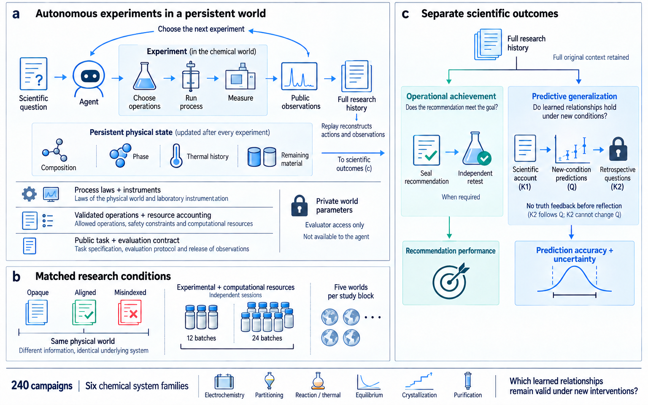
a
Autonomous experiments in a persistent world
c
Separate scientific outcomes
Choose the next experiment
Full research
history
Experiment (in the chemical world)
Full original context retained
Scientific
question
Agent
Choose
operations
Run
process
Measure
Public
observations
Full research
history
Operational achievement
Predictive generalization
Replay reconstructs
actions and observations
Does the recommendation
meet the goal?
Do learned relationships hold
under new conditions?
Persistent physical state (updated after every experiment)
Composition
Phase
Thermal history
Remaining
material
To scientific
outcomes (c)
Scientific
account
(K1)
New-condition
predictions
(Q)
Retrospective
questions
(K2)
Process laws + instruments
Seal
recommendation
Independent
retest
Laws of the physical world and laboratory instrumentation
Private world
parameters
When required
No truth feedback before reflection
Validated operations + resource accounting
(K2 follows Q; K2 cannot change Q)
Allowed operations, safety constraints and computational resources
Evaluator access only
Public task + evaluation contract
Not available to the agent
Recommendation performance
Prediction accuracy +
uncertainty
Task specification, evaluation protocol and release of observations
b
Matched research conditions
Opaque
Aligned
MisIndexed
Experimental + computational resources
Five worlds
per study block
Independent sessions
Same physical world
12 batches
24 batches
Different information; identical underlying system
240 campaigns
Six chemical system families
Electrochemistry
Partitioning
Reaction / thermal
Equilibrium
Crystallization
Purification
Which learned relationships
remain valid under new interventions?
Notes:
Retained artwork: paper\figures\ncs-full\figure01-framework.png. Only the overall title area and typography are edited. Illustrations remain raster artwork; overlaid labels are editable PowerPoint text. ChemWorld framework and retained 240-campaign programme. No new evidence.

Slide 2
a
A complete 24-batch experimental history
Materials (1–6) → process variation (7–18) → hotter reaction (19) → joint process change (20) → refinement (21–24)
B8 Thermal-cycle probe; fines 52.8%
B20 First quality-feasible batch
B23 Best feasible; selected
quality-feasible
infeasible
best feasible so far
b
From a failed batch to a retested procedure
B19 → B20 first feasible result
B23 sealed recommendation
Heating
390 K / 30 min
→
410 K / 20 min
Charge S2/C1 → heat 450 K / 15 min → quench → seed 50 mg
Cooling
Direct to 260 K
→
320 → 290 → 260 K
Cool 310 → 280 → 250 K (4 h each) → hold 4 h → filter + assay
Particle check
Performed
→
Omitted
Source batch: 57.0% recovery · 14.2% fines
Recovery 49.0% → 52.9% · fines 52.8% → 21.5%
Independent retest: 58.1% recovery · 19.3% fines
Changes occurred together; their separate effects are not identified.
c
What the original researcher inferred and predicted
K1 · after research
Q · sealed forecast
K2 · after sealed Q
Upstream chemistry and cooling were
interpreted jointly; seed conditioning
was not directly measured.
Hold 2 h → reheat + recool
With no reference feedback, it said
the B8 negative result was underused
and even the sign was uncertain.
Predicted fines: 49% → 35%
80% intervals: [28, 71] → [16, 59]%
Evaluator-only reference for the same hold → reheat contrast
Fines: 35% → 100%
The sealed forecast had the opposite direction.
Reference outcomes were unavailable during K1, Q and K2.
Notes:
Selected complete W05 B24 Aligned autonomous session. All 24 source batches are retained. K1 followed the experiments and sealed recommendation, Q was sealed without laboratory or target feedback, and K2 followed Q without target feedback. Displayed K1/K2 text is author-condensed. The Q07/Q08 evaluator references were withheld. The source session is illustrative, not a cohort effect.

Slide 3
a
Electrochemistry
b
Reaction processing
Upper right: better operation, worse prediction
Upper right: better operation, worse prediction
Retest improves: 26/30
Retest improves: 9/30
Prediction improves: 14/30
Prediction improves: 8/30
Better retest + worse prediction: 13/30
Better retest + worse prediction: 5/30
Opaque
Aligned
MisIndexed
Notes:
Figure 3. Retained complete strategy comparisons. EC and RX have 30 matched pairs each. P has 15 recommendations. Source: integrated-results/analysis.json and campaign_metrics.csv.

Slide 4
a
Electrochemistry Discovery
b
Electrochemistry Optimization
c
Partitioning
Score MAE
Score MAE
Organic-fraction MAE
12 batches
24 batches
11/15
12 batches
24 batches
12/15
12 batches
24 batches
13/15
0.1738
0.1122
improved
0.1781
0.1082
improved
0.0829
0.0238
improved
-0.3
0
+0.3
-0.3
0
+0.3
-0.2
0
+0.2
Prediction error reduction
Prediction error reduction
Prediction error reduction
d
Crystallization Recovery
e
Crystallization Fines interval coverage
f
Crystallization Retested recovery
Recovery MAE
Fines coverage (%)
Retested recovery
12 batches
24 batches
8/15
12 batches
24 batches
7/15
12 batches
24 batches
7/15
0.1043
0.0794
improved
35.6%
43.9%
improved
42.1%
39.9%
improved
-0.3
0
+0.3
-50
0
+50
-0.6
0
+0.6
Prediction error reduction
Coverage gain (percentage points)
Recovery gain
Favorable
Unfavorable
Source-assay shortfall
Median (n = 15)
Notes:
Figure 4. Six source-driven matched independent 12/24-batch outcomes. The upper pair in each panel gives campaign means. The lower swarm plots all 15 signed world-arm differences at their true horizontal values; vertical offset only prevents collisions. Black diamonds show medians. Open crosses retain source-assay shortfalls. Source: retained campaign metrics.

Slide 5
Same dilute recipe in each world: 13.3 µM
Withheld reference
Opaque
Aligned
MisIndexed
Observed in
research
5.5–9.2%
Band: pooled range of 180 research observations. Reference outcomes were withheld.
Original 80% prediction intervals: Supplementary Table F1. Regime statistics: Table 1.
Notes:
Five-world reference versus original prediction comparison at Q08, 13.3 micromolar. All 15 predictions and 180 source assays retained. The shaded band is the pooled source minimum/maximum, not an uncertainty interval. Native manuscript Table 1 reports regime aggregates; Table F1 retains every original interval. No experiments or internal reasoning reconstructed.

Slide 6
a
Measured purity stays high; forecasts depart from it
98.5%
98.5%
93.5%
94.9%
Measured in research
Withheld outcomes
Agent forecast: 12 batches
Agent forecast: 24 batches
30 campaigns
30 campaigns
15 campaigns
15 campaigns
335 of 360 individual purity forecasts fall below the withheld reference.
b
Recovery prediction error
c
Purity prediction error
Agent more accurate in 26/30 campaigns
Observed mean more accurate in 30/30 campaigns
Negative: agent better. Positive: observed mean better.
Negative: agent better. Positive: observed mean better.
Opaque
Aligned
MisIndexed
Notes:
All 30 original crystallization campaigns, including the retained source-assay shortfall. Source: BASELINE_REANALYSIS.json, retained-figure-data.json. Error differences are agent MAE minus the public source-mean MAE in percentage points. No ratios or logarithmic errors. Vertical offsets in panels b/c only separate campaigns.

Slide 7
EC/E, disc., 12
EC/E, disc., 24
EC/E, opt., 12
EC/E, opt., 24
Score MAE
Score MAE
Score MAE
Score MAE
O
A
M
O
A
M
O
A
M
O
A
M
PA/E, disc., 12
PA/E, disc., 24
RX/P, disc., 12
RX/S, disc., 12
Organic-fraction MAE
Organic-fraction MAE
Macro MAE
Macro MAE
O
A
M
O
A
M
O
A
M
O
A
M
RX/P, opt., 12
RX/S, opt., 12
EQ/P, char., 12
EQ/S, char., 12
Macro MAE
Macro MAE
Macro MAE
Macro MAE
O
A
M
O
A
M
O
A
M
O
A
M
C/E, delivery, 12
C/E, delivery, 24
P/E, delivery, 12
P/E, delivery, 12
Fines MAE
Fines MAE
Purity MAE
Recovery MAE
O
A
M
O
A
M
O
A
M
O
A
M
Opaque
Aligned
MisIndexed
Notes:
Supplementary Figure S1. Complete prior overview, retaining the existing 16 selected readouts. Five matched worlds per panel, with all 240 campaigns retained in the tables. Source: campaign_metrics.csv. Scales differ.

Slide 8
a
Reaction processing: discovery
b
Reaction processing: optimization
Opaque
Aligned
MisIndexed
Opaque
Aligned
MisIndexed
Aligned improves over Opaque in 4/5 worlds
Aligned improves over Opaque in 4/5 worlds
c
Equilibrium: parameter prior
d
Equilibrium: parameter prior
Other nine
Dilute three
Other nine
Dilute three
Opaque
Aligned
MisIndexed
Points: five worlds per arm; short lines: means. EQ grouping is exploratory.
Notes:
RX parameter-prior positive controls and post hoc EQ dilution groups. Five worlds per arm. All retained values, no new scientific experiments.

Slide 9
a
b
c
d
e
f
Electrochemistry
Discovery
Electrochemistry
Optimization
Partitioning
Crystallization
Recovery prediction
Crystallization
Interval coverage
Crystallization
Operating delivery
Score MAE
Score MAE
Organic-fraction
MAE
Recovery MAE
Fines coverage (%)
Retested recovery
Mean, 12
0.1738
0.1781
0.0829
0.1043
35.6%
0.4205
Mean, 24
0.1122
0.1082
0.0238
0.0794
43.9%
0.3994
Improved
11/15
12/15
13/15
8/15
7/15
7/15
O
World 1
A
M
O
World 2
A
M
O
World 3
A
M
O
World 4
A
M
O
World 5
A
M
Mean change
-0.3
0
+0.3
-0.3
0
+0.3
-0.2
0
+0.2
-0.3
0
+0.3
-50
0
+50
-0.6
0
+0.6
MAE reduction
MAE reduction
MAE reduction
MAE reduction
Coverage gain
(percentage points)
Recovery gain
Favorable
Unfavorable
Source shortfall
Notes:
Budget effects. All 90 response comparisons in 15 matched independent 12/24 pairs per panel. Positive change denotes lower MAE, higher coverage or higher recovery. Native editable data marks. Source shortfalls are retained and crossed. Complete response detail remains in the supplementary view. Source: campaign_metrics.csv.

Slide 10
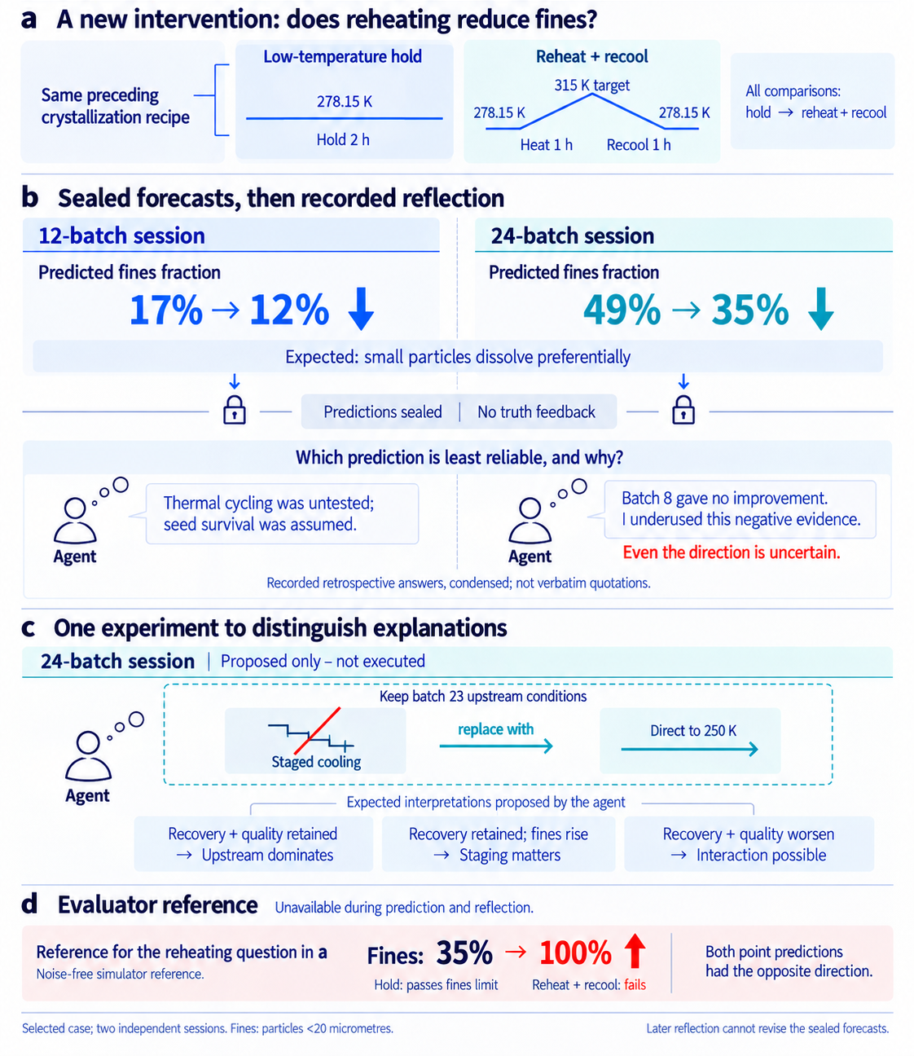
a
A new intervention: does reheating reduce fines?
Low-temperature hold
Reheat + recool
Same preceding
crystallization recipe
278.15 K
315 K target
All comparisons:
hold → reheat + recool
278.15 K
278.15 K
Hold 2 h
Heat 1 h
Recool 1 h
b
Sealed forecasts, then recorded reflection
12-batch session
24-batch session
Predicted fines fraction
Predicted fines fraction
17% → 12%
49% → 35%
Expected: small particles dissolve preferentially
Predictions sealed | No truth feedback
Which prediction is least reliable, and why?
Thermal cycling was untested;
seed survival was assumed.
Batch 8 gave no improvement.
I underused this negative evidence.
Agent
Agent
Even the direction is uncertain.
Recorded retrospective answers, condensed; not verbatim quotations.
c
One experiment to distinguish explanations
24-batch session
Proposed only – not executed
Keep batch 23 upstream conditions
replace with
Direct to 250 K
Staged cooling
Agent
Expected interpretations proposed by the agent
Recovery + quality retained
→ Upstream dominates
Recovery retained; fines rise
→ Staging matters
Recovery + quality worsen
→ Interaction possible
d
Evaluator reference
Unavailable during prediction and reflection.
Reference for the reheating question in a
Fines:
35% → 100%
Both point predictions
had the opposite direction.
Noise-free simulator reference.
Hold: passes fines limit
Reheat + recool: fails
Selected case; two independent sessions. Fines: particles <20 micrometres.
Later reflection cannot revise the sealed forecasts.
Notes:
Retained artwork: paper\figures\ncs-full\figure07-posttest-reflection.png. Only the overall title area and typography are edited. Illustrations remain raster artwork; overlaid labels are editable PowerPoint text. Original C-W05 Q/K2. Reflection received no reference feedback. Proposed cooling experiment was not executed. Evaluator reference is for reheating only.

Slide 11
a
Purification
b
Size index
c
Fines
Eligible: 0/5, 3/5, 0/5 (O, A, M)
4/30 lower agent error
21/30 lower agent error
Opaque
Aligned
MisIndexed
Notes:
Retained secondary outcomes moved from main Figures 2 and 6. Purification has 15 recommendations; crystallization has all 30 original campaigns including its source shortfall.

