Slide 1
Unmanned System health management
邱江杰, 胡天祁, 姚润徽
2024/01/02

Slide 2
TABLE OF CONTENT
Background Introduction
Data Pre-Processing
Methods and Results
Conclusion and Discussion

Slide 3
Background Introduction
Motivation: intelligent unmanned systems perform tasks in a complex and unknown environment → failures or anomalies can result in severe accidents → fault diagnosis capabilities essential for ensuring safety and reliability
Small quadrotor autonomous underwater vehicle (AUV):
investigate and monitor the environment of inland waters (e.g., lakes, reservoirs)
five health conditions: normal state (F1), abnormal load (F2), depth sensor failure (F3), major propeller failure (F4), and minor propeller failure (F5).
Dataset: 16 different sensors (motor control signals, battery voltage, depth, angular velocity, acceleration, and vehicle attitude information) with 250 data samples for each health conditions → 1220 data samples
Goal: A classification algorithm to identify AUV fault situations

Slide 4
Data pre-Processing
Normalization
Max Scaling
Min-Max Scaling
Data Augmentation
Sliding Window Data Augmentation
Anomaly Detection
Isolation Forest Algorithm
Shuffle Data
One-Hot Encoding

Slide 5
Methods and results
First approach by implementing popular algorithms for classification of time series data
Algorithm | Accuracy
Decision Tree | 87.8%
Random Forest | 96.7%
Support Vector Machine: | 88.6%
Bagging | 93.9%
CNN (1 Conv Layer) | 72.2%
CNN (2 Conv Layer) | 80.8%
RNN | 80.0%

Slide 6
Methods and results - Random Forest
Meta estimator that fits a number of decision tree classifiers on various sub-samples of the dataset and uses averaging to improve the predictive accuracy and control overfitting →reduction in variance
Small increase in bias and loss of interpretability for performance boost
sklearn.ensemble.RandomForestClassifier Parameters:
N_estimators: number of trees in the forest
Criterion: function to measure the quality of a split (Gini, Entropy or Log Loss)
Max_depth: maximum depth of the tree
Random_state: controls randomness of the bootstrapping of the samples used when building tree and sampling of the features to consider when looking for the best split at each node

Slide 7
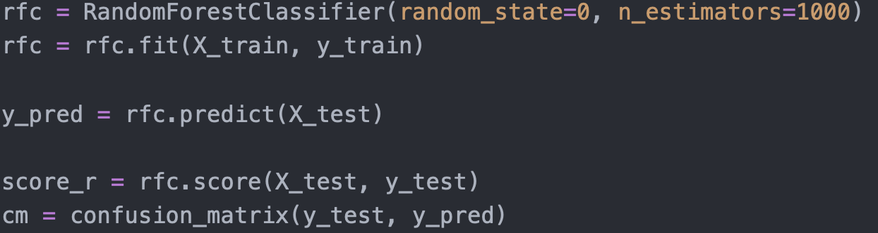
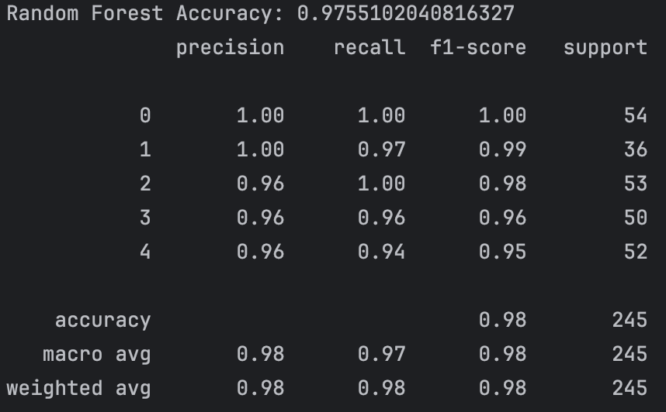
Methods and results - Random Forest

Slide 8
Other method: Multiple classifier
For each type of damage, we have developed a Random Forest Classifier to decide whether an object is of this type.
Type | Accuracy
Normal | 96.3%
AddWeight | 100%
PressureGain_constant | 99.2%
PropellerDamage_bad | 96.3%
PropellerDamage_slight | 94.7%

Slide 9
Other method: Multiple classifier
Classify Method I:
For each object, we first decide if it can be classified into a single type using the 5 classifiers of the 5 types (Step 1)
If the object classification is ambiguous, use the random forest classifier developed before to decide its type (Step 2)
Accuracy for classes ‘AddWeight’ and ‘PressureGain_constant’ improved
Classify Method II:
Adaption: use improved classifiers from Method 1 → for others, use the original Random Forest Classifier
Accuracy: 97.1% each (vs. Random Forest Classifier: 97.5%)
→ No improvement

Slide 10
What we do with rnn and what we get
Simple RNN
Layers, Learning Rate, Batch Size, Optimizer……
Add Ensemble
Models Vote to Get the Final Prediction
Use Meta Model
Model Makes Final Prediction Based on the Base Models’ Prediction
Parameter Tuning
Using Optuna to Find a Set of Parameters Which Maximizes the Accuracy

Slide 11
What We Found in Feature Engineering
Which Data Should We Select as Features ?
For RNN we organize the data into a time series matrix while retaining the original features
For traditional machine learning methods, we remove the time column, flatten the data, and use the entire dataset as features
What are the drawbacks of these practices ?
What about PCA ?
How can we visualize the importance of each feature ?
How can we visualize the impact of each feature on the decision ?

Slide 12
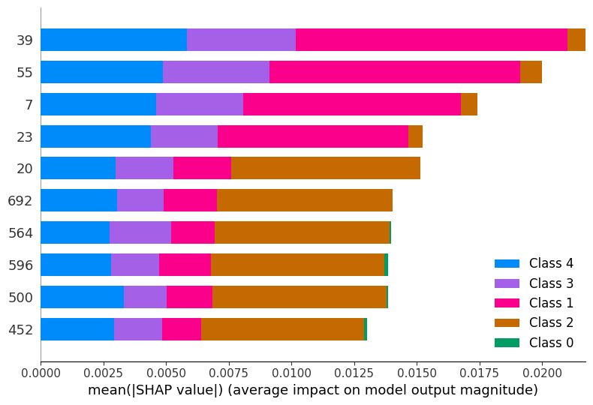
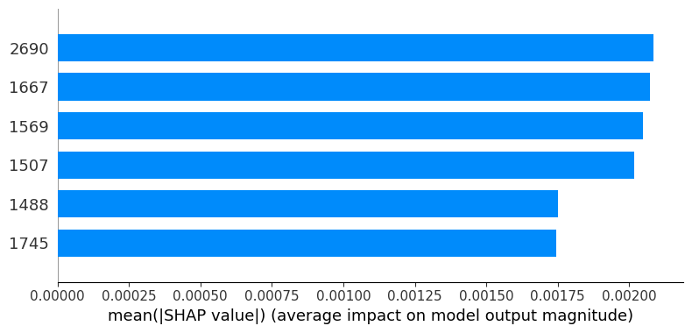
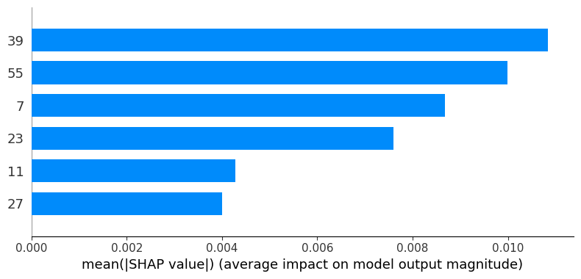
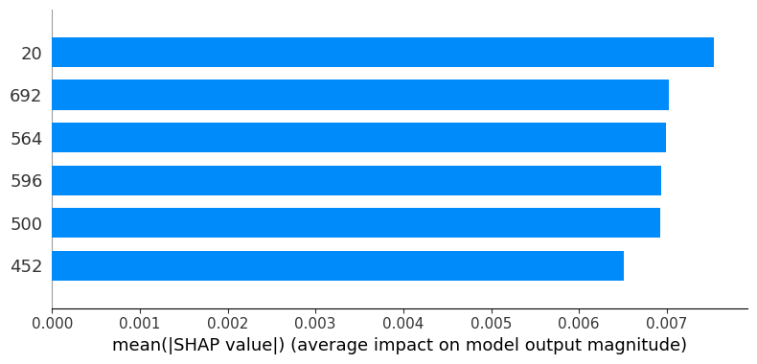
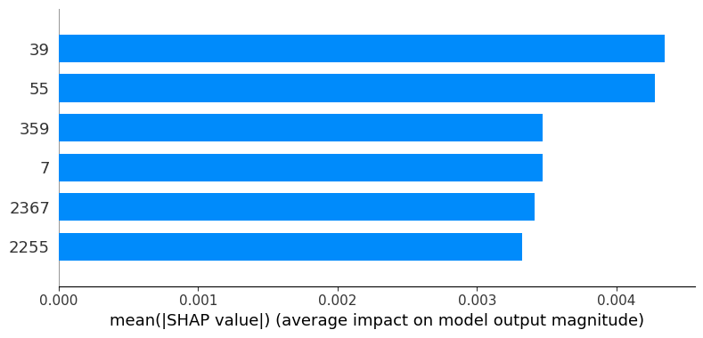
What We Found in Feature Engineering
How can we visualize the importance of each feature ?

Slide 13
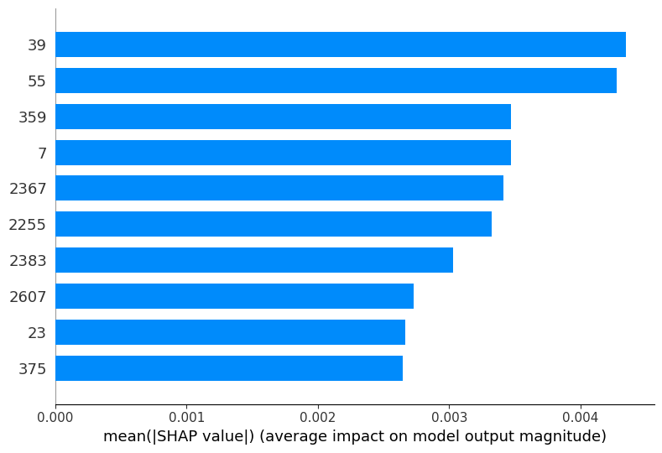
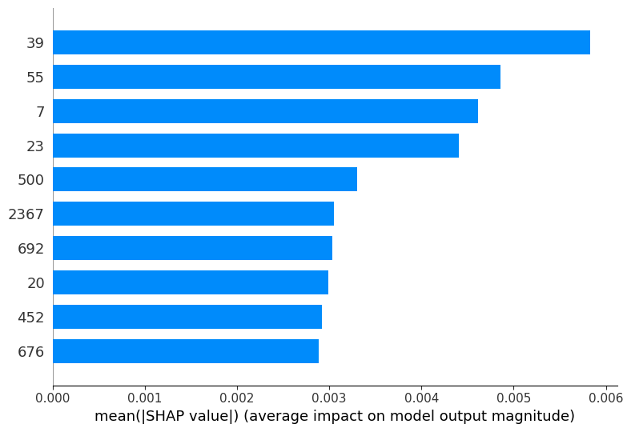
What We Found in Feature Engineering
How can we visualize the importance of each feature ?
Damage Bad
Damage Slight

Slide 14
conclusion and discussion
Why Do Traditional Machine Learning Methods Outperform Neural Networks ?
Why Do These Data Processing Methods Lead to a Decrease in Model Performance ?
Data Augmentation
Anomaly Detection
Shuffle Data
One-Hot Encoding
What We Found in Feature Engineering ?

Slide 15
Thank you!

