Slide 1
Unmanned System health management
邱江杰, 胡天祁, 姚润徽
2024/01/02

Slide 2
TABLE OF CONTENT
Background Introduction
Data Pre-Processing
Methods and Results
Conclusion and Discussion

Slide 3
Background Introduction
Motivation: intelligent unmanned systems perform tasks in a complex and unknown environment → failures or anomalies can result in severe accidents → fault diagnosis capabilities essential for ensuring safety and reliability
Small quadrotor autonomous underwater vehicle (AUV):
investigate and monitor the environment of inland waters (e.g., lakes, reservoirs)
five health conditions: normal state (F1), abnormal load (F2), depth sensor failure (F3), major propeller failure (F4), and minor propeller failure (F5).
Dataset: 16 different sensors (motor control signals, battery voltage, depth, angular velocity, acceleration, and vehicle attitude information) with 250 data samples for each health conditions → 1220 data samples
Goal: A classification algorithm to identify AUV fault situations

Slide 4
Data pre-Processing
Normalization
Max Scaling
Min-Max Scaling
Data Augmentation
Sliding Window Data Augmentation
Anomaly Detection
Isolation Forest Algorithm
Shuffle Data
One-Hot Encoding

Slide 5
Methods and results
First approach by implementing popular algorithms for classification of time series data
Algorithm | Accuracy
Decision Tree | 87.8%
Random Forest | 97.1%
Support Vector Machine: | 88.6%
Bagging | ???????????
CNN (1 Conv Layer) | 72.2%
CNN (2 Conv Layer) | 80.8%
RNN | 80.0%

Slide 6
What we do with rnn and what we get
Simple RNN
Layers, Learning Rate, Batch Size, Optimizer……
Add Ensemble
Models Vote to Get the Final Prediction
Use Meta Model
Model Makes Final Prediction Based on the Base Models’ Prediction
Parameter Tuning
Using Optuna to Find a Set of Parameters Which Maximizes the Accuracy

Slide 7
conclusion and discussion

Slide 8
conclusion and discussion
Why Do Traditional Machine Learning Methods Outperform Neural Networks ?

Slide 9
conclusion and discussion
Why Do Traditional Machine Learning Methods Outperform Neural Networks ?
Why Do These Data Processing Methods Lead to a Decrease in Model Performance ?
Data Augmentation
Anomaly Detection
Shuffle Data
One-Hot Encoding

Slide 10
conclusion and discussion
Why Do Traditional Machine Learning Methods Outperform Neural Networks ?
Why Do These Data Processing Methods Lead to a Decrease in Model Performance ?
Data Augmentation
Anomaly Detection
Shuffle Data
One-Hot Encoding
What We Found in Feature Engineering ?

Slide 11
What We Found in Feature Engineering
Which Data Should We Select as Features ?
For RNN we organize the data into a time series matrix while retaining the original features
For traditional machine learning methods, we remove the time column, flatten the data, and use the entire dataset as features
What are the drawbacks of these practices ?
What about PCA ?
How can we visualize the importance of each feature ?
How can we visualize the impact of each feature on the decision ?

Slide 12
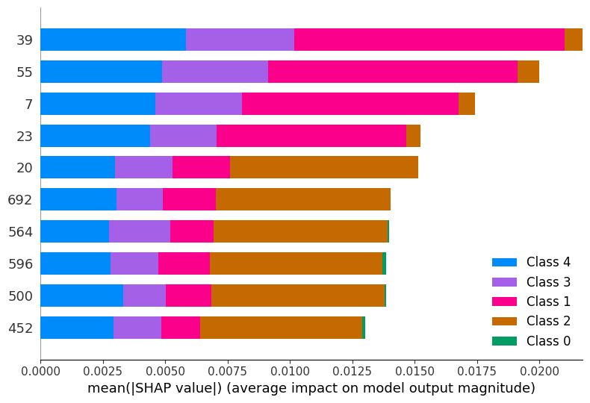
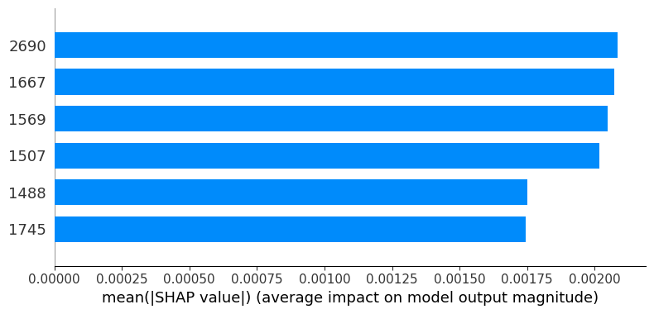
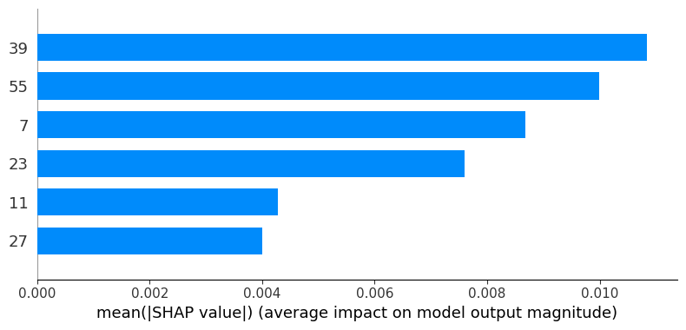
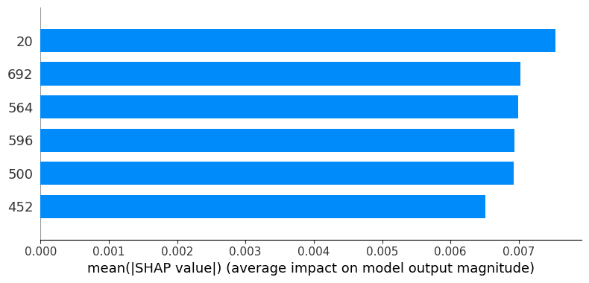
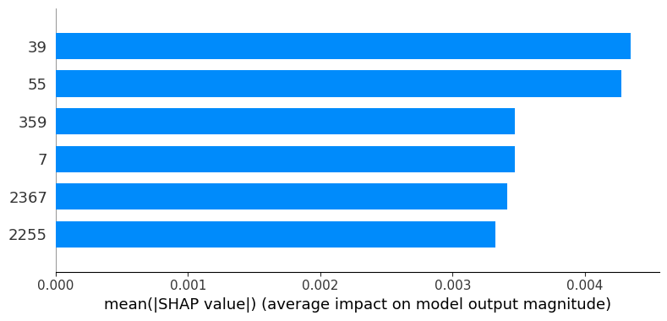
What We Found in Feature Engineering
How can we visualize the importance of each feature ?

Slide 13
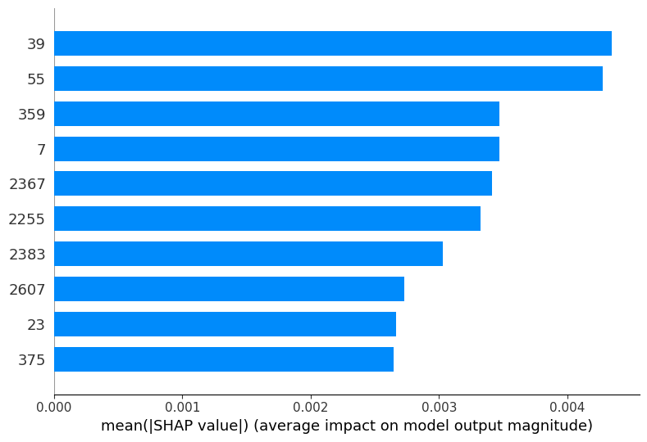
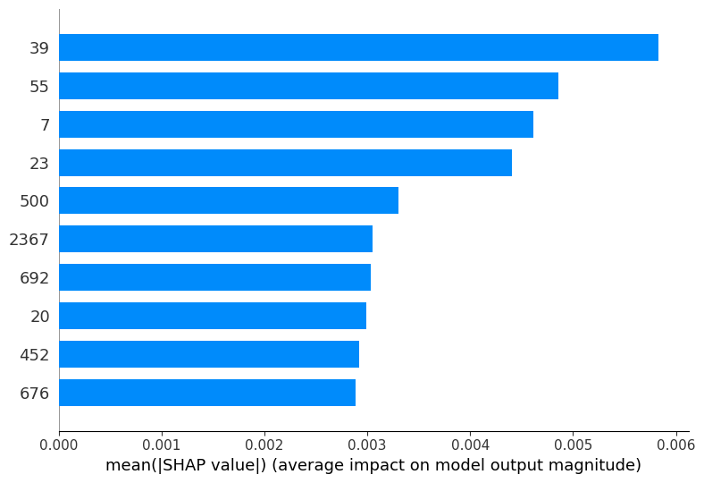
What We Found in Feature Engineering
How can we visualize the importance of each feature ?
Damege Bad
Damege Silght

Slide 14
What We Found in Feature Engineering
How can we visualize the impact of each feature on the decision

Slide 15
conclusion and discussion
How to Improve the Results ?

Slide 16
Thank you!

