Slide 1
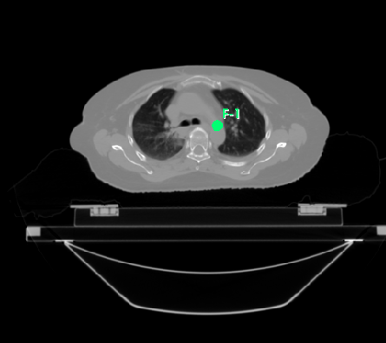
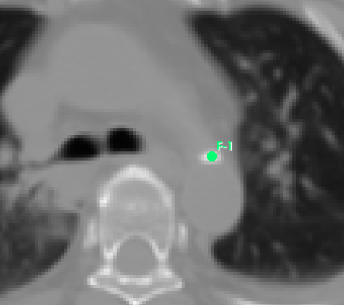
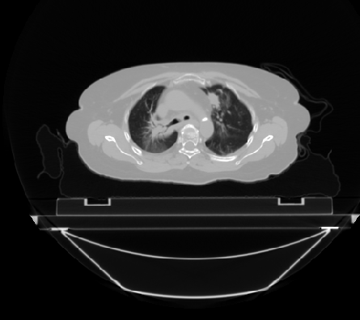
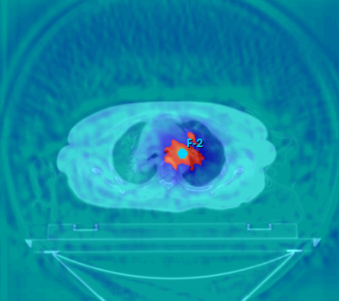
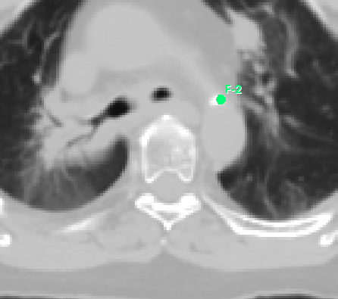
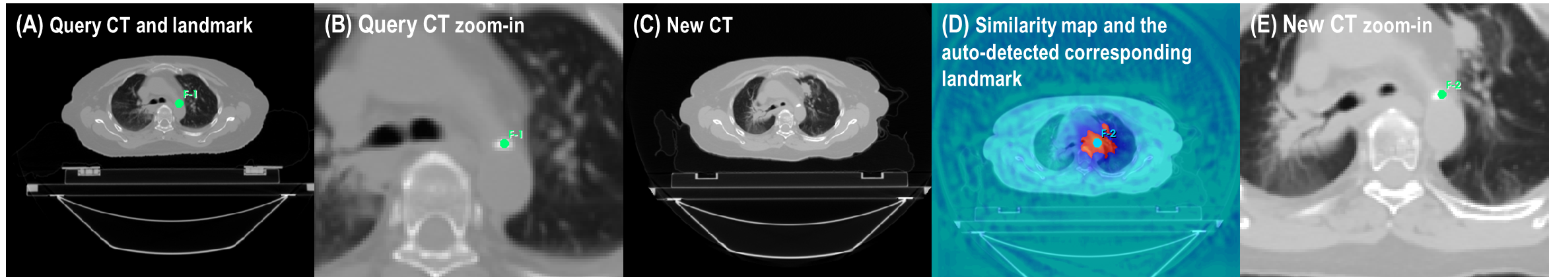
(A) Query CT and landmark
(B) Query CT zoom-in
(C) New CT
(D) Similarity map and the auto-detected corresponding landmark
(E) New CT zoom-in

Slide 2
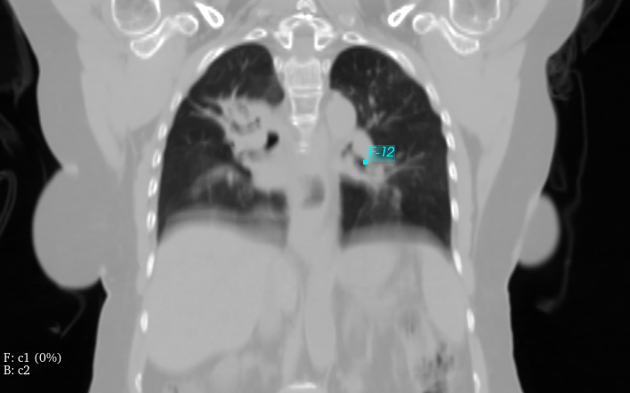
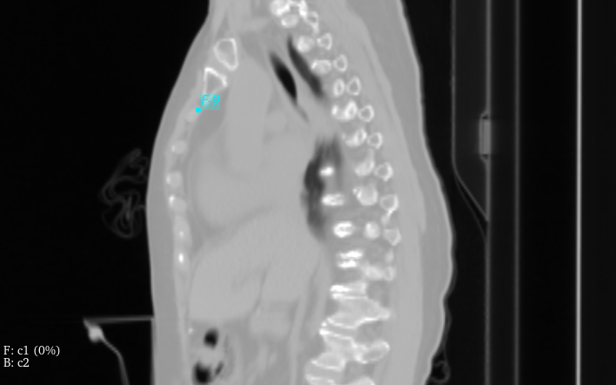
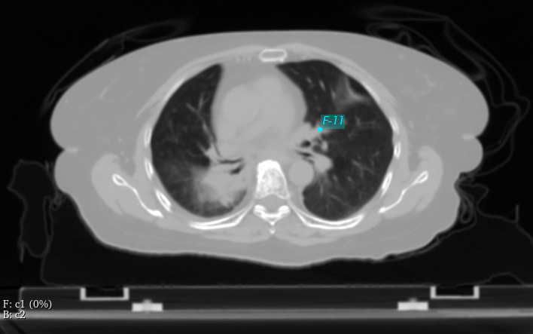
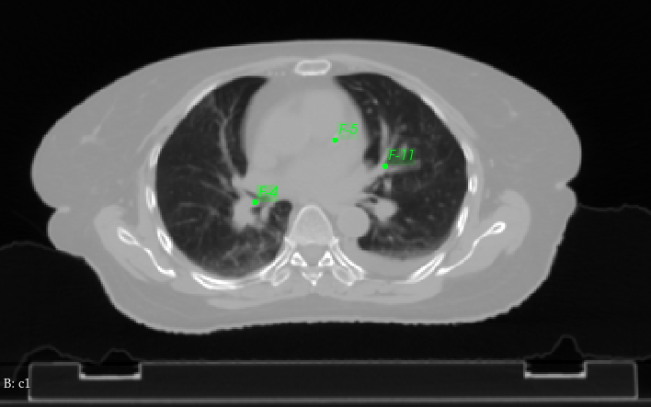
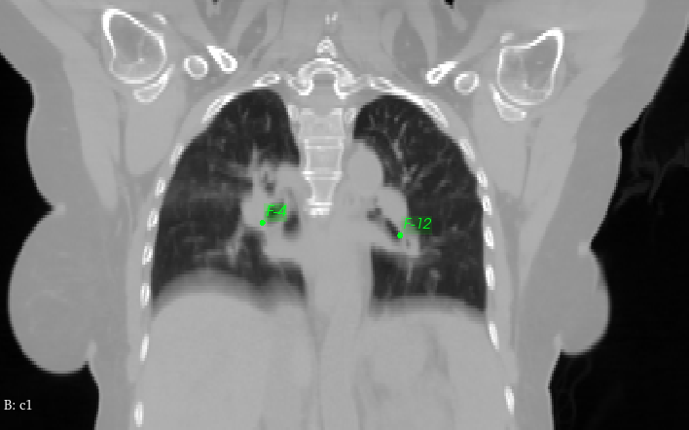
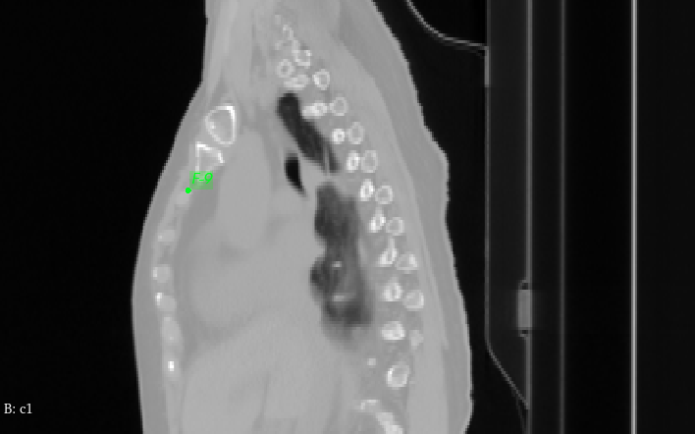
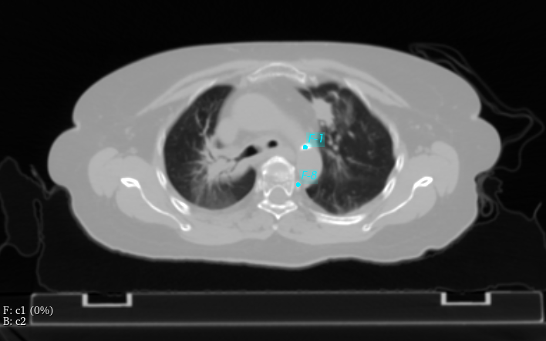
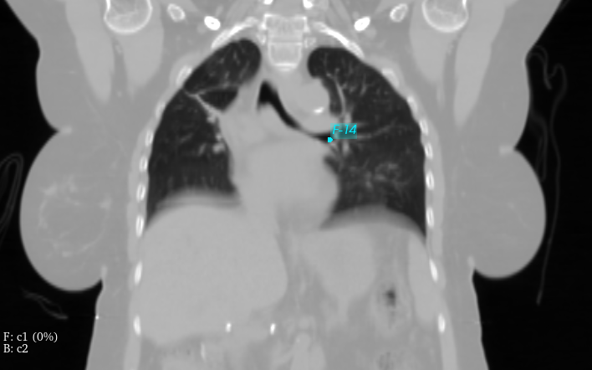
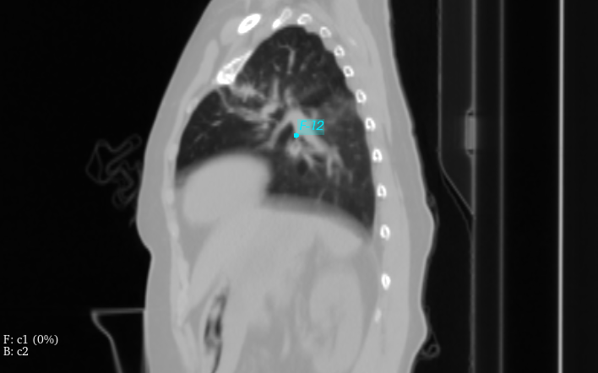
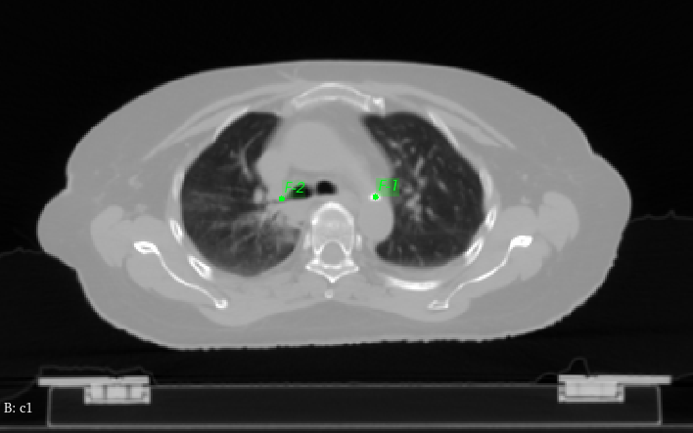
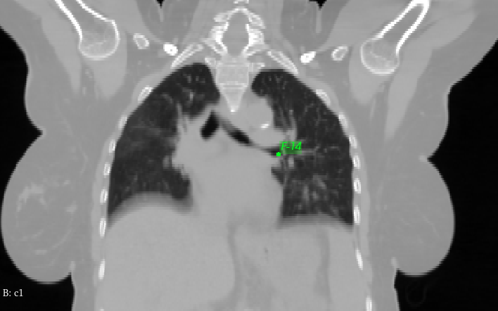
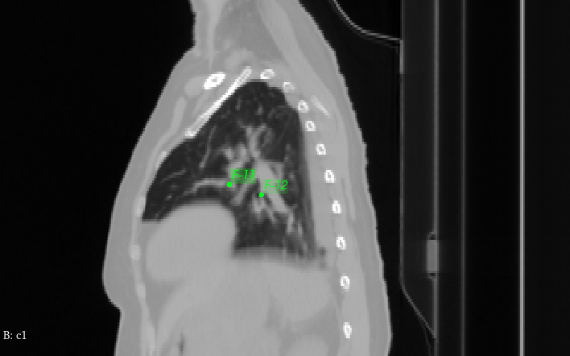

Slide 3
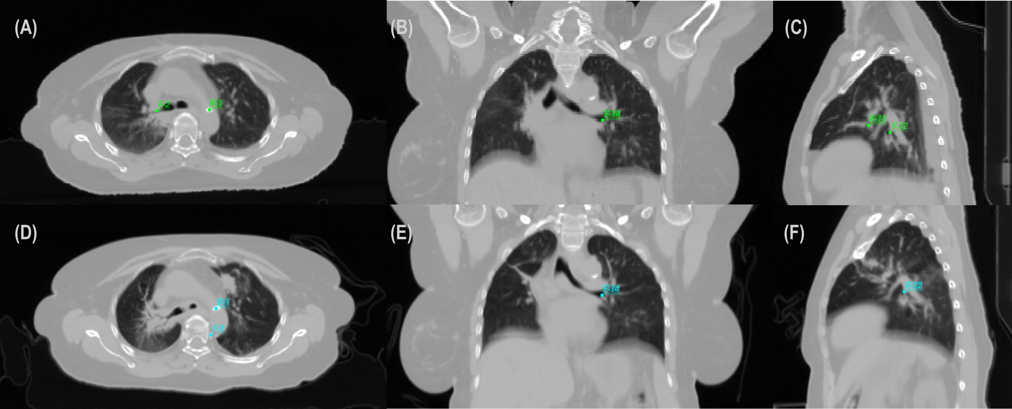
(A) (B) (C)
(D) (E) (F)

Slide 4
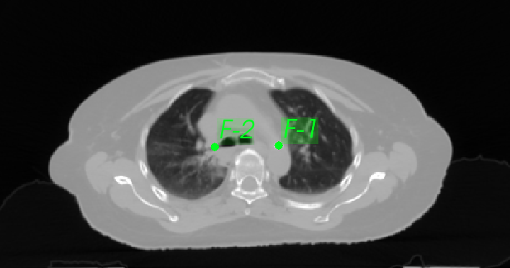
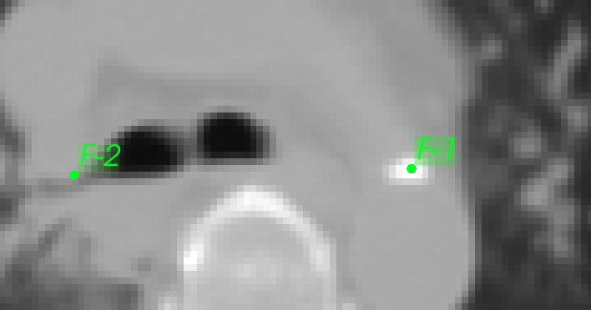
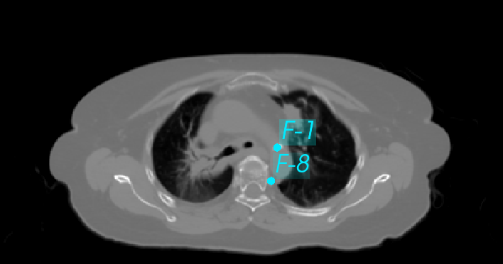
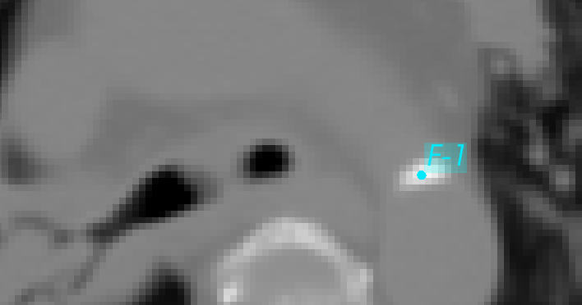
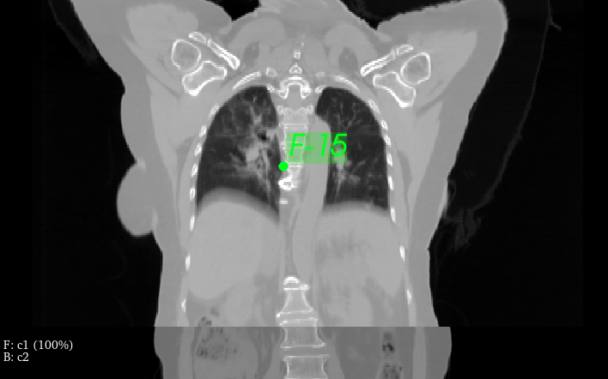
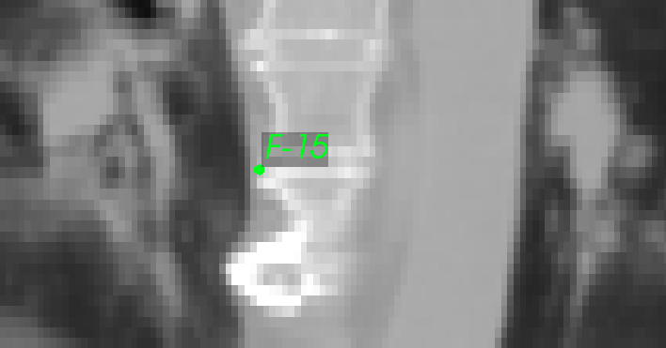
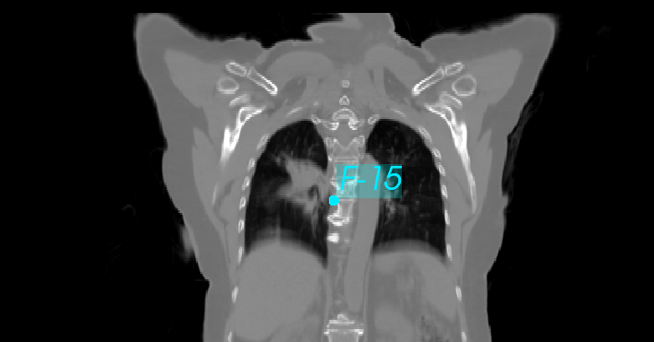
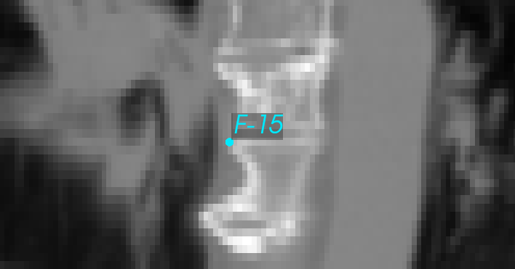
(A) (B)
(C) (D)
(E) (F)
(G) (H)

Slide 5
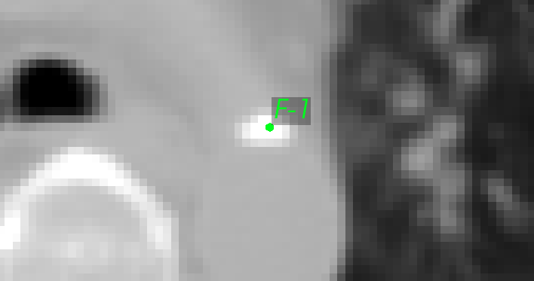
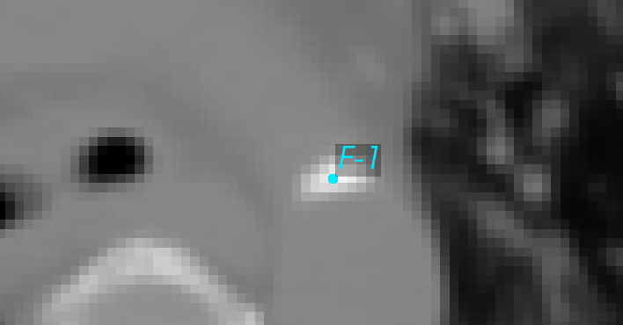
(A) (B) (C)
(D) (E) (F)

Slide 6
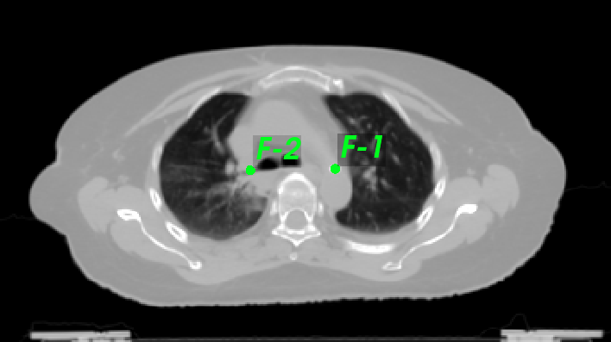
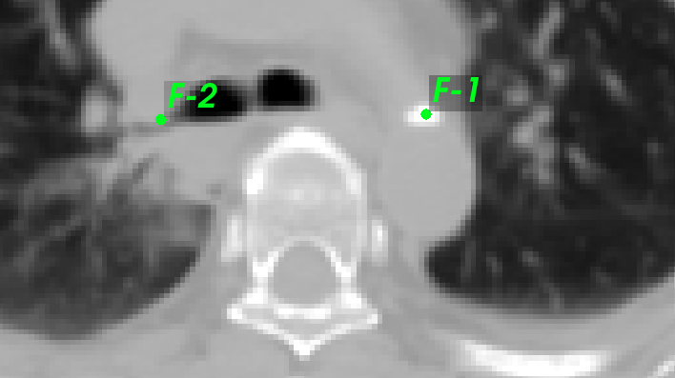
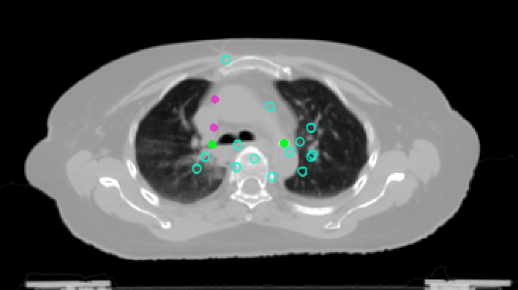
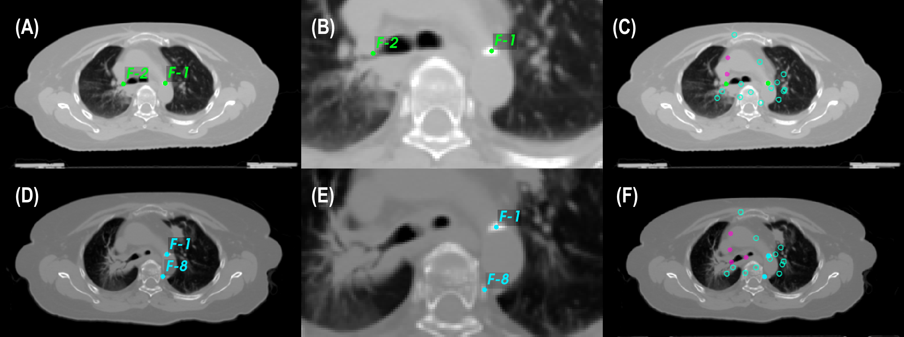
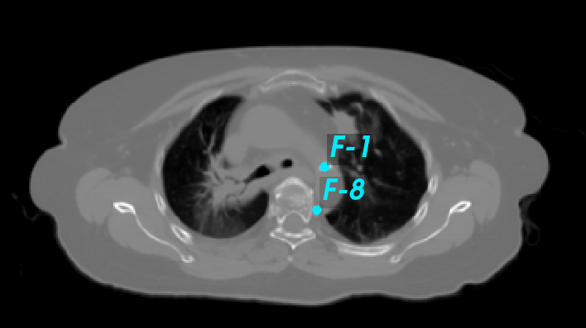
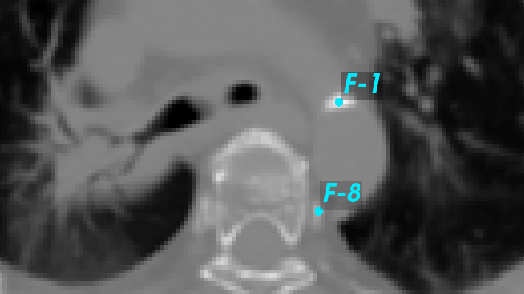
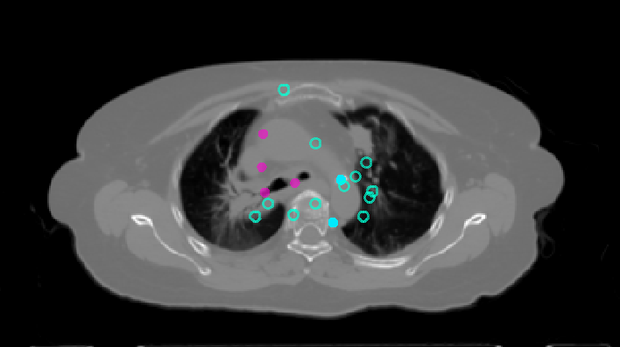
(A) (B) (C)
(D) (E) (F)

Slide 7
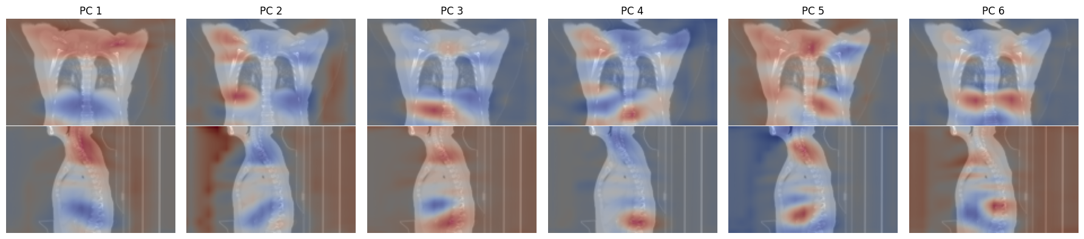
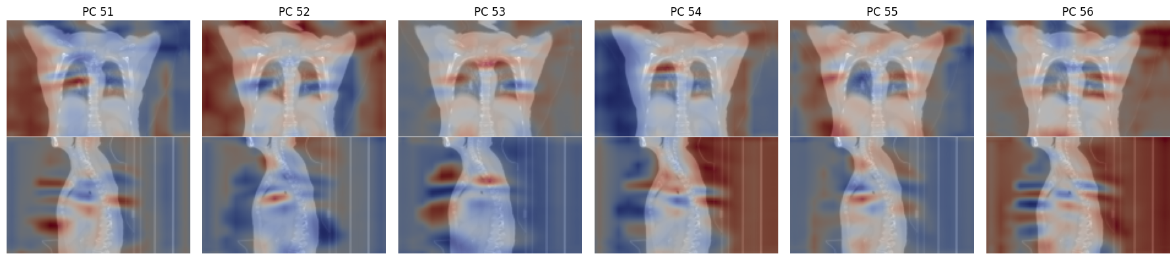

Slide 8
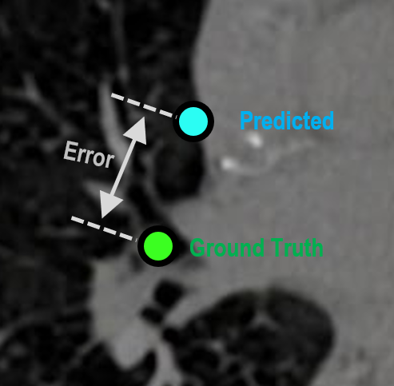
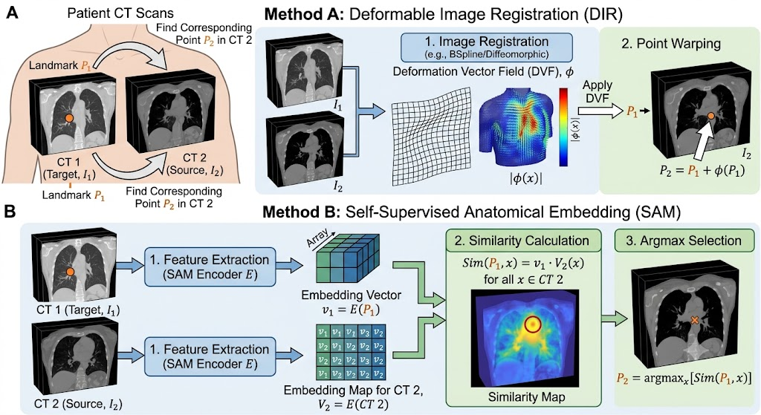
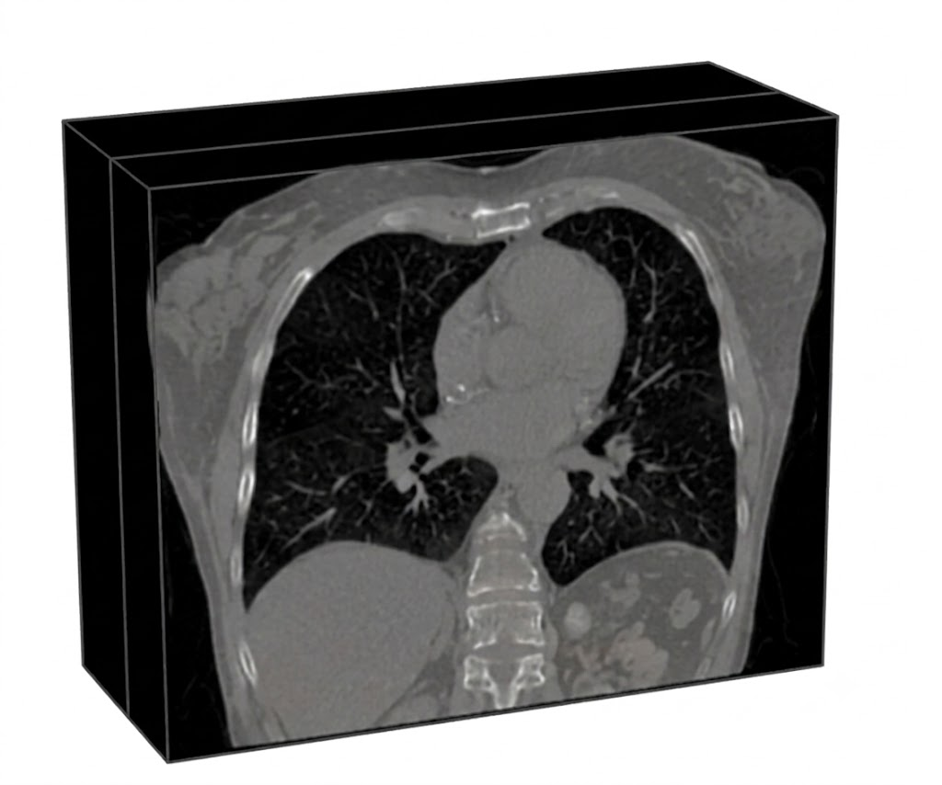
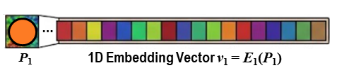
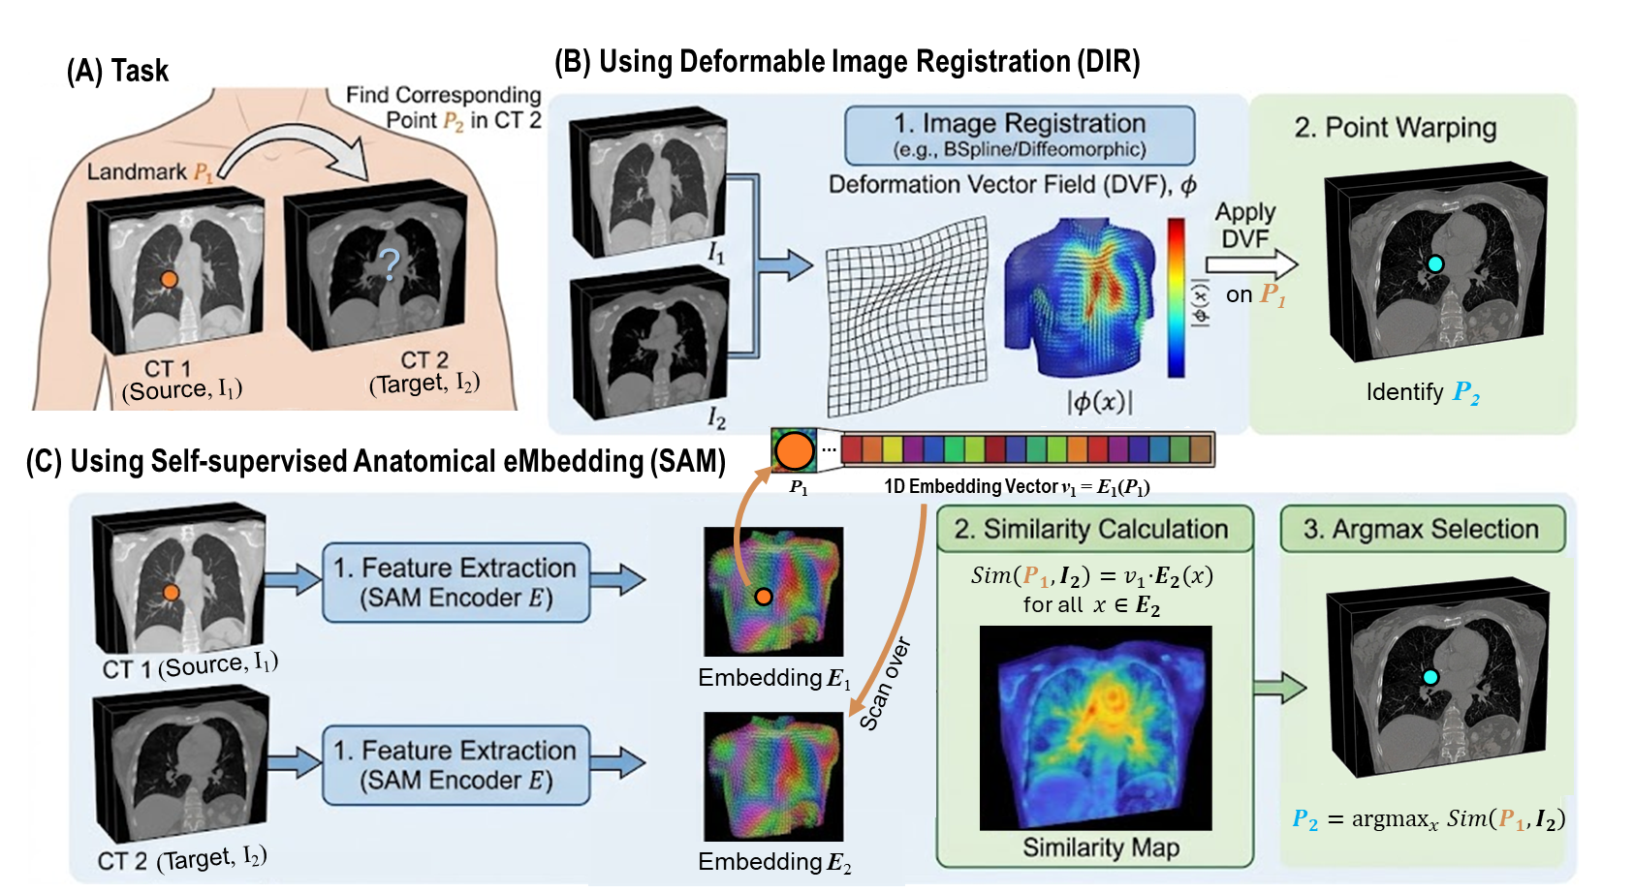

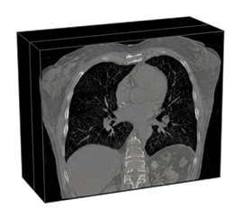
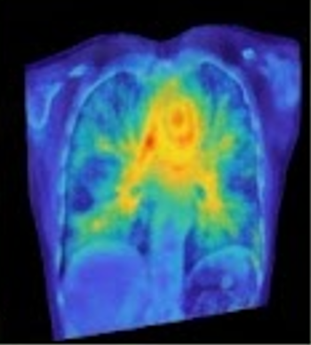


(A) Task
(B) Using Deformable Image Registration (DIR)
?
on P₁
(Source, I₁)
(Target, I₂)
Identify P₂
(C) Using Self-supervised Anatomical eMbedding (SAM)
$Sim\left(P_{1},I_{2}\right)=v_{1}\text{⋅}E_{2}\left(x\right)$ for all $x∈E_{2}$
Scan over
(Source, I₁)
Embedding E₁
$$P_{2}={argmax}_{x} Sim\left(P_{1},I_{2}\right)$$
(Target, I₂)
Embedding E₂

Slide 9
(A) Task
(B) Using Deformable Image Registration (DIR)
?
on P₁
(Source, I₁)
(Target, I₂)
Identify P₂
(C) Using Self-supervised Anatomical eMbedding (SAM)
$Sim\left(P_{1},I_{2}\right)=v_{1}\text{⋅}E_{2}\left(x\right)$ for all $x∈E_{2}$
Scan over
(Source, I₁)
Embedding E₁
$$P_{2}={argmax}_{x} Sim\left(P_{1},I_{2}\right)$$
(Target, I₂)
Embedding E₂

Slide 10
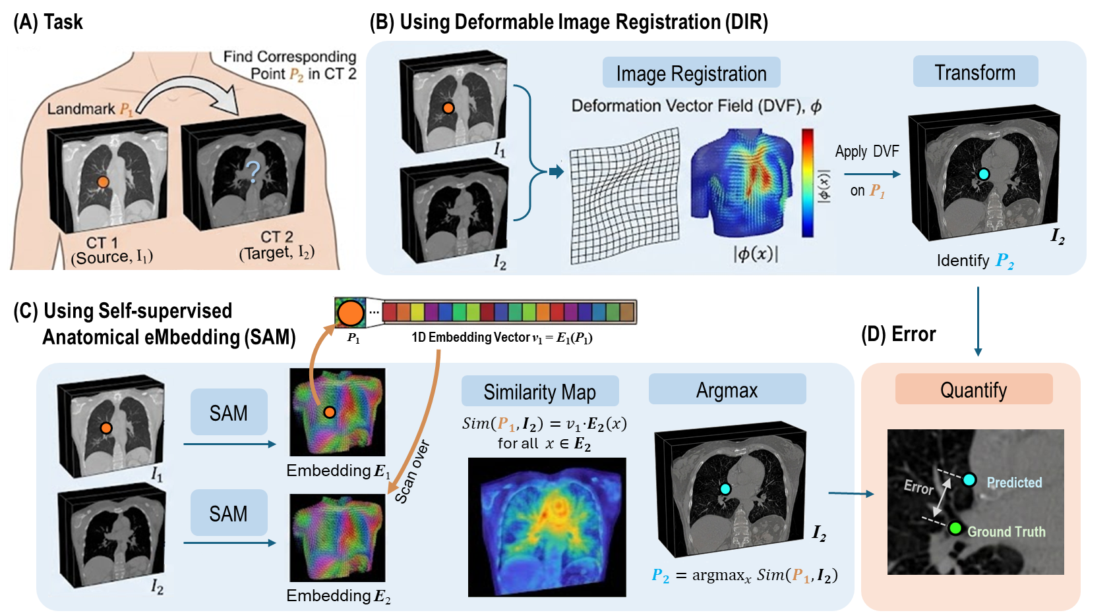
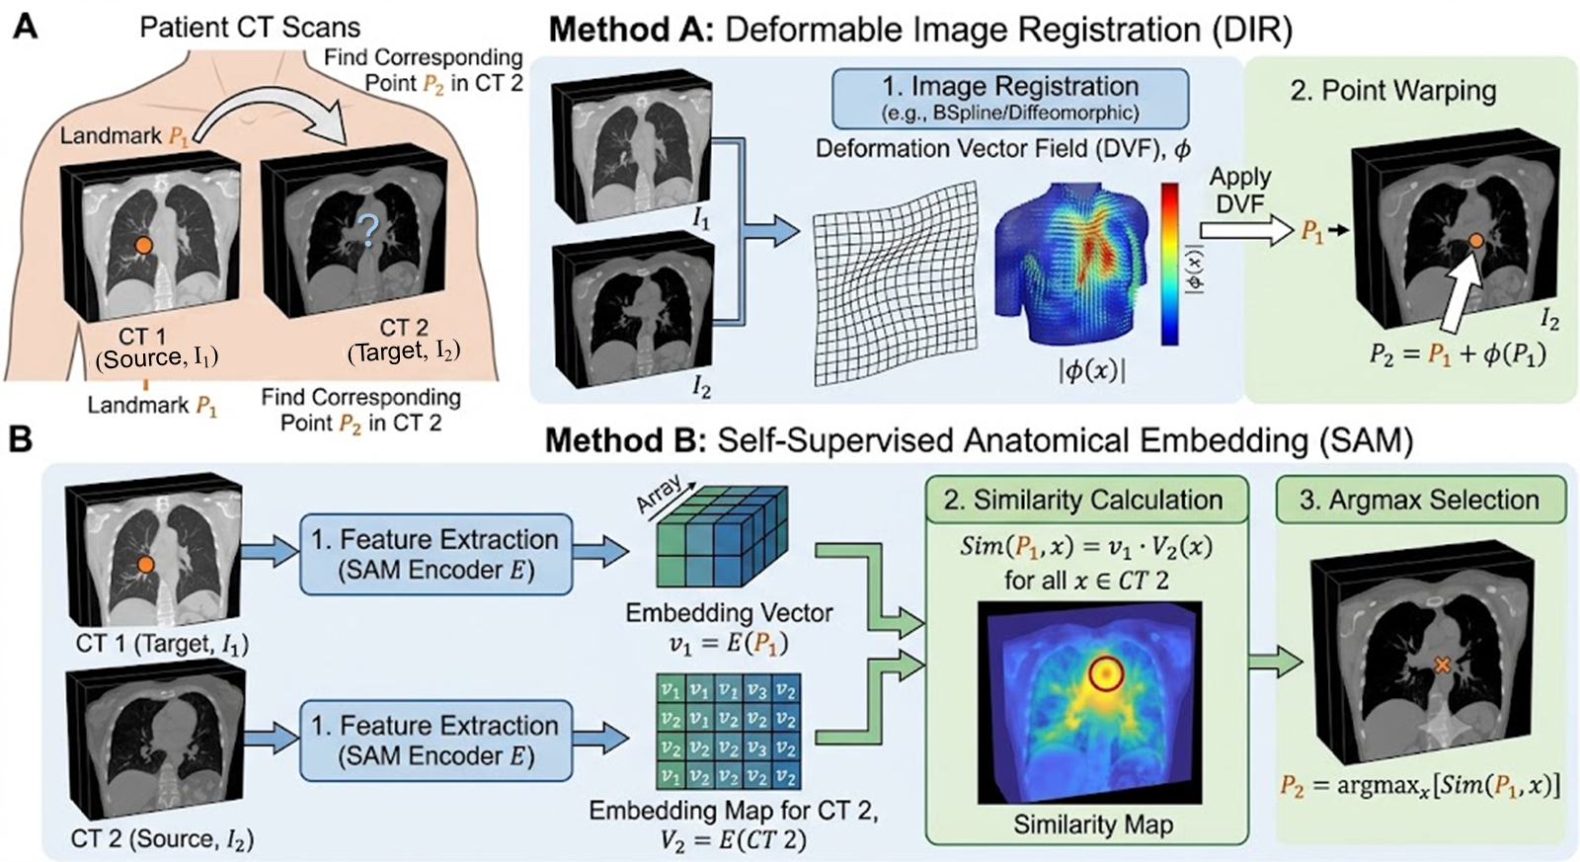
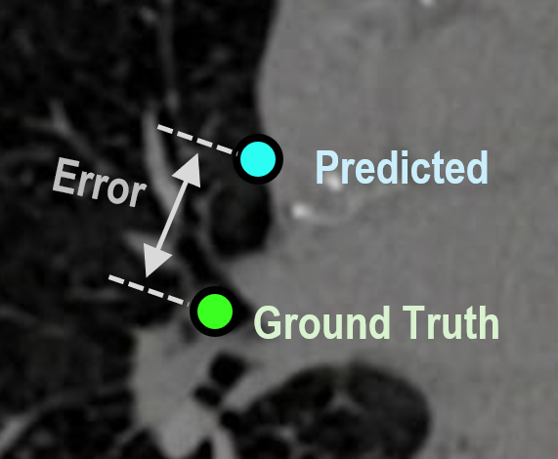


(A) Task
(B) Using Deformable Image Registration (DIR)
Image Registration
Transform
Apply DVF
on P₁
I₂
Identify P₂
(C) Using Self-supervised
Anatomical eMbedding (SAM)
(D) Error
Similarity Map
Argmax
Quantify
SAM
Scan over
$Sim\left(P_{1},I_{2}\right)=v_{1}\text{⋅}E_{2}\left(x\right)$ for all $x∈E_{2}$
Embedding E₁
SAM
I₂
$$P_{2}={argmax}_{x} Sim\left(P_{1},I_{2}\right)$$
Embedding E₂

Slide 11

…
P₁
1D Embedding Vector v₁ = E₁(P₁)

Slide 12
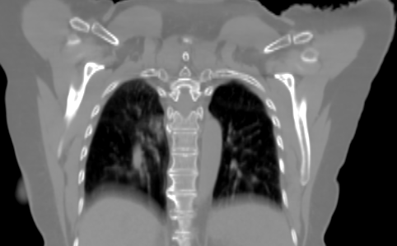
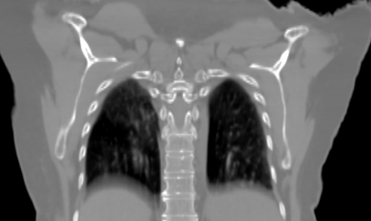




DIR
DVF

Slide 13


Slide 14

Error
Predicted
Ground Truth

Slide 15



(A) (B)

Slide 16



(A) (B)

Slide 17



Slide 18




(A) (B) (C)

