Slide 1
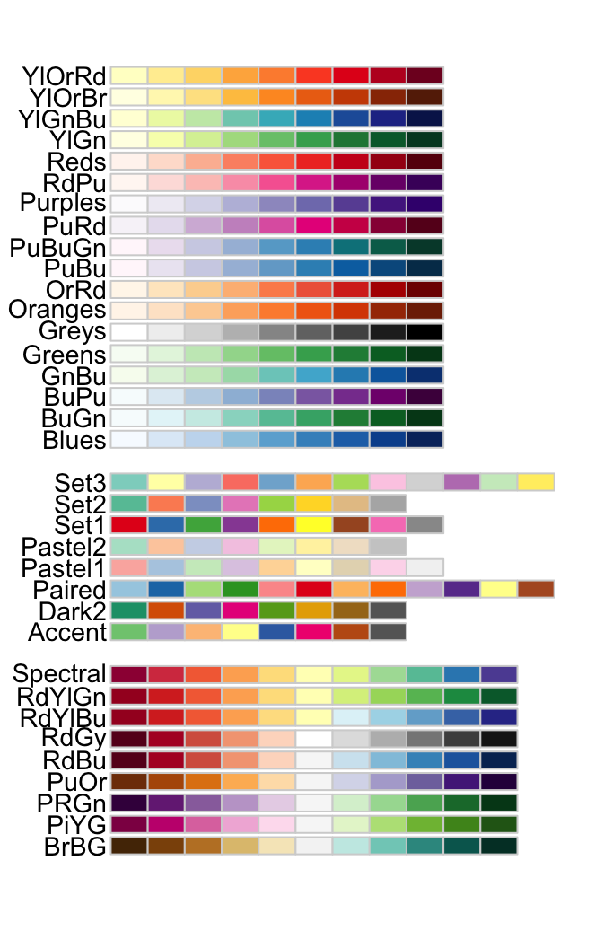
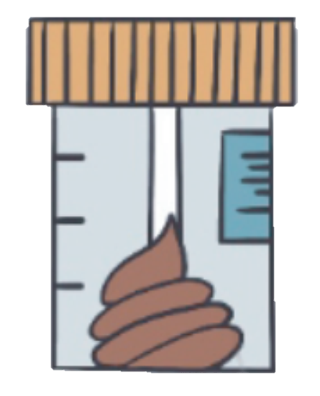
Figure 2
b
Species 1
d
CAMI2
Marine, Plant-associated, and Strain madness simulation datasets
N=131
f
Species 2
Species 1
Species 3
Species 2
Species 4
Species 4
…
Species 5
Species N
Microbial genomes
Microbial genomes
Insilco
digestion &
comparison
Training
Insilco
digestion &
comparison
Species 1
Species 2
Species 1
Species 3
C
Species 2
Species 4
Species 4
…
R
Species 5
Species N
N
Preconstructed unique
2b tag database
Pretrained false positive and
true positive classifier
Sample-specific
unique 2b tag database
a
c
e
g
Species 1
Species 1
Species 1
Species 1
Species 2
Species 2
Species 2
Species 2
Species 3
Species 3
Species 4
Species 4
1st round reads alignment
Species 4
Species 4
2nd round
reads
alignment
Species 5
Species 5
Species 5
Species 5
Input WMS sequencing data
Insilco extracted 2b tags
1st round profiling result
Species identification result
Abundance estimation
Final profiling result
Microbial genomes from GTDB and EnsembleFungi
WMS sequencing reads
Species-specific 2b tags
Insilco extracted 2b tags
Species identified as true positives
Species identified as false positives

Slide 2





Figure S5
Input WMS originated 2b tags
nonredundant sequenced
unique 2b tag ($U_{i})$
Depth
sequenced unique 2b tag ($Q_{i})$
Mapping
results
Total reads number ($R$)
unique 2b tag ($E_{i}$)
Microbial genomes
Species 1
theoretically existent 2b tags ($H_{i}$)
WMS sequencing reads
Species 2
Species-specific 2b tags
Species 3
Duplicated 2b tags
Species 4
Undetected unique 2b tags
Species N
Preconstructed unique 2b database

