Slide 1


GIS IN THE ERA OF AI AND BIG DATA
GeoSDG Toolkit
Empowering the Sustainable Future under a Spatial Context
School of Geographic Sciences, East China Normal University
Sun, Z., Gao, M., Li, M., Xu, Z., & Li, X. (2026). IJGIS. doi:10.1080/13658816.2026.2717629

Slide 2
Agenda
01 · BACKGROUND
02 · METHOD
Why Spatialize the SDGs?
The GeoSDG Framework
Spatial essence of the goals, and the gaps of existing approaches.
Indicators, dual simulation (CALUCC + CAINFRA), and priority areas.
03 · CASE STUDY
04 · TOOL EVOLUTION
Yangtze River Delta
GUI → CLI → AI Agent
What the toolkit can do — and where its honest limits lie.
From a paper artifact toward an AI-era intelligent assistant.
23 slides · ~15–20 min

Slide 3

01 · BACKGROUND
Why Spatialize the SDGs?
Spatial at the Core
Many goals and indicators are inherently spatial — they depend directly on land use and infrastructure conditions, not just national statistics.
17
169
230+
GOALS
TARGETS
INDICATORS
2030 → 2050
From Retrospective to Prospective
With 2030 approaching and progress lagging, the agenda is being extended to 2050 — demanding scenario-based foresight, not just retrospective assessment.
2030
2050
Mid-term checkpoint + long-term horizon for policy.

Slide 4
01 · BACKGROUND
Three Gaps in Existing Approaches
GAP 01
GAP 02
GAP 03
Retrospective
Non-Spatial
Single-Domain
Existing scores rely on historical statistics and lack dynamic simulation of future trends and policy interventions.
Frameworks like iSDG, IFs, SDG-IO, T21 are statistics-driven, ignoring spatial variability and process-driven dynamics.
Existing CA models simulate land use only — no framework yet couples it with infrastructure dynamics critical for accessibility indicators.
A framework that is prospective, spatially explicit, and dual-domain is still missing.

Slide 5
01 · BACKGROUND
Research Question & Contributions
How to upgrade SDG spatialization from retrospective assessment to prospective, spatial dynamic modeling?
1
2
3
CA for 27 Indicators
CAINFRA Dual Simulation
Prioritized Intervention
Introduce CA into spatial assessment of 10 land-related SDGs, 27 indicators.
Propose CAINFRA to simulate infrastructure coverage in parallel with land use.
Identify critical time windows, regional disparities, and priority intervention areas.
Indicator system
Dual-domain coupling
Policy targeting

Slide 6
02 · METHOD
Method Overview: Three Modules
MODULE 1
MODULE 2
MODULE 3
Indicator Selection & Quantification
Spatiotemporal Simulation & Scoring
Future Sustainability Outlook
10 SDGs · 27 indicators
CALUCC + CAINFRA
SSP scenarios 2030–2050
Four measurement primitives
Priority-area identification
Multi-scale synthesis
Corresponds to Figure 1 in the paper

Slide 7
02 · METHOD
Spatial SDG Indicator System — Table 1 (10 Goals · 17 Targets · 27 Indicators)
LP 比例
LC 转换
BZ 缓冲区
TS 统计
YES = 直接指标
SDG | Target | Indicator | Type | Direct
Goal 2 |  | End Hunger
 | 2.1.2 | Proportion of land for agriculture use | LP | YES
 |  | Grain yield | TS | —
 | 2.4.1 | Proportion of land for easy accessibility | BZ | —
 |  | Proportion of land for efficient irrigation practices | BZ | —
Goal 3 |  | Good Health & Well-being
 | 3.8.1 | Proportion of health facility coverage | BZ | —
 |  | Proportion of elderly care facility coverage | BZ | —
 |  | Proportion of sport & cultural facility coverage | BZ | —
 | 3.c.1 | Proportion of community healthcare institution coverage | BZ | —
 |  | Proportion of city-level hospital coverage | BZ | —
 |  | Proportion of tiered hospital coverage | BZ | —
Goal 4 |  | Quality Education
 | 4.1.2 | Proportion of preschool coverage | BZ | —
 |  | Proportion of primary school coverage | BZ | —
 |  | Proportion of secondary school coverage | BZ | —
 | 6.6.1 | Trends in water-related ecosystems over time | LP | YES
 | 7.2.1 | Proportion of community clean energy facility coverage | BZ | —
SDG | Target | Indicator | Type | Direct
Goal 9 |  | Industry, Innovation & Infrastructure
 | 9.1.1 | % of population residing within 2 km of a road | BZ | —
 |  | % of population served by subway stations | BZ | —
 | 9.c.1 | % of population served by a mobile network | BZ | —
Goal 11 |  | Sustainable Cities & Communities
 | 11.2.1 | % of population served by subway stations | BZ | —
 |  | % of population served by bus stations | BZ | —
 | 11.3.1 | Ratio of land consumption rate to population growth | TS | YES
 | 11.7.1 | Coverage rate of urban open public spaces | BZ | —
Goal 13 |  | Climate Action
 | 13.2.2 | Status of achieving “Carbon Peak” | TS | YES
Goal 14 |  | Life Below Water
 | 14.5.1 | Changes in water ecosystem within protected areas | LC | YES
Goal 15 |  | Life on Land
 | 15.1.1 | % of forest area relative to total land area | LP | YES
 | 15.2.1 | % of progress towards sustainable forest management | LC | YES
 | 15.3.1 | % of degraded land compared to total land area | LC | YES
Goal 2 · 3 · 4 · 6 · 7
Goal 9 · 11 · 13 · 14 · 15
Corresponds to Table 1 in the paper · LP=Land Proportion · LC=Land Conversion · BZ=Buffer Zone · TS=Total Statistics

Slide 8
02 · METHOD
Indicator Calculation Paradigm
Input Data
4 Primitives
Normalize
SDG Score
Land use · Population · Roads · POIs · DEM
Proportion · Conversion · Buffer · Statistics
Positive · Neutral · Negative → 0–100
SDG = Σ wᵢ · Xnorᵢ (Eq. 1–2)
Four Measurement Primitives → 27 Indicators
Normalization Direction
① Land Proportion
② Land Conversion
Positive
Neutral
Negative
Ratio of target land class to total (e.g. forest %, agricultural land %)
Change / transition of land class over time (e.g. degraded land, water ecosystem)
higher = better
closer to opt
lower = better
③ Buffer Zone
④ Total Statistics
Population served within buffer of facility / road / station
Aggregate counts & sums (e.g. grain yield, carbon emissions)
Weighted synthesis
SDG = Σwᵢ · Xnorᵢ(k indicators)
Corresponds to Figure 3 & Eq. 1–2 in the paper

Slide 9
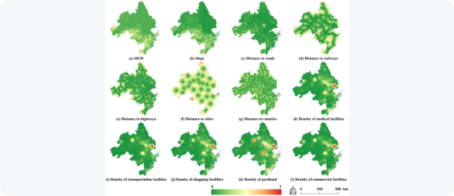
02 · METHOD
Land-Use Simulation: CALUCC
COMBINED TRANSITION PROBABILITY
PRF · Random Forest
×
Ω · Neighborhood
×
Inertia · Adaptive
×
Constraint
×
Random factor
Selection via roulette-wheel · Eq. 3–5
Spatial Driving Factors
Figure 8
Where "AI" Lives
Random Forest learns transition rules from driving factors.
Adaptive Inertia
Balances supply and demand across land types.
Neighborhood Effect
Captures spatial aggregation of neighboring land uses.

Slide 10
02 · METHOD
Infrastructure Simulation: CAINFRA
Driving Factors X
Random Forest
Two-State Cell
Patch-Seeding
Physical · Transport · Location · Socio-economic · Neighbourhood
Pcover(x) = Σ I(hm(x)=d) / M (Eq. 6)
k=1 covered / k=0 not covered (Eq. 7)
Competitive cell-level evolution → future coverage
Simplified Two-State CA
Unlike land-use CA (multiple classes), CAINFRA distinguishes only covered vs not covered, adapting Eq. 4 transition rules with infrastructure coverage probability.
A First: Dual Simulation
CAINFRA extends conventional land-use CA by simulating land use and infrastructure coveragesimultaneously.
Avoid Circularity
Land Use
Infrastructure
POI categories directly representing the simulated infrastructure (e.g. transit stations) are excluded from predictors.
CALUCC
CAINFRA
multi-class · Eq. 3–5
two-state · Eq. 6–7
Corresponds to Figure 4 & Eq. 6–7 in the paper

Slide 11
02 · METHOD
Multi-Scale Assessment & Priority Areas
Multi-Scale Aggregation
Priority-Area Identification
Four priority types integrated via raster overlay into a single ranking.
Raster
City
Cluster
Ensures comparability across regions and resolutions.
LOW
Moderate
High
Critical
Corresponds to Figures 5 & 6 in the paper

Slide 12

03 · CASE STUDY
Study Area & Multi-Source Geographic Data
Table 2 · Figure 7
211,700
Study Area & Land Use Classification
Figure 7
km²
Shanghai · Jiangsu · Zhejiang · Anhui
27
1/5
cities
of national GDP
11 heterogeneous datasets across raster & vector formats drive the 27 indicators and CA simulation.
Table 2 · Sources of Multi-Source Geographic Data
11 datasets
Data | Format | Resolution | Data Year(s) | Publisher
Land use | GeoTiff | 30 m | 2010, 2015, 2020 | Resource & Environment Science and Data Center
Ecological conservation areas | Shapefile (Polygon) | — | Latest (2024) | Protected Planet
DEM | GeoTiff | 30 m | 2019 | ASTER GDEM
POIs data | Shapefile (Point) | — | 2014, 2019 | GaoDe
Roads | Shapefile (Line) | — | 2014, 2019 | OpenStreetMap
Administrative divisions | Shapefile (Line) | — | Latest (2024) | Geographical Information Monitoring Cloud Platform
Current population | GeoTiff | 1 km | 2010, 2015, 2020 | WorldPop Hub
Future population | GeoTiff | 1 km | 2020–2050 | Li et al. (2022)
Waters | Shapefile (Polygon) | — | Latest (2024) | OpenStreetMap
Carbon emission coefficients | Text | — | 2023 | Yao et al. (2023)
Mobile base station data (POIs) | Text | — | Latest (2024) | OpenCelliD

Slide 13
03 · CASE STUDY
Table 3 · Disc. D1 · D3
Value 1 — How Accurate Is It?
CALUCC
CAINFRA
0.128
0.815
0.263
0.923
FoM
OA
FoM
OA
Administrative-Unit Validation
Table 3 · Correlation with Official Scores
Pearson r + t-test
SDG type | Correlation r | t-test (p) | Strength
SDG 2 · End Hunger | 0.380 | 0.269 | n.s.
SDG 3 · Good Health | 0.415 | <0.001 | moderate
SDG 4 · Education | 0.475 | <0.001 | moderate
SDG 6 · Clean Water | 0.604 | <0.001 | moderate
SDG 7 · Clean Energy | 0.311 | 0.294 | n.s.
SDG 9 · Infrastructure | 0.421 | 0.762 | n.s.
SDG 11 · Cities | 0.898 | 0.003 | strong
SDG 13 · Climate | −0.141 | <0.001 | weak (−)
SDG 14 · Life Below Water | 0.370 | 0.072 | weak
SDG 15 · Life on Land | 0.831 | <0.001 | strong
SDG Score (overall) | 0.283 | 0.002 | weak
>70% units FoM > 0.1
70%+
>90% units OA > 0.8
90%+
Validated against official statistical SDG scores (Xu et al. 2020b) as ground truth.
Strongest where indicators directly reflect land cover & ecology (SDG 11/15, r > 0.8); weakest for socio-economic proxies (SDG 2/7/9)

Slide 14
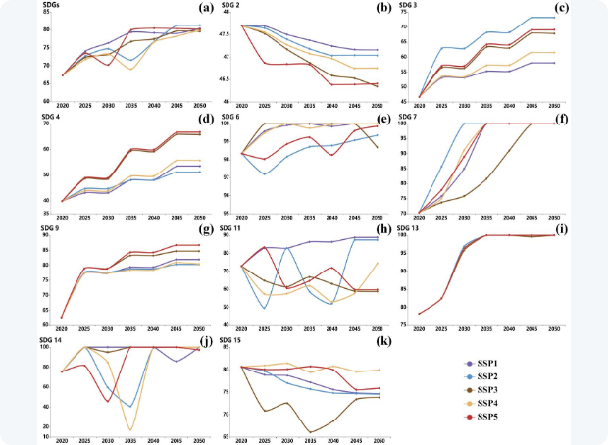
03 · CASE STUDY
Disc. D1 · D5
Value 2 — How Far Ahead Can It Look?
Overall Scores Rise
Simulated SDG Trajectories, 2020–2050
Figure 9
All scenarios improve; SSP1 / SSP2 / SSP5 reach the highest by 2050.
Critical Window: 2030–2035
The key fluctuation period where trajectories diverge.
Three Temporal Patterns
Gradual improvement
Gradual decline
Fluctuation
SDG 6/7/13/14 strong (>90) · SDG 2/15 decline · SDG 11 fluctuates

Slide 15
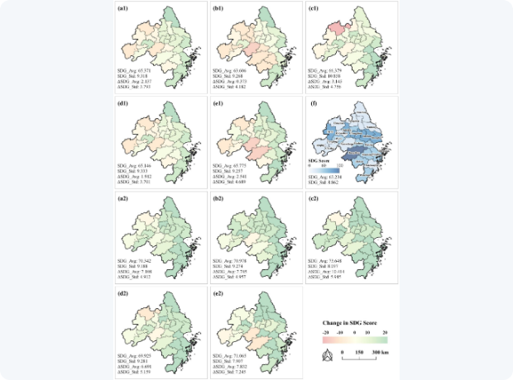
03 · CASE STUDY
Disc. D5
Value 3 — How Fine-Grained Is the View?
BASELINE · 2020
Spatial Patterns of SDG Composite Index
Figure 10
High Center, Low Edges
A central high, north–south low distribution across the delta.
2030
SSP3: Largest Imbalance
SSP2 / SSP4 improve least; SSP3 shows the greatest imbalance.
2050
SSP3: Largest Uplift · SSP4: Widest Gap
Underdeveloped areas improve most; SSP3 gains the most, SSP4 stays the most unequal.
Separates overall performance from intra-regional inequality.

Slide 16


03 · CASE STUDY
Disc. D6
Value 4 — Where Should We Intervene?
2030 Priority Areas
Priority-Area Distribution under SSPs
Figure 11
>15,000
8,667
SSP3 · km² (largest)
SSP2 · km² (smallest)
Nearly 20% overlap across multiple SDGs.
2050 Priority Areas
22,853
+130%
SSP3 · km² (still largest)
SSP2 · fastest growth
Province-Level Priorities, 2050
Expands under all scenarios except SSP1.
Figure 12
Clustered in southern Jiangsu, northern Zhejiang, eastern Anhui.

Slide 17
03 · CASE STUDY
Disc. D3 · D4
Honest Limits — Complement, Not Substitute
Weak for Socio-Economic Goals
Transferability Is Conceptual
Spatial proxies underperform for SDG 2 / 7 / 9 / 13 — complex socio-economic processes.
The modular design is adaptable, but transferability is conceptual so far — validated only in the Yangtze River Delta.
Requires local data, recalibration, and adapted indicators & weights.
Complement, not replace, traditional statistical monitoring.
An honest accounting of the toolkit's boundary — builds credibility

Slide 18
04 · TOOL EVOLUTION
GUI → CLI → AI Agent
V1.0 · PAPER
V2.0 · REFACTOR
V3.0 · IN PROGRESS
GUI
CLI
AI Agent
Windows · C++ · GPL-3.0
figshare DOI
Cross-platform · scriptable
reproducible
Natural language · skills
intelligent assistant
Motivation: the paper-era architecture is hard to apply directly in the AI era.

Slide 19
04 · TOOL EVOLUTION
v1 — Paper GUI (figshare)
What It Is
Limits (Gentle)
Windows Desktop
C++ / GPL-3.0
Graphical user interface
Open-source, full docs & source
Windows-only binding
Desktop interaction paradigm
Hard to join AI / automated workflows
High barrier to reproduce & rework
Published with the Paper
figshare DOI: 10.6084/m9.figshare.29445089.v3

Slide 20
04 · TOOL EVOLUTION
v2 — Cross-Platform CLI
Core Algorithms Refactored
Why It Matters
Indicator calculation
CA simulation
Priority-area identification
Cross-platform & scriptable
Reproducible, batch-friendly pipelines
Integrates into third-party systems
Built on GDAL Raster Operators
A mature geospatial ecosystem for raster processing.
Programmability is the precondition for AI automation.

Slide 21
04 · TOOL EVOLUTION
The Landing Point
v3 — AI Agent (In Progress)
The Interaction Chain
Natural-language question
LLM understands intent
Invokes the Skill
CLI / GDAL computes
Result + interpretation
From a research artifact to an AI-era intelligent assistant — the strongest echo of the conference theme.

Slide 22
CONCLUSION
Conclusions & Outlook
1
2
3
Spatially explicit, prospective tools are key to SDG implementation.
GeoSDG couples CA + SSP for land & infrastructure co-simulation and scenario assessment.
From GUI → CLI → AI Agent: open, reproducible, intelligent.
Honest Limitations
Outlook
27 indicators · single region (YRDUA) · long-term prediction uncertainty.
Cross-region validation · indicator expansion · a smarter Agent version (in progress).

Slide 23

Acknowledgments & References
Funding
Reference
National Natural Science Foundation of China, Key Project 42130107.
Sun, Z., Gao, M., Li, M., Xu, Z., & Li, X. (2026). New Pathways for UN SDGs Spatialization: GeoSDG Toolkit Empowering the Sustainable Future under a Spatial Context.
International Journal of Geographical Information Science, 1–24.
PAPER DOI
Collaborators
10.1080/13658816.2026.2717629
DATA & CODE (FIGSHARE)
Minyi Gao · Mengya Li · Ziheng Xu · Xia Li
10.6084/m9.figshare.29445089.v3
Thank you

