Slide 1

Distributed
Algorithms
2025
1
Warm-up

Slide 2
Algorithms for networks
How can individual nodes
in a large computer network
work together towards
a common goal?

Slide 3
Learning objectives
Understand models of
distributed computing
Design and analyze efficient
distributed algorithms
Prove impossibility results
Use standard graph-theoretic
concepts
Practiced in exercises
Tested in exams

Slide 4
Zero to research-level
No prior knowledge on
distributed systems expected
We will reach topics close
to current research by
the end of the course
Good start for
a Master’s thesis
or PhD studies

Slide 5
This is a theory course
100% mathematics
  definitions
  theorems
  proofs …
0% practice
  programming
  hardware
  protocols …
Expected: basic knowledge of university-level mathematics
Example: what is a mathematical proof

Slide 6
Preparation
You should have already done this:
  register in Sisu
  read instructions in MyCourses
  join our Zulip workspace
  watch two pre-recorded videos
  solve this week’s quiz
This week: extra time
to solve the quiz until midnight tomorrow!

Slide 7
Our weekly routine
Mon: videos, quiz, lecture (10:15pm)
Wed: 1 exercise (midnight)
Thu: exercise session (10:15am)
Fri: 2 exercises (midnight)
Workload:
10–11 h/week

Slide 8
Quiz
One quiz per week, in MyCourses
Solve before the lecture
Automatically graded
  2 points for correct answer
  0.5-point penalty per wrong answer

Slide 9
Exercises
5+ exercises per week, in the textbook
Solve 1 by Wednesday, 2 more by Friday
Submit your answers in MyCourses
The answers need to be complete
  full details, complete proofs
  e.g. why does your algorithm work correctly?
  ask if unclear!

Slide 10
Challenging exercises
In the textbook, marked with a star
Solve at any point during the course
Again, the answers need to be complete

Slide 11
Grading
To pass the course:
  you need to pass both exams
For a good grade:
  you need to solve exercises
  quiz + exercises = max 96 points in total
  80 points = grade 5/5

Slide 12
This week’s content…

Slide 13
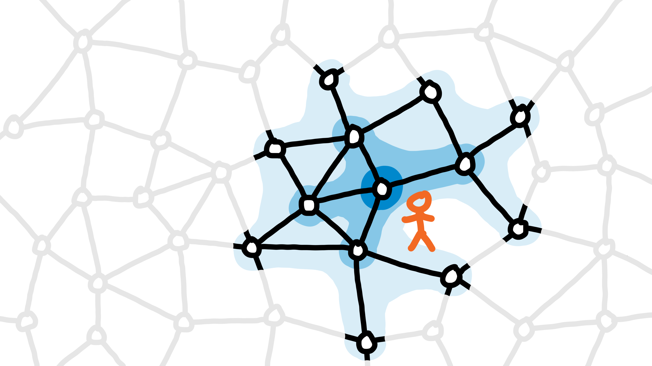
Video 1a: introduction

Slide 14
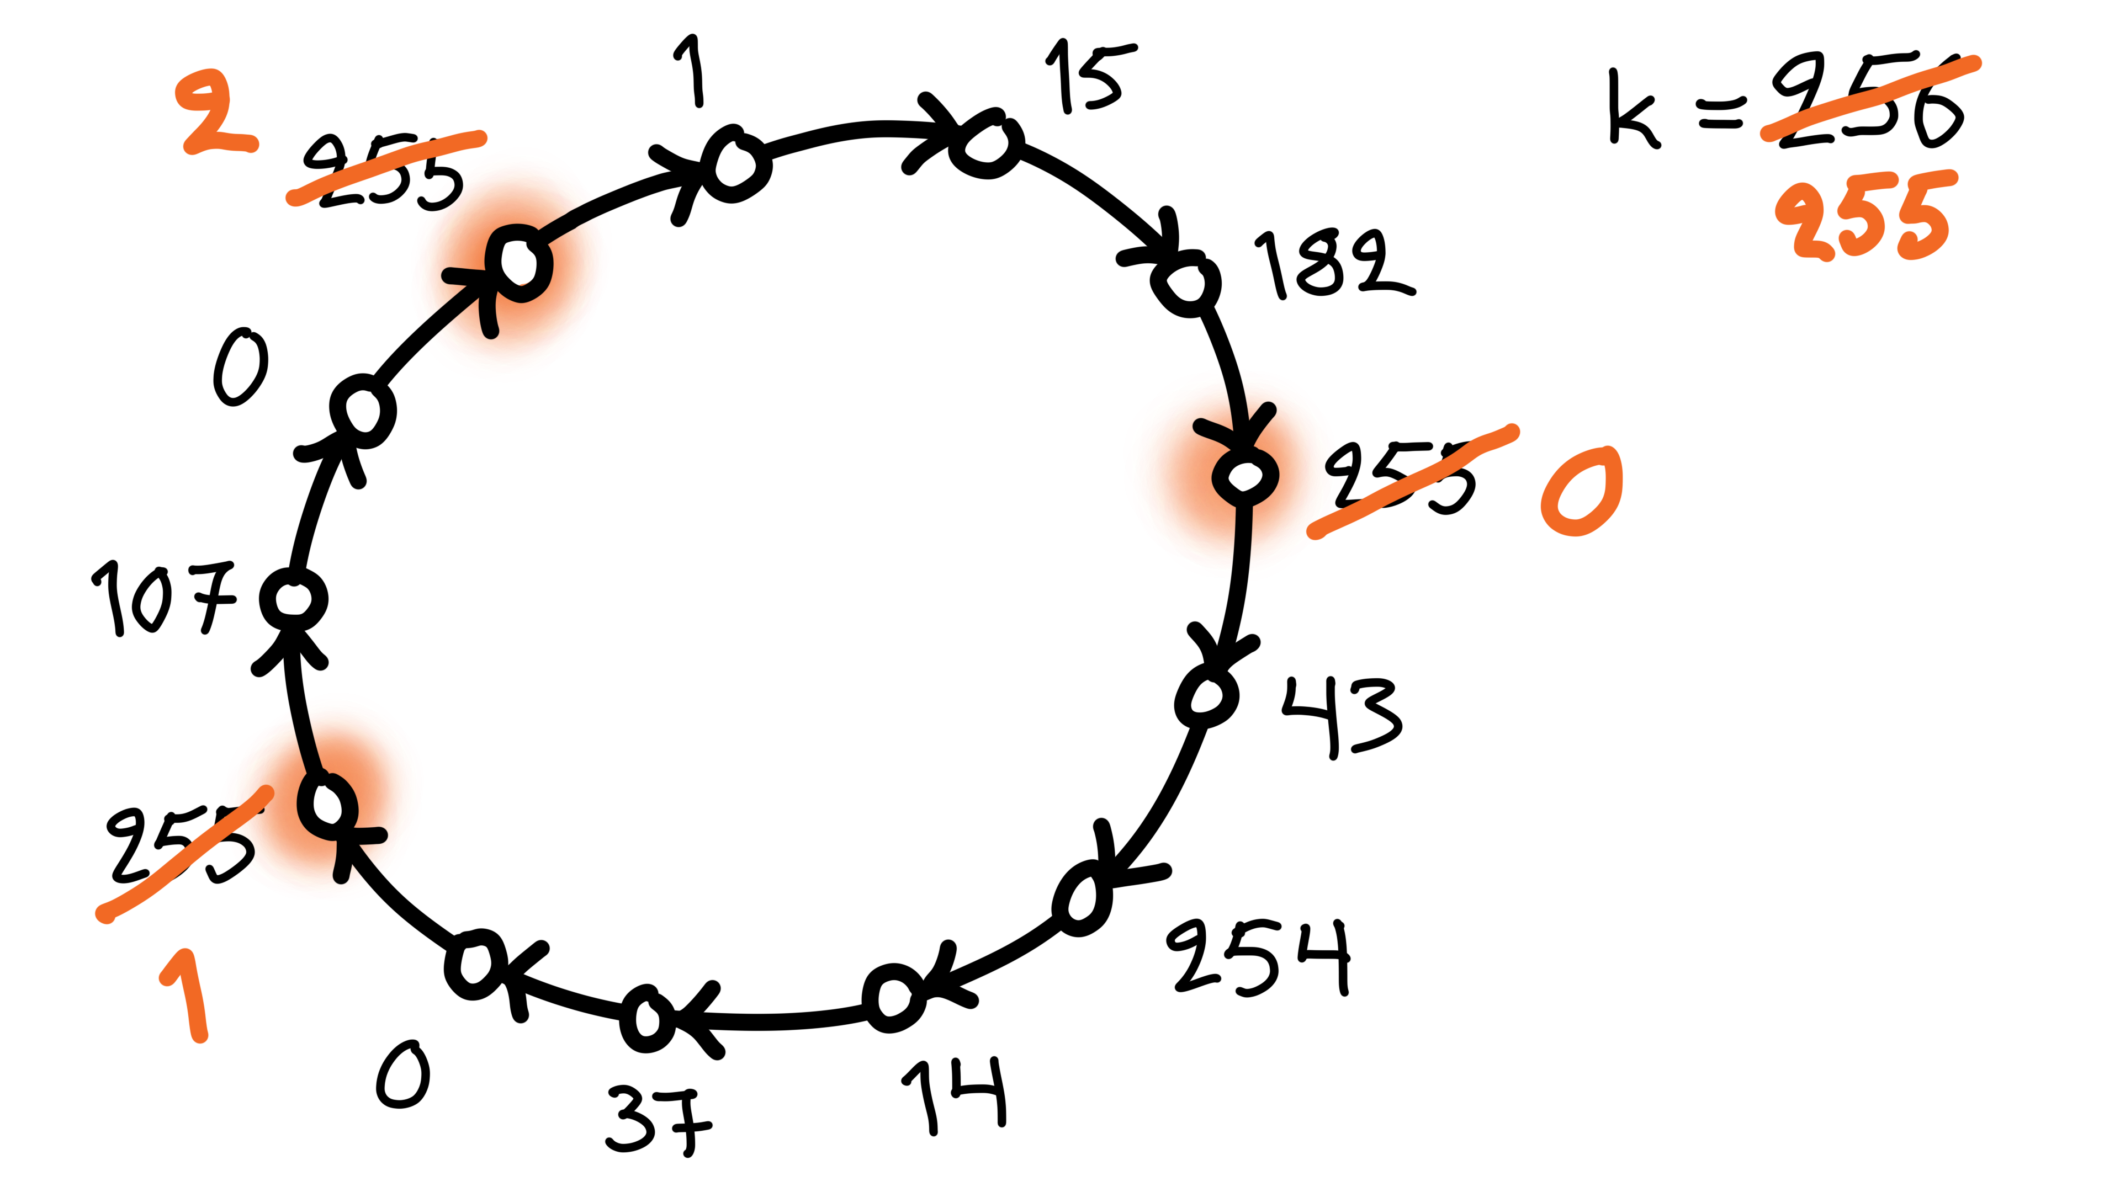
Video 1b: coloring

Slide 15
Slow color reduction
Algorithm idea:
  all nodes with the largest color are active
  active nodes pick
  the smallest color
  that is not used
  by their neighbors

Slide 16
Puzzle 1
Consider a simpler algorithm idea:
  all nodes pick the smallest color that
  is not used by their neighbors
What would go wrong?
  construct an example in which this algorithm fails!

Slide 17
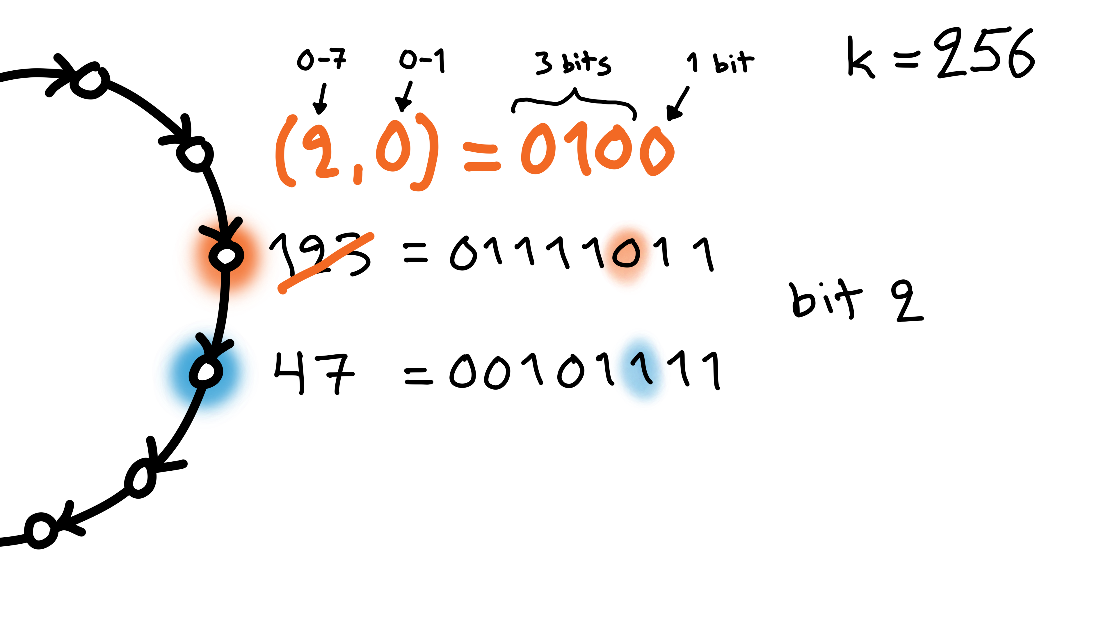
Video 1b: coloring fast

Slide 18
Fast color reduction
Algorithm idea:
  find the first bit that differs in successor
  index i, bit value b
  new color is (i, b)

Slide 19
Puzzle 2
Algorithm idea:
  find the first bit that differs in successor
  index i, bit value b
  new color is (i, b)
What would go wrong if the new color
was just b ?
  construct an example in which it fails!

Slide 20
Puzzle 3
Algorithm idea:
  find the first bit that differs in successor
  index i, bit value b
  new color is (i, b)
What would go wrong if the new color
was just i ?
  construct an example in which it fails!

Slide 21
Puzzle 4
Algorithm idea:
  find the first bit that differs in successor
  index i, bit value b
  new color is (i, b)
Why does the algorithm work correctly?
  why is my new color always different from the
  new colors of my successor and my predecessor?

Slide 22
Coming next
Week 2: graph theory
Weeks 3–6: models of distributed computing
  examples of efficient distributed algorithms
Weeks 7–11: proving impossibility results
Week 12: conclusions, recap

