Slide 1

Distributed
Algorithms
2025
2
Graph-theoretic foundations

Slide 2
Graphs in this course
Defining:
  models of distributed computing
  what we want to solve
  what are the assumptions
Designing & analyzing algorithms
Proving impossibility results
Often: graph ≈ network, node ≈ computer

Slide 3
Quiz
Graph where maximal independent sets
are never minimum dominating sets?

Slide 4
Please do not confuse
Maximal
  not a subset of another solution
  very easy to find: add greedily
Maximum
  largest possible solution
  often hard to find

Slide 5
Please do not confuse
Minimal
  not a superset of another solution
  very easy to find: remove greedily
Minimum
  smallest possible solution
  often hard to find

Slide 6
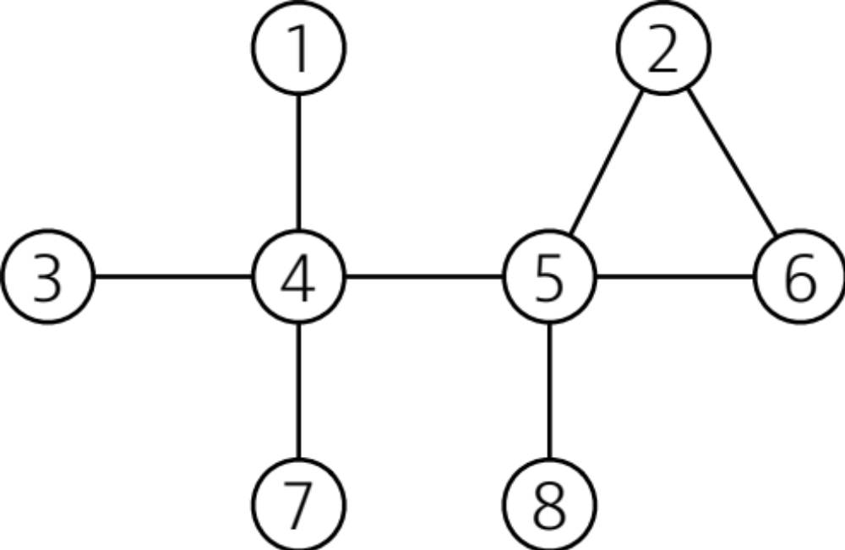
Minimum
vertex cover

Slide 7
Minimum
dominating set

Slide 8
Maximum
independent set

Slide 9
Smallest
set of nodes
that is both
an independent set
and a dominating set

Slide 10
Largest
set of nodes
that is both
an independent set
and a dominating set

Slide 11
Maximum
matching

Slide 12
Minimum
edge cover

Slide 13
Minimum
edge dominating set

Slide 14
Smallest
set of edges
that is both
a matching and
an edge dominating set

Slide 15
Largest
set of edges
that is both
a matching and
an edge dominating set

Slide 16
Minimum
edge dominating set
that is not a matching

Slide 17
Largest set of
nodes that induces
a bipartite subgraph

Slide 18
Largest
set of edges
that induces
a subgraph with
2 connected components

Slide 19
Largest
set of nodes
that induces
a subgraph of
maximum degree 2

Slide 20
Largest
set of edges
that induces
a subgraph of
maximum degree 2

Slide 21
Set of nodes
that induces
a 2-regular subgraph

Slide 22
Nodes u
and v such
that the distance
from u to v equals
the diameter of the graph

