Slide 1

Distributed
Algorithms
2025
3
Port-numbering model

Slide 2
Port-numbered network
N = (V, P, p)
Distributed algorithm
A = (init, send, receive)
Output of algorithm A
in network N

Slide 3
Bipartite maximal matching

Slide 4
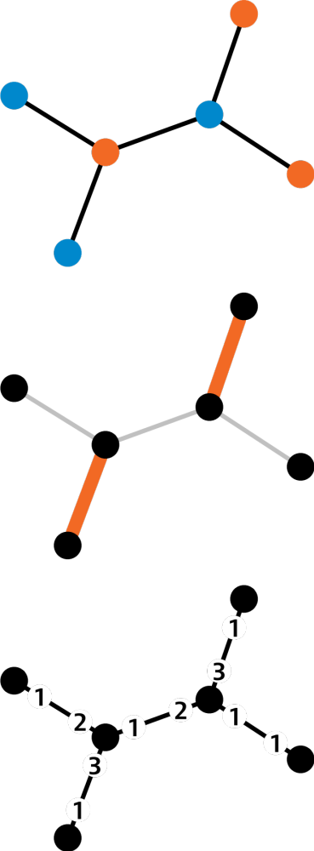
Input:
proper 2-coloring
Output:
maximal matching
Model of computing:
PN model

Slide 5
Algorithm
Orange nodes send proposals to
their neighbors, one by one
  order by port numbers
Blue nodes accept the first proposal they get,
reject everything else
  break ties by port numbers

Slide 6
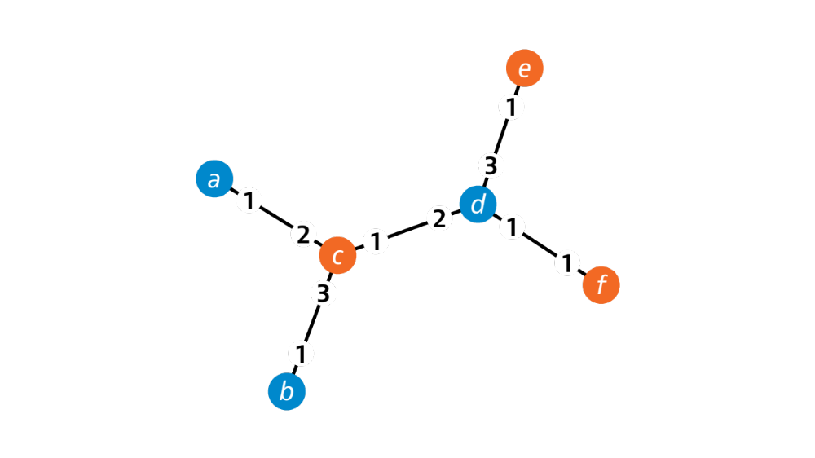

Slide 7


Slide 8


Slide 9
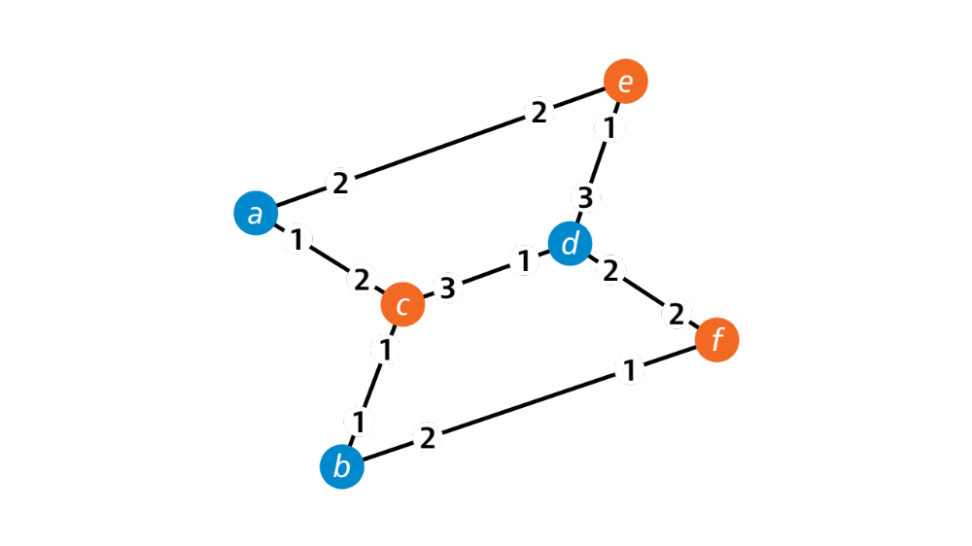

Slide 10


Slide 11
Vertex cover

Slide 12
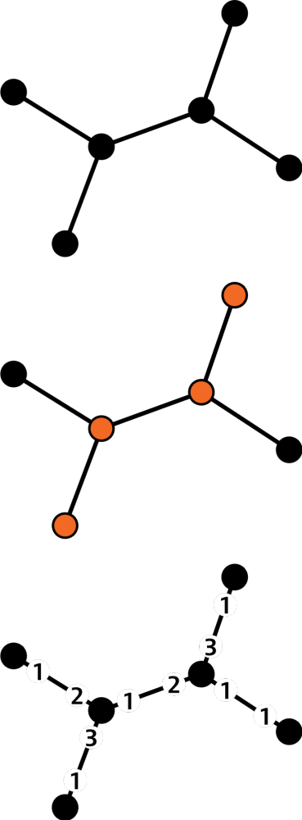
Input:
nothing
Output: 3-approximation of minimum vertex cover
Model of computing:
PN model

Slide 13
Algorithm
Construct bipartite double cover G’
  one node in G: two virtual copies in G’
  one edge in G: two virtual copies in G’
Find a maximal matching M’ in G’
Take all original nodes of G whose
virtual copies are matched in M’

Slide 14
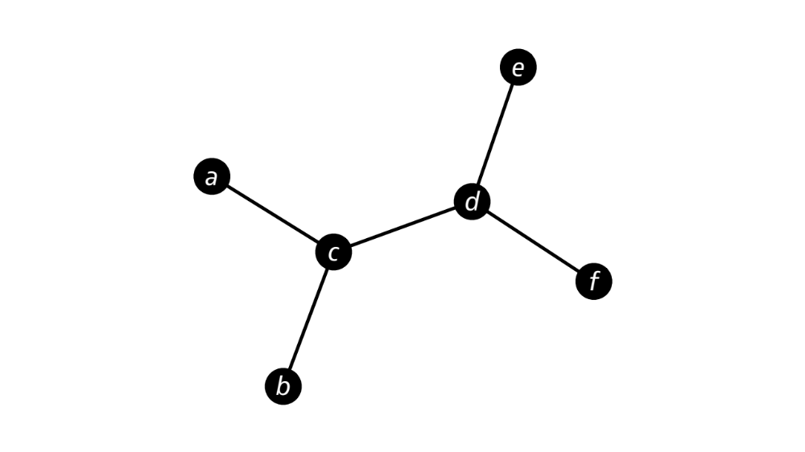
Graph G

Slide 15
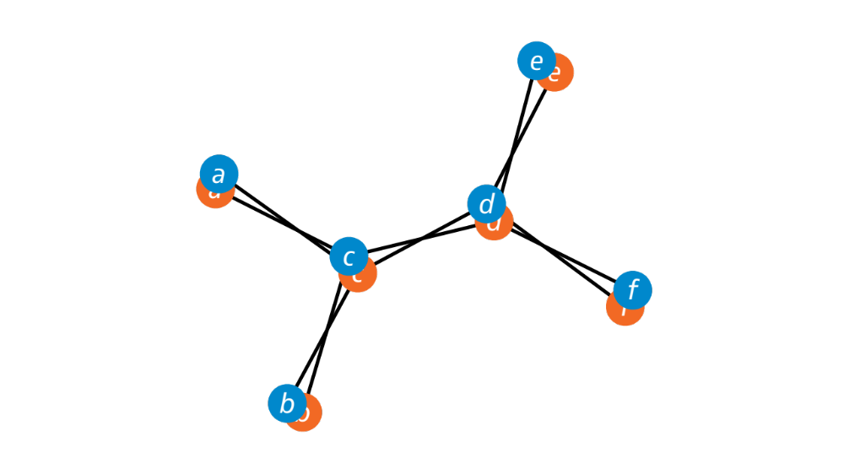

Slide 16
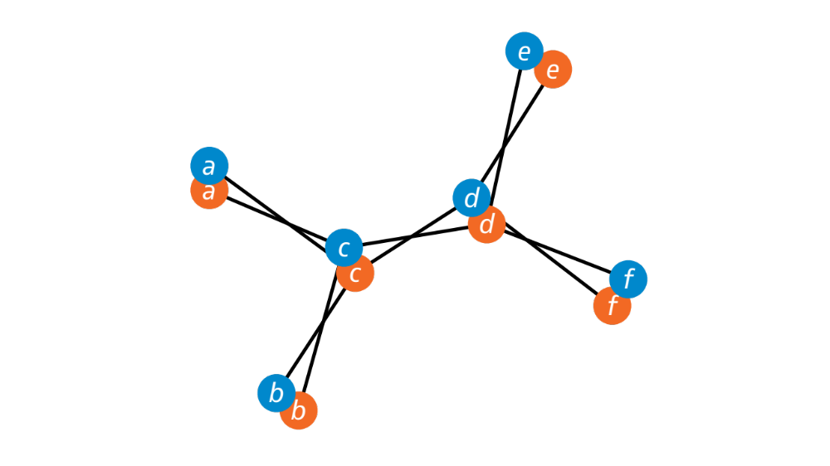

Slide 17
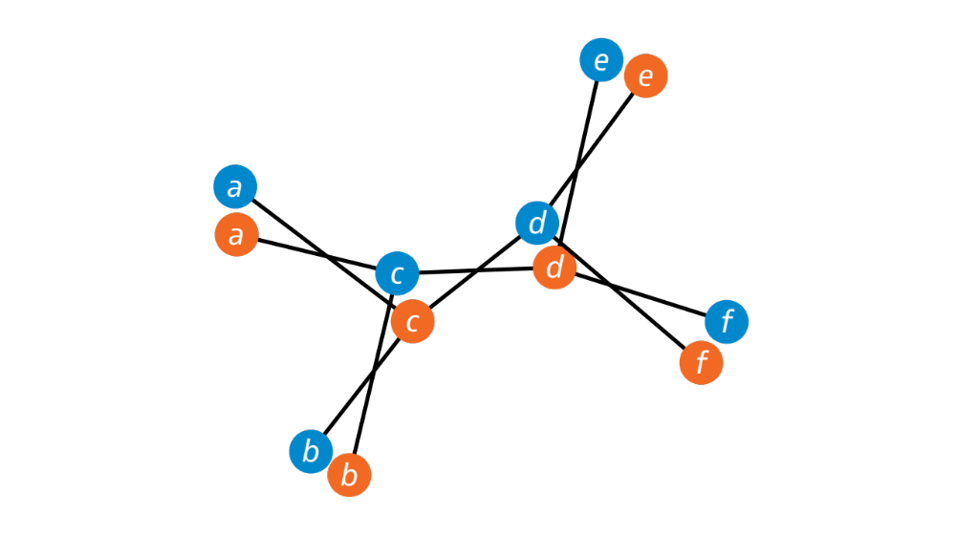

Slide 18
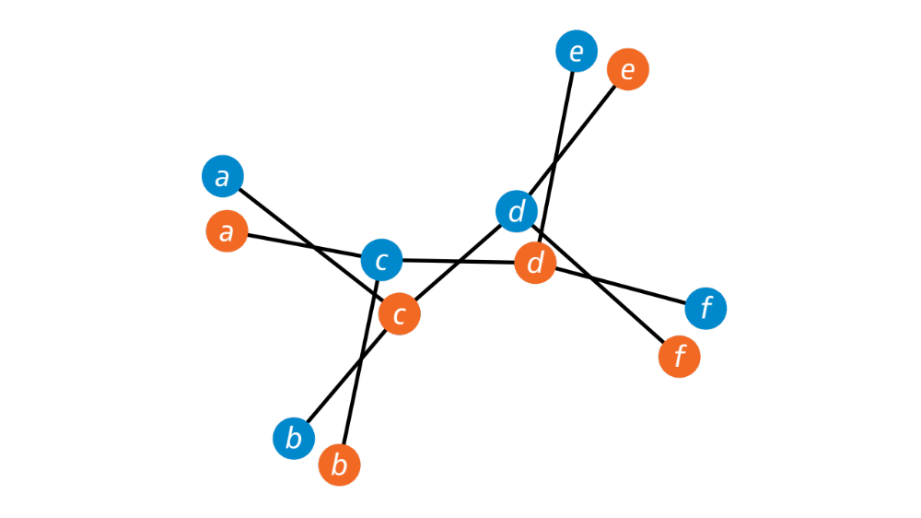
Graph G’

Slide 19
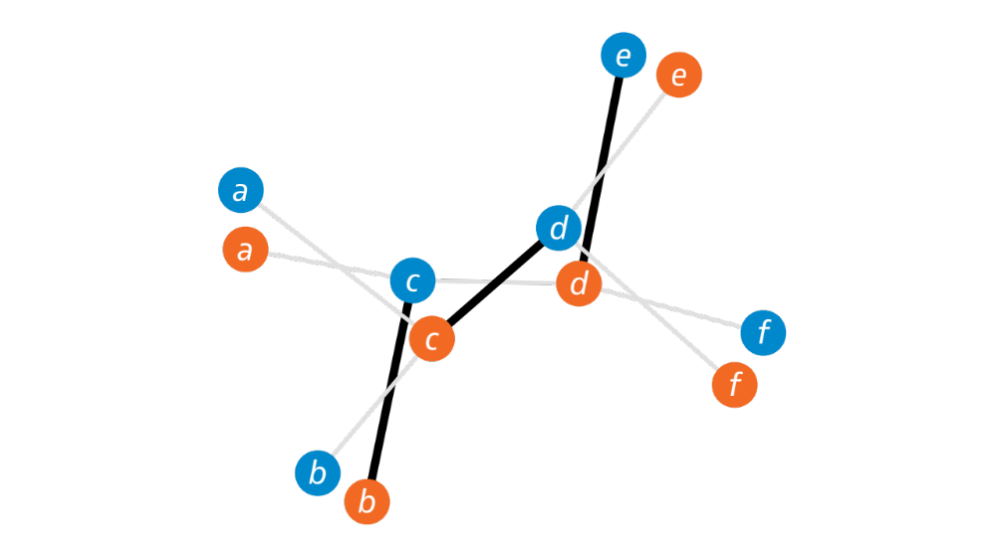
Maximal matching M’

Slide 20
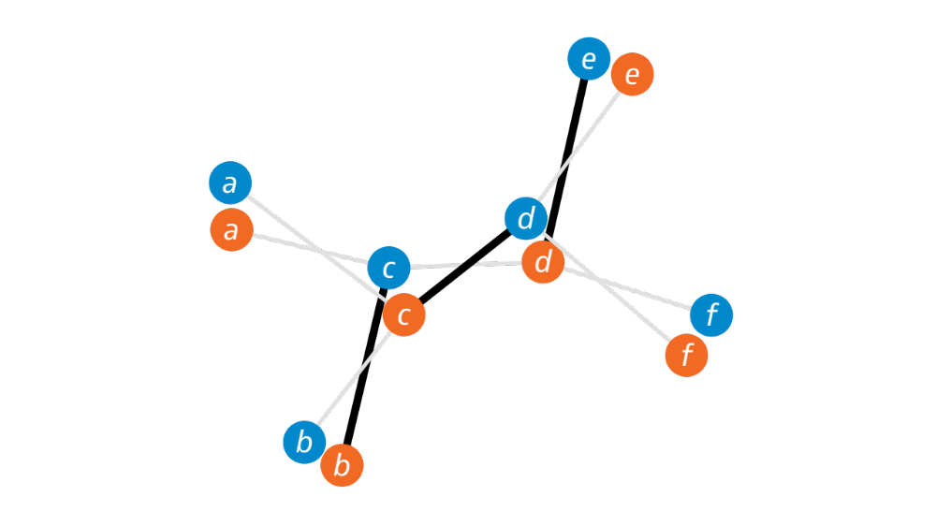

Slide 21
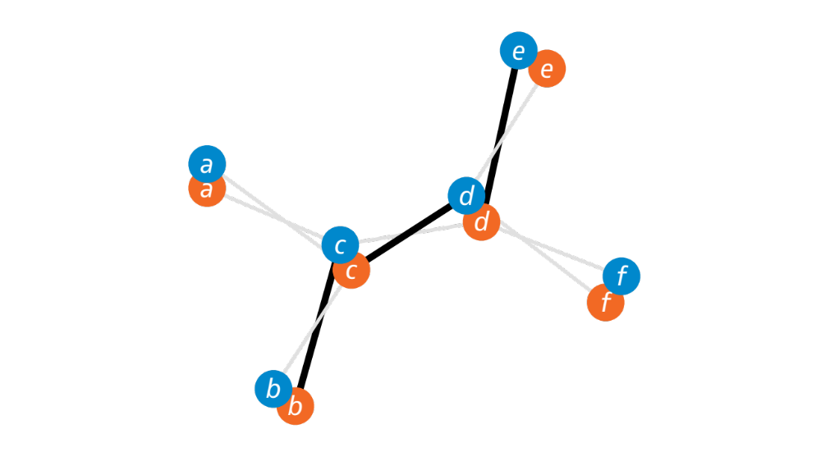

Slide 22
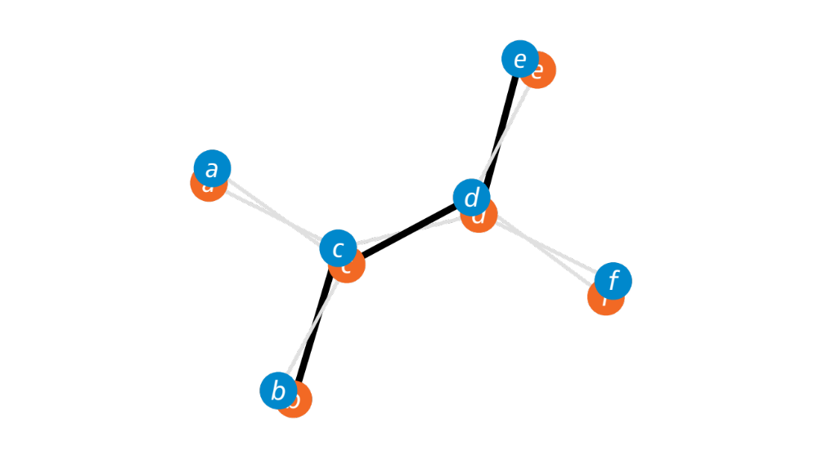

Slide 23
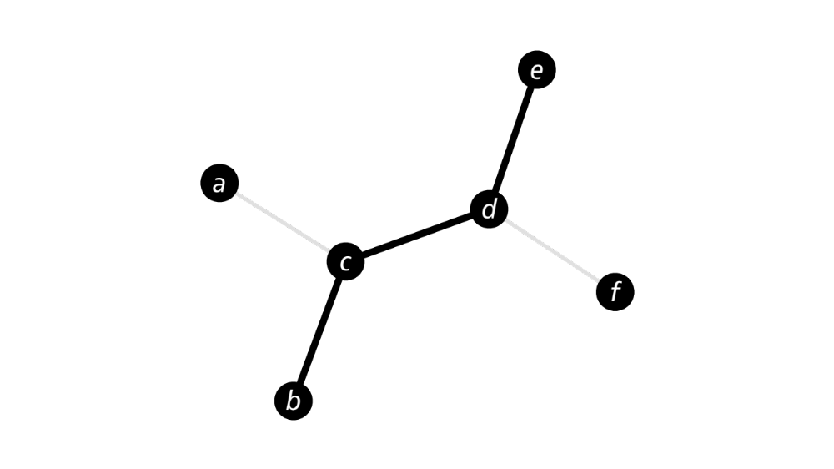
Set of edges M

Slide 24
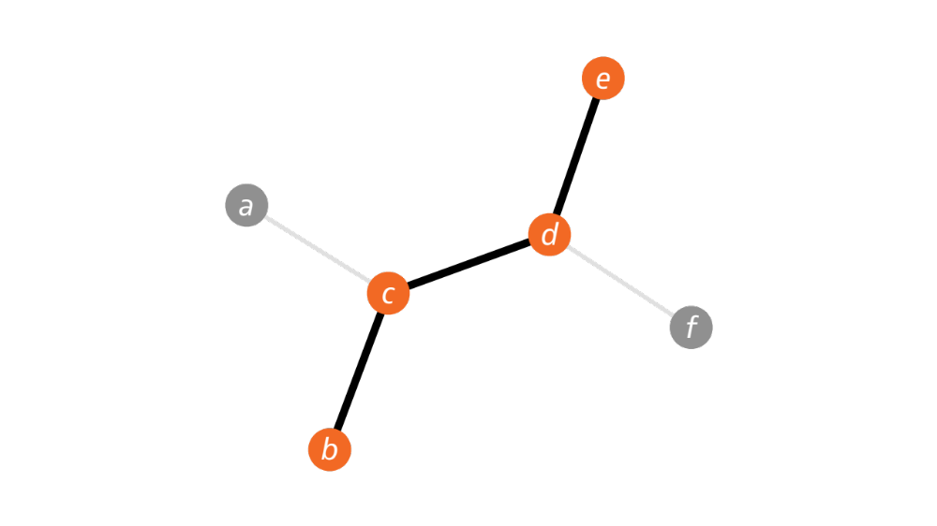
Set of nodes C

Slide 26
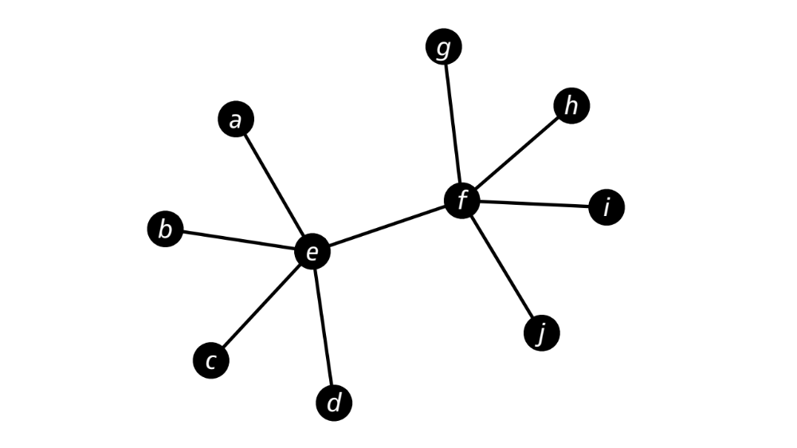

Slide 27
