Slide 1

Distributed
Algorithms
2025
4
LOCAL model:
Unique identifiers

Slide 2
LOCAL model
=
port-numbering model
+ unique identifiers
Nodes have distinct labels from {1, 2, …, poly(n)}

Slide 3
LOCAL model
Everything can be solved in diam(G)+1 rounds!
Universal algorithm: “each node tells its neighbors everything it knows”
  1 round: everyone aware of its adjacent nodes and incident edges
  T rounds: everyone aware of all nodes and edges within distance T
  diam(G)+1 rounds: everyone knows G

Slide 4
LOCAL model
Not so interesting:
“What can be computed?”
Very interesting:
“What can be computed efficiently?”
(efficient ≈ o(diam(G)) rounds)

Slide 5
Coloring
Input | Output | Rounds | Algorithm
Unique IDs | O(Δ²)-coloring | O(log* n) | Cover-free families
O(Δ²)-coloring | O(Δ)-coloring | O(Δ) | Rotating clocks
O(Δ)-coloring | (Δ+1)-coloring | O(Δ) | Greedy color reduction
Unique IDs | (Δ+1)-coloring | O(Δ + log* n) | Combine these algorithms

Slide 6
Coloring
Input | Output | Rounds | Algorithm
Unique IDs | O(Δ²)-coloring | O(log* n) | Cover-free families
O(Δ²)-coloring | O(Δ)-coloring | O(Δ) | Rotating clocks
O(Δ)-coloring | (Δ+1)-coloring | O(Δ) | Greedy color reduction
Unique IDs | (Δ+1)-coloring | O(Δ + log* n) | Combine these algorithms

Slide 7
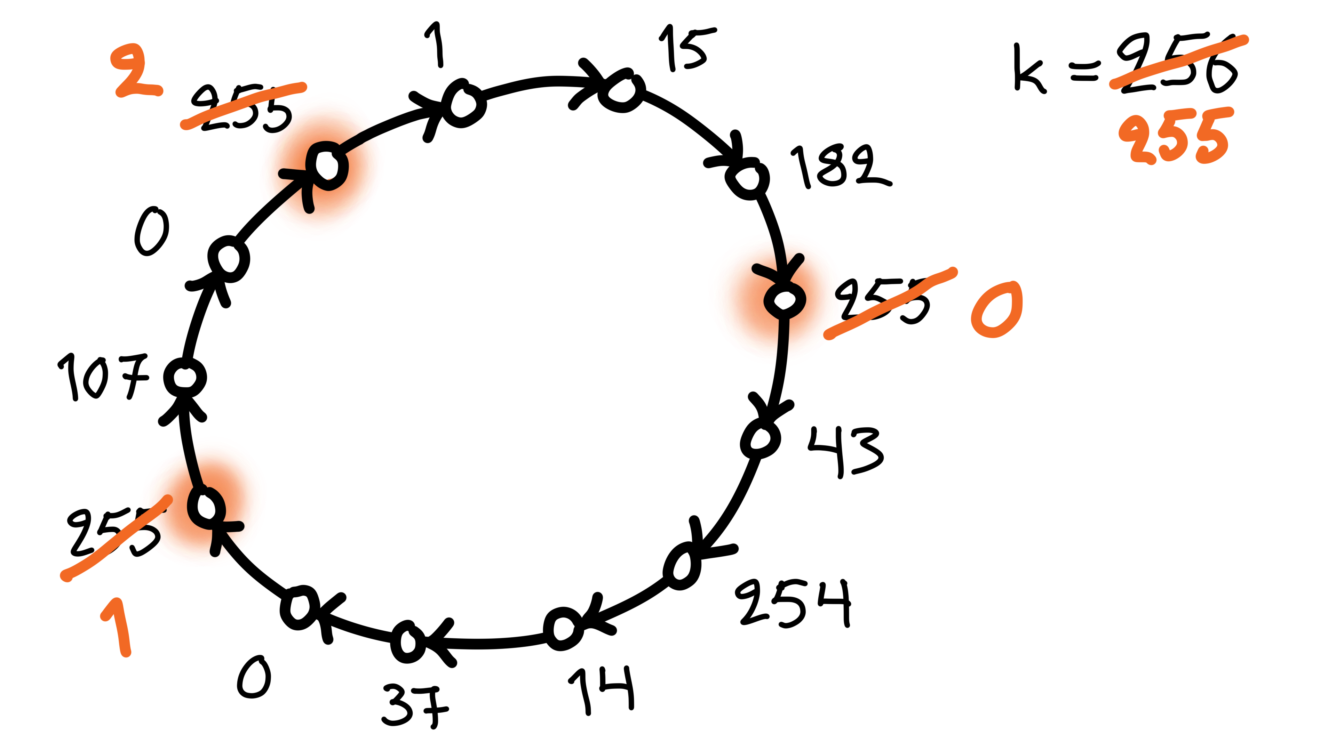
Greedy color reduction
If I am a local maximum:
  pick the smallest free color that is not used
  by any of my neighbors
k+1 colors → k colors
  provided that k ≥ Δ+1

Slide 8
Coloring
Input | Output | Rounds | Algorithm
Unique IDs | O(Δ²)-coloring | O(log* n) | Cover-free families
O(Δ²)-coloring | O(Δ)-coloring | O(Δ) | Rotating clocks
O(Δ)-coloring | (Δ+1)-coloring | O(Δ) | Greedy color reduction
Unique IDs | (Δ+1)-coloring | O(Δ + log* n) | Combine these algorithms

Slide 9
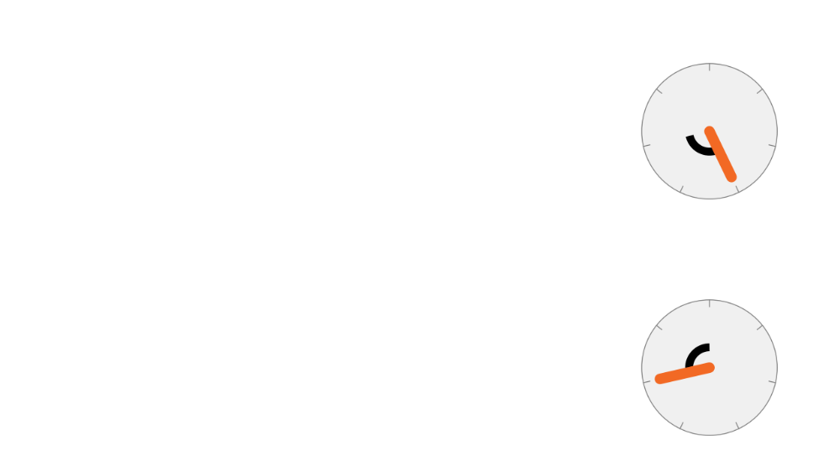
Rotating clocks
(2, 3)
q = prime, q > 2Δ
q² colors → q colors in q rounds
If no conflicts:
  (a, b) → (0, b)
Otherwise:
  (a, b) → (a, b+a mod q)
3
(2, 5)
5

Slide 10
Coloring
Input | Output | Rounds | Algorithm
Unique IDs | O(Δ²)-coloring | O(log* n) | Cover-free families
O(Δ²)-coloring | O(Δ)-coloring | O(Δ) | Rotating clocks
O(Δ)-coloring | (Δ+1)-coloring | O(Δ) | Greedy color reduction
Unique IDs | (Δ+1)-coloring | O(Δ + log* n) | Combine these algorithms

Slide 11
Cover-free families
Old color of node v is a set S(v) ⊆ {1, 2, …, m}
Promise:
  new color of v is an element of S(v)
Safe:
  pick an element of S(v) that is not
  in any S(u) for any neighbor u
{1, 2, 3}
v
{1, 4, 7}
{2, 4, 6}

Slide 12
Cover-free families
Old color of node v is a set S(v) ⊆ {1, 2, …, m}
Bad:
  sets of neighbors cover
  all values in my set
  no safe choice left
{1, 2, 3}
v
{1, 4, 6}
{2, 4, 6}

Slide 13
Cover-free families
Old color of node v is a set S(v) ⊆ {1, 2, …, m}
Good:
  my set is not fully covered
  by my neighbors
  there is a safe choice
{1, 2, 3}
v
{1, 4, 7}
{2, 4, 6}

Slide 14
1-cover-free family
For up to 1 neighbor these sets are good:
S₁ | = | { | 1, | 2 |  |  | }
S₂ | = | { | 1, |  | 3 |  | }
S₃ | = | { | 1, |  |  | 4 | }
S₄ | = | { |  | 2, | 3 |  | }
S₅ | = | { |  | 2, |  | 4 | }
S₆ | = | { |  |  | 3, | 4 | }

Slide 15
2-cover-free family
For up to 2 neighbors these sets are good:
S₁ | = | { | 1, | 2, | 3 |  |  |  |  | }
S₂ | = | { |  |  | 3, | 4, | 5 |  |  | }
S₃ | = | { |  |  |  |  | 5, | 6, | 7 | }
S₄ | = | { | 1, |  |  | 4, |  |  | 7 | }
S₅ | = | { |  | 2, |  | 4, |  | 6 |  | }

Slide 16
Cover-free families
Assume: x-coloring, maximum degree Δ
Assume: a Δ-cover-free family S₁, S₂, …, S_{x}
  all subsets of {1, 2, …, m}
Nodes of color c pick set S_{c}
There is always a safe choice for any node!
Color reduction from x to m

Slide 17
Cover-free families
Δ-cover-free family S₁, S₂, …, S_{x}
  all subsets of {1, 2, …, m}
Good if:
  Δ large → works in high-degree graphs
  x large → tolerates many input colors
  m small → produces a good output coloring
E.g. x = m is trivial (why?)

Slide 18
Constructing cover-free families

Slide 19
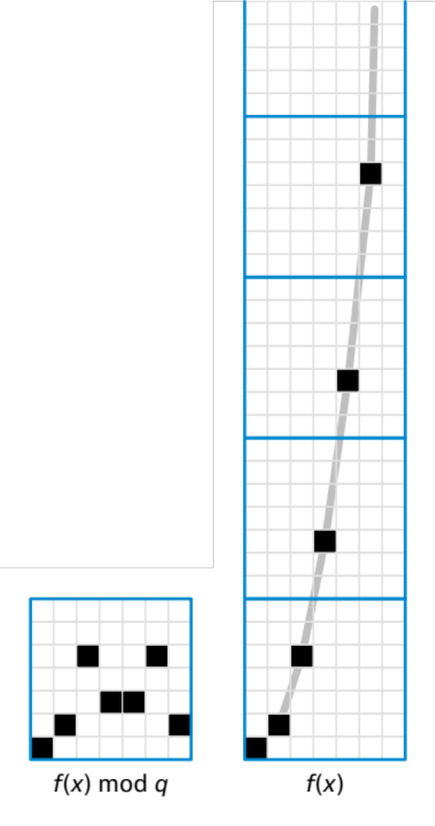
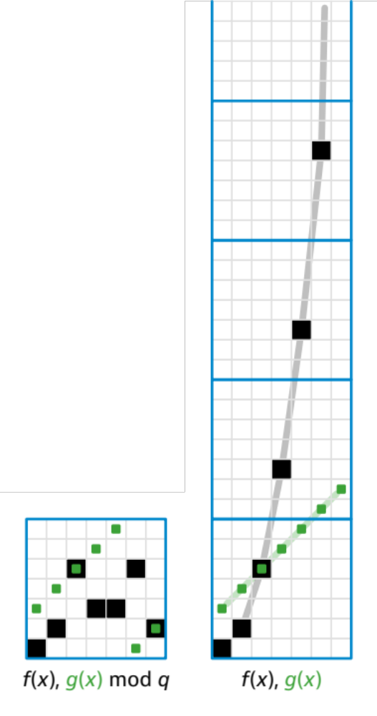
q = prime, GF(q) ≈ integers modulo q
f = degree-d polynomial over GF(q)
  at most d points where f(x) = g(x)
  q^{d+1} possible polynomials
S_{f} = { (x, f(x)) | x = 0, 1, …, q−1 }
  base set: all q² possible pairs (x, y)
  q^{d+1} possible subsets, each with q elements
  intersection of S_{f} and S_{g} has size at most d
If q > Δd: a Δ-cover-free family
  why?

Slide 20
Cover-free families
Construct Δ-cover-free families with
suitable parameters
n → ≈ Δ² log² n
n → ≈ Δ² log² log n
n → ≈ Δ² log² log log n
n · · ·
n → ≈ Δ² log² Δ
n → ≈ Δ²
O(log* n) steps

Slide 21
Coloring
Input | Output | Rounds | Algorithm
Unique IDs | O(Δ²)-coloring | O(log* n) | Cover-free families
O(Δ²)-coloring | O(Δ)-coloring | O(Δ) | Rotating clocks
O(Δ)-coloring | (Δ+1)-coloring | O(Δ) | Greedy color reduction
Unique IDs | (Δ+1)-coloring | O(Δ + log* n) | Combine these algorithms

