Slide 1

Distributed
Algorithms
2025
7
Covering maps

Slide 2
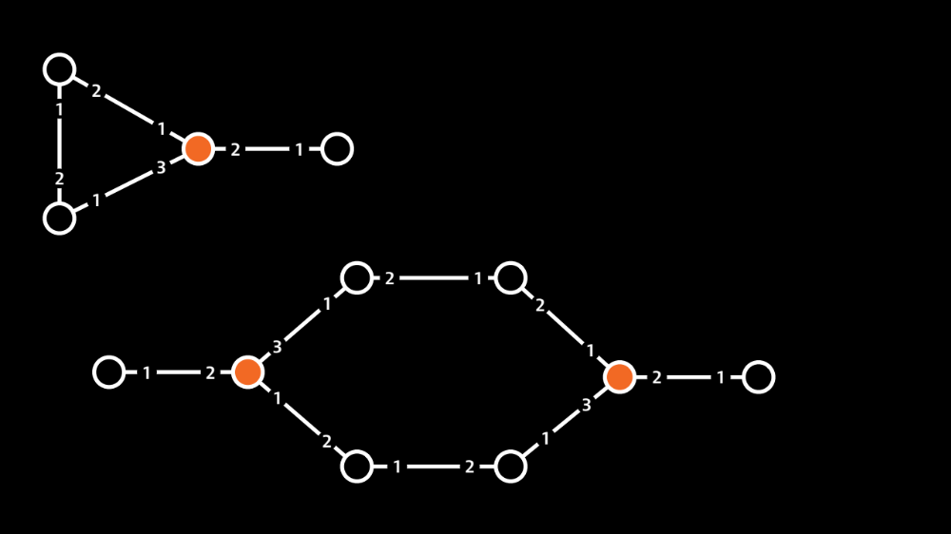

Slide 3
You are in a room
with three doors,
labeled 1, 2, and 3.
> _

Slide 4
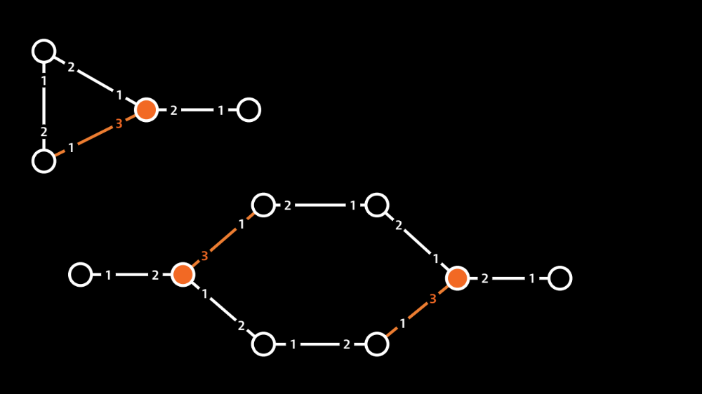
You are in a room
with three doors,
labeled 1, 2, and 3.
> open door 3

Slide 5
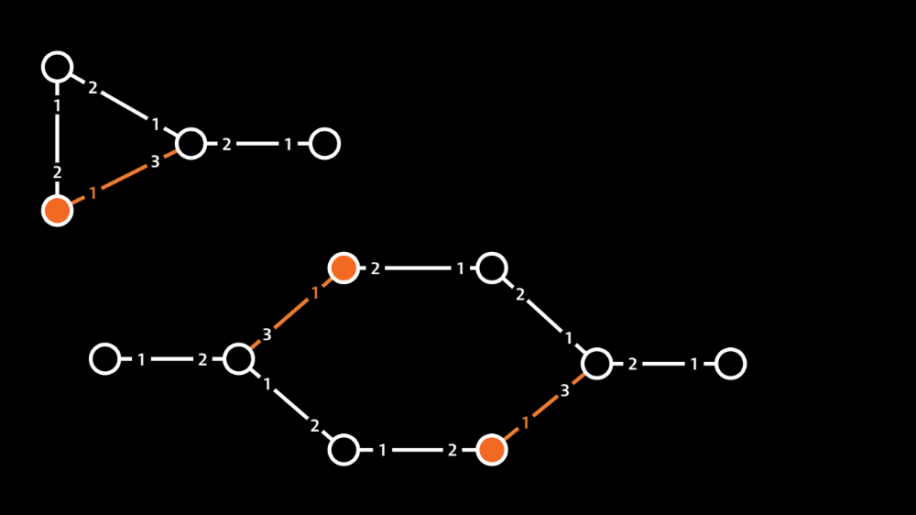

Slide 6
You enter a room with
two doors, labeled 1
and 2. You just came
in through doorway 1.
> _

Slide 7
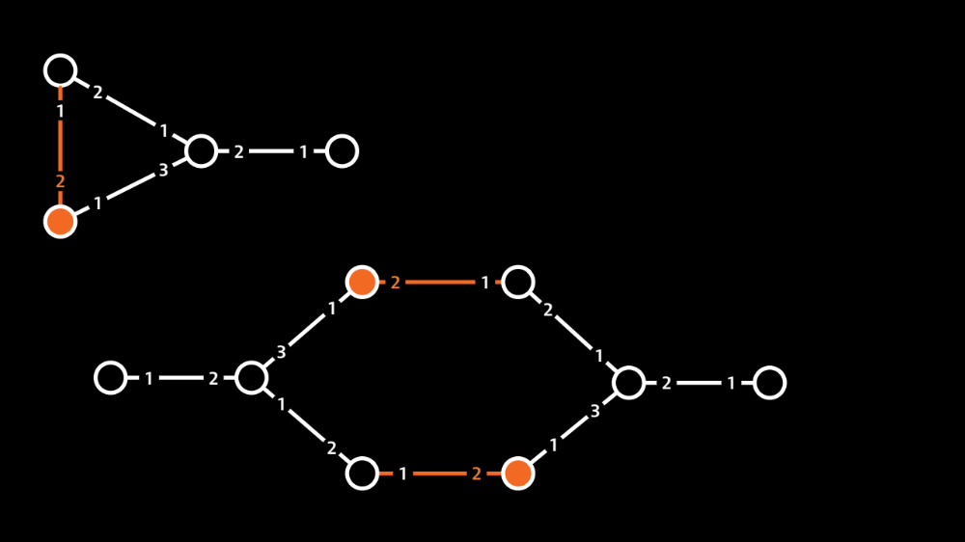
You enter a room with
two doors, labeled 1
and 2. You just came
in through doorway 1.
> open door 2

Slide 8
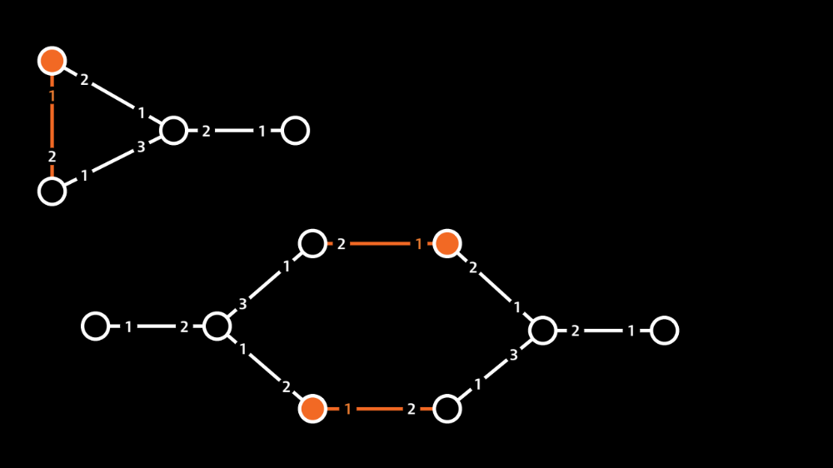

Slide 9
You enter a room with
two doors, labeled 1
and 2. You just came
in through doorway 1.
> _

Slide 11
High-level plan
Goal:
  show that problem X cannot be solved
  in the port-numbering model

Slide 12
High-level plan
Goal:
  show that problem X cannot be solved
  in the port-numbering model
General approach:
  construct port-numbered networks so that some nodes u, v, … will always produce the same output
  show that if u, v, … have the same output, then
  it is not a feasible solution for X

Slide 13
High-level plan
Covering maps used here
Goal:
  show that problem X cannot be solved
  in the port-numbering model
General approach:
  construct port-numbered networks so that some nodes u, v, … will always produce the same output
  show that if u, v, … have the same output, then
  it is not a feasible solution for X

Slide 14
Covering map
Two port-numbered networks:
  N = (V, P, p)
  N’ = (V’, P’, p’)
Surjection f: V → V’ that preserves:
  inputs
  degrees
  connections
  port numbers

Slide 15
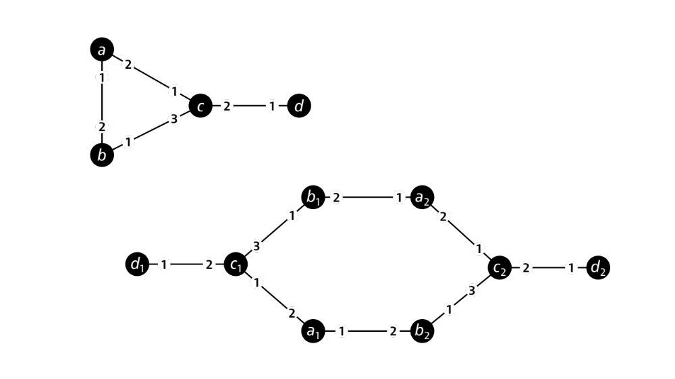

Slide 16
Covering map
“Fools” any deterministic algorithm
If f is a covering map from N to N’, then:
  v and f(v) have the same state before round 1
  v and f(v) send the same messages in round 1
  v and f(v) receive the same messages in round 1
  v and f(v) have the same state after round 1

Slide 17
Covering map
“Fools” any deterministic algorithm
If f is a covering map from N to N’, then:
  v and f(v) have the same state before round T
  v and f(v) send the same messages in round T
  v and f(v) receive the same messages in round T
  v and f(v) have the same state after round T

Slide 18
Common steps
Starting point: graph problem X
Which graph G would be a “hard instance”?
How to choose a port numbering N of G ?
How to choose the other network N’ ?
How to construct mapping from N to N’ ?

Slide 19
Example: 2-node path

Slide 20
Example: 4-node path

Slide 21
Common setup
N is the network we care about
  simple port-numbered network
  well-defined and interesting underlying graph
N’ is something strange
  not necessarily a simple port-numbered network
  running A in N’ makes no sense
  introduced only to analyze what happens when we run A in N

Slide 22
Example: 5-node path

Slide 23
Example: two cycles

Slide 24
Observations
We can use covering maps to construct universal counterexamples
  adaptive: “for any given algorithm A we can find
  a hard input N”
  universal: “there is an input N that is hard
  for any algorithm A”

Slide 25
Week 8 (October 27–31)
DISC 2025 conference
No course meetings
  no lecture, no exercise session
Other course activities as usual
  self-study as usual
  quiz as usual, exercise deadlines as usual
  help available in Zulip

