Slide 1

Distributed
Algorithms
2025
8
Local neighborhoods

Slide 2
High-level plan
Algorithm A runs in T rounds and solves problem X
A is a mapping from radius-T neighborhoods to local outputs
Such a mapping cannot solve X correctly
Problem X is not solvable in T rounds

Slide 3
Distributed
Algorithms
2025
9
Round elimination

Slide 4
Can we automate our own work?

Slide 5
Meta-algorithmics
Normal algorithms — example:
  input: graph G
  output: coloring of graph G
Meta-algorithms — example:
  input: computational problem P
  output: algorithm for solving P
How to represent
problems or algorithms?

Slide 6
This week’s plan
Topic: round elimination
  function that maps problem X with complexity T
  to problem X’ = re(X) with complexity T − 1
Video: how to use round elimination
  “re” was a black box
Today: how to do round elimination
  what happens inside the black box and why?

Slide 7
Round elimination
Basic idea already used by Linial (1987)
  “it is not possible to 3-color cycles
  in o(log* n) rounds”
Until 2015 it was thought this is an ad-hoc
trick that only works for graph coloring
Lots of new applications since 2016
General idea formalized in 2019

Slide 8
Weak 3-labeling
Labels: 1, 2, 3
Active nodes:
  degree 3
  not all labels same
Passive nodes:
  degree 2
  both labels same

Slide 9
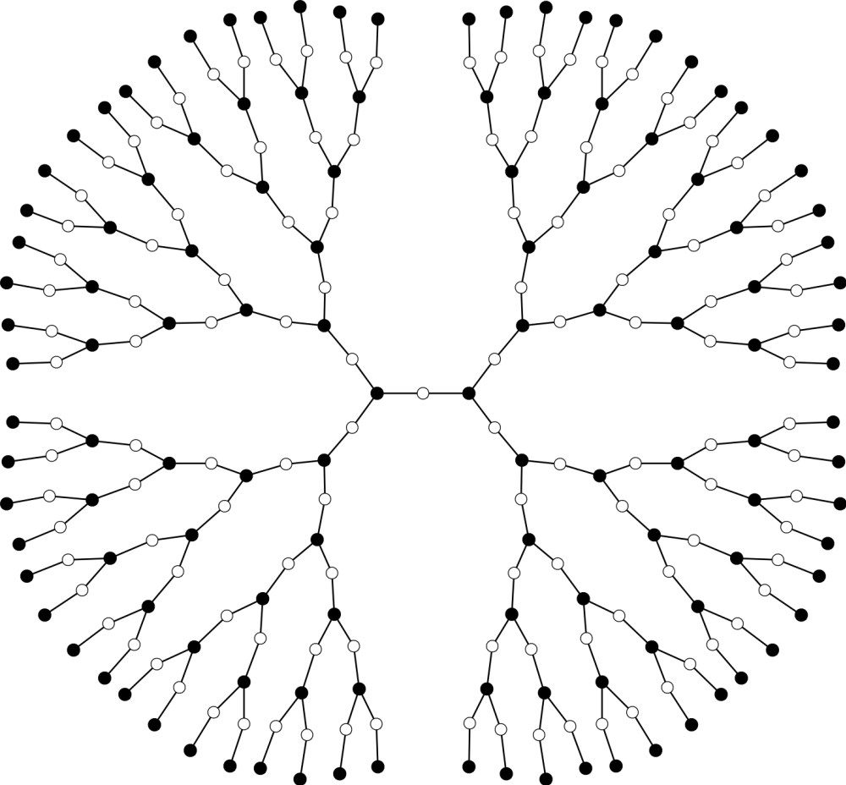

Slide 10
