Slide 1
DISCRETE MATHEMATIC LEC-06: Polynomials
Fall, 2024

Slide 2
Polynomial
Degree: d
Coefficients are real numbers
a is a root if P(a) = 0
Notes:
2

Slide 3
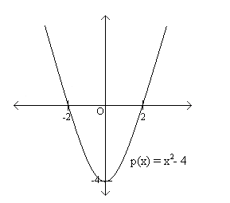
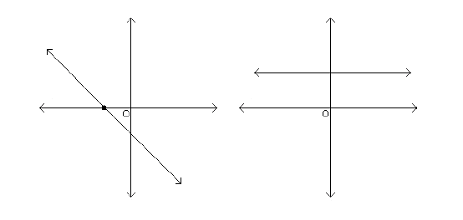
Property 1
A non-zero polynomial of degree d has at most d roots.
d = 1: linear function
d = 2: quadratic function
Notes:
3

Slide 4
Proof
a is a root of p(x) iff (x-a) divides p(x)
Assume that a₁, a₂, …, a_{d+1} are d+1 distinct roots of p(x) (degree d)
p(x) = c(x - a₁)…(x - a_{d+1})
P(x) has degree >= d + 1. Constradiction.
Notes:
4

Slide 5
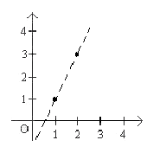
Property 2
Given d+1 pairs (x₁,y₁), (x₂,y₂)…, (x_{d+1},y_{d+1}), there is a unique polynomial of degree (at most) d: P(x_{i})=y_{i} (1≤i ≤d+1)
d = 1: two points determine a line
d = 2: three points determine a degree 2 polynomial
Notes:
5

Slide 6
Proof by Contradiction
Assume there exists P₁(x) and P₂(x) (degree less than d) that goes through d+1 points.
Let P(x) = P₁(x) – P₂(x)
P(x) has at least d+1 roots
P(x) has at most degree d. Contradiction.
Notes:
We divide the number by 7
6

Slide 7
Question
Notes:
We divide the number by 7
7

Slide 8
Question
Notes:
We divide the number by 7
8

Slide 9
Question
Notes:
We divide the number by 7
9

Slide 10
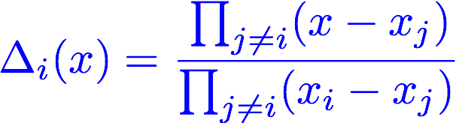
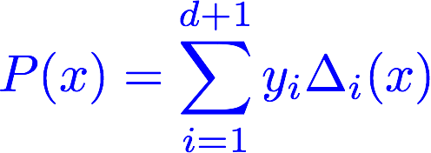
How to find
Notes:
Greatest common devisor
10

Slide 11
Finite Field (Galois Field)
The numbers used are limited to the range {0, 1, …, m-1}
m = 5: GF(5)
4 + 2 = 1 (mod 5) 5 divides 4 + 2 - 1
3 - 4 = 4 (mod 5) 3 - 4 – 4 is divisible by 5
3 x 4 = 2 (mod 5) 3 x 4 – 2 is divisible by 5
4 / 3 = 3 (mod 5) 2 is multiplicative inverse of 3
Notes:
11

Slide 12
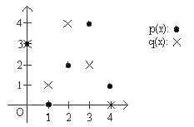
Finite Field GF(5)
Notes:
Greatest common devisor
12

Slide 13
Secret Sharing
A password is required to launch a nuclear strike.
N major officials know part of the password.
Any group of k officials can figure out the password.
No group of k-1 officials can figure out the password.
Notes:
Greatest common devisor
13

Slide 14
Secret Sharing
There are n officials. Group of k officials can learn the secret.
The launch code is s
Pick a random polynomial P of degree k-1 such that P(0) = s
Give P(1) to the first official, P(2) to the second official…
Any k officials, having the value of the polynomial at k points, can find P, and then compute P(0) to learn the secret.
Notes:
Greatest common devisor
14

Slide 15
Example
There are 3 people. Group of 2 can learn the secret. The secret is 4.
P(x) = x+4
Give P(1)=5 to the first official, P(2)=6 to the second official, P(3)=7 to the last official.
If official 1 and 3 get together, they know P(1)=5 and P(3)=7, they can find P(x)=x+4.
Notes:
Greatest common devisor
15

