Slide 1
Competition (Team Effort): Predicting House Prices via Data Mining Techniques
Team Members: Samuel Uong, Richard Ching, Simon Roschmann, Pavni Bakhshi, and David Balcon

Slide 2
Table of Contents
Data Analysis/Preprocessing
Implementation/Data Models
Output
Results

Slide 3
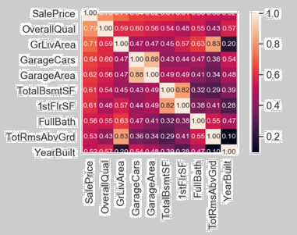
Data Analysis
Analyze data to find correlations
Correlation matrix determines any relationships.
Allows us to understand what features to focus on.

Slide 4
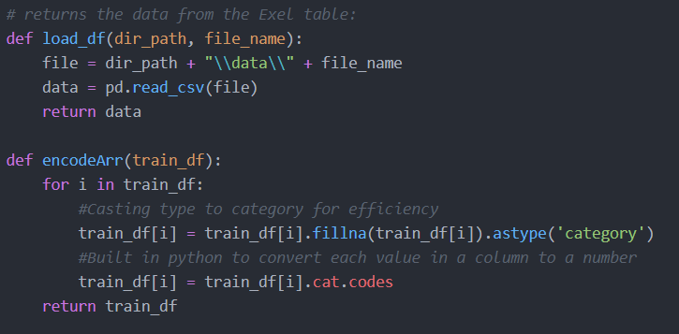
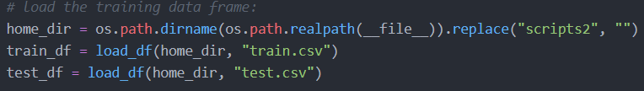
Data Preprocessing: Data Ingestion
Imported and utilizing the pandas library
Ingested training and test data as panda dataframe objects.
Helps apply pre-processing techniques to the data.
Figure 1: Functions defining loading data into data frames.
Figure 2: Loading data into data frame objects

Slide 5
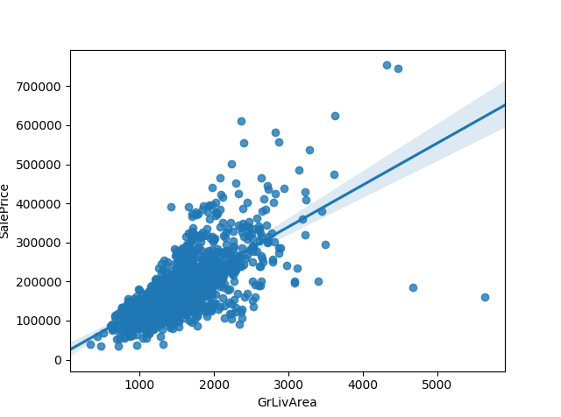
Data Preprocessing: Removing Outliers
Discovered outliers in highly correlated features.
Example: Figure 0b - Ground Living Area scatter plot before outlier removal
Removed outliers (Figure 0c) that may negatively affect prediction outcomes.

