Slide 1
Competition (Team Effort)
Samuel Uong, Richard Ching, Simon Roschmann, Pavni Bakhshi, and David Balcon

Slide 2
Table of Contents
Data Analysis/Preprocessing
Implementation/Data Models
Results

Slide 3
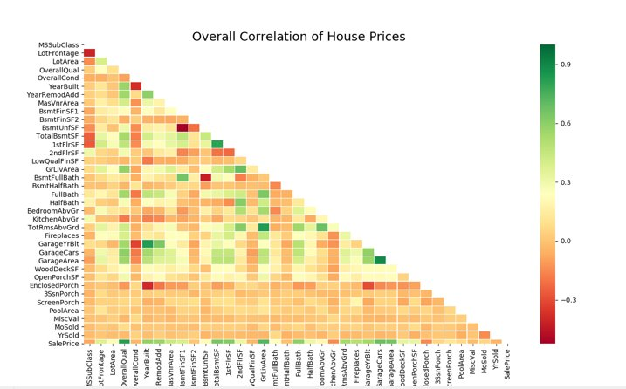
Data Analysis
Analyze Data to find correlations
Correlation matrix determines relationships
Allows us to understand what features to focus on.

Slide 4
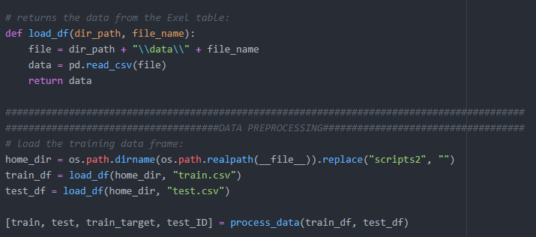
Data Preprocessing: Data Ingestion
Imported and utilizing the pandas library
Ingested training and test data as panda dataframe objects.
Helps apply pre-processing techniques to the data.

Slide 5
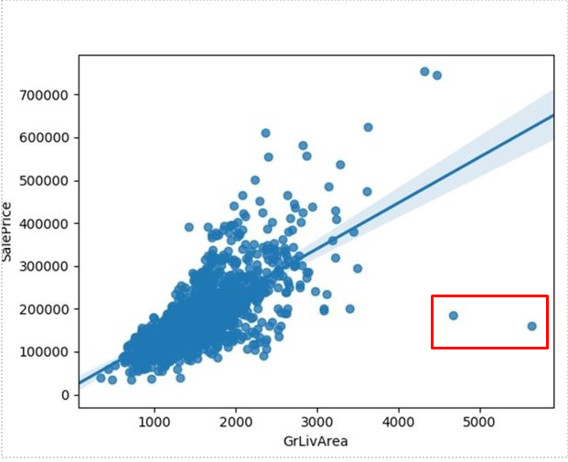
Data Preprocessing: Removing Outliers
Discovered outliers in highly correlated features.
Example: Ground Living Area scatter plot before outlier removal
Removed outliers that may negatively affect prediction outcome.
Note the two bottom right outliers negatively affecting the trend.

Slide 6

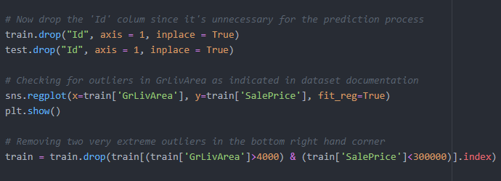
Data Preprocessing: Removing Outliers

Slide 7
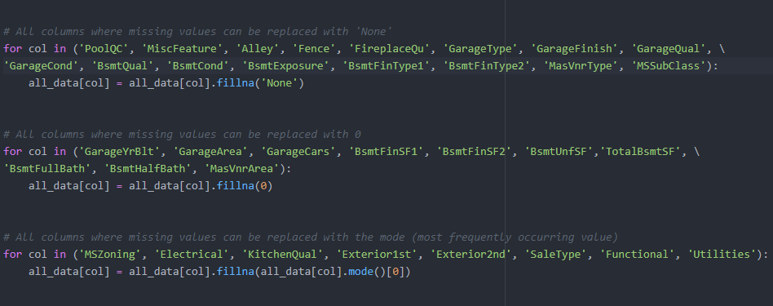
Data Preprocessing: Cleaning the Data
Constructing the data sets
Merged training and testing data to form total data set.
Cleaned the data by dropping ‘ID’ and ‘SalesPrice’.
Put target data as a separate data frame.
Cleaned Empty Values:
Data that specified having a value/relation were set to ‘None’.
Numerical null data replaced with 0’s.
Certain specific columns with clear standard type of data were set to the mode.

Slide 8
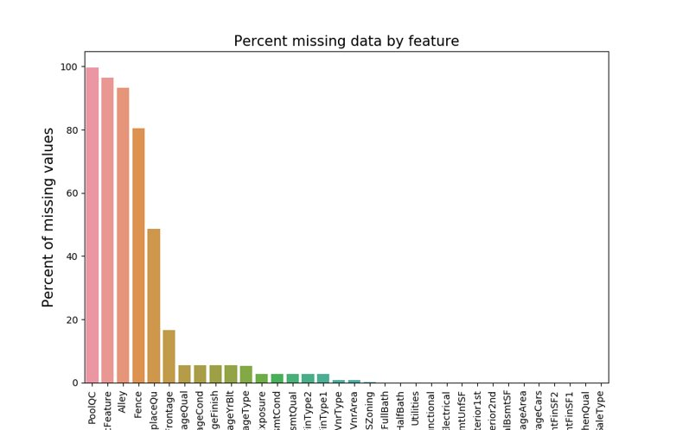
Data Preprocessing: Cleaning the Data
Percent of Missing Data by Feature

Slide 9
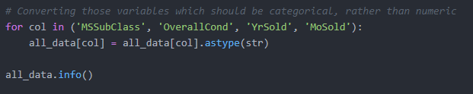
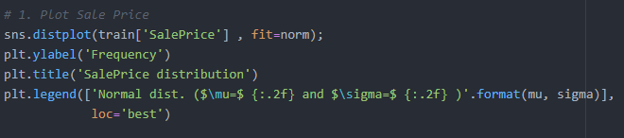
Data Preprocessing: Cleaning the Data
Merged related features into new columns.
Numeric Columns: Normalized numerical values and target data. Includes normalizing target data for predictions.
Numerical ratings: Some numerical variables correlate with a category. Converted these types to strings.

Slide 10
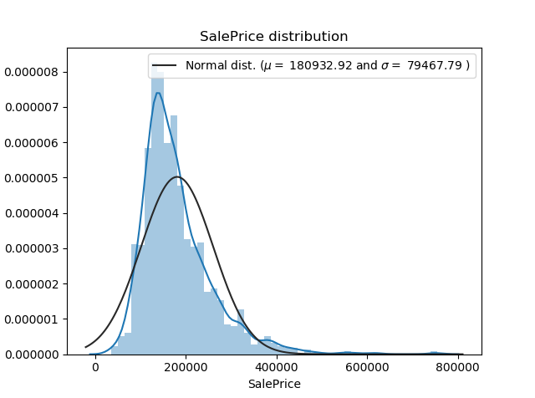
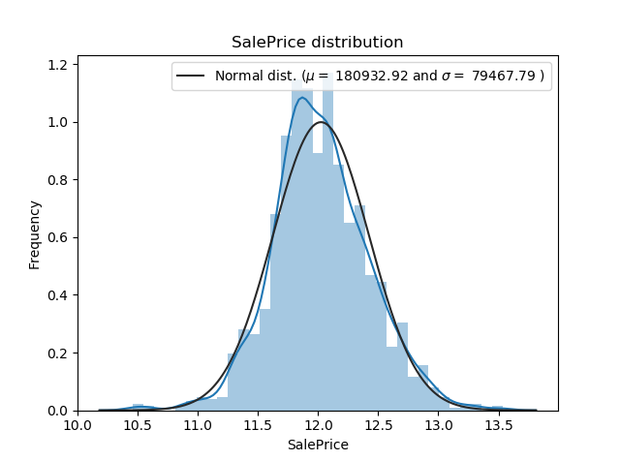
Data Preprocessing: Normalization of Data

Slide 11
Table of Contents
Data Analysis/Preprocessing
Implementation/Data Models
Results

Slide 12
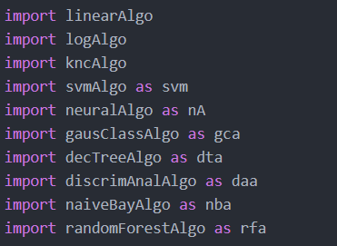
Implementation / Data Models
Imported the Sci-Kit library classes for data algorithms.
Tested various machine learning algorithms.
Used uncleaned data initially to test performance.
Determined from initial test that best performance was Multi-Layer Perceptron, Linear Regression, and a stacked approach model.

Slide 13
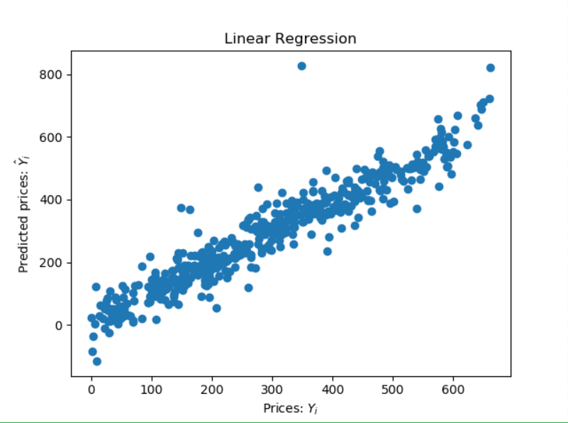
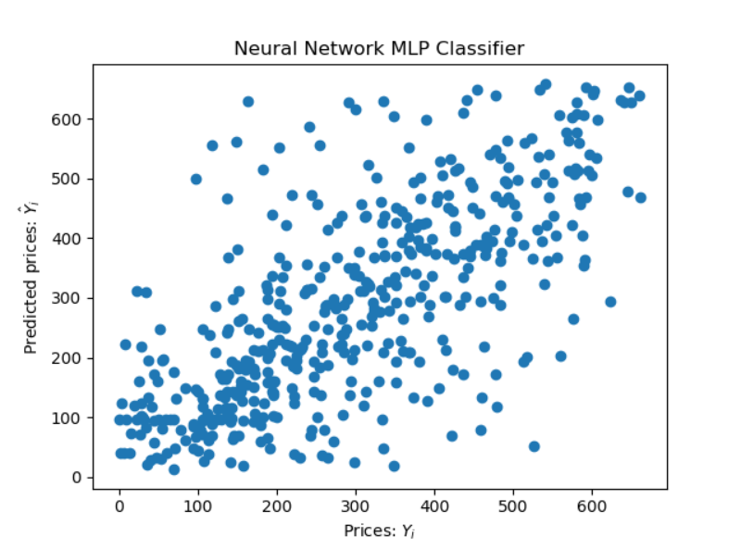
Implementation/Data Models: Predicted Prices to Actual Prices Correlation (Before Data Preprocessing)

Slide 14
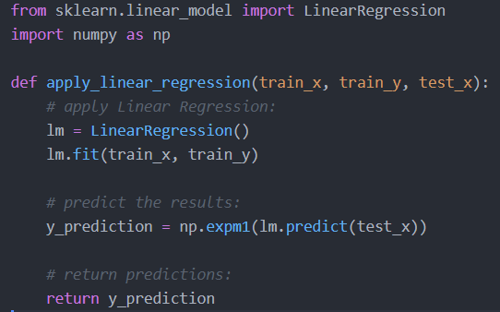
Implementation/Data Models: Linear Regression
Applied a simple linear-regression formula to the data.
Paramaters only included training data.
Results stored in y_prediction value and returned by the function.

Slide 15
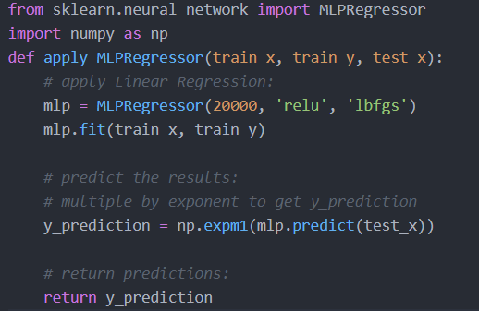
Implementation/Data Models: Multilayer Perceptron Regression
Hidden Layers: Tuned to 20,000 layers to calculate with enough accuracy, but to avoid overfitting.
Solver: Limited-memory Broyden-Fletcher-Goldfarb-Shanno (LBFGS), optimzation algorithm.
Activation: Rectified Linear Unit (ReLU), activation function that determines output of the summed weight of each layer’s nodes.

Slide 16
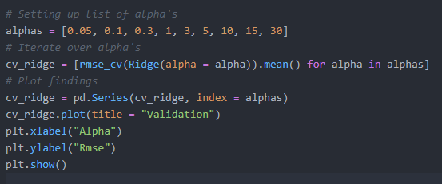
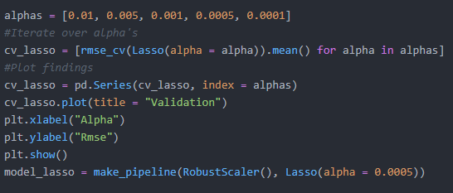
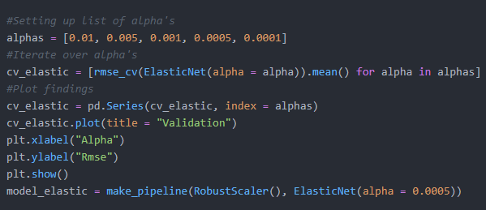
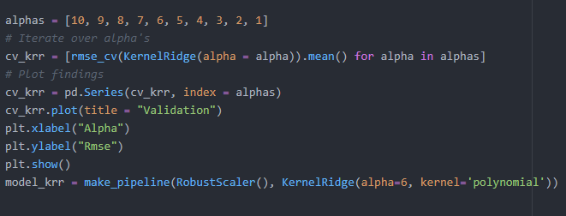
Implementation/Data Models: Stacked Approach
Ridge Regression
Lasso Regression
Utilized a combination of algorithms. Ridge, Lasso, Elastic Net, and Kernel Ridge. Completed stacked model took averages of all model predictions.
Alpha: Constant that determines number of parameters. Plotted alpha values vs. RMSE values, and chose alpha paramatern at lowest RMSE.
RMSE: Root Mean Square Error.
Elastic Net Regression
Kernel Ridge Regression

Slide 17
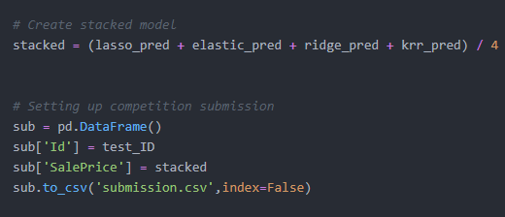
Implementation/Data Models: Averaging the Algorithms

Slide 18
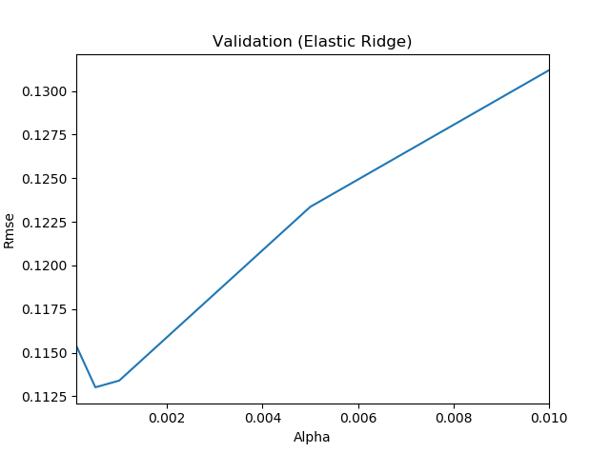
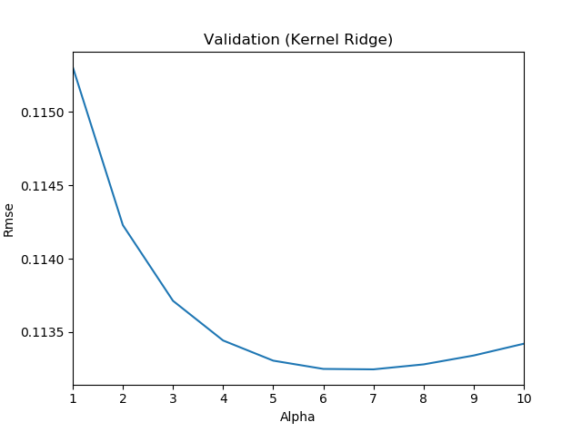
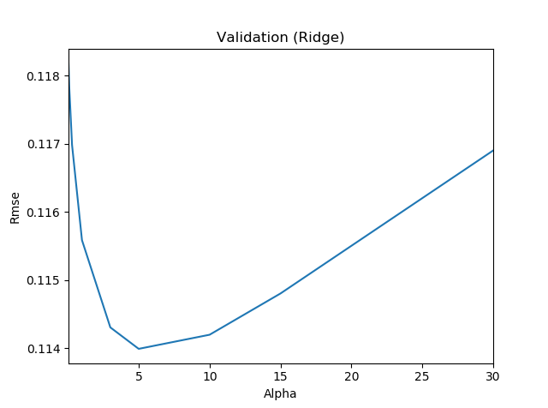
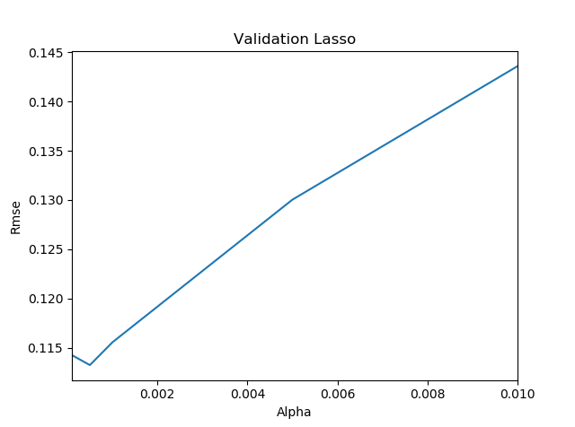
Implementation/Data Models: Determining Alpha Value

Slide 19
Table of Contents
Data Analysis/Preprocessing
Implementation/Data Models
Results

Slide 20
Results
Multilayer Perceptron
Root Mean Squared Logarithmic Error (Score): 0.13261
Stacked Regression (Best Performing)
Root Mean Squared Logarithmic Error (Score): 0.12067
Highest Ranking Position: 1083rd Place
Linear Regression
Did not perform as expected. Model was too simple for the complexity of the data.
Reached Top 50% of the leaderboard.

